Slide 1
50 Base SAS Tips

Slide 2
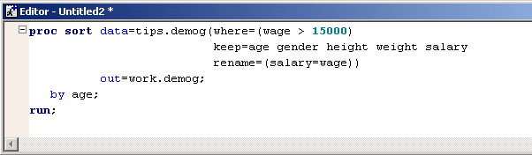
Tip 1 – Keep, Rename and then Where
Order of processing by SAS is, drop or keep first then the rename and finally the where clause.
Basically it’s in ALPHABETICAL order!

Slide 3
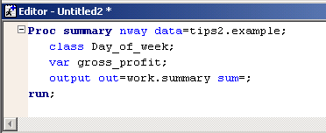

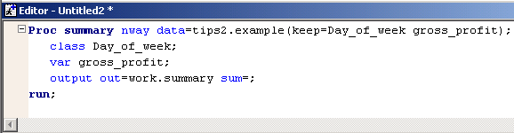
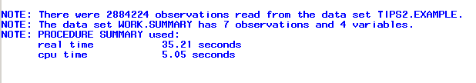
Tip 2 – Use Keep and Drop for Efficiency

Slide 4
Tip 3 – Be Consistent
Make life easy for those who have to read your code by being consistent. Place statements like label, length, format and retain together.
But keep in mind
Same statements (eg length) need to be used
Placement may effect variable order in data set

Slide 5
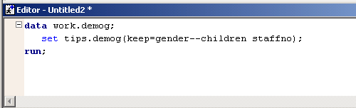
Tip 4 – Keep b--a
Keeps the variables gender, children and all variables between. Uses the order of the variables within the data set ie: the LPDV.

Slide 6
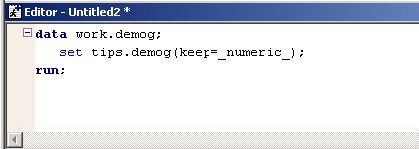
Tip 5 – Keep _numeric_
Keeps all the numeric variables within the demog data set. _character_ also works.

Slide 7
Tip 6 – a=b=c=d?
If b=c and c=d then a=1;
Else a=0
If b=c=d then a=1;
Else a=0;
A=b=c=d;

Slide 8
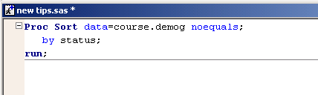
Tip 7 – Proc Sort – Option Noequals
More efficient because it does not keep the order of other that a data set is currently in with same sort variables.

Slide 9
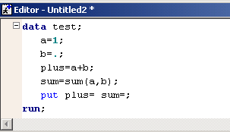
8 – Sum Function
When adding a missing value sum treats as 0, the + sign returns a missing value

Slide 10
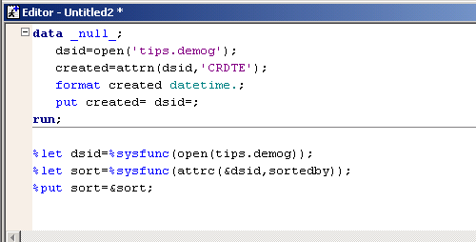
Tip 9 – Use SCL Functions in Base
You can use SCL functions in BASE SAS either within a data step or within macros using %sysfunc

Slide 11
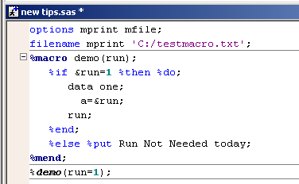
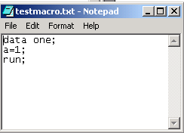
Tip 10 – Mfile Option for Macros
Writes the base SAS code generated by a macro to a external file.

Slide 12
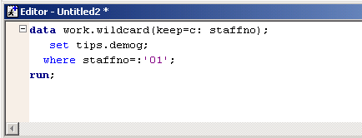
Tip 11 – Use : As Wildcard
Selecting variables that start with c, and observations where the staffno begins with 01

Slide 13
Tip 12 – Scan Function
A=scan(textstring,-1)
From V8 onwards the second parameter can be negative. In the above example the last word is selected.

Slide 14
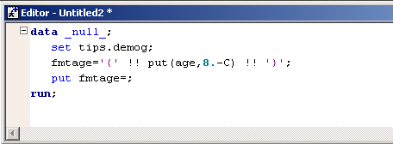

Tip 13 – Align with Put
The –C centres the result from the put statement.
-L and –R are also available for left and right

Slide 15
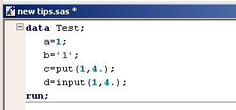
Tip 14 – Put and Input
Put, always returns a Character String
Input, always returns a Numeric Value

Slide 16
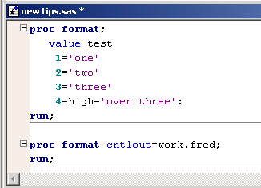
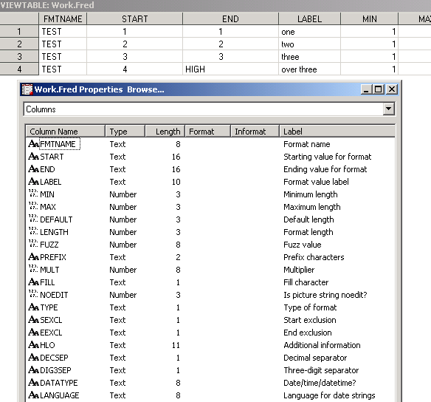
Tip 15 – Formats to SAS Data Set

Slide 17
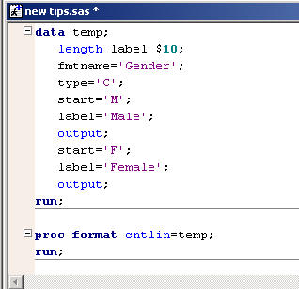
Tip 16 – SAS Data Set to Format

Slide 18
Tip 17 – HLO Values For Formats
HLO - character variable that contains range information. Possible Values
  H- range's ending value is HIGH
  I - numeric informat range
  L - range's starting value is LOW
  N - format or informat has no ranges, including no OTHER= range
  O - range is OTHER
  R - ROUND option is in effect
  S - NOTSORTED option is in effect

Slide 19
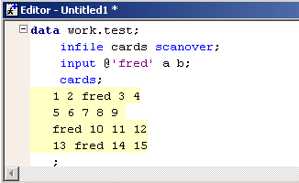
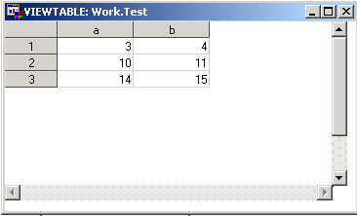
Tip 18 - Scanover

Slide 20
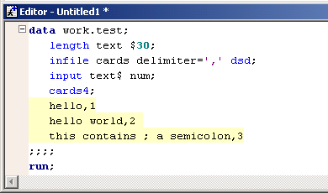
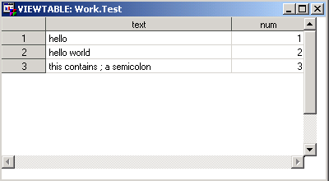
Tip19 - Cards4

Slide 21
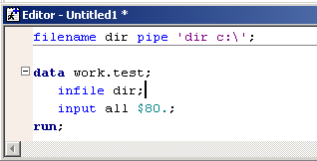
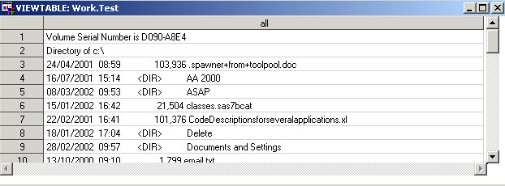
Tip 20 – File Pipe

Slide 22
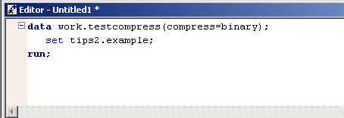
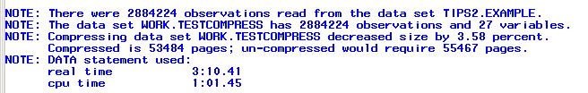
Tip 21 – Compress Option
COMPRESS=YES | NO | CHAR | BINARY

Slide 23
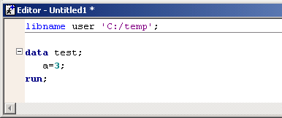
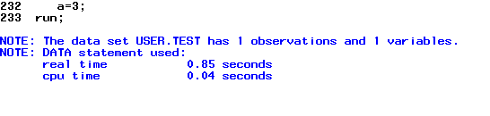
Tip 22 – User Libref
If you assign a libname with a libref of “user” the data sets with a one level name will be saved here and not in “work”.

Slide 24
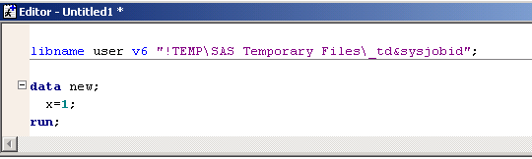
Tip 23 – V6 Work Library in V8
Allocate libref of user with v6 engine to the current work library.
Use as normal work area
Will be cleared out when session finishes

Slide 25
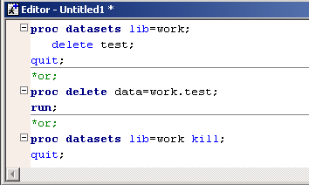
Tip 24 – Clear up Work Library
Jobs can fail due to work space running out. When you no longer need a data set delete it.

Slide 26
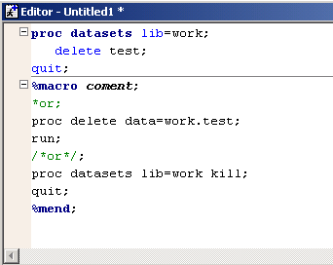
Tip 25 – Commenting out Large Sections of Code
Think about using a macro to comment out code. Just place code in macro and don’t call the macro.

Slide 27
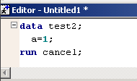
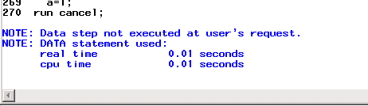
Tip 26 – Run Cancel
Checks the syntax without running the data step.

Slide 28
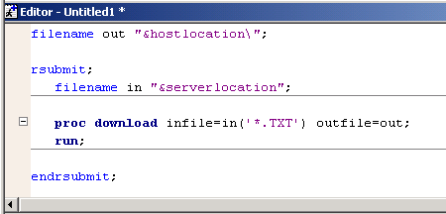
Tip 27 – Copy non SAS Files
Use proc download to copy files from a server to your pc, they don’t have to be SAS files.

Slide 29
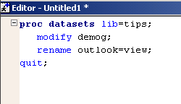
Tip 28 – Rename your Variables
Rename your variables without the use of a data step.

Slide 30
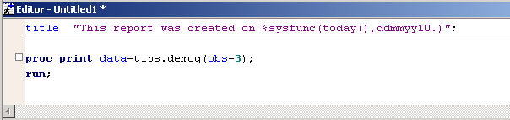
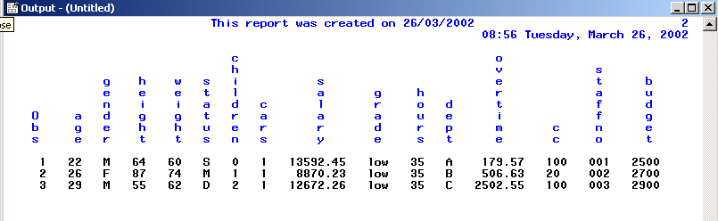
Tip 29 – Formatting Titles With Sysfunc

Slide 31
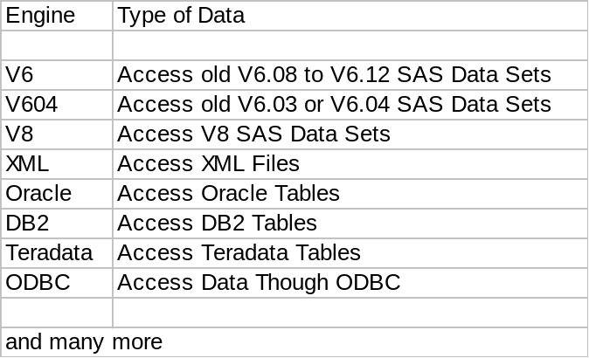
Tip 30 – Libname Engines
Use a engine to access new types of data.
Libname olddata v6 ‘C:\temp’;
Engine

Slide 32
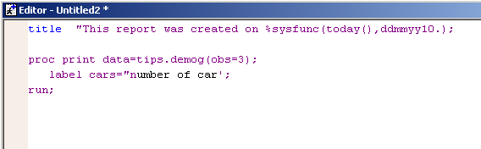
Tip 31 – Easy to spot unbalanced quotes in Enhanced Editor
Just look at the colours

Slide 33
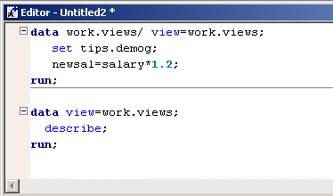
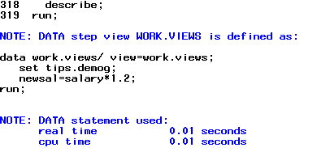
Tip 32 – Describing Data Step Views
New in version 8 is the ability to find out the code behind a data step view.

Slide 34
Tip 33 – WSAVE Command
The WSAVE command saves your window setting changes (e.g. colour, position, and size). After you have changed to your desired settings issue the WSAVE command from the command line.
To return to the default settings delete the catalog entry SASUSER.PROFILE.window.WSAVE, as this is where you changes have been saved.

Slide 35
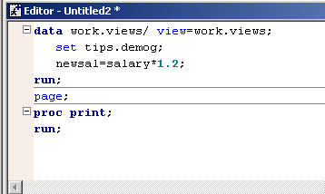
Tip 34 – Skip and Page for a Better Log
Use the SKIP and PAGE statements to separate steps or particular parts of your program in the log. These statements allow you to customise your log for ease of reading.

Slide 36
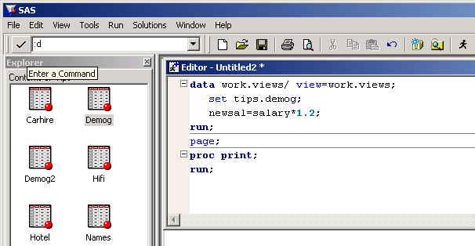
Tip 35 – Command Line Commands
You can still use some of the old line commands in the enhanced editor. Just run them from the command line with the prefix of :
Supported Comments are:
I,IA,IB,R,D

Slide 37
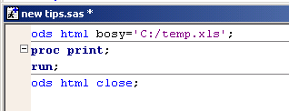
Tip 36 – ODS To Excel
We Can take advantage of the way Excel interoperates HTML to create our own Excel spreadsheets

Slide 38
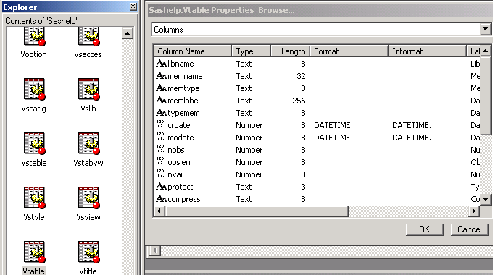
Tip 37 – SASHELP Views
There are a number of views available in SASHELP which contain information about your SAS session. They can be very useful to use during SAS processing.

Slide 39
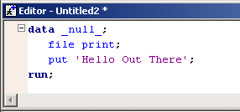
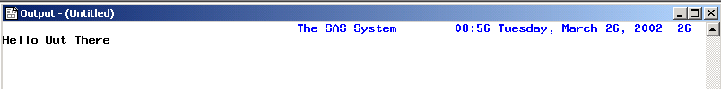
Tip 38 – File Print
Send your data step put statements to the output window by using file print. Very useful with ODS.

Slide 40
Tip 39 - Autosave
Did you just crash SAS, or did you forget to save your SAS program. ‘No Worries Mate’ with SAS autosave.
Goto Tools-Options-Preferences under the edit tab is an autosave option.

Slide 41
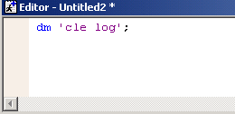
Tip 40 – dm Statement
To run SAS commands from SAS code use the ‘dm’ statement

Slide 42
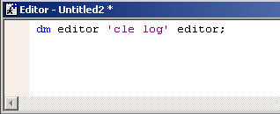
Tip 41 – No More PGM with dm
A feature(?) of V8 is if you run a dm command from the enhanced editor the program editor appears and becomes the active window.
You can stop this by adding an editor statement before and after the command.

Slide 43
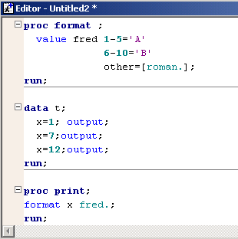
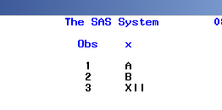
Tip 42 – Formats from Within Formats
Formats can be used within a format definition.

Slide 44

Tip 43 – Multilabel Formats

Slide 45



Tip 43 – Multilabel Formats

Slide 46

Tip 44 – Pre-Load Formats

Slide 47


Tip 44 - Pre-Load Formats

Slide 48


Tip 45 – Misstext

Slide 49



Tip 46 – Variable Values in Title

Slide 50


Tip 47 – Proc Summary with Types
New to V8 we can now select what types are required.

Slide 51


Tip 48 – Proc Summary with Ways

Slide 52

Tip 49 - Sleep
If you are not already asleep, use the sleep function to send your SAS session to sleep for a number of seconds. Very useful when running x commands and they may not have finished.

Slide 53
Tip 50 – Don’t Tell Everybody Everything You Know
?

Slide 54
Sources of Information
Amadeus Software Ltd Technical Staff
Phil Holland of Holland Numerics
Phil Mason of Wood Street Consultants
Alan Davies of Scorpio Software Services
SAS Online Doc
SAS Today a Year of Terrific Tips

