Slide 1
Challenge #16 – CUDA vs PyTorch
Results confirmed identical outputs

Slide 2
Numeric Validation
• CUDA output : -2.487491
• PyTorch output: -2.487491
Outputs match to < 1×10⁻⁵ → correctness ✅

Slide 3
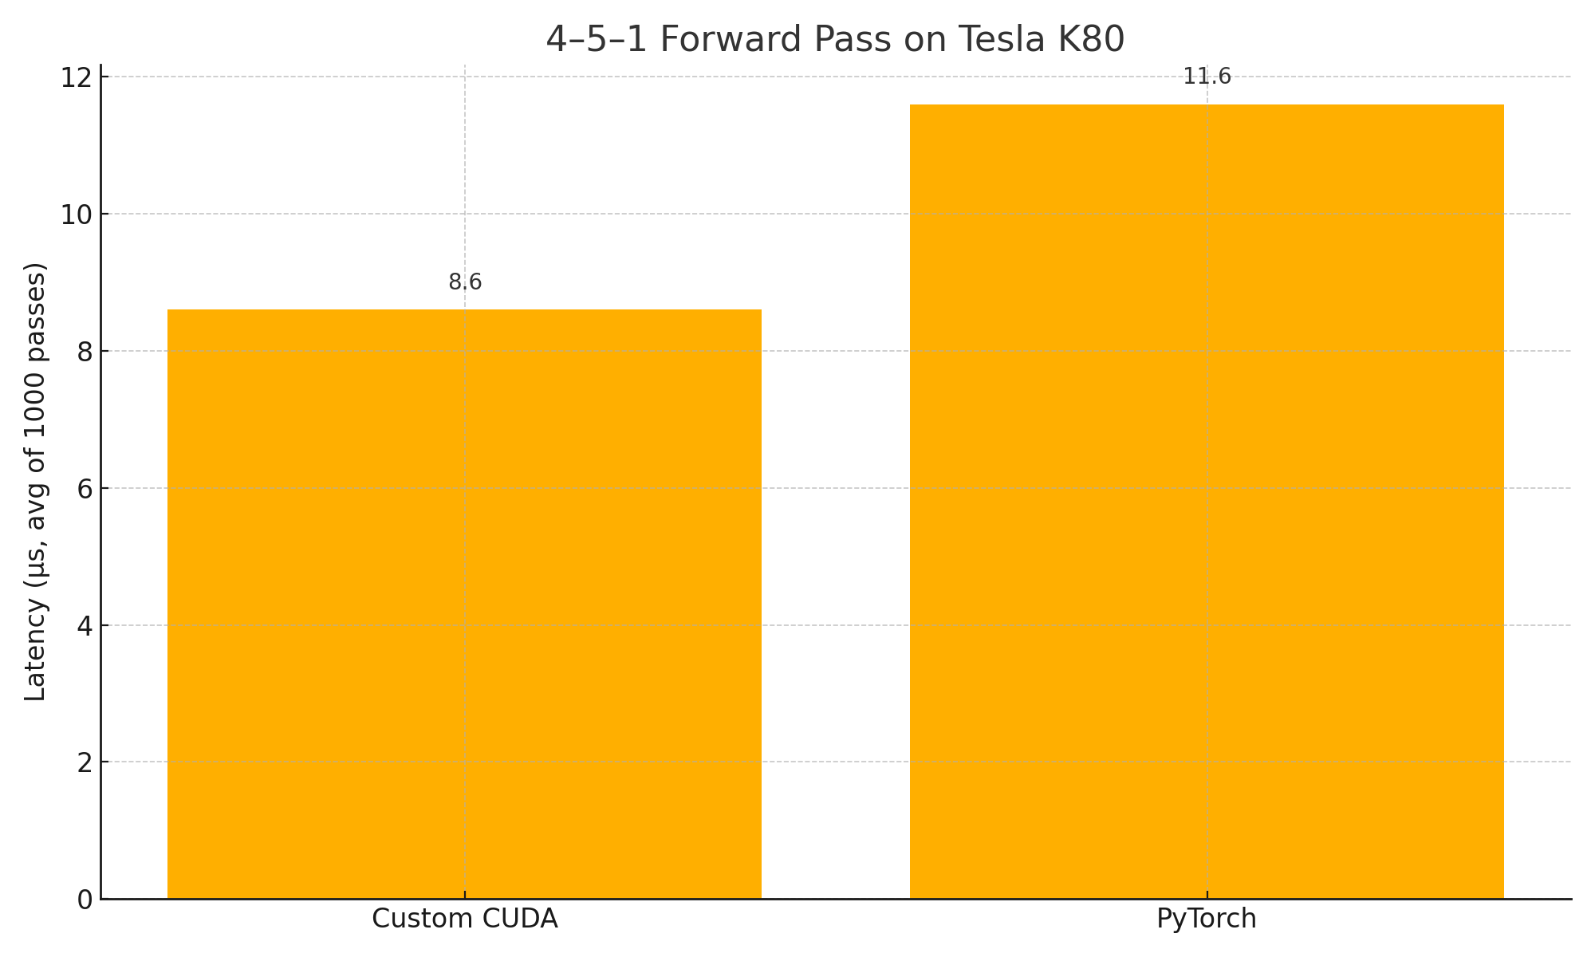
Latency (avg of 1 000 passes, µs)

