Slide 1
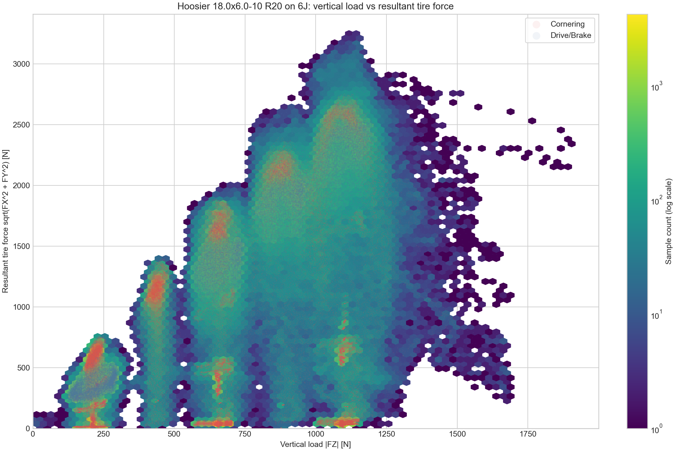
Aerodynamics
Aerodynamic Device Overview
0.1 Why aerodynamic devices were adopted
Aerodynamic devices were introduced to achieve sharper vehicle behavior.
1. Simulation showed that downforce gains outweigh the added weight.
2. The team had enough members to develop and manufacture them.
3. Production tests were completed last year, so preparation was ready
0.2 Development targets
For the first aero package, the design focused on four targets:
1. Easy-to-manufacture geometry.
2. Sufficient downforce.
3. Strength against failure.
4. Weight reduction, while prioritizing manufacturability.
increases almost linearly
Fig1. vertical load VS resultant tire force
0.4 Performance target
The figure plots vertical load on the horizontal axis and resultant tire force on the vertical axis.
Looking only at the maximum tire force, the trend increases almost linearly as vertical load rises.
Therefore, the aero design prioritizes maximizing downforce. Simulation also showed that downforce benefit exceeds drag loss when L/D is above 3, so L/D > 3 was set as a design constraint.
0.3 Development risk management
As the first aero package, this work could affect the whole vehicle schedule. To control risk and workload, development would stop immediately if SES approval was delayed or a critical issue occurred.

Slide 2
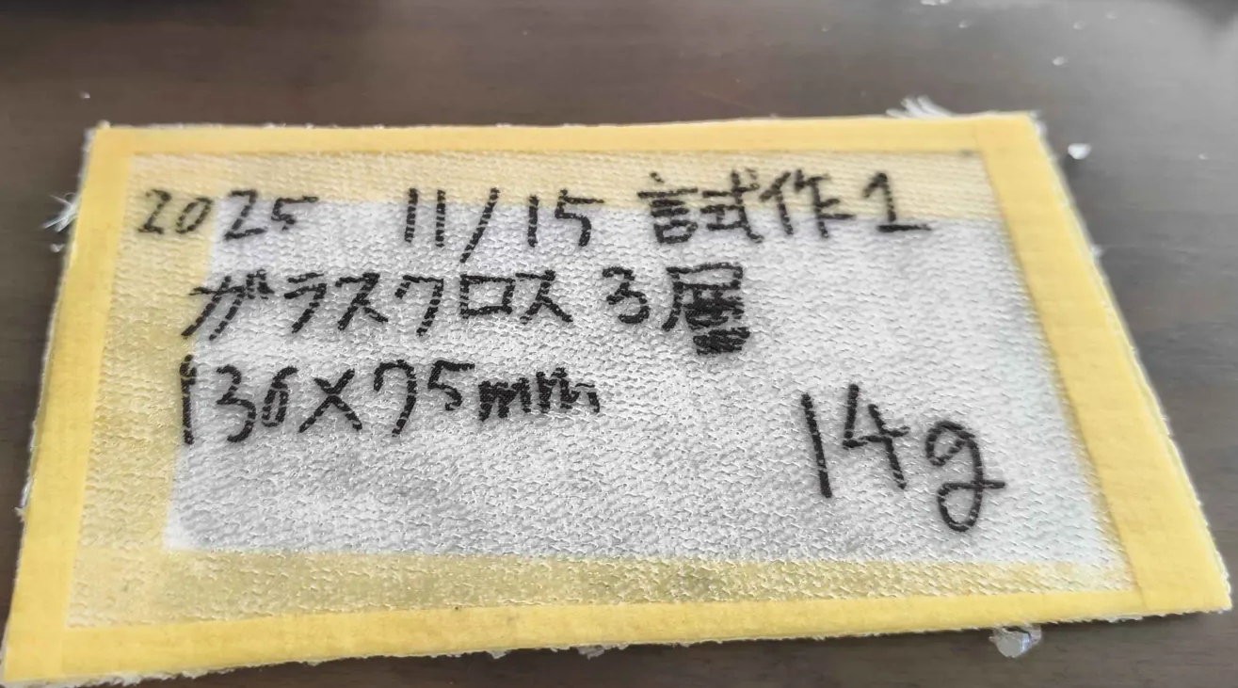
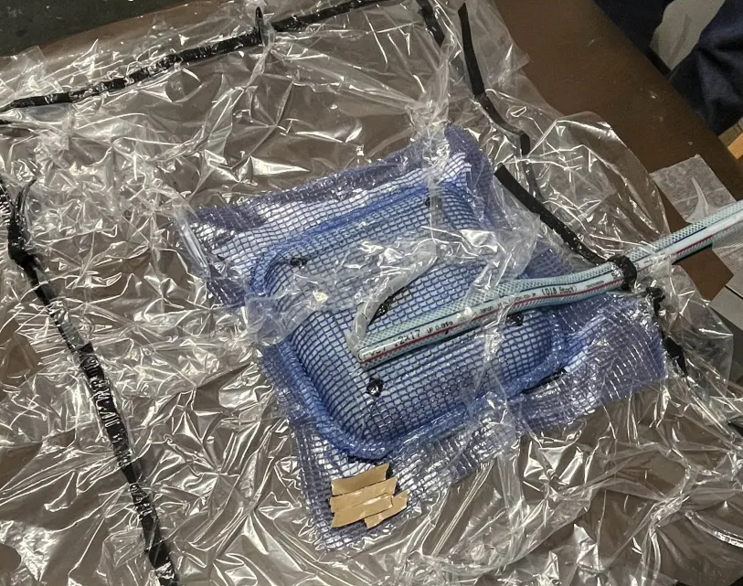
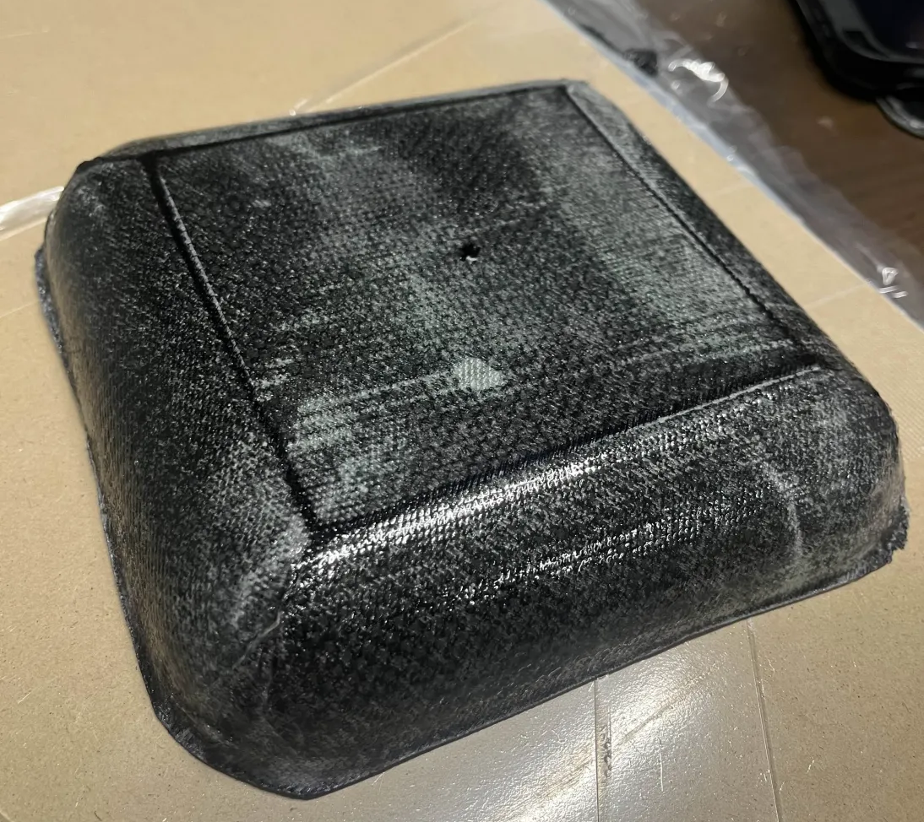
Aerodynamics
Manufacturability Verification
0.5 Manufacturing feasibility tests
Small-scale production tests were repeated before final aero manufacturing.
1. Wet layup sandwich samples were produced with glass fiber and foam core.
2. VaRTM trials were also conducted to verify resin flow and bagging quality.
3. Vacuum bagging reached -0.92 atm, confirming sufficient suction for trial parts.
4. A first 1-ply sample bonded to the MDF board, showing release was the main issue.
Fig2. FRP test pece
0.6 Release-process findings
The team tested several changes to improve demolding:
1. Move samples to the MDF board edges to allow tool access.
2. Increase peel-ply size to about four times the previous area.
3. Increase PVA concentration from 1:3 to 1:1.
0.8 Manufacturing readiness
Mold preparation also progressed through gelcoat application for tooling.
For actual production, simple wet layup is used for large parts where speed and handling are important.
VaRTM is used for smaller parts where resin control, fiber volume, and repeatability are easier to manage.
These tests fixed the practical constraints: release margin, peel-ply coverage, tool access, vacuum quality, and cure time.
0.7 Cure-time lesson
Even after an overnight cure, strong adhesion and tacky PVA remained. This indicated that catalog cure time was not enough under actual workshop conditions, so longer curing and thicker PVA application were treated as process requirements.
←Fig3. VaRTM tests
Fig4. CFRP test tray→

