Slide 1
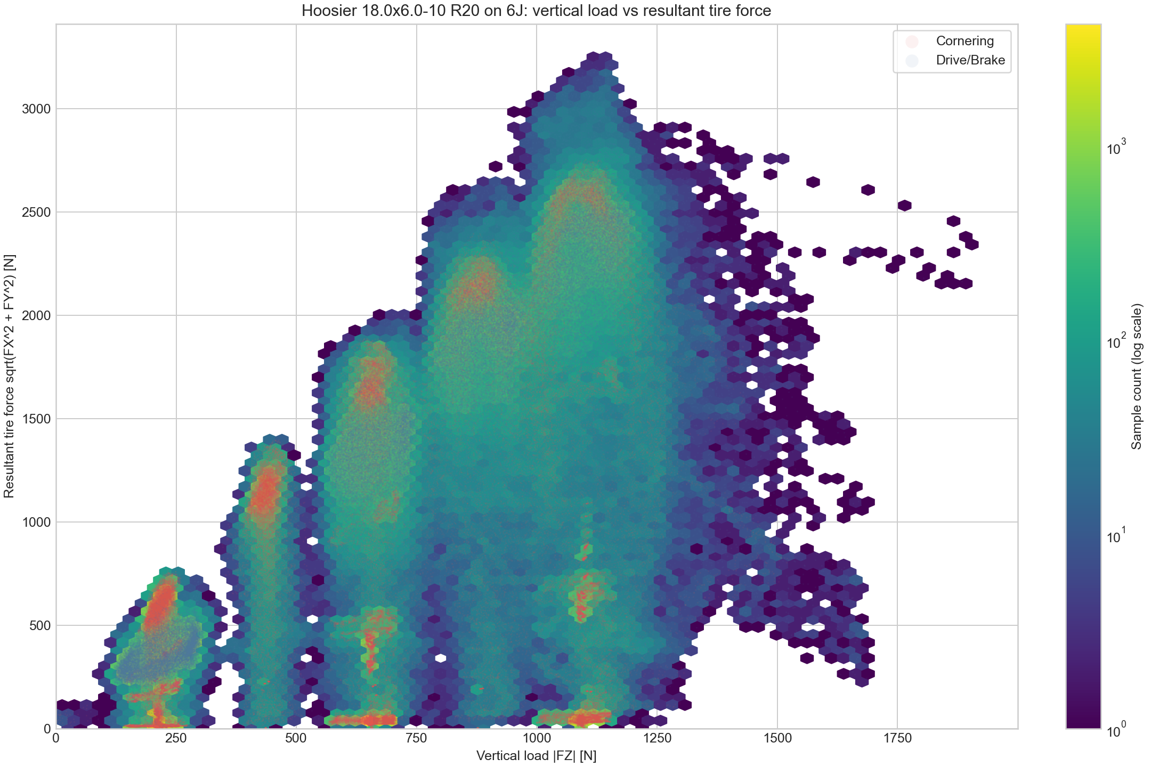
Aerodynamics
Aerodynamic Device Overview
0.1 Why aerodynamic devices were adopted
Aerodynamic devices were introduced to achieve sharper vehicle behavior.
1. Simulation showed that downforce gains outweigh the added weight.
2. The team had enough members to develop and manufacture them.
3. Production tests were completed last year, so preparation was ready
0.2 Development targets
For the first aero package, the design focused on four targets:
1. Easy-to-manufacture geometry.
2. Sufficient downforce.
3. Strength against failure.
4. Weight reduction, while prioritizing manufacturability.
increases almost linearly
Fig1. vertical load VS resultant tire force
0.4 Performance target
The figure plots vertical load on the horizontal axis and resultant tire force on the vertical axis.
Looking only at the maximum tire force, the trend increases almost linearly as vertical load rises.
Therefore, the aero design prioritizes maximizing downforce. Simulation also showed that downforce benefit exceeds drag loss when L/D is above 3, so L/D > 3 was set as a design constraint.
0.3 Development risk management
As the first aero package, this work could affect the whole vehicle schedule. To control risk and workload, development would stop immediately if SES approval was delayed or a critical issue occurred.

Slide 2
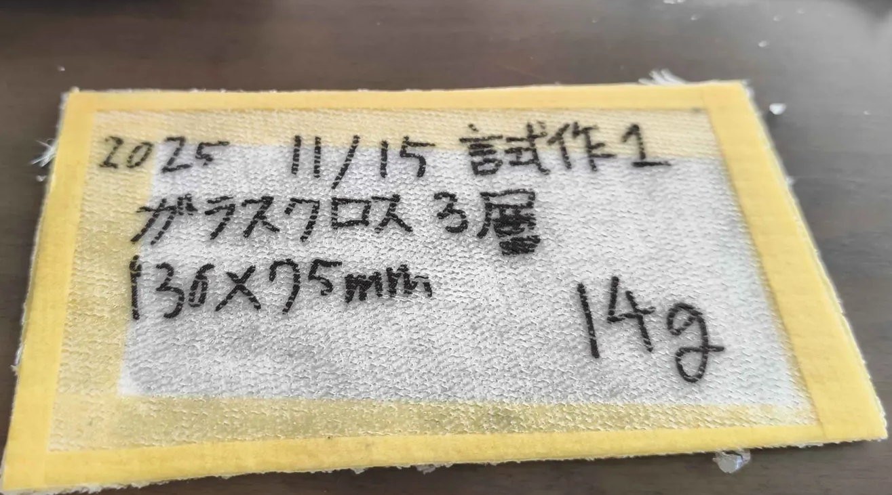
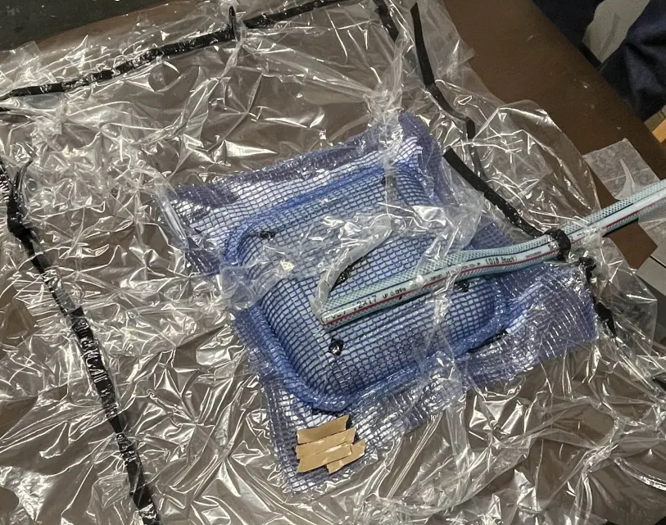
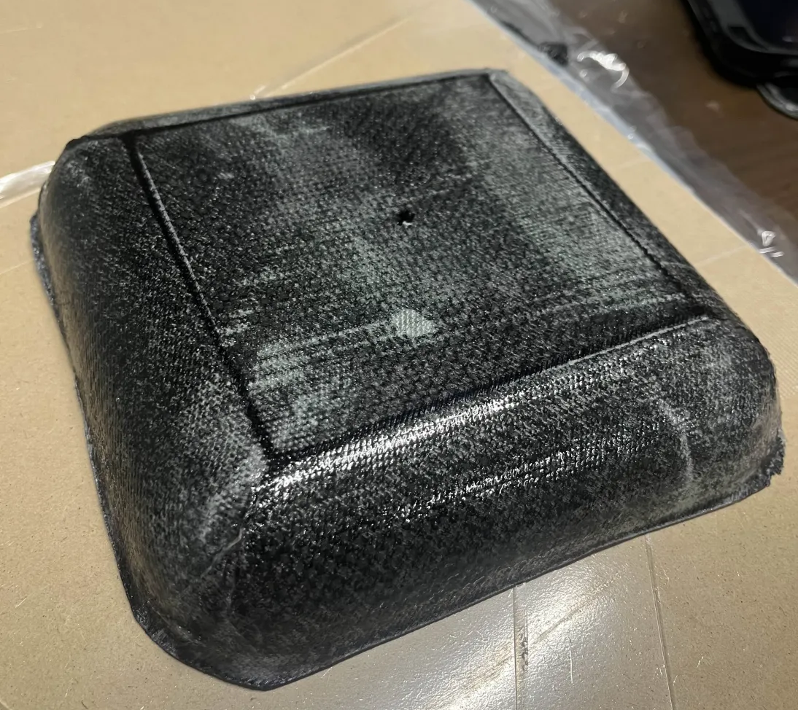
Aerodynamics
Manufacturability Verification
0.5 Manufacturing feasibility tests
Small-scale production tests were repeated before final aero manufacturing.
1. Wet layup sandwich samples were produced with glass fiber and foam core.
2. VaRTM trials were also conducted to verify resin flow and bagging quality.
3. Vacuum bagging reached -0.92 atm, confirming sufficient suction for trial parts.
4. A first 1-ply sample bonded to the MDF board, showing release was the main issue.
Fig2. FRP test pece
0.6 Release-process findings
The team tested several changes to improve demolding:
1. Move samples to the MDF board edges to allow tool access.
2. Increase peel-ply size to about four times the previous area.
3. Increase PVA concentration from 1:3 to 1:1.
0.8 Manufacturing readiness
Mold preparation also progressed through gelcoat application for tooling.
For actual production, simple wet layup is used for large parts where speed and handling are important.
VaRTM is used for smaller parts where resin control, fiber volume, and repeatability are easier to manage.
These tests fixed the practical constraints: release margin, peel-ply coverage, tool access, vacuum quality, and cure time.
0.7 Cure-time lesson
Even after an overnight cure, strong adhesion and tacky PVA remained. This indicated that catalog cure time was not enough under actual workshop conditions, so longer curing and thicker PVA application were treated as process requirements.
←Fig3. VaRTM tests
Fig4. CFRP test tray→

Slide 3
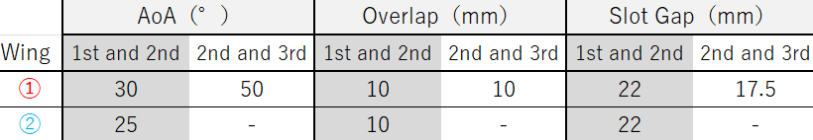
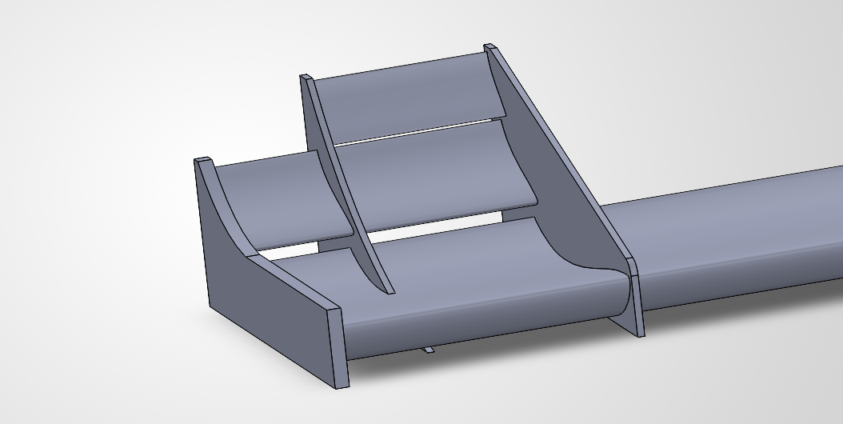
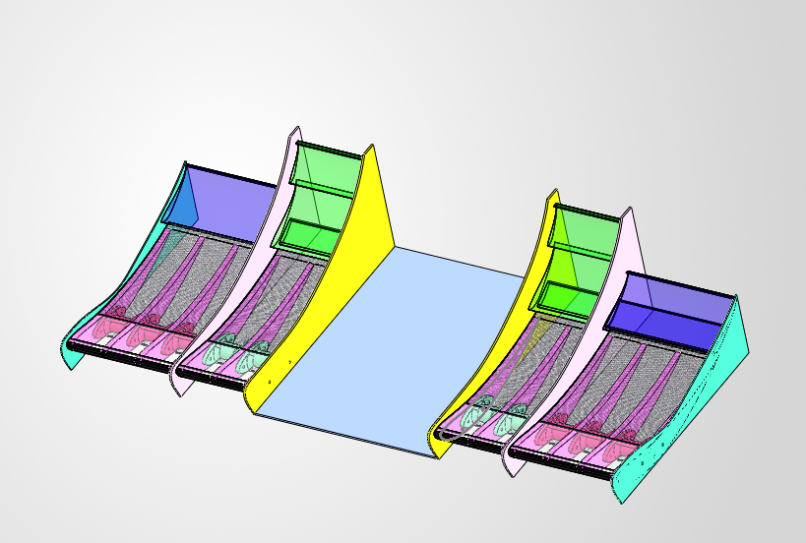
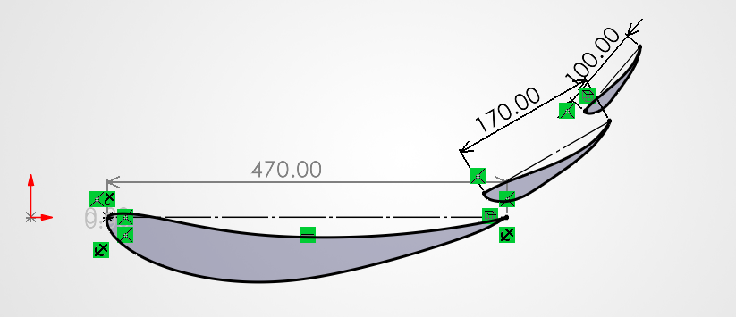
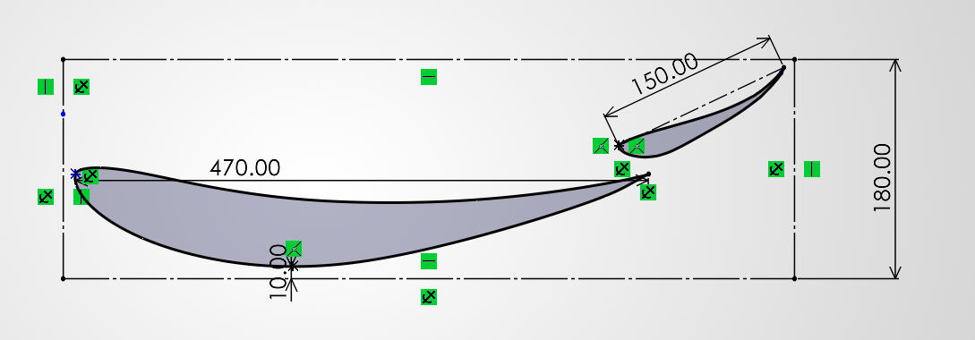
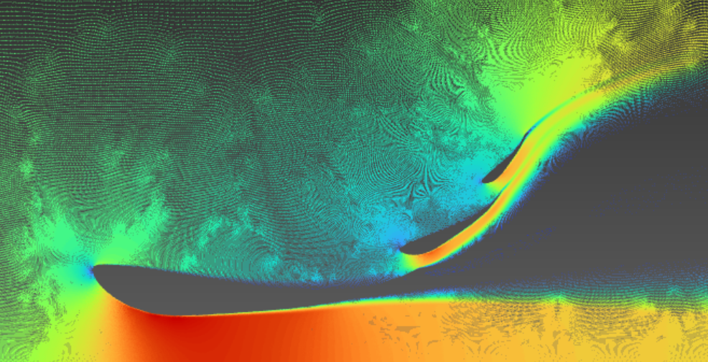
Aerodynamics
Front Wing
1. Target / constraints
Use different element counts inside and outside the tire-front regulated area.
Target: span 1 m, wind speed 11 m/s (= 39.6 km/h), downforce >= 130 N.
Design aim: increase Df while minimizing drag;
Since we focused on the machine's drive wheels rear:front aero balance guideline = 4:6.
2. Solution / iteration
2D and 3D Ansys analyses measured Df and drag; SolidWorks Flow Simulation checked local airflow.
S1223 was the base low-Re airfoil, but 80 mm ride height limited ground effect.
The first tire-front (1) and inboard (2) elements were changed to E423 to suppress drag increase.
3. Evaluation / final result
Configuration checks: 129.08 N / 23.00 N drag and 110.76 N / 20.83 N drag.
Final evaluated result at span 1 m and 11 m/s: Df = -122 N, drag = 23.7183 N.
Ribs secure wing strength; the FB-lower section is flat to avoid IA/frame interference in collision.
Final position table
Regulation concept
Airfoil / structure
Config. 1
Config. 2
Visualization Flow Field
Df 129.08 N / drag 23.00 N
Df 110.76 N / drag 20.83 N
Conclusion
The front wing target was set from a 130 N downforce requirement at 1 m span and 11 m/s. The design was solved by iterating element count, airfoil choice, and wing position under regulation constraints, then evaluated by Df/drag analysis and manufacturability/impact-clearance checks.

Slide 4
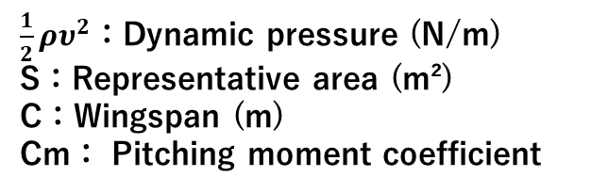
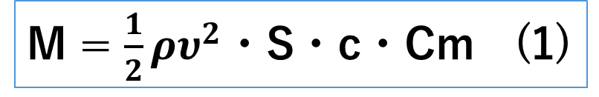
Aerodynamics
Rear Wing
This reduced the pitching moment coefficient from approximately -0.24 to approximately -0.10, which reduced the pitching moment by about 58%, thereby ensuring structural and dynamic stability.(based on Equation (1))
First, the design process is outlined below.
１．Selection of Airfoil and Determination of Angle of Attack
２． Determining Slot Gaps and Overlaps
３． 3D Modeling
M = $\frac{1}{2}ρυ^{2}$・S・c・Cm (1)
１. Selection of Airfoil Shapes and Determination of Angle of Attack
First, the design was based exclusively on the S1223 material, which has a high lift coefficient and delivers excellent performance in the low Reynolds number range.
We designed a three-bladed multi-element wing, assuming a span of 1000 mm. After repeatedly performing 2D analysis in Ansys while varying the angle of attack, we found that settings of
0°, 30°, and 50° resulted in the lowest drag.
Therefore, we decided to use these angles.
Furthermore, considering the structural loads caused by large negative pitching moments and the instability of downforce, we decided to replace the S1223 main wing with the S1223 RTL, which features an upward-curved trailing edge.
$\frac{1}{2}ρυ^{2}$：Dynamic pressure (N/m)
S：Representative area (m²)
C：Wingspan (m)
Cm： Pitching moment coefficient
We also decided to incorporate an upper wing to generate downforce.
However, since the first wing of the upper wing design tended to stall easily, we opted for the E423.
We considered the NACA M3 as well, but because the angle of attack on the second wing was small, we didn’t observe a significant difference in stall or drag.
Therefore, we chose the E423, which is better suited for generating downforce.

Slide 5
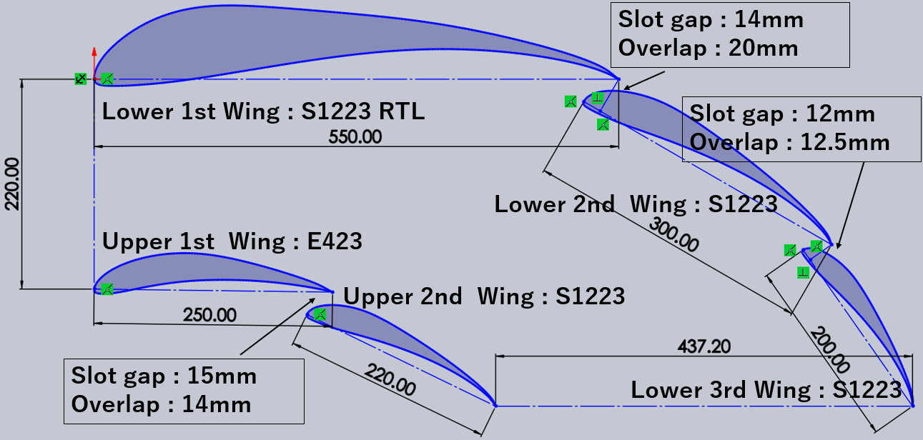
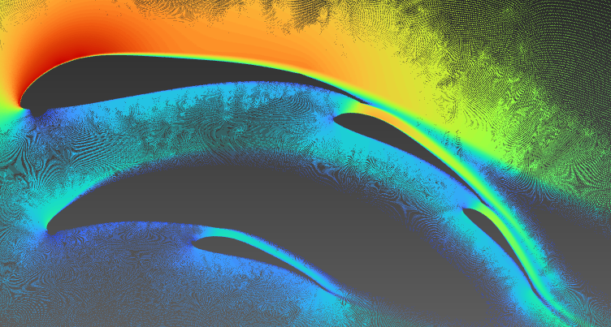
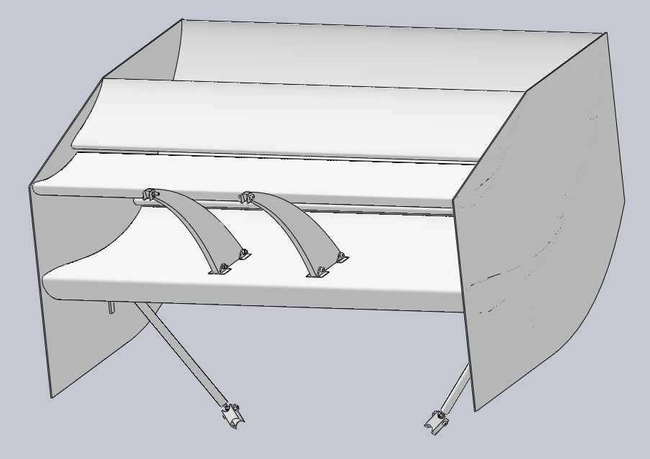
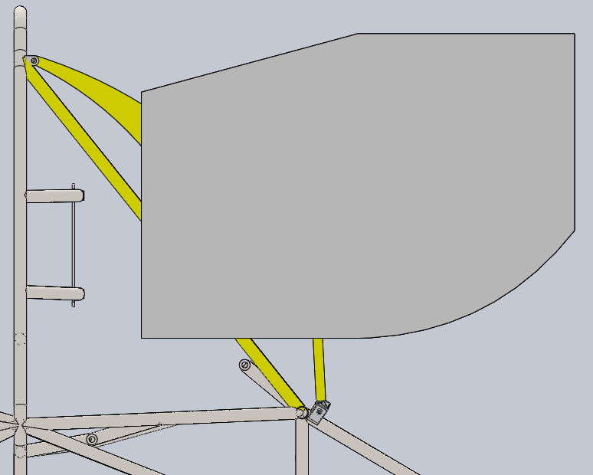
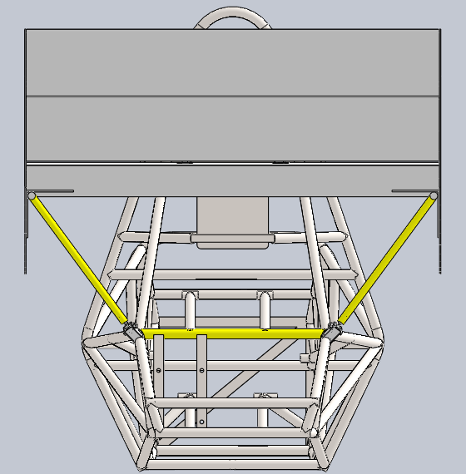
Aerodynamics
２. Determining Slot Gaps and Overlaps
After determining the airfoil and angle of attack, we performed repeated 2D analyses in Ansys, making changes only to the slot gap and overlap.
Focusing on reducing drag, the airfoil, slot gap, and overlap values ultimately adopted are shown in Figure 1.
The final 2D analysis results are shown in Figure 2.
３. 3D Modeling
We created a 3D model based on the results of the 2D analysis.
Considering the tread width of 1,335 mm, the tire width of approximately 200 mm, the weight, and manufacturing tolerances, the span length was determined to be 1,040 mm.
We also examined the placement of the struts and other components. The design was intended to create a geometrically rigid structure by forming a triangular configuration with the swan neck and struts when viewed from the side, and by arranging the struts in a V-shape when viewed from the rear.
(Please refer to the images below.)
Figure 2
Figure 1
Swanneck
Wind speed 40km/h
down force : 159N drag : 4.9N (Span length: 1000 mm)
＊the image is inverted vertically for analysis purposes.
stay

Slide 6
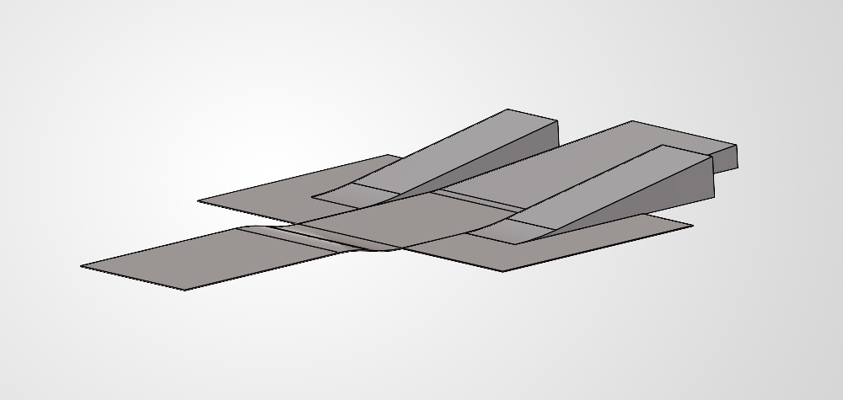
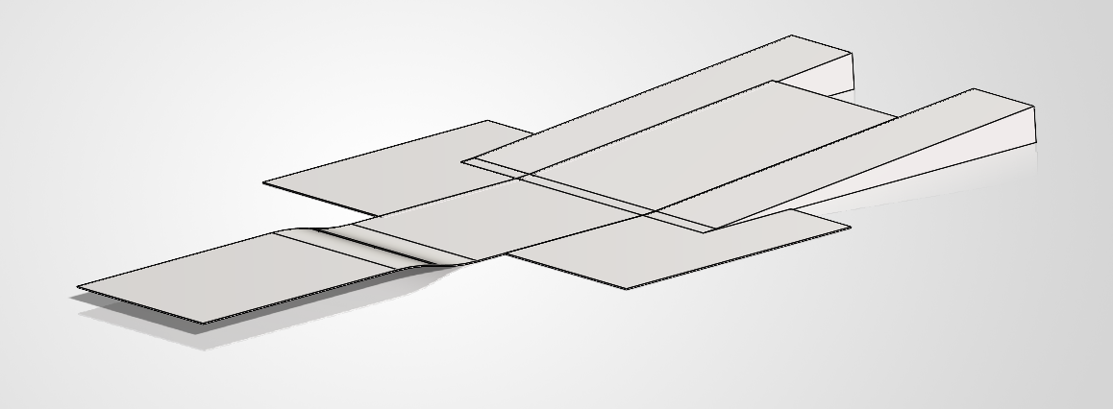
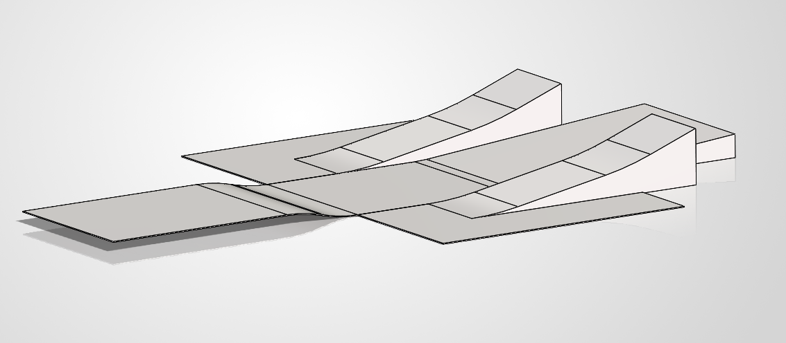
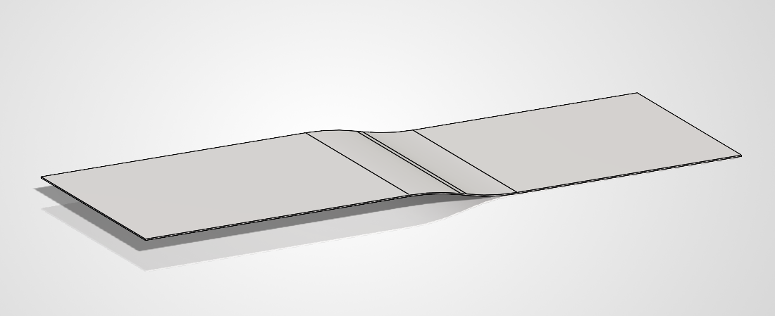
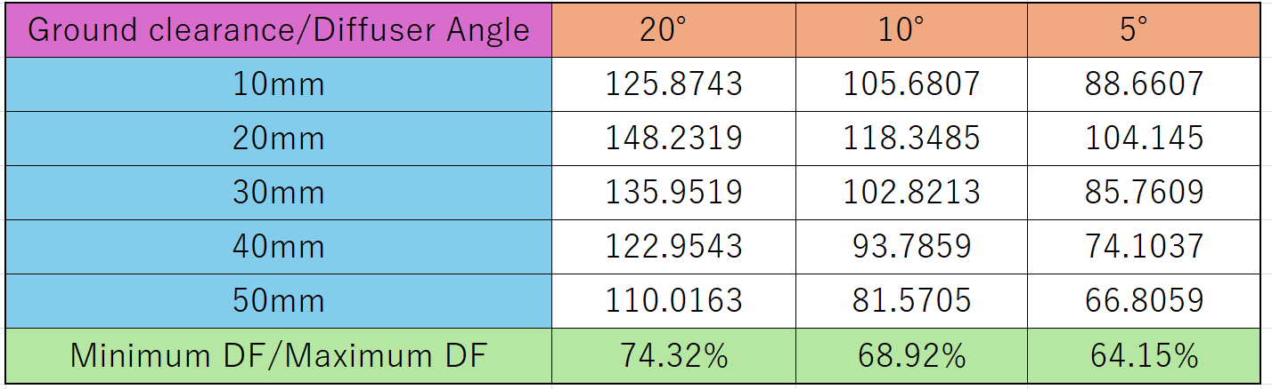
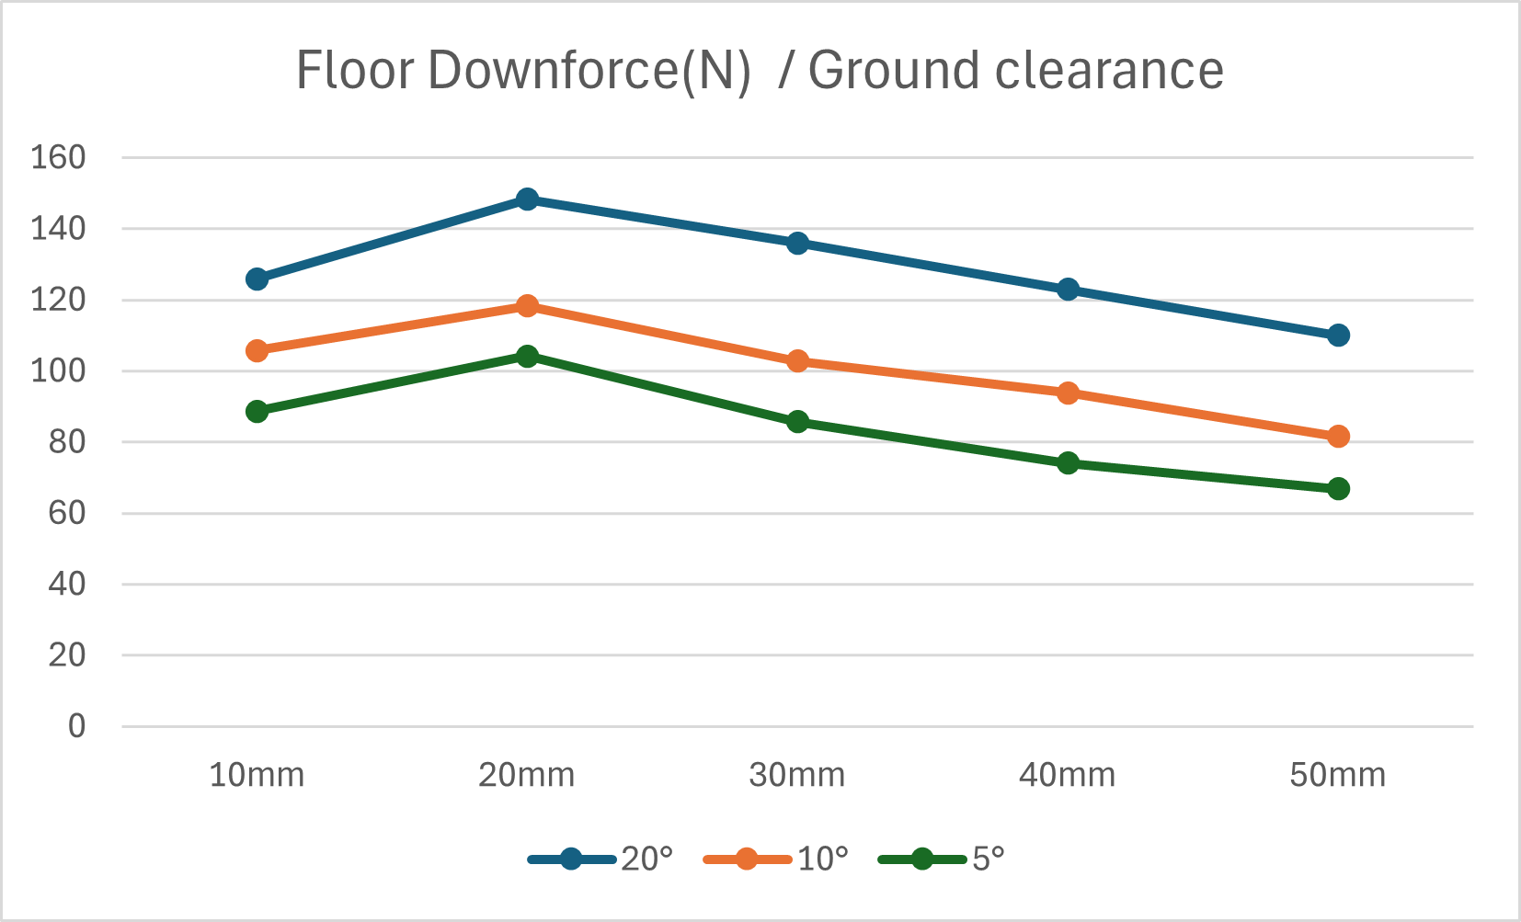
Aerodynamics
Floor
Diffuser angle selection
Packaging around the powertrain limited the diffuser angle, so 5°, 10°, and 15° models were analyzed in 3D.
Ride height was varied from 10 to 50 mm in 10 mm steps to evaluate downforce stability during vertical vehicle motion.
The final angle was selected by prioritizing the largest minimum-to-maximum downforce ratio.
Vehicle concept: “Strong, Sharp, Reliable”
For sharp cornering
- From “protection only” to “load generation”
- Provide stable downforce
For reliable operation
- Protect the radiator
- Select suitable mold method
- Select suitable material
10°
<Last year>
Purpose: driver protection
Material: glass mat
5°
15°
<This year>
Purpose: 1. driver protection
2. increase wheel load
→ diffuser added
Material: AFRP
Analysis tool: OpenFOAM Flow speed: 11 m/s (= 40 km/h)

