Slide 1
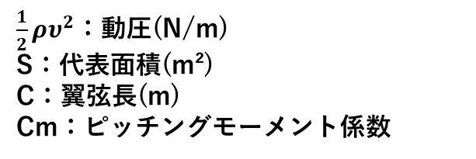
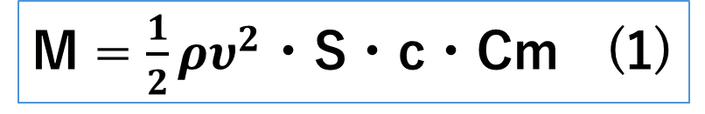
Aerodynamics
リアウイング
まずは設計の流れを以下に示す。
これによりピッチングモーメント係数を-0.24ほどから
-0.10ほどまで減少でき、式(1)よりピッチングモーメントを約58％軽減することができ、構造や挙動の安定性を得ることが出来た。
１．翼型の選定および迎え角の決定
２．スロットギャップ・オーバーラップの決定
３．3Dモデル化
M = $\frac{1}{2}ρυ^{2}$・S・c・Cm (1)
１．翼型の選定および迎え角の決定について
まず初めに、高い揚力係数を持ち、低レイノルズ数域で優れた性能を出すS1223のみを採用して設計を行った。
3枚翼のマルチエレメントで設計し、スパン長を1000mmと仮定して、迎え角を変更してAnsysの2D解析を繰り返し行うと、0°30°50°と設定した場合が最も抵抗を抑えてダウンフォースを稼げたため、迎え角はこの角度に決定した。
また、設計を進めていく中で、大きな負のピッチングモーメントによる構造的な負荷やダウンフォースの不安定性を考慮して、メインプレーンをS1223から、後端を上向きに反り返らせたS1223 RTLを用いることに決めた。
$\frac{1}{2}ρυ^{2}$：動圧(N/m)
S：代表面積(m²)
C：翼弦長(m)
Cm：ピッチングモーメント係数
また、ダウンフォースを稼ぐためにアッパーウイングを導入することに決めた。
ただアッパーウイングの1stウイングは失速しやすい傾向にあったため、E423を採用することにした。
NACA M3も検討したが、2ndウイングの迎え角が小さかったことで剥離や抵抗にあまり大きな差は見られなかったため、ダウンフォースを稼ぎやすいE423を採用した。

Slide 2
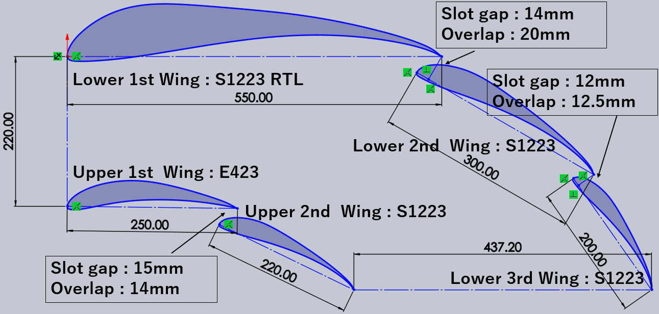
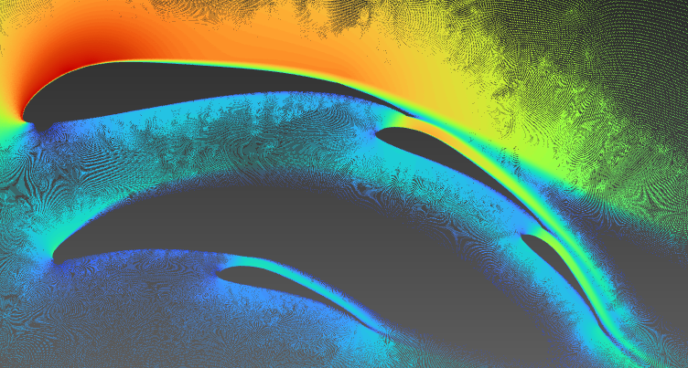
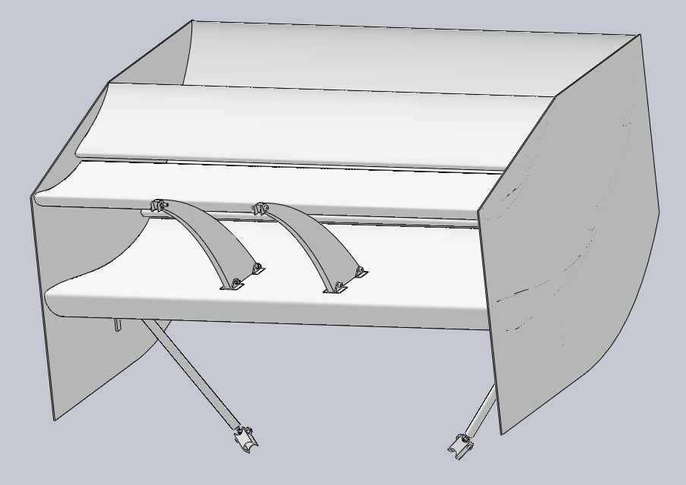
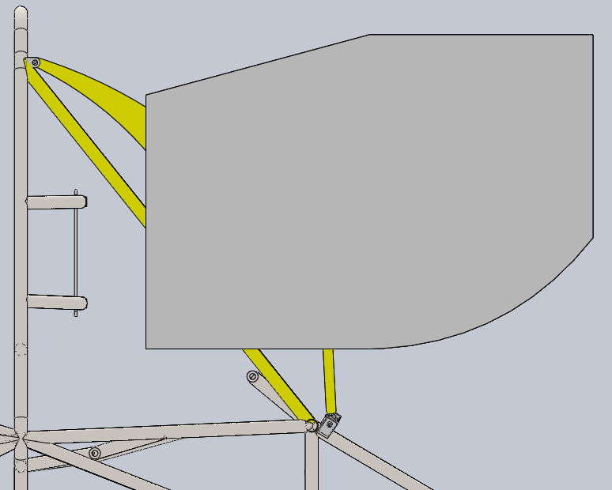
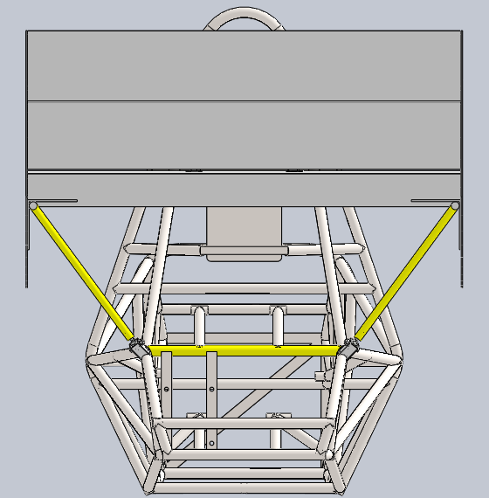
Aerodynamics
２．スロットギャップ・オーバーラップの決定について
翼型や迎え角の決定後、スロットギャップやオーバーラップのみに変更を加えてAnsysの2D解析を繰り返し行った。ドラッグの軽減に焦点を当てて、最終的に採用した翼やスロットギャップ、オーバーラップの大きさは図1の通りである。
最終的な2Dの解析結果を図2に示す。
３．3Dモデル化について
2D解析の結果をもとに3Dモデル化を行った。
トレッド幅が1335mm,タイヤ幅が約200mmであることと重量、製作時の誤差を考慮してスパン長は1040mmに決定した。
またステー等の配置について、側面から見た際にスワンネックとステーで三角形構造をつくり、後方から見た際にステーをV字に配置することで、部品点数を抑えつつ幾何学的に高剛性な構造となるように設計を行った(以下の画像を参照してください)。
図2
図1
Swanneck
Wind speed 40km/h
down force : 159N drag : 4.9N (Span length: 1000 mm)
＊the image is inverted vertically for analysis purposes.
stay

Slide 3
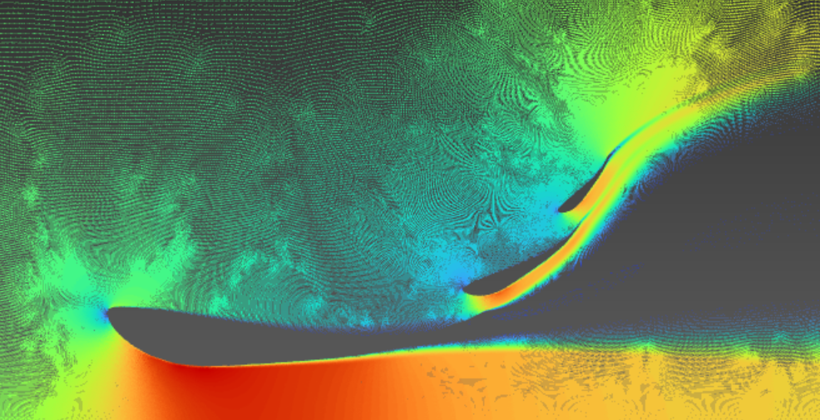
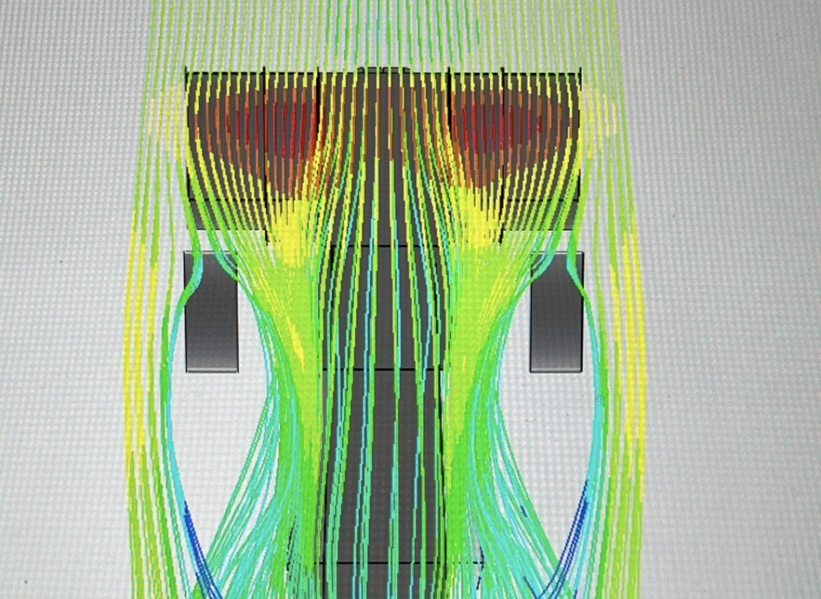
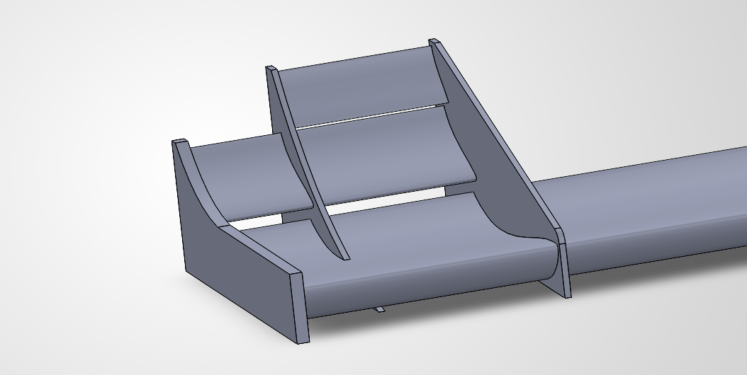
Aerodynamics
フロントウイング
〈目標値〉
スパン長1m、風速11m/s (= 39.6km/s) の条件で
Df：130N以上
解析については、Ansysによる2D、3D解析を行い、スパン長1m、風速11m/sの条件でDf、drag値を測定した。この値を基にして、Df値が目標値の130Nになるように、かつdrag値が出来るだけ小さくなることを目指し、何度も解析を繰り返しながらウイングの位置を決定していった。
また、3D解析に関しては、Ansysとは別にSolidWorksのFlowSimulation機能を用いて、ウイング周りの風の流れ方も観測した。
・なるべくdragを抑えつつDfを増やせるように設計。
・マシンの駆動輪が後輪であることを考慮し、リアのDfが多めになるようにリア:フロント＝4:6を目安とした。
内側と外側で枚数の違うウイングを製作する方針に。これにより、レギュレーションに準じたままより多くのDfが見込められる。
←イメージ図。規定があるのはタイヤ前のウイングであるので、それより内側を一枚増やすことが可能である。

Slide 4
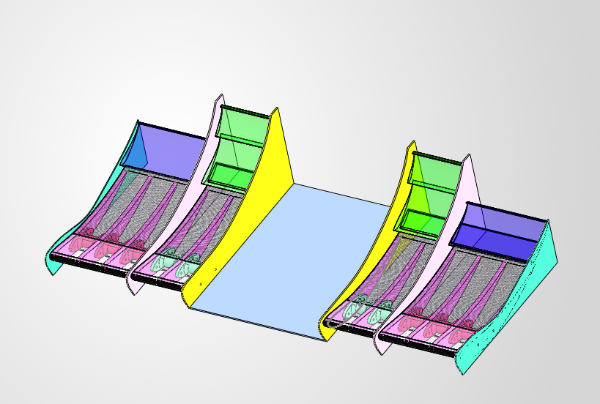
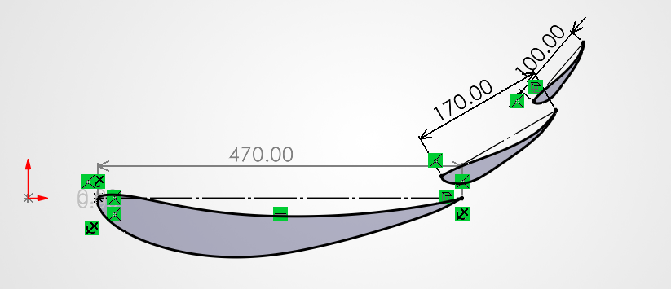
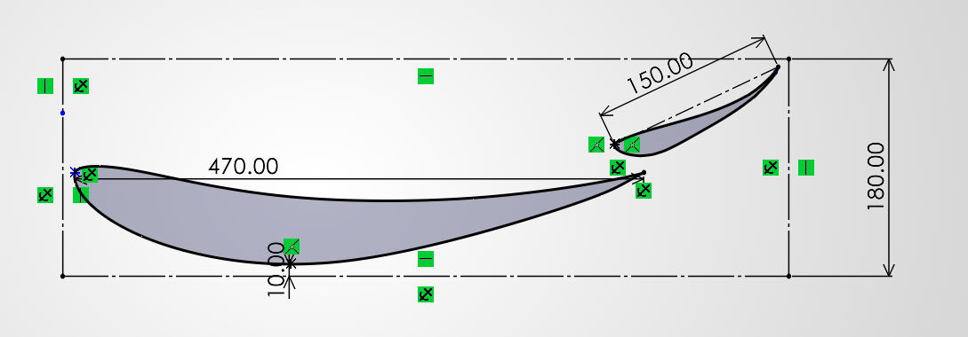
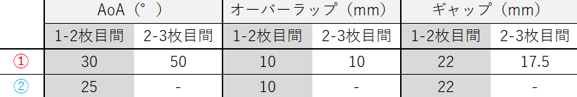
Aerodynamics
➀
②
➀
Df：129.08N drag：23.00N
②
Df：110.76N drag：20.83N
図1
図2
図3
・基本的に翼型は低レイノルズ数で大きなダウンフォースを出せる s1223 を採用している。しかし、地面との接触を避けるため地上高を80mmで設定した結果、地面効果を十分に得られないと判断。そこで、タイヤ前（➀）、内側のウイング（②）ともに１枚目のみを e423 に変更 (地面効果に特化していないが、dragの増加を防げる等、一般的な空力性能に優れる）した。
・解析によるDf、drag値を参考にそれぞれ位置を調整。最終的な位置を上の表に示す。
・図１にも示している通り、内部にリブを立てることによって強度を確保。また、衝突時にウイングがIAやフレームに干渉しないよう、FB下の部分を平板で構成。
最終的に、スパン長1m、風速11m/sの条件で
Df：N、drag：N
となった。

Slide 5
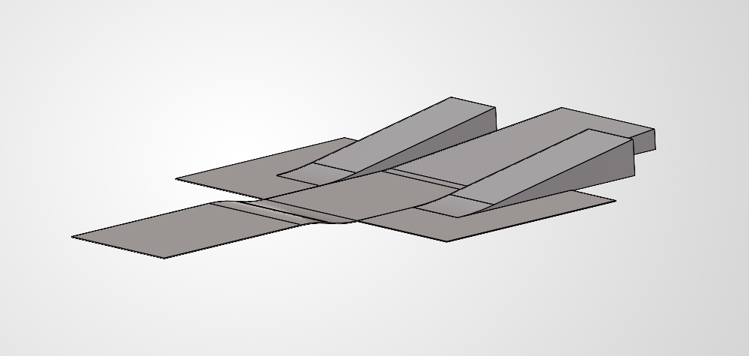
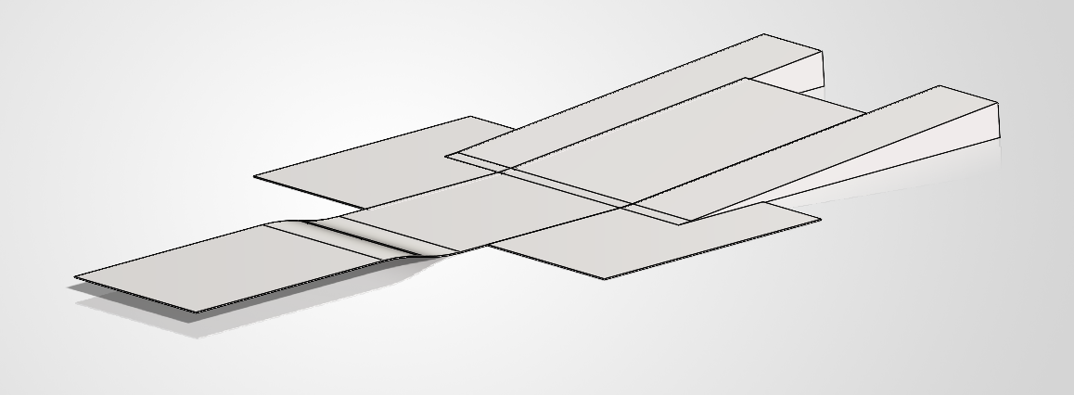
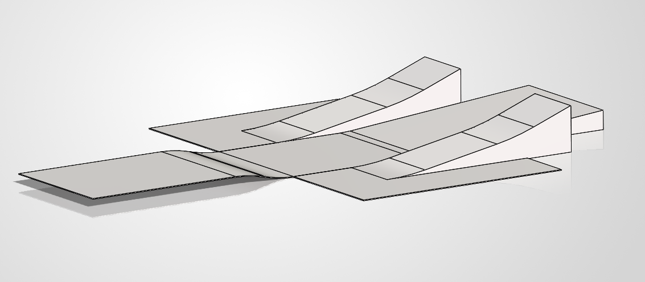
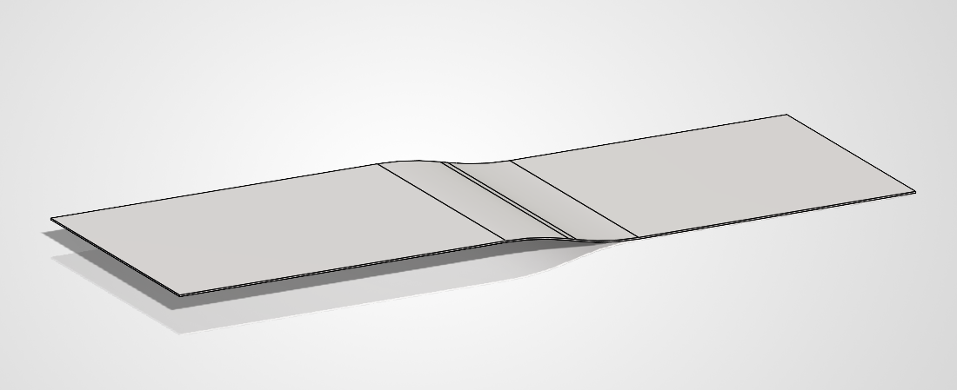
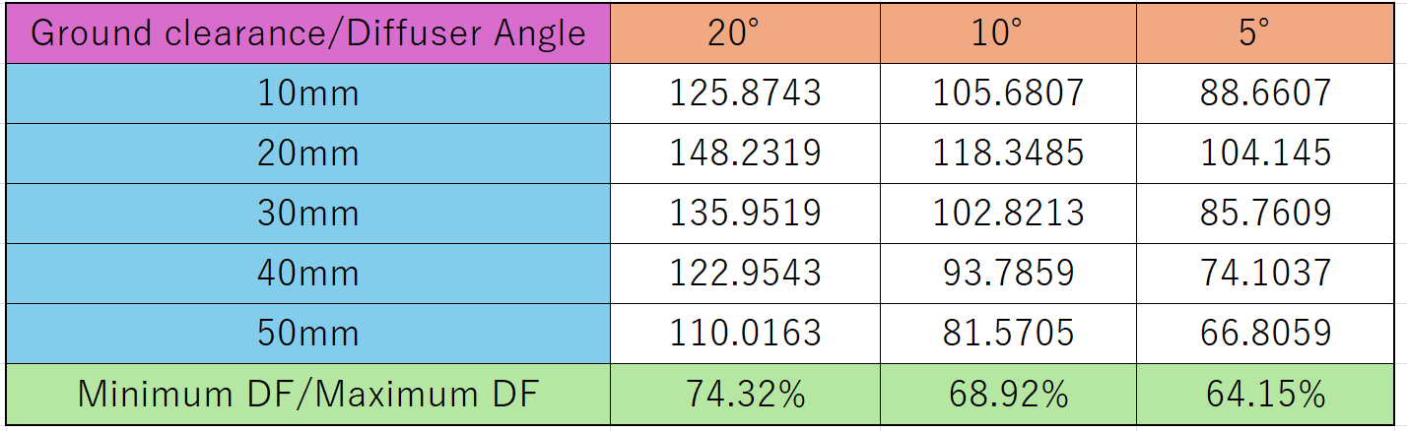
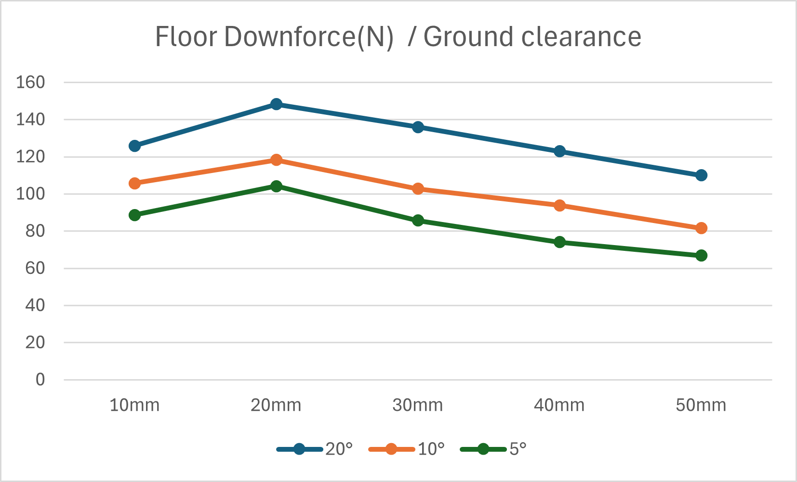
Aerodynamics
フロア
ディフューザー角選定について
パワートレイン部品の配置による制限により、ディフューザー角の上限を15°とし5°,10°,15°でモデルを用意し3D解析を行った。それぞれ10~50mmの間で10mmずつ地上高を変動させた場合のダウンフォースも計測し、車両が上下に移動した場合のダウンフォースの安定性を調べた。
結果は下に示す通りである。
最終的に最大DFに対して
最小DFの割合が最も大きい
20°のものを採用した。
車両コンセプト「強く、鋭く、確実に」
鋭いコーナリングのために
・「保護」→「荷重を付加」
・安定したDFを供給
確実に動作するように
・ラジエーターの保護
・型の選定
・素材の選定
10°
＜昨年度＞
目的：ドライバー保護
素材：ガラスマット
5°
15°
＜今年度＞
目的:①ドライバー保護
②輪荷重増加
→ディフューザー追加
素材:AFRP
解析ツール:OpenFOAM 流速:11m/s (=40km/h)

Slide 6
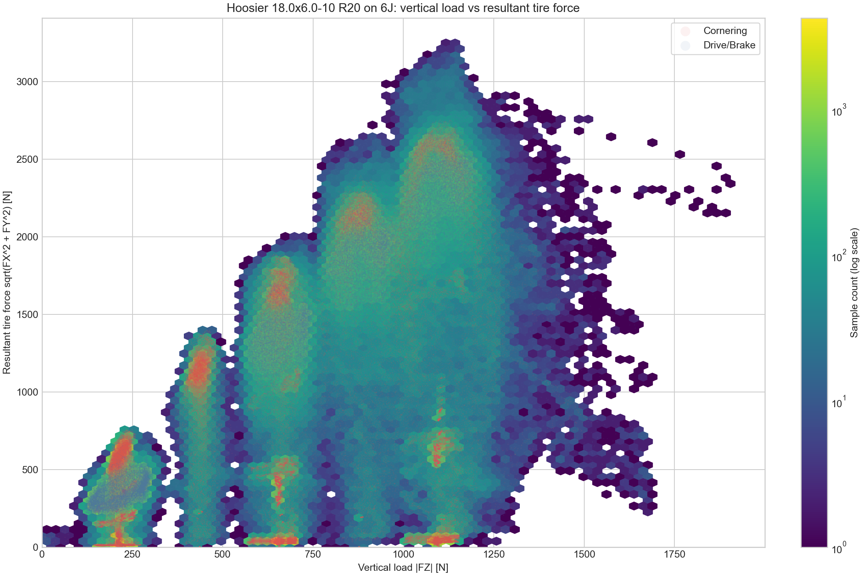
Aerodynamics
Aerodynamic Device Overview
0.1 Why aerodynamic devices were adopted
Aerodynamic devices were introduced to achieve sharper vehicle behavior.
1. Simulation showed that downforce gains outweigh the added weight.
2. The team had enough members to develop and manufacture them.
3. Production tests were completed last year, so preparation was ready
0.2 Development targets
For the first aero package, the design focused on four targets:
1. Easy-to-manufacture geometry.
2. Sufficient downforce.
3. Strength against failure.
4. Weight reduction, while prioritizing manufacturability.
increases almost linearly
Fig1. vertical load VS resultant tire force
0.4 Performance target
The figure plots vertical load on the horizontal axis and resultant tire force on the vertical axis.
Looking only at the maximum tire force, the trend increases almost linearly as vertical load rises.
Therefore, the aero design prioritizes maximizing downforce. Simulation also showed that downforce benefit exceeds drag loss when L/D is above 3, so L/D > 3 was set as a design constraint.
0.3 Development risk management
As the first aero package, this work could affect the whole vehicle schedule. To control risk and workload, development would stop immediately if SES approval was delayed or a critical issue occurred.

Slide 7
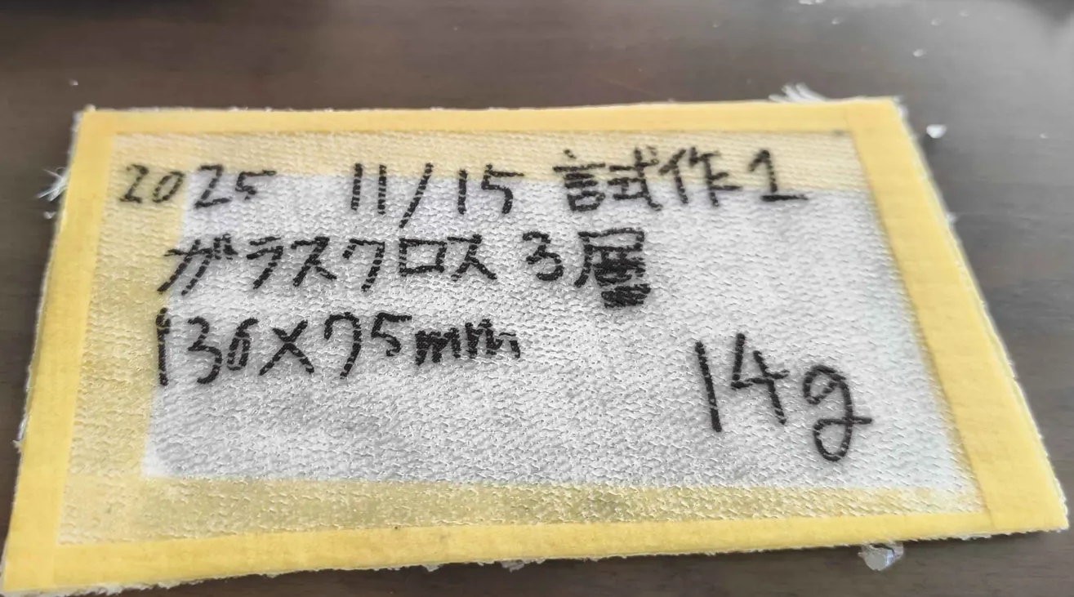
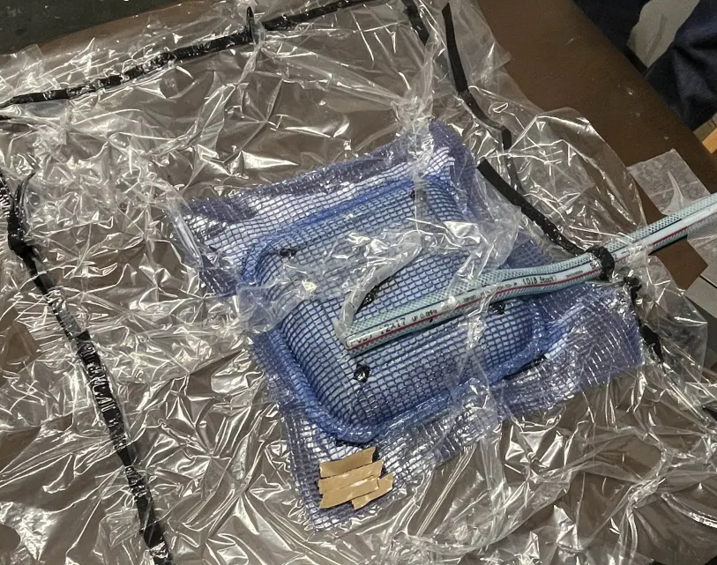
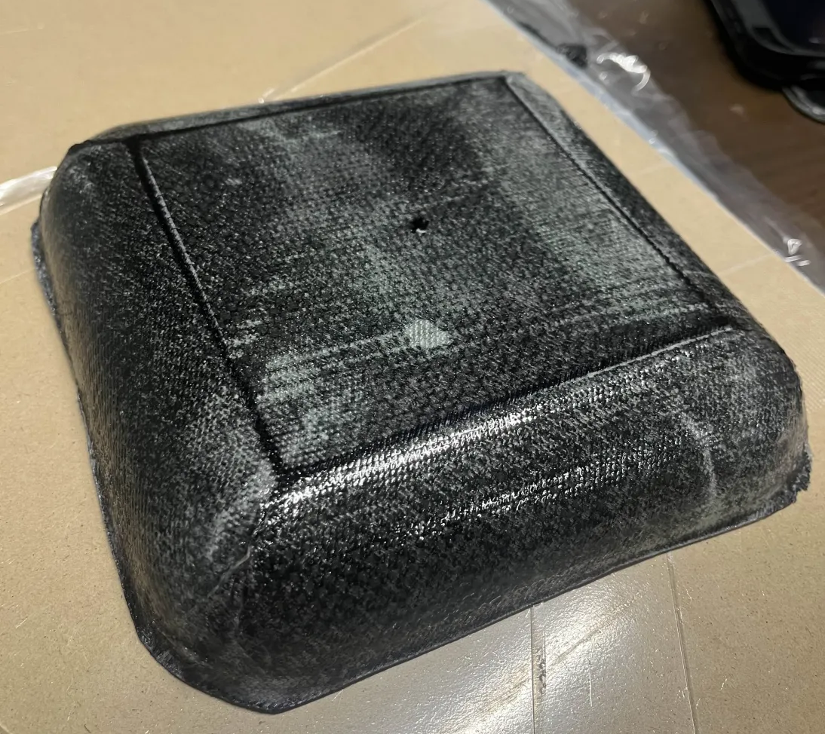
Aerodynamics
Manufacturability Verification
0.5 Manufacturing feasibility tests
Small-scale production tests were repeated before final aero manufacturing.
1. Wet layup sandwich samples were produced with glass fiber and foam core.
2. VaRTM trials were also conducted to verify resin flow and bagging quality.
3. Vacuum bagging reached -0.92 atm, confirming sufficient suction for trial parts.
4. A first 1-ply sample bonded to the MDF board, showing release was the main issue.
Fig2. FRP test pece
0.6 Release-process findings
The team tested several changes to improve demolding:
1. Move samples to the MDF board edges to allow tool access.
2. Increase peel-ply size to about four times the previous area.
3. Increase PVA concentration from 1:3 to 1:1.
0.8 Manufacturing readiness
Mold preparation also progressed through gelcoat application for tooling.
For actual production, simple wet layup is used for large parts where speed and handling are important.
VaRTM is used for smaller parts where resin control, fiber volume, and repeatability are easier to manage.
These tests fixed the practical constraints: release margin, peel-ply coverage, tool access, vacuum quality, and cure time.
0.7 Cure-time lesson
Even after an overnight cure, strong adhesion and tacky PVA remained. This indicated that catalog cure time was not enough under actual workshop conditions, so longer curing and thicker PVA application were treated as process requirements.
←Fig3. VaRTM tests
Fig4. CFRP test tray→

Slide 8
Aerodynamics
Frontwing
For the analysis, 2D and 3D analyses were performed using Ansys, and Df and drag values ​​were measured under conditions of a span length of 1m and a wind speed of 11m/s. Based on these values, the wing position was determined by repeatedly performing analyses, aiming to achieve a Df value of 130N while minimizing the drag value as much as possible.In addition, for the 3D analysis, the airflow around the wing was observed using SolidWorks' FlowSimulation function, separate from Ansys.
<Target Values>
Under the conditions of a span length of 1m and a wind speed of 11m/s (= 39.6km/s),
Down force (Df): 130N or higher
- Designed to maximize drag while increasing Df.
- Considering that the machine's drive wheels are the rear wheels, a rear:front ratio of 4:6 was used as a guideline to maximize rear Df.
The plan is to manufacture wings with different numbers of layers on the inside and outside. This will allow for more Df while still adhering to regulations.
←Illustrative diagram. The regulations only apply to the wing in front of the tires, so it is possible to add an extra wing further inside from there.

Slide 9
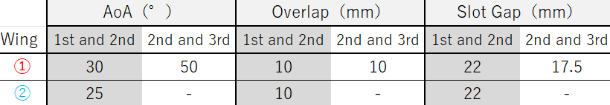
Aerodynamics
➀
②
➀
Df：129.08N drag：23.00N
②
Df：110.76N drag：20.83N
Figure 1
Figure 2
Figure 3
The airfoil is basically the s1223, which can generate a large downforce at a low Reynolds number. Only the first wing in front of the tire (①) and the inner wing (②) was changed to the e423 (which is not specialized for ground effect, but is excellent in general aerodynamic performance, such as preventing an increase in drag).
Adjust the positions based on the Df and drag values ​​obtained from the analysis. The final positions are shown in the table above.
As shown in Figure 1, strength is ensured by adding ribs to the inside. In addition, the part under the FB is constructed of a flat plate to avoid frame during a collision..
Under the conditions of a span length of 1m and a wind speed of 11m/s,
Df: -122.N, drag: 23.7183 N was obtained.

Slide 10
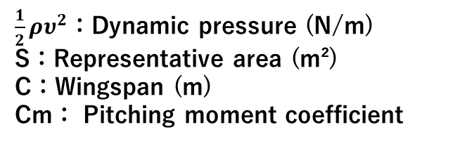
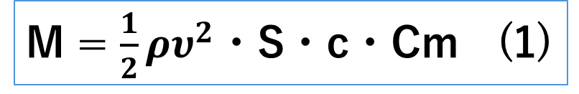
Aerodynamics
Rear Wing
First, the design process is outlined below.
This reduced the pitching moment coefficient from approximately -0.24 to approximately -0.10, which reduced the pitching moment by about 58%, thereby ensuring structural and dynamic stability.(based on Equation (1))
１．Selection of Airfoil and Determination of Angle of Attack
２． Determining Slot Gaps and Overlaps
３． 3D Modeling
M = $\frac{1}{2}ρυ^{2}$・S・c・Cm (1)
１. Selection of Airfoil Shapes and Determination of Angle of Attack
First, the design was based exclusively on the S1223 material, which has a high lift coefficient and delivers excellent performance in the low Reynolds number range.
We designed a three-bladed multi-element wing, assuming a span of 1000 mm. After repeatedly performing 2D analysis in Ansys while varying the angle of attack, we found that settings of
0°, 30°, and 50° resulted in the lowest drag.
Therefore, we decided to use these angles.
Furthermore, considering the structural loads caused by large negative pitching moments and the instability of downforce, we decided to replace the S1223 main wing with the S1223 RTL, which features an upward-curved trailing edge.
$\frac{1}{2}ρυ^{2}$：Dynamic pressure (N/m)
S：Representative area (m²)
C：Wingspan (m)
Cm： Pitching moment coefficient
We also decided to incorporate an upper wing to generate downforce.
However, since the first wing of the upper wing design tended to stall easily, we opted for the E423.
We considered the NACA M3 as well, but because the angle of attack on the second wing was small, we didn’t observe a significant difference in stall or drag.
Therefore, we chose the E423, which is better suited for generating downforce.

Slide 11
Aerodynamics
２. Determining Slot Gaps and Overlaps
After determining the airfoil and angle of attack, we performed repeated 2D analyses in Ansys, making changes only to the slot gap and overlap.
Focusing on reducing drag, the airfoil, slot gap, and overlap values ultimately adopted are shown in Figure 1.
The final 2D analysis results are shown in Figure 2.
３. 3D Modeling
We created a 3D model based on the results of the 2D analysis.
Considering the tread width of 1,335 mm, the tire width of approximately 200 mm, the weight, and manufacturing tolerances, the span length was determined to be 1,040 mm.
We also examined the placement of the struts and other components. The design was intended to create a geometrically rigid structure by forming a triangular configuration with the swan neck and struts when viewed from the side, and by arranging the struts in a V-shape when viewed from the rear.
(Please refer to the images below.)
Figure 2
Figure 1
Swanneck
Wind speed 40km/h
down force : 159N drag : 4.9N (Span length: 1000 mm)
＊the image is inverted vertically for analysis purposes.
stay

