Slide 1
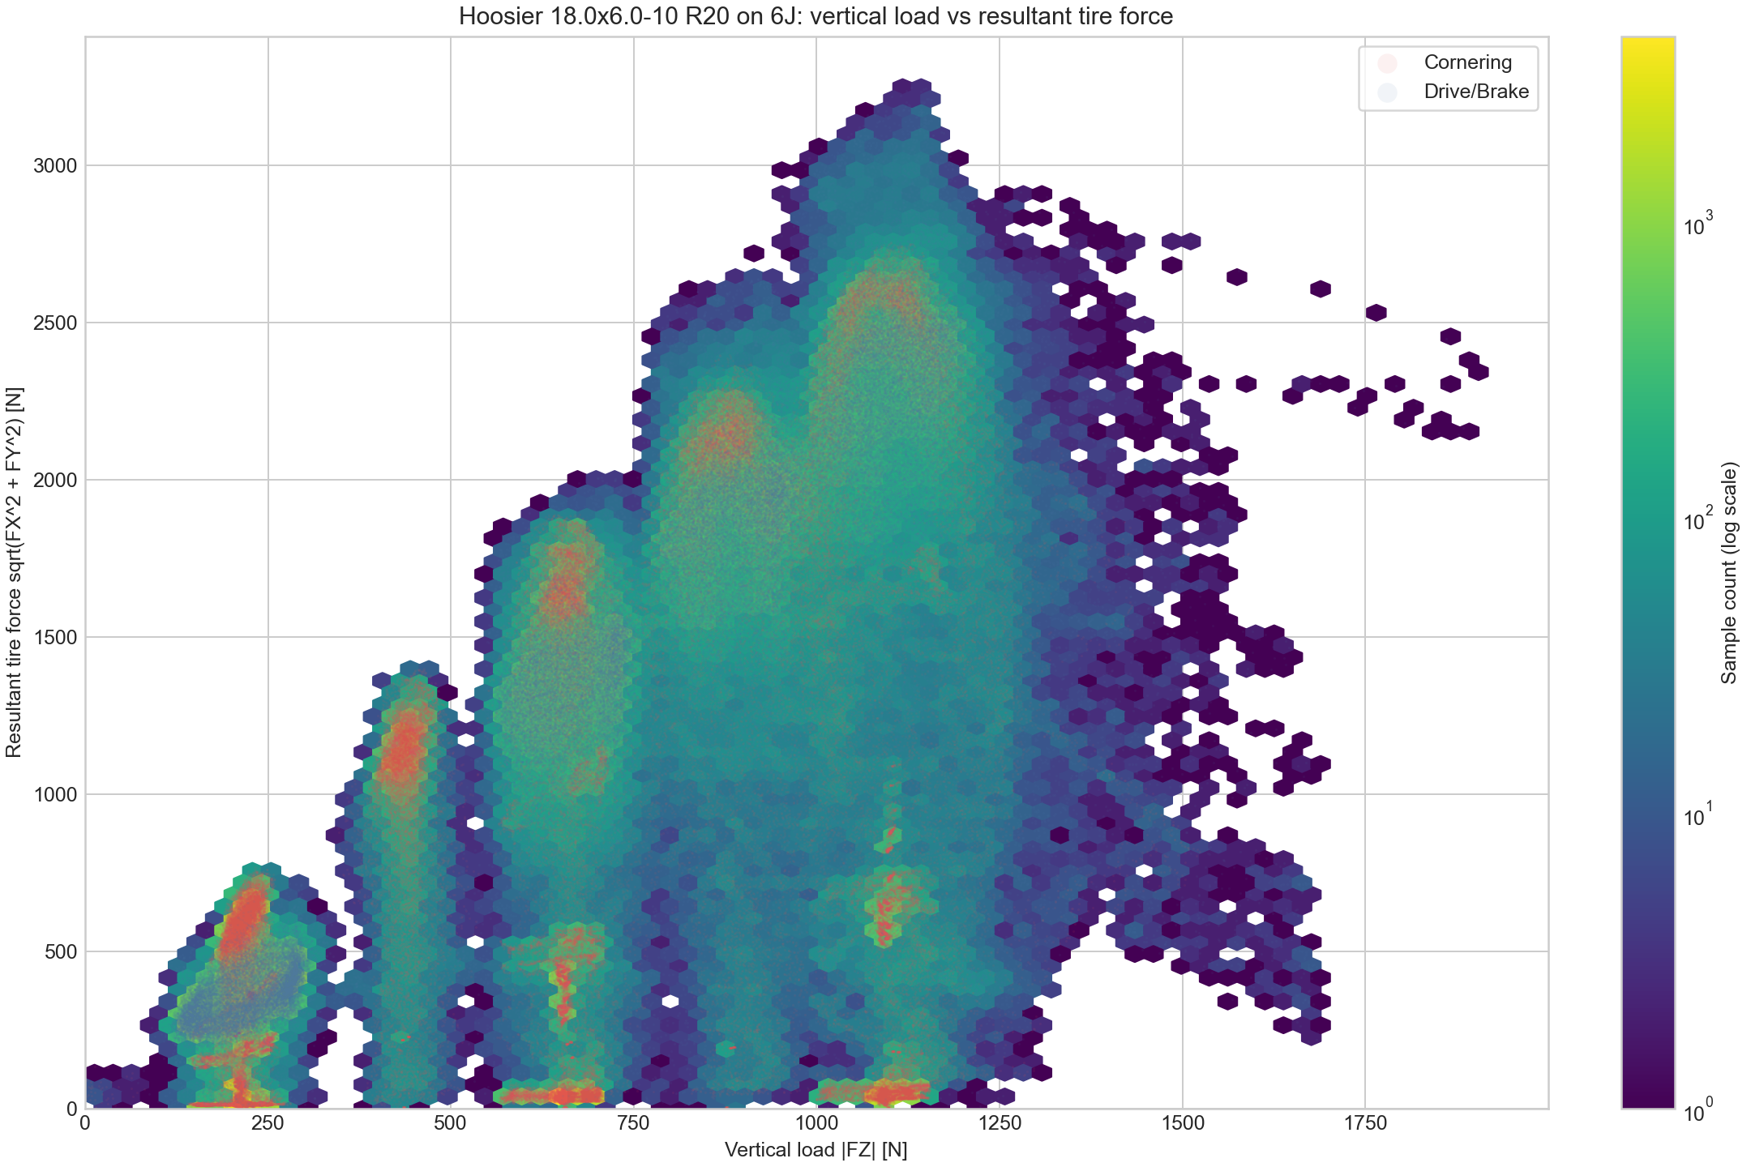
Aerodynamics
Aerodynamic Device Overview
0.1 Why aero devices were adopted
Aero devices were introduced to achieve sharper vehicle behavior.
Simulation showed that downforce gains outweigh the added weight.
The team also had enough members and prior production tests to support development.
0.2 Development targets
1. Easy-to-manufacture geometry.
2. Sufficient downforce.
3. Strength against failure.
4. Weight reduction while prioritizing manufacturability.
almost linear increase
Fig. 1 Vertical load vs. resultant tire force
0.4 Performance and production strategy
The tire-force plot shows vertical load on the horizontal axis and resultant tire force on the vertical axis.
Maximum tire force increases almost linearly with vertical load, so the design prioritizes downforce.
Manufacturing tests confirmed wet layup, VaRTM, demolding, vacuum quality, and cure-time requirements.
0.3 Risk management
Because this was the first aero package, development was managed so it would not disrupt the full vehicle schedule.
If SES approval was delayed or a critical issue occurred, aero development would be stopped immediately.

Slide 2
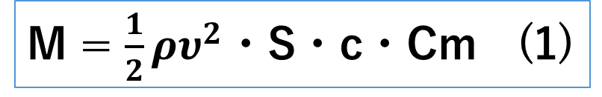
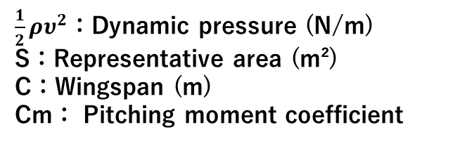
Aerodynamics
Rear Wing
The design process is summarized below.
The pitching moment coefficient was reduced from about -0.24 to about -0.10.
This cuts pitching moment by approximately 58%, improving structural and dynamic stability.
1. Select airfoils and angles of attack
2. Determine slot gaps and overlaps
3. Build the 3D model
M = $\frac{1}{2}ρυ^{2}$・S・c・Cm (1)
1. Airfoil selection and angle of attack
The rear wing was designed around S1223 because it has a high lift coefficient and strong low-Reynolds-number performance.
For a 3-element wing with a 1000 mm span, repeated 2D Ansys analyses showed that 0°, 30°, and 50° produced high downforce with low drag.
To reduce structural load and downforce instability from a large negative pitching moment, the main plane was changed from S1223 to S1223 RTL.
$\frac{1}{2}ρυ^{2}$：Dynamic pressure (N/m)
S：Representative area (m²)
C：Wingspan (m)
Cm： Pitching moment coefficient
An upper wing was added to increase downforce.
The first upper element tended to stall, so E423 was selected.
NACA M3 was also checked, but with the small second-element angle there was little difference in separation or drag; E423 was better for downforce.

Slide 3
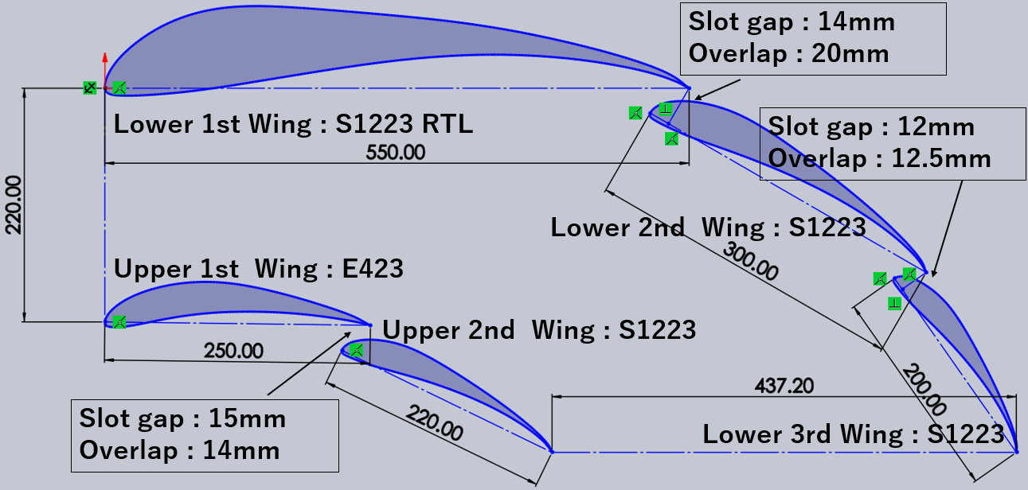
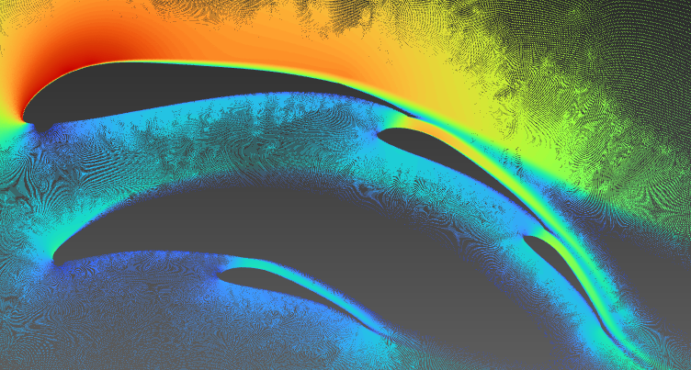
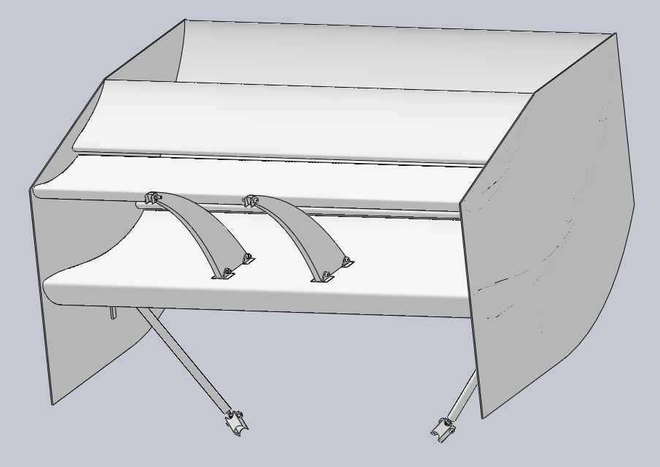
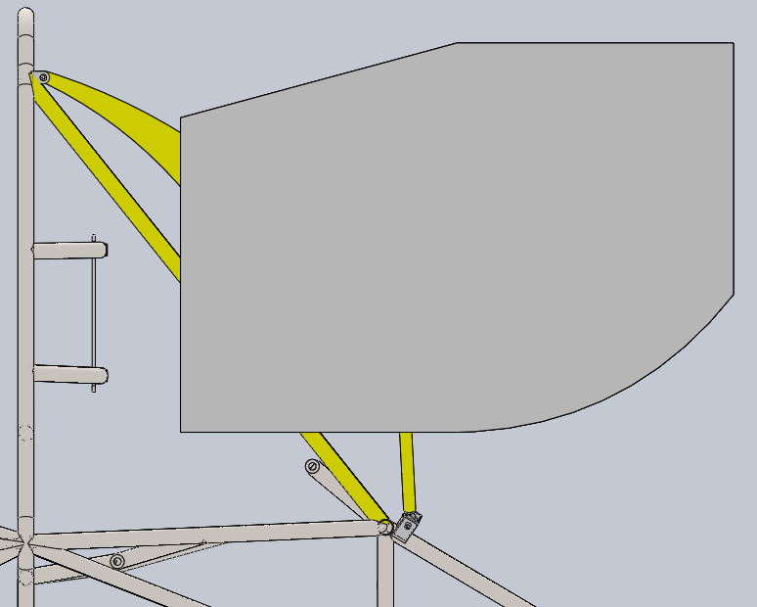
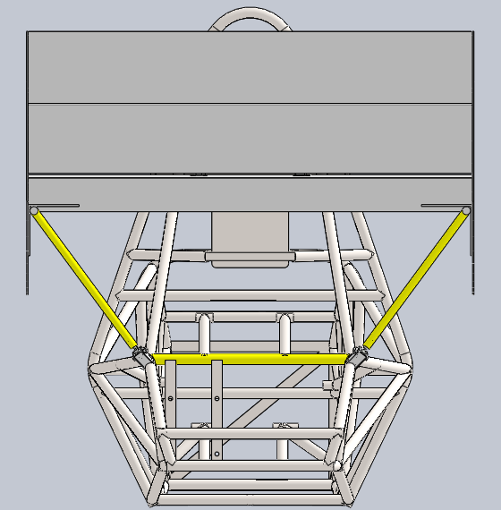
Aerodynamics
2. Slot gaps and overlaps
After fixing the airfoils and angles of attack, 2D Ansys analyses were repeated while changing only slot gap and overlap.
The final airfoil layout, gap, and overlap values are shown in Fig. 1, and the final 2D result is shown in Fig. 2.
3. 3D modeling
The 3D model was built from the 2D results.
Considering the 1335 mm tread, approximately 200 mm tire width, weight, and manufacturing tolerance, the span was set to 1040 mm.
Strut placement was also optimized.
From the side, the swan neck and stay form a triangular structure; from the rear, the stays form a V shape.
This reduces part count while maintaining geometric stiffness.
Figure 2
Figure 1
Swanneck
Wind speed: 40 km/h
Downforce: 159 N Drag: 4.9 N Span: 1000 mm
Image is vertically inverted for analysis.
stay

Slide 4
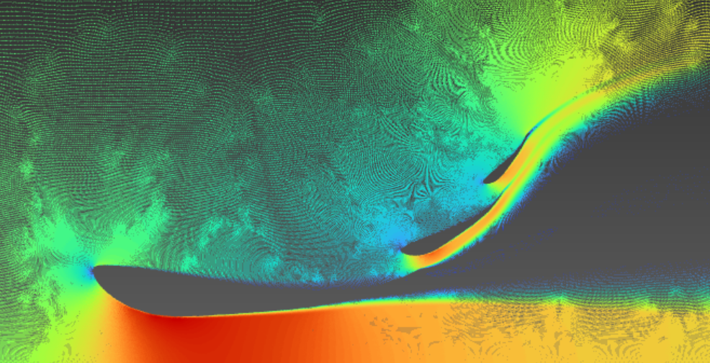
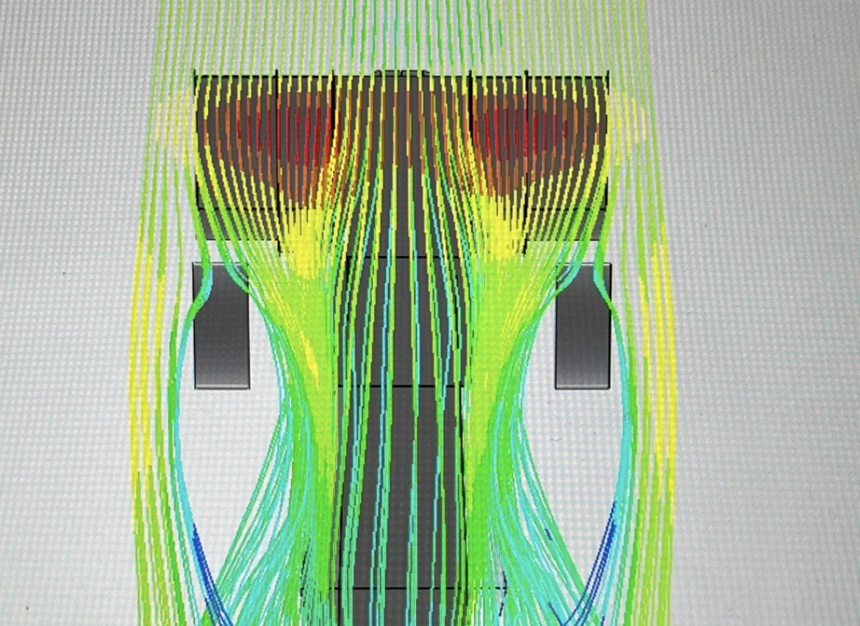
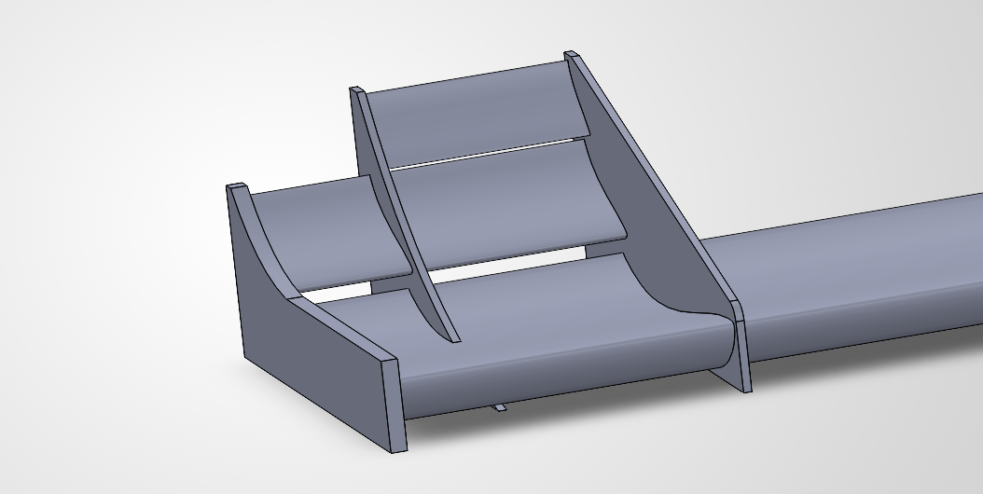
Aerodynamics
Front Wing
2D and 3D Ansys analyses were performed at 1 m span and 11 m/s to measure downforce and drag.
Wing positions were iterated to reach the 130 N target while minimizing drag.
SolidWorks Flow Simulation was also used to observe airflow around the wing.
<Target>
Span: 1 m, wind speed: 11 m/s (= 39.6 km/h)
Downforce: 130 N or higher
- Designed to increase downforce while minimizing drag.
- Because the car is rear-wheel drive, the aero balance target was rear:front = 4:6 with slightly more rear downforce.
The front wing uses different element counts between the inner and outer regions.
This increases downforce while staying within the regulation-controlled tire-front area.
Illustration: regulations apply to the wing in front of the tire, so one extra inner element can be added inside that region.

Slide 5
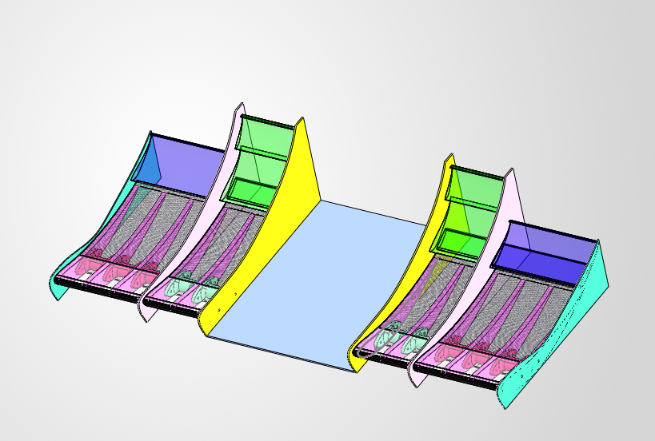
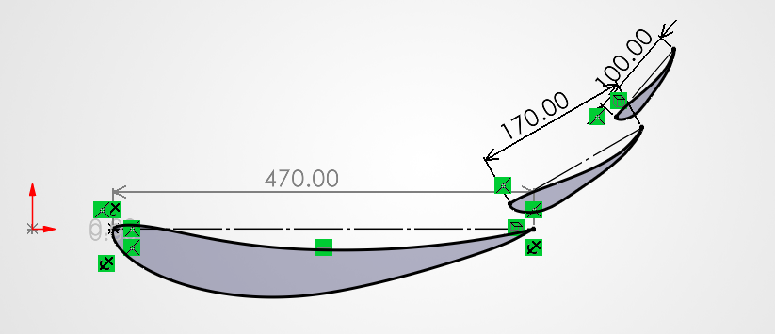
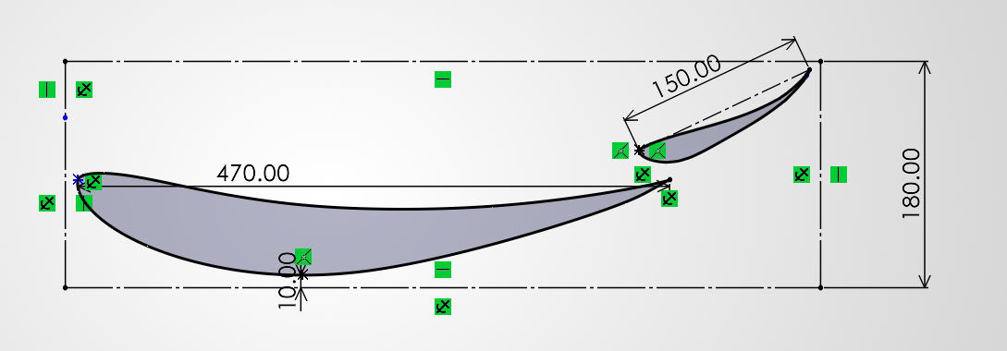
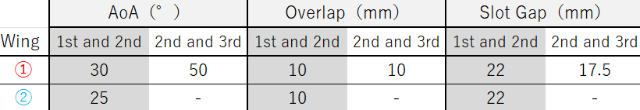
Aerodynamics
➀
②
➀
Df：129.08N drag：23.00N
②
Df：110.76N drag：20.83N
Figure 1
Figure 2
Figure 3
S1223 was used as the base airfoil because it generates high downforce at low Reynolds numbers.
With an 80 mm ride height, ground effect was judged insufficient.
Therefore, only the first elements in front of the tire (1) and inboard wing (2) were changed to E423, which offers strong general aero performance and suppresses drag increase.
Final positions were adjusted using the downforce and drag values from analysis.
The adopted positions are shown in the table above.
Ribs are added inside the wing to secure strength.
The section below the front bulkhead is a flat plate so the wing does not interfere with the IA or frame during a collision.
Final result at span 1 m and wind speed 11 m/s:
Downforce: -122 N Drag: 23.7183 N

Slide 6
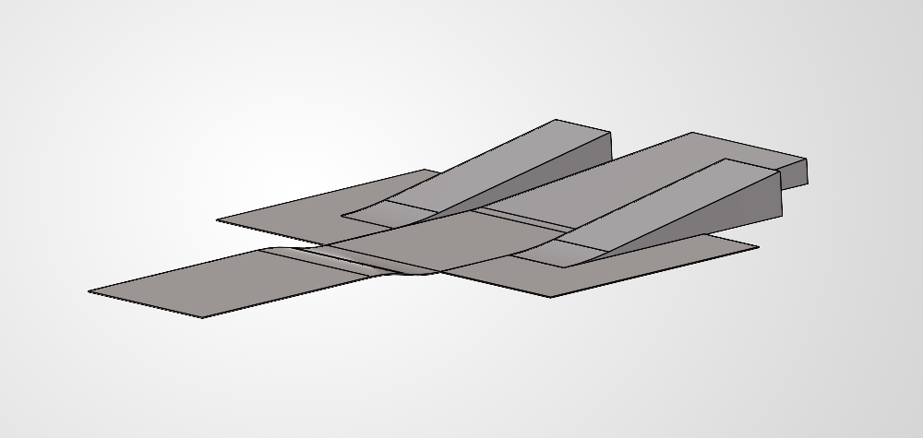
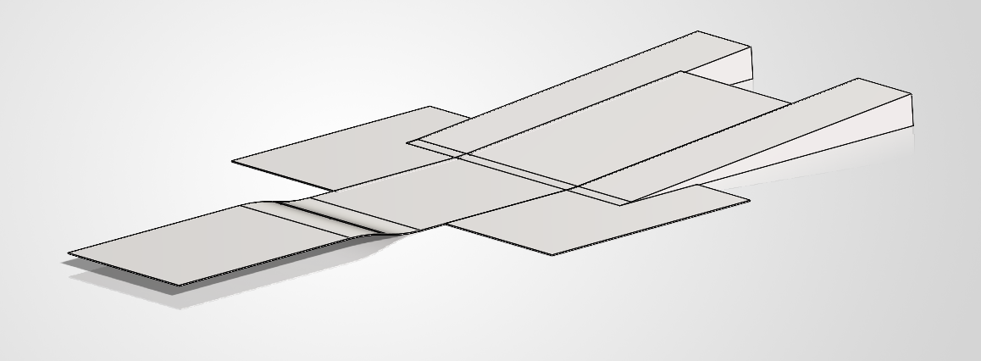
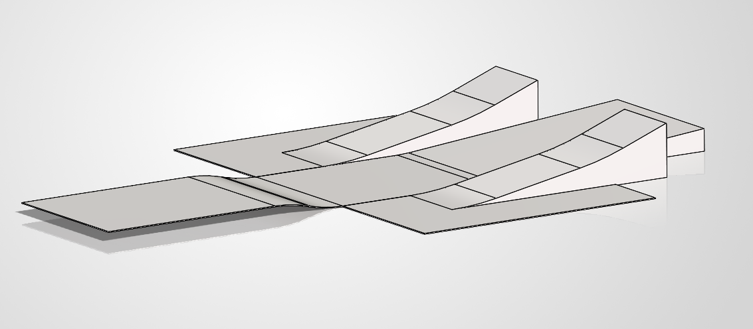
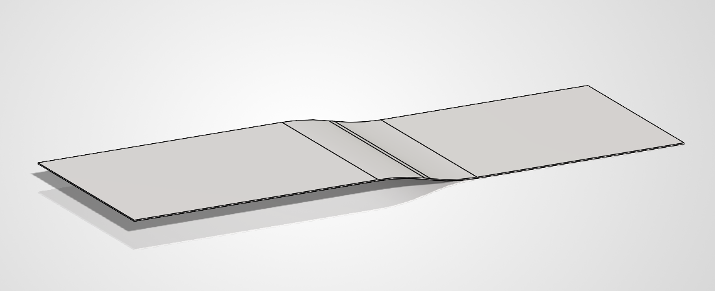
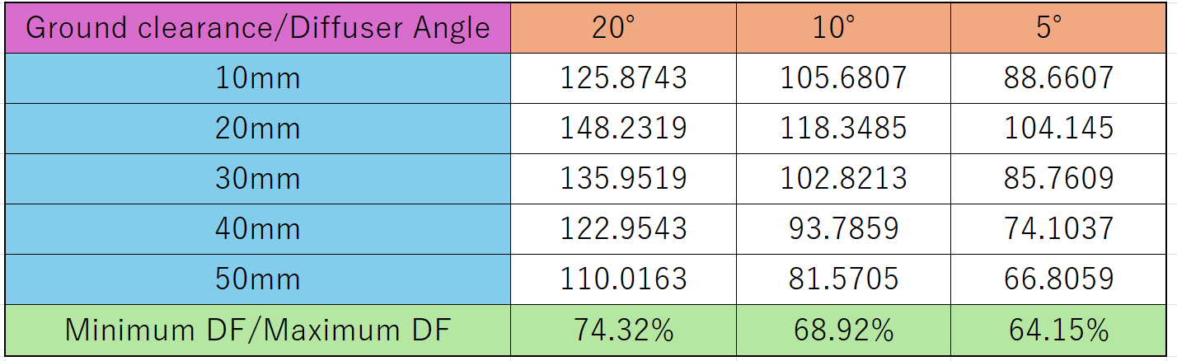
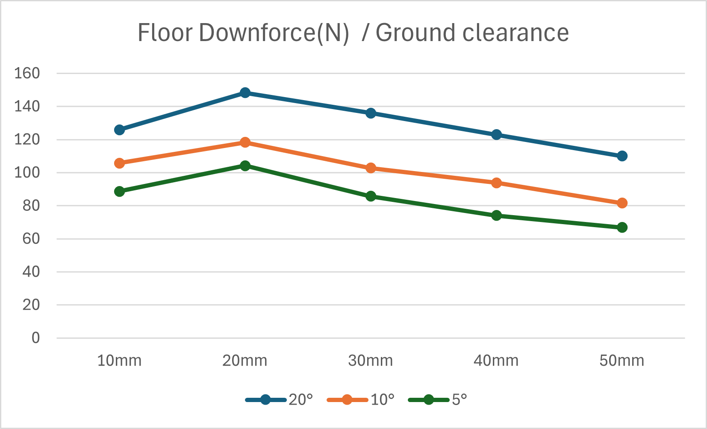
Aerodynamics
Floor
Diffuser angle selection
Packaging around the powertrain limited the diffuser angle, so 5°, 10°, and 15° models were analyzed in 3D.
Ride height was varied from 10 to 50 mm in 10 mm steps to evaluate downforce stability during vertical vehicle motion.
The final angle was selected by prioritizing the largest minimum-to-maximum downforce ratio.
Vehicle concept: “Strong, Sharp, Reliable”
For sharp cornering
- From “protection only” to “load generation”
- Provide stable downforce
For reliable operation
- Protect the radiator
- Select suitable mold method
- Select suitable material
10°
<Last year>
Purpose: driver protection
Material: glass mat
5°
15°
<This year>
Purpose: 1. driver protection
2. increase wheel load
→ diffuser added
Material: AFRP
Analysis tool: OpenFOAM Flow speed: 11 m/s (= 40 km/h)

