Slide 1
Multiple Regression Analysis of Longitudinal Tire Force
Using TTC Tire Data
01 / 11
Fx main analysis with Fy comparison for Hoosier_18p0X6p0-10_R20_Rim6
Main target: Fx
Comparison target: Fy
Outliers removed by Mahalanobis distance
Template: Azusa 3
Tone: English, research presentation
Extension: PINN in the second half
Data Analysis Special Lecture / Formula TMU / sota / 2026-06-02

Slide 2
Can longitudinal tire force Fx be explained by a multivariate linear model?
02 / 11
Using TTC measurements, this report tests whether slip, load, camber, and temperature explain the main trends relevant to Formula SAE traction and braking.
Background
- In Formula SAE, tire forces directly affect lap time.
- Fx directly governs acceleration, braking, and traction.
- TTC data provide measured forces together with load, slip, temperature, and camber.
Questions and hypothesis
motivation: To create a full-scale beagle simulator, I want to predict continuous functions based on tire data obtained from point cloud data.
1. How much of Fx can be explained by SR, Fz, IA, and TSTC?
2. Compared with Fy, which factors are shared and which are dominant?
3. Where does a linear baseline stop being sufficient?
Hypothesis: Fx is governed mainly by SR and Fz, while IA and TSTC act as secondary factors.
Goal: build an interpretable Fx baseline, compare it with Fy, and clarify where a PINN becomes necessary.

Slide 3
The dataset is TTC Hoosier 18x6.0-10 R20 Rim6, which includes both drive/brake and cornering tests.
03 / 11
The same tire can therefore be used for both Fx and Fy, and the variables connect directly to the existing tire_pinn pipeline.
Total samples
329600
DriveBrake
162647
Cornering
166953
Why this tire?
- Same-tire comparison for Fx and Fy
- Both DriveBrake and Cornering are available
- Directly compatible with the existing PINN workflow
Inputs SR / SA / Fz / IA / TSTC
Outputs Fx / Fy / Mx / Mz
Fx: longitudinal force | Fy: lateral force
Dataset: Hoosier_18p0X6p0-10_R20_Rim6 | Source: Tire Testing Consortium (www.fsaettc.org)

Slide 4
The main analysis extracts near-pure longitudinal DriveBrake data and explains Fx with four variables.
04 / 11
The same OLS pipeline is also applied to Fy so that the dominant factors for longitudinal and lateral force can be compared.
Main analysis: Fx
Objective variable: Fx (longitudinal force)
Explanatory variables: SR, Fz, IA, TSTC
Filters
- DriveBrake data only
- |SA| <= 1.0 deg
- Fz >= 300 N
- 35 <= TSTC <= 85 C
Samples after filtering: 41059
Comparison analysis: Fy
Objective variable: Fy (lateral force)
Explanatory variables: SA, Fz, IA, TSTC
Filters
- Cornering data only
- |SR| <= 0.02
- Fz >= 300 N
- 35 <= TSTC <= 85 C
Samples after filtering: 17153
Pure longitudinal and pure cornering conditions are cut out separately and evaluated with the same regression workflow.

Slide 5
No strong univariate outliers appeared; outliers emerged mainly as multivariate combinations.
05 / 11
Final regression uses samples after removing points above the 95% Mahalanobis threshold in explanatory-variable space.
Univariate outliers: 0 cases for both Fx and Fy under the 1.96 SD and 1.5 IQR checks
Fx main analysis
- Samples after filtering: 41059
- Mahalanobis outliers: 1269
- Samples after removal: 39790
Takeaway: the dominant anomalies were multivariate, not univariate.
Fy comparison analysis
- Samples after filtering: 17153
- Mahalanobis outliers: 1214
- Samples after removal: 15939
Following the lecture requirement, the final regression uses the cleaned dataset.
Outlier rule: remove Mahalanobis distance > chi-square(0.95, df=4)

Slide 6
In the Fx model, collinearity is weak and SR is the dominant explanatory variable.
06 / 11
All VIF values stay near 1, so coefficient instability from multicollinearity is limited under these filtered conditions.
Coef., standardized beta, t-value, p-value
Variable Coef. Beta t p
Intercept -1097.62 - -21.52 <1e-100
SR 16393.42 0.9494 537.54 <1e-300
Fz 0.1937 0.0212 12.26 1.78e-34
IA 21.39 0.0195 11.09 1.50e-28
TSTC 21.76 0.0507 28.27 4.25e-174
R^2 = 0.8830
Adjusted R^2 = 0.8830
VIF
SR 1.06
Fz 1.01
IA 1.05
TSTC 1.09
Interpretation
- SR is the primary driver of Fx.
- Fz, IA, and TSTC are also statistically significant.
- Severe multicollinearity is not observed.
Model: Fx = a0 + a1*SR + a2*Fz + a3*IA + a4*TSTC

Slide 7
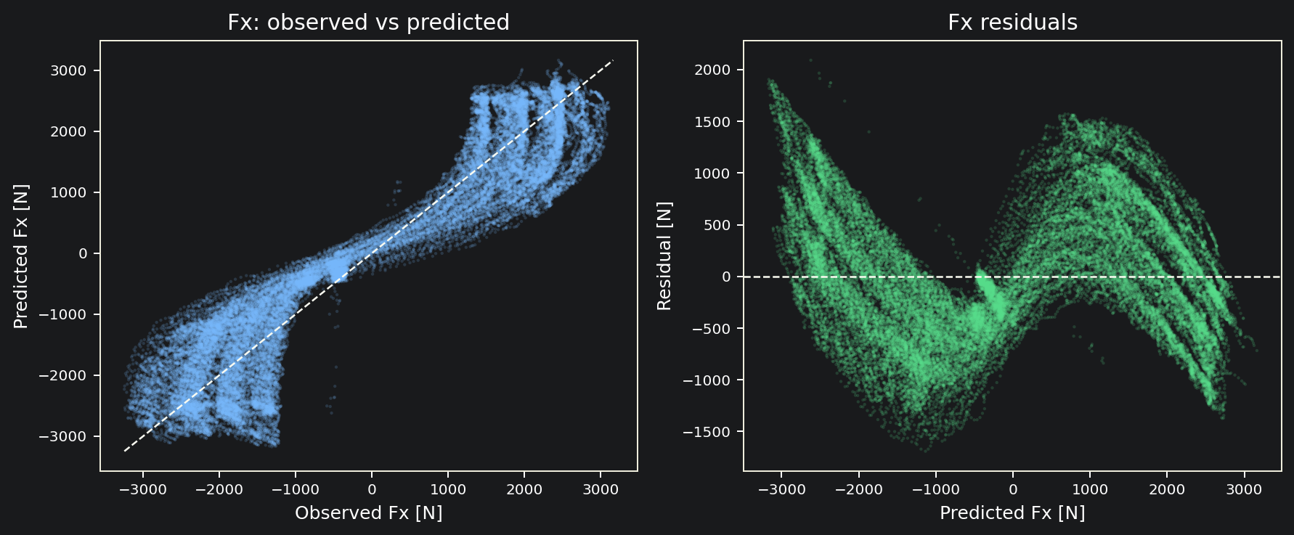
The linear Fx model reaches R^2 = 0.883 and works as a strong baseline.
07 / 11
Observed-vs-predicted and residual views show high explanatory power, while also revealing the limit of a purely linear approximation.
Key reading
- Points gather close to the diagonal, so the linear baseline is strong.
- Residuals stay near zero on average but widen in saturation regions.
- Therefore, linear regression is a valid first step, not the final model.
Panels: observed vs predicted and residuals after outlier removal

Slide 8
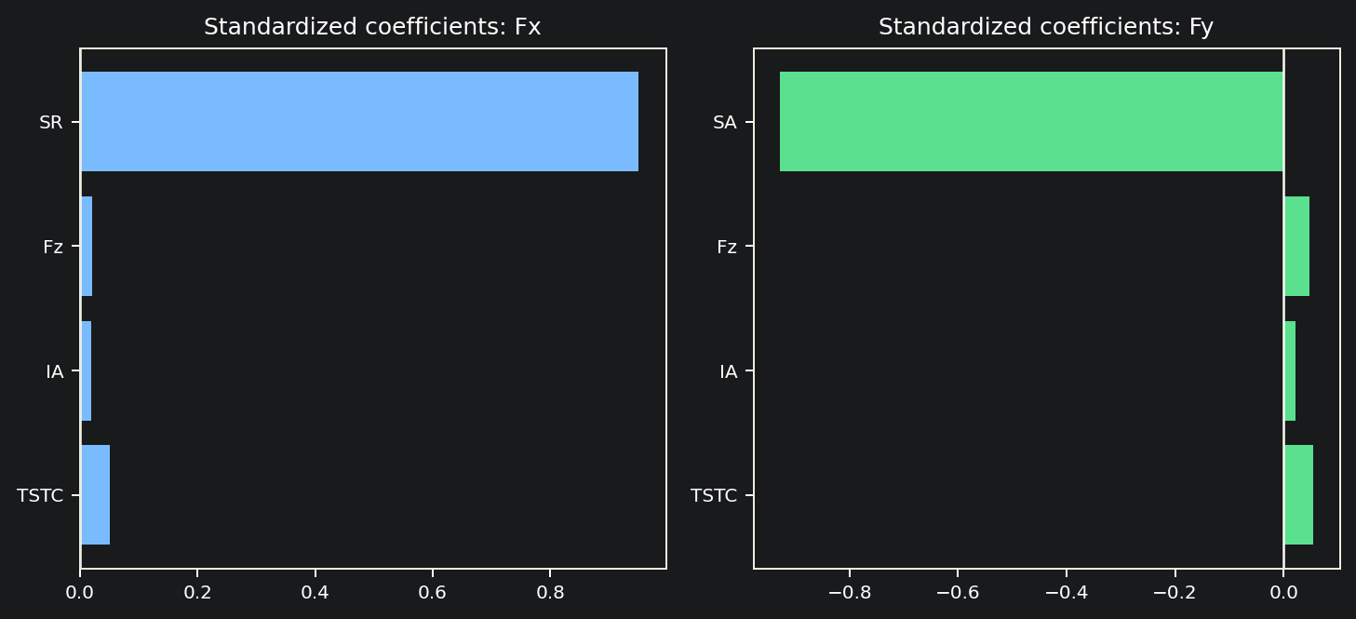
Comparing Fy shows that load, temperature, and camber matter for both longitudinal and lateral force.
08 / 11
Fx is driven mainly by SR and Fy by SA, but Fz, IA, and TSTC remain shared explanatory factors in both models.
Fy summary
R^2 = 0.8937
Adjusted R^2 = 0.8937
Std. beta / t-value
SA -0.9274 / -349.42
Fz 0.0481 / 17.85
IA 0.0217 / 7.93
TSTC 0.0545 / 20.94
Takeaway
- Fx: SR-driven
- Fy: SA-driven
- Fz, IA, TSTC are shared factors
Comparison: standardized coefficients and Fy regression summary

Slide 9
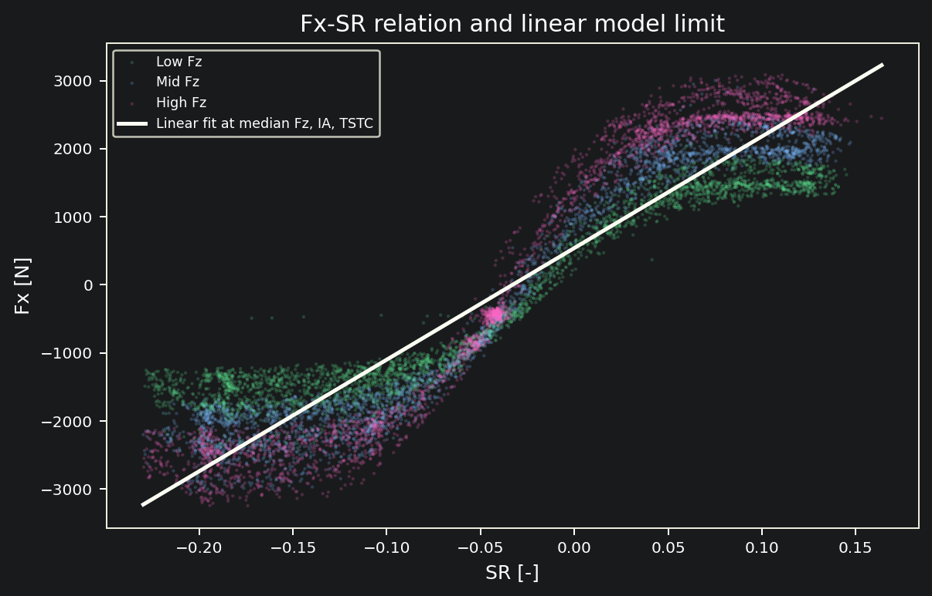
Linear regression is a useful baseline, but it cannot capture the intrinsic nonlinearities of tire behavior.
09 / 11
The Fx-SR scatter by load level shows saturation, load-dependent slope changes, and combined-slip structure beyond a linear approximation.
What linear regression misses
- Saturation at high slip ratios
- Load-dependent slope changes
- Coupled limits between Fx and Fy
- Nonlinear temperature effects
For that reason, the next step needs a nonlinear model with physical constraints.
Limits of the linear model: saturation, friction-circle effects, combined slip, temperature dependence

Slide 10
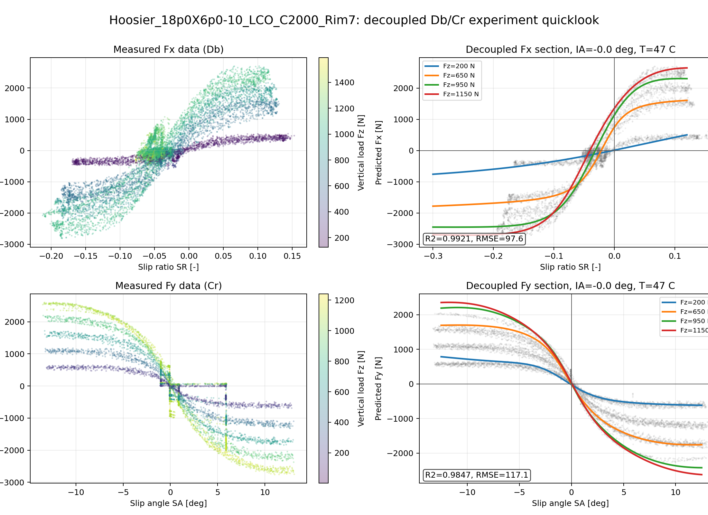
PINN extends the analysis to a nonlinear model with physical constraints.
10 / 11
The regression stage identifies influential variables and provides an interpretable baseline; PINN then handles saturation, load dependence, and combined-slip nonlinearities.
What the existing PINN quicklook shows
- Fx slices: R^2 = 0.9921, RMSE = 97.6 N
- Fy slices: R^2 = 0.9847, RMSE = 117.1 N
- The model reproduces smooth load-dependent section shapes.
Why it connects to this report
- Reuse SR, SA, Fz, IA, and TSTC.
- PINN adds saturation and load dependence.
- Rim6 is the regression case; Rim7 is the reference implementation.
Figure: decoupled Db/Cr quicklook for Hoosier_18p0X6p0-10_LCO_C2000_Rim7

Slide 11
The Fx main analysis and Fy comparison reveal the multivariate structure of tire forces in TTC data.
11 / 11
Multiple regression works as an interpretable first step, and PINN becomes a natural extension when nonlinear structure must be modeled explicitly.
Key findings
- Fx is explained mainly by SR with R^2 = 0.8830.
- Fy is explained mainly by SA with R^2 = 0.8937.
- Fz, IA, and TSTC are significant in both models.
- Collinearity is weak, and the relevant outliers are multivariate.
- Linear regression is interpretable and useful, but limited in saturation regions.
Next step
1. Add nonlinear interaction terms or piecewise models.
2. Extend the same variable set to a PINN.
3. Validate the model on combined-slip TTC sections.
In one sentence:
Multiple regression is a valid and interpretable first step for TTC tire-force modeling.
Conclusion: regression and PINN are complementary stages rather than competing approaches.

