Slide 1


S.O.S Munka
Made by: Wágner János, Fábián Zsolt, Rámháp Gergő

Slide 2

A folyamat megtervezése
solution
planing
execution

Slide 3
About Our Website
S.O.S. Work is a fast and simple platform for advertising and finding skilled workers.
Users can register as clients or workers and browse through job listings.
The goal of the website is to help workers complete jobs as quickly as possible.

Slide 4
Zsolt's Role in the Project
Frontend:
Posts, My Posts, Account Settings, Navbar, Appointment Booking, Premium Page, Create a Post, Writing Documentation

Slide 5
Jani's Role in the Project
Frontend:
Homepage design, Navbar, Posts, Registration, Login, Account Settings, Appointment Booking, Create a Post, Writing Documentation

Slide 6
Gergő's Role in the Project
Frontend:
Registration, Login, Appointment Booking, Messages, Password, Profile Picture, Images, Posts Backend:
Queries and server.js for these pages

Slide 7
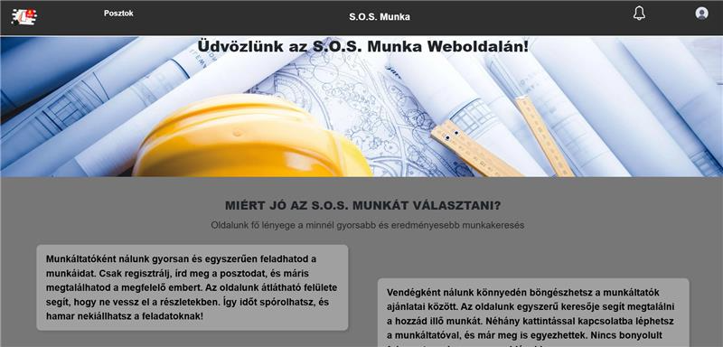
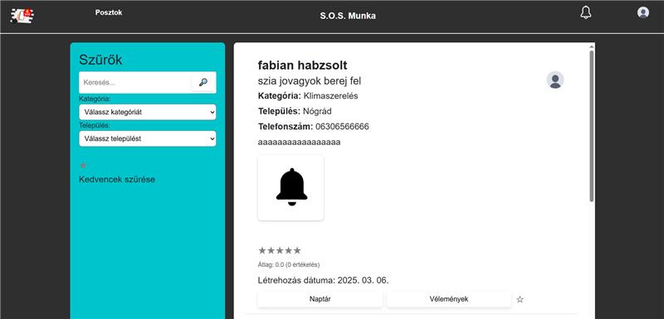
A Few Illustrations of the Website
Homepage
Posts

Slide 8
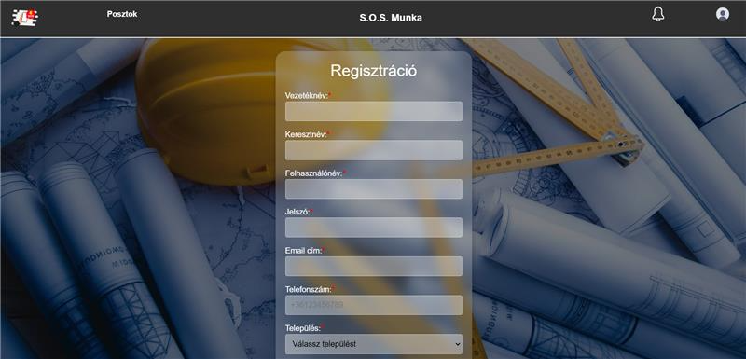
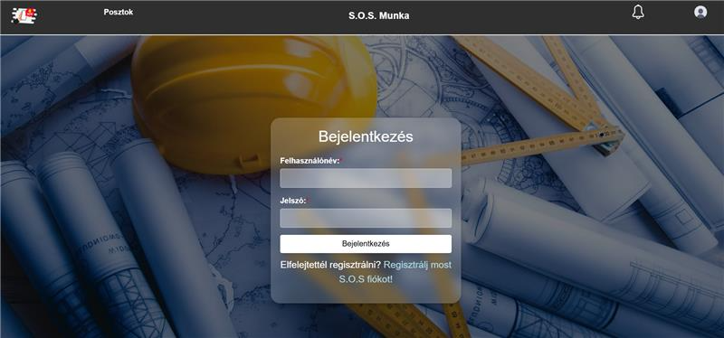
Additional Illustrations
Registration
Login

Slide 9
Future Work
Since we don’t have time before the deadline, we won’t start anything new. Instead, we’ll keep refining the site until we consider it perfect.

Slide 10

Thank you for your attention!

