Slide 1

35
CMR College of Engineering and Technology
Department of Computer Science and Engineering
IV Year
GUIDED BY
Major Dr. V. A. Narayana
B Mary Margaret ( 5C7 )
C Hemanth ( 5D0 )
Pavan kumar K ( 5D6 )
Ranking of Web site documents based on Inverse document frequency

Slide 2

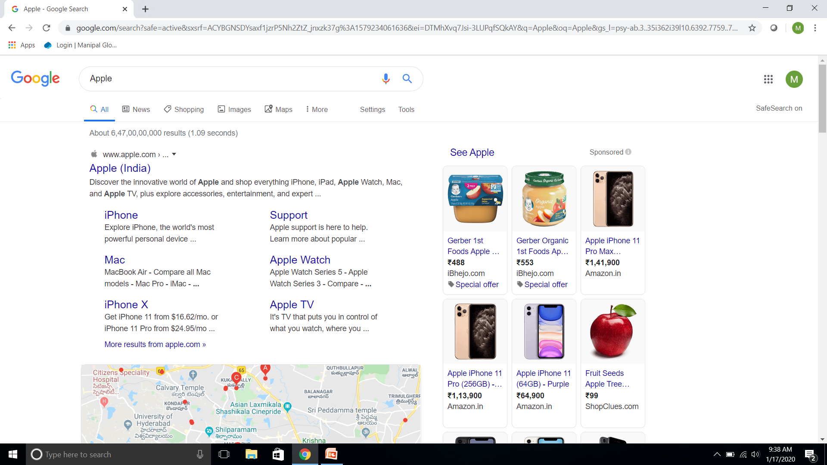

Slide 3
Ranking of Web site documents based on Inverse document frequency
Page Rank
PageRank is an algorithm used by Google Search to rank web pages in their search engine results.
WIKI SAYS
Inverse Document Frequency
TFIDF, short for term frequency–inverse document frequency, is a numerical statistic that is intended to reflect how important a word is to a document in a collection or corpus.
Bag Of Words
A text is represented as the bag of its words, disregarding grammar and even word order but keeping multiplicity.

Slide 4






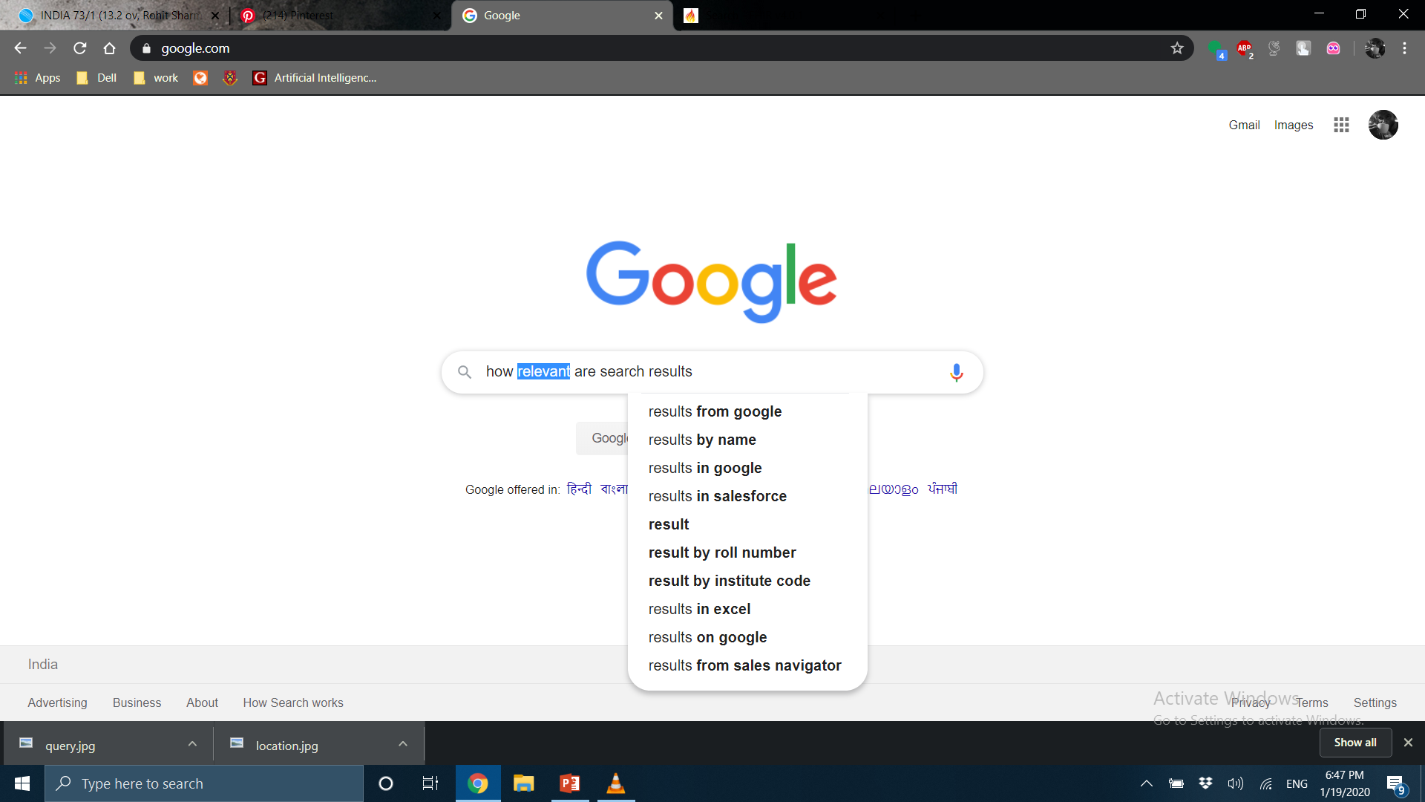



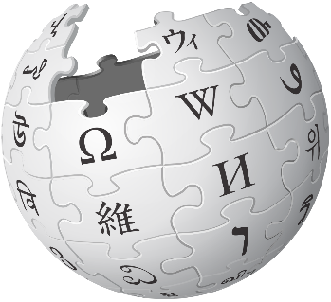

Factors which should effect Search Results
Words of Query
Relevance of Page
Usability of Page
Expertise of Source
User’s Location
User’s Settings(Over18 Years/ NSFW)

Slide 5

How Google Search Algorithm Works
Google’s ranking systems are designed to sort through hundreds of billions of web-pages in Search index to find most relevant, useful results in a fraction of a second and present in a very presentable way .

Slide 6

Role of Advertisements
Google claims that it is ads which is helping them to run search engine for free.
Ads are clearly labeled as ads (Transparency).
Google only charges advertisers when users interact with the ads.
Google claims that its commercial relationships have no impact on algorithmic search changes, i.e. issues are handled based on importance to users but not due to financial relation with google.

Slide 7

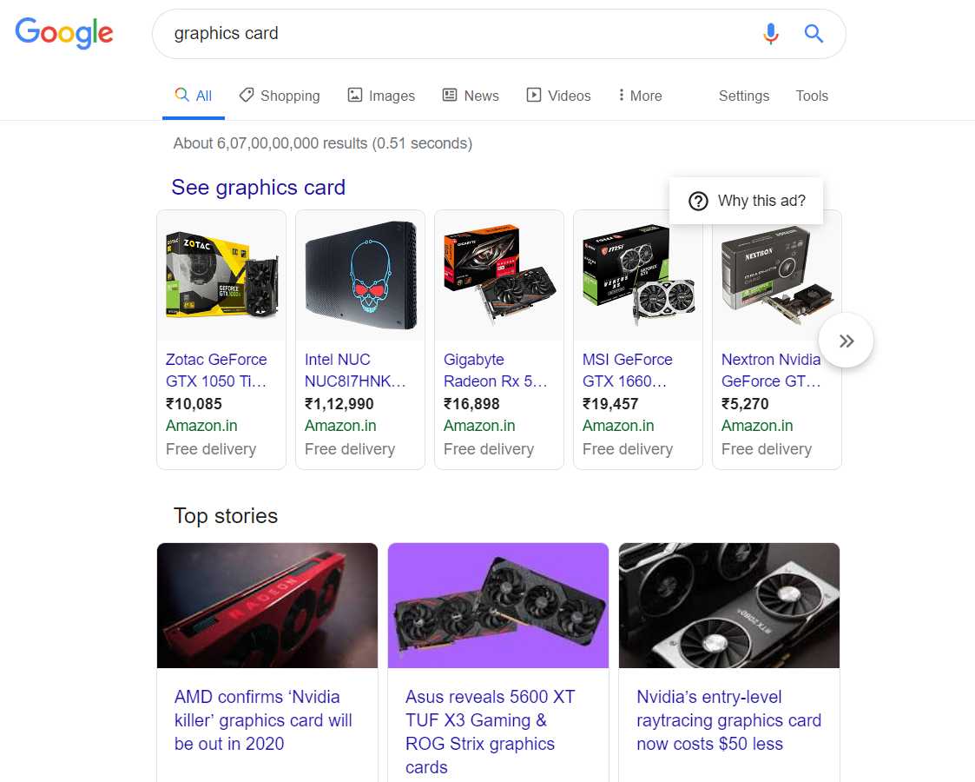
Role of Advertisements

Slide 8
ABSTRACT
Page Ranking is an algorithm which decides what to bring on first page for query on a search engine.
Page Rank rates a web page’s importance by looking at how many outside links points to it and how important those links are.
Search results have to be relevant according to location, words of query, usability of page, user’s settings and expertise of source.
It is based on idea that the popularity of a web page is determined not only by the number of incoming links but also by the kind of incoming links.
This project comes under the domain Text mining and Information Retrieval. Some of the other algorithms include Bag of Words, TF-IDF (Term Frequency- Inverse Document Frequency).

Slide 9
The project aims at developing a tool for Ranking of Web site documents based on Inverse document frequency
OBJECTIVE

Slide 10
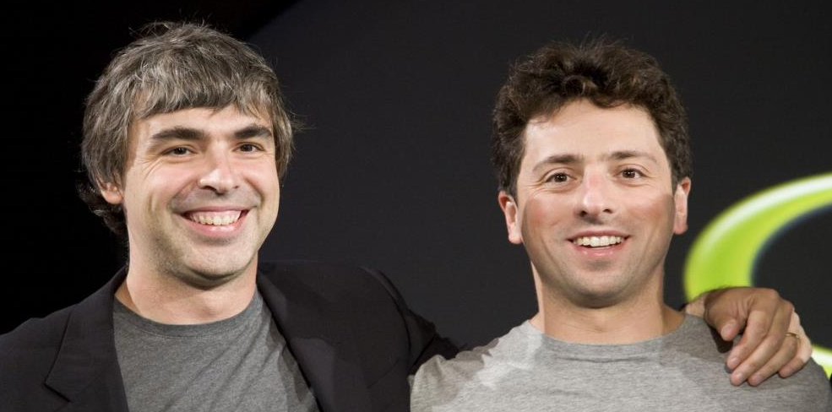
PAGE RANK
Larry Page and Sergey Brin

Slide 11
Rates a web Page’s importance by looking at how many outside links it provides to it and whether those links are important ?

Slide 12
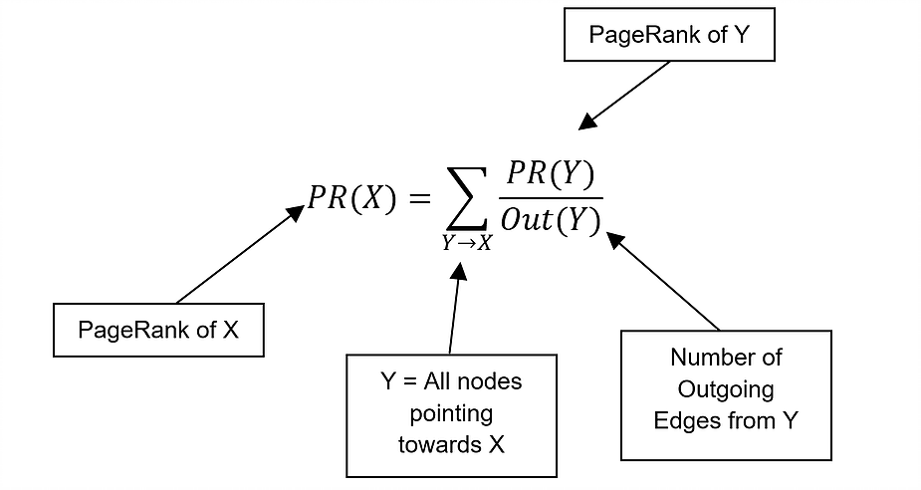
PAGE RANK
PageRank is a global ranking of all web pages based on their locations in the web graph structure
PageRank uses information which is external to the web pages – backlinks
Backlinks from important pages are more significant than backlinks from average pages
The structure of the web graph is very useful for information retrieval tasks.

Slide 13
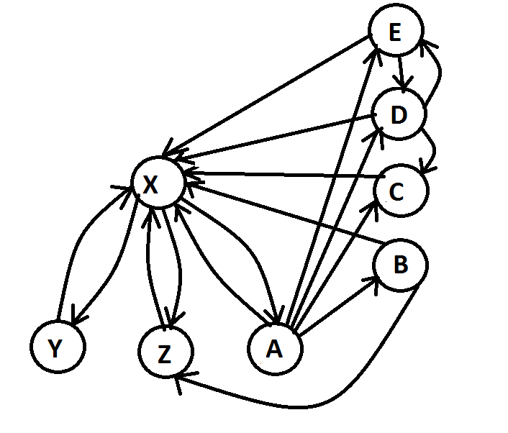
PAGE RANK – Example

Slide 14
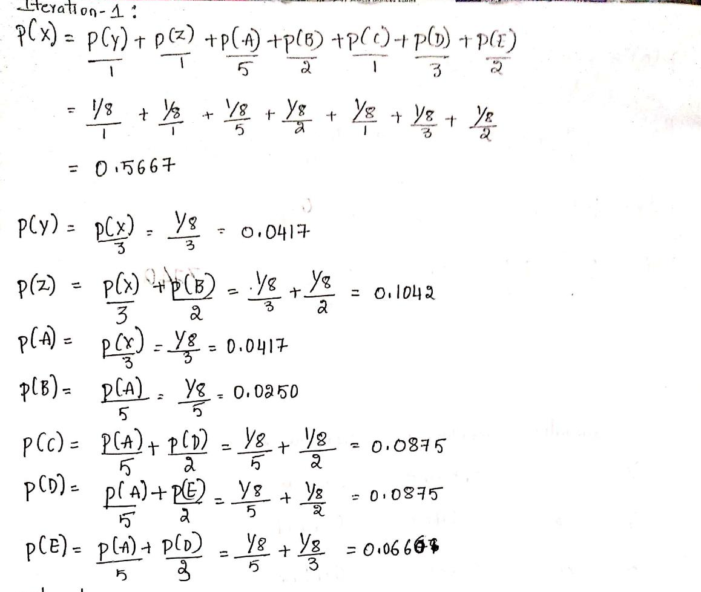
PAGE RANK – Example

Slide 15
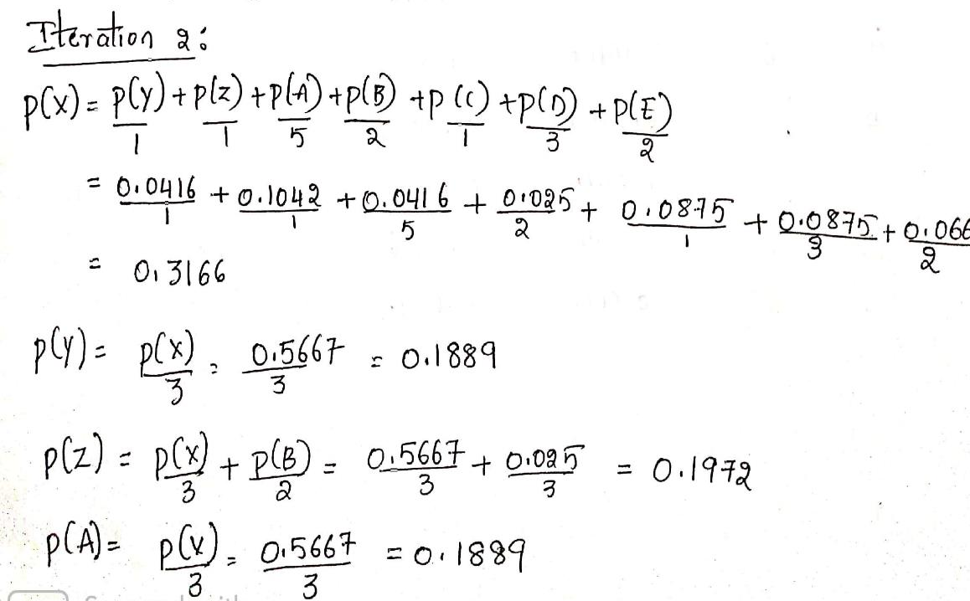
PAGE RANK – Example

Slide 16
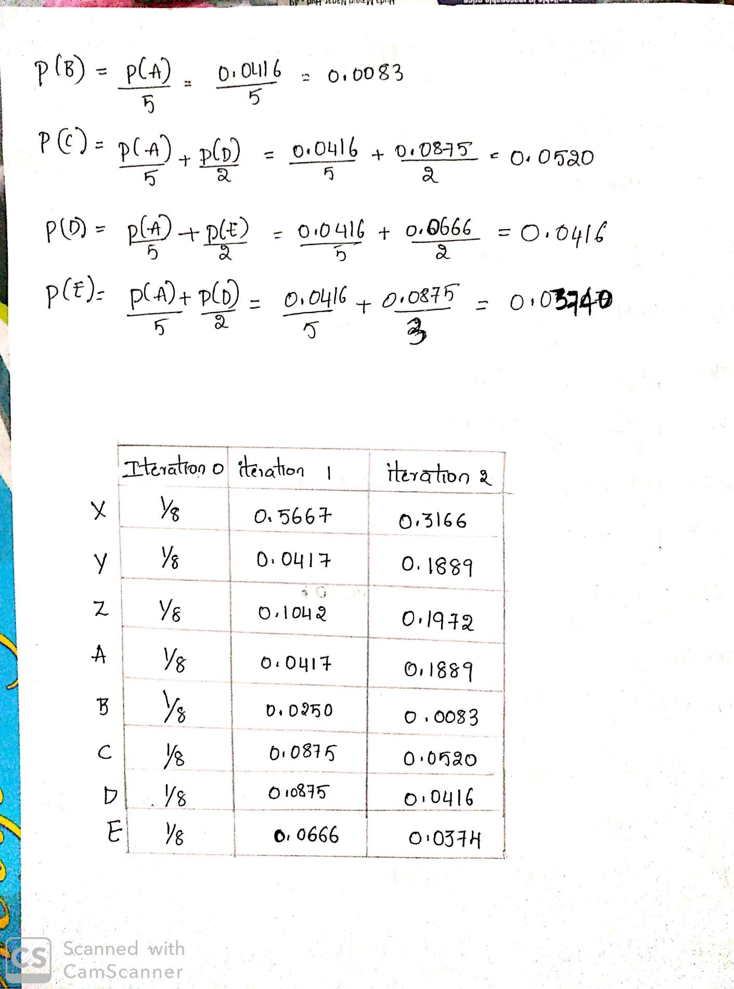
PAGE RANK – Example

Slide 17
PAGE RANK – Example

Slide 18
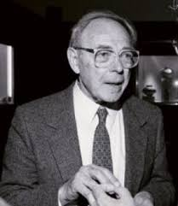
BAG OF WORDS
Zellig Harris

Slide 19
Creates a vocabulary extracting the unique words from the documents and keeps the vector with the term frequency of the particular word in corresponding document

Slide 20
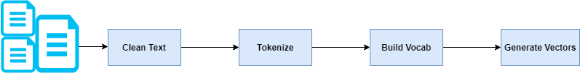
BAG OF WORDS
In this approach, we use the tokenized words for each observation and find out the frequency of each token.
We treat each sentence as a separate document and we make a list of all words from all the documents excluding the punctuation.
The next step is to create vectors.
The process of converting NLP text into numbers is called vectorization

Slide 21
BAG OF WORDS
Clean Text - Text contains punctuations. We don't want punctuations to be the part of our word frequency dictionary. In the following script, we first convert our text into lower case and then will remove the punctuation from our text. Removing punctuation can result in multiple empty spaces. We will remove the empty spaces from the text using regex.
Load Data
Split by Whitespace
Select Words
Split by Whitespace and Remove Punctuation
Normalizing Case

Slide 22
BAG OF WORDS
Tokenize- The next step is to tokenize the sentences in the corpus and create a dictionary that contains words and their corresponding frequencies in the corpus.
Split into Sentences
Split into Words
Filter Out Punctuation
Filter out Stop Words (and Pipeline)
Stem Words

Slide 23
BAG OF WORDS Example
Review 1 : This pasta is very tasty and affordable.
Review 2: This pasta is not tasty and is affordable.
Review 3 : This pasta is delicious and cheap.
Review 4: Pasta is tasty and pasta tastes good.
Vocabulary
‘This’
‘pasta’
‘is’
‘very’
‘tasty’
‘and’
‘affordable’
‘not’
‘delicious’
‘cheap’
‘tastes’
‘good’
Clean data and Tokenize
‘This’
‘pasta’
‘is’
‘very’
‘tasty’
‘and’
‘affordable’
‘not’
‘delicious’
‘cheap’
‘tastes’
‘good’

Slide 24


BAG OF WORDS Example
A measure of the presence of known words
Review 1 : This pasta is very tasty and affordable
Review 4: Pasta is tasty and pasta tastes good.

Slide 25
Drawbacks of Bag Of Words
BOW doesn’t work very well when there are small changes in the terminology we are using as here we have sentences with similar meaning but with just different words (Synonyms).
B
O
W

Slide 26
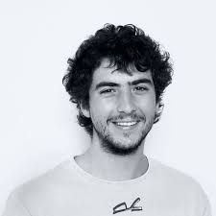
TF-IDF
Enrique Fueyo Ramírez

Slide 27
Inverse document frequency(IDF) is a measure that considers two factors i.e. keywords and their frequency of occurrence

Slide 28
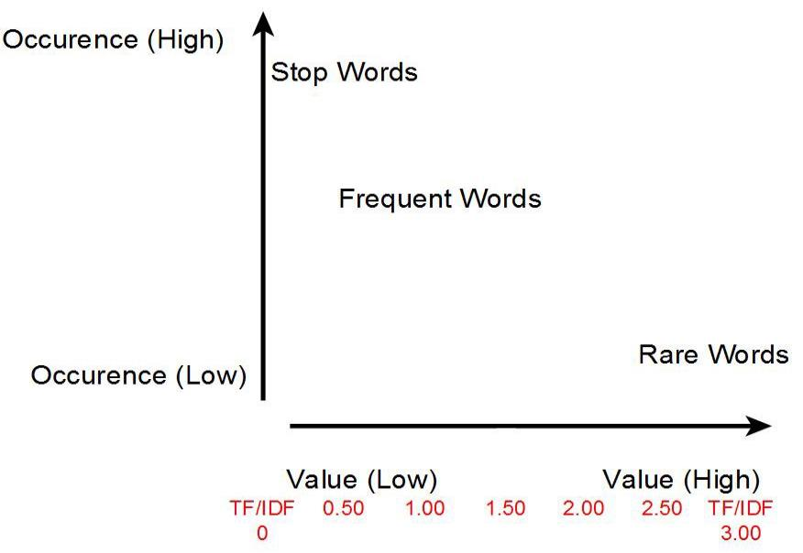
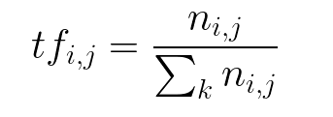
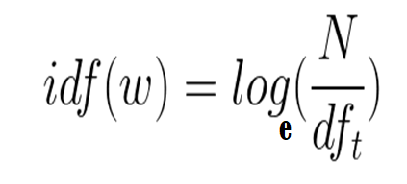
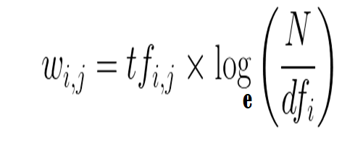
TF-IDF
The TF-IDF weight is used in text mining and information retrieval.
The weight is a measure given to a document among a collections of documents
We remove stop-words, punctuations and work with root of word (stem).
More frequency of word, more important the word.

Slide 29
Stemming and lemmatization
This is the idea of reducing different forms of a word to a core root.
Words that are derived from one another can be mapped to a central word or symbol, especially if they have the same core meaning.
Stemming is the process of converting the words of a sentence to its non-changing portions. In the example of amusing, amusement, and amused above, the stem would be amus.
Lemmatization is the process of converting the words of a sentence to its dictionary form. For example, given the words amusement, amusing, and amused, the lemma for each and all would be amuse.

Slide 30
TF-IDF - Example
Document 1 Sachin, Kapil and Dhoni are the “hallmarks” of Indian cricket always in form known worldwide.
Document 2 Sachin is known as “God Of Cricket”, whereas Kapil and Dhoni are known for fitness levels.
Document 3 Virat and Rohit are in form of their life because they break many records for Indian Cricket with their modern fitness levels.
Document 4 Watching Sachin, Virat or Virat, Dhoni play together has always been treat for cricket viewers worldwide.

Slide 31
TF-IDF - Example
Step 1 Clean data
Document 1 sachin kapil and dhoni are the hallmarks of indian cricket always in form known worldwide
Document 2 sachin is known as god of cricket whereas kapil and dhoni are known for fitness levels
Document 3 virat and rohit are in form of their life because they break many records for indian cricket with their modern fitness levels
Document 4 watching sachin virat or virat dhoni play together has always been treat for cricket viewers worldwide

Slide 32
TF-IDF - Example
Step 2 Tokenize
Document 1 sachin kapil dhoni hallmarks india cricket form worldwide
Document 2 sachin god of cricket whereas kapil dhoni fit level
Document 3 virat rohit form life break many record india cricket modern fit level
Document 4 watch sachin virat virat dhoni play together treat cricket view worldwide

Slide 33
TF-IDF - Example
Step 3 TF
Word | Document 1 | Document 2 | Document 3 | Document4
Sachin | 0.066 | 0.625 | 0 | 0.062
Kapil | 0.066 | 0.625 | 0 | 0
Dhoni | 0.066 | 0.625 | 0 | 0.062
Hallmarks | 0.066 | 0 | 0 | 0
India | 0.066 | 0 | 0.045 | 0
Cricket | 0.066 | 0.625 | 0.045 | 0.062
Form | 0.066 | 0 | 0.045 | 0
WorldWide | 0.066 | 0 | 0 | 0.062
God | 0 | 0.625 | 0 | 0
Whereas | 0 | 0.625 | 0 | 0
Fit | 0 | 0.625 | 0.045 | 0
Level | 0 | 0.625 | 0.045 | 0
Virat | 0 | 0 | 0.045 | 0.125
Rohit | 0 | 0 | 0.045 | 0
Life | 0 | 0 | 0.045 | 0
Break | 0 | 0 | 0.045 | 0

Slide 34
TF-IDF - Example
Step 3 TF
Word | Document 1 | Document 2 | Document 3 | Document4
Many | 0 | 0 | 0.045 | 0
Record | 0 | 0 | 0.045 | 0
Modern | 0 | 0 | 0.045 | 0.062
Watch | 0 | 0 | 0 | 0.062
Play | 0 | 0 | 0 | 0.062
Together | 0 | 0 | 0 | 0.062
Treat | 0 | 0 | 0 | 0.062
view | 0 | 0 | 0 | 0.062

Slide 35
TF-IDF - Example
Step 3 Find IDF
Word | Formula | Value
Sachin | Ln(4/3) | 0.287
Kapil | Ln(4/2) | 0.693
Dhoni | Ln(4/3) | 0.287
Hallmarks | Ln(4/1) | 1.386
India | Ln(4/2) | 0.693
Cricket | Ln(4/4) | 0
Form | Ln(4/2) | 0.693
WorldWide | Ln(4/2) | 0.693
God | Ln(4/1) | 1.386
Whereas | Ln(4/1) | 1.386
Fit | Ln(4/2) | 0.693
Level | Ln(4/2) | 0.693
Virat | Ln(4/2) | 0.693
Rohit | Ln(4/1) | 1.386
Life | Ln(4/1) | 1.386
Break | Ln(4/1) | 1.386

Slide 36
TF-IDF - Example
Step 3 Find IDF
Word | Formula | Value
Many | Ln(4/1) | 1.386
Record | Ln(4/1) | 1.386
Modern | Ln(4/1) | 1.386
Watch | Ln(4/1) | 1.386
Play | Ln(4/1) | 1.386
Together | Ln(4/1) | 1.386
Treat | Ln(4/1) | 1.386
view | Ln(4/1) | 1.386

Slide 37
TF-IDF - Example
Step 4 Compare results
Words / Dcouments | Sachin | Kapil | Dhoni | Hallmarks | India | Cricket | Form | WorldWide | God | Whereas | Fit | Level
Document1 | 0.018 | 0.045 | 0.018 | 0.091 | 0.045 | 0 | 0.045 | 0.045 | 0 | 0 | 0 | 0
Document2 | 0.179 | 0.433 | 0.176 | 0 | 0 | 0 | 0 | 0 | 0.866 | 0.866 | 0.433 | 0.433
Document3 | 0 | 0 | 0 | 0 | 0.031 | 0 | 0.031 | 0 | 0 | 0 | 0.031 | 0.031
Document4 | 0.001 | 0 | 0.001 | 0 | 0 | 0 | 0 | 0.042 | 0 | 0 | 0 | 0
Words / Dcouments | Virat | Rohit | Life | Break | many | Record | Modern | Watch | Play | Together | Treat | View
Document1 | 0 | 0 | 0 | 0 | 0 | 0 | 0 | 0 | 0 | 0 | 0 | 0
Document2 | 0 | 0 | 0 | 0 | 0 | 0 | 0 | 0 | 0 | 0 | 0 | 0
Document3 | 0.031 | 0.062 | 0.062 | 0.062 | 0.062 | 0.062 | 0.062 | 0 | 0 | 0 | 0 | 0
Document4 | 0.086 | 0 | 0 | 0 | 0 | 0 | 0.085 | 0.085 | 0.085 | 0.085 | 0.085 | 0.085

Slide 38
Simple algorithm for matching words in the query to document relevant to query.
It is very efficient.
From the research, many scholars have proven the TF-IDF document which is highly relevant to query.
Easy to compute the problem.
Have some basic metric to extract the descriptive document.
Easily compute the similarity between the documents using it.
ADVANTAGES OF TF-IDF

Slide 39
SOFTWARE
HARDWARE
It requires a 64-bit Ubuntu Operating System.
Python Qt Designer for designing user interface.
MY SQL server for storing database Entities.
Pyuic for converting the layout designed user interface (UI) to python code.
Python language for coding.
Requires a minimum of 2.16 GHz processor.
Requires a minimum of 4 GB RAM.
Requires 64-bit architecture.
Requires a minimum storage of 500GB.
REQUIREMENTS

Slide 40
THANK
YOU!

