Slide 1
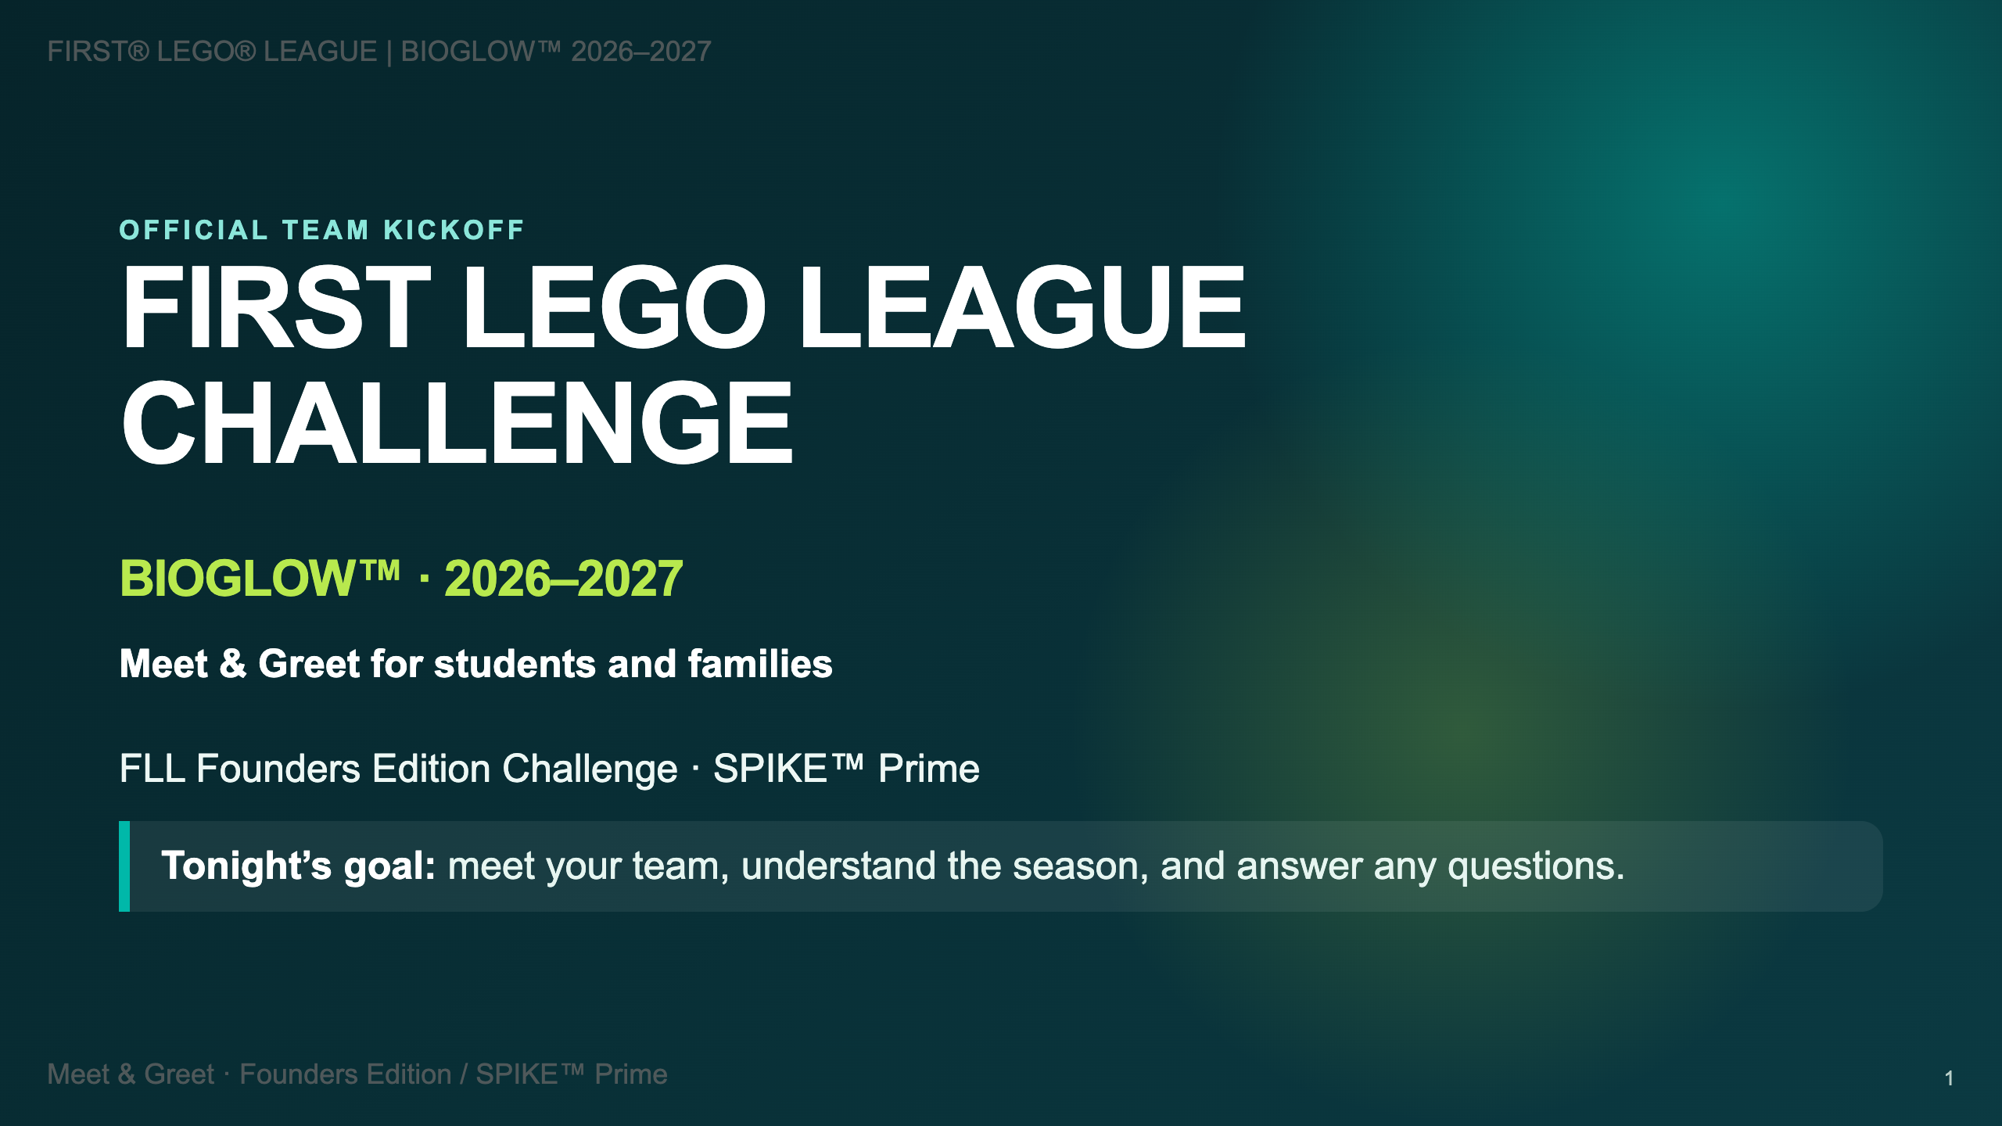

Slide 2
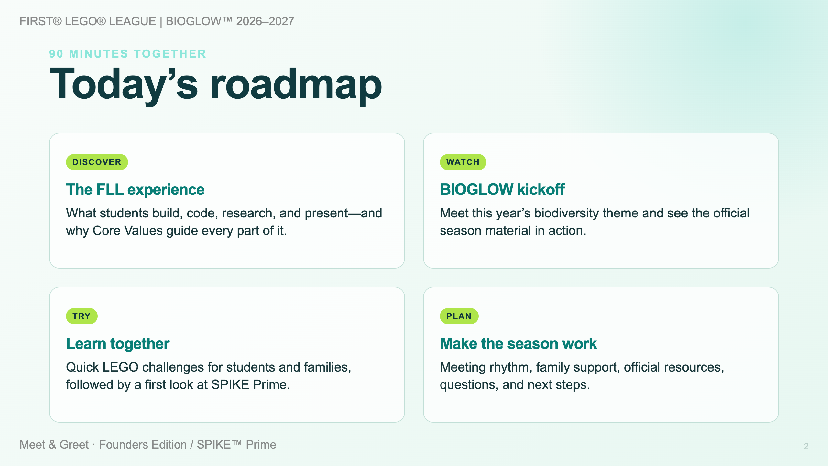

Slide 3
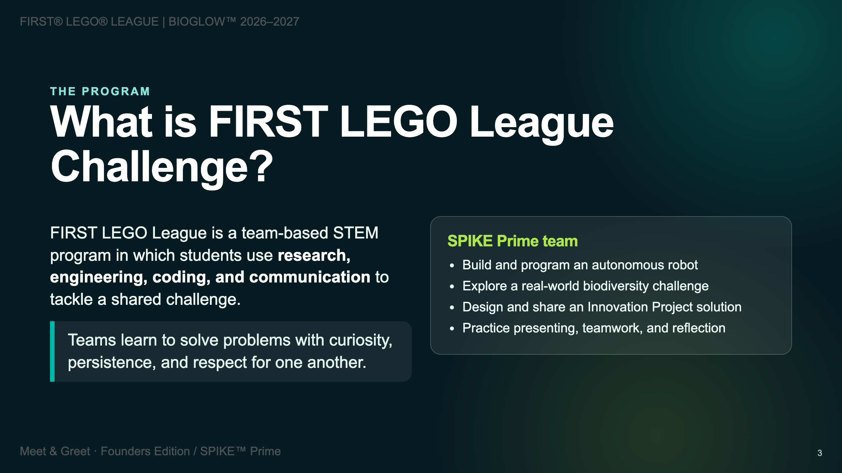

Slide 4
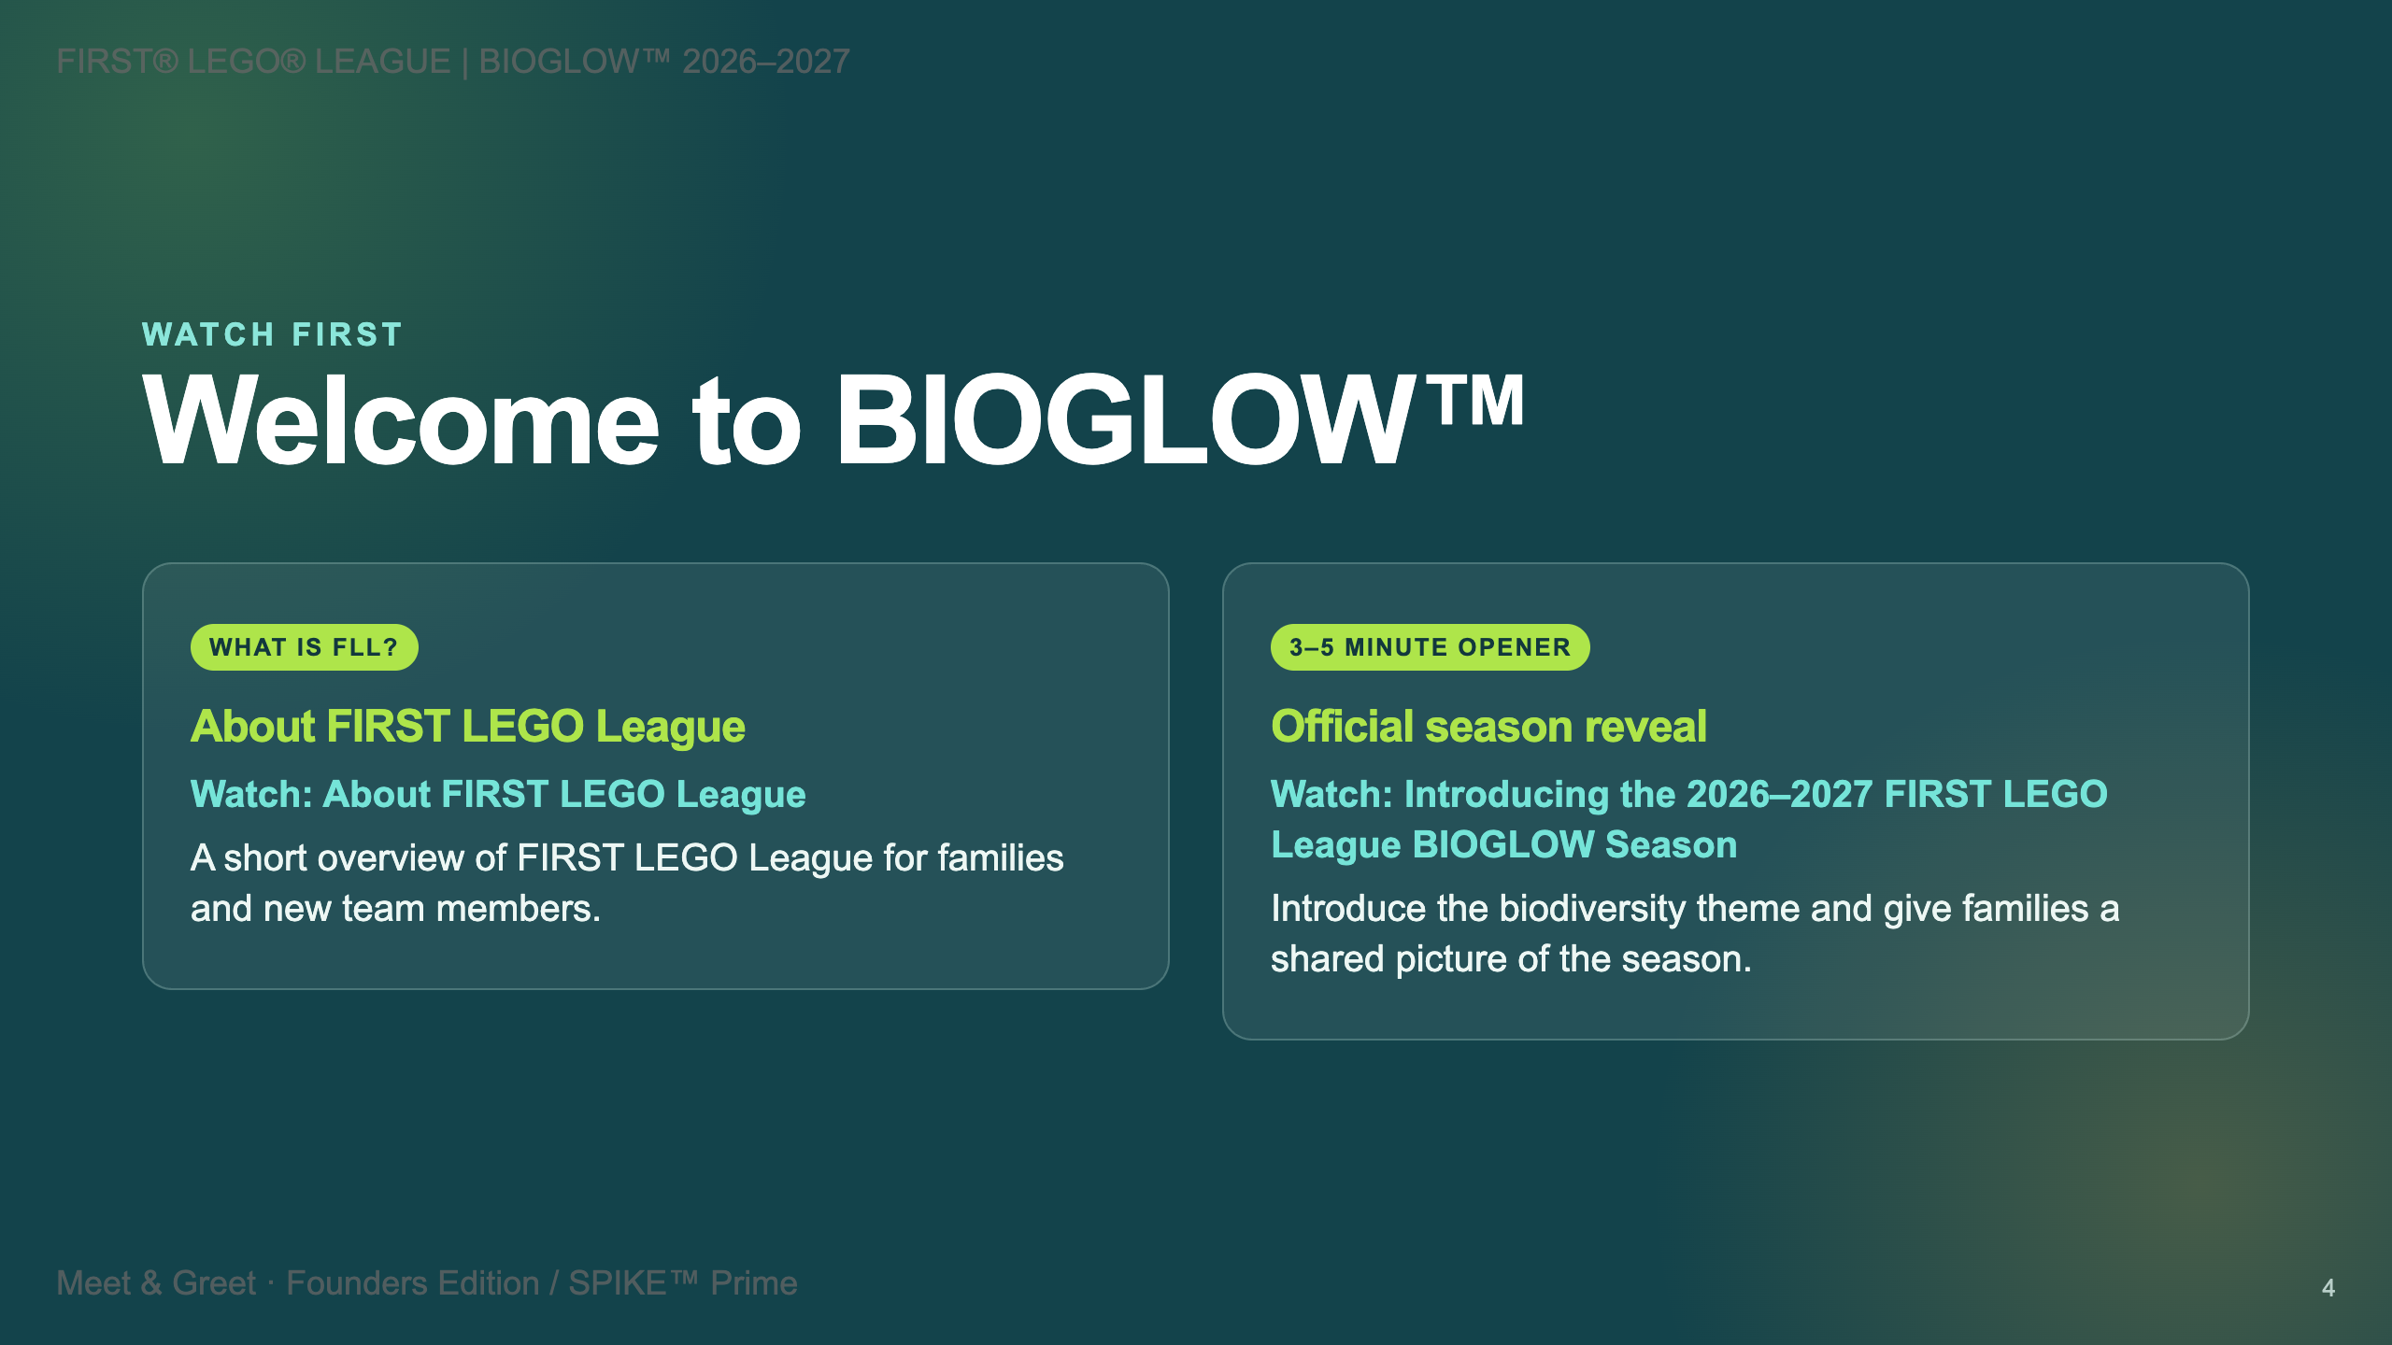

Slide 5
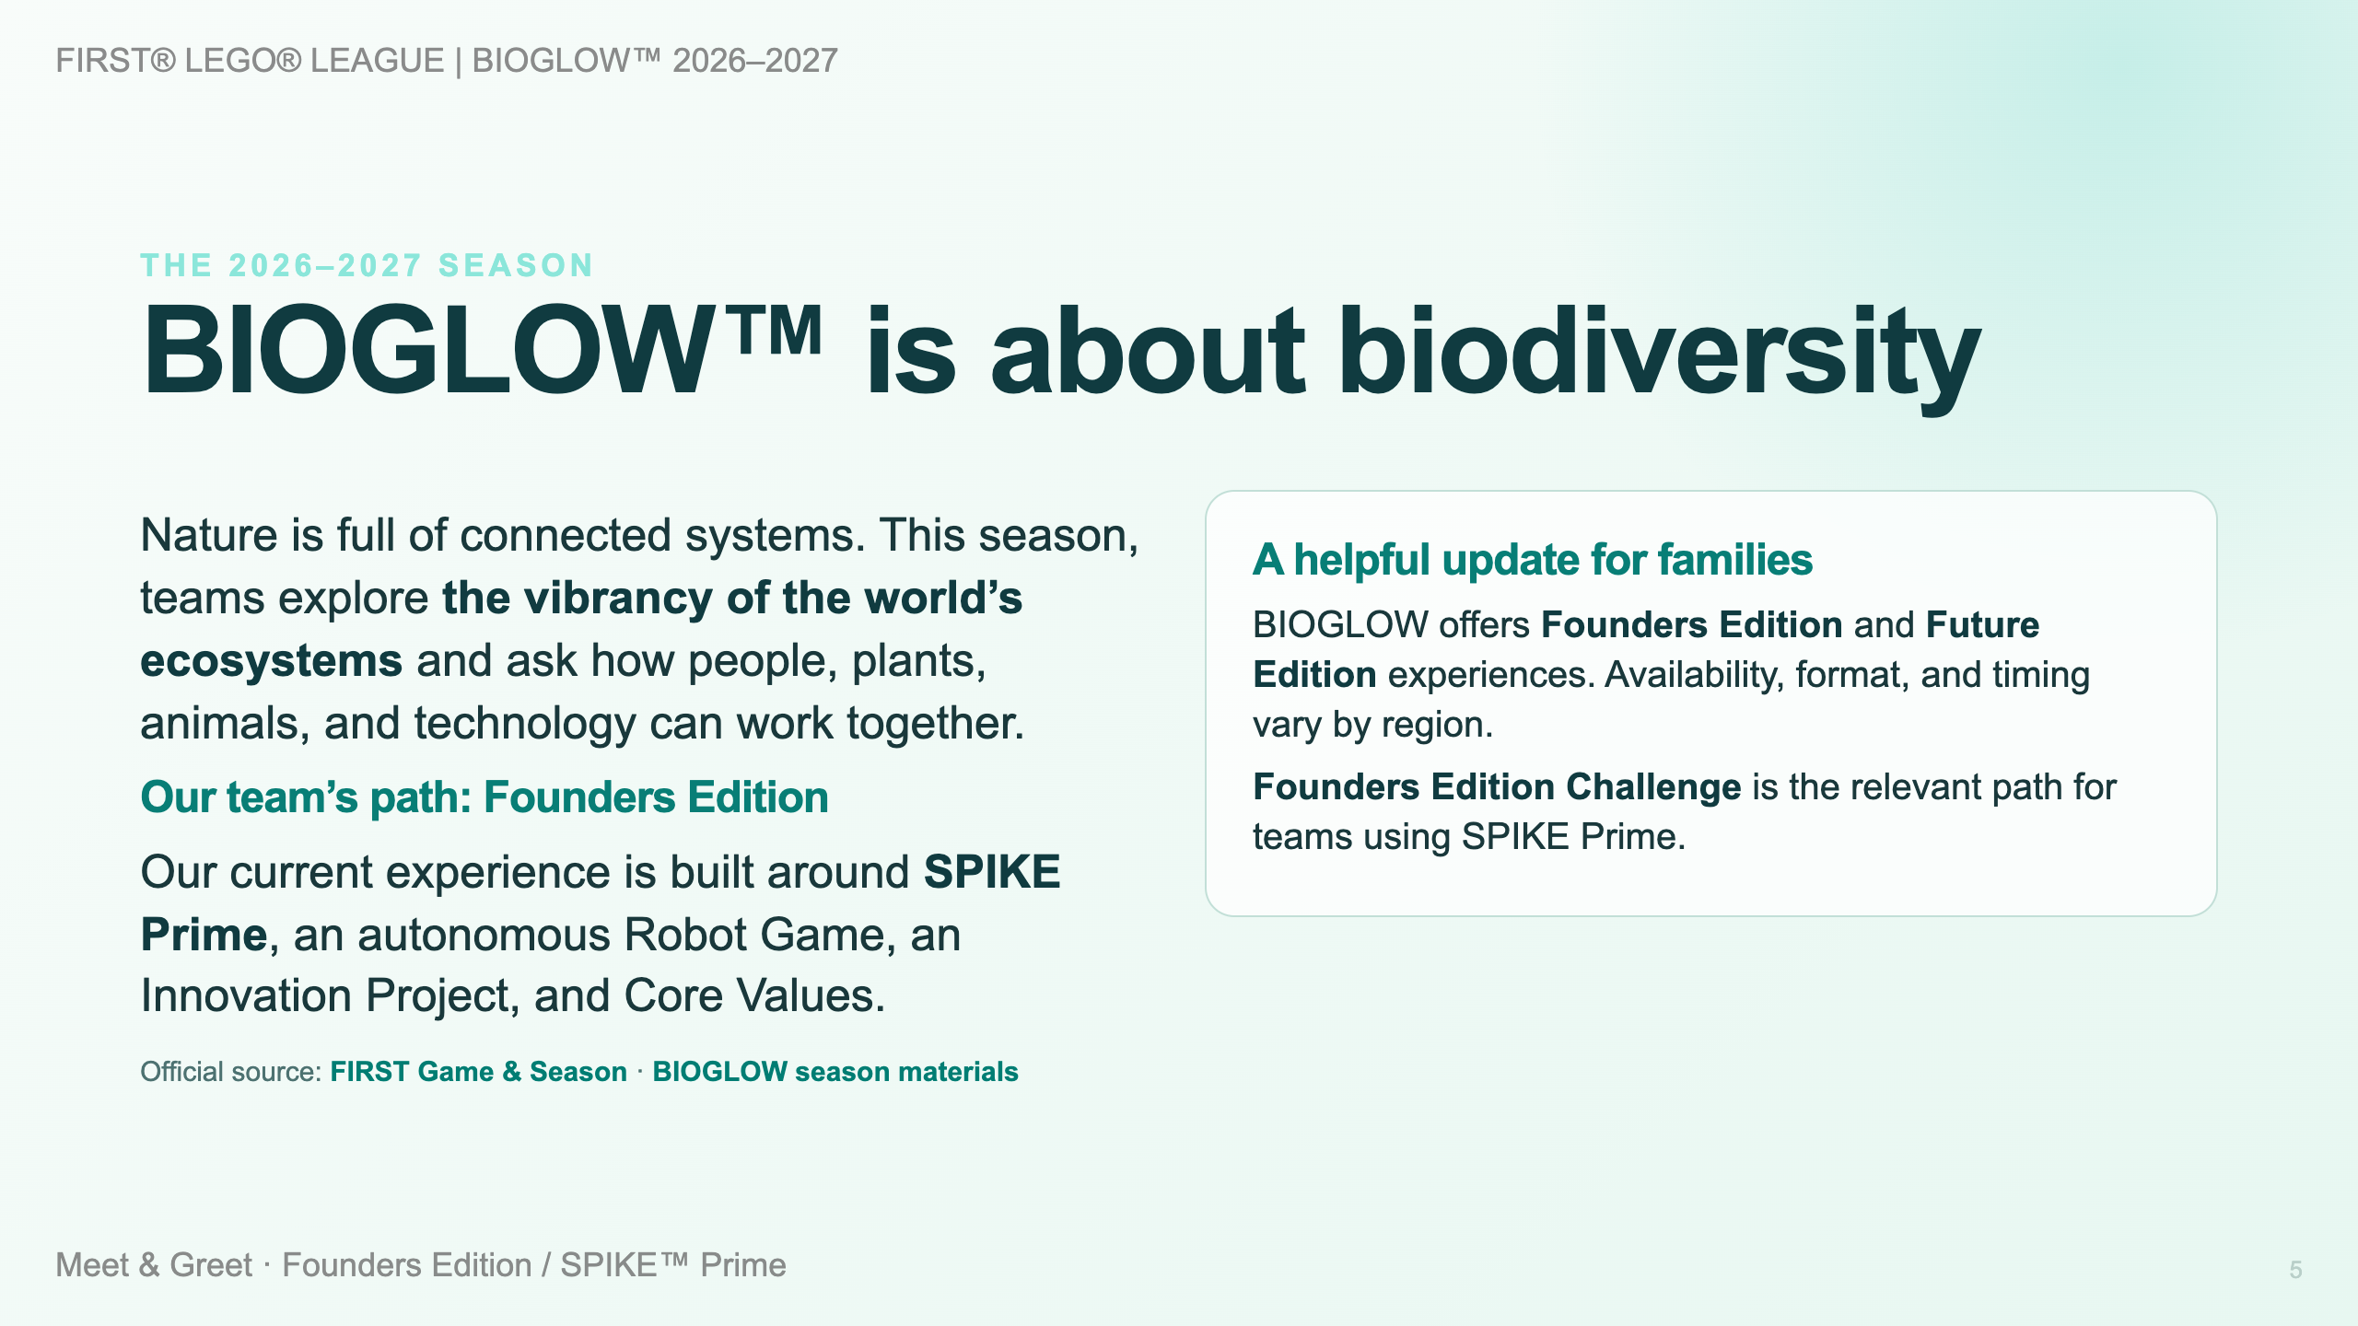

Slide 6
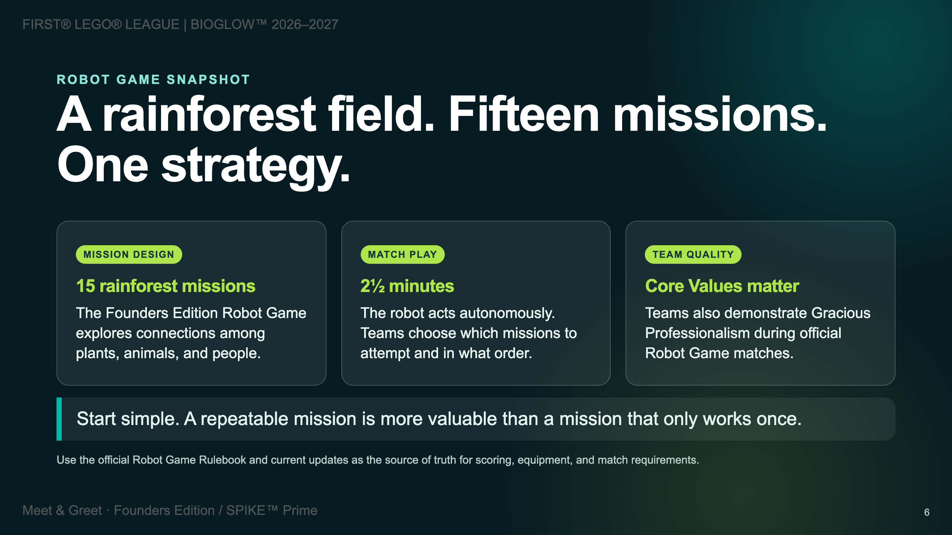

Slide 7
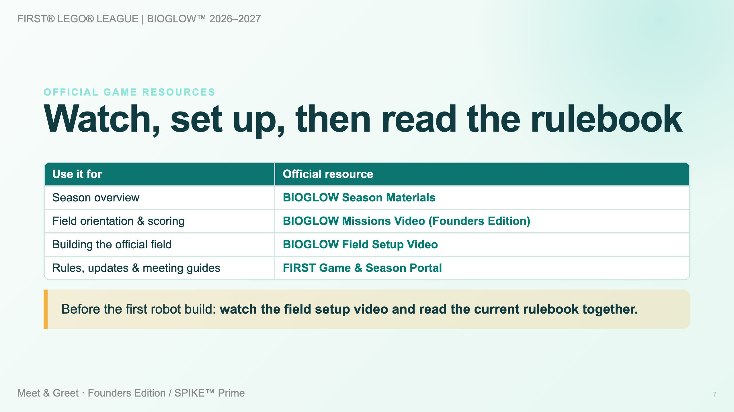

Slide 8
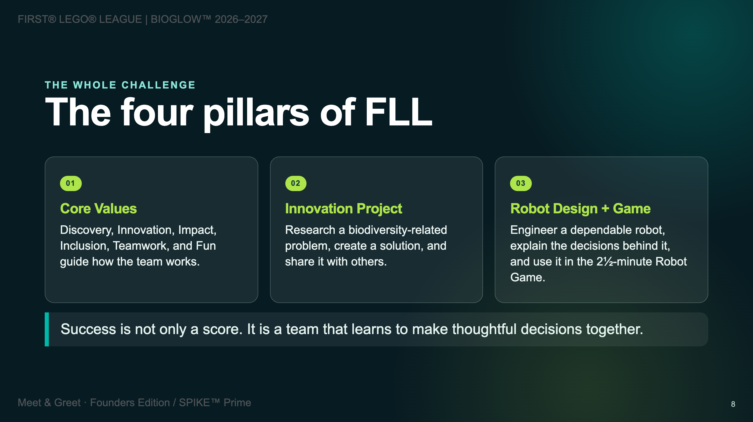

Slide 9
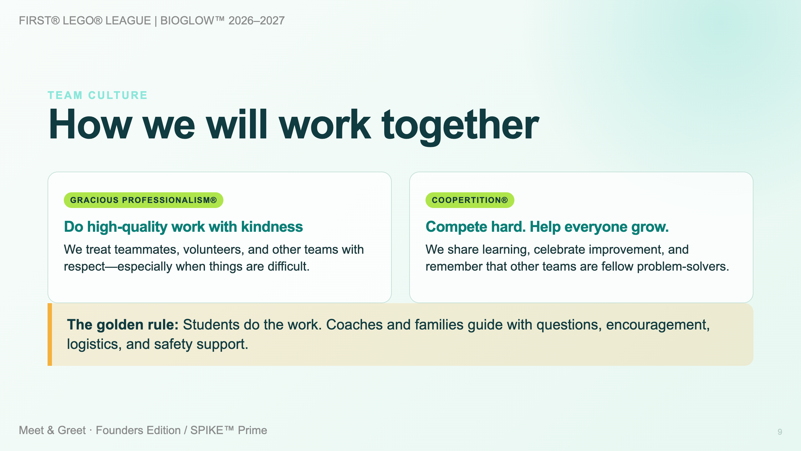
Notes:
--- <div class="kicker">Try it now</div> # Three quick team challenges <div class="columns-3"> <div class="card"> <span class="tag">3 minutes</span> ### Tallest tower Use 10 LEGO bricks to build the tallest freestanding tower you can. **Debrief:** What made your base stable? </div> <div class="card"> <span class="tag">5 minutes</span> ### Ecosystem engineer Build a model that helps a rainforest plant or animal survive. **Debrief:** What problem does it solve? </div> <div class="card"> <span class="tag">5 minutes</span> ### Direction relay One partner builds while the other gives precise, respectful directions. **Debrief:** Which instructions helped most? </div> </div>

Slide 10
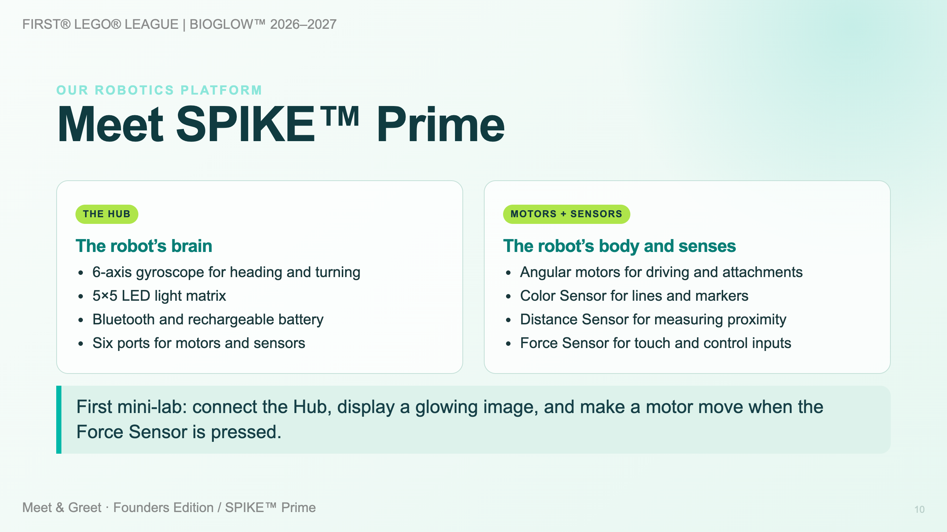

Slide 11
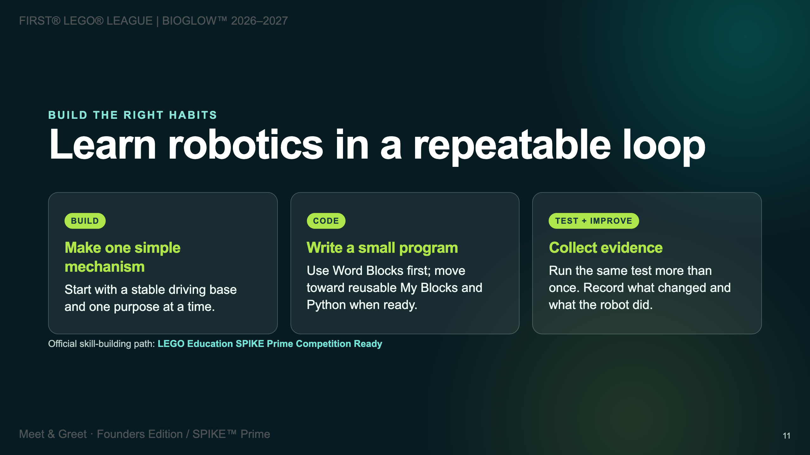

Slide 12
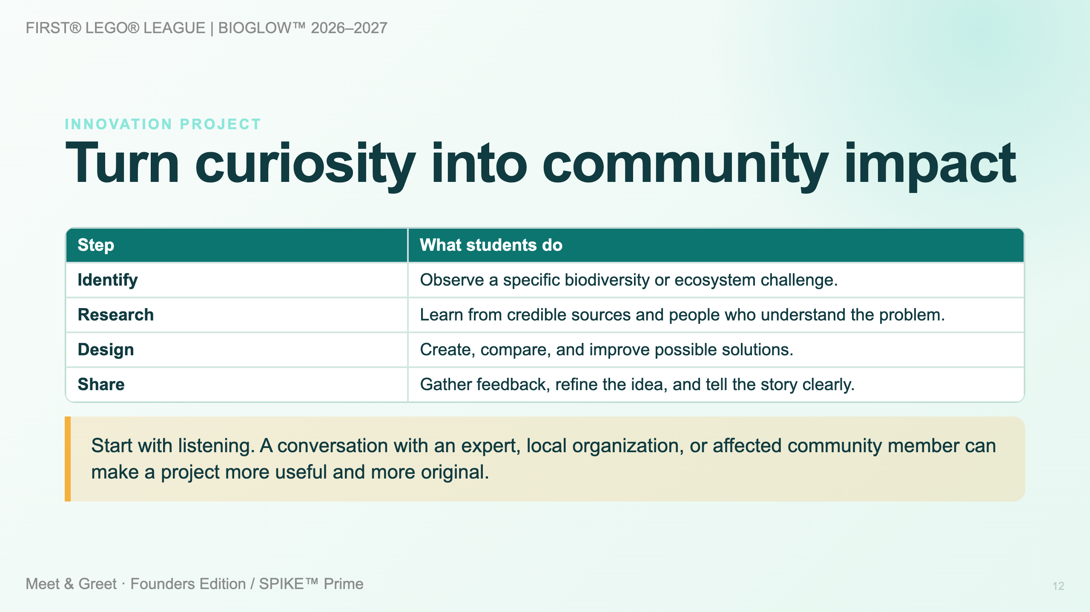

Slide 13
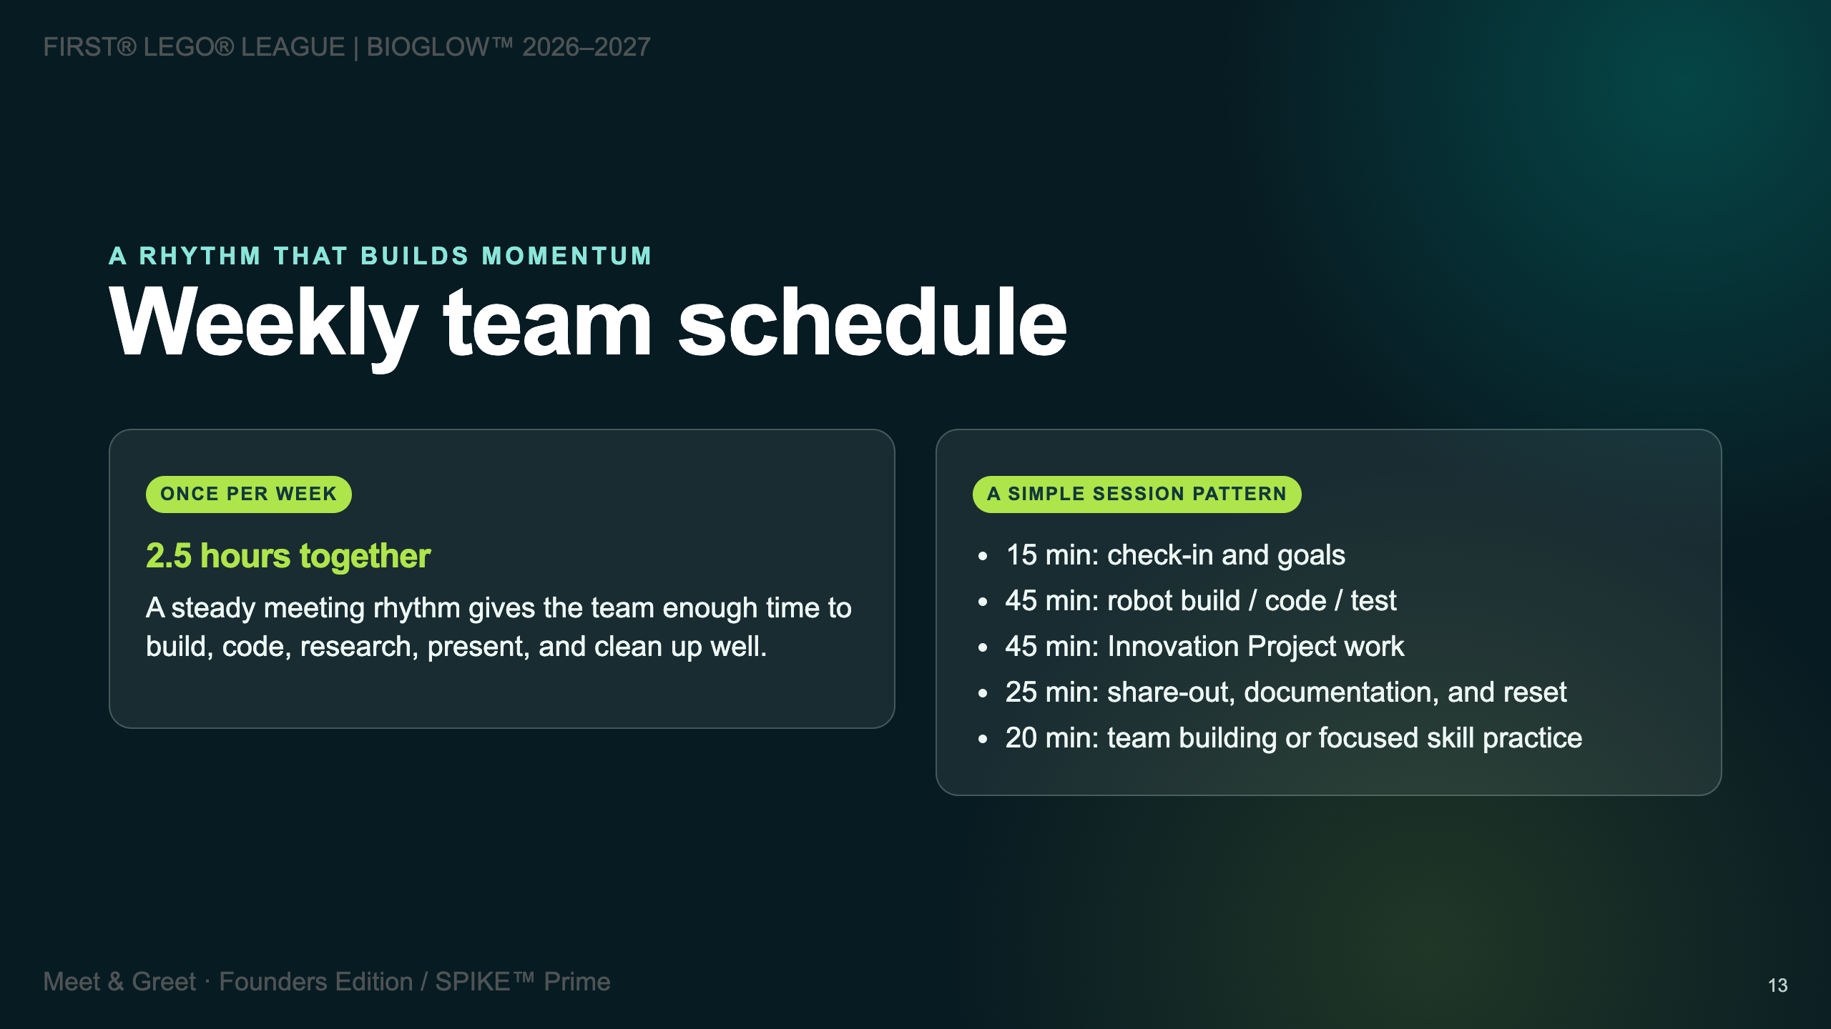

Slide 14
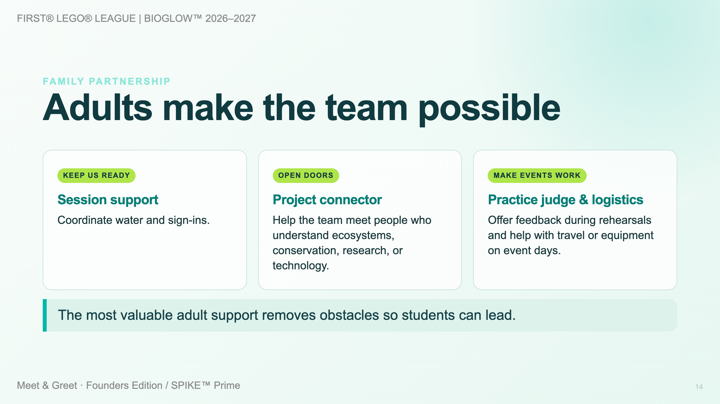

Slide 15
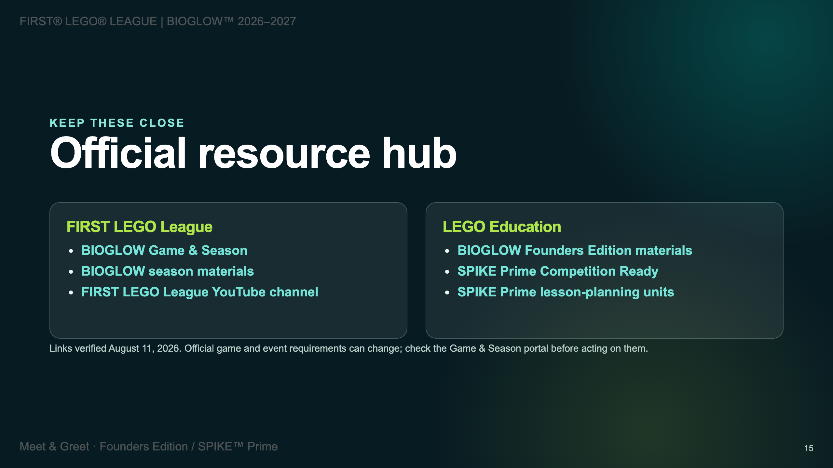

Slide 16
