Slide 1


SESSION 3
I can work with my team to identify their innovation project problem to solve and then research solutions.
I can work with my team to code our robot to avoid obstacles using a sensor.
Students will begin to work on their innovation project and continue with the building and coding a robot. ​

Slide 2

Discussion
What did we do last session?
Notes:
Discuss with students the coding and building skills they learned last session and ask them what innovation project ideas interest them. ​​

Slide 3

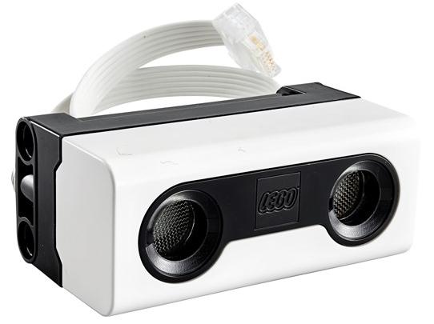
Key Vocabulary
research: the collecting of information about a particular subject
robot game: complete missions in 2.5 minute match
sensor: a device that detects something and responds by transmitting a signal
Notes:
Session specific vocab

Slide 4
Introduction
Review the Project Sparks.
Share your ideas with your team.
Project Spark Ideas:
Make sure everyone has a chance to share.
Notes:
Introduction:
Review the innovation project information on page 5 and the Project Sparks on page 6.
Pick a Project Spark or one of your own ideas and think of the problem your team will explore.
Session Tips:
If your team has already agreed on the focus of their project, encourage them to start researching.
You can find helpful links on the Season Resources page.
While the team might not choose every member’s preferred problem, they should choose something everyone supports.
The team will write their problem statement on the Innovation Project Planning page.
Remember, teams can choose one of the problems from the Project Sparks.
Encourage the team to use their Engineering Notebooks and to take notes when researching their ideas.
Have the team think about how to use the attachment from the robot lesson to complete missions.

Slide 5

Tasks
Record your team’s problem statement.
A problem statement describes the problem that your team wants to solve.
Notes:
Tasks ​
Record your team’s problem statement on page 29.
Open the SPIKE™ app. Find your lesson.
Competition Ready Unit Training Camp 2: Playing with Objects
Talk about the skills you learned in this lesson and how they will help you in the robot game.
Try it out! See if you can code your robot to attempt a mission.
Discuss the reflection questions and record your progress.
Session Tips​
If your team has already agreed on the focus of their project, encourage them to start researching.
You can find helpful links on the Season Resources page.
While the team might not choose every member’s preferred problem, they should choose something everyone supports.
The team will write their problem statement on the Innovation Project Planning page.
Remember, teams can choose one of the problems from the Project Sparks.
Encourage the team to use their Engineering Notebooks and to take notes when researching their ideas.
Have the team think about how to use the attachment from the robot lesson to complete missions.

Slide 6

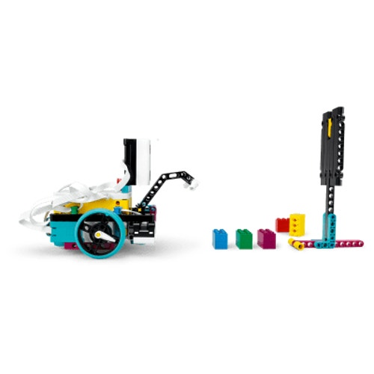
Tasks
In the SPIKETM app, complete the following lesson.
Competition Ready Unit Training Camp 2: Playing with Objects
Notes:
Tasks ​
Record your team’s problem statement on page 29.
Open the SPIKE™ app. Find your lesson.
Competition Ready Unit Training Camp 2: Playing with Objects
Talk about the skills you learned in this lesson and how they will help you in the robot game.
Try it out! See if you can code your robot to attempt a mission.
Discuss the reflection questions and record your progress.
Session Tips​
If your team has already agreed on the focus of their project, encourage them to start researching.
You can find helpful links on the Season Resources page.
While the team might not choose every member’s preferred problem, they should choose something everyone supports.
The team will write their problem statement on the Innovation Project Planning page.
Remember, teams can choose one of the problems from the Project Sparks.
Encourage the team to use their Engineering Notebooks and to take notes when researching their ideas.
Have the team think about how to use the attachment from the robot lesson to complete missions.

Slide 7
Tasks
Try to code your robot to attempt a mission.
You might want to adjust the attachment for the mission you selected.
Notes:
Tasks ​
Record your team’s problem statement on page 29.
Open the SPIKE™ app. Find your lesson.
Competition Ready Unit Training Camp 2: Playing with Objects
Talk about the skills you learned in this lesson and how they will help you in the robot game.
Try it out! See if you can code your robot to attempt a mission.
Discuss the reflection questions and record your progress.
Session Tips​
If your team has already agreed on the focus of their project, encourage them to start researching.
You can find helpful links on the Season Resources page.
While the team might not choose every member’s preferred problem, they should choose something everyone supports.
The team will write their problem statement on the Innovation Project Planning page.
Remember, teams can choose one of the problems from the Project Sparks.
Encourage the team to use their Engineering Notebooks and to take notes when researching their ideas.
Have the team think about how to use the attachment from the robot lesson to complete missions.

Slide 8

Reflect
What additional research is necessary to select an idea for the project?
What objects does your robot need to avoid in the robot game?
What missions does your team want to attempt next?
Notes:
Session Tips: Have the team think about how to use the attachment from the robot lesson to complete missions.

Slide 9



Share
Share the robot skills learned in this session.
Notes:
Share ​
Discuss the reflection questions
Get together at the mat. Share the robot skills you learned in this session.
Clean up your space.
​
Session Tips​
Have the team practice their new skills by trying to drive the robot to a model and return to home..

Slide 10

Clean Up

Slide 11


LEGO, the LEGO logo, the Minifigure, LEGO Education, the LEGO Education logo, and the SPIKE logo are trademarks of the/sont des marques de commerce du/son marcas registradas de LEGO Group. ©2026 The LEGO Group. All rights reserved/Tous droits réservés/Todos los derechos reservados. FIRST®, the FIRST® logo, and FIRST® CANOPY™ are trademarks of For Inspiration and Recognition of Science and Technology (FIRST). LEGO® is a registered trademark of the LEGO Group. FIRST® LEGO® League and BIOGLOW™ are jointly held trademarks of FIRST and the LEGO Group. ©2026 FIRST and the LEGO Group. All rights reserved.

