Slide 1

DEPARTMENT OF COMPUTER ENGINEERING, MODELING, ELECTRONICS AND SYSTEM ENGINEERING LM-Telecommunication Engineering: Smart Sensing, Computing and Networking Smart and Programable Networks Project with Title: Multi-controller Network Management Load Balancing Supervisor : Dr. Mauro Tropea Dr. Mattia Spina
Implemented by :
Eng. Rami Saleh Eng. Hussein Mohammed

Slide 2
introduction & Motivation
SDN separates control plane from data plane.
OpenFlow 1.3 : Controller-Switch Communication.
Ryu Framework & Mininet :Implementation Stack.
Ryu: Lightweight Python SDN controller.
Mininet: Network emulation (OVS switches, hosts).
Open vSwitch: Production-quality virtual switch.
Flask: REST API for inter-controller communication.
Why Load Balancing in SDN ?
Single controller becomes a bottleneck in large networks.
Distributed controllers improve scalability and fault tolerance.
Single Controller → Multi-Controller → Load Balancing
Challenge : How to efficiently distribute workload ?
Solution : Dynamic controller load balancing

Slide 3
Project Objectives
We Investigate :
Dynamic switch migration based on controller load.
Compare No-LB vs. LB under variable weights (CPU, Memory, Packet-in).
Scalability from 2-controller to 3-controller systems.
Evaluate fairness and scalability using KPI-based analysis.

Slide 4
System components & Data flow
Controllers: Each controller runs a Ryu instance responsible for managing a subset of OpenFlow switches. Controllers expose REST endpoints (/load, /switches) via Flask to share load information.
Switches: Open vSwitch (OVS) instances connected to Mininet hosts. Each switch reports packet_in events to its assigned controller.
Hosts: Generate network traffic using Mininet commands (e.g., pingall), creating varying control-plane loads.
Monitor Thread (per controller): Periodically collects CPU %, Memory %, and Packet-in rates, computes a composite score, and writes to /tmp/kpi_log_cX.csv.
Flask /load Endpoint: Provides real-time metrics (cpu, memory, packet_in, score) to peer controllers for comparison.
Load Balancing Logic: Each controller compares its score to peers, and if imbalance exceeds the threshold, triggers switch migration.
data → monitor → Flask/load → migration decision

Slide 5
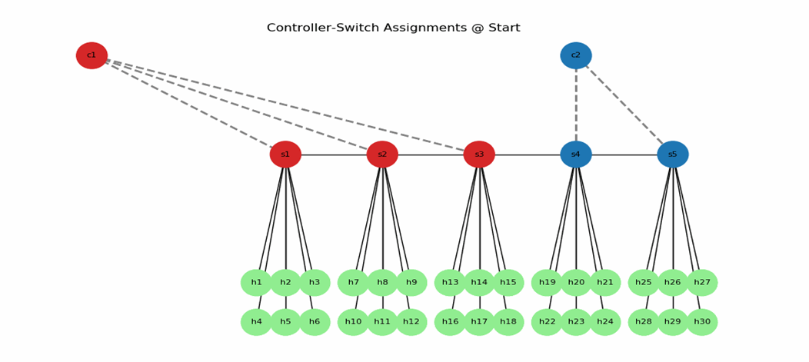
Scenario 1 - Network Topology
Two-Controller Setup
2 controllers: C1 (port 6633), C2 (port 6634).
5 switches (S1- S5) in linear topology.
30 hosts (6 per switch).
Initial: C1→S1, S2, S3 (18 hosts) | C2→ S4 , S5 (12 hosts).
Asymmetric initial load: 3:2 ratio.

Slide 6
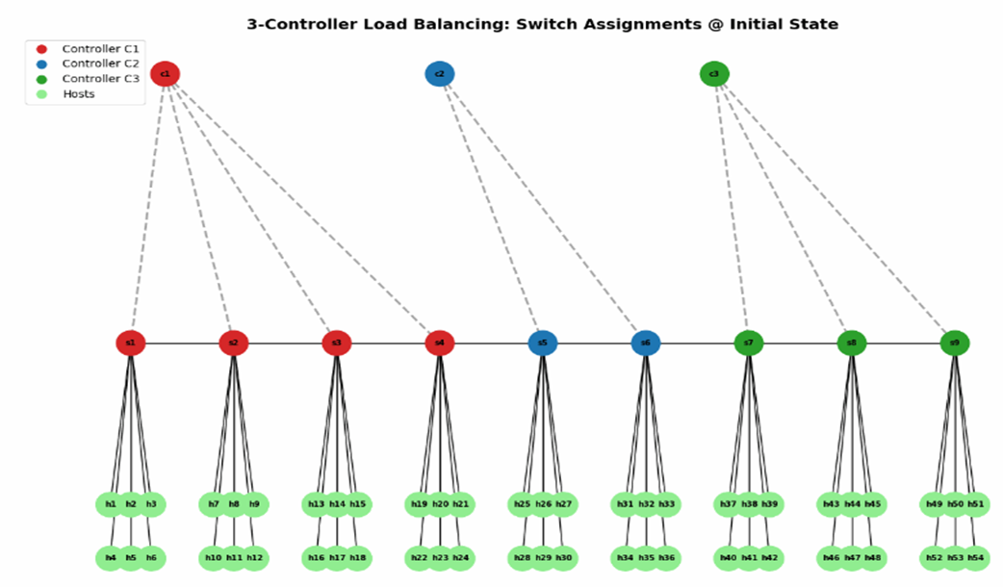
Scenario 2 - Network Topology
Three-Controller Setup
3 controllers: C1 (6633), C2 (6634), C3 (6635).
9 switches (S1- S9) in linear topology.
54 hosts (6 per switch).
Initial: C1→S1- S4 (24 hosts) | C2→S5, S6 (12 hosts) | C3→S7- S9 (18 hosts).
Asymmetric initial load: 4:2:3 ratio.

Slide 7
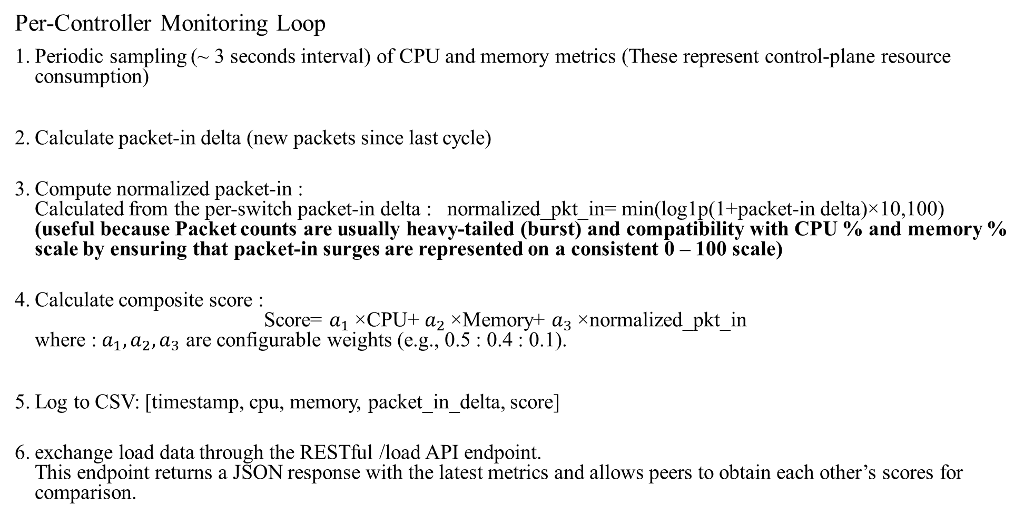
Monitoring & Metrics Collection & Load Scoring Formula
Per-Controller Monitoring Loop
Periodic sampling (~ 3 seconds interval) of CPU and memory metrics (These represent control-plane resource consumption)
Calculate packet-in delta (new packets since last cycle)
Compute normalized packet-in : Calculated from the per-switch packet-in delta : normalized_pkt_in= min(log1p(1+packet-in delta​)×10,100) (useful because Packet counts are usually heavy-tailed (burst) and compatibility with CPU % and memory % scale by ensuring that packet-in surges are represented on a consistent 0 – 100 scale)
Calculate composite score : Score= $a_{1}$​×CPU+ $a_{2}$×Memory+ $a_{3}$ ​×normalized_pkt_in where : $a_{1},a_{2},a_{3}$ are configurable weights (e.g., 0.5 : 0.4 : 0.1).
Log to CSV: [timestamp, cpu, memory, packet_in_delta, score]
exchange load data through the RESTful /load API endpoint. This endpoint returns a JSON response with the latest metrics and allows peers to obtain each other’s scores for comparison.

Slide 8
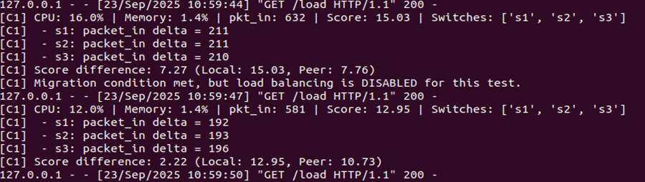
No Load Balancing (No-LB) Behavior
The system focuses on monitoring and observation, not redistribution.
Baseline Configuration
startup delay (~ 20 seconds ) to ensure metric stability (prevents false positives due to transient startup load)
Controllers monitor continuously
Compute load scores
All scores are logged locally and shared passively among controllers via /load API — no migration or reallocation occurs.
This phase establishes a baseline performance profile for later comparison with the active load-balancing stage.
As a figure , Controller 1 (C1) calculates its load score and compares it with the peer’s load score (C2). When the difference exceeds the migration threshold ( 14 > difference > 7 ) the system detects that migration would normally be triggered. However, since this experiment is running under the No Load Balancing (No-LB) behavior, C1 explicitly skips migration and logs the message: “Migration condition met, but load balancing is DISABLED for this test.”

Slide 9
Load Balancing (LB) behavior
When load balancing is enabled, controllers actively compare their composite scores through the /load API.
Each controller continuously evaluates score differences with its peers.
A migration decision is triggered when:
The local score is significantly higher than a peer’s (score difference > 7 ).
The controller owns more than one switch (ensuring viable redistribution).
A hybrid migration policy is applied:
If the imbalance is moderate ( 7 – 14 ), the lightest switch is migrated.
If the imbalance is severe ( > 14 ), the heaviest switch is migrated.
Each migration updates /tmp/migration_log.txt with the switch ID and source–destination controllers.
A short per-switch cooldown timer (8 seconds after a migration) prevents the same switch from being moved repeatedly, ensuring stable and controlled redistribution.
This allows real-time redistribution of switches among controllers when imbalance exceeds the defined migration threshold.

Slide 10
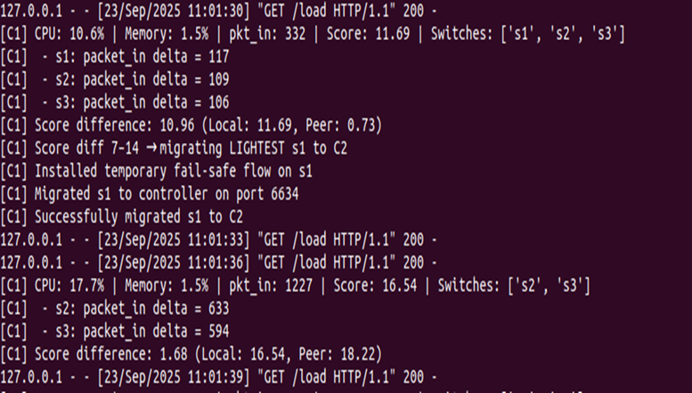
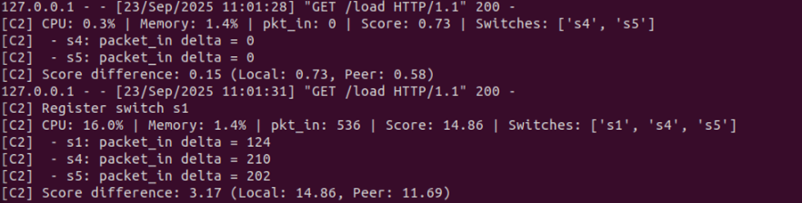
Switch Migration Process
migrate_switch() performs Safe Handoff Procedure :
install temporary fail-safe flow (match all → OFPP_NORMAL) on the switch to preserve forwarding.
run ovs-vsctl set-controller sX tcp:127.0.0.1:target_port to point switch to new controller.
Update local tracking variables (packet counts, previous counts, owned switches) within a self.lock section to ensure thread-safe synchronization between monitoring and migration processes.
log migration (migration_log.txt) and record last migration time.
As a first figure when the score difference falls within the defined migration threshold range (7 < difference < 14) , C1 triggers a load balancing action. Based on the “lightest switch” policy, switch S1 is selected and migrated from C1 to C2. in figure 2 controller 2 registers switch 1 (S1).

Slide 11
Analysis Framework & Fairness Metrics Explained
Comparing No-LB vs LB
Load CSV logs from all controllers.
Align timestamps across all datasets.
Trim to common measurement window (exclude warmup = 10 seconds), which means the script ignores the first 10 seconds of data (the warm-up period) and starts analyzing only from the 10th second onward.
Generate time-series plots showing dynamic behavior.
Compute aggregated KPI tables.
Calculate fairness metrics (STD, DIFF, CV).
Measuring Load Distribution Balance
STD (Standard Deviation)
How spread out controller loads are from average (to measure overall fairness)
Lower = more balanced
DIFF (Max Difference)
Gap between busiest and least busy controller
Lower = smaller imbalance
CV (Coefficient of Variation)
It shows the imbalance level relative to mean (how big the STD is compared to the average)
Lower = better fairness at any load level

Slide 12
Scenario 1: experimental procedure
Process 1: start No-LB controllers + topology; run 6× pingall; stop.
Process 2: start LB controllers + topology; run 6× pingall; stop.
Process 3: run analyze kpi.py then animation.py to build GIF.
Repeat for each weight group.
The evaluation is based on :
bar chart and time-series plots and KPI tables. bar chart shows LB reduces load on the busy controller while increasing fairness overall, time-series plots that quantify performance differences.

Slide 13
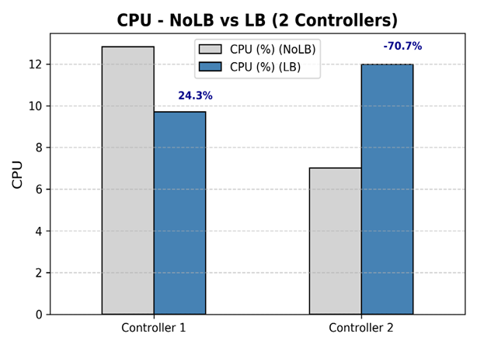
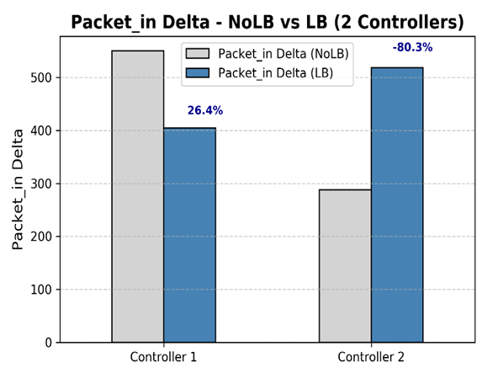
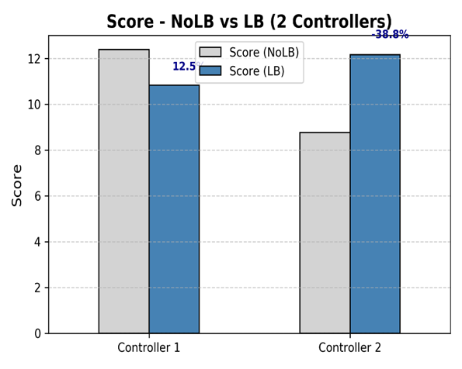
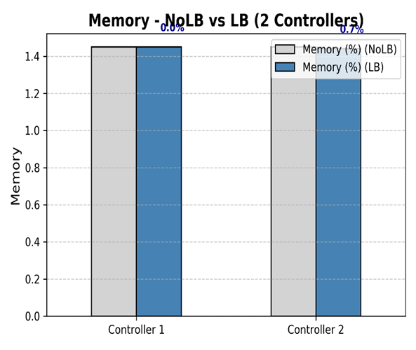
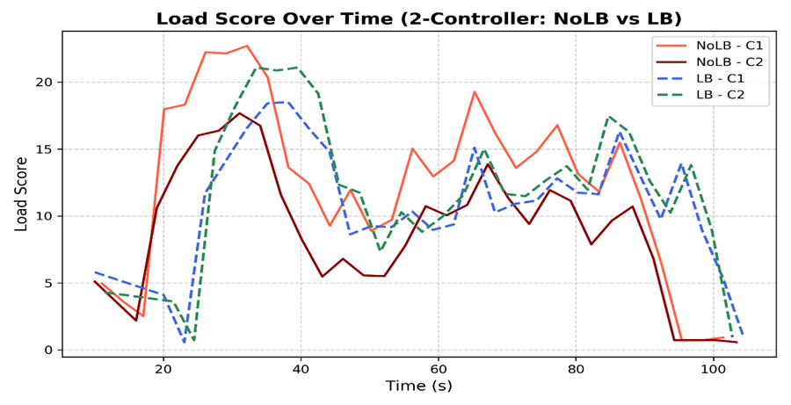
Scenario 1 - Weight Group 1 (0.5:0.4:0.1)
No – LB : C1 CPU = 12.83% , packet_in ≈ 550 , score = 12.39 / C2 CPU = 7.02% , packet_in ≈ 288 , score = 8.76 LB : C1 CPU = 9.71% , packet_in ≈ 405 , score =10.84 / C2 CPU = 11.98% , packet_in ≈ 519, score = 12.16. Fairness : CPU STD improvement 61.0%; Packet STD improvement 56.8%; Score STD improvement 63.7%. the system achieved clearer fairness improvements across controllers

Slide 14
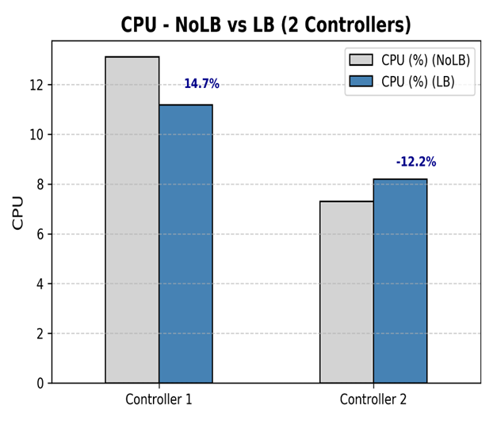
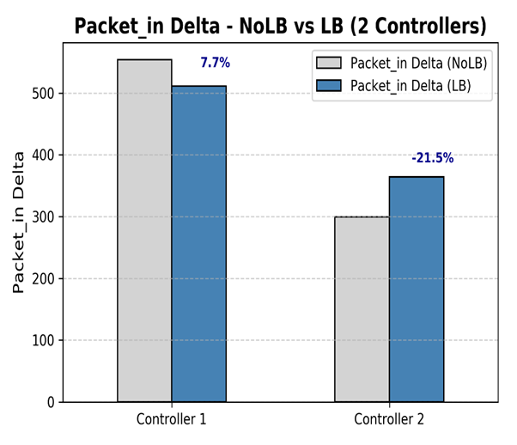
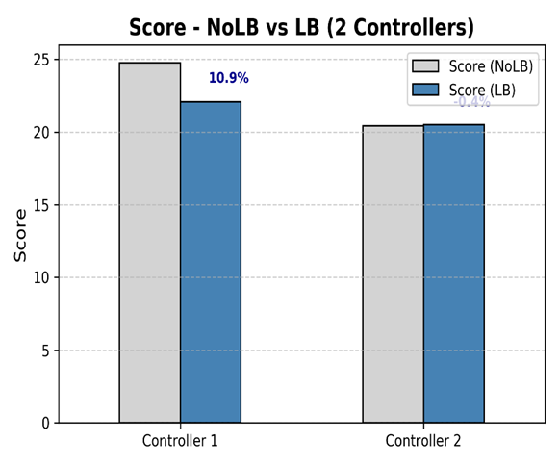
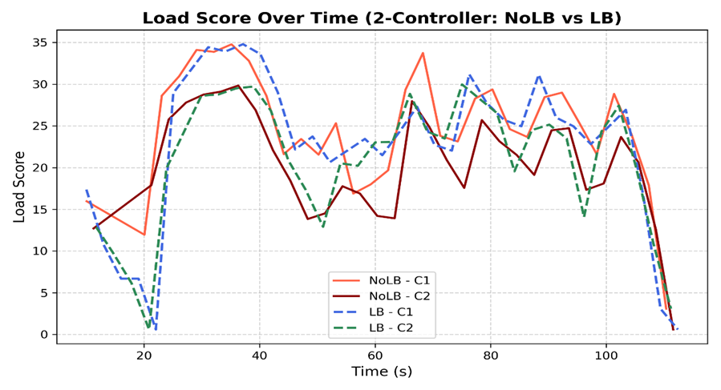
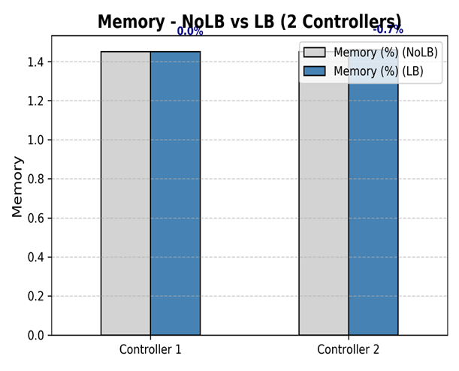
Scenario 1 - Weight Group 2 (0.33:0.33:0.34)
NoLB: C1 CPU= 13.11%, packet_in= 553.8, score= 24.76 / C2 CPU= 7.30%, packet_in= 299.6, score= 20.41. LB: C1 CPU= 11.18%, packet_in= 511.0, score= 22.07 / C2 CPU= 8.19%, packet_in= 364.1, score= 20.50. Fairness: moderate improvements across controllers (CPU STD 48.3%, Packet STD 42.2%, Score STD 63.8%).

Slide 15
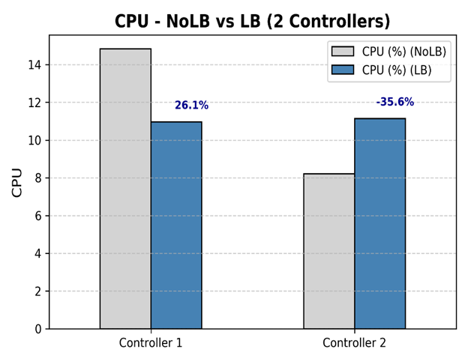
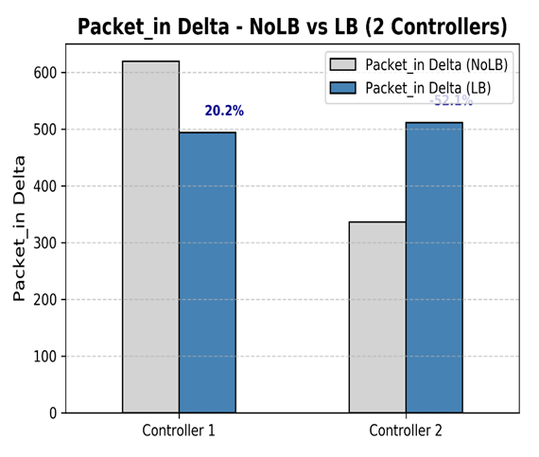
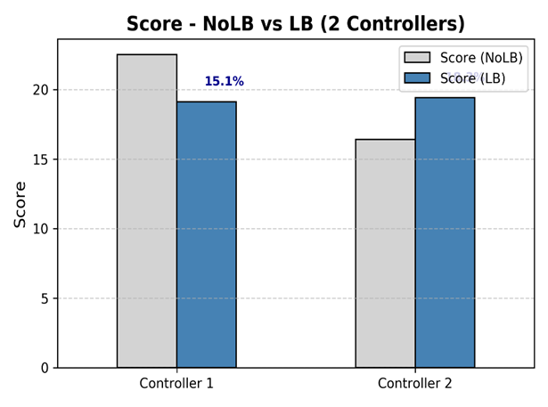

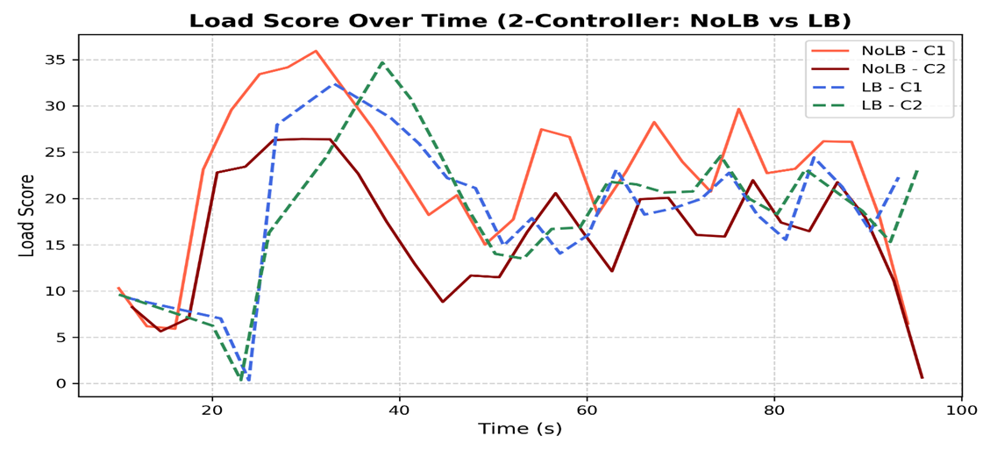
Scenario 1 - Weight Group 3 (0.7:0.1:0.2)
No - LB: C1: CPU=14.83%, Packet_in=619.34, Score=22.52 / C2: CPU=8.21% Packet_in=335.97 Score=16.41 (Large imbalance between controllers) LB: C1: CPU=10.96%, Packet_in==19.13 ✓ / C2: CPU=11.13%, Packet_in=511.04, Score=19.42 ✓ (Controllers converged to ~11% CPU) the system achieves excellent load balancing performance, particularly in CPU and overall score metrics.

Slide 16
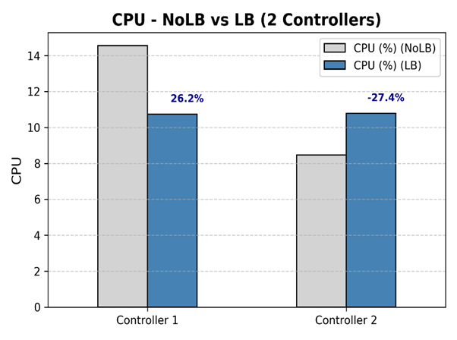
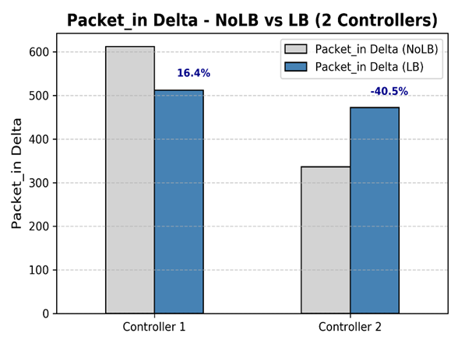
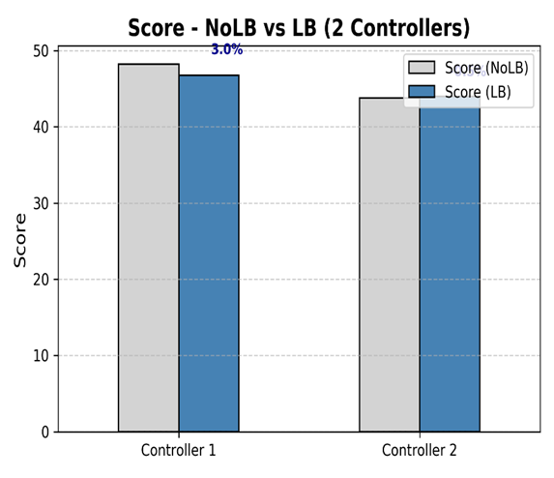

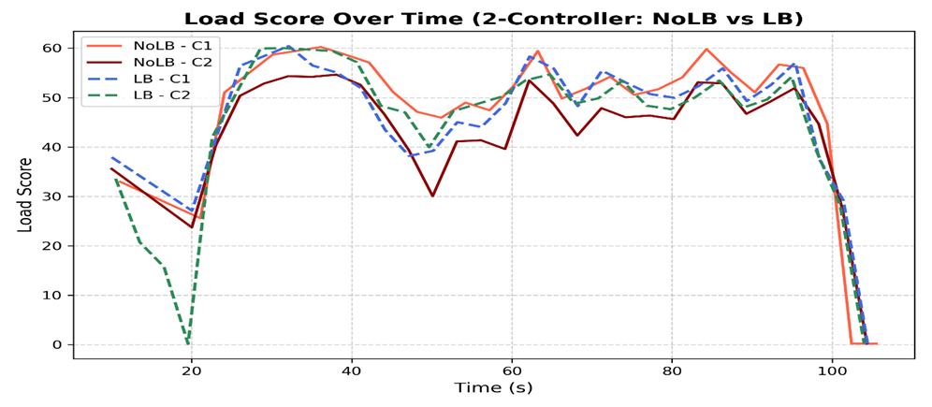
Scenario 1 - Weight Group 4 (0.1:0.1:0.8)
NoLB: C1 CPU= 14.55%, packet_in= 611.97, score= 48.22 / C2 CPU= 8.47%, packet_in= 336.23, score= 43.77. LB: C1 CPU= 10.74%, packet_in= 511.89, score= 46.77 / C2 CPU= 10.79%, packet_in= 472.37, score= 44.01. the system achieved excellent CPU and packet fairness, but because the score formula was heavily packet-weighted (0.8), and packet rates still differed slightly between controllers, the score variance decreased only moderately (~ 38 %).

Slide 17
Results Overview - Scenario 1
Weight Configuration Impact (2 Controllers)
So, Weight Group 3 (0.7:0.1:0.2) – OPTIMAL
Group | Weights (CPU : Memory : Packets) | CPU STD Improvement (%) | Packet STD Improvement (%) | Score STD Improvement (%) | Observation / Dominant Factor
1 | 0.5 0.4 0.1 | 61.0 % | 56.8 % | 63.7 % | Moderately CPU-weighted; effective in reducing overload on C1
2 | 0.33 0.33 0.34 | 48.3 % | 42.2 % | 63.8 % | Balanced weights; moderate improvement
3 | 0.7 0.1 0.2 | 97.6 % | 94.0 % | 95.1 % ⭐ | Strong CPU emphasis; achieved near-perfect workload balance
4 | 0.1 0.1 0.8 | 99.3 % | 85.7 % | 37.8 % | Packet-focused; excellent CPU fairness but less uniform scores

Slide 18
Multi-Controller Communication - Scenario 2
Full Mesh Communication (Scenario 2)
Each controller maintains peer URLs
C1 queries: C2 and C3
C2 queries: C1 and C3
C3 queries: C1 and C2
Selects least-loaded peer as migration target

Slide 19
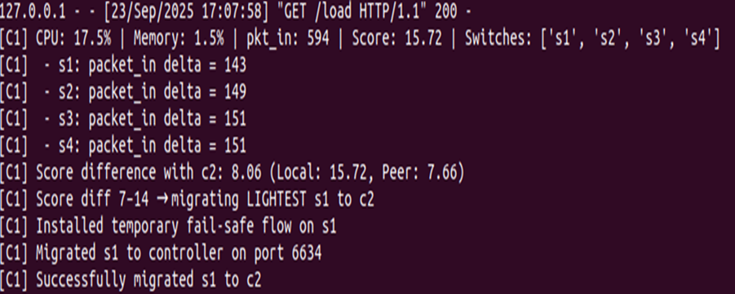
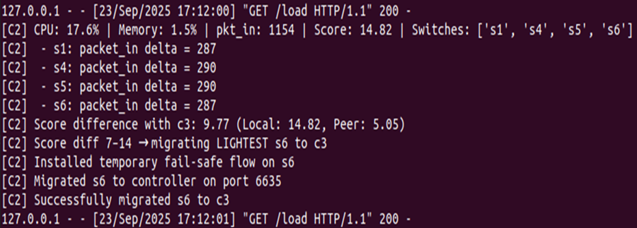
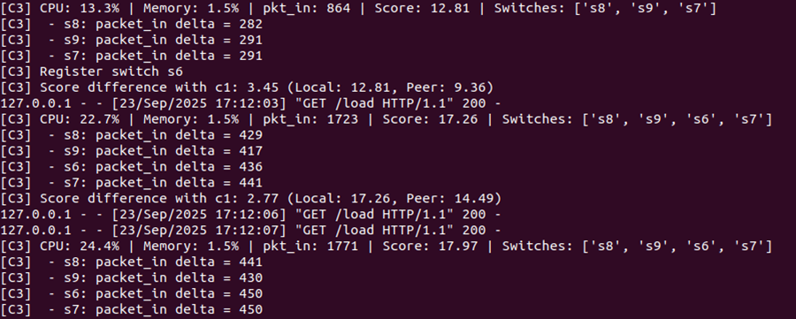
Switch Migration Process – Scenario 2
migrate_switch () performs the same process as scenario 1.
1 - As a figure Controller 1 (C1) monitors its load score and compares it with the peer controller (C2), the score falls within (7 < difference < 14), C1 triggers a load balancing action. Based on the “lightest switch” policy, switch S1 is selected and migrated from C1 to C2. The logs confirm the process with steps: installing a temporary fail-safe flow, initiating migration, and successfully attaching S1 to Controller 2 on port 6634.
2 - The controller 2 registers switch 1 ( S1 ) and after a while , the score difference with C3 falls within (7 < difference < 14), C2 triggers a load balancing action. Based on the “lightest switch” policy, switch S6 is selected and migrated from C2 to C3. The logs confirm the process with steps: installing a temporary fail-safe flow, initiating migration, and successfully attaching S6 to Controller 3 on port 6635.
3 - The controller 3 registers switch 6 ( S6).

Slide 20
Scenario 2: experimental procedure
Process 1: start No-LB controllers + topology; run 4 × pingall; stop.
Process 2: start LB controllers + topology; run 4 × pingall; stop.
Process 3: run analyze kpi.py then animation.py to build GIF.
Repeat for each weight group.
The evaluation is based on :
bar chart and time-series plots and KPI tables. bar chart shows LB reduces load on the busy controller while increasing fairness overall, time-series plots that quantify performance differences.

Slide 21
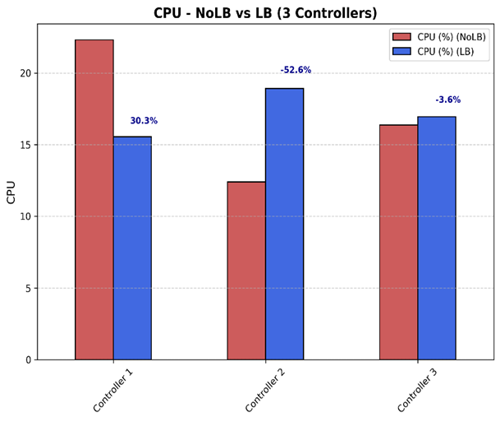
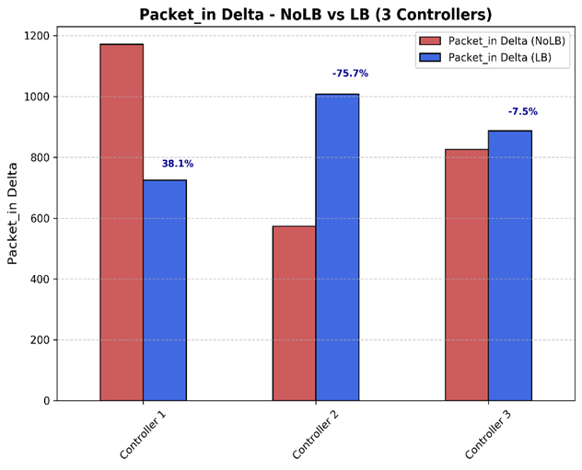
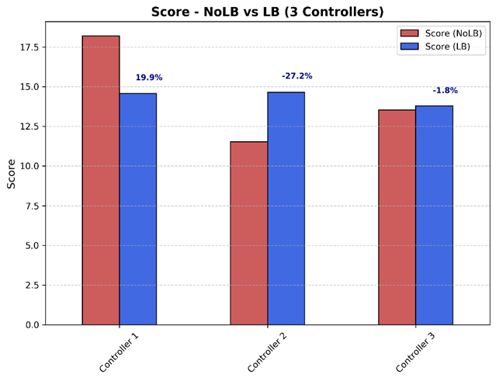
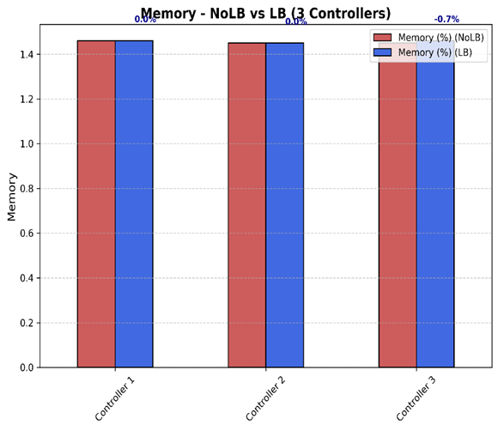
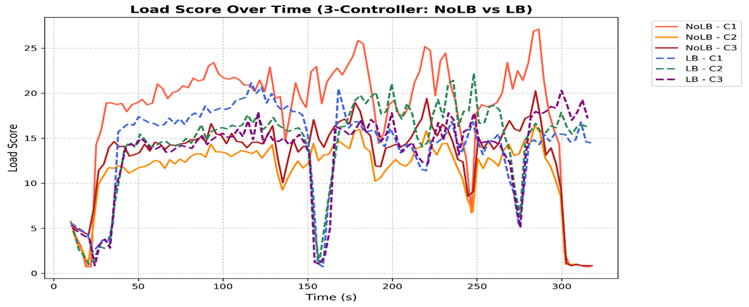
Scenario 2 - Weight Group 1 (0.5:0.4:0.1)
C1 relieved substantially; load redistributed primarily to C2 (and C3). CPU STD improvement ≈ 66.1%; Packet STD Improvements ≈ 52.7 % ; Score STD improvement ≈ 86.0%. the system achieved clearer fairness improvements across controllers.

Slide 22
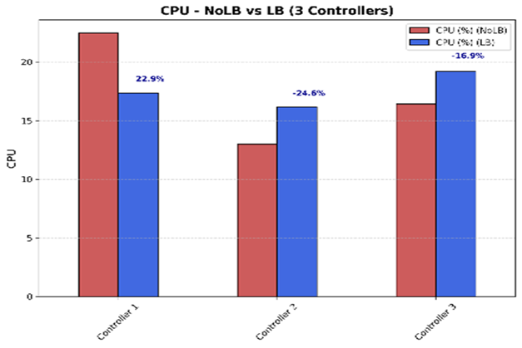
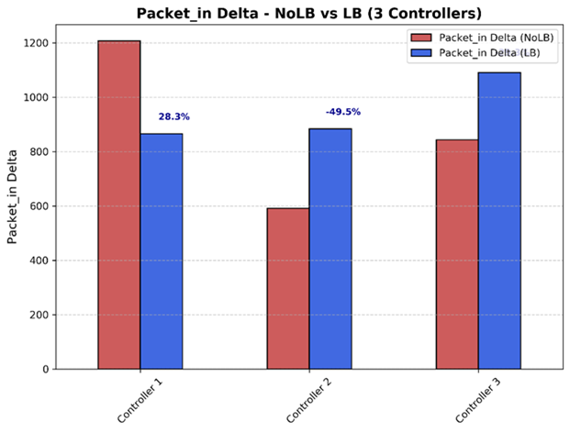
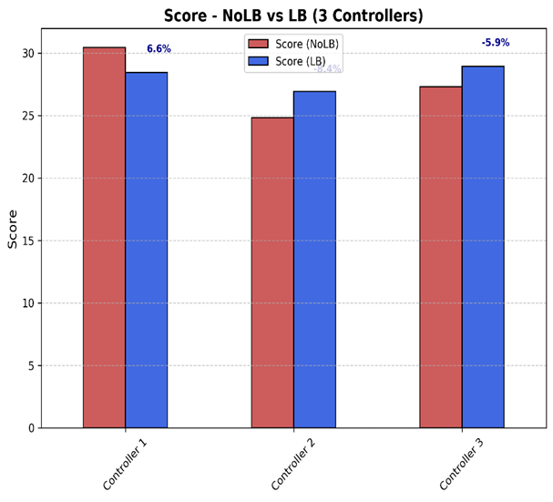

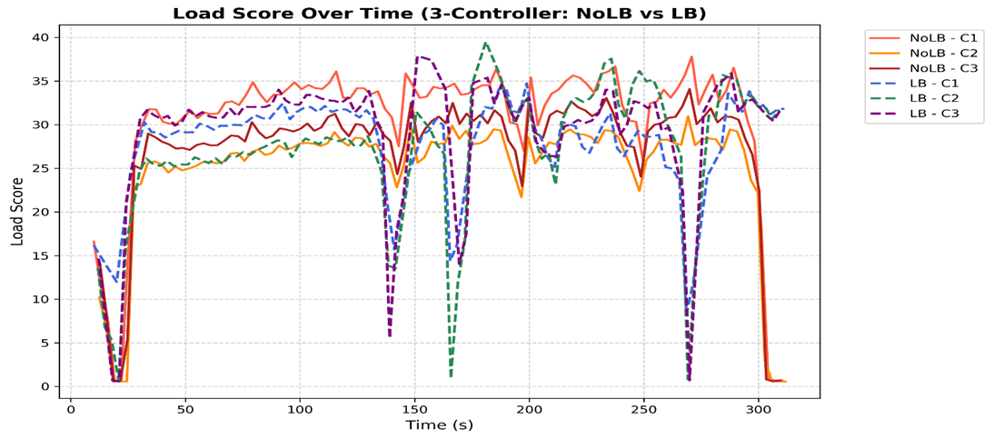
Scenario 2 - Weight Group 2 (0.33:0.33:0.34)
The result is a moderate yet steady redistribution of traffic across C1, C2, and C3 — none of the controllers remains significantly overloaded. CPU STD improvement ≈ 68.1%; Packet STD Improvements ≈ 59.7 % ; Score STD improvement ≈ 62.6%.

Slide 23
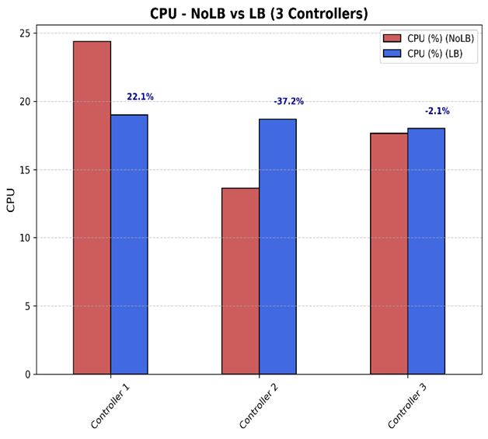
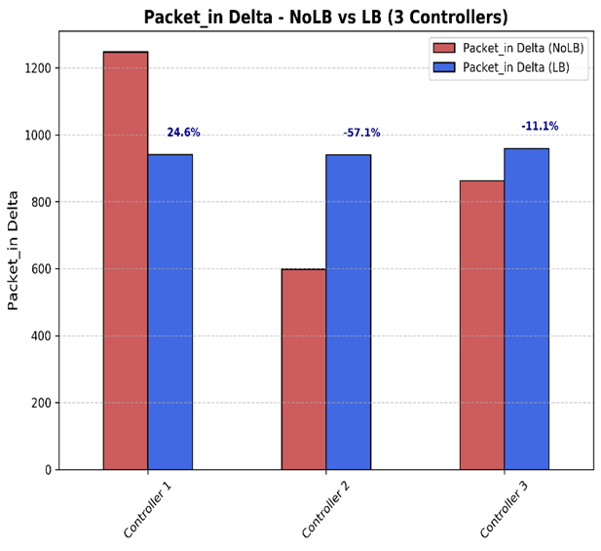
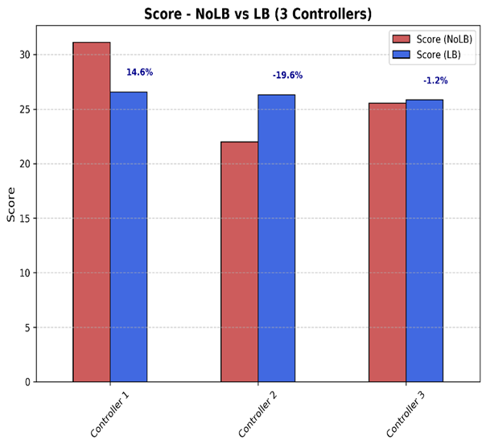

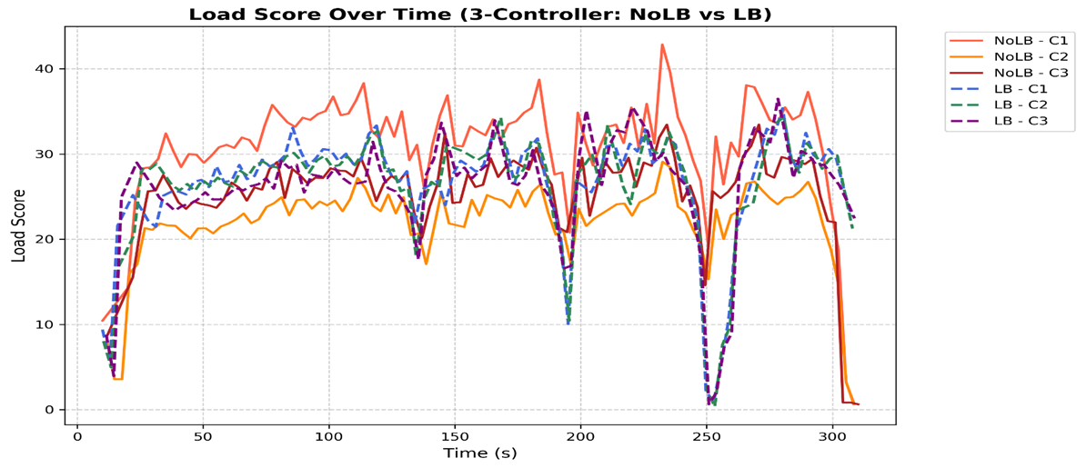
Scenario 2 - Weight Group 3 (0.7:0.1:0.2)
The results in dramatic improvements in CPU and packet handling fairness — the system achieves excellent fairness in Packet_in and score metrics, the system achieves excellent load balancing performance, particularly in CPU and overall score metrics. CPU STD improvement ≈ 90.8%; Packet STD Improvements ≈ 96.8 % ; Score STD improvement ≈ 92.0 %.

Slide 24
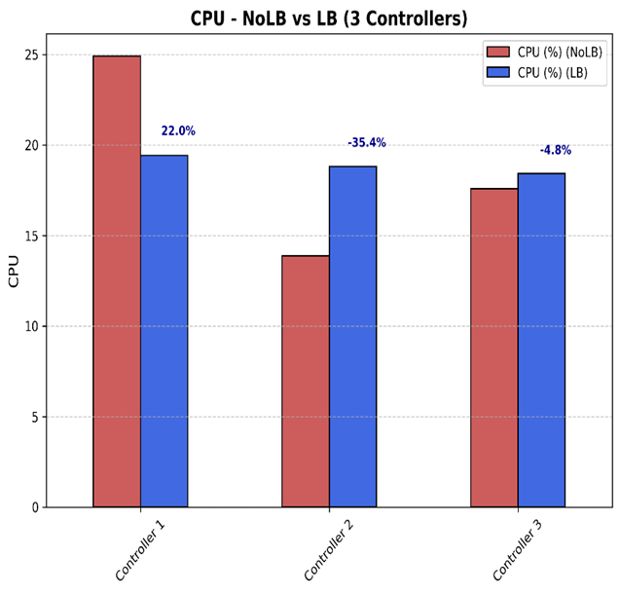
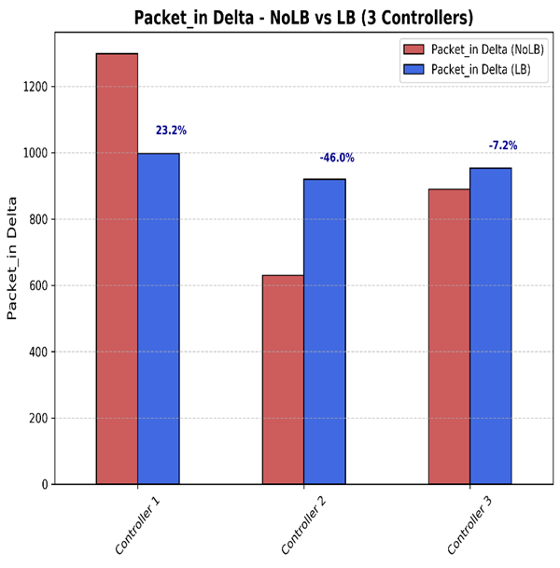
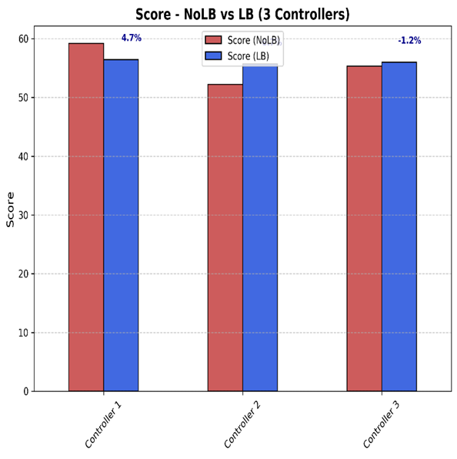

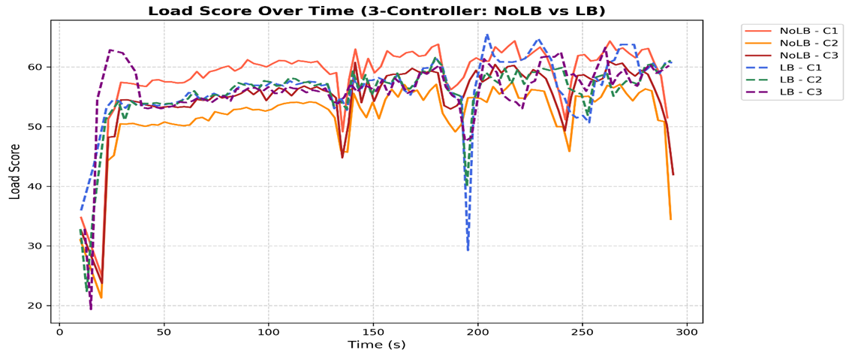
Scenario 2 - Weight Group 4 (0.1:0.1:0.8)
the LB mechanism effectively targets packet-based workloads, the system achieves excellent fairness in Packet_in and score metrics, CPU STD improvement ≈ 91.9%; Packet STD Improvements ≈ 88.5 % ; Score STD improvement ≈ 89.9 %.

Slide 25
Results Overview - Scenario 2
Weight Configuration Impact (3 Controllers)
So, Weight Group 3 (0.7:0.1:0.2) – OPTIMAL
Group | Weights (CPU : Memory : Packets) | CPU STD Improvement (%) | Packet STD Improvement (%) | Score STD Improvement (%) | Observation / Dominant Factor
1 | 0.5 0.4 0.1 | 66.1 % | 52.7 % | 86.0 % | Moderately CPU-weighted; relieved overloaded C1 effectively
2 | 0.33 0.33 0.34 | 68.1 % | 59.7 % | 62.6 % | Balanced configuration; achieved consistent load distribution gains, reflecting balanced but moderate responsiveness across controllers.
3 | 0.7 0.1 0.2 | 90.8 % | 96.8 % | 92.0 % ⭐ | Strong CPU emphasis; near-uniform load across all controllers
4 | 0.1 0.1 0.8 | 91.1 % | 88.5 % | 89.9 % | Packet-focused; outstanding traffic fairness and overall balance

Slide 26
Comparative insights
Across both scenarios, LB consistently reduces imbalance (STD, DIFF, CV improvements).Weight selection matters:
CPU-dominant → aggressive reductions in CPU imbalance and fast stabilization (achieves near-perfect CPU balancing (~ 95 %) and Best overall performance)
Packet-dominant → strong responsiveness to traffic bursts and Excellent packet-in fairness (~ 90 %) but Less uniform score balancing
Balanced weights → conservative, Moderate improvements (~ 45 - 65%)
Multi-peer (3 controllers) enables finer-grained redistribution (better load distribution options) and often better fairness.

Slide 27
Migration Animation Insights
Visual Behavior Patterns
Switches change color based on owner
Red = C1, Blue = C2, Green = C3
First phase: Heavy migration activity
Second phase: Gradual stabilization
Demonstrates convergence to balanced state

Slide 28
Conclusion & Future Work
The implemented LB framework (Ryu + OVS) achieves adaptive switch migration that substantially improves control-plane fairness across tested weight sets and topologies. behavior patterns are repeatable despite simulation variability.
Repeated runs show small numerical variation due to Mininet/Ryu nondeterminism (timing, host load, scheduling).
Despite fluctuations, behavior patterns are consistent: No-LB → imbalanced controllers LB → more even distribution.
Focus analysis on relative changes and patterns, not exact digits.
Future Work : Adaptive weights, geographic distribution, ML-based optimization.

Slide 29
Thank You Very Much

