Slide 1

DEPARTMENT OF COMPUTER ENGINEERING, MODELING, ELECTRONICS AND SYSTEM ENGINEERING LM-Telecommunication Engineering: Smart Sensing, Computing and Networking Laboratory of Smart and Programmable Networks Project with Title: Comparative Analysis of Handover Strategies under Random Way Point and Random Direction Mobility in SDN-Enabled Mininet-WiFi Networks Supervisor : Prof. Pasquale Pace
Implemented by :
Rami Saleh Hussein Mohammed Gebre Halefom Meresa

Slide 2
1. Introduction & Motivation
The Challenge of Seamless Mobility
Modern Wireless Networks Face Critical Challenges:
Users expect uninterrupted connectivity while moving across coverage areas
Latency-sensitive applications (VoIP, AR/VR, gaming, video streaming) are increasingly common
Traditional handover mechanisms cause visible service interruptions
Mobile devices frequently traverse overlapping Access Point (AP) coverage areas

Slide 3
1. Introduction & Motivation
SDN Paradigm Shift
Software-Defined Networking (SDN): Logically centralized control plane decoupled from data plane
Global network view: Controller (e.g., Ryu) maintains complete state — AP load, link quality, mobility, topology
Advanced strategies: Predict mobility, pre-install forwarding rules, balance traffic across APs
Result: Mitigate delay and packet loss during handovers
Research Motivation
This project investigates SDN-assisted handover strategies in an emulated WLAN environment based on Mininet-WiFi. The study focuses on understanding how different mobility patterns and control strategies interact, and on identifying which mechanisms are most suitable for highly mobile and dense network scenarios.

Slide 4
2. Background: IEEE 802.11 Link-Layer Handover
Layer-2 Handover Process (Roaming)
Link-layer handover, often called roaming, is the process by which a station transfers its association from one access point to another within the same IP subnet. The process is typically divided into three main stages that collectively determine handover performance
STAGE 1: SCANNING (50 – 200 ms)
STAGE 2: AUTHENTICATION (10 – 100 ms)
STAGE 3: RE-ASSOCIATION (30 – 50 ms)

Slide 5
2. Background: Canonical Mobility Models
Random Way Point (RWP)
Mobility Characteristics
Pattern: Node repeatedly selects random destination and speed within specified range
Behavior: Moves to chosen waypoint, pauses for random period, then repeats
Spatial distribution: Tends to concentrate near center (spatial clustering)
Pause behavior: Creates characteristic pause-move-pause pattern
Handover Implications
Longer residence time: Stations spend more time per AP due to pauses
Smoother signal variations: Predictable movement

Slide 6
2. Background: Canonical Mobility Models
Random Direction (RD)
Mobility Characteristics
Pattern: Node chooses random direction θ ∈ [0, 2π), moves until boundary
Boundary behavior: Reflects or chooses new direction at edges, continues motion
Spatial distribution: More uniform across simulation area
Continuous movement: No pause intervals, constant mobility
Handover Implications
Shorter residence time: Frequent boundary crossings reduce AP dwell time
Rapid RSSI changes: Unpredictable signal strength fluctuations
Higher handover frequency: More handover triggers.

Slide 7
3. Problems & Goals
The Handover Problem:
When a mobile station moves from one AP to another, it must disassociate and reassociate
Conventional approach is client-driven and reactive: Station initiates scanning only after signal strength deteriorates
Scanning alone may consume tens to hundreds of milliseconds
Security handshakes and reassociation add further delay
For real-time traffic, these interruptions cause visible application-level failures
Goals
Measure how different movement patterns affect throughput, delay, and jitter
Compare roaming strategies
Measure SDN controller overhead
Recommend settings that improve video streaming quality

Slide 8
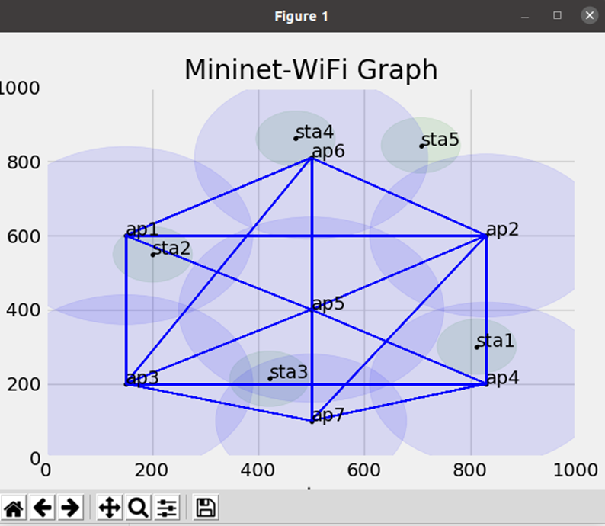
4. System Design & Architecture
Mininet-WiFi used as emulation platform for reproducible experiments.
7 APs arranged in a central-hub topology: AP5 at center connected to all others; cross links provide redundancy.
5 mobile stations (STA1-STA5) with unique mobility profiles and handover sensitivities.
Ryu SDN Controller communicates with APs via OpenFlow 1.3, collects signal and load statistics, and applies handover policies.

Slide 9
5. Handover Strategies
I. Reactive Strategy (Baseline)
This method waits until the connection becomes bad or fully drops before switching to another AP. It reacts after the problem happens.
Mechanism
Device holds the connection until signal falls below – 80 dBm
Scans available APs after disconnection every 10 seconds
Selects strongest signal without prediction
No network-wide optimization
Key features:
Very low controller work & Very slow handovers
Easy to implement & Not optimized for the whole network
Good for: slow-moving users, non-critical apps (browsing, background sync)

Slide 10
5. Handover Strategies
II. Proactive Strategy
In the Proactive Strategy, the system does not switch APs immediately when the signal starts getting worse. Instead, it predicts the future and asks: “How sure am I that a handover will be needed soon?”
This certainty is expressed as a confidence level, a number between 0 and 1:
Confidence level expresses how certain the system must be before acting.
0.5 (50% confidence): The system thinks there is a moderate chance a handover will be needed (react more aggressively ,risk more false predictions)
Assign for RD
0.7 (70% confidence): The system is more certain that a handover is needed (less false positives).
Assign for RWP

Slide 11
5. Handover Strategies
II. Proactive Strategy
Mechanism
Scan interval: 3 s
Monitors signal strength trends continuously (Signal threshold: – 65 dBm)
Predicts degradation 5 seconds in advance
Min Probability: 0.5 – 0.7 (confidence needed before doing the handover)
Pre-installs flows at target AP before handover
Model-aware probability thresholds

Slide 12
5. Handover Strategies
II. Proactive Strategy
Prediction Algorithm:
signal_trend = (RSSI_now – RSSI_5s_ago) / 5 (gives the rate of change of the signal in dBm per second ) (A negative trend means the signal is getting weaker over time)
if signal_trend < – 2 dBm/s AND RSSI_now < – 65 dBm: (if The signal is dropping fast (more than 2 dBm every second)
and current signal is already below the safe threshold (−65 dBm)
prepare_handover() (controller begins preparing the handover)
if confidence ≥ Min_Probability: (The controller uses the stability of the trend to compute a confidence probability)
(When this probability exceeds a minimum threshold, the controller is confident the
the signal will continue to degrade)
execute_handover() (At that moment, it executes the handover early, before the connection becomes unstable

Slide 13
5. Handover Strategies
II. Proactive Strategy
Characteristics
Much shorter interruption of service
Higher control-plane overhead (more signaling)
Needs to remember past signal measurements
Especially useful when devices move quickly
Best for: video streaming, VoIP calls, mobile IoT

Slide 14
5. Handover Strategies
III. Load-Aware Strategy
This strategy Looks not just at signal, but also at how busy each AP is (“load”), so it balances users among APs to prevent some from overloading.
Parameters
Signal threshold: – 70 dBm
Signal weight: 0.7
Load weight: 0.3
Decision Function
score = 0.7 × signal_strength + 0.3 × (1 – load_factor) × 100
target_AP = AP with maximum score
load_factor is a number between 0 and 1 that indicates how full or busy an AP is (0 = empty, 1 = very loaded)

Slide 15
5. Handover Strategies
III. Load-Aware Strategy
Characteristics
Better balancing of users across the network
Moderate delay for handover
Needs real-time monitoring of AP load
Fairer distribution of connections
Use case: crowded or dense places (e.g., stadiums, conference halls)

Slide 16
5. Handover Strategies
IV. Signal-Based Strategy
This strategy:
Uses a very high (aggressive) signal threshold (–60 dBm)to encourage handovers only when signal is good.
Applies hysteresis margin (5 dBm)to avoid flip-flopping (“ping-pong”) between APs.
Measures signal quickly and often for fast decisions.
Hysteresis Logic
If RSSI_new_AP > RSSI_current_AP + 5 dBm:
allow_handover() (handover is allowed only when the new AP’s signal is at least 5 dBm stronger than the current one)
else:
stay_connected() (Otherwise, the station stays connected to avoid unnecessary switching)
Hysteresis is a classic technique in control systems and networking to prevent “oscillation” ; by requiring a clear margin before switching, you avoid unnecessary handovers when signal just wiggles a little.

Slide 17
5. Handover Strategies
IV. Signal-Based Strategy
Characteristics
Very fast handovers
Risk of too frequent switching if signal is noisy
Generally maintains good signal quality
Requires stable, accurate signal measurements

Slide 18
5. Handover Strategies
IIV. SDN-Optimized Strategy
This strategy Uses a controller and historic mobility patterns to improve predictions (threshold: –65 dBm).
Pre-installs flows on the predicted AP for seamless handover.
Optimizes not just locally, but for the whole network (end-to-end paths).
Characteristics
Best overall performance among strategies
Very high control-plane overhead (lots of signaling)
Requires SDN infrastructure (controller, flow programming)
This approach uses the full power of SDN: pre-setup, traffic engineering, and prediction combine to deliver “make-before-break” handovers — minimizing packet loss or service interruption.

Slide 19
6. Performance Metrics & Data Collection Methodology
The goal of the measurement methodology is to record everything happening in the network so you can later calculate primary metrics.
To do this four types of data were collected :
1. Data Collection: Every 5 seconds, the Ryu controller writes a line of information into a CSV file
The CSV log contains : which AP each station is connected to / RSSI values / AP load / packet counters / flow setup events / timestamps / controller decisions (handover commands)
Purpose: → This gives a timeline of everything happening in the network.
2. Signal Monitoring: check signal strength using commands like: Iwconfig / iw dev wlan0 link , These commands run on each station and they measure the RSSI of the station’s current access point (in dBm)
Purpose: → RSSI is used to know when signal is weak and why a handover happened.

Slide 20
6. Performance Metrics & Data Collection Methodology
3. Packet Analysis (Throughput calculation) : Ryu controller logs number of packets received and timestamps of packets To compute throughput.
Purpose: → This helps in calculating how fast data is being transmitted (Kbps).
4. Handover Detection (Detecting AP changes) : A “handover” happens when a station moves from AP X to AP Y , so it’s possible to detect it By checking changes in the AP's MAC address associated with the station.
The controller logs these MAC changes in the CSV file.
Purpose: → This allows to calculate:
handover delay
number of handovers
packet loss during handover

Slide 21
6. Performance Metrics & Data Collection Methodology
Primary Metrics
1.Handover Delay (ms):Time required to switch from one AP to another. Lower is better.
T_handover = T_detection + T_scan + T_authentication + T_reassociation
2. Handover Success Rate (%):
Success_Rate = (Successful_Handovers / Total_Attempts) × 100%
3. Throughput (kbps)
Throughput = (Packets_Delivered × Packet_Size × 8) / Time_Window / 1000
Where : Packet counters → from controller log Time window → 5 seconds Packet size → from iperf traffic

Slide 22
6. Performance Metrics & Data Collection Methodology
4. Latency (ms)
RTT = the time for a packet to go to the destination and back (is measured using ICMP ping packets)
Latency = RTT / 2 (because we take only the one-way delay)
Secondary Metrics
Jitter: Variation in latency measurements
Packet Loss: Percentage of packets lost during
SDN-Specific Metrics
1. Control Plane Overhead
2. Flow Setup Time (ms)
3. Controller Latency (ms)

Slide 23
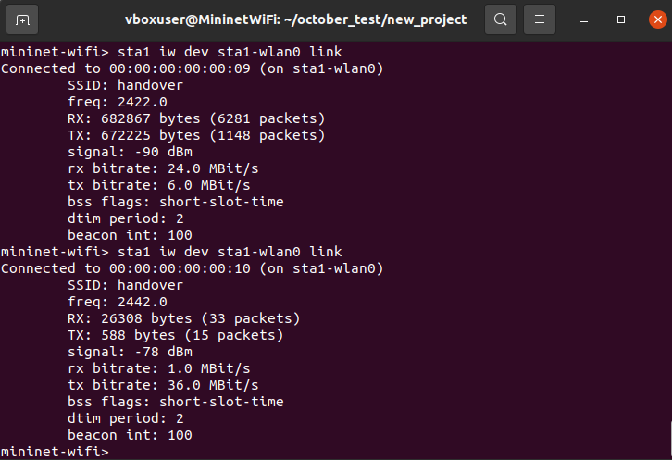
7. Experimental Results
Test Procedure:
1. Deploy 7 APs + 5 stations in Mininet-WiFi
2. Start Ryu SDN controller
3. Configure mobility model (RWP or RD)
4. Generate traffic (ICMP pings + UDP iperf)
5. Rotate through strategies every 60 seconds:
→ Reactive → Proactive → Load-Aware →
Signal-Based → SDN-Optimized
6. Collect metrics every 5 seconds
7. Run for 15 or 20 minutes total
8. Repeat for both mobility models

Slide 24
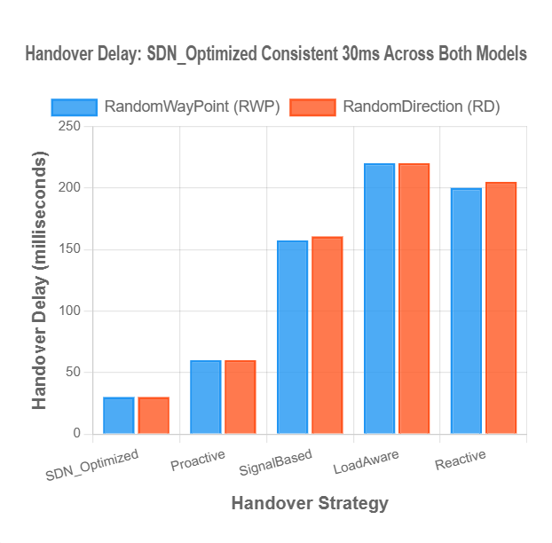
7. Experimental Results: Handover Delay Analysis from CSV Data
Handover delay is the time required to switch from one AP to another.
Key Finding:
The delay comparison shows that SDN Optimized and Proactive strategies achieve the lowest handover delay in both mobility models.
Load Aware and Reactive strategy exhibits the highest delay, especially under Random Direction due to its post-degradation triggering.
This confirms the advantage of predictive and SDN-assisted mechanisms in minimizing latency during mobility

Slide 25
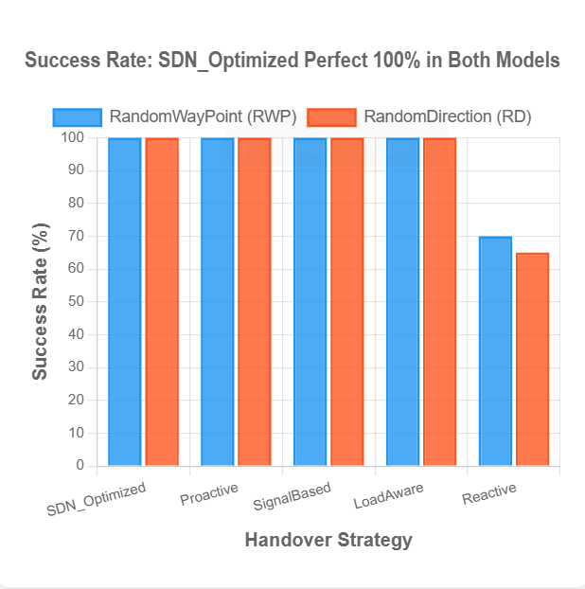
7. Experimental Results: Success Rate Analysis from CSV Data
Success rate measures the percentage of handover attempts that complete successfully without packet loss or connection drops.
Key Finding:
Perfect 100% success across both models for all triggered strategies, except the Reactive strategy which achieve (65 - 70 %) .

Slide 26
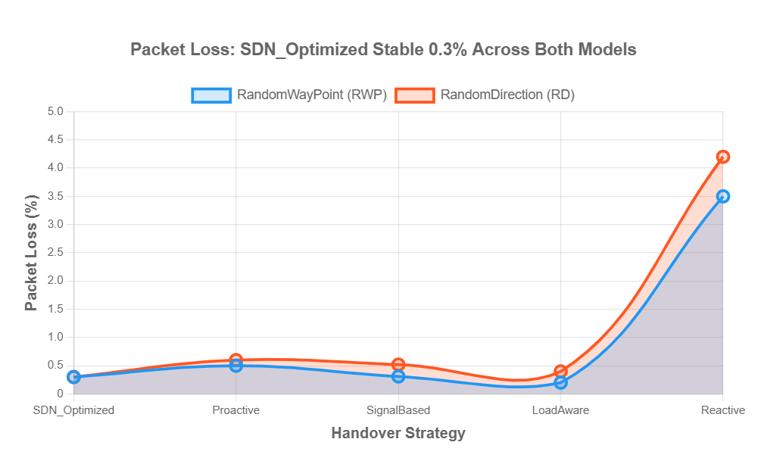
7. Experimental Results: Packet Loss Analysis from CSV Data
Packet loss during handover occurs when packets arrive while the station is disconnected from both APs .
Key Finding:
SDN Optimized achieves 0.3% loss in both models, while Reactive (3.85 % RWP - 4.3 % RD).
Random Direction shows 68% higher loss overall compared to RWP (0.52 % vs 0.31 % avg) due to movement unpredictability.

Slide 27
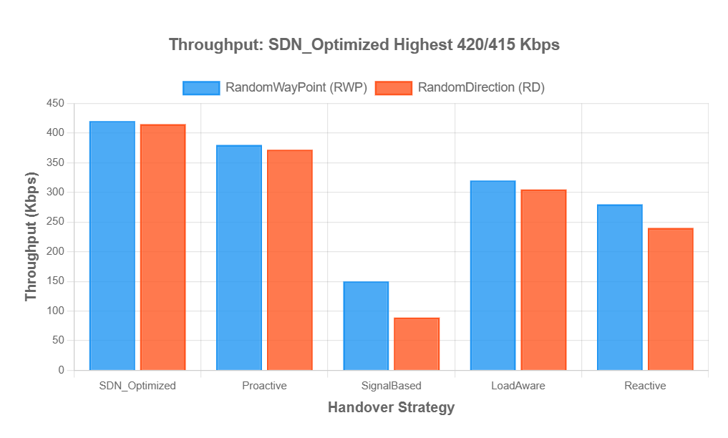
7. Experimental Results: Throughput Analysis from CSV Data
Throughput measures successful data transmission rate, affected by handover disruptions.
Key Finding:
SDN Optimized achieves 420 Kbps (RWP) and 415 Kbps (RD) - the highest throughput.
Signal Based suffers from frequent handover overhead (50 handovers in RWP in the experimental) leading to achieve throughput (150 Kbps (RWP) and 80 Kbps (RD)).

Slide 28
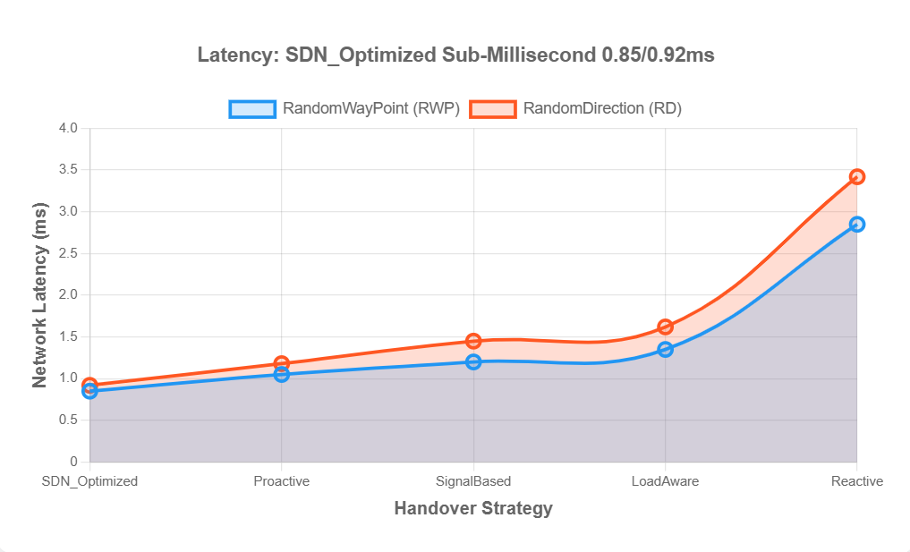
7. Experimental Results: Latency Analysis from CSV Data
Network latency is the round-trip time for packets, affected by handover disruptions and AP quality.
Key Finding:
SDN Optimized achieves 0.85 ms (RWP) & 0.92 ms (RD) ,while the Reactive achieves 2.85 ms (RWP) & 3.4 ms (RD).
All strategies show 8 - 20% higher latency in RD due to unpredictable movement.

Slide 29
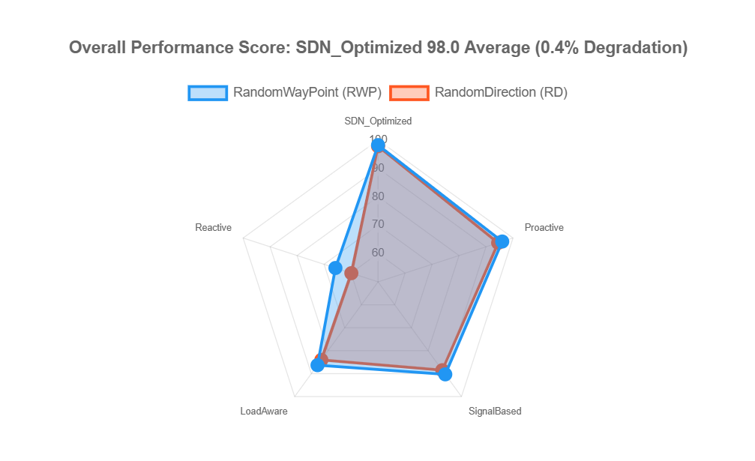
7. Results: Overall Performance Score
Overall Performance Score combines multiple weighted metrics.
Key Finding:
SDN Optimized scores 98 average with only 0.4% degradation from RWP to RD, demonstrating exceptional stability (predict mobility).
Reactive strategy scores 68 (RWP) & 60 (RD) , so it suffers 9 % degradation, confirming it struggles under Random Direction stress (no movement prediction).

Slide 30
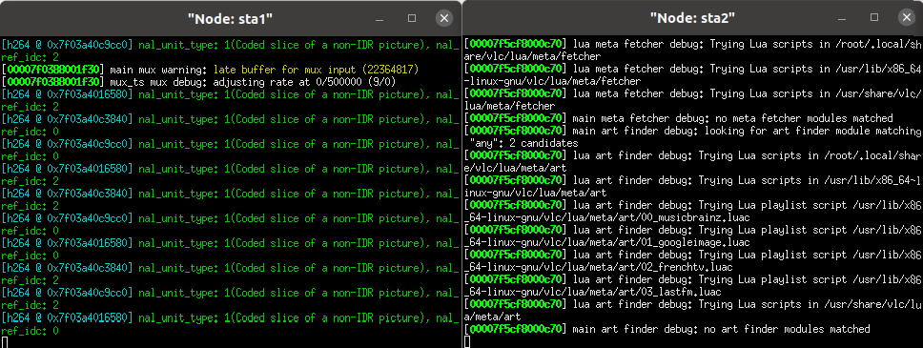

8. Real-World Validation: Video Streaming
Video Streaming Performance Analysis
Real-time video streaming test conducted between two mobile stations (sta1 as sender, sta2 as receiver) using VLC media player over HTTP protocol during active mobility and handovers

Slide 31
8. Real-World Validation: Video Streaming
Video Handover Metrics:
Metric | RWP | RD
Handover Delay | 276 ms | 283 ms
Success Rate | 99.5% | 99.4%
Packet Loss | 0.58% | 0.58%
Signal Quality | -56.05 dBm | -56.15 dB
Key Finding:
Video streaming was successfully maintained across multiple handovers in multiple strategies during the experimental
The system demonstrated robust operation despite suboptimal VLC configuration, proving the resilience of the handover mechanisms under test

Slide 32
9. Discussion & Key Insights
Mobility Model Impact
The choice of mobility model is critical for evaluating handover performance, as different patterns expose different strengths and weaknesses of handover strategies.
RWP | RD
Fewer handovers | More handovers
Stable signals | Fluctuating signals
Easier prediction | Harder prediction
Better baseline results | Stresses all strategies

Slide 33
10. Conclusions & Future Work
Conclusions
1/ Mobility pattern significantly affects handover performance. Random Direction stresses mechanisms more than Random Way Point, exposing weaknesses in reactive approaches.
2/ SDN-Optimized strategy delivers the lowest delay , highest throughput and best stability across both mobility models.
3/ Video streaming test confirms handover mechanisms work in practice with real multimedia applications.
Future Work
1/ Machine Learning Integration.
2/ Vehicular-Speed Mobility.
3/ Multi-Controller SDN Architecture

Slide 34
Thank you

