Slide 1

Automated service ordering between international service providers for hybrid and NFV services
Dddddddddddddddddddddddddddd June 26,2017
Students: Wissam Abu Sinni, Rami Geraisy Supervisors: Itzik Ashkenazi,Mark Gibson AND Ran Yazdi

Slide 2
Introduction
MEF (www.mef.net) is a standards forum that works closely with service providers to build interoperation definitions. They build ontop of other standards bodies and don’t write their own protocols.
MEF are moving into building open interoperable interface specs
This project will focus on the SONATA reference point which handles inter-service provider ordering

Slide 3
Background LSO - Lifecycle Service Orchestration:
LSO provides orchestration capabilities for the open and interoperable management and control of Third Network Connectivity Services [MEF ThirdNetwork]. The LSO Reference Architecture characterizes the management and control domains and entities that enable cooperative LSO capabilities. This architecture also outlines high level operational threads describing orchestrated Connectivity Service behavior as well as interactions among management entities. LSO overcomes existing complexity by defining product, service, and resource abstractions that hide the complexity of underlying technologies and network layers from the applications and users of the services.

Slide 4
Project Description
The project aim is to allow network service providers to support services across the globe by leasing connection from peers in other countries. The project seeks to make this process fully automatic and reduce the time from days and weeks using email to a series of simple API calls.

Slide 5
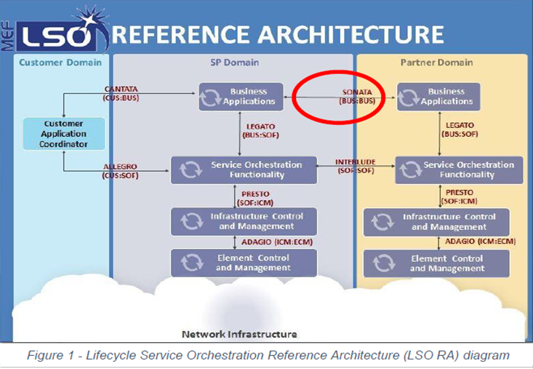
Our Focus in: Sonata R1

Slide 6
How things currently work
Everything done manually by e-mail, fax etc.
“I’d like to order an Ethernet EVC with this configuration”
Some hours/days pass
“That will cost €100 per month and will take about 6 weeks to deliver”
More hours/days pass
“OK, can I have that please?”
More hours/days pass
“Sure, we started that work, it is Order 123”
Several weeks/months pass
“Order 123 has been delivered and is now working, we are going to start charging you now”
At least 4 weeks, but as much as 6 months

Slide 7
How things will change
Things happen quickly
“I’d like to order an Ethernet EVC with this configuration”
About 2 seconds pass
“That will cost €100 per month and will take about 6 weeks to deliver”
About 5 seconds pass
“OK, can I have that please?”
About 10 seconds pass
“Sure, we started that work, it is Order 123”
About 5 minutes pass
“Order 123 has been delivered and is now working, we are going to start charging you now”
Approximately 5½ minutes

Slide 8
Our Project Missions
1) Matching the buyer location in the peer service provider to ensure they can support them. 2) Ordering the service from the seller service provider gateway to the buyer location. Steps: (Overview) 1. Address validation (checking whether an address is correct and making sure it is in the right format and The seller provide services in this address) 2. Serviceability Check (finding out if you can buy what you want in a specific location) 3. Create a new Order

Slide 9
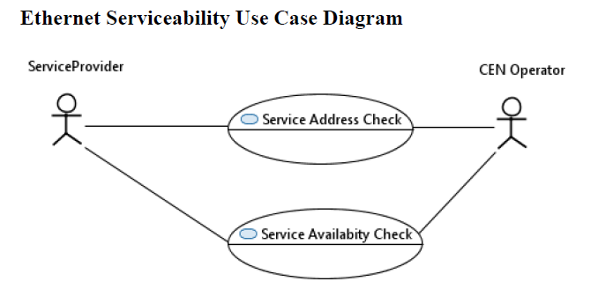
Step 1+2 :Address Validation Serviceability Check
.

Slide 10
Step 1+2 :Address Validation Serviceability Check
the process of handle serviceability requests between a Partner/Access Provider (Seller) and Service Provider (Buyer) is twofold:
1) Validate an address for a specific site associated with the service delivery location. (Address Validation)
2) Determine if service can be delivered to a specific customer site within a Partner’s domain. As shown in the following high level flow: ( next slide)
We used for this step the TMF APIs(Address Management API and Service Qualification API) message format.

Slide 11
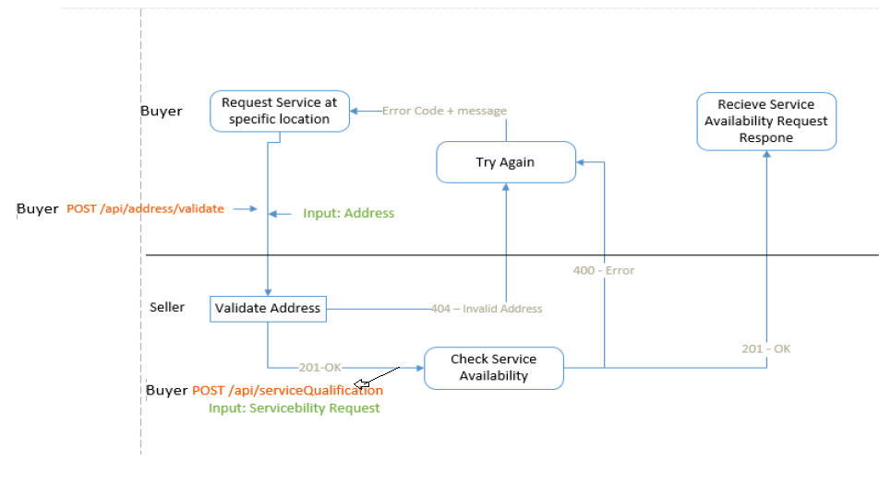
Step 1+2 :Address Validation Serviceability Check

Slide 12
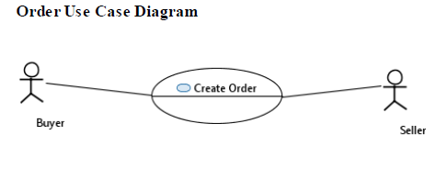
Step 3: Create a new Order

Slide 13
Step 3: Create a new Order (1)
Create new Order: A request initiated by the Buyer to order a new service.
Parameters: Servicequalification_responseId,Product(UNI/EVC) + all product characteristics to initate order delivery. Response (to the buyer) : productOrderId + OrderStaus (Acknowledged or Rejected) Pre-Conditions :
1.Buyer may have completed pre-order inquiries/serviceability request.

Slide 14
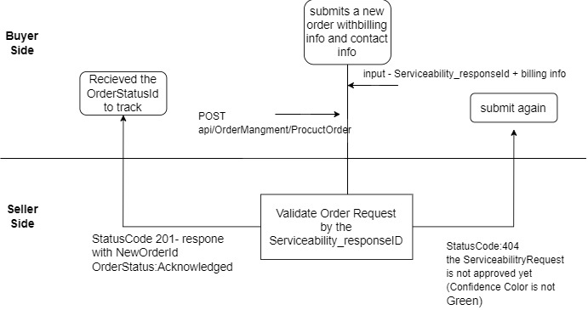
Step 3: Create a new Order (2)

Slide 15
Step 3: Create a new Order (2)
Process Steps: 1.The Buyer initiates and submits a new order with billing info and contact info.
2.The Seller's gateway receives a new order.
3.The Seller validates the new order (ServiceQualification request by the buyer is completed with GREEN confidence color).
4.The Seller accepts the new order and provides a response with an assigned Seller
Post-Conditions: 1.The "Acknowledged" order is ready for processing including additional business rule validation.
2.Seller initiates order processing and notifies the Buyer of commitment to provide the requested product by a specific date.

Slide 16
Our Work Flow
Studying RESTful web services and HTTP protocol
Fully understanding the system workflow (TMF)
Writing the code in JAVA
Creating & Preforming use case example

Slide 17
DEMO TIME

Slide 18
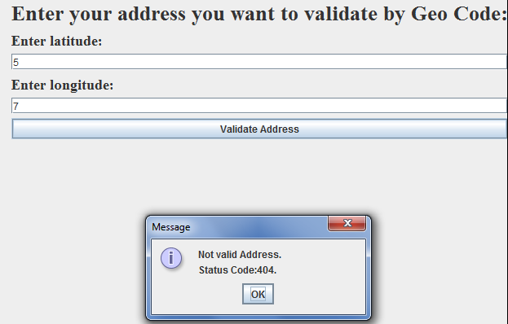
USE CASE SIMULATION (1)
Address Validation :
Wrong address – in our terms the seller cannot provide services at this location:

Slide 19
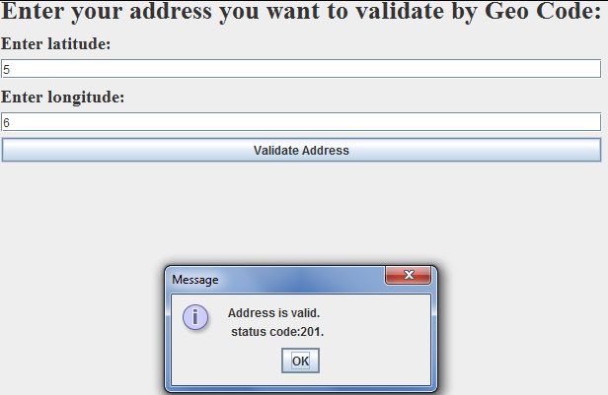
USE CASE SIMULATION (2)
Address Validation :
Valid address– in our terms the seller can provide services at this location:

Slide 20
USE CASE SIMULATION (3)
Serviceability Request :
Serviceability Request failed– in our terms the seller cannot provide the specific service due to invalid parameter ( in this case the maxport speed):

Slide 21
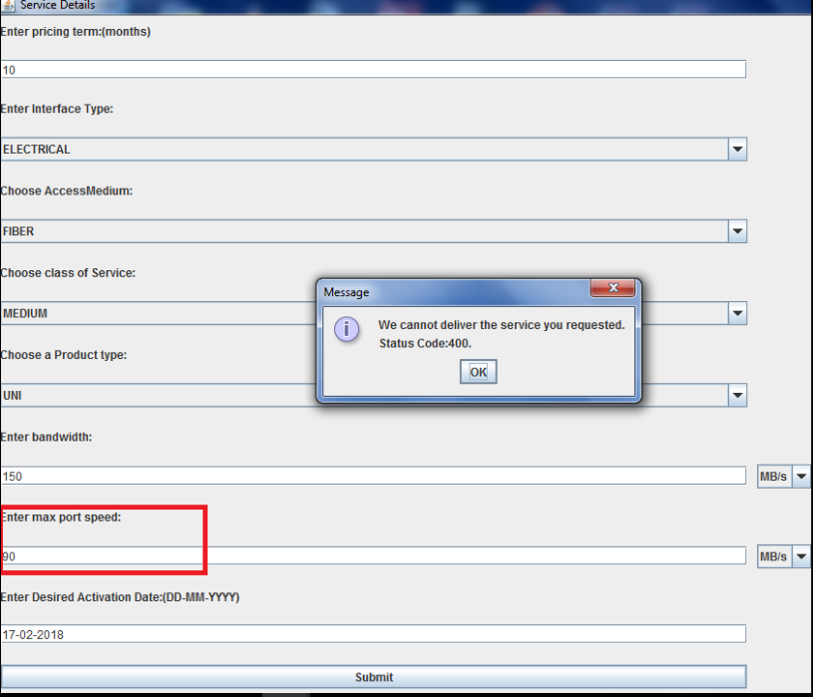

Slide 22
USE CASE SIMULATION (4)
Serviceability Request :
Serviceability Request approved– in our terms the seller can provide the specific service with the attributes the buyer submitted.

Slide 23
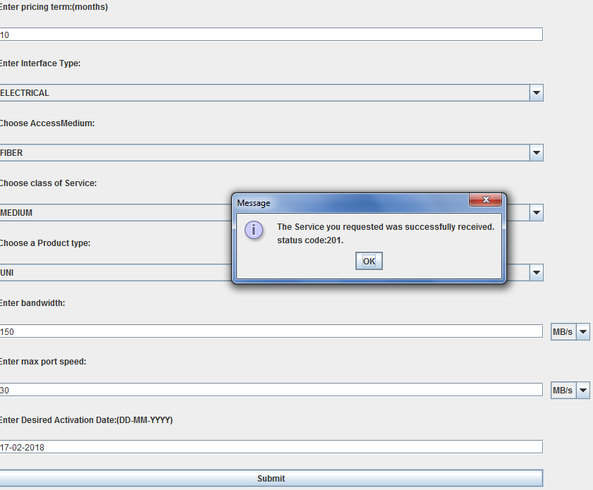

Slide 24
USE CASE SIMULATION (4)
Create a new Order :
After the Serviceability request approved: We send to the buyer the price of the service.

Slide 25
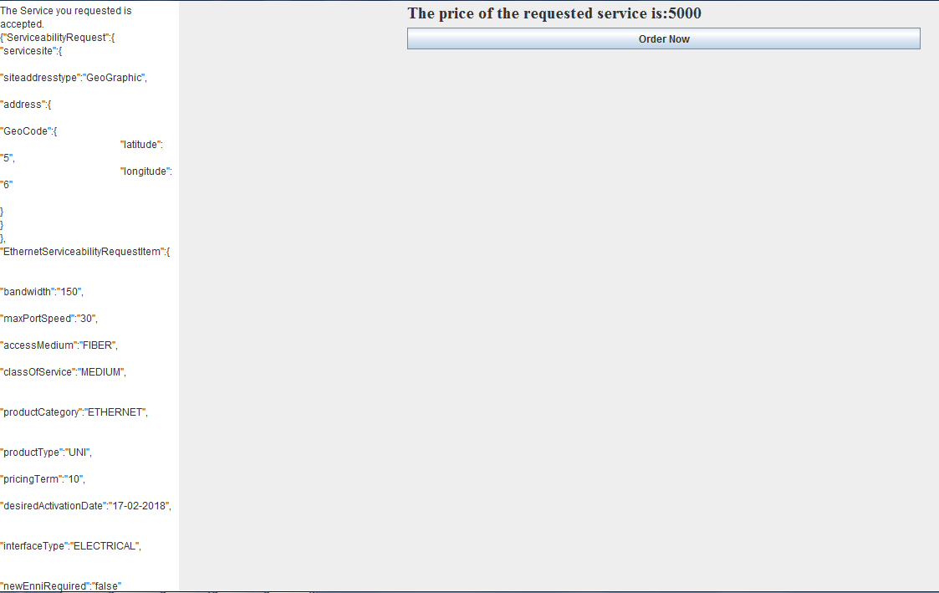

Slide 26
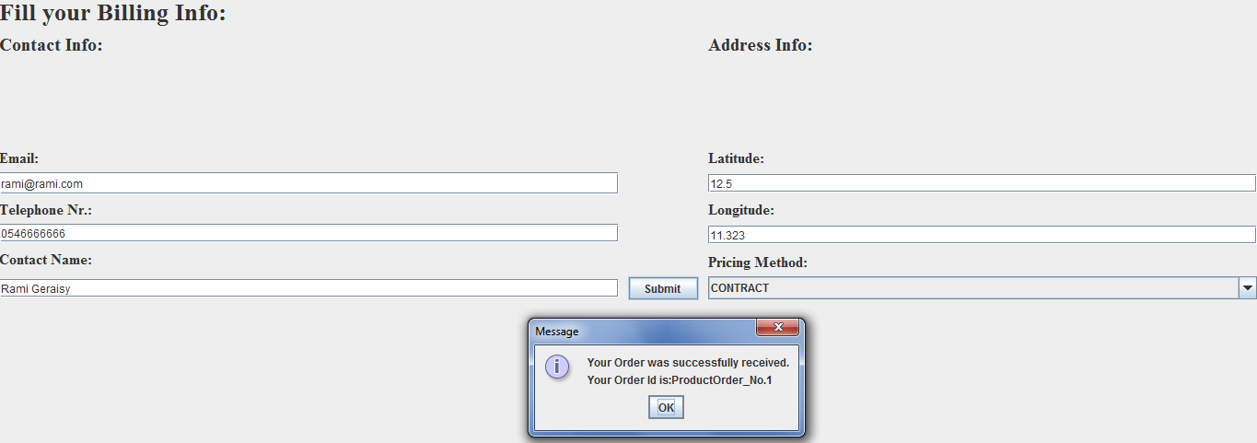

Slide 27
The things we’ve learned
REST
HTTP REQUESTS/RESPONSES
BUILD SERVER side and CLIENT side
MAVEN
Work with OpenSource code
Languages and Technologies:
git
Use and deploy APACHE tomcat servers
MySQL

Slide 28
What’s next ?
- Implement All the use cases :
1) Change Order- change to an existing active service or service component(s).
2) Cancel In-Progress/Pending Order - A request initiated by the Buyer or Seller to cancel an in-progress/pending order.
3) Create Disconnect Order - A request initiated by the Buyer to terminate (e.g., disconnect) existing active service(s) or service component(s).
4) Complete Order - A notification initiated by the Seller to the Buyer to close an in-progress/pending order. This use case notifies the Buyer the service is now activated and no further actions are required
- R1 only covers E-ACCESS services, next releases will include another services.

Slide 29

THE END
Thank you!

