Slide 1
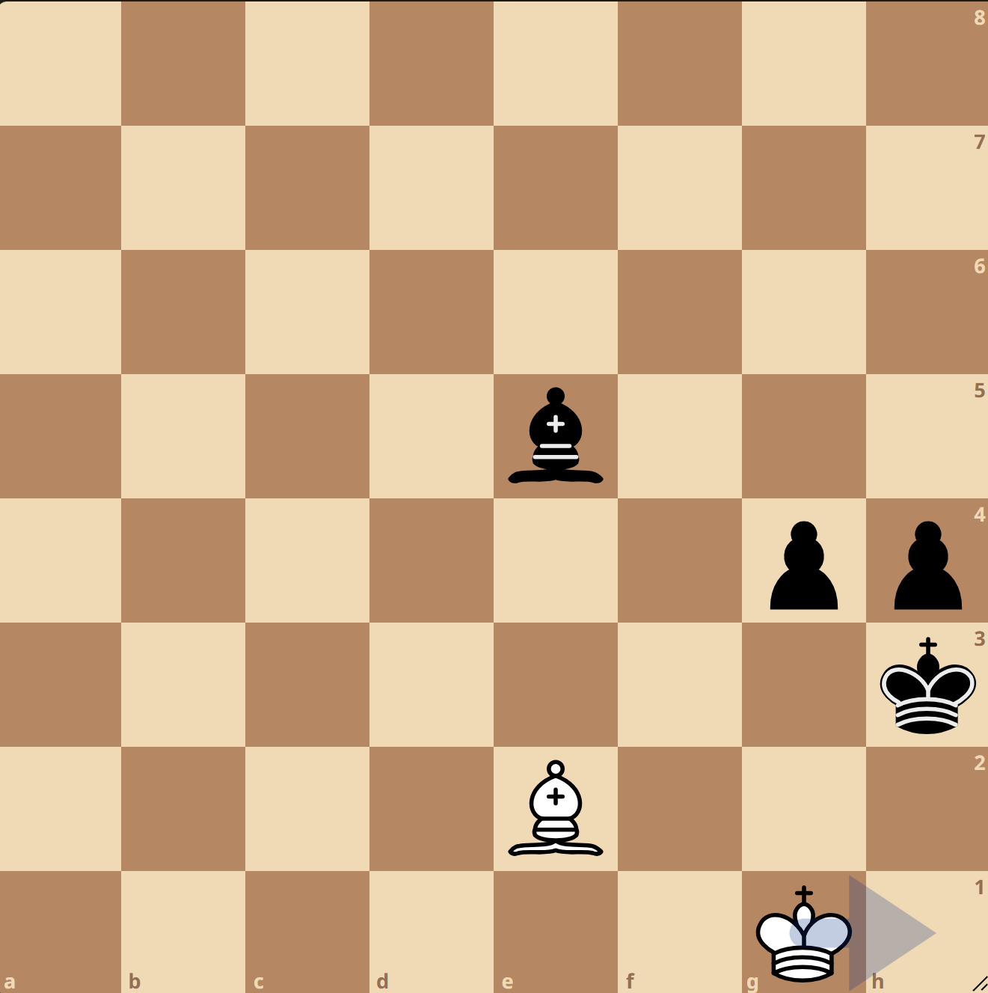
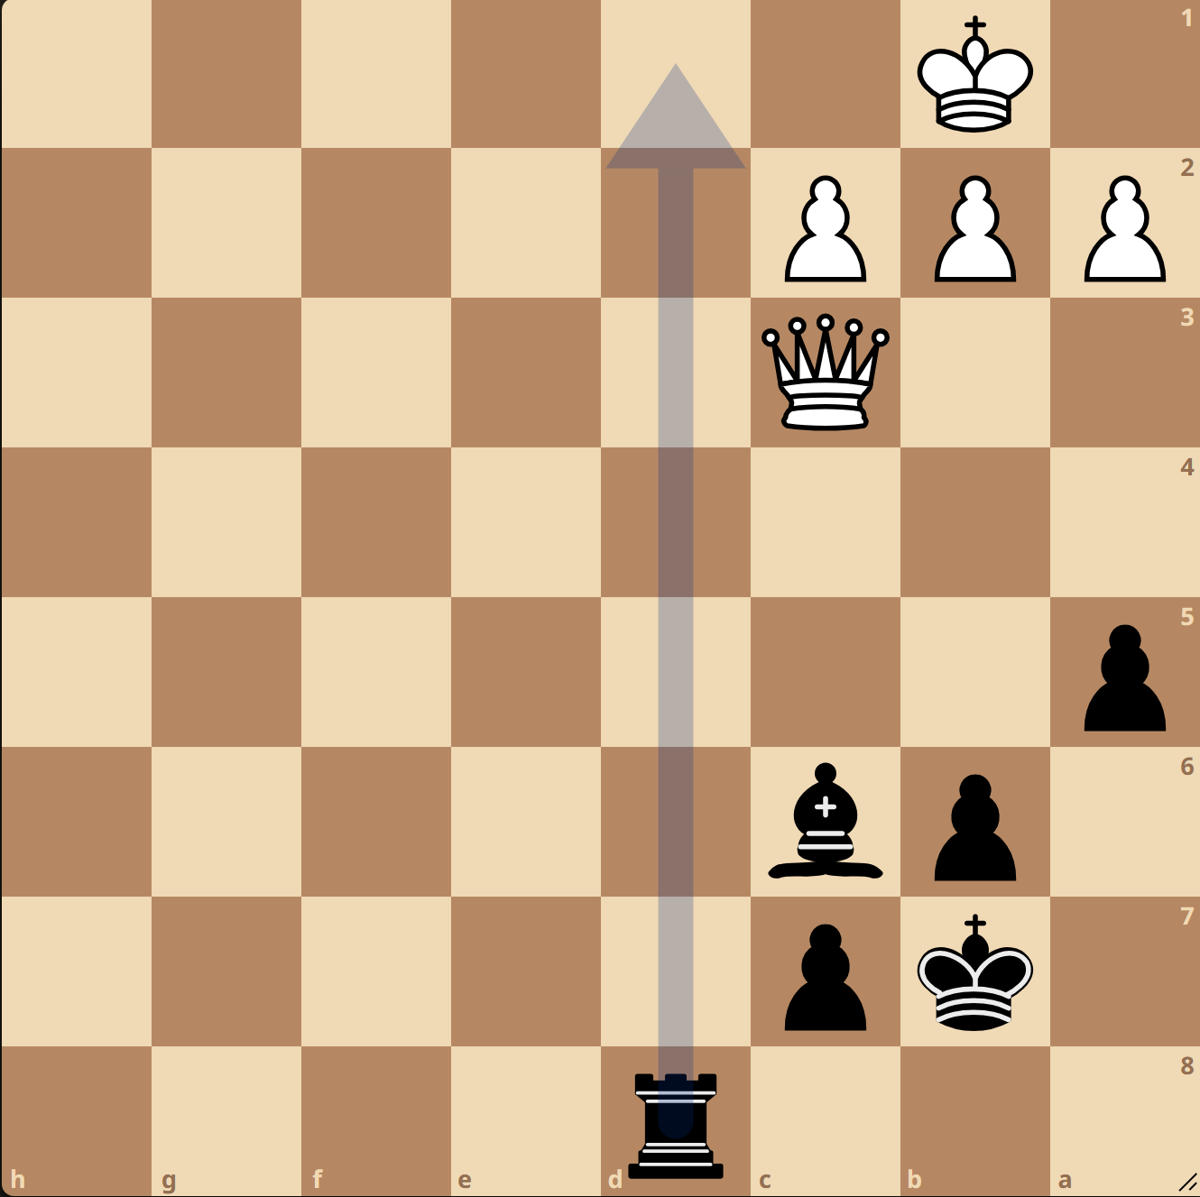
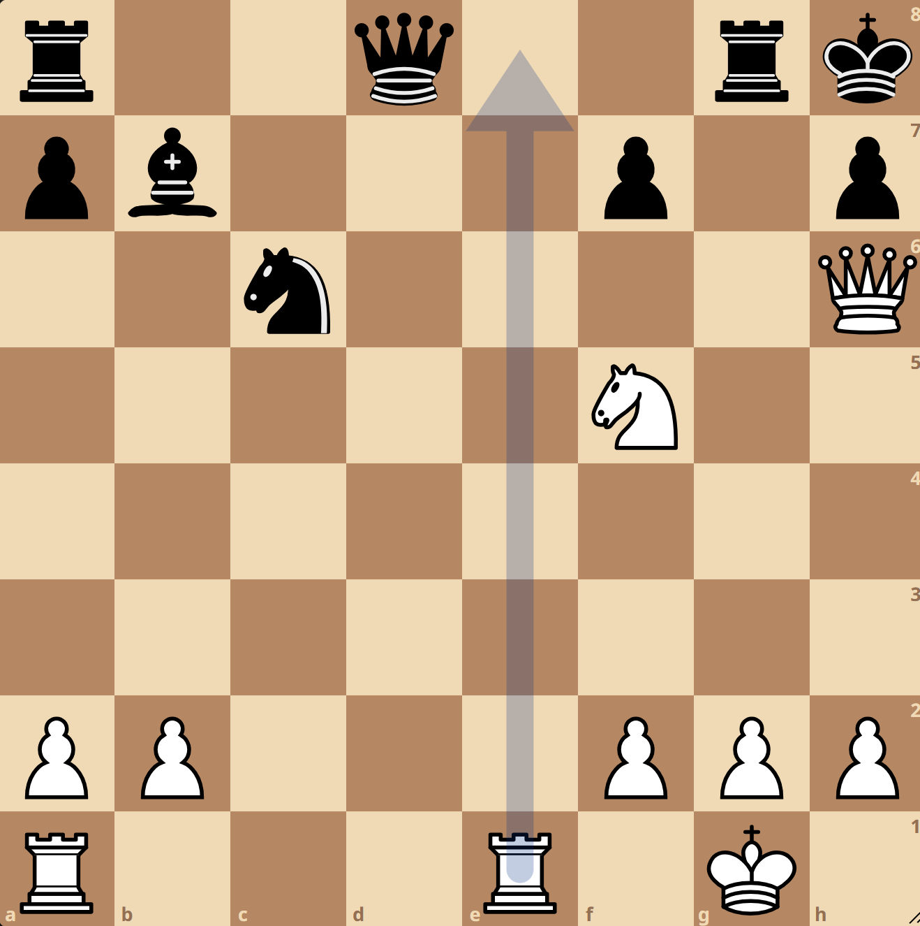
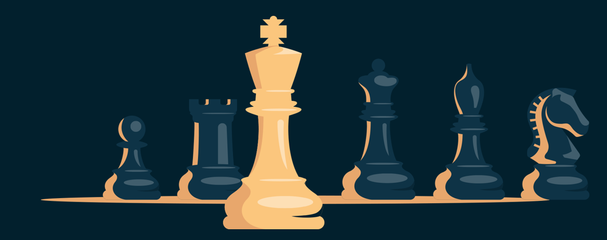
Architectural Inductive Biases
Shape Chess Intelligence:
CNNs Learn Tactics, Transformers Learn Strategy
By Rami Abu Mukh, Omar Garah & Ameer Khalaily
CNN ✓
Transformer X
CNN X
Transformer ✓
CNN 85.3%
Transformer 53.9%

Slide 2


Same Training, Different Intelligence
Same data. Same training. Opposite strengths. How?
The AlphaZero Legacy
AlphaZero (2017) : Superhuman chess using deep CNNs
CNNs became the dominant paradigm for chess engines
AlphaZero authors noted: "CNNs may struggle with long-range dependencies"
CNN ✓
Transformer X
CNN X
Transformer ✓
CNN 85.3%
Transformer 53.9%

Slide 3

No Fair Comparison Exists
The AlphaZero Legacy
CNN ✓
Transformer X
CNN X
Transformer ✓
CNN 85.3%
Transformer 53.9%
AlphaZero (2017) : Superhuman chess using deep CNNs
CNNs became the dominant paradigm for chess engines
AlphaZero authors noted: "CNNs may struggle with long-range dependencies"
Prior CNN vs Transformer studies vary: - Different datasets (size, quality, source) - Different training regimes (epochs, optimizers, learning rates) - Different model scales (10M vs 100M parameters)
Problem: Can't isolate architectural effects
Can Transformers do better?
Our solution: Rigorously controlled comparison

Slide 4
No Fair Comparison Exists
The AlphaZero Legacy
First Controlled Architecture Comparison
Prior CNN vs Transformer studies vary: - Different datasets (size, quality, source) - Different training regimes (epochs, optimizers, learning rates) - Different model scales (10M vs 100M parameters)
Problem: Can't isolate architectural effects
AlphaZero (2017) : Superhuman chess using deep CNNs
CNNs became the dominant paradigm for chess engines
AlphaZero authors noted: "CNNs may struggle with long-range dependencies"
Same dataset
Same capacity
Same training
13.3M positions
~18M parameters each
Identical hyperparameters, optimizer, hardware, random seed
Can Transformers do better?
Our solution: Rigorously controlled comparison

Slide 5
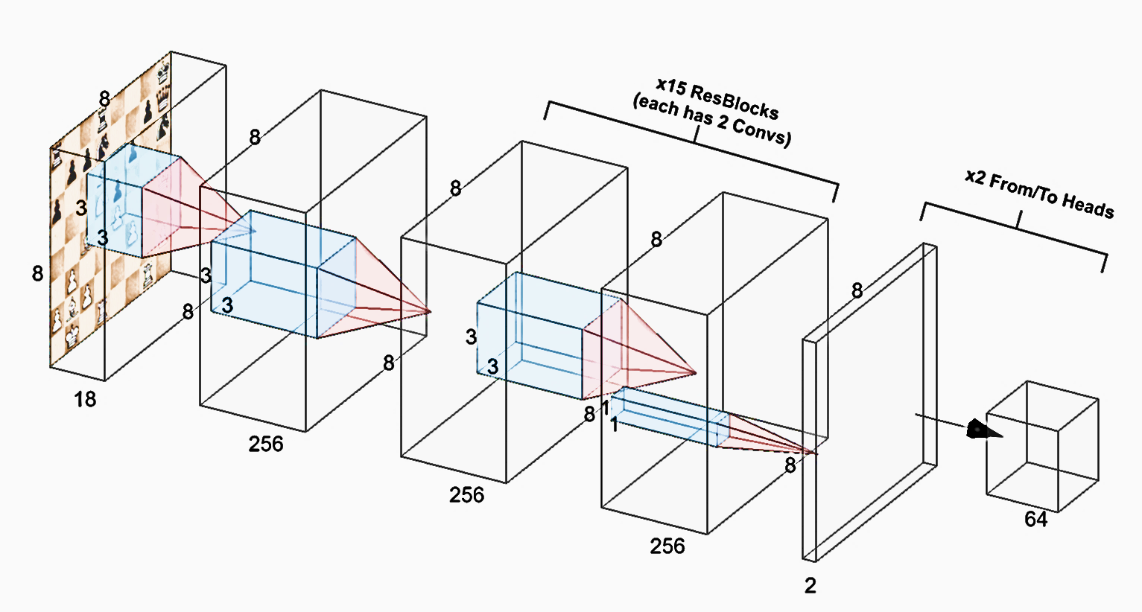


No Fair Comparison Exists
CNNs: Spatial Inductive Bias
First Controlled Architecture Comparison
Input: 18 × 8 × 8 board tensor
15 residual blocks with 3×3 convolutions
Output: Dual heads for from-square/to-square
Advantages:
Detects geometric patterns (forks, pins, mates) anywhere on board
Grows layer-by-layer (local → global)
Prior CNN vs Transformer studies vary: - Different datasets (size, quality, source) - Different training regimes (epochs, optimizers, learning rates) - Different model scales (10M vs 100M parameters)
Problem: Can't isolate architectural effects
Same dataset
Same capacity
Same training
13.3M positions
~18M parameters each
Identical hyperparameters, optimizer, hardware, random seed
Our solution: Rigorously controlled comparison

Slide 6
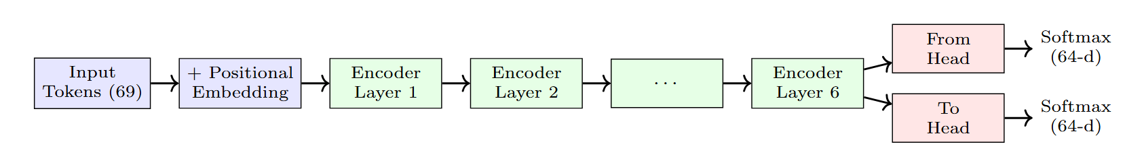
CNNs: Spatial Inductive Bias
First Controlled Architecture Comparison
Transformers: Global Attention
Input: 64 square tokens (8×8 flattened)
8 self-attention layers
Each square attends to all 64 squares from layer 1
Output: Dual heads for from-square/to-square
Advantages:
Models distant piece coordination
Global receptive field
Input: 18 × 8 × 8 board tensor
15 residual blocks with 2x: 3×3 convolutions
Output: Dual heads for from-square/to-square
Advantages:
Detects geometric patterns (forks, pins, mates) anywhere on board
Grows layer-by-layer (local → global)
Same dataset
Same capacity
Same training
13.3M positions
~18M parameters each
Identical hyperparameters, optimizer, hardware, random seed

Slide 7
Transformers: Global Attention
Input: 64 square (8×8 flattened) -> 69 tokens
8 self-attention heads
Each square attends to all 64 squares from layer 1
Output: Dual heads for from-square/to-square
Advantages:
Models distant piece coordination
Global receptive field
Controlled Comparison Design
Supervised move prediction
Factorized: from-square (64 classes) + to-square (64 classes)
- Correct only if both match ground truth
- 90/10 train/validation split
- Training: Cross-entropy loss, label smoothing (ε=0.1)
- Hardware: Identical GPUs, batch sizes, learning rates

Slide 8
Tactical Puzzles (1M puzzles)
Live Gameplay (Lichess.org)
Validation Accuracy
Transformers: Global Attention
Input: 64 square tokens (8×8 flattened)
8 self-attention layers
Each square attends to all 64 squares from layer 1
Output: Dual heads for from-square/to-square
Advantages:
Models distant piece coordination
Global receptive field
Lichess puzzle database
15 tactical themes analyzed
"Can you find the objectively best move?"
Three Complementary Tests
Controlled Comparison Design
128 head-to-head games
Expert Games positions
"Can you predict what strong players do?"
Supervised move prediction
Factorized: from-square (64 classes) + to-square (64 classes)
- Correct only if both match ground truth
- 90/10 train/validation split
- Training: Cross-entropy loss, label smoothing (ε=0.1)
- Hardware: Identical GPUs, batch sizes, learning rates

Slide 9
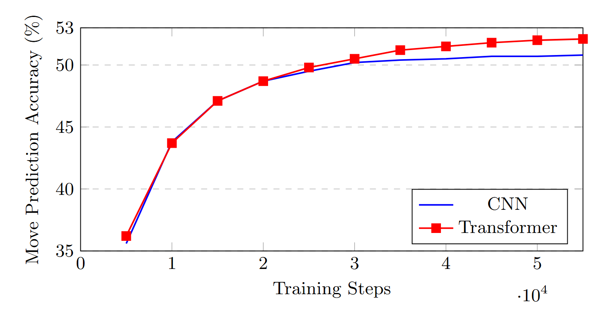
Validation Accuracy
Three Complementary Tests
Controlled Comparison Design
Expert Games positions
"Can you predict what strong players do?"
Transformer Wins
Validation... Barely
Supervised move prediction
Tactical Puzzles (1M puzzles)
Factorized: from-square (64 classes) + to-square (64 classes)
- Correct only if both match ground truth
- 90/10 train/validation split
- Training: Cross-entropy loss, label smoothing (ε=0.1)
- Hardware: Identical GPUs, batch sizes, learning rates
Lichess puzzle database
15 tactical themes analyzed
"Can you find the objectively best move?"
Live Gameplay (Lichess.org)
128 head-to-head games
 | Training Time (h) | Inference Speed (ms/pos)
CNN | 5.3 | 6.2
Transformer | 52 | 11.9

Slide 10
Tactical Puzzles (1M puzzles)
Transformer Slightly Stronger in Games
Live Gameplay (Lichess.org)
Validation Accuracy
Lichess puzzle database
15 tactical themes analyzed
"Can you find the objectively best move?"
Three Complementary Tests
128 head-to-head games
Expert Games positions
"Can you predict what strong players do?"
Transformer Wins
Validation... Barely
Time Control | Bot | Elo | Win% | Draw% | Loss%
Bullet (1+0) | CNN | 1638 | 46.9 | 19.6 | 33.5
 | Transformer | 1649 | 48.2 | 16.8 | 35.0
Blitz (3+0) | CNN | 1516 | 46.0 | 15.8 | 38.2
 | Transformer | 1577 | 48.5 | 18.5 | 33.0
 | Training Time (h) | Inference Speed (ms/pos)
CNN | 5.3 | 6.2
Transformer | 52 | 11.9

Slide 11
Transformer Slightly Stronger in Games
Transformer Wins
Validation... Barely
Time Control | Bot | Elo | Win% | Draw% | Loss%
Bullet (1+0) | CNN | 1638 | 46.9 | 19.6 | 33.5
 | Transformer | 1649 | 48.2 | 16.8 | 35.0
Blitz (3+0) | CNN | 1516 | 46.0 | 15.8 | 38.2
 | Transformer | 1577 | 48.5 | 18.5 | 33.0
 | Training Time (h) | Inference Speed (ms/pos)
CNN | 5.3 | 6.2
Transformer | 52 | 11.9

Slide 12
Transformer Dominates Direct Play
Transformer Slightly Stronger in Games
Time Control | Bot | Elo | Win% | Draw% | Loss%
Bullet (1+0) | CNN | 1638 | 46.9 | 19.6 | 33.5
 | Transformer | 1649 | 48.2 | 16.8 | 35.0
Blitz (3+0) | CNN | 1516 | 46.0 | 15.8 | 38.2
 | Transformer | 1577 | 48.5 | 18.5 | 33.0
128 games, Blitz 3+0 time control
Transformer advantage: **+15.6 percentage points
Average game length: 92.3 moves
Strategic advantages > tactical precision in full games ?

Slide 13
Puzzles Tell a Different Story
Transformer Dominates Direct Play
128 games, Blitz 3+0 time control
Model | Accuracy On 1M Puzzles
CNN | 38.07%
Transformer | 37.91%
Transformer advantage: **+15.6 percentage points
Average game length: 92.3 moves
Strategic advantages > tactical precision in full games ?
Lines cross at ~1500 rating: task complexity determines winner

Slide 14
Puzzles Tell a Different Story
Transformer Dominates Direct Play
Model | Accuracy On 1M Puzzles
CNN | 38.07%
Transformer | 37.91%
128 games, Blitz 3+0 time control
Transformer advantage: **+15.6 percentage points
Average game length: 92.3 moves
Strategic advantages > tactical precision in full games ?
Lines cross at ~1500 rating: task complexity determines winner

Slide 15
Puzzles Tell a Different Story
Model | Accuracy On 1M Puzzles
CNN | 38.07%
Transformer | 37.91%
Lines cross at ~1500 rating: task complexity determines winner

Slide 16
Architecture Determines Intelligence Type
CNN = Tactical Calculator
Spatial inductive bias → geometric pattern recognition
Excels at: local tactics, endgame precision, geometric calculation
Consistent performance across game phases (84-85%)
Transformer = Strategic Thinker
Global attention → non-local coordination
Excels at: opening theory, complex sacrifices, strategic planning
Phase-dependent: strong openings (95.8%), weak endgames (53.9%)

Slide 17
Qualitative Analysis :
Why Transformers Fail at Endgames
Endgames require precise geometric calculation:
King opposition (adjacent squares matter)
Square of the pawn (exact distance calculation)
Triangulation (geometric maneuvering)
Transformer limitation:
Must learn all spatial relationships from data
Learned representations fail to generalize

Slide 18
Conclusion
Same Training, Different Chess Minds
First rigorously controlled CNN vs Transformer comparison for chess
Identical training reveals architectural biases shape learned behaviors
CNNs and Transformers develop complementary chess skills
Key insight: inductive biases determine what types of patterns models learn efficiently
Broader impact: Domain structure should guide architecture selection

Slide 19
Thank You

