Slide 1
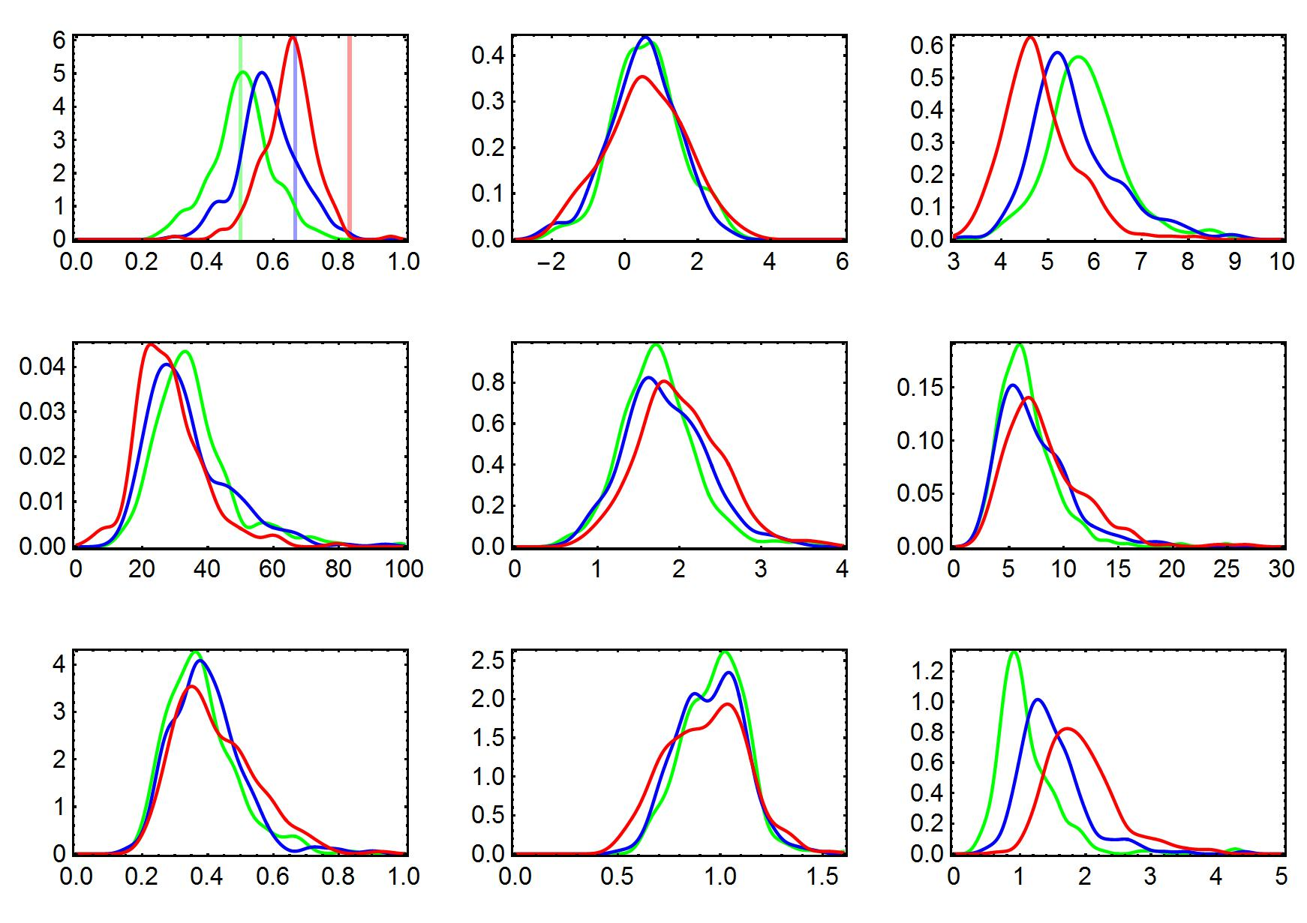
Asymmetric speciation t = 50
frequency of 1
gamma
mean bl
Frequency distribution
variance bl
skewness bl
kurtosis bl
Colless index
Sackin index
relative tip age

Slide 2
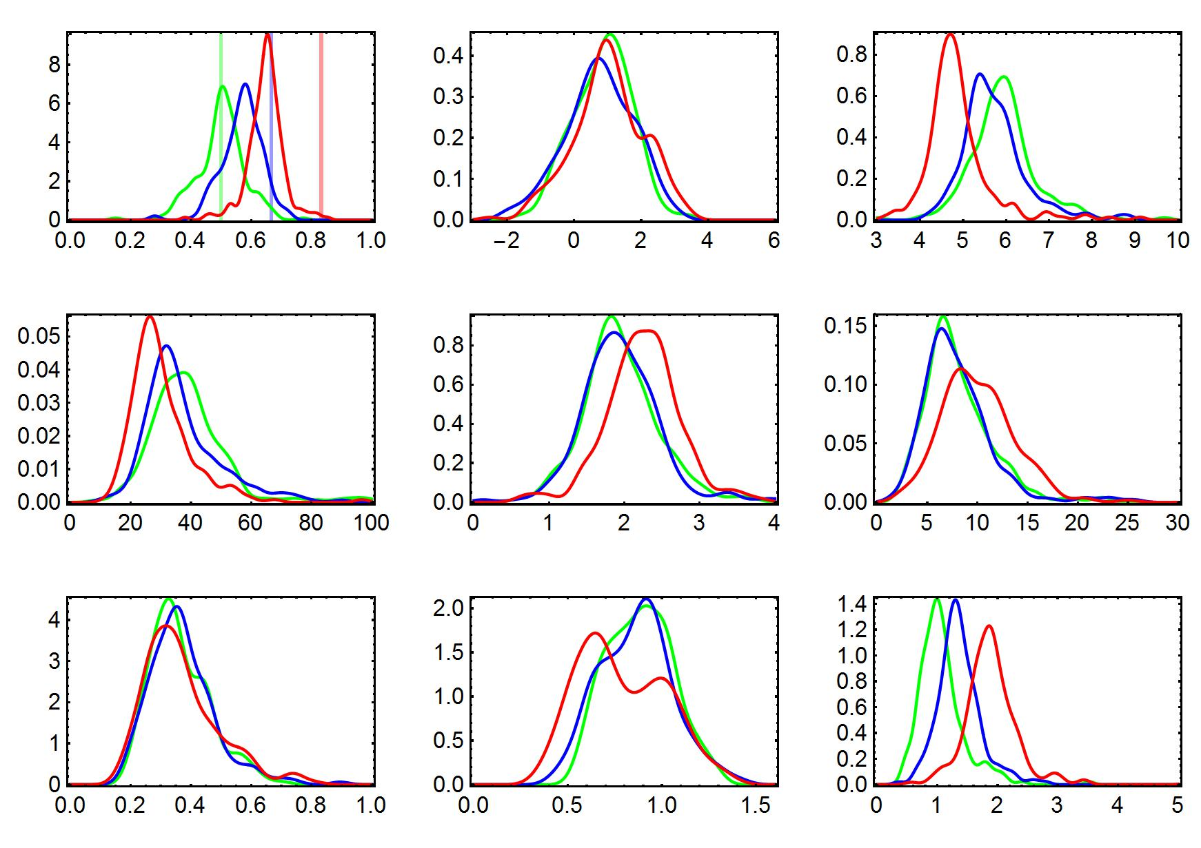
Asymmetric speciation t = 60
frequency of 1
gamma
mean bl
Frequency distribution
variance bl
skewness bl
kurtosis bl
Colless index
Sackin index
relative tip age

Slide 3
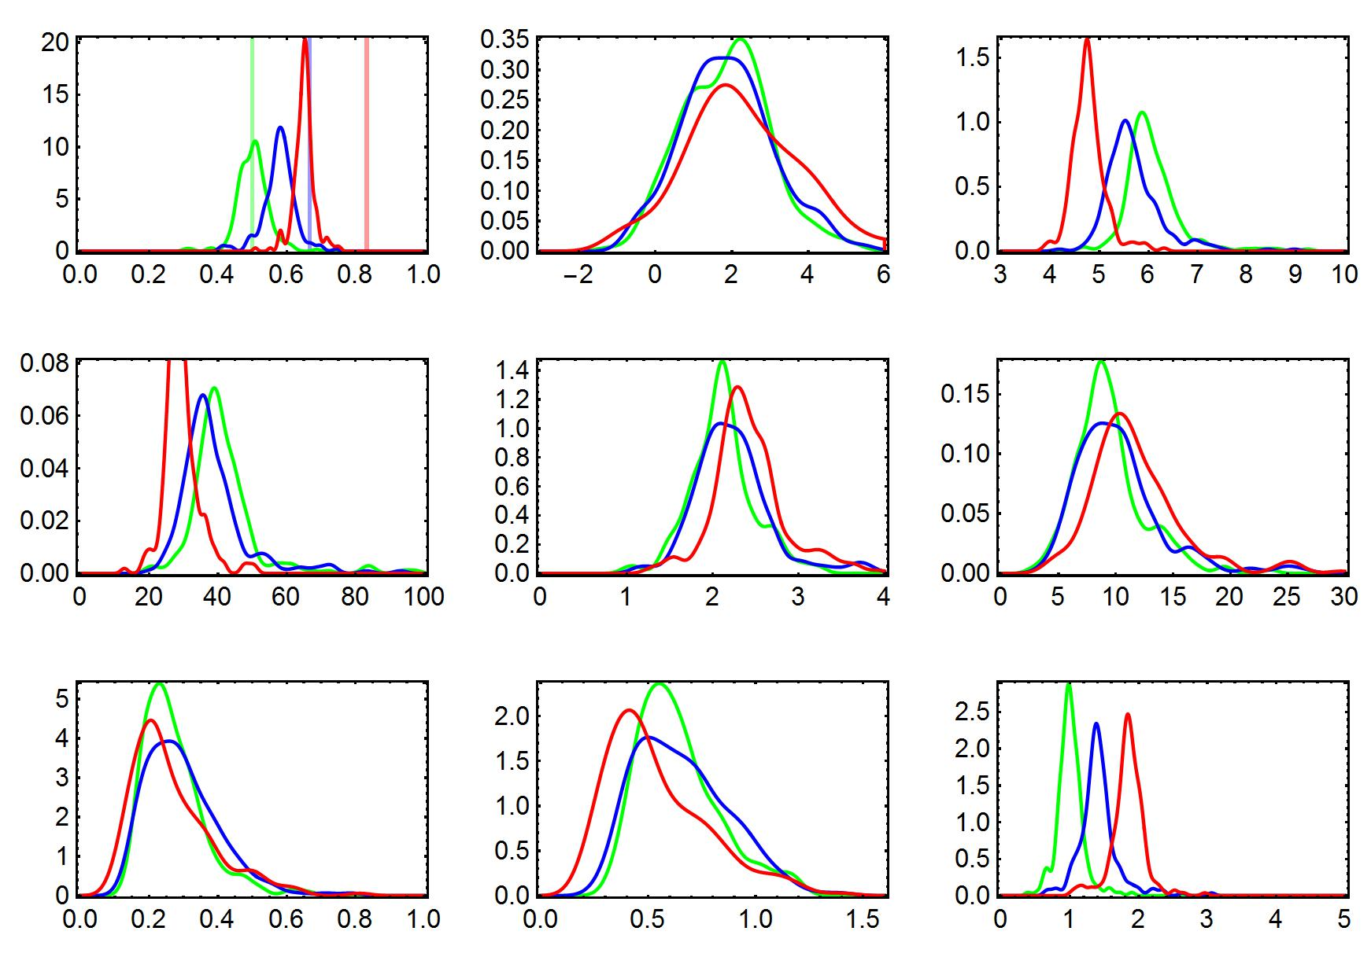
Asymmetric speciation t = 80
frequency of 1
gamma
mean bl
Frequency distribution
variance bl
skewness bl
kurtosis bl
Colless index
Sackin index
relative tip age

Slide 4
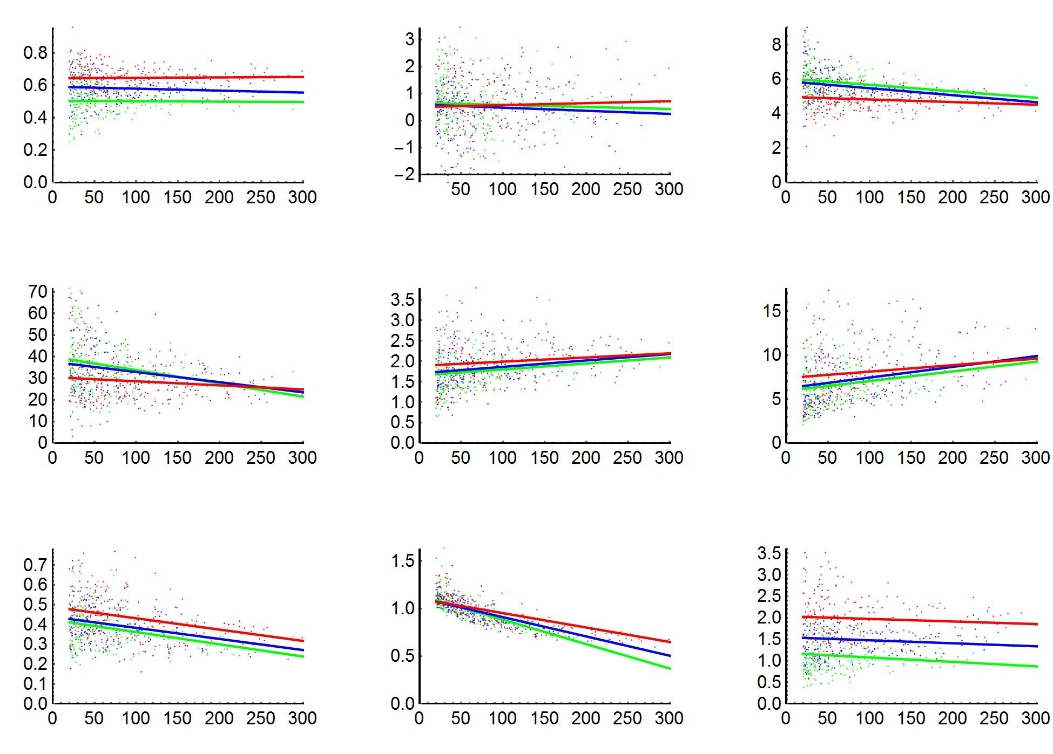
Asymmetric speciation
frequency of 1
gamma
mean bl
Number of tips
variance bl
skewness bl
kurtosis bl
Number of tips
Colless index
Sackin index
relative tip age
Number of tips

Slide 5
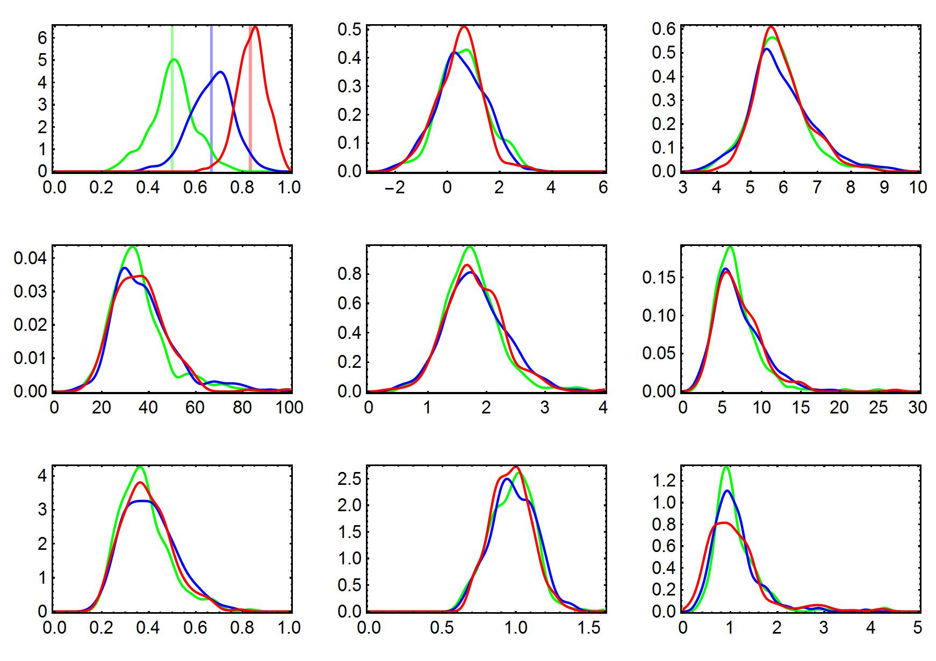
Asymmetric colonization t = 50
frequency of 1
gamma
mean bl
Frequency distribution
variance bl
skewness bl
kurtosis bl
Colless index
Sackin index
relative tip age

Slide 6
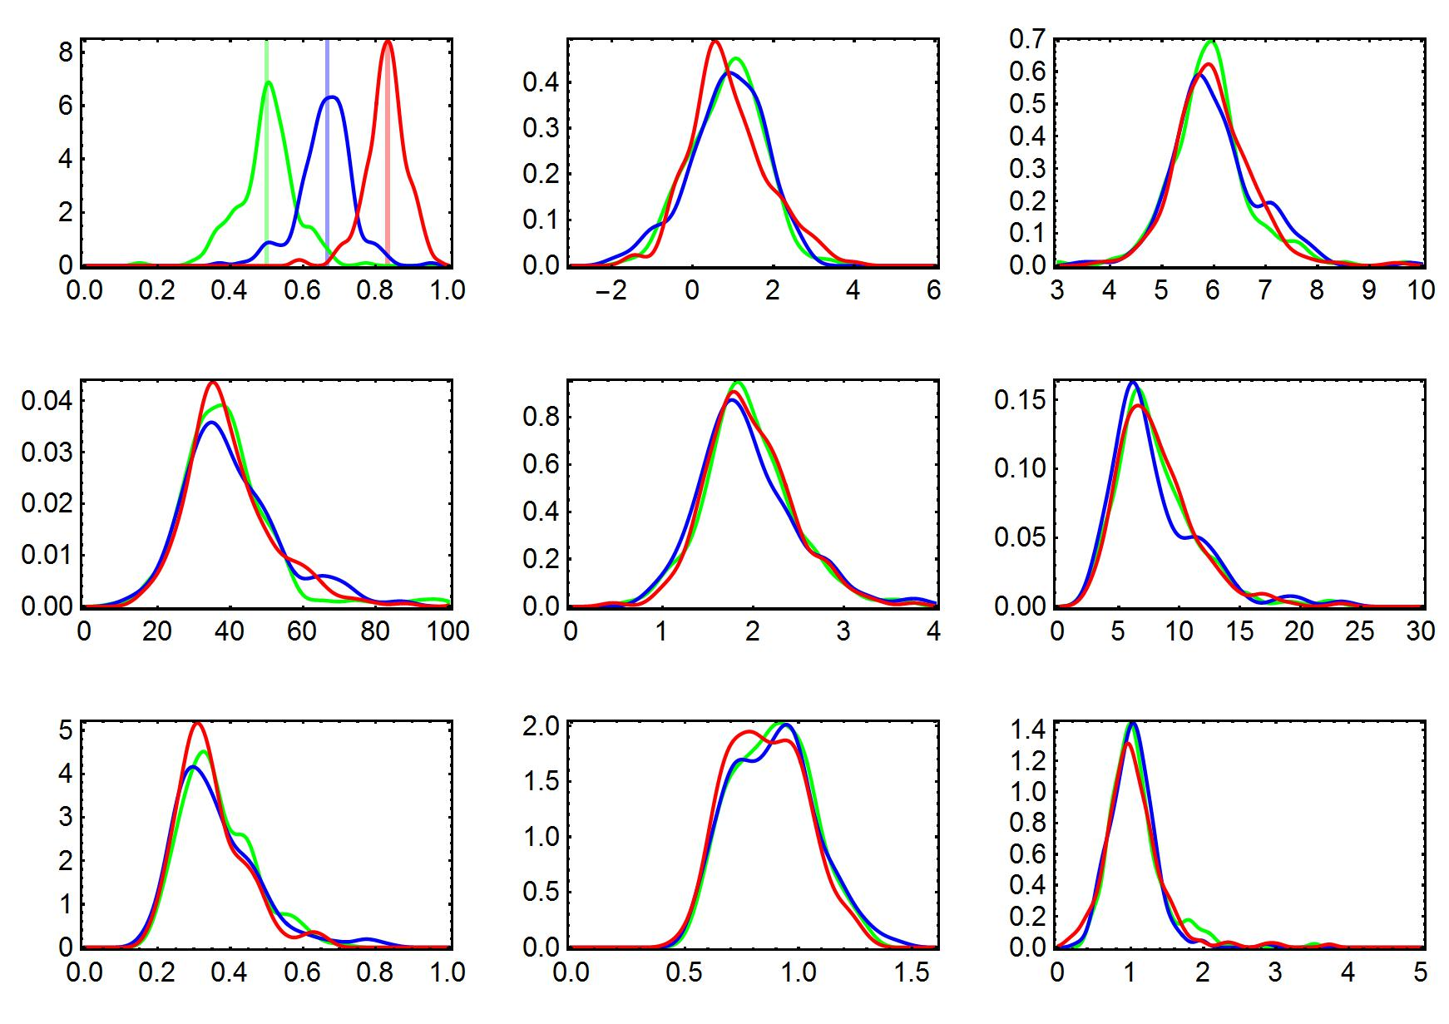
Asymmetric colonization t = 60
frequency of 1
gamma
mean bl
Frequency distribution
variance bl
skewness bl
kurtosis bl
Colless index
Sackin index
relative tip age

Slide 7
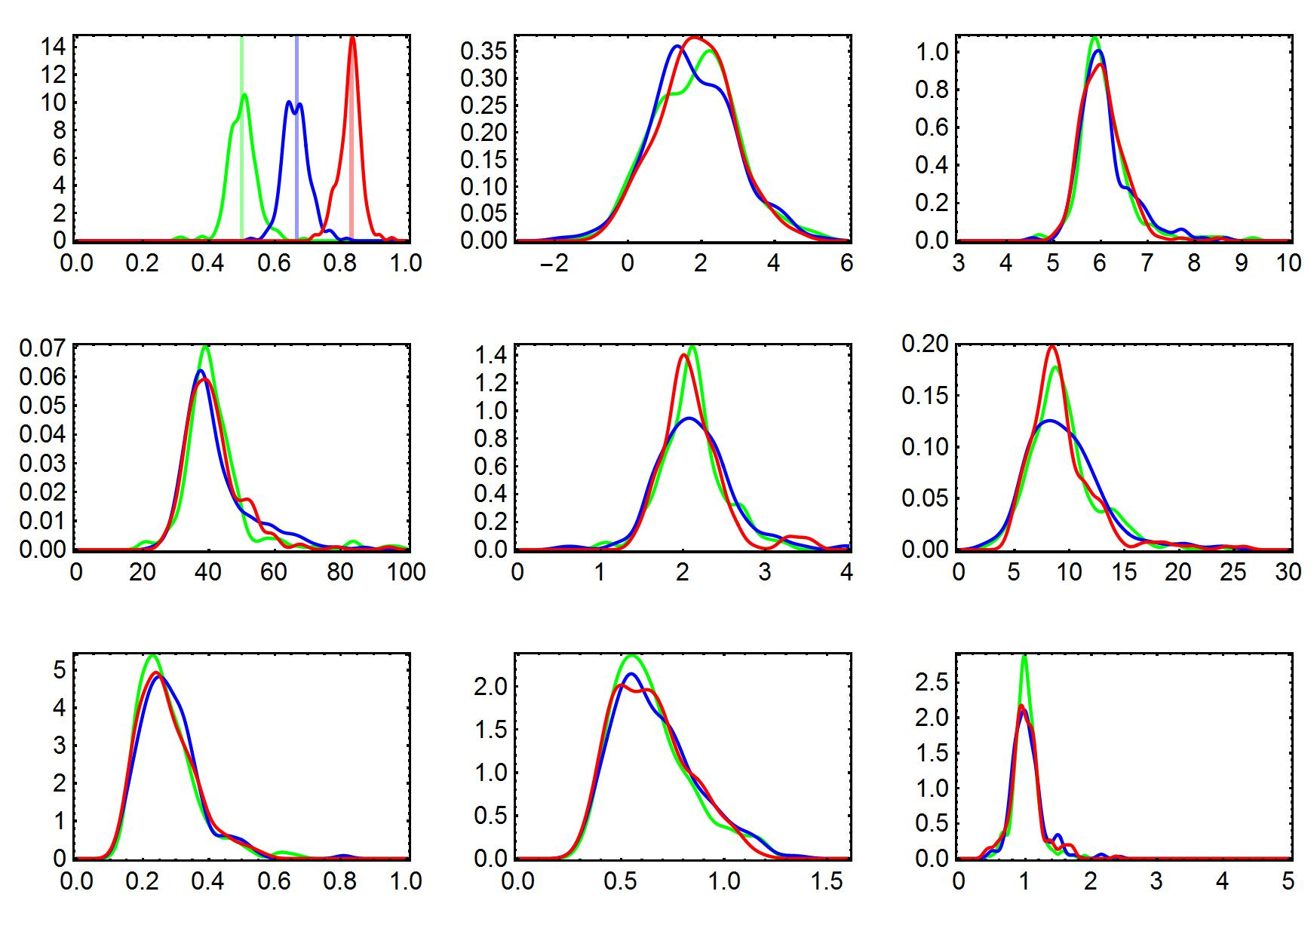
Asymmetric colonization t = 80
frequency of 1
gamma
mean bl
Frequency distribution
variance bl
skewness bl
kurtosis bl
Colless index
Sackin index
relative tip age

Slide 8
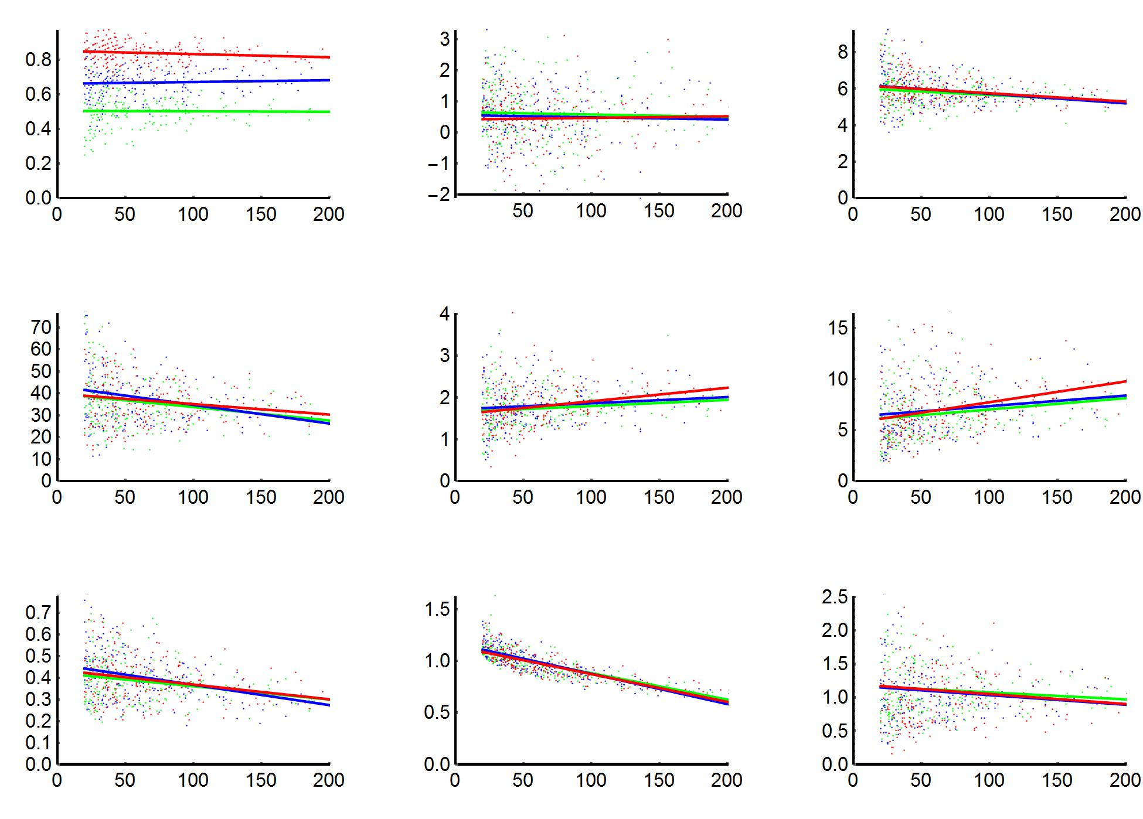
Asymmetric colonization
frequency of 1
gamma
mean bl
Number of tips
variance bl
skewness bl
kurtosis bl
Number of tips
Colless index
Sackin index
relative tip age
Number of tips

Slide 9
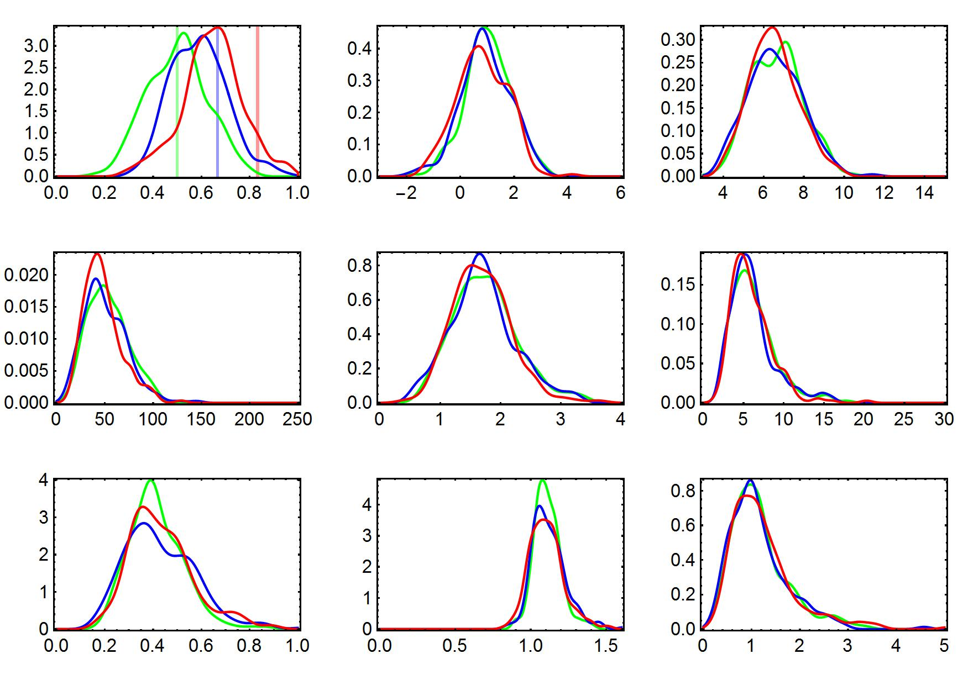
Asymmetric extinction t = 50
frequency of 1
gamma
mean bl
Frequency distribution
variance bl
skewness bl
kurtosis bl
Colless index
Sackin index
relative tip age

Slide 10
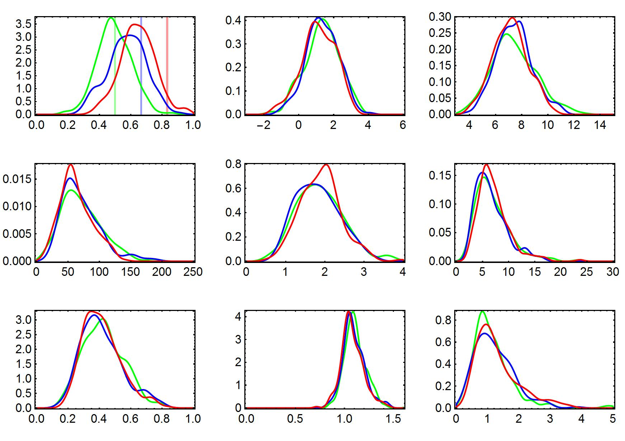
Asymmetric extinction t = 60
frequency of 1
gamma
mean bl
Frequency distribution
variance bl
skewness bl
kurtosis bl
Colless index
Sackin index
relative tip age

Slide 11
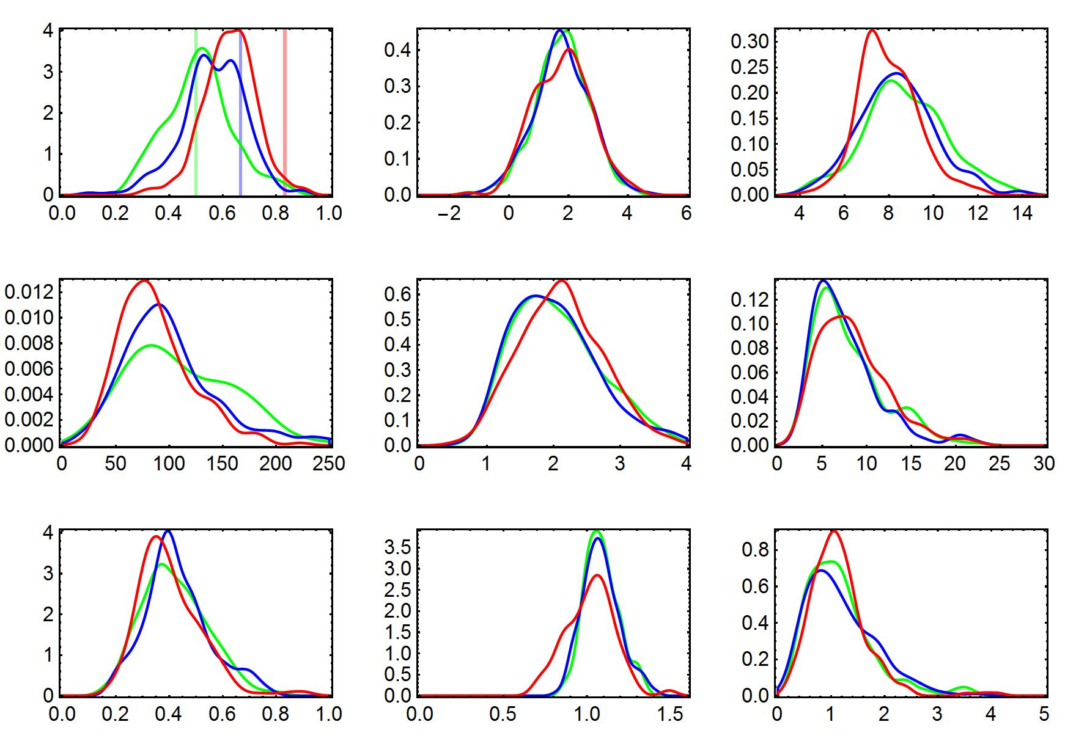
Asymmetric extinction t = 80
frequency of 1
gamma
mean bl
Frequency distribution
variance bl
skewness bl
kurtosis bl
Colless index
Sackin index
relative tip age

Slide 12
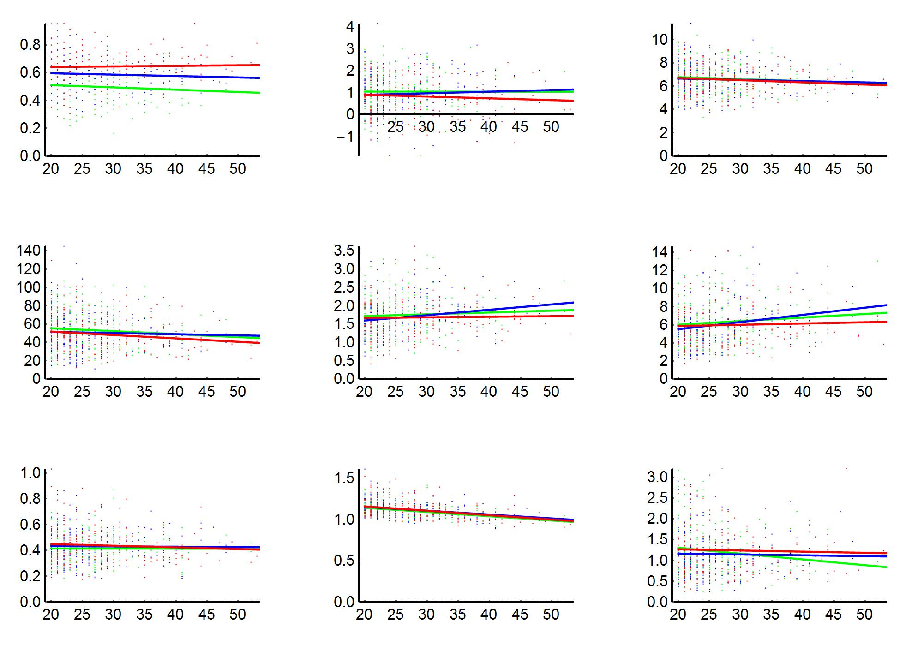
Asymmetric colonization
frequency of 1
gamma
mean bl
Number of tips
variance bl
skewness bl
kurtosis bl
Number of tips
Colless index
Sackin index
relative tip age
Number of tips

