Slide 1
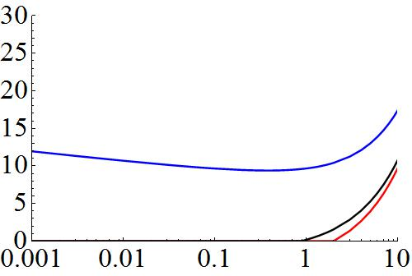
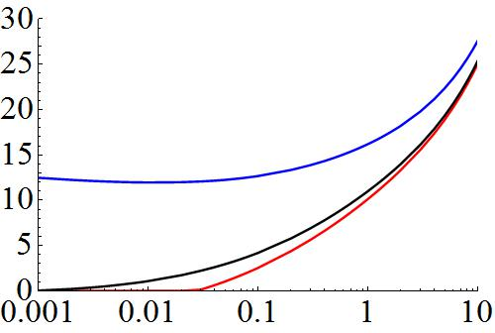
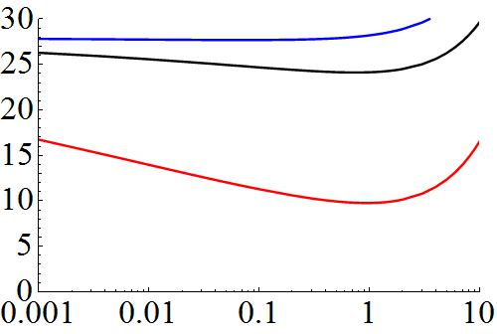
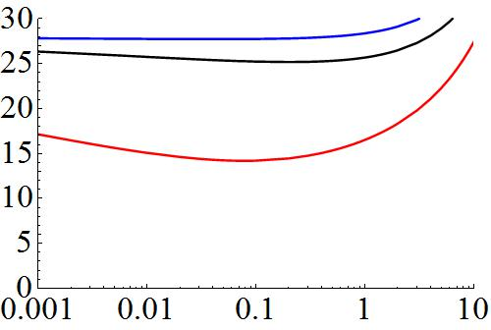
Default K1
K1 = 0.1 x default value
a)
b)
Free convection
Minimum environmental temperature
c)
d)
Laminar convection
Figure 3
Body size in gram
Notes:
Solar radiation was increased from 0 to 0.25 of maximum value during 6 hours. Temperature is fixed. Wind speed 0.5 m/s

Slide 2
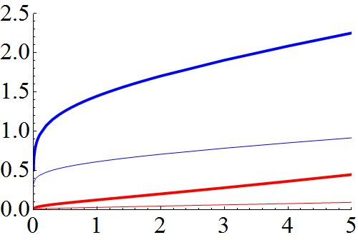
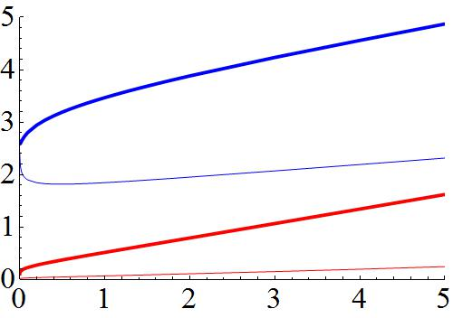
Free convection
Laminar convection
a)
b)
Warm-up time in hour
Body size in gram
Figure 4
Notes:
Solid default, dashed = small conductance between thorax and the rest of the body, temperature fixed at 20 degree C. Blue starts at sunrise, red starts at sunrise plus 3 hours.

Slide 3
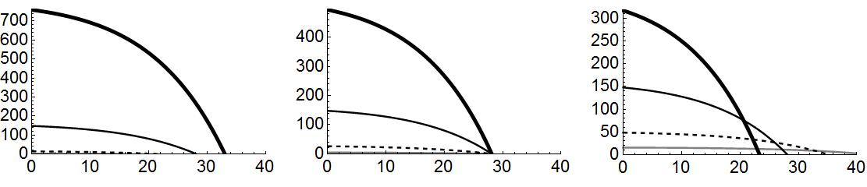
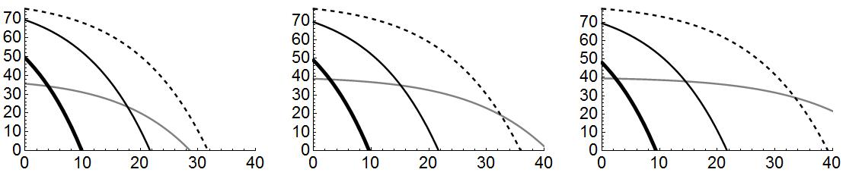
a)
b3 = 1
b)
b3 = 0.75
c)
b3 = 0.5
Fixed time
Net energy gain
b3 = 0.75
b3 = 0.5
d)
b3 = 1
e)
f)
Fixed resource
Environmental temperature
Figure 5

Slide 4
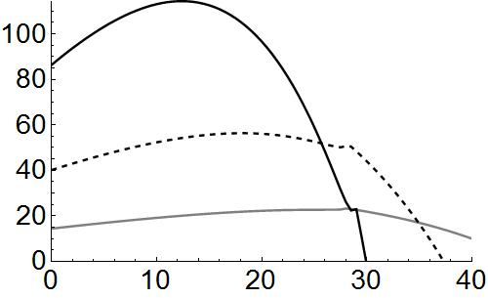
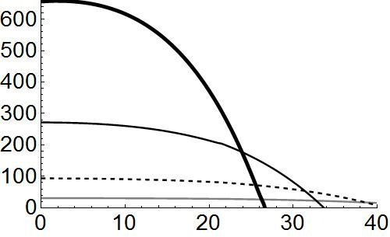
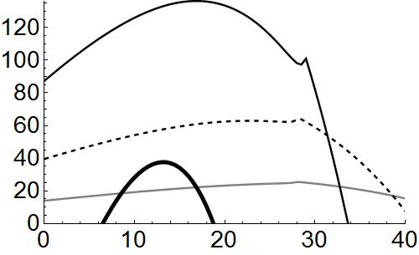
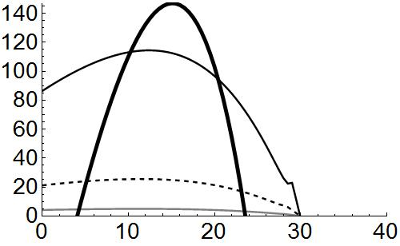
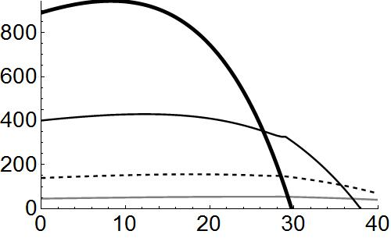
Tmax = T sunrise +10 C
Warm-up 3hrs after sunrise
default
b3 = 0.75
Total foraging = 4hrs
default = start warm-up at sunrise + 2 hours of foraging + b_3 = 0.5 + constant temperature
Figure 6

Slide 5
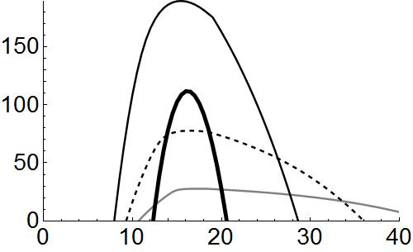
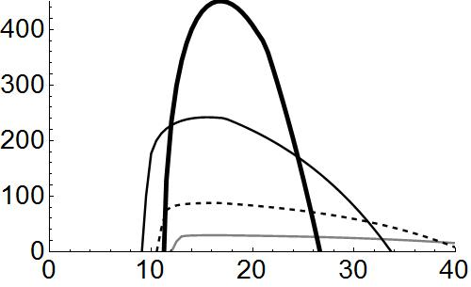
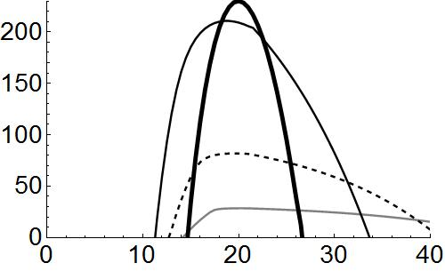
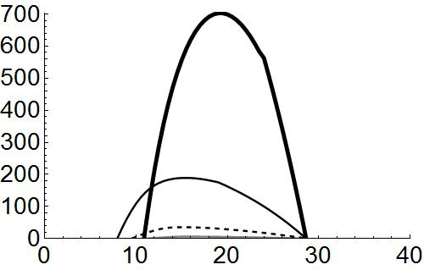
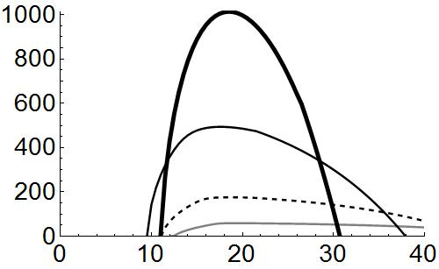
T_max = T_sunrise +10 C
Warm-up 3hrs after sunrise
default
b3 = 0.75
Total foraging = 4hrs
default = start warm-up 3 hours after sunrise + 2 hours of foraging + b_3 = 0.5 + constant temperature
Figure 7

