Slide 1
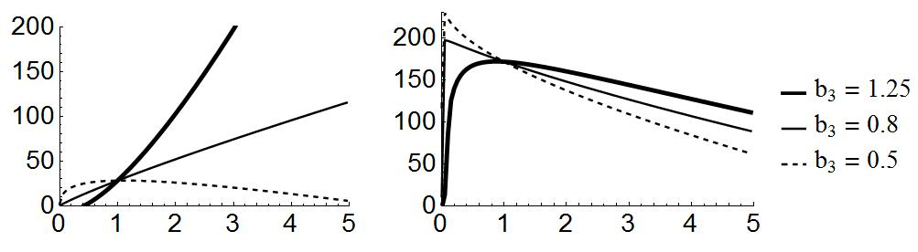
a)
b)
Net gain
Body size in gram
Figure 1
Notes:
Net energy gain for different values of b_3
Time is limiting (0.5 hours)
Resource is limiting (20 gram)

Slide 2
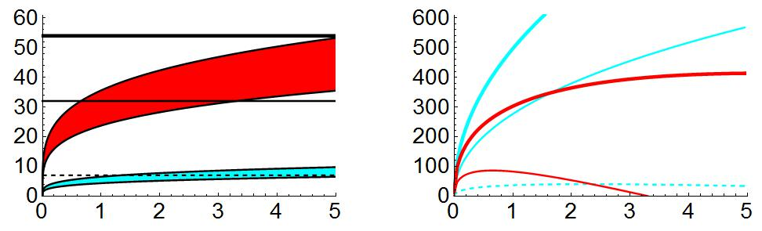

a)
b)
Net gain
$$\tilde{dE_{n}},\tilde{E_{n}}, ε$$
Body size in gram
Body size in gram
Figure 2
Notes:
Net energy gain as a function of body size for different resource quality (epsilon)
Shaded regions show conditions where the net energy gain is maximized for intermediate body size given that resource quality (horizontal line) falls within. (blue = 15 , red = 35).
Example of patterns of energy gain from a)
Other parameters: b3 = 0.5, foraging time = 1hour

Slide 3
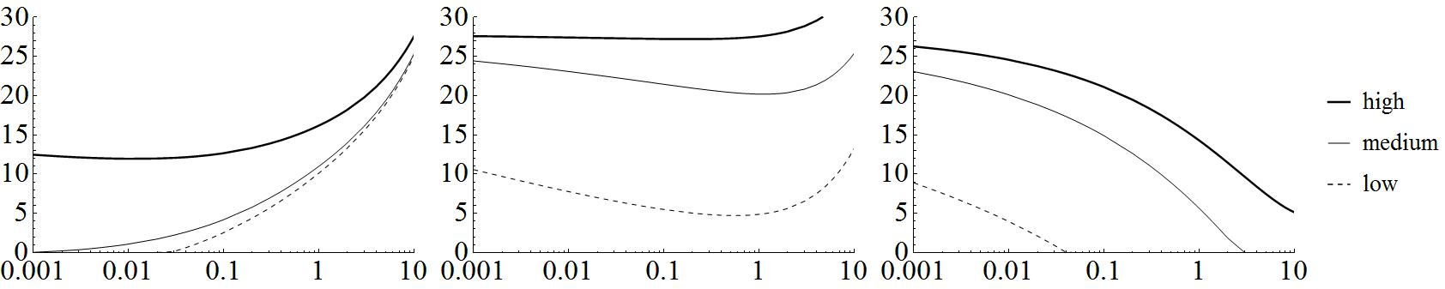
Ectotherm
Ectotherm
Endotherm
Free convection
Laminar convection
Free convection
a)
b)
c)
Convection:
Lowest temperature
Body size in gram
Figure 3
Notes:
Minimum environmental temperature for warm-up to succeed.
Ectotherm: free convection, conductance is low (0.1).
Ectotherm: laminar convection, conductance is default (1)
Endotherm: laminar convection (aw = 1.25)
Solar radiation was increased from 0 to 0.25 of maximum value during 6 hours. Temperature is fixed. Wind speed 0.1 m/s

Slide 4
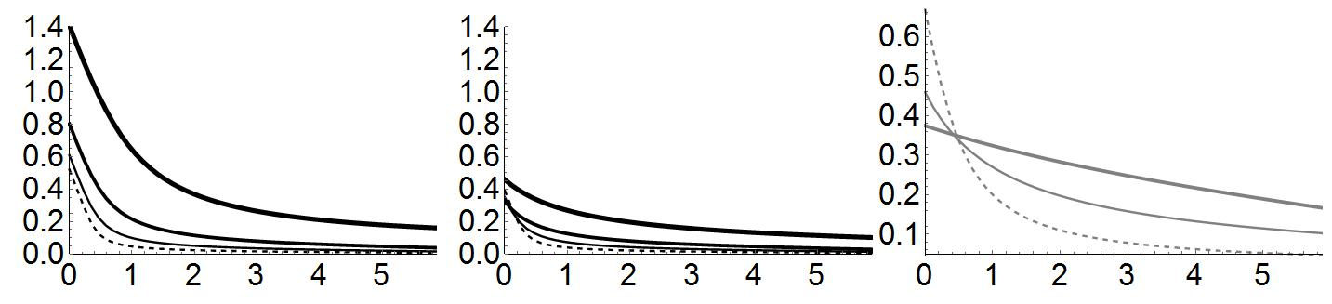
Endotherm
with different
conductance
Ectotherm
Endotherm
a)
b)
c)
Total warm-up time
In hours
Timing of warm-up after sunrise
Figure 4
Notes:
Duration of warm- up time as a function of when warm-up starts.
In a) and b) thickest, thick, thin, and dashed denotes body size z = 10, 1, 0.1, 0.01
In c) Thick, thin, and dashed denote high, medium, and low conductance between the rest-of-the-body and the thorax.
Other parameters: temperature at sunrise = 15 and peaks at 30 at the middle of the afternoon.
aw = 1.25 for the endotherm, rK2 = 0.1 all the time.
Latitude =30, day = 72.

Slide 5
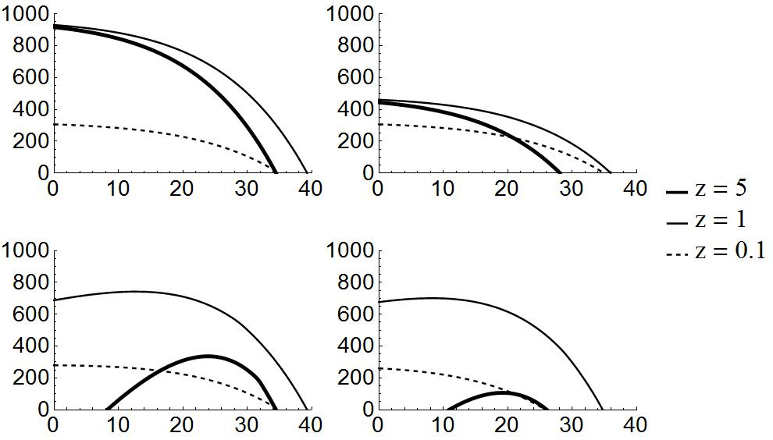
a)
b)
Default
Halving resource availability
Net gain
c)
d)
Adding warm-up
Variable temperature
Environmental temperature
Figure 5
Notes:
Niche shape as a function of temperature during one day.
No warm-up, high resource availability (30 gram), and constant temperature
Resource availability is cut in half, no warm-up and constant temperature
Warm-up is added but resource availability is restored to high
Warm-up is added and temperature increases by 15 during the day which peaks at 30 in mid afternoon.
Other parameters: b3 = 1, b2 = b1 = 0.75, metabolic scope = 20, aw = 1.25.

