Slide 1
Mechatronics System Design
MCE410 Project
Path Clearing Rover
Joe Saroufim
Giovanni Juan
RAMI AKL
Samer hayek
Fall 2021
Presented to:
Dr. Jawad El Khoury

Slide 2
Outline:
Project Description
Electric Circuits
Tasks Achieved
Hardware Overview

Slide 3
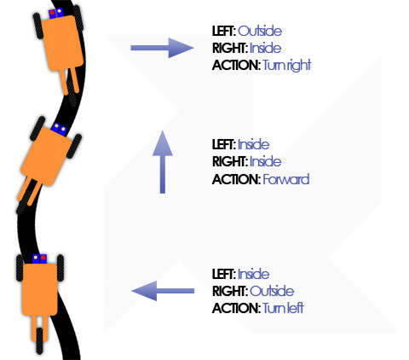
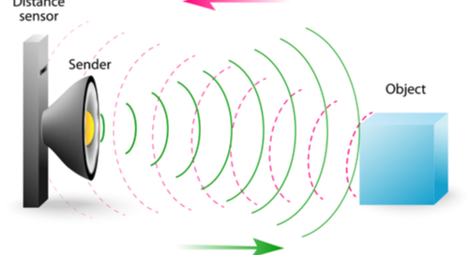

Project Description
Line Tracking
Follows a certain black path
Obstacle detection
Stops at a fixed distance from the obstacle
Smart Reaction
Go left
Go right
Push

Slide 4
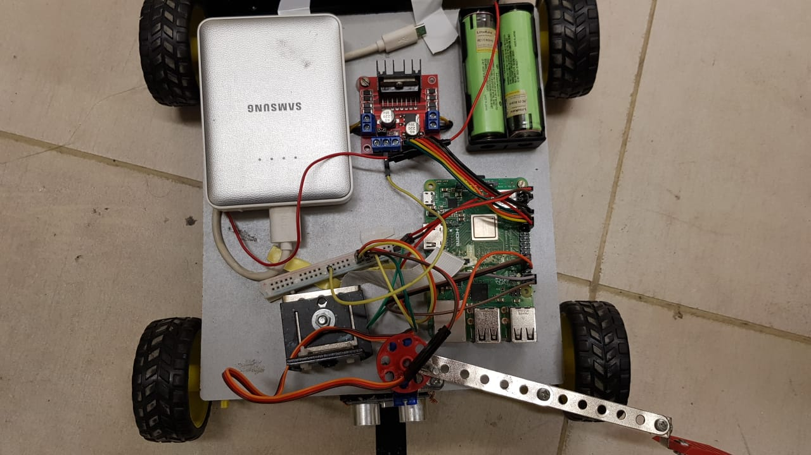
Hardware Overview
Motor Driver
Batteries (3.7V, 3400mAh supply each)
Power Bank
5V , 2A
Raspberry Pi 3 B+
DC Motors (6V)
Servomotor
Camera
Distance Sensor
Two IR Sensors

Slide 5
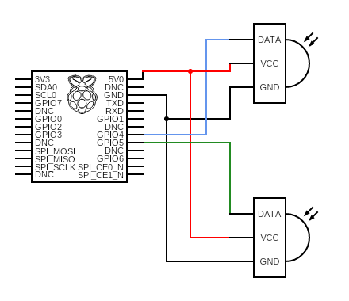
Infrared Line Sensors
White: Output HIGH
Black: Output LOW

Slide 6
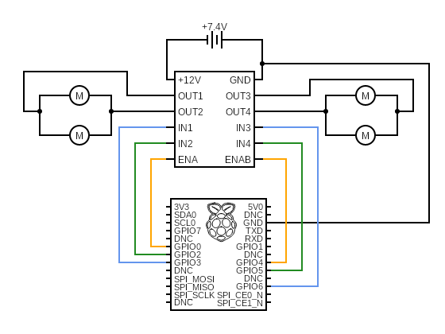
Driving Motors
Motors connected in parallel on each side
Enable pins: PWM signal
IN1, IN2, IN3 and IN4 for switching directions
All control pins on motor driver are connected to GPIO on Raspberry Pi

Slide 7
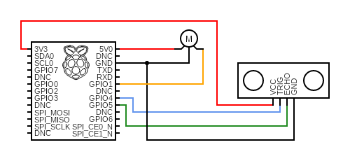
Servo Motor & Distance Sensor
Servo motor:
Servo motor is used for pushing obstacle
Powered by 5V pin on raspberry pi
Ultrasonic:
Ultrasonic sensor reads the distance from the obstacle
VCC pin for powering the ultrasonic sensor
Echo is the receiver pin
Trig is the emitter pin

Slide 8
Following the Line
Stage | Right Sensor | Left Sensor | Motion
1 | 1 | 1 | Forward
2 | 1 | 0 | Right
3 | 0 | 1 | Left
4 | 1 | 1 | Forward
5 | 0 | 0 | Stop
5
4
3
2
IR Sensors
1

Slide 9
Approaching the Object
30 cm
Distance Sensor
13 cm
When the distance sensor reads a distance that is less than 40 cm, the rover stops.
The rover then moves forward gradually until the sensor reads a distance of 13 cm.

Slide 10
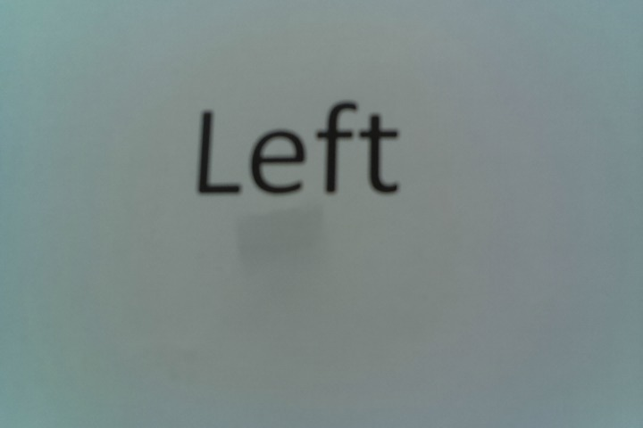
Reading the Sign
Sample image taken by the camera
13 cm
At a distance of 13 cm, the camera can detect text properly
Based on the detected text, the program decides to avoid or push the sign.
Tesseract
Python Library
string
“Right”
“Left”
“Push”

Slide 11
Avoiding the Object
5
4
3
Right IR Sensor
6
7
1
2
The rover stops following the line and executes the sequence below:
Backwards
Right
Forward
Left
Forward
The rover resumes line following when the right sensor detects the line

Slide 12
Pushing the Object
The arm of the servomotor rotates to push the object
The rover then resumes line following

Slide 13
Thank you!

