Slide 1
Compositional Control-Driven Boolean Circuits
Damian Arellanes
Theoretical Computer Science Group

Slide 2
Motivation

Slide 3
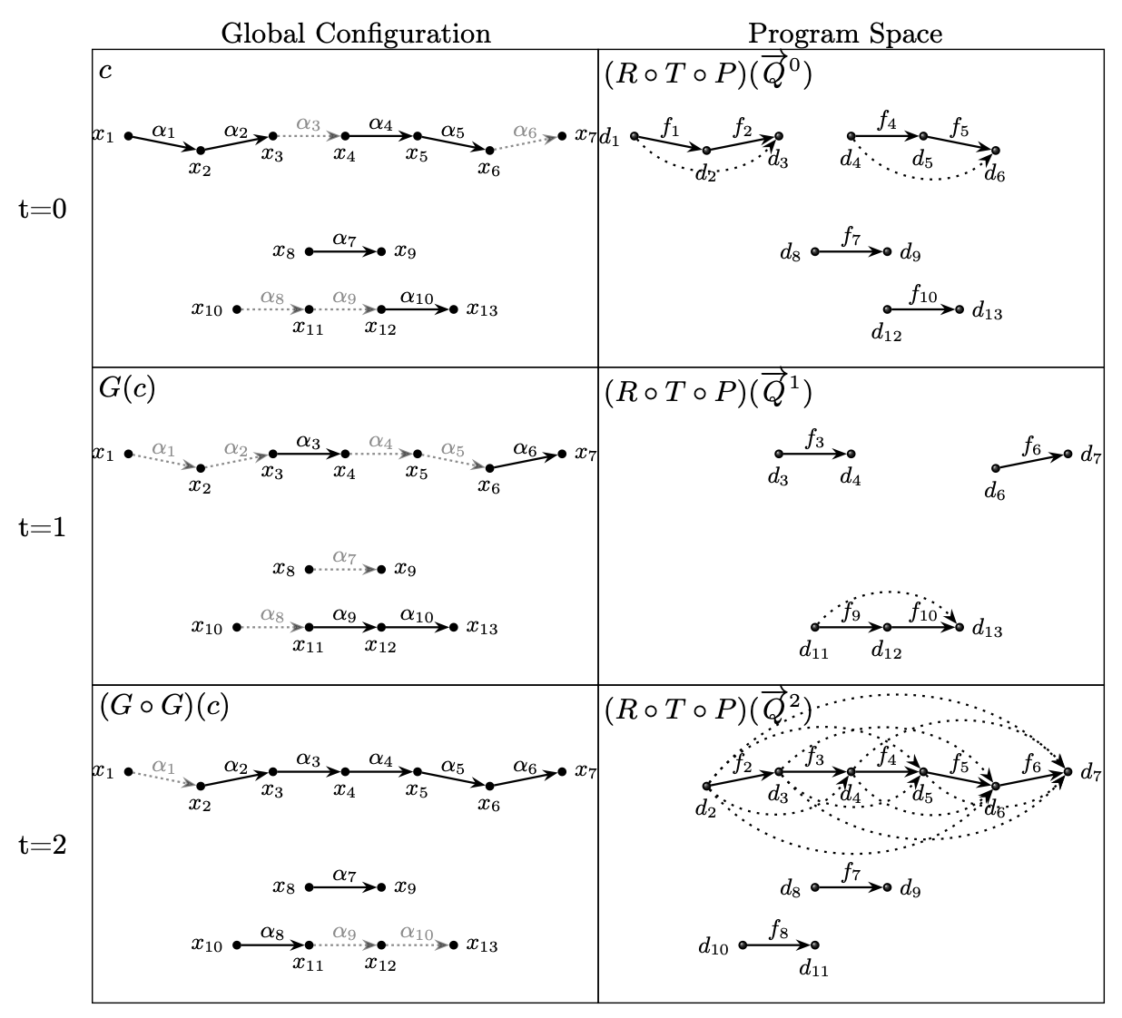
Emergence of Sequential Program Spaces (2021)

Slide 4
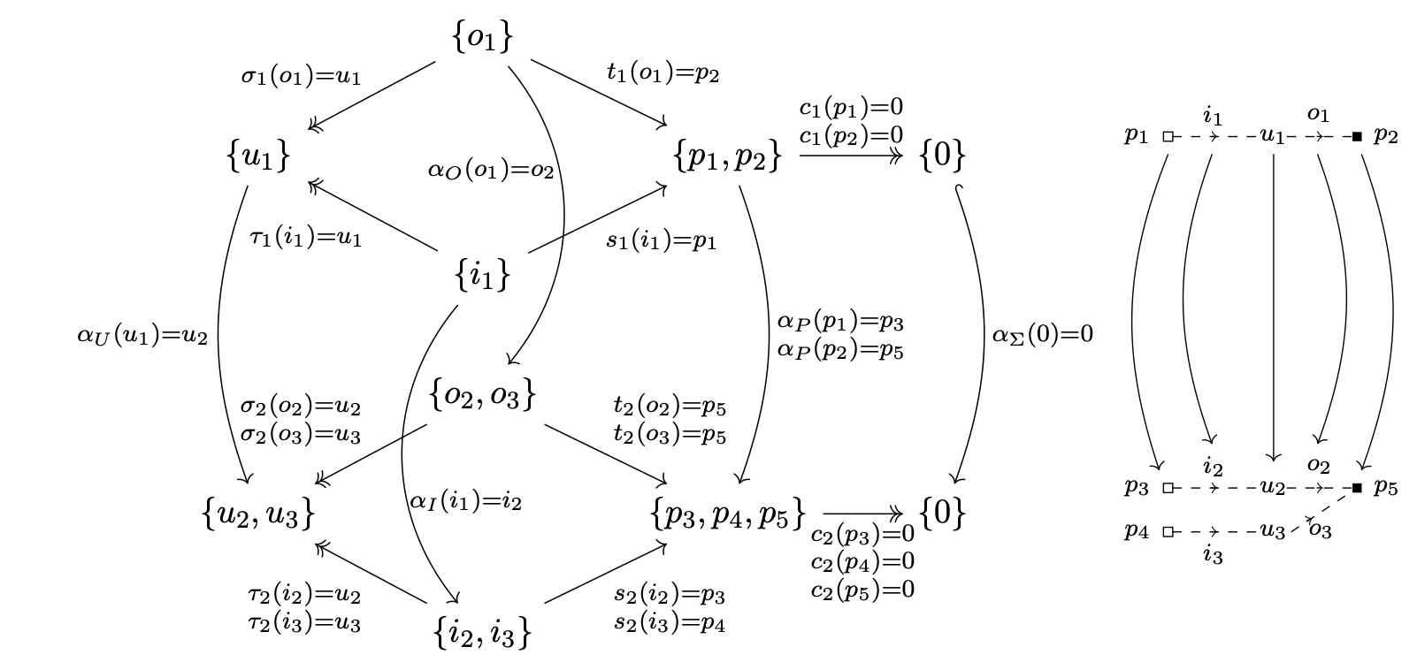
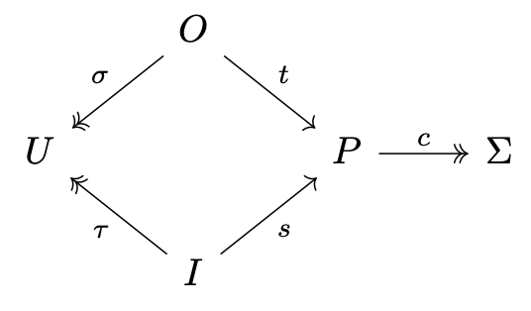
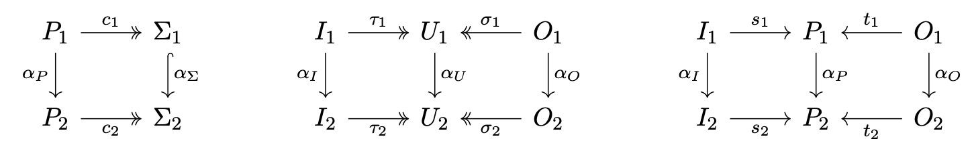
Computons (2023)
D. Arellanes. Compositional Separation of Control Flow and Data Flow.
Journal of Logical and Algebraic Methods in Programming, vol. 150, 2026.
Notes:
Separation of composition from operation
Separation of control flow and data flow

Slide 5
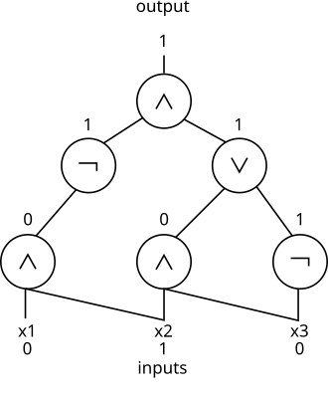
Boolean Circuits
Source: https://en.wikipedia.org/wiki/Boolean_circuit

Slide 6

Functional Completeness
Examples of (minimal) functional complete sets
$\left\{∧,∨,¬\right\}$
$\left\{→,¬\right\}$
$\left\{↑\right\}$
Notes:
Sheffer function when single connective (only NAND and NOR)

Slide 7
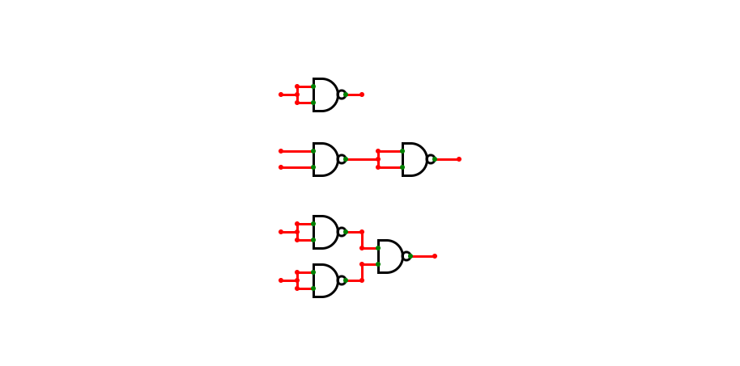



Functional Completeness
We can use NAND gates to construct any possible Boolean circuit
NOT $≡$
AND $≡$
OR $≡$
*Circuits created with CircuitVerse: https://circuitverse.org/

Slide 8
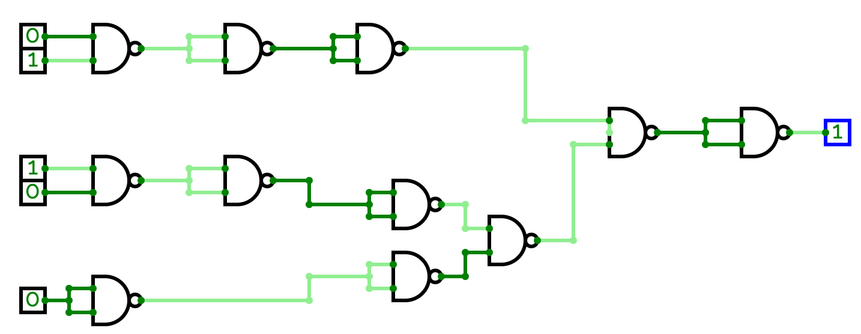

Functional Completeness
We can use NAND gates to construct any possible Boolean circuit
$$≡$$

Slide 9
Functional Completeness
We can use NAND gates to construct any possible Boolean circuit
Insight: There is implicit control flow in every Boolean circuit
Problem: How to make it explicit?

Slide 10
Control-Driven Boolean Circuits

Slide 11
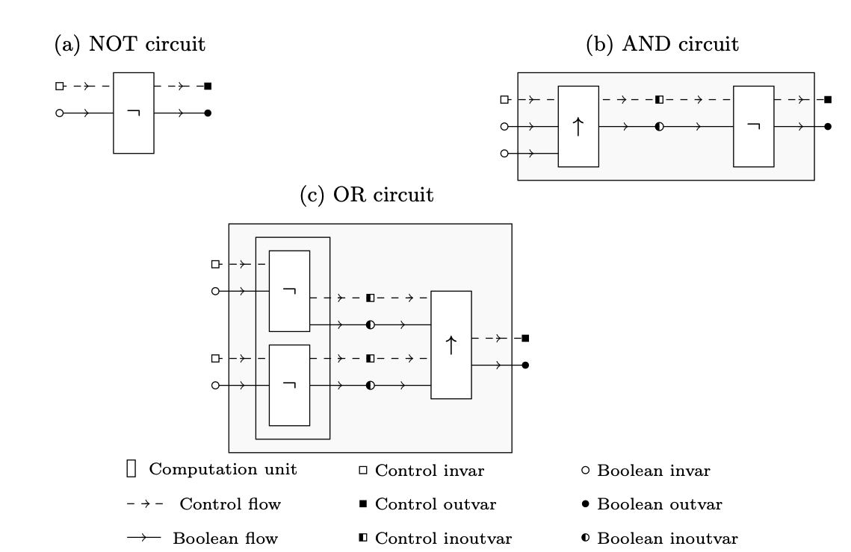
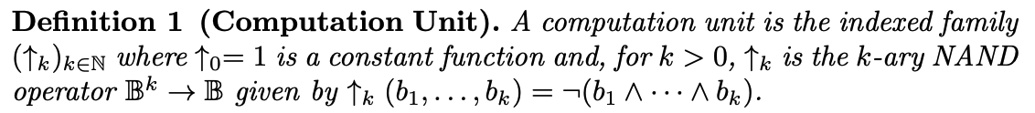
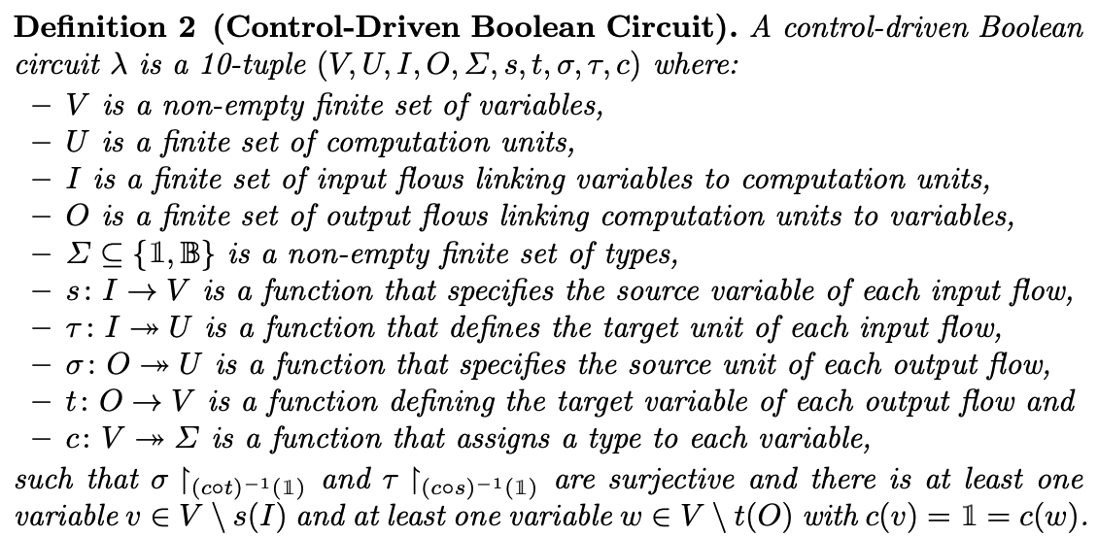
Control-Driven Circuits

Slide 12
Control-Driven Circuits

Slide 13


Circuit Interfaces
$$V^{+}$$
$$V^{−}$$

Slide 14
Soundness

Slide 15
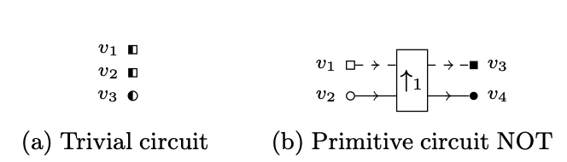
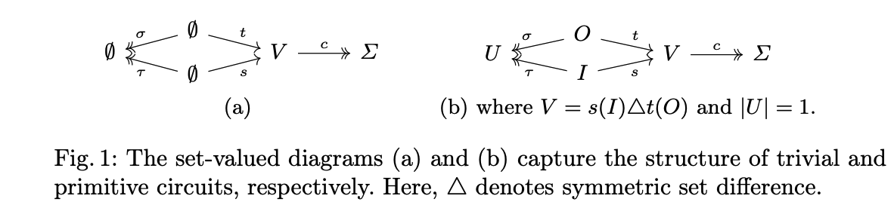
Primitive and trivial Circuits
Trivial Circuits
Primitive Circuits

Slide 16
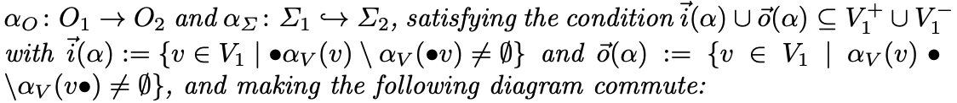
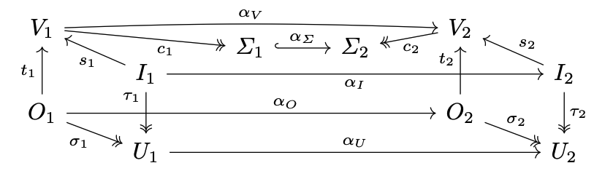
Circuit Morphisms

Slide 17
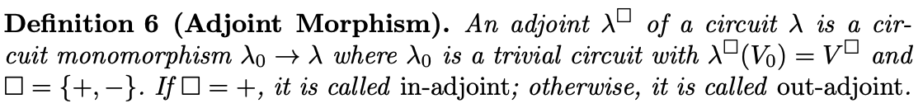
Adjoint Morphisms

Slide 18
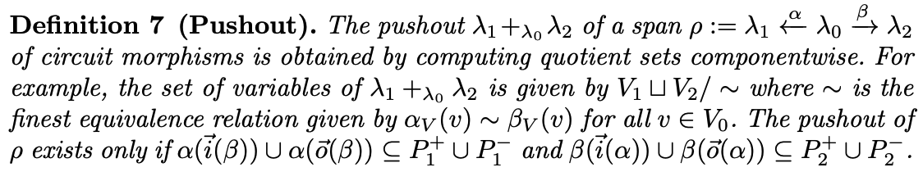
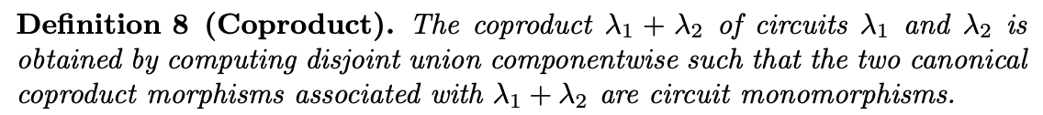
Colimit Constructions

Slide 19
Composition Operators

Slide 20
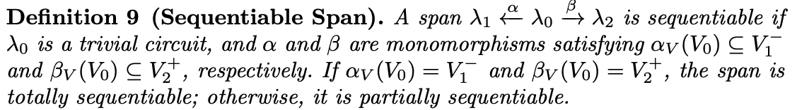
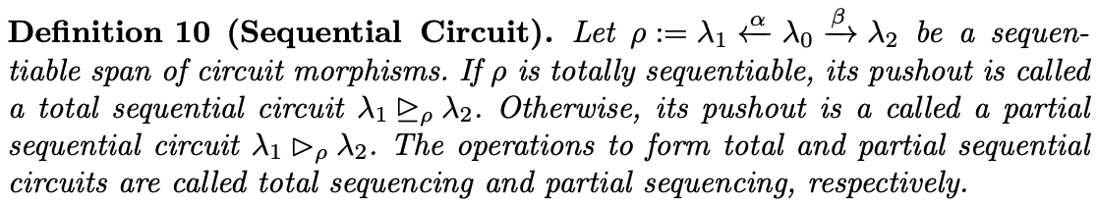
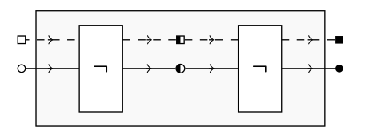
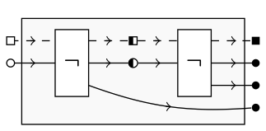
Sequential Circuits
AND Circuit
Buffer Circuit
Partial Buffer

Slide 21
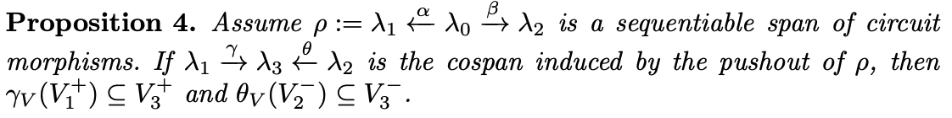
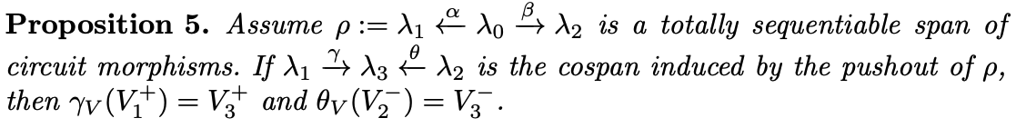
Sequential Circuits

Slide 22
Parallel Circuits
Parallel NOT circuit

Slide 23
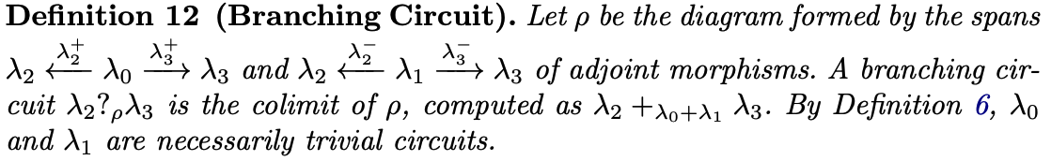
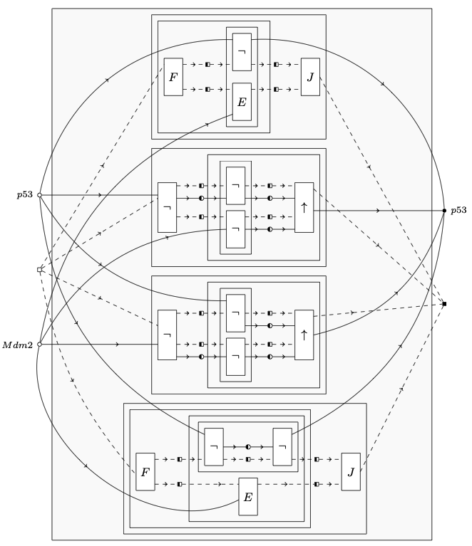
Branching Circuits
Oscillatory dynamics of a p53-Mdm2

Slide 24
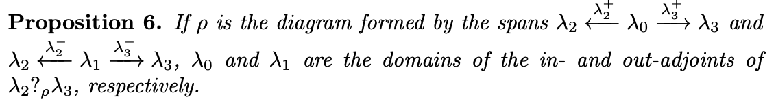
Branching Circuits

Slide 25
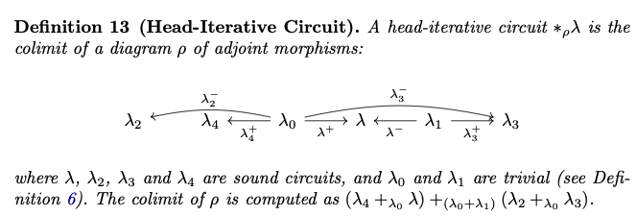
Iterative Circuits

Slide 26
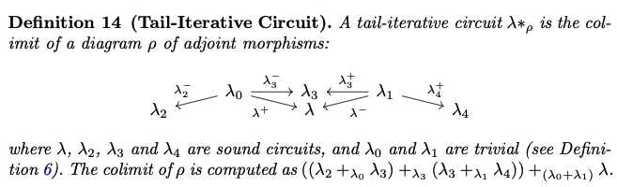
Tail-Iterative Circuits

Slide 27
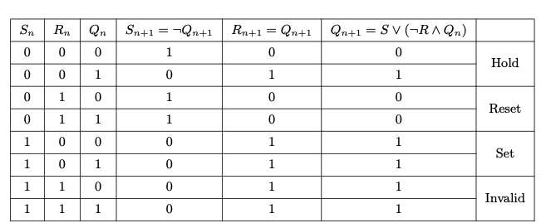
Constructing a Tail-Iterative Circuit
Toggle action of a clocked set-reset flip-flop

Slide 28
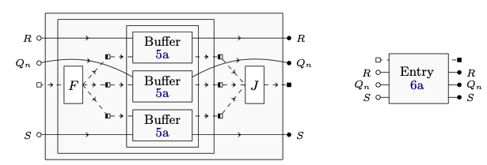
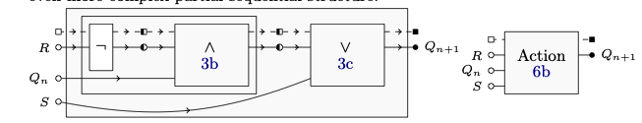

Constructing a Tail-Iterative Circuit

Slide 29
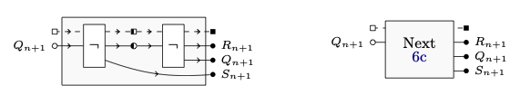
Constructing a Tail-Iterative Circuit

Slide 30
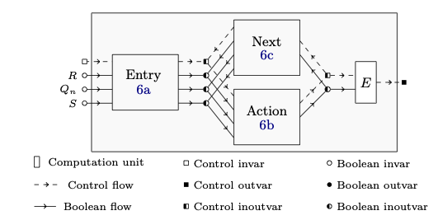
Constructing a Tail-Iterative Circuit

Slide 31
Circuit Dynamics

Slide 32
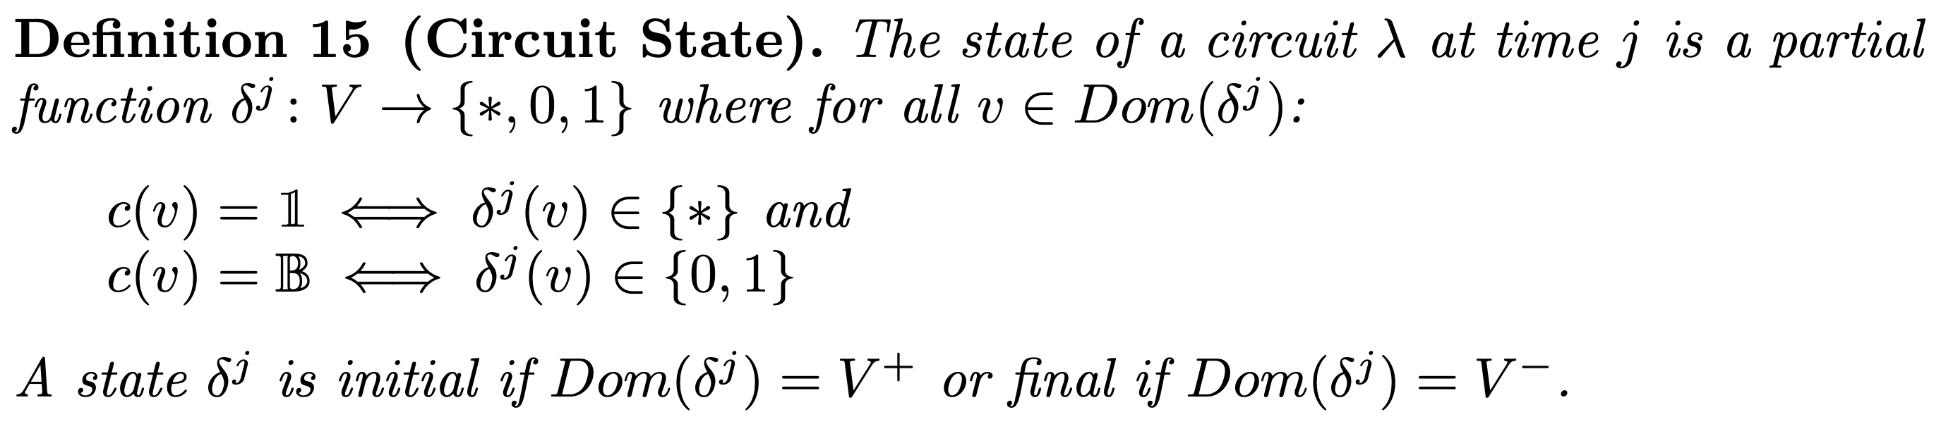
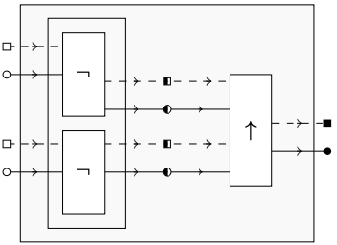
Circuit State
*
1
*
*
1
0
An Initial State
A Final State

Slide 33
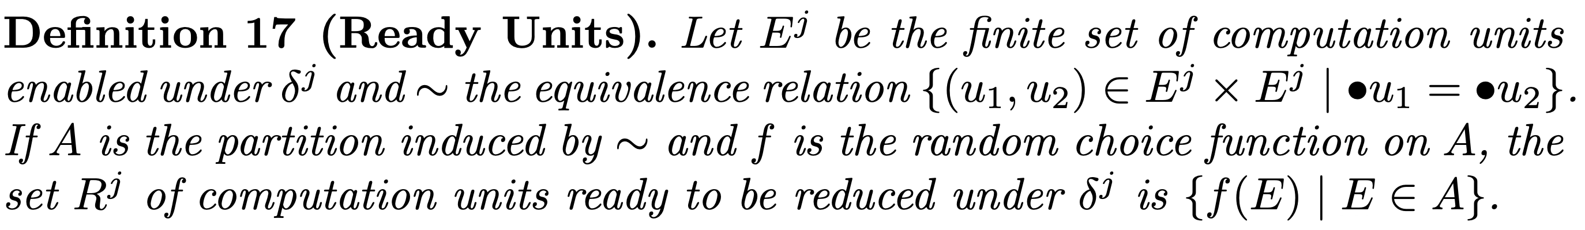

Choosing Units for Reduction
*
E
These two units
are in $R^{0}$
1
I
*
0
E

Slide 34
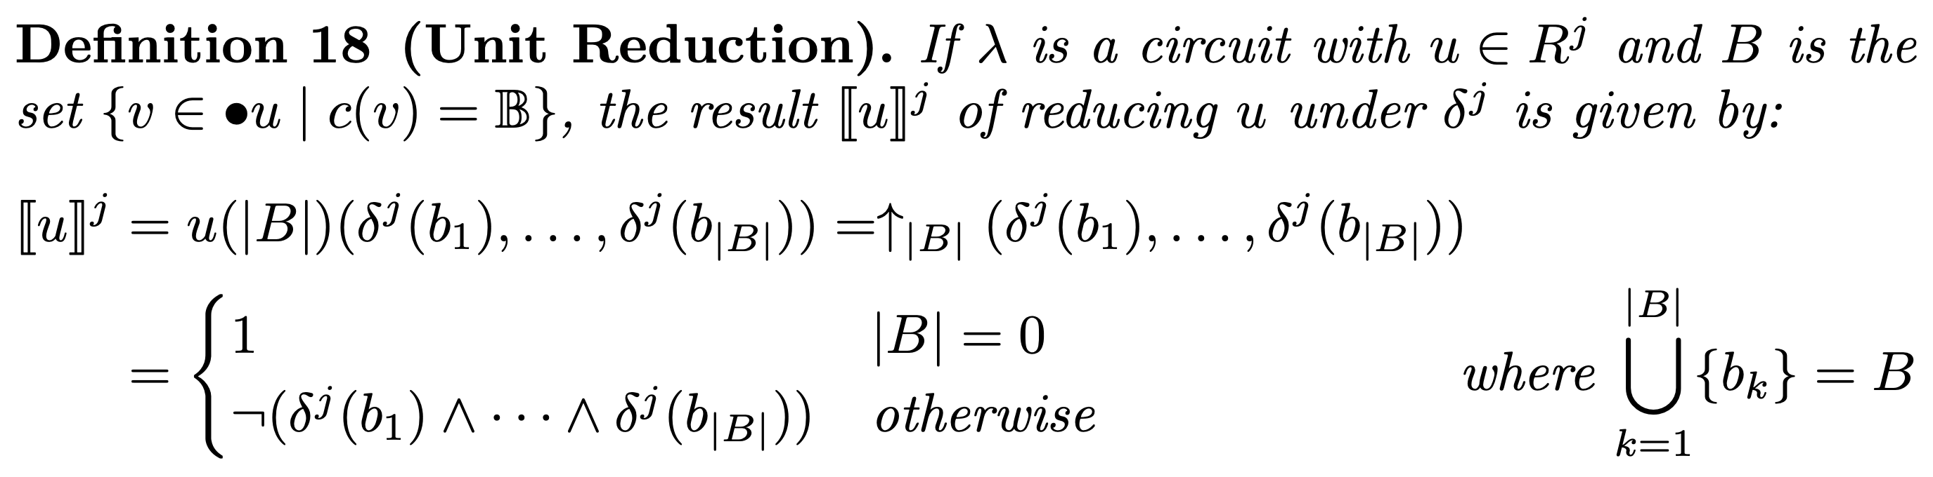
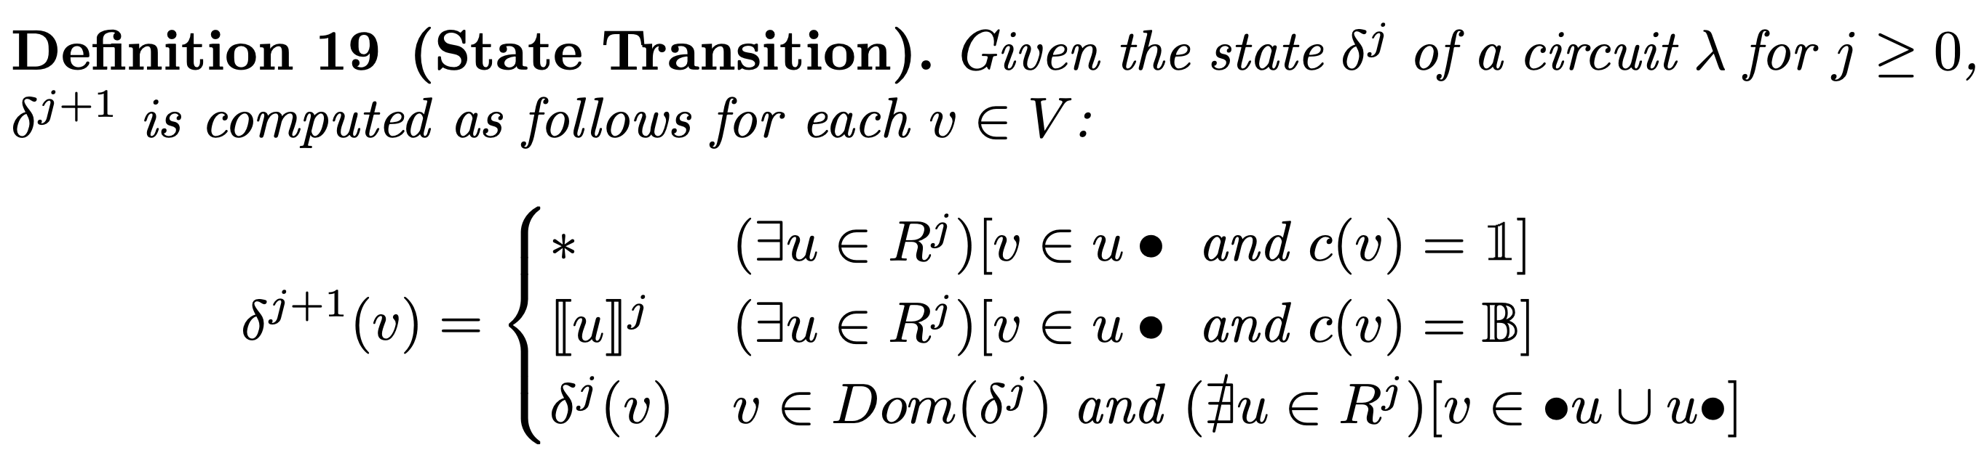
Unit Reduction and State Transition

Slide 35

Unit Reduction and State Transition
*
1
*
0
*
*
0
1
$$↑_{2}\left(0,1\right)=¬\left(0∧1\right)=1$$
*
1

Slide 36
Control-Driven vs Classical

Slide 37
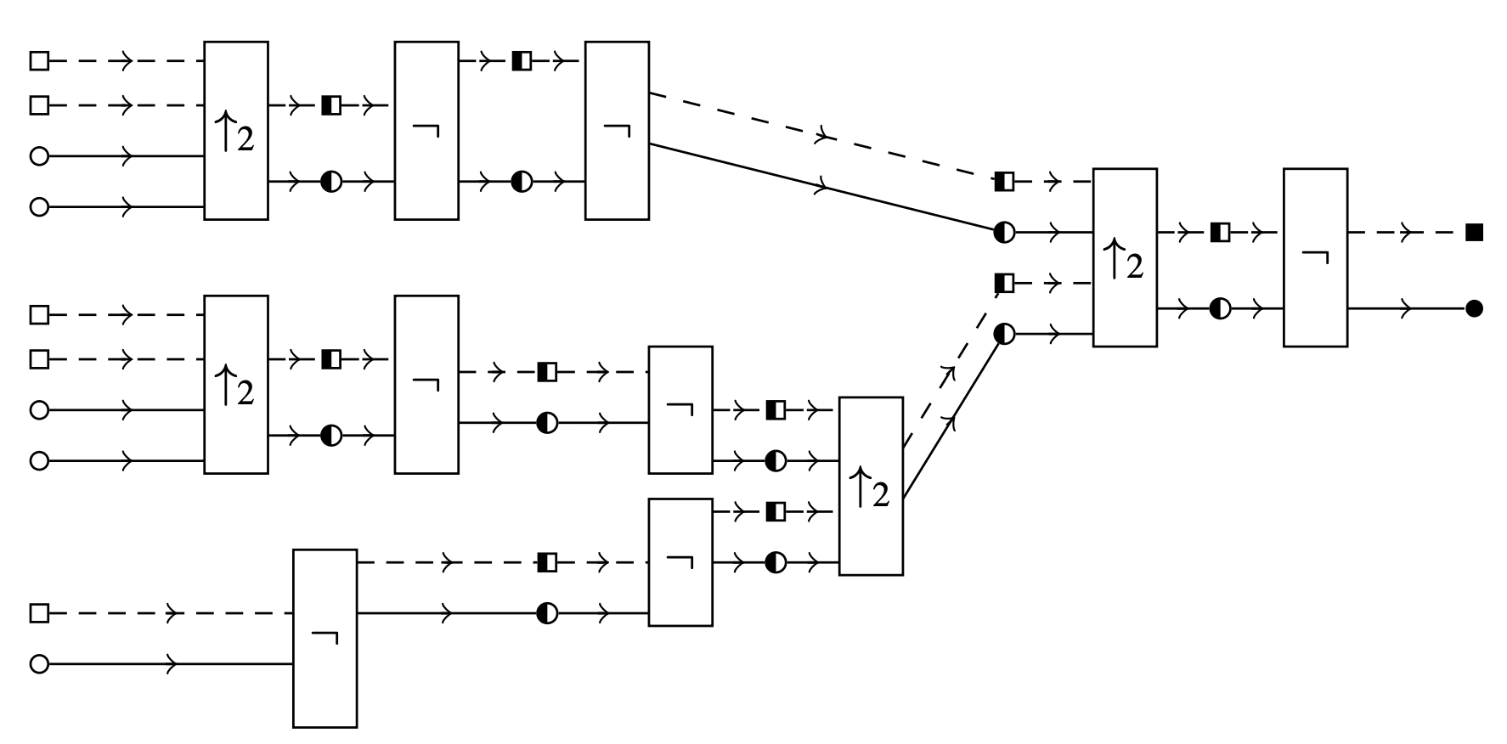
NAND Circuits are Control-Driven Circuits!

Slide 38
NAND Circuits are Control-Driven Circuits!

Slide 39
Non-Uniform Computation

Slide 40

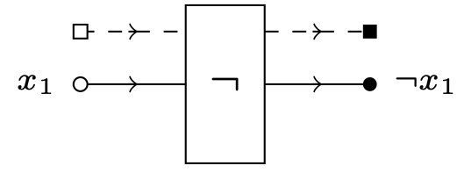

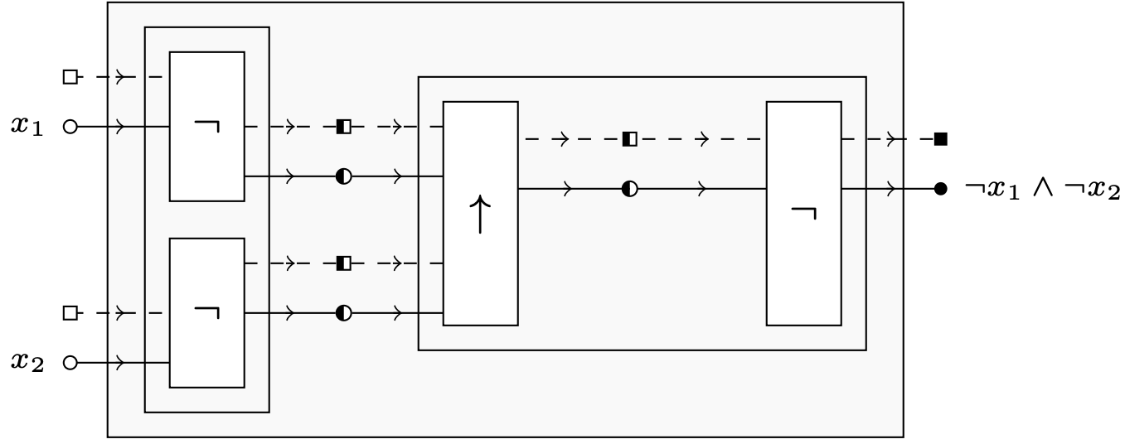

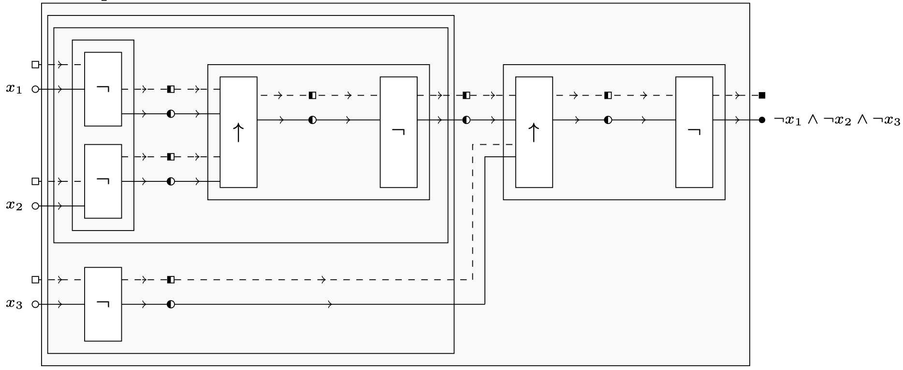

Non-Uniform Computation

Slide 41
Conclusions
Families of control-driven Boolean circuits
Non-uniform model of computation
Colimit-based composition operations:
Partial sequencing (identity)
Total sequencing (identity, associative)
Parallelising (commutative, associative)
Branching (commutative, associative)
Iteration
Showed that every NAND circuit is a control-driven one
Other functional complete sets can be used for extra expressivity!

Slide 42
Future Work
Decomposition operators
Less complex circuits in terms of size upon transformation
Characterisation of Boolean functions that can be represented via iteration
More expressive branching structures via:
Pre/Post-conditions
Probabilistic choice

Slide 43
Thank you for attending!

