Slide 1
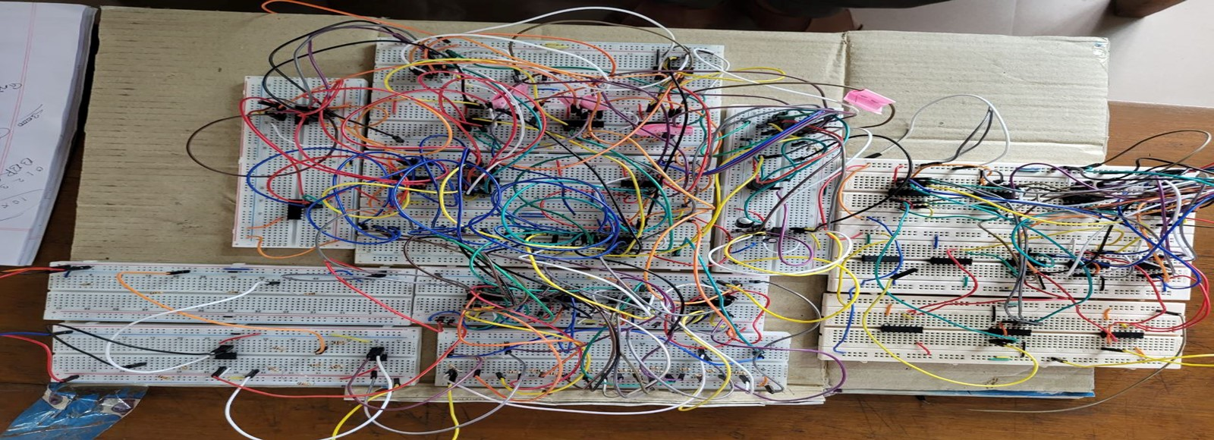
Fire Detection System with Customised Analog to Digital Converter and Magnitude Comparator
EEE 304 – Digital Electronics Laboratory
July 2022 Level-3 Term-II Section A1
Final Project Demonstration
Supervisors:
Nafis Sadik
Lecturer, EEE, BUET
Mrinmoy Kundu
Lecturer(PT), EEE, BUET

Slide 2
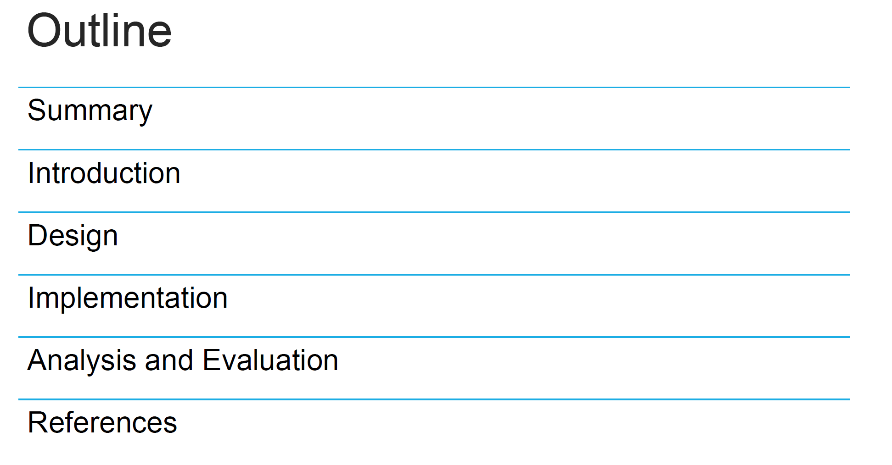

Slide 3
Fire Detection System with Customised Analog to Digital Converter and Magnitude Comparator
Summary
Acknowledgement and References
Introduction
Technical Details of Design
Practical Considerations
Reflection on Individual and Teamwork
Demonstration

Slide 4
Fire Detection System with Customised Analog to Digital Converter and Magnitude Comparator
Summary
Acknowledgement and References
Introduction
Technical Details of Design
Practical Considerations
Reflection on Individual and Teamwork
Demonstration

Slide 5
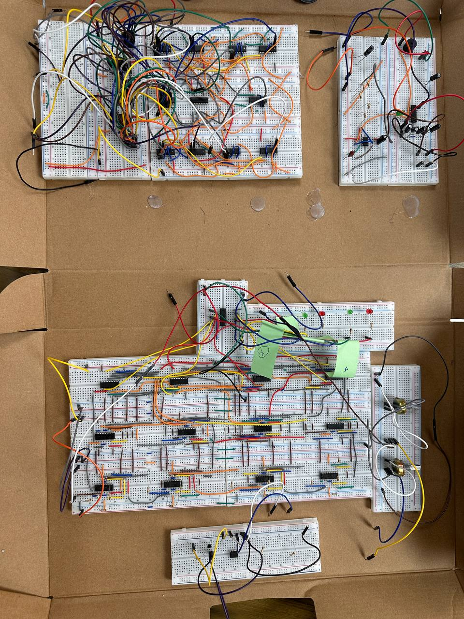
1. Summary / Abstract
Implemented a fire alarm using 4 bit ADC and self built magnitude comparator
An alarm will indicate the presence of fire.
Alarm will stop after certain time

Slide 6
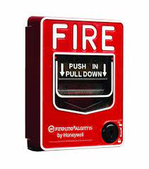
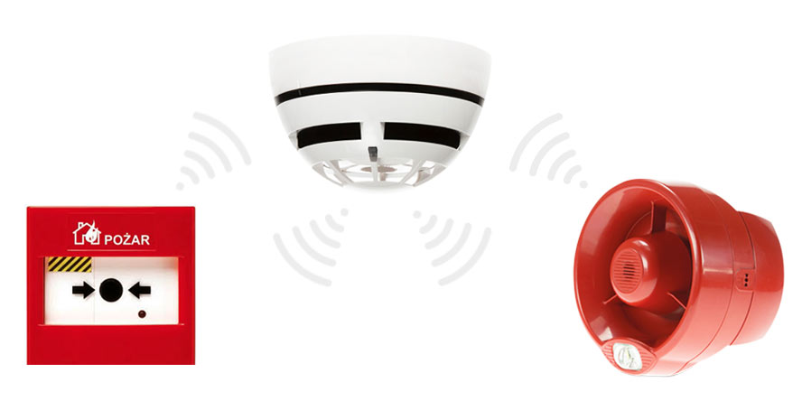
2.1 Complexity Analysis
No. of components
Speed of operation
Complexity of the algorithm
Working with hardware logic gate ic

Slide 7
Fire Detection System with Customised Analog to Digital Converter and Magnitude Comparator
Summary
Acknowledgement and References
Introduction
Technical Details of Design
Practical Considerations
Reflection on Individual and Teamwork
Demonstration

Slide 8



2. Introduction
21000
Fire Incidents
Reported Annually
180
People in Dhaka Dies Annually in Fire Outbreak
40%
Caused by Electrical Short Circuits

Slide 9
Fire Detection System with Customised Analog to Digital Converter and Magnitude Comparator
Summary
Acknowledgement and References
Introduction
Technical Details of Design
Practical Considerations
Reflection on Individual and Teamwork

Slide 10
3.1 Design: Methods
Components
LM35 (Temp Sensor)
LM324 (Quad Op-Amp)
IC7805 (5V REGULATOR)
IC7404 (NOT)
IC7408 (AND)
IC7432 (OR)
IC7486 (XOR)
LED, BUZZER, POT
BREADBOARD, JUMPER
555 Timer IC

Slide 11
3.1 Design: Methods (Continued)
Temperature | Voltage | Decimal Equiv.
0-8 | 0-0.3125 | 0
8-18 | 0.3125-0.625 | 1
18-28 | 0.625-0.9375 | 2
28-38 | 0.9375-1.25 | 3
38-48 | 1.25-1.5625 | 4
48-58 | 1.5625-1.875 | 5
58-68 | 1.875-2.1875 | 6
68-78 | 2.1875-2.5 | 7
Temperature | Voltage | Decimal Equiv.
78-88 | 2.5-2.8125 | 8
88-98 | 2.8125-3.125 | 9
98-108 | 3.125-3.4375 | 10
108-118 | 3.4375-3.75 | 11
118-128 | 3.75-4.0625 | 12
128-138 | 4.0625-4.375 | 13
138-148 | 4.375-4.6875 | 14
148-150 | 4.6875-5 | 15
Working Range for LM35:
Temperature Limit: -50°C to 150°C
Resolution: 10mV / °C
V_{max} = 1.5V
A_{gain} = 5V / 1.5V = 3.33

Slide 12
3.1 Design: Novelty
Implemented 4bit flash ADC using basic logic gates
Implemented 4 bit Magnitude Comparator
Simulated the working of LM35 Temperature sensor using voltage divider
Implemented a timer circuit to stop the buzzer after certain time to prevent from continuous buzzing

Slide 13
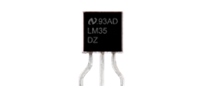




3.1 Design: Methods(Continued)
Temp Sensor
Output
Non-Inverting
Amplifier
4-bit
Flash ADC
T_{sensor} < T_{ref}
4-bit
Magnitude
Comparator
T_{sensor} = T_{ref}
Reference/Threshold
Temperature
(User Defined
4-bit Binary)
T_{sensor} > T_{ref}

Slide 14
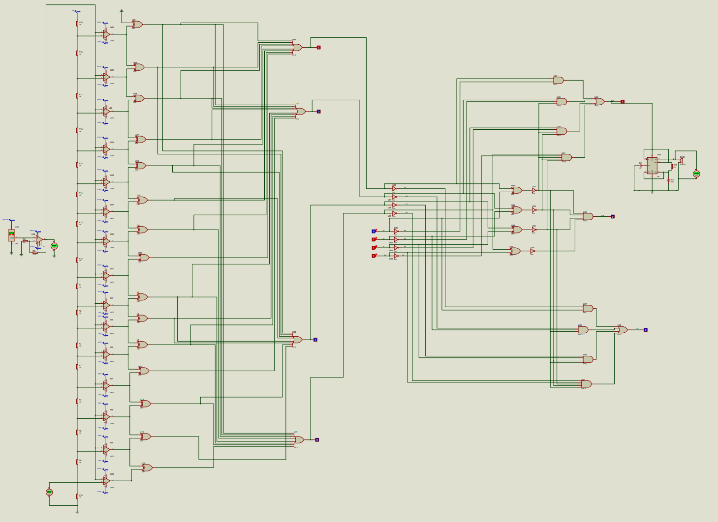
3.2 Design: Circuit Diagram

Slide 15
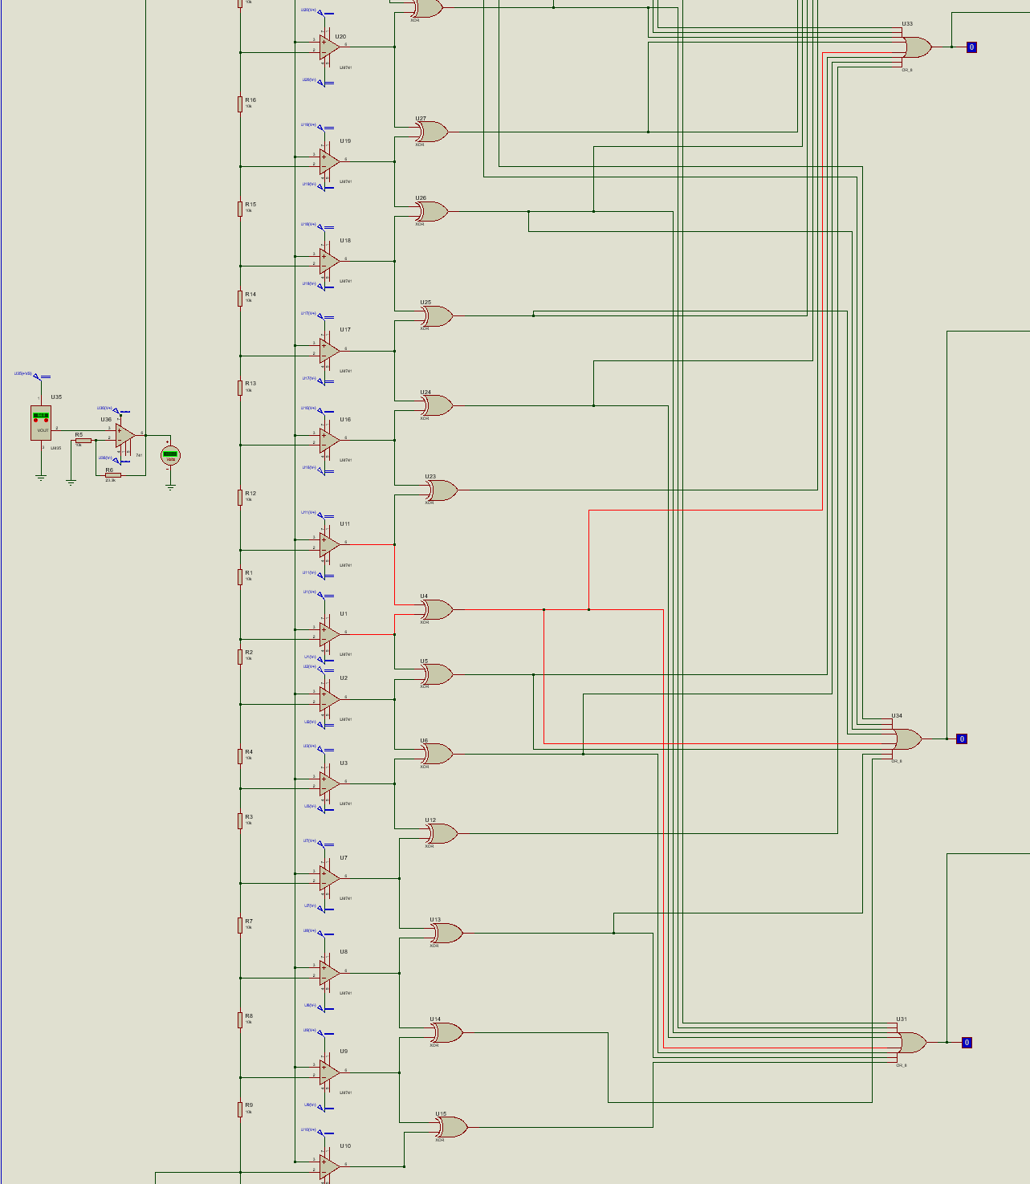
3.2 Design:

Slide 16
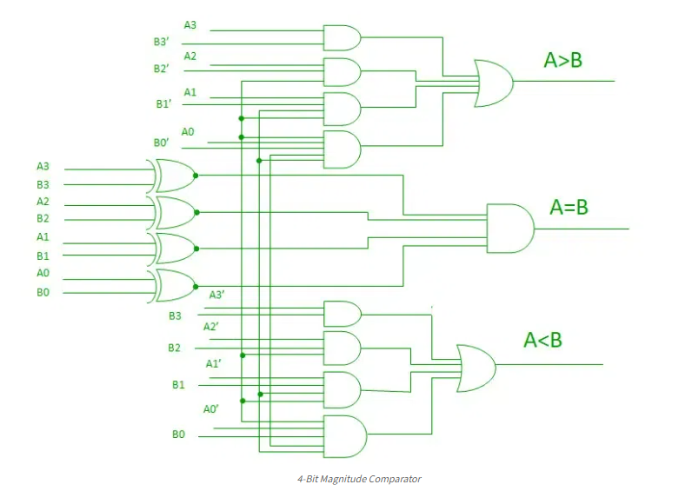
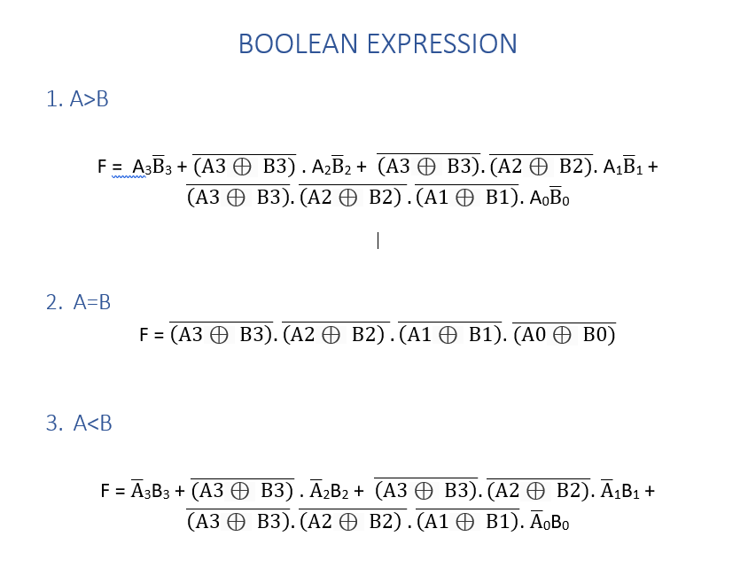
Comparator Circuit
Comparator Boolean Expression

Slide 17
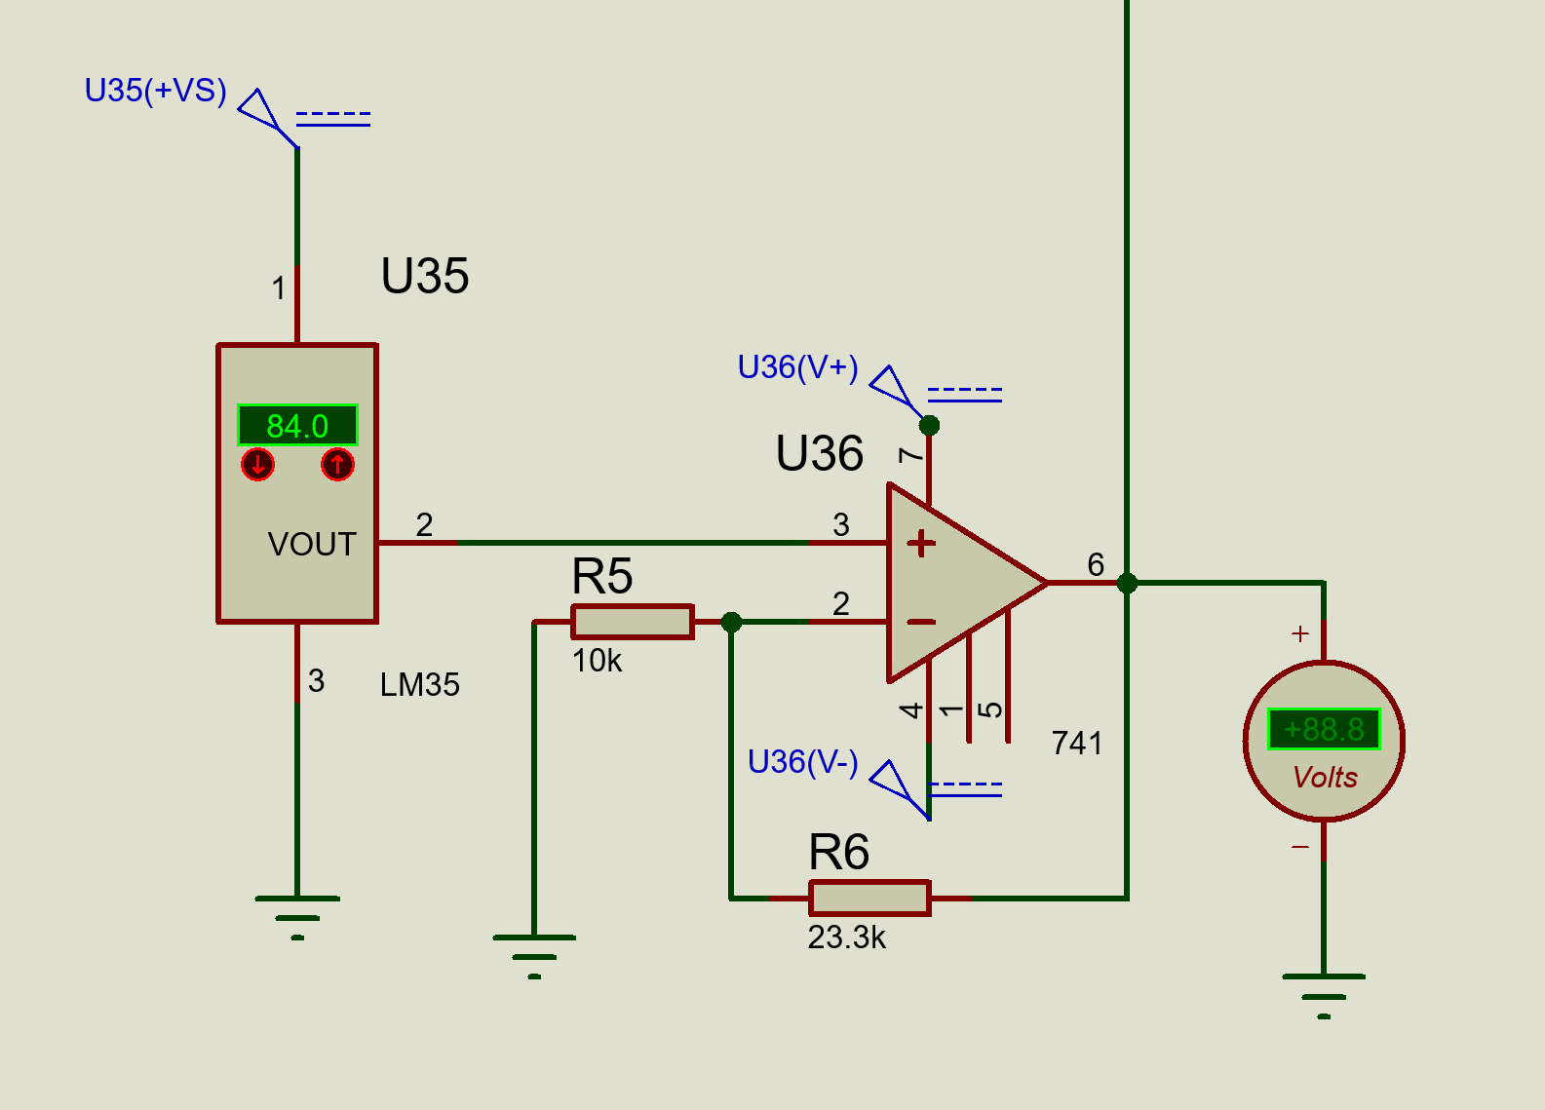
Temperature Sensor Circuit

Slide 18
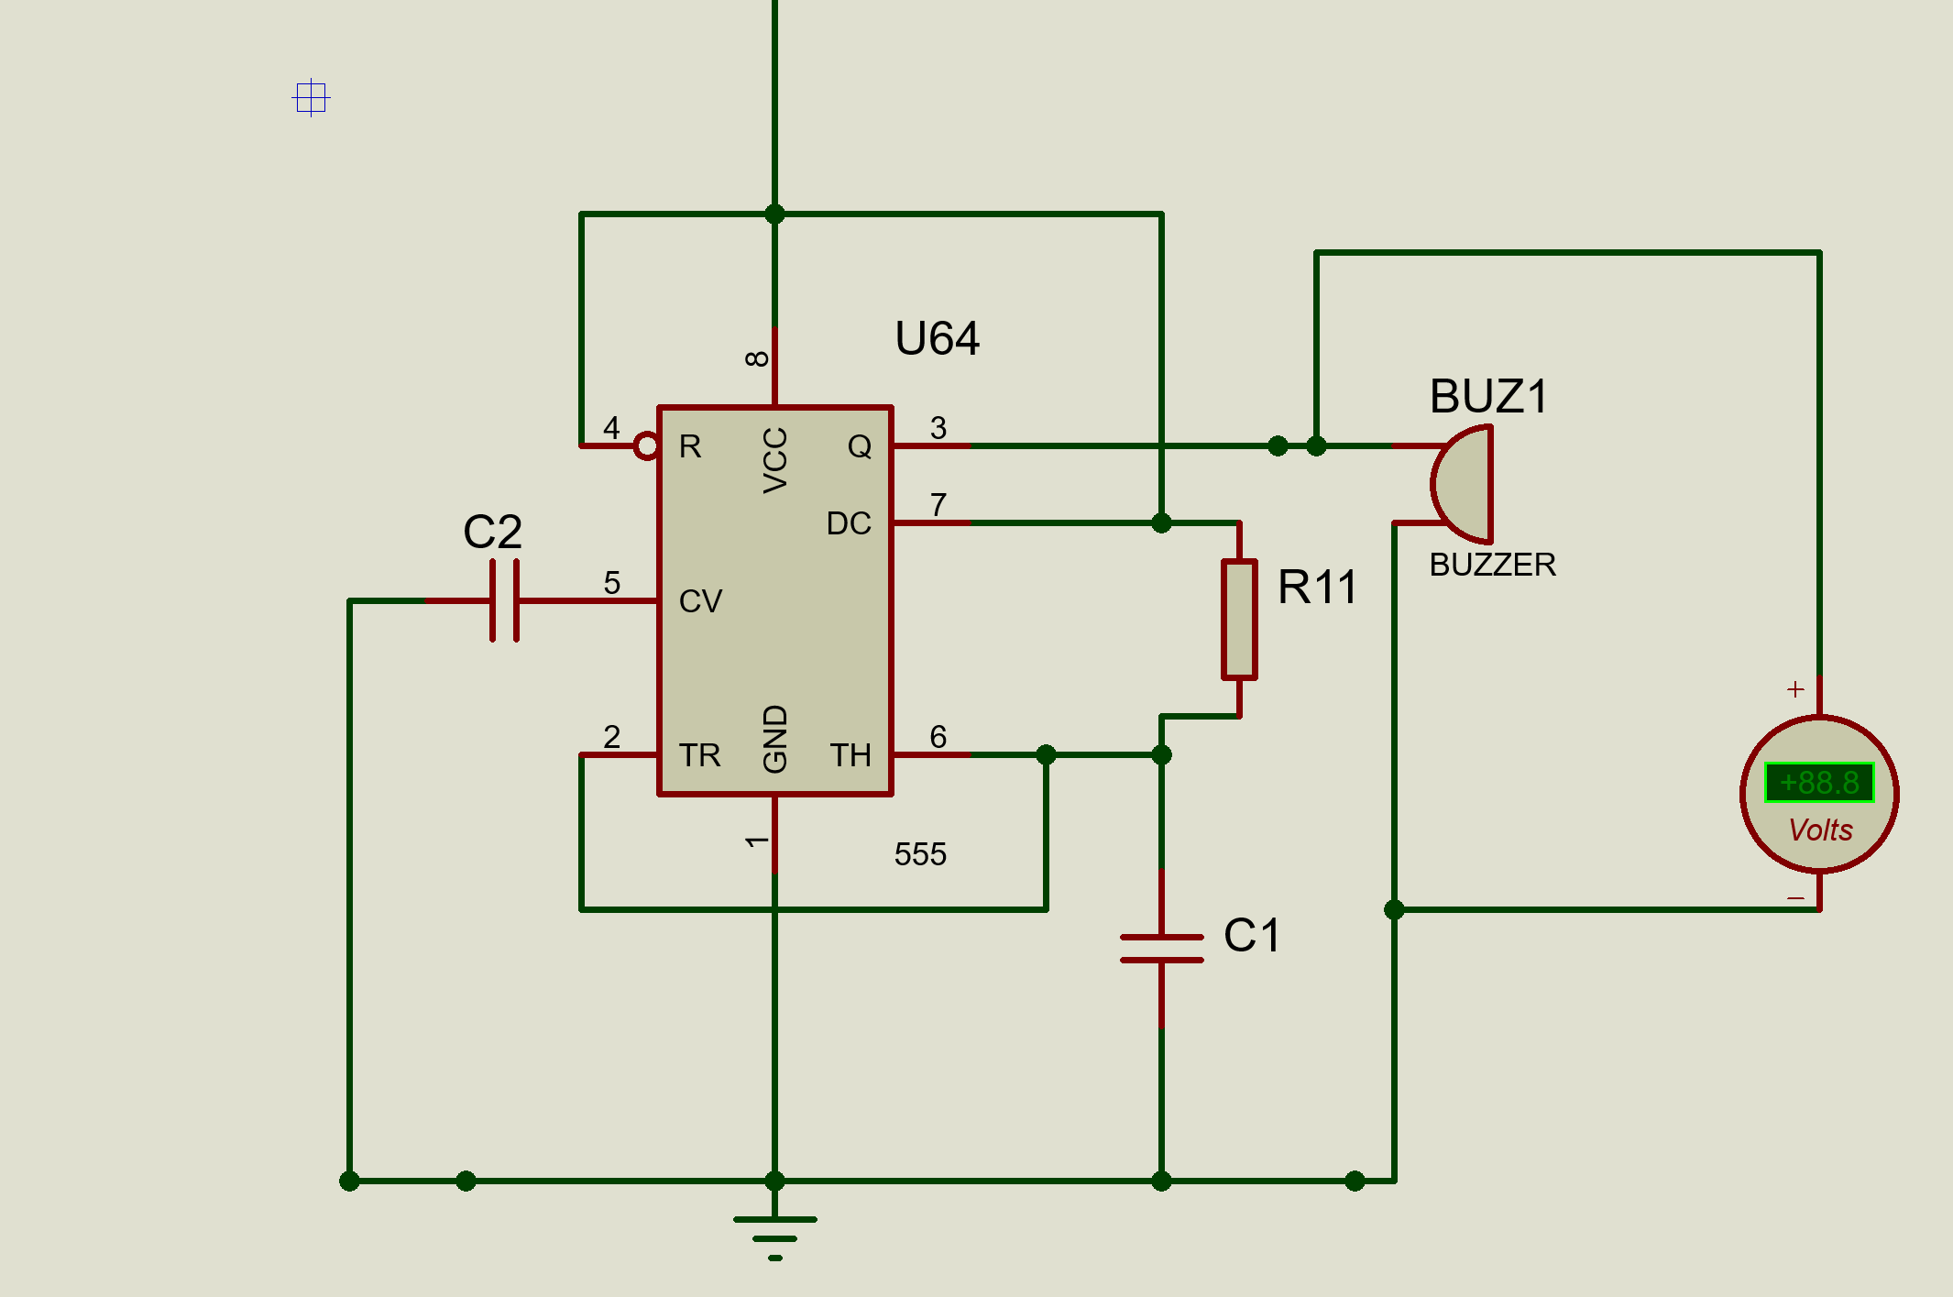
Timer Circuit

Slide 19
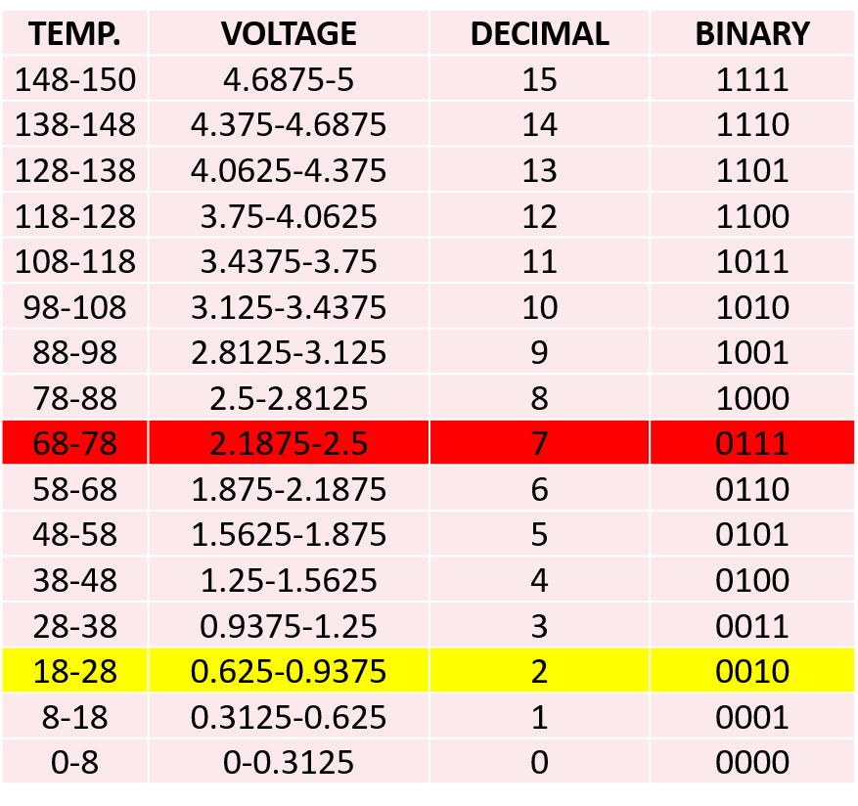

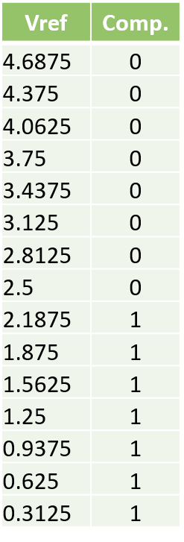

3.3 Design: Result explanation

Slide 20
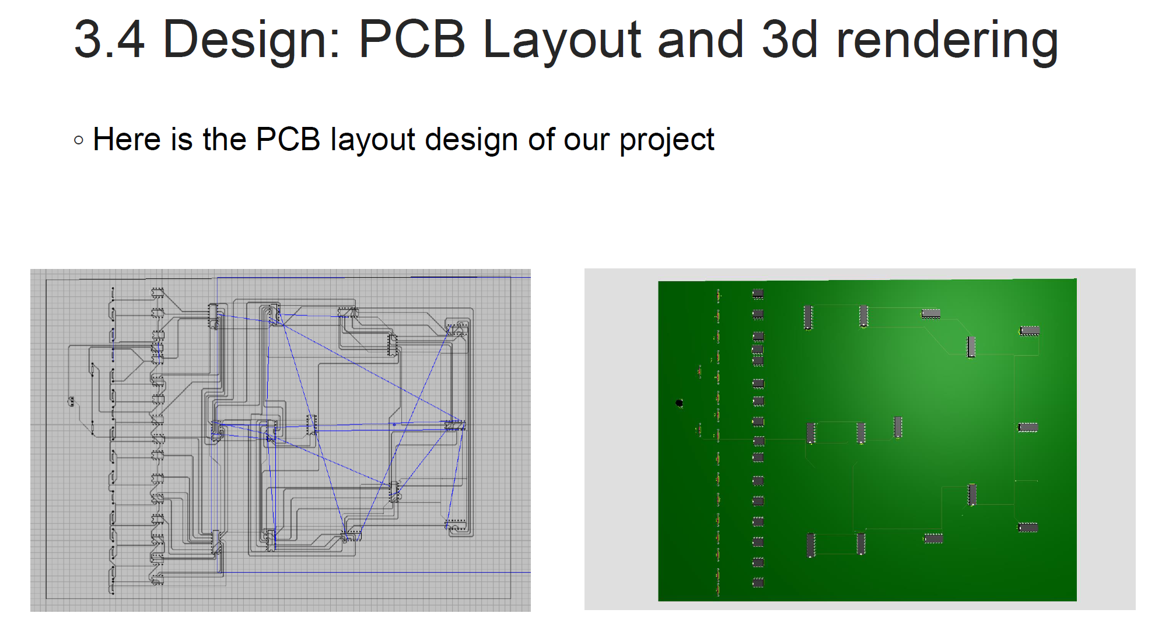

Slide 21
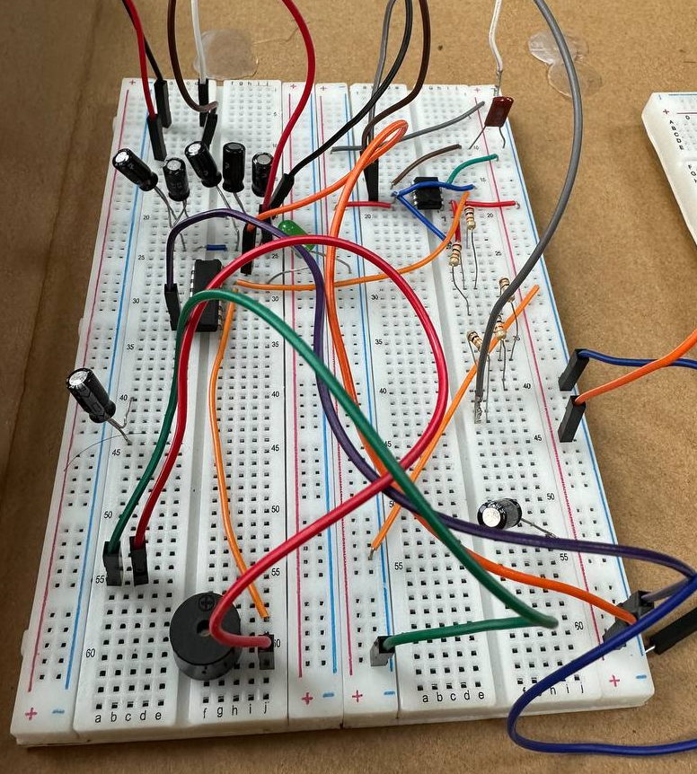
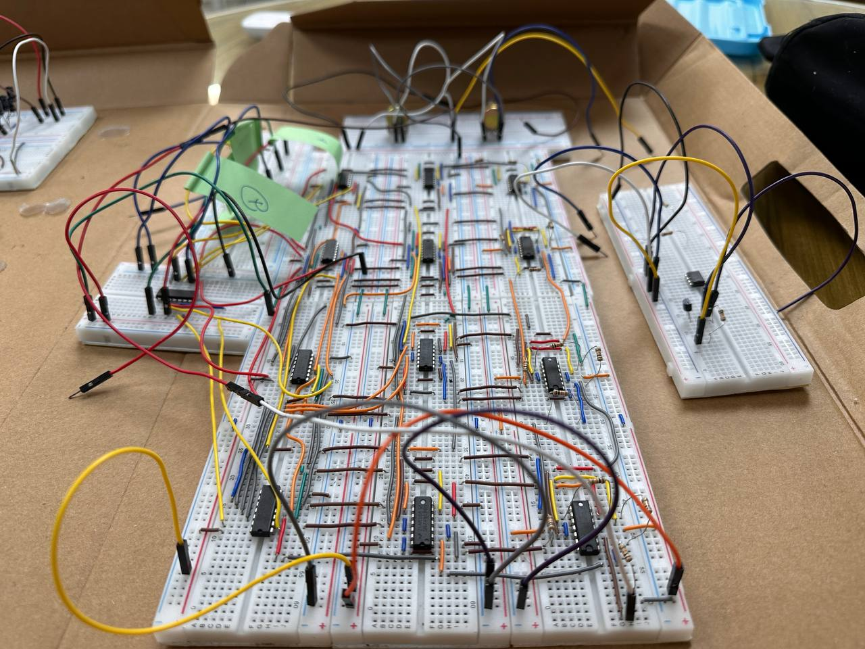
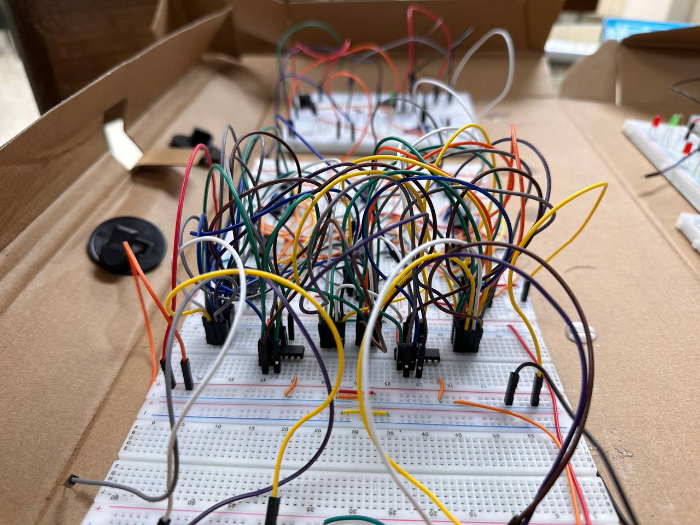
3.5 Implementation: Photo Gallary
16 to 4 bit ADC
4 bit Comparator
Timer Circuit

Slide 22
Fire Detection System with Customised Analog to Digital Converter and Magnitude Comparator
Summary
Acknowledgement and References
Introduction
Technical Details of Design
Practical Considerations
Reflection on Individual and Teamwork
Demonstration

Slide 23

3.6 Implementation: External Links
Project Video

Slide 24
Fire Detection System with Customised Analog to Digital Converter and Magnitude Comparator
Summary
Acknowledgement and References
Introduction
Technical Details of Design
Practical Considerations
Reflection on Individual and Teamwork
Demonstration

Slide 25
4. Practical Considerations: Public Health and Safety
Fire alarms play a crucial role in ensuring public health and safety by providing early warning of potential fire hazards.
Early warning: Fire alarms provide early warning of potential fires, allowing people to evacuate the building and call emergency services before the fire spreads.
Prevention: In addition to providing early warning, fire alarms can also help prevent fires from starting in the first place.
Peace of mind: Fire alarms can provide peace of mind for building occupants, knowing that they are being protected by an effective fire safety system.

Slide 26
4.2 Practical Considerations: Societal and Cultural
Fire alarms can have a significant impact on societal and cultural aspects in several ways.
Safety culture: Fire alarms can promote a culture of safety by raising awareness of fire hazards and encouraging individuals and organizations to take preventive measures.
Community resilience: In the event of a fire, fire alarms can help communities respond quickly and effectively to limit the impact of the fire.
Architectural design: Fire alarm reduces the probability of fire destruction of cultural heritage.

Slide 27
4.2 Practical Considerations: Environment
Fire alarm has significant impact on the environment.
Air pollution: Fire alarm reduces the probability of fire incidence as well as air pollution.
Habitat destruction: Fires can destroy natural habitats, leading to a loss of biodiversity and ecosystem services.
Soil contamination: Fires can result in the release of toxic substances, such as heavy metals or asbestos, which can contaminate soils and impact soil health.
Overall, fire accidents can have significant negative impacts on the environment, including air pollution, water pollution, soil contamination, habitat destruction, and climate change.

Slide 28
Fire Detection System with Customised Analog to Digital Converter and Magnitude Comparator
Summary
Acknowledgement and References
Introduction
Technical Details of Design
Practical Considerations
Reflection on Individual and Teamwork
Demonstration

Slide 29
6. Reflection on Individual and Team work
6.1 Individual Contribution of Each Member
6.2 Mode of Team Work
6.3 Diversity Statement of Team
6.4 Log Book of Project Implementation

Slide 30



Team Management
Anindya Kishore Choudhury
1906081
Toki Bin Alam
1906083
Ramim Hasan Shawn
1906082
Iftekar Sadiq
1906085

Slide 31

6.2 Mode of Team Work and Diversity

Slide 32
Fire Detection System with Customised Analog to Digital Converter and Magnitude Comparator
Summary
Acknowledgement and References
Introduction
Technical Details of Design
Practical Considerations
Reflection on Individual and Teamwork
Demonstration

Slide 33
7. References
https://www.geeksforgeeks.org/magnitude-comparator-in-digital-logic/

