Slide 1
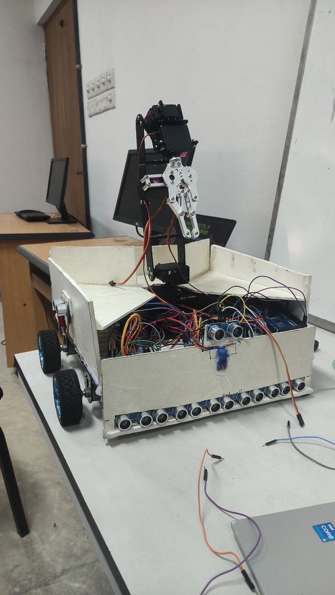
MediClean: Smart Autonomous Medical Waste Collection and Segregation Management With UV-Disinfection
MediClean is an innovative solution to medical waste management challenges. This robot autonomously collects, segregates, and disposes of medical waste, ensuring safe and efficient waste handling in healthcare facilities

Slide 2
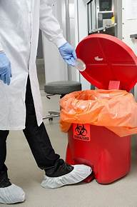
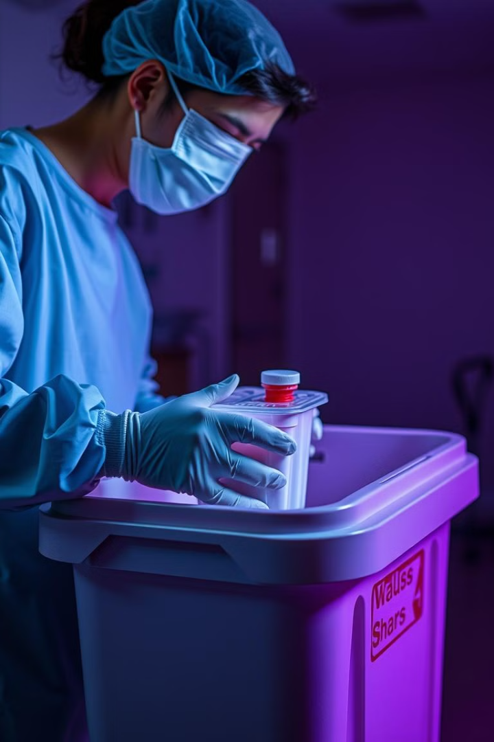
Importance of Proper Medical Waste Management
1
Infection Control
2
Environmental Protection
Improper medical waste handling can lead to the spread of infectious diseases, posing a significant risk to healthcare workers, patients, and the community.
Medical waste contains hazardous substances that can contaminate the environment, requiring proper disposal to minimize environmental impact.
3
Patient Safety
4
Legal Compliance
Safe and efficient medical waste management is crucial for maintaining a clean and hygienic environment in healthcare facilities, ensuring patient safety.
Healthcare facilities are subject to stringent regulations regarding medical waste management, necessitating adherence to proper disposal procedures.

Slide 3
Challenges in Current Medical Waste Management
Manual Labor
Risk of Exposure
Inaccurate Segregation
Reliance on manual labor for medical waste handling is labor-intensive, time-consuming, and potentially hazardous for healthcare workers.
Manual handling of medical waste exposes workers to potential hazards, including infectious agents and sharps injuries.
Manual segregation of medical waste can lead to errors, resulting in improper disposal and potential environmental contamination.

Slide 4
Introduction to the MediClean Robot
Autonomous Operation
Deep Learning Integration
MediClean operates autonomously, navigating healthcare facilities and collecting medical waste without human intervention.
The robot utilizes advanced deep learning algorithms to accurately identify and segregate various types of medical waste.
Enhanced Efficiency
MediClean streamlines waste handling processes, reducing the time and effort required for manual waste management.

Slide 5

Deep Learning-Based Detection and Segregation System
1
Image Acquisition
MediClean captures images of medical waste using high-resolution cameras integrated into its system.
2
Data Analysis
The captured images are processed using deep learning algorithms (EfficientNetB0) to identify and classify different waste types.
3
Waste Segregation
Based on the analysis, the robot autonomously segregates the waste into designated containers for each category.

Slide 6
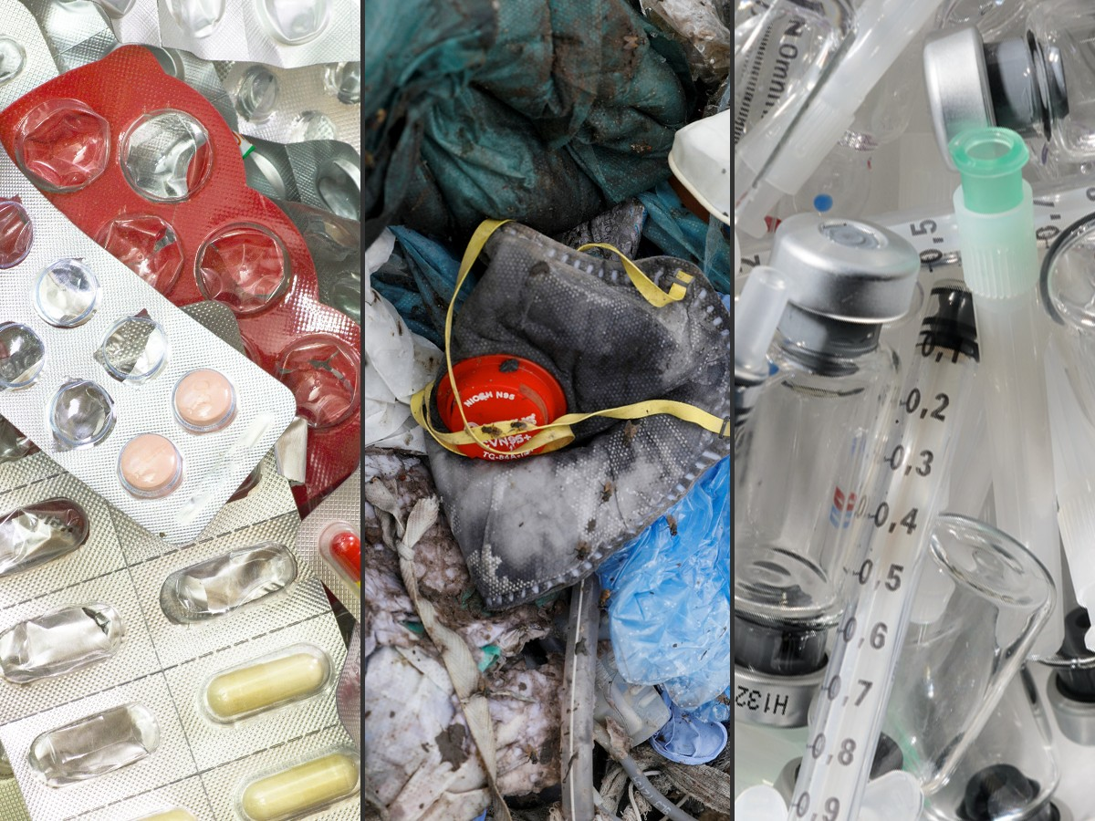
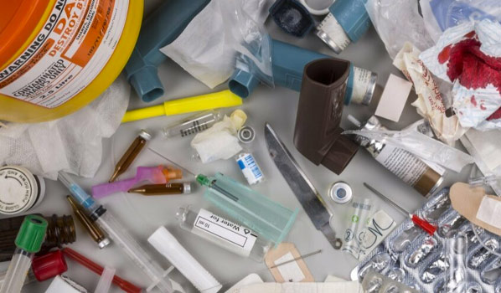
Waste Identification and Classification Capabilities
Waste Type
Description
Metal
Needles, syringes, blades, and other sharp objects
Plastic
Expired or unused medications, drug vials, and other pharmaceutical waste
Glass
Test tubes and other glass like objects
General Medical Waste (Paper)
Bandages, dressings, gloves, and other non-hazardous medical waste

Slide 7
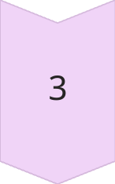
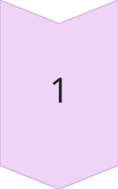
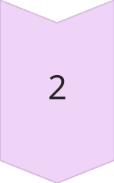
Methodology
Waste Drop and Return
Training the model
4
Obstacle Detection and Navigation
Waste Detection and
Classification
5
Waste Detection and Collection
Continuous Disinfection
6

Slide 8
Improved Safety and Hygiene in Healthcare Facilities
Reduced Exposure
Enhanced Hygiene
1
2
By automating waste handling, MediClean minimizes human exposure to potential hazards, promoting a safer working environment.
The robot's automated operation contributes to a cleaner and more hygienic environment in healthcare facilities.
Improved Efficiency
4
Builds patient trust
3
MediClean frees up healthcare workers from time-consuming waste management tasks, allowing them to focus on patient care.
Clean environment soothes the mind of patient and it can help the medical to gain their trust more.

Slide 9
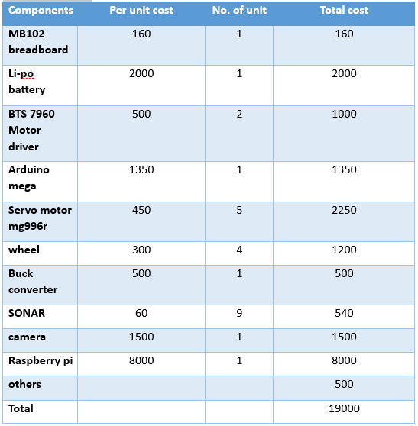
Cost Analysis:
UV c led
25
20

Slide 10



Future work
Scheduled Collection
Real-Time Tracking
Customizable Routes
MediClean can be programmed to collect waste at specific times, ensuring regular waste removal.
The robot's location and waste collection progress can be monitored in real-time, providing transparency and accountability.
The robot's collection routes can be customized to suit the specific layout and waste management needs of each facility.

