Slide 1
Git
A most widespread and easy-to-use version control system
Manage different versions of the code over time and reverse the changes in case of errors or wrong approach.
Team work on a shared source code

Slide 2
setup
Download git for OSX
Download git for Windows Download git for Linux

Slide 3
create a new repository
create a new directory, open it and perform a
git init
to create a new git repository.

Slide 4
checkout a repository
create a working copy of a local repository by running the command
git clone /path/to/repository
when using a remote server, your command will be
git clone username@host:/path/to/repository

Slide 5
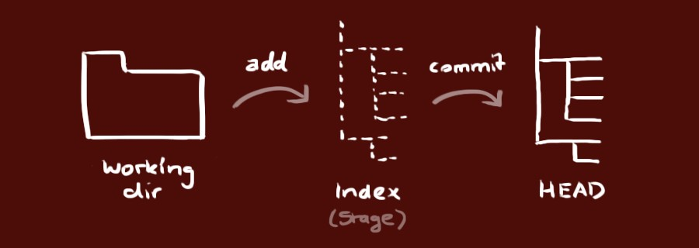
your local repository consists of three "trees" maintained by git. the first one is your Working Directory which holds the actual files. the second one is the Index which acts as a staging area and finally the HEAD which points to the last commit you've made.
workflow

Slide 6
add & commit
You can propose changes (add it to the Index) using
git add filename git add .
This is the first step in the basic git workflow. To actually commit these changes use
git commit -m "Commit message"
Now the file is committed to the HEAD, but not in your remote repository yet.

Slide 7
status
to check the status of the local repository
git status
in your working directory to get a list of staged and untracked items

Slide 8
pushing changes
Your changes are now in the HEAD of your local working copy. To send
those changes to your remote repository, execute
git push origin master
Change master to whatever branch you want to push your changes to.
If you have not cloned an existing repository and want to connect your repository to a remote server, you need to add it with
Now you are able to push your changes to the selected remote server
git remote add origin <server>

Slide 9
update & merge
to update your local repository to the newest commit, execute
git pull –u origin master
in your working directory to fetch and merge remote changes.

Slide 10
replace local changes
In case you did something wrong, which for sure never happens ;), you can replace local changes using the command
git checkout -- <filename>
this replaces the changes in your working tree with the last content in HEAD. Changes already added to the index, as well as new files, will be kept.

