Slide 1
Binary Image Segmentation using UNet on Brain Tumor Dataset
Ramin Mohammadi

Slide 2
References
Dataset
https://www.kaggle.com/datasets/pkdarabi/brain-tumor-image-dataset-semantic-segmentation/
Tutorial
https://www.kaggle.com/code/toufikalhajj/brain-tumor-unet-segmentation
NOTE, in addition to following above tutorial,
I verified that the TensorFlow model followed the UNet architecture correctly by reading and analyzing the UNet paper
and I added a dropout layer to the last downsampling block and added one more data augmentation (albumentations.ElasticTransform()) leading to improved IoU (Intersection over Union) and DSC (Dice Similarity Coefficient) scores
UNet Paper
https://arxiv.org/abs/1505.04597

Slide 3
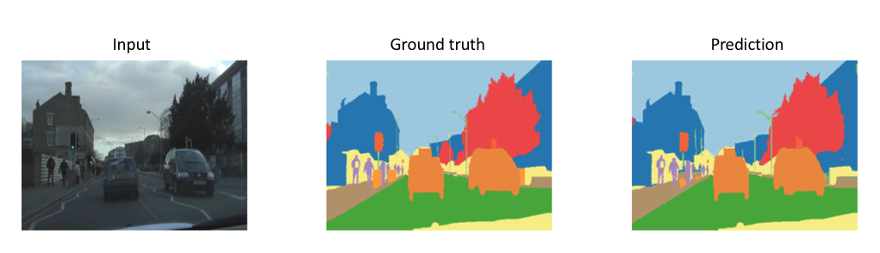
What is Image Segmentation?
Rather just performing image classification (predicting a label for an entire set of pixels -> image), you can have a model predict a label to EACH pixel in an image
Visually, the predicted labels per pixel can segment different objects/entities in an image whether it be a car or a cancer tumor

Slide 4
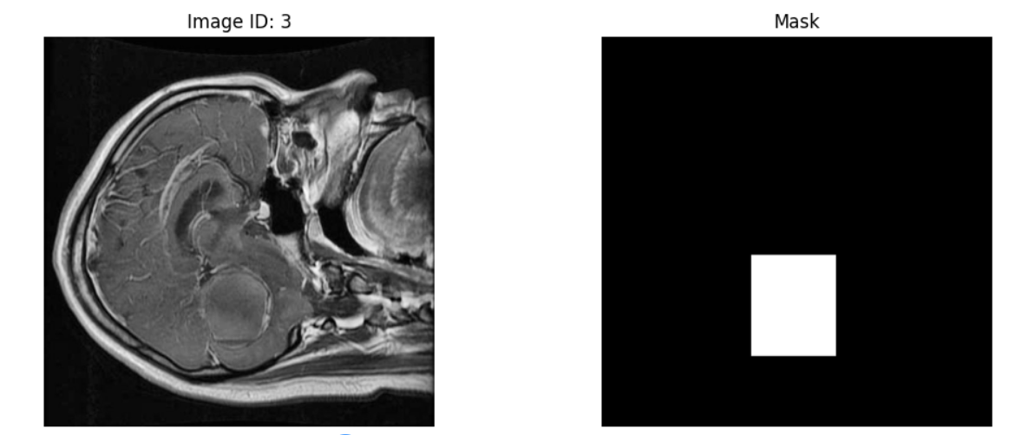
Brain Tumor Dataset
https://www.kaggle.com/datasets/pkdarabi/brain-tumor-image-dataset-semantic-segmentation/
Labels
Tumor: 1
No Tumor: 0
Here we only have 2 labels so dealing with a binary image segmentation task
Image Shape: (width, height, channel) = (640, 640, 3)
Mask Shape: (width, height) = (640, 640)
For right image, the “mask” is the ground truth image segmentation where white are pixels that represent the tumor and black are non-tumor regions

Slide 5
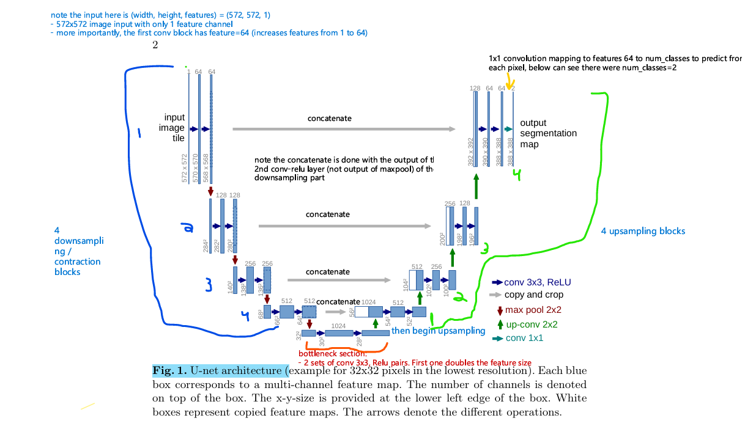
UNet

Slide 6
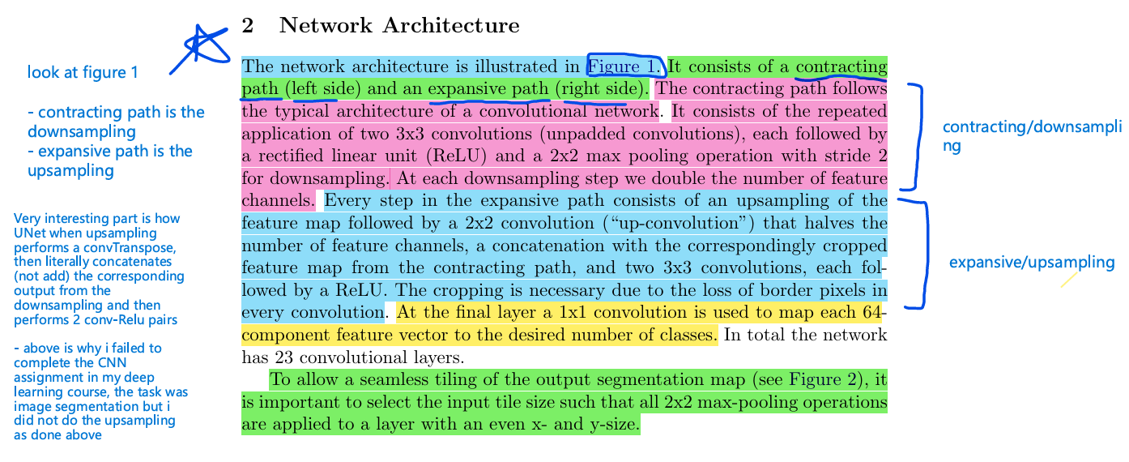
UNet

Slide 7
UNet
Unet downsampling / "contracting path" block, (below from Unet paper)
- "The contracting path follows the typical architecture of a convolutional
network. It consists of the repeated application of
- two 3x3 convolutions (unpadded convolutions),
each followed by a rectified linear unit (ReLU)
- and a 2x2 max pooling operation with stride 2 for downsampling.
- At each downsampling step we double the number of feature channels"
- Unet paper uses 4 downsampling blocks with first block starting with out_features=64

Slide 8
UNet
“BottleNeck”
Between downsampling and upsampling, unet paper has 2 sets of 3x3 conv - Relu pairs where the first convolution layer doubles the out_features

Slide 9
UNet
Every step in the expansive path consists of an upsampling of the feature map followed by a: (below is one upsampling block)
- 2x2 convolution ( up-convolution ) that halves the number of feature channels,
- a concatenation with the correspondingly cropped feature map from the contracting path (downsampling),
- and two 3x3 convolutions, each followed by a ReLU.
The cropping is necessary due to the loss of border pixels in every convolution.
(4 upsampling blocks)
- At the final layer a 1x1 convolution is used to map each 64 component feature vector to the desired number of classes.

Slide 10
UNet
1x1 conv
Note differences between binary segmentation (this problem is binary segmentation) or multiclass segmentation
2 labels:
(non_tumor: 0, tumor: 1)
For Binary Segmentation (2 classes: e.g., "object" and "background")
Output features (channels): 1
Activation: Sigmoid
Loss Function: Binary Cross-Entropy (BCE)
In this setup, the single output channel produces a probability map where each pixel value is a probability
between 0 and 1. A threshold (usually 0.5) is applied to this single value to assign a pixel to one of the two classes.
This is the most efficient and standard way to handle binary segmentation.
For Multi-Class Segmentation (>2 classes: e.g., "car," "road," "sky")
Output features (channels): num_classes (e.g., 3 for the example above)
Activation: Softmax
Loss Function: Categorical Cross-Entropy (CCE)
In this scenario, each pixel in the output has a vector of probabilities (one for each class), and the softmax function ensures these probabilities sum to 1. The output channel count must equal the number of classes.
So, for our case of a U-Net with only 2 classes, setting the output features to 1 with a sigmoid activation is the correct and simpler approach.

Slide 11
Loss
For binary image segmentation, it can be more stable to use a combined loss
Combined Loss for binary segmentation: Dice Loss + Binary Cross-Entropy Loss
using a weighted sum of Binary Cross-Entropy (BCE) and Dice loss is a widely used and often effective approach for binary segmentation. This combined loss function is commonly referred to as Combo Loss.
By taking a weighted sum, you leverage the benefits of both: BCE helps with general classification and stable gradients, while Dice loss ensures better overlap, especially for small or imbalanced foreground objects.

Slide 12
Loss
- Binary Cross-Entropy (BCE): BCE is a pixel-wise loss that is effective at penalizing incorrect classifications for every single pixel. It focuses on local accuracy but can be sensitive to class imbalance, meaning a large background area might dominate the loss, leading to poor segmentation of smaller objects.

Slide 13
Loss
- Dice Loss: Dice loss is a region-based loss that measures the overall overlap between the predicted segmentation mask and the ground truth (the Dice coefficient). It is better at handling class imbalance because it inherently balances the contribution of foreground and background pixels by focusing on the relationship between predicted and true positive regions

Slide 14
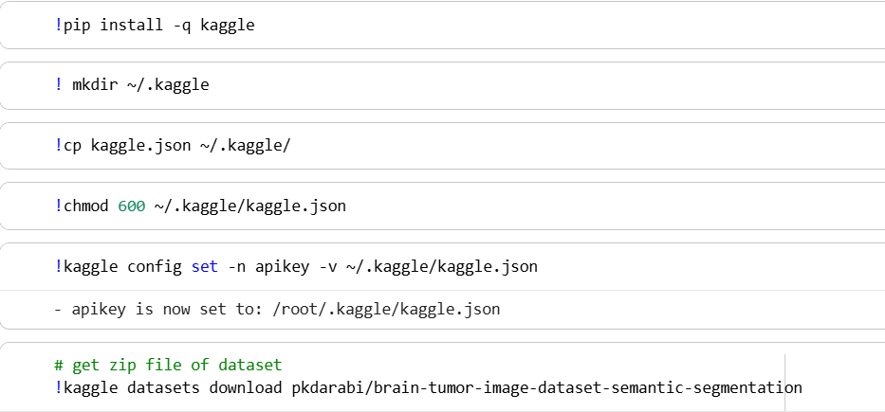
WalkThrough
Connect to a GPU (say T4)
Drag and drop your kaggle.json file into the notebook
Run the commands to download the dataset

Slide 15

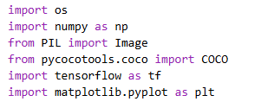
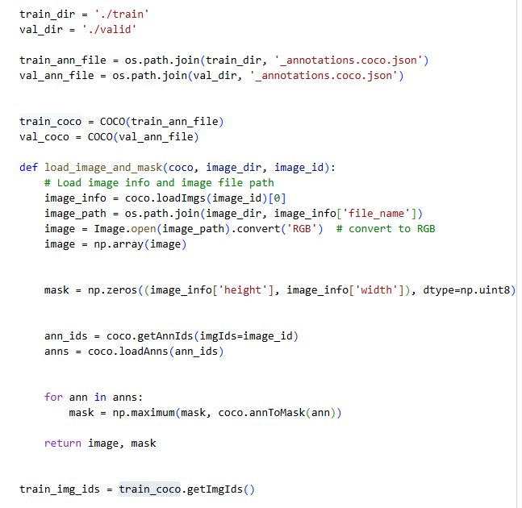
WalkThrough
Unzip dataset
Setup training and validation data

Slide 16
WalkThrough
Data Augmentation
- note this dataset is not very large so augmentations as done in the unet paper will really help increase the dataset size
- the UNet paper really signified making data augmentations to be able to train a well performing model using small datasets
https://albumentations.ai/docs/3-basic-usage/choosing-augmentations/
Very useful link for advice on data augmentations and how to go about using them
- note documentation recommends dropout as having significant impact but bc our task is image segmentation which tries to predict tumor pixels, I don’t think its a good augment bc it would set pixel values to 0 which logically seems like it will mess with the model’s learning of pixel level classification

Slide 17
WalkThrough
Data Augmentation
https://explore.albumentations.ai/transform/ElasticTransform
“Data augmentation is essential to teach the network the desired invariance and robustness properties, when only few training samples are available.”
The UNet paper mentions rotations, gray value variations but really signifies random elastic deformations
They used gaussian distribution, variance of 10 and bicubic interpolation for the elastic transform
Also they mention having a dropout layer at the end of the last downsampling block can be a data augmentation to perform too

Slide 18
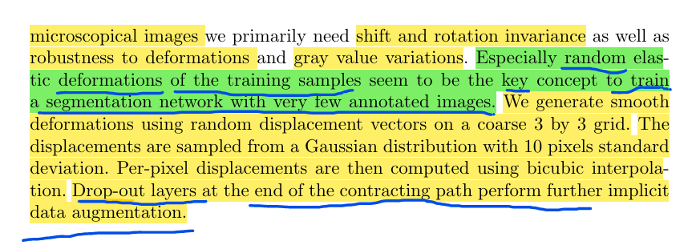
WalkThrough
Data Augmentation

Slide 19
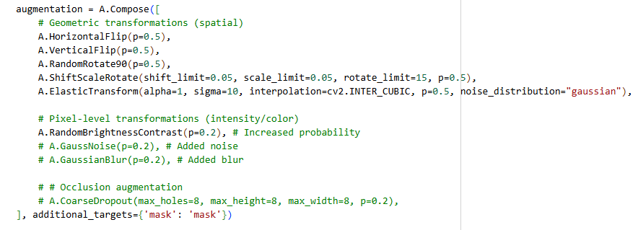
WalkThrough
Data Augmentation

Slide 20
WalkThrough
Data Augmentation
As recommended in the UNet paper, I added the elastic transform to the augmentation pipeline (with the same parameters used in the paper)
This was an addition I made to the tutorial I built off of and individually adding did lead to slight improvements in IoU, DsC and all overall metrics (accuracy, precision, recall, F1)

Slide 21
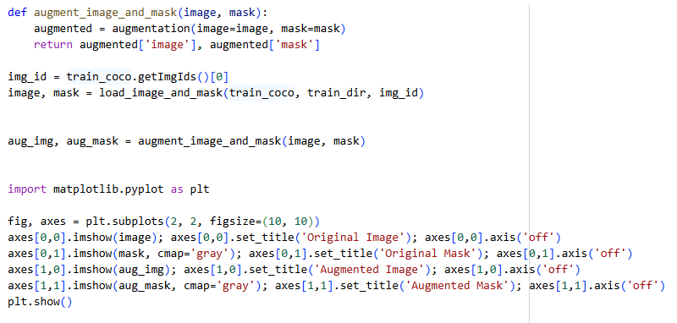
WalkThrough
Perform augmentation on data (both the images and corresponding masks)

Slide 22
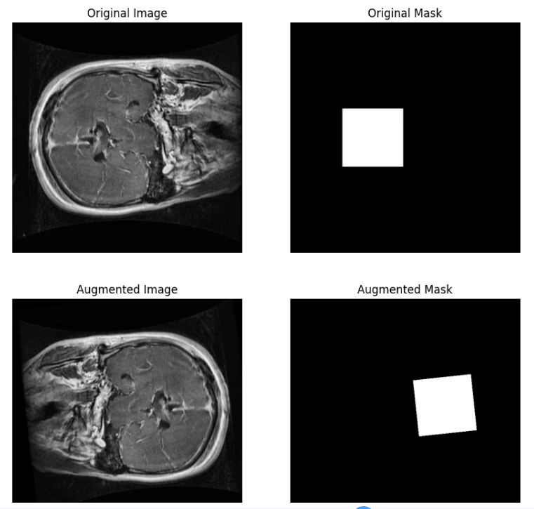
WalkThrough

Slide 23
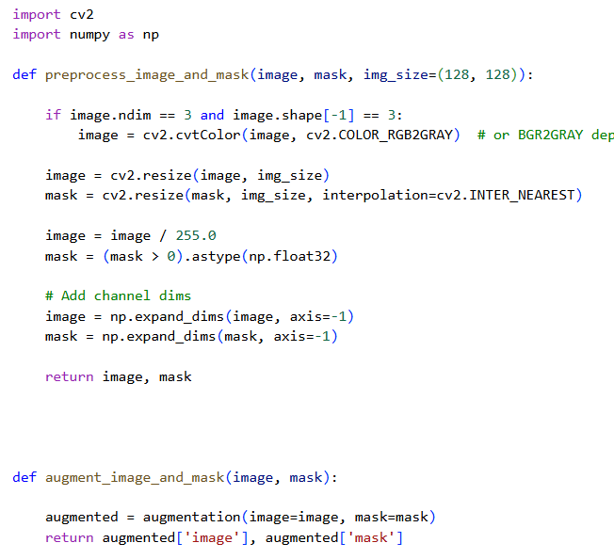
WalkThrough
Define preprocessing method which will
convert the images from 3 channels RGB to grayscale (1 channel)
Resize the images to from 640x640 to 128x128
Normalize the pixel values (divide by 255)
In mask strictly binarize the values (0 pixel value is black and 255 is white so in case any noisy values, will strictly turn values into true labels 0: non tumor and 1: tumor
Add channel dimension back

Slide 24
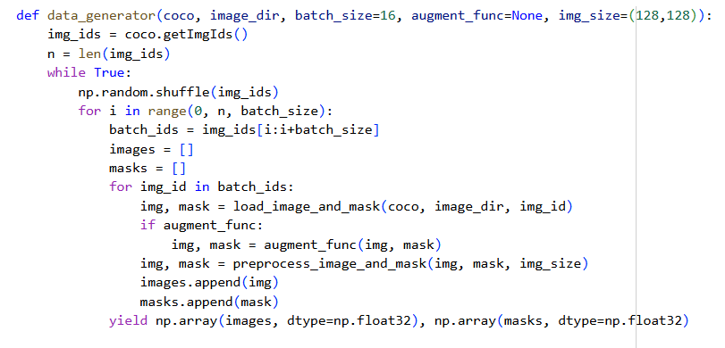
WalkThrough
Data pipeline

Slide 25
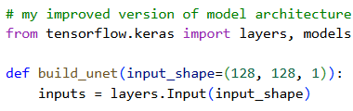
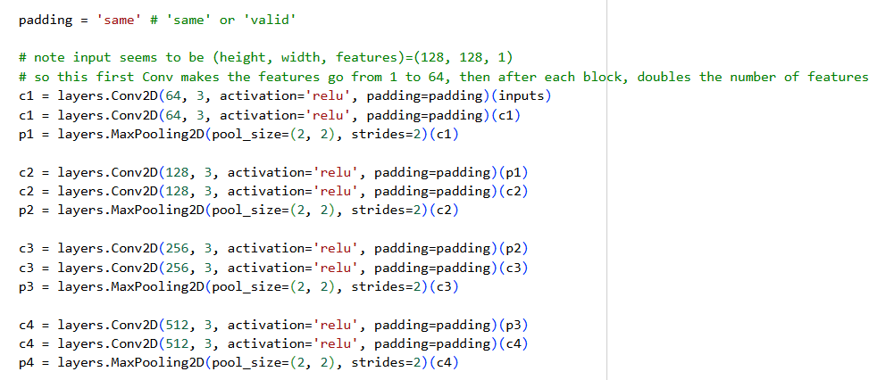
Walkthrough
Over next few slides is the UNet Architecture defined in build_unet
Here is the downsampling

Slide 26
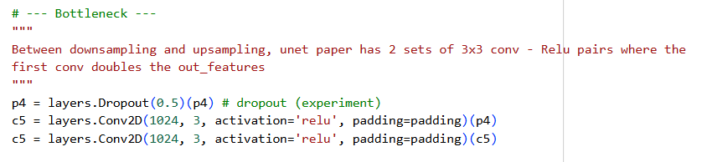
WalkThrough
Bottleneck
NOTE here I added a Dropout layer after the last downsampling block as suggested in the last sentence of the data augmentation section of the UNet paper and this addition alone increased IOU and DCS accuracy

Slide 27
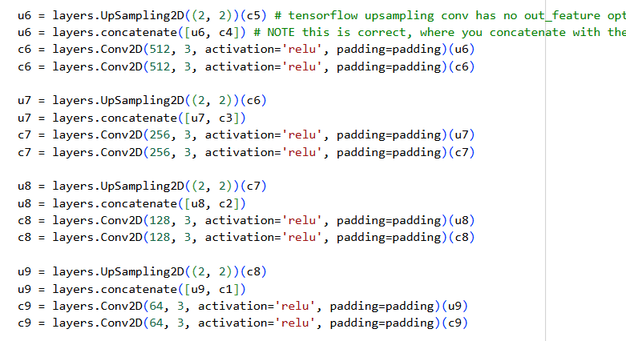
WalkThrough
Upsampling
An interesting aspect to note is that unet concatenates the corresponding output from the downsampling (output of the 2nd conv,relu pair) to the output of the corresponding upsampling output

Slide 28
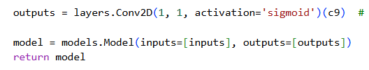
WalkThrough
1x1 conv
Note as explained in beginning of slides, our task is binary segmentation so we use sigmoid activation (sigmoid is used in binary classification situations as its range is [0,1] so classification can simply be based off whether >= 0.5)
And the output feature is just 1
In multi class segmentaiton, the out_features would be the # of classes to predict from

Slide 29
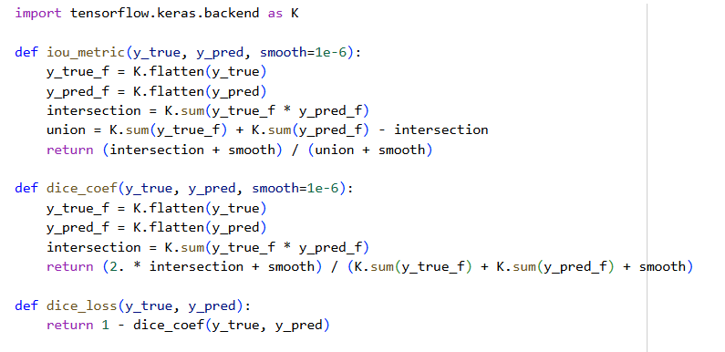
WalkThrough
Metric measurements for our model as we train it

Slide 30
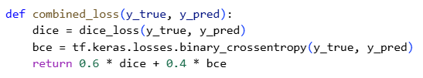
WalkThrough
Loss
As explained in beginning of slides, a combined loss of BCE and dice can help control learning for binary segmentation

Slide 31
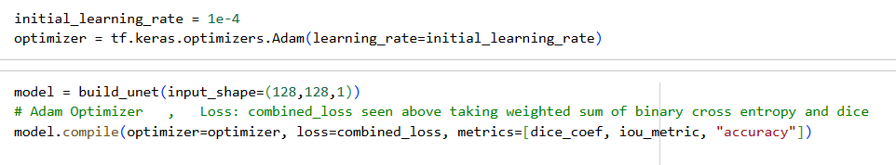
WalkThrough
Adam optimizer with LR=0.0001
Create the model object containing the unet architecture
And store the optimizer, loss and metrics in the obejct

Slide 32
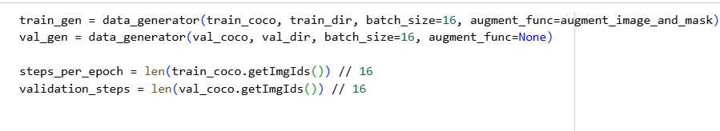
WalkThrough
Run training and validation data through our data_generator pipeline (does preprocessing, etc.)

Slide 33
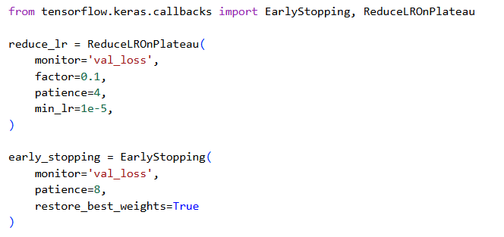
WalkThrough
Additional optimization for our model’s training

Slide 34
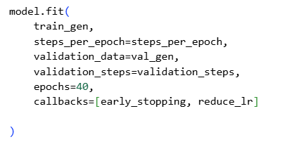
WalkThrough
Training
40 epochs
On T4 GPU, took about 30 mins

Slide 35
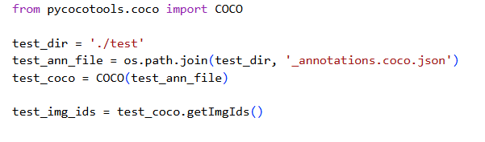
WalkThrough
Load test data

Slide 36
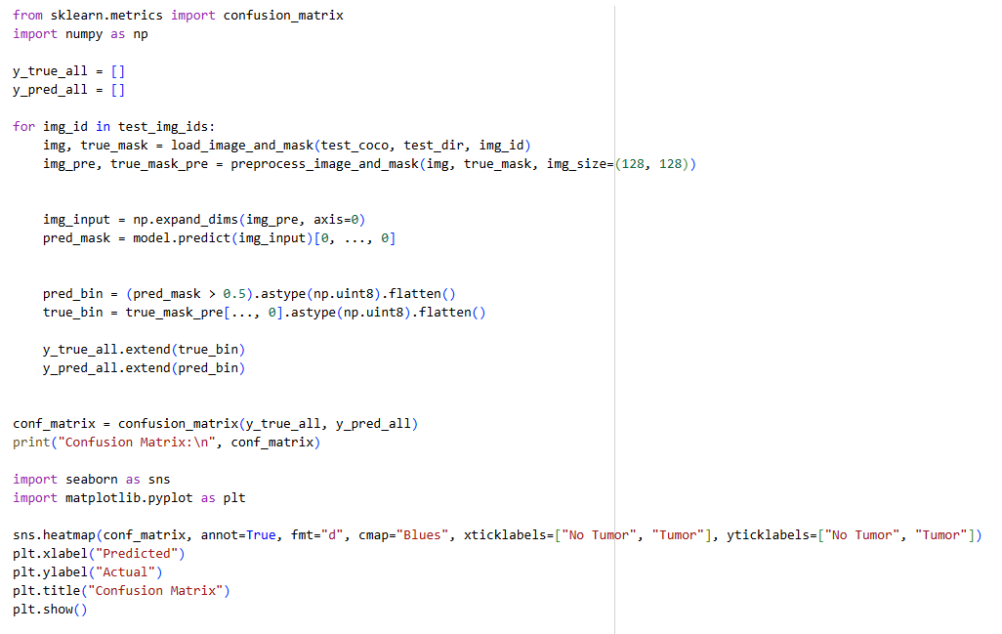
WalkThrough
Perform binary image segmentation on the test data using the trained model and then create confusion matrix

Slide 37
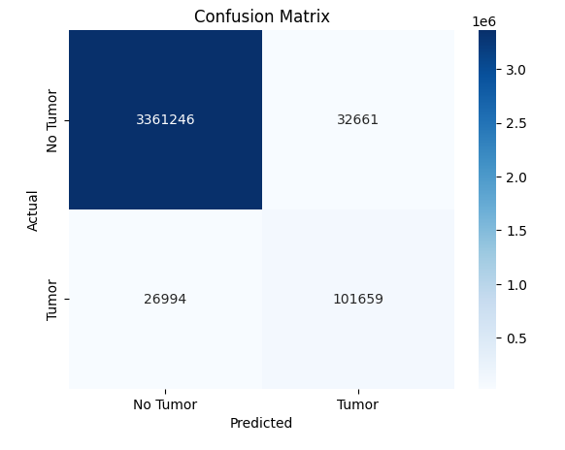
WalkThrough
My Confusion Matrix with my changes
Added dropout layer after last downsampling block
Added ElasticTransform to data augmentation
Both were suggestions made in the UNet paper that were not done in the tutorial I built off of

Slide 38
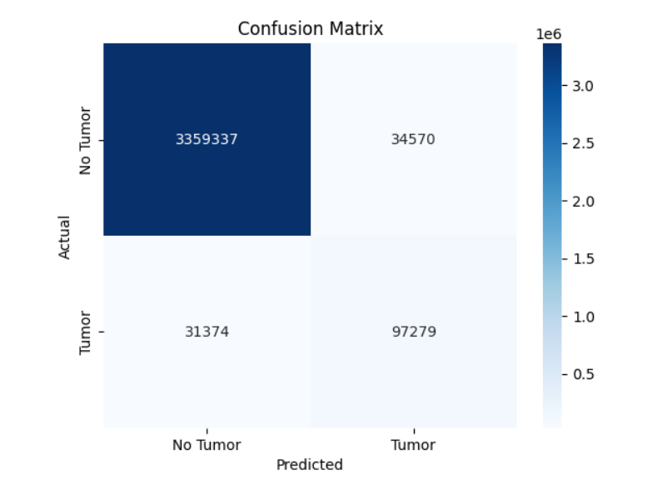
WalkThrough
This is the confusion matrix from the original tutorial i followed
My confusion matrix (previous slide) is overall better showing I improved the model
I have more True positive and True negatives
And I have less false positives and false negatives

Slide 39
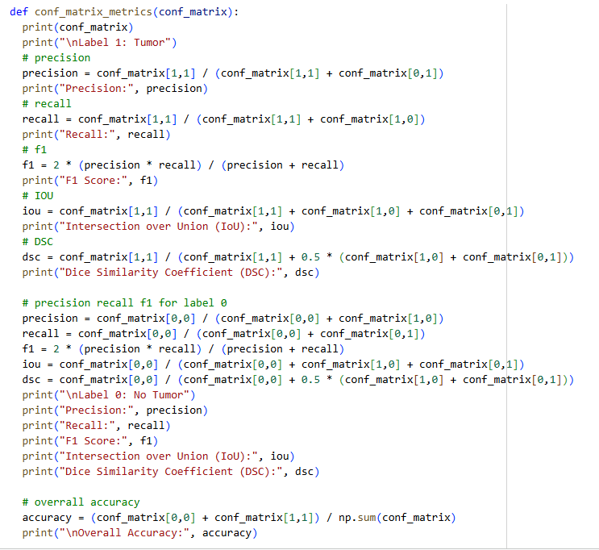
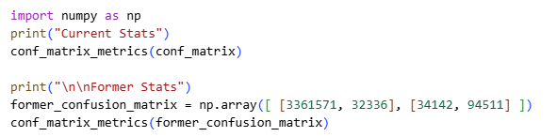
WalkThrough
Metrics

Slide 40
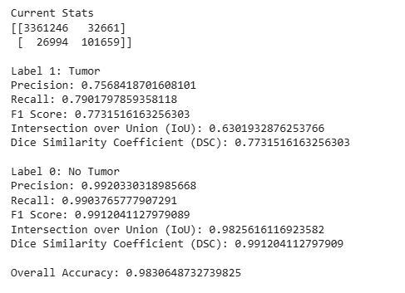
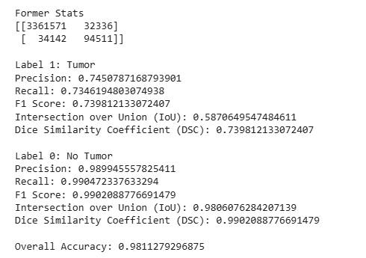
WalkThrough

Slide 41
WalkThrough
In previous slide current stats were the metrics for changes I made to the model (left pic)
Former stats were the metrics for the confusion matrix of the original tutorial that I ran (no changes to the tutorial) , (right pic)
These stats are from running the trained model on TEST data
I performed the set of metrics on both label 1 (tumor) and label 0 (no tumor)
Can clearly see increased IOU and DSC and just overall every metric is improved slightly with my changes

Slide 42
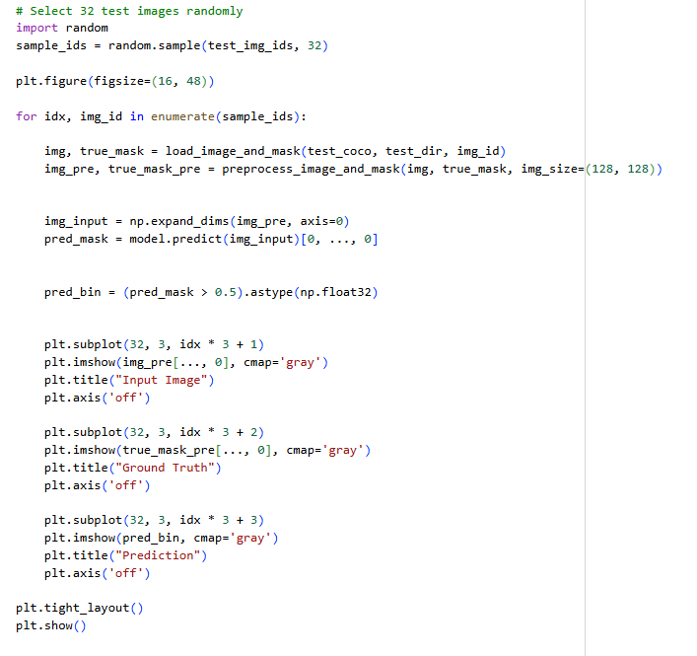
WalkThrough
Print test samples predicted and ground truth masks

Slide 43
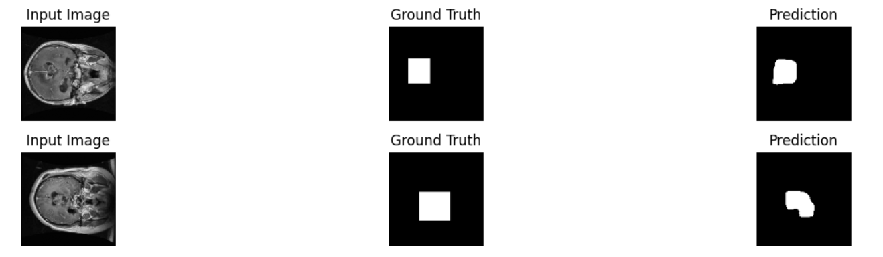

Slide 44
