Slide 1
Server-Sent Events

Slide 2
Overview
Server-Sent Events (SSE) is a server push technology enabling a client to receive automatic updates from a server via an HTTP connection.
Designed to enhance native, cross-browser streaming through a JavaScript API called EventSource.
EventSource API is standardized as part of HTML5 by the W3C.
On September 1, 2006, the Opera web browser implemented this new experimental technology in a feature called "Server-Sent Events".

Slide 3
Building a real-time web application
Short polling (client pull)
Long polling (client pull)
Server-Sent Events (server push)
WebSockets (server push)

Slide 4
Short Polling
Client makes a request to the server
Server can respond in two ways:
It sends an empty response
It sends data object in its body (JSON Object)
Client repeats the above process after a fixed delay.
Challenges
Establish a new connection (TCP, SSL, and Data)
Query for new data, respond in-deterministic
Closing connection and cleanup resources

Slide 5
Long Polling
Client makes a request to the server
Server can respond in two ways:
If it has some new data available, it can respond right away.
If it doesn't have anything new data, it will keep that connection open for a period of time and when it receives new data it will respond back with updated data.
Challenges
- Performance and scaling (resource-intensive)
- Data loss
- Message ordering and delivery when opening multiple connections

Slide 6
WebSockets
Real-time data transfer over a single TCP connection
Keeps a unique connection open, allowing messages to be passed back and forth
Headers are not sent every-time we need to get more information from the server.
Origin-based security model
Lightweight footprint on servers
Supports UTF-8 encoding and binary data
Challenges
Does not automatically recover when connections are terminated
Multiplexing over HTTP/2 is complicated
Use a library to tackle setups and complexities

Slide 7
SSE
One-way publish-subscribe model (Only Server -> Client data channel)
Standard JavaScript client API named EventSource
Multiplexing over HTTP/2 out of the box
Server can see that the client missed N number of messages with unique Id for messages
Clients automatically handle disconnections by reconnecting
Only UTF-8 decoding is supported, no binary data
No way to add headers with the EventSource object
Max of 6 client connections from a single host (HTTP/1.1)

Slide 8
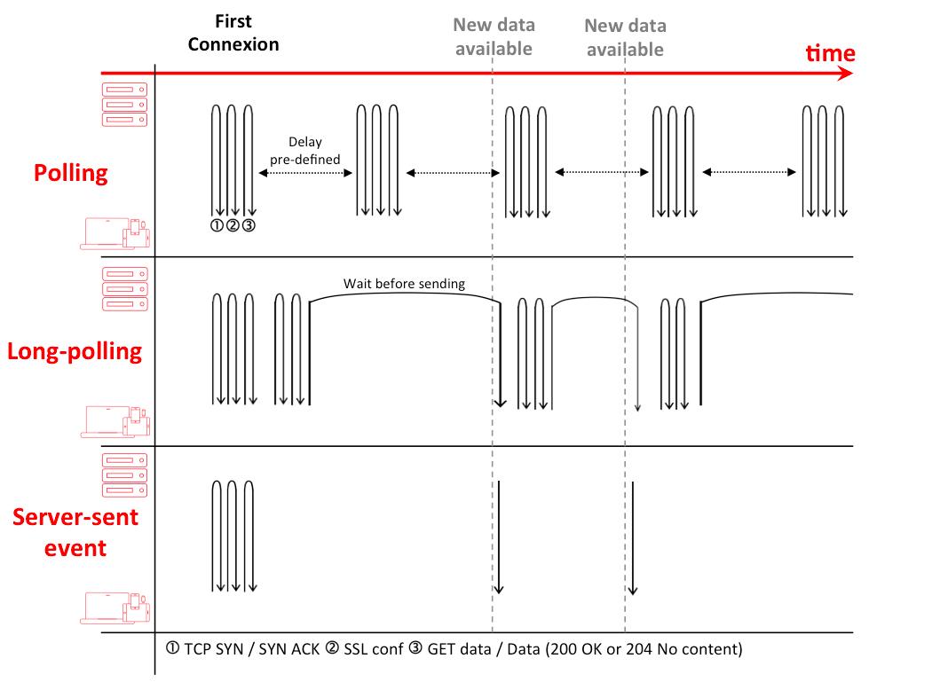

Slide 9
Generic server implementation
Server response headers
Content-Type: text/event-stream
Cache-Control: no-cache
Connection: keep-alive
Body encoding in UTF-8 in the following format
[field]: value\n
Field can have the following values
data
event
id
retry
: This is a comment ignored by browsers

Slide 10
Response data format
data
data: message\n\n
data: begin message\n
data: continue message\n\n
data: {\n
data: "foo": "bar",\n
data: "baz": 555\n
data: }\n\n
event
event: connected\n
data: User1 just got online\n\n
event: disconnected\n
data: generic unnamed event\n\n
retry
retry: 10000\n
id
id: 1\n
data: message1\n\n
id: X\n
data: messageX\n\n

