Slide 1

Introduction to WebAssembly
Ramin Jafary

Slide 2
What is WebAssembly?
WASM is a low-level, bytecode, and assembly-like language designed to run natively on the web.
Supported by major browsers like Chrome, Edge, Firefox, Safari, and Opera.
Initial version was launched in 2017 as an open standard created and maintained by W3C, Mozilla, Microsoft, Google, and Apple.
Execute efficient modern browser-based apps at high-performance levels without jeopardizing compatibility or security.
Compile target for programming languages like C/C++, C#, GO, and Rust, etc.

Slide 3
The Anatomy of WebAssembly
Values: There are currently four listed types, including integers and more sophisticated floating-point numbers
Module: It’s a piece of executable machine code compiled by the browser from WebAssembly binary. It has the .wasm file extension
Table: It is an array pointers to function memory locations.
Functions: Blocks of code that accept and return sets of values as parameters and outputs, respectively.

Slide 4
WASM Compilation
To compile WASM code, the browser’s Virtual Machine goes through three processes:
Decoding the modules
Compile, optimize, and validate the code against predefined criteria
Executing the compiled code

Slide 5
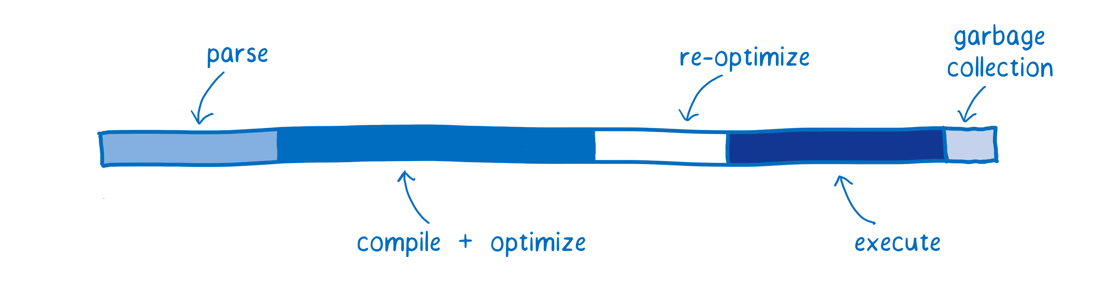
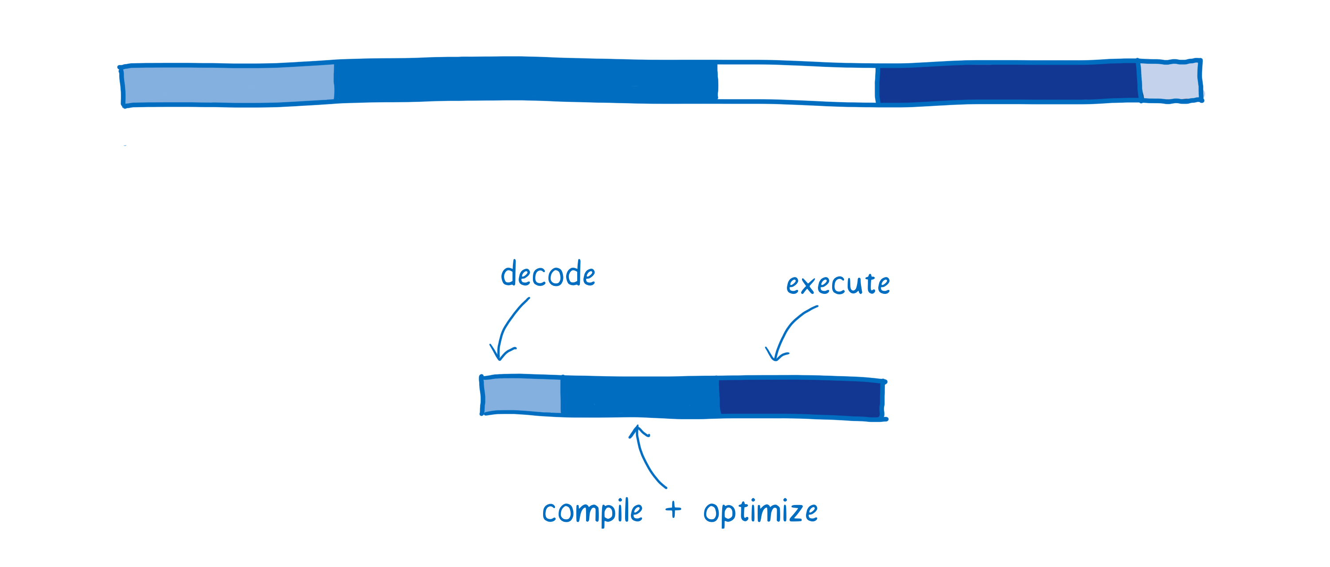
JS vs Wasm

Slide 6
JavaScript
Pros
Flexibility
Simplicity
Relatively Fast
Use Cases
Developing mobile applications
Creating User interfaces for Web Applications
Powering server-side applications using Node.js
Cons
Client-Side Security
Inconsistent Browser Support
Inefficient Debugging Support

Slide 7
WebAssembly
Pros
Fast performance (1.2x native speed)
Cross-Platform Support
Security
Use Cases
Hybrid-platform apps
Developing CPU intensive Games
High-performance scientific simulations
Music streaming and Image processing applications
Developing applications that encrypt sensitive data
Cons
Early Stage
Language Complexity
Imperfect Security

Slide 8
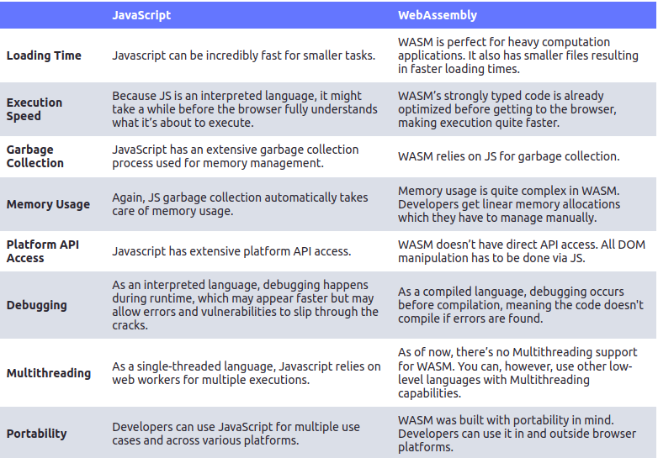

Slide 9
WebAssembly Syntax (wat)
S-expressions : A simple textual notation for representing trees. Basically, it is about nesting parenthesized lists.
Stack Machine: Each instruction pushes and/or pops a certain value to/from a stack.
(module
(func (export "main")
(result i32)
i32.const 42 ;; Pushes the 32-bit value x to the stack.
Return)) ;; Exits the current function and returns the value(s) on the top of the stack.

