Slide 1


Member Access Method Analysis
On REALTOR Website and App

Slide 2
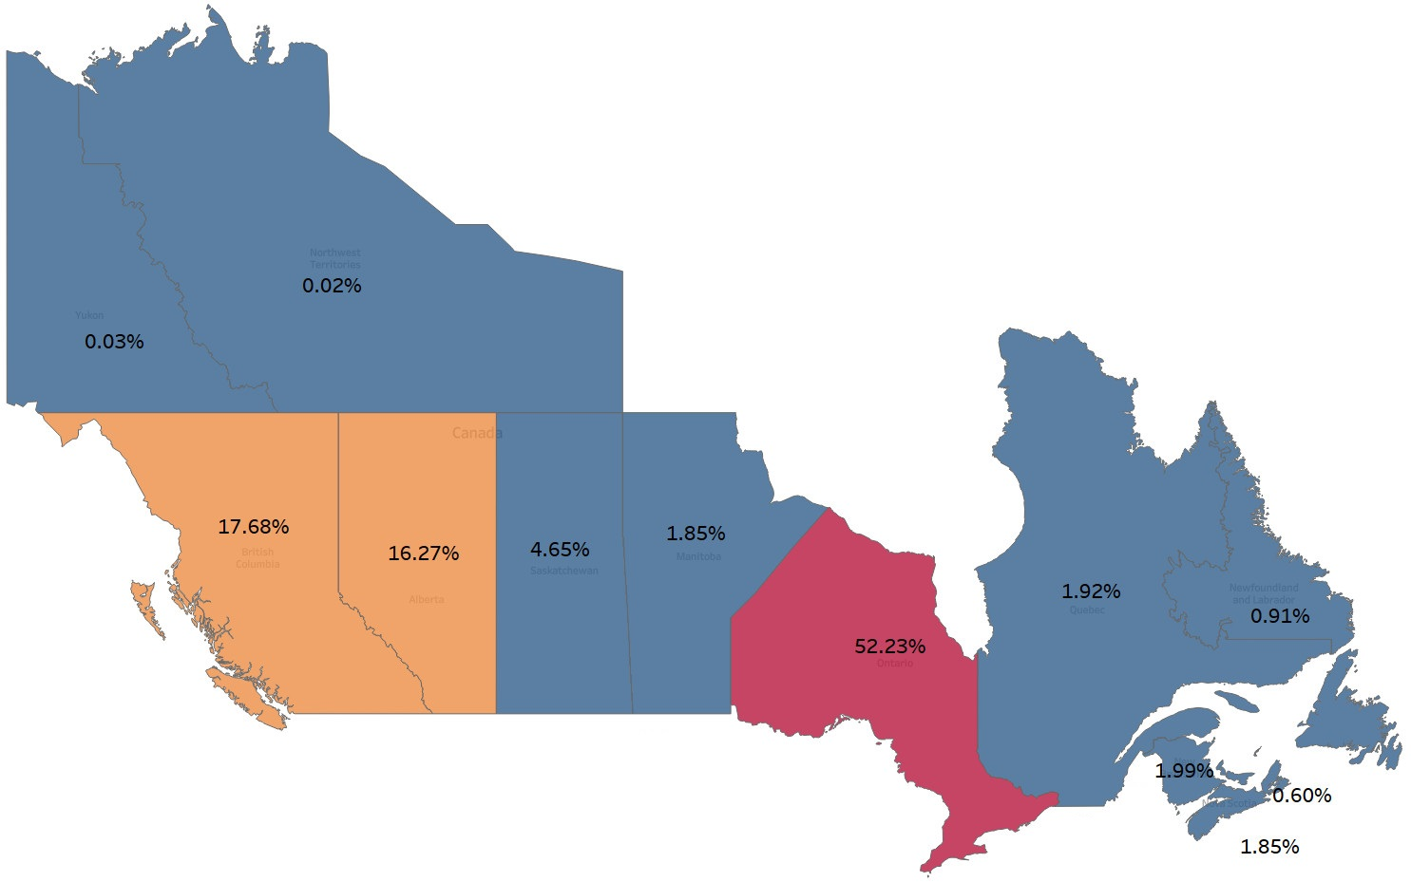
Slide 3
Distribution of Members across Canada
Input
01
144,637 Members Across Canada
and 10,995 Members that use Website, App or Both
Goal
02
Determining the Usage of the Website and App in each Board and Province
Approach
03
Explanatory Analysis on the Input Data by using Python Plotting Libraries and Tableau Software
Outcome
04
Result Interpretation and Storyboarding
1
Notes:
1- Information regarding website and app usage was provided for 8% of members based on the available data.
2- More than 86% of CREA members are in three provinces of Ontario, British Columbia, and Alberta.
3- Due to the high quantity of data in the three provinces of Ontario, British Columbia, and Alberta, our usage analytics will focus on these three provinces.

Slide 3
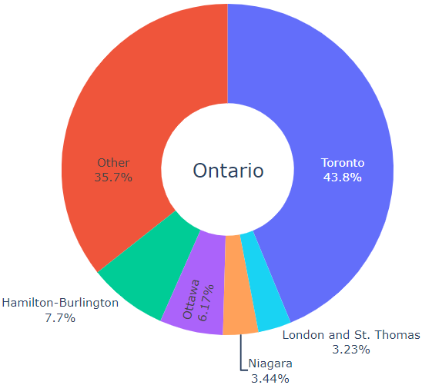
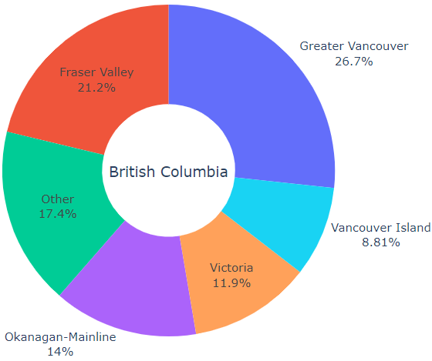
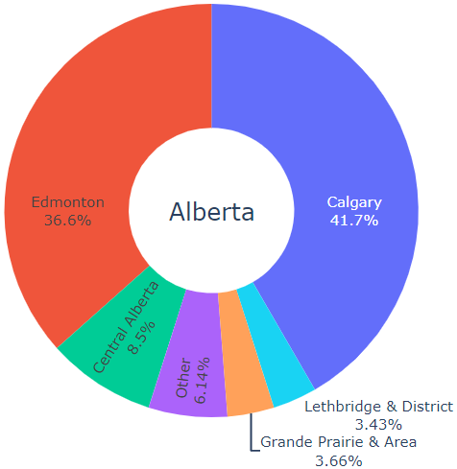
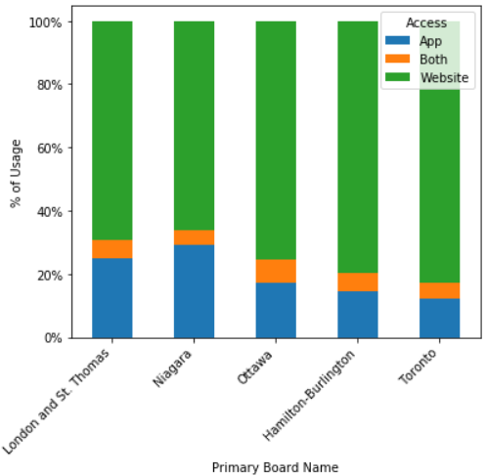
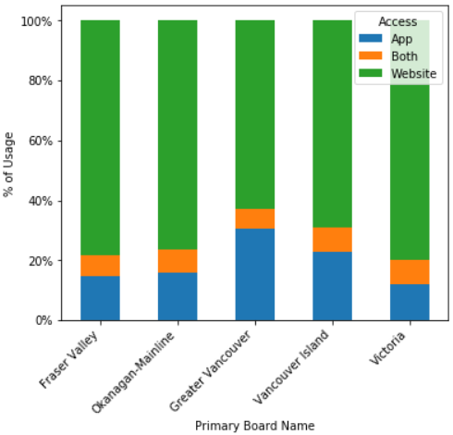
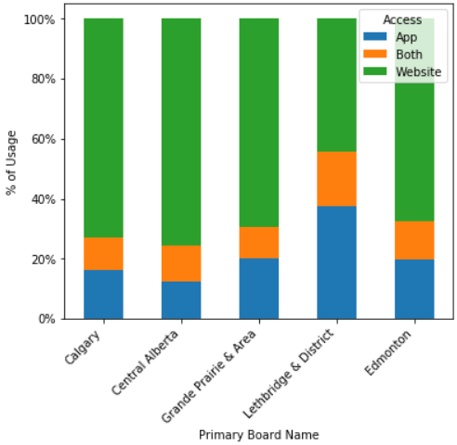
Slide 3
Usage Analysis in Boards of Top 3 Provinces
Your logo
2
Notes:
4- Toronto Real Estate Board has the highest number of members in Ontario
5- Due to the high number of Boards in Ontario, small Boards own a higher percentage of members in Ontario.
6- On average, 20% of members use the REALTOR app, 75% use the website, and 5% of members use both tools for having access to REALTOR in Ontario.
7- Niagara Association of Realtors has the highest rate of app usage across Ontario, and Toronto Real State Board has the lowest percentage.
8- Distribution of members across British Columbia shows that the number of members has proper distribution in different Boards.
9- Greater Vancouver and Fraser Valley Boards have the highest percentage of members in British Columbia
10- On average, 20% of members use the REALTOR app, 75% use the website, and 5% of members use both tools for having access to REALTOR in British Columbia.
11- Real Estate Board of Greater Vancouver has the highest rate of app usage across British Columbia, and Victoria Real State Board has the lowest percentage.
12- Distribution of members across Alberta shows that the Calgary Real Estate Board and REALTORS Association of Edmonton have more than 78% of members across Alberta.
13- On average, 20% of members use the REALTOR app, 75% use the website, and 5% of members use both tools for having access to REALTOR in Alberta.
14- Lethbridge & District Association of REALTORS has the highest rate of app usage across Alberta, and Central Alberta REALTORS Association has the lowest percentage.
15- More than 55% of members of the Lethbridge & District Association of REALTORS use the app, which is the highest rate across the top 3 provinces of Canada.
** Other plots and analytics regarding the other provinces have been done, and it is available in a separate Jupyter Notebook.

Slide 4
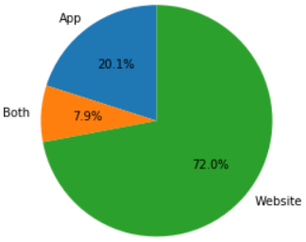
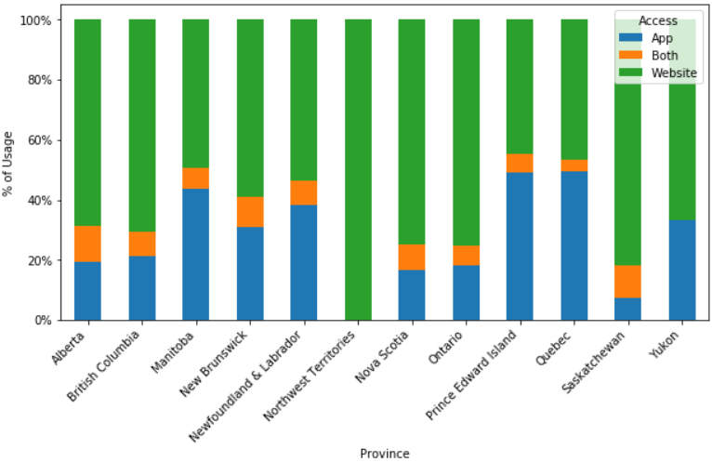
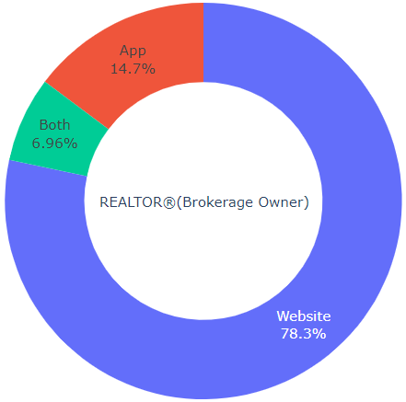
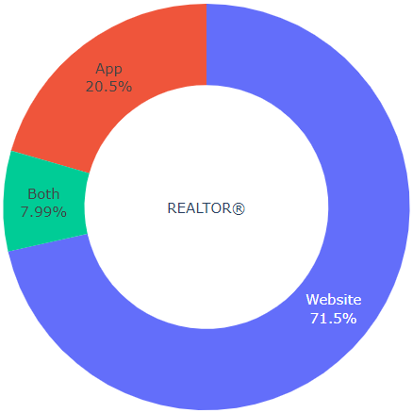
Slide 3
Member Access Type in Canada
Member Access Type in each Province
Member Contact Record Type in Canada
Your logo
3
Notes:
16- On average, 70% of members use the website as the primary tool to have access to their REALTOR account, and another 28% of members have this experience to use the app.
17- having data regarding the usage of the app during the time, the period that the app was available for members, and marketing methods for introducing the app to the members can give us more insight into the success and efficiency of the REALTOR app.
18- Brokerage owners use the website more than the app. This may demonstrate that members with a higher number of accesses to the REALTOR prefer the website, and this can have several reasons, such as having a higher access speed or being more user-friendly.
19- Analyzing member access to the app and website in different provinces shows that the app has the highest rate of usage in the three provinces of Manitoba, Quebec, and Prince Edward Island, and it has the lowest rate of usage in Northwest Territories with zero percentage of usage.
20- A higher proportion of app usage in provinces with the lower number of members shows that they probably had a higher chance of getting notified about the capabilities and benefits of using the app.
21- Providing a better experience, adding more features, and informing existing members about the benefits of using the app can increase the rate of app usage for REALTOR members.

Slide 5

Thank You
Ramin Mardani
(647) 769 5570
Ramin.Mardani@mail.utoronto.ca
www.raminmardani.github.io/index/

