Slide 1
MLBlocks: Arming FPGA architectures with Dense & Low Precision units in classic column based manner
Weight Stream to load
Weight Stream to load
DWConv & Standard Conv
PE
PE
PE
PE
PE
PE
DW_CH0
PE
PE
PE
-
PE
PE
PE
DW_CH1
DotPtoduct_0
PE
PE
PE
PE
PE
PE
BRAM18
Ch: 0 R: 0
DW_CH2
BRAM18
Ch: 0
PE
PE
PE
DotPtoduct_1
Ch: 1 R: 0
PE
PE
PE
DW_CH3
Ch: 1
DotPtoduct_2
Ch: 2 R: 0
Ch: 2
Ch: 3 R: 0
Ch: 3
BRAM18
Ch: 0 R: 1
BRAM18
Ch: 4
Ch: 1 R: 1
PE
PE
PE
Ch: 5
Ch: 2 R: 1
Ch: 6
PE
PE
PE
Ch: 3 R: 1
PE
PE
PE
Ch: 7
PE
Ch: 0 R: 2
PWConv & Matrix-Matrix Multiplication
Ch: 8
PE
PE
PE
BRAM18
Ch: 1 R: 2
PE
PE
PE
BRAM18
Ch: 9
PE
PE
PE
Ch: 2 R: 2
PE
PE
PE
Ch: 10
Ch: 3 R: 2
Ch: 11
PE
PE
PE
Reg
×
PE
PE
PE
+
Reg
PE
PE
PE
PE
PE
PE
PE
PE
PE
PE
PE
PE
PE
PE
PE
PE
PE
PE
Contributions:
1- Reconfigurable PE (DSP size, Systolic array, Column based)
6 times more 8x8 multiplier comparing to a DSP Block (two 8x8),
RS Data flow, High frequency, flexible data movement. Great for SConv, DWConv, PWConv, Matrix-Matrix Multiplication
DPS – BRAM ratio 1/1 (same as Ultrascale+ arch), Low number of intermediary outputs in practice
Parameterized (for any budget limitation) – can integrate multi precision idea
2- Compare with cascade paper (Prof. Nachiket)
3- new suggestion to use each 18KBRAM as 36bit streamer using external controler circuit (delivering 662MHz) (in cascade paper: 18bit)
PE
PE
PE

Slide 2
UltraScale+ architecture distribution:
URAM
BRAM18
DSP48
BRAM18
DSP48
BRAM18
DSP48
BRAM18
DSP48
BRAM18
DSP48
BRAM18
DSP48
URAM
BRAM18
DSP48
BRAM18
DSP48
BRAM18
DSP48
URAM
BRAM18
DSP48
BRAM18
DSP48
BRAM18
DSP48
BRAM18
DSP48
BRAM18
DSP48
BRAM18
DSP48
URAM
BRAM18
DSP48
BRAM18
DSP48
BRAM18
DSP48
URAM
BRAM18
DSP48
BRAM18
DSP48
BRAM18
DSP48
BRAM18
DSP48
BRAM18
DSP48
BRAM18
DSP48
URAM
BRAM18
DSP48
BRAM18
DSP48
BRAM18
DSP48
URAM
BRAM18
DSP48
BRAM18
DSP48
BRAM18
DSP48
BRAM18
DSP48
BRAM18
DSP48
BRAM18
DSP48
URAM
BRAM18
DSP48
BRAM18
DSP48
BRAM18
DSP48

Slide 3
Virtex 7 → 28nm DSP48E1 Fmax=742MHz
Virtex U→ 20nm
Virtex UP→ 16nm
4096x72
12
URAM
72
PE
BRAM18
b
res_out_v
9
72
a
a_out
Reg
Reg
State
Machine
s/u 8x8
mult.
b_addr
BRAM18
res_in_h
Shifter
res_out_h
+
Reg
res_in_v
b_out

Slide 4
Normal
H
L
H
L
LL
David’s
idea V2
HL
H
L
LH
H
L
HH
LL_{H}
HL
LH
David’s
idea
H
L
HH
H
L
L
HL
L_{H}
L_{L}
LH
L
HH
L_{H}
L_{L}
0
L_{H}
0
L_{H}
X

Slide 5
My amassing
MLBlocks world

Slide 6
URAM
BRAM18
DSP48
BRAM18
DSP48
BRAM18
DSP48
Reg
W1
BRAM18
DSP48
BRAM18
DSP48
BRAM18
DSP48
R1
Reg
Reg
W2
URAM
BRAM18
DSP48
BRAM18
DSP48
BRAM18
DSP48
R2
W3
URAM
BRAM18
DSP48
BRAM18
DSP48
BRAM18
DSP48
R3
R4
R5
R6
BRAM18
DSP48
BRAM18
DSP48
BRAM18
DSP48
URAM
BRAM18
DSP48
BRAM18
DSP48
BRAM18
DSP48
W3
W2
W1
R3
R2
R1
URAM
DSP48
DSP48
DSP48
3-Dot
Product
BRAM18
BRAM18
BRAM18
R4
BRAM18
DSP48
BRAM18
DSP48
BRAM18
DSP48
URAM
R5
BRAM18
DSP48
BRAM18
DSP48
BRAM18
DSP48
R6
URAM
BRAM18
DSP48
BRAM18
DSP48
BRAM18
DSP48
R7
BRAM18
DSP48
BRAM18
DSP48
BRAM18
DSP48
URAM
BRAM18
DSP48
BRAM18
DSP48
BRAM18
DSP48

Slide 7
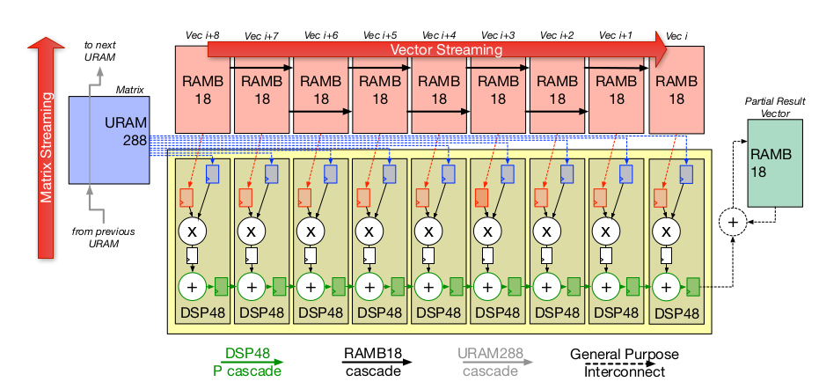
Each 9 clocks
0,0
0,1
1,0
0,2
1,1
2,0

Slide 8
_{Dis Parallel:}
1- more fan in and outs (since we are talking about small Pes it is fine)
_{Dis Systolic:}
1- tougher scheduling, rythmic scheduling
2- prevent circuit fusions (less optimization)
parallel
unrolled
Each algorithm loop
(such as B)
Systolic
Sequential
B = B_{Seq} × B_{par} × B_{Sys}
# of Physical MAC: × B_{par} × B_{Sys}
# of Input: × B_{par} (without internal serial to parallel)
# of Output: × B_{par}

Slide 9
Params = {right side indexes}
for param^{i}_{sch_0}: 0 → sch^{i}_0
for param^{i}_{sch_1}: 0 → sch^{i}_1
for param^{i}_{sch_2}: 0 → sch^{i}_2
for param^{i}_{seq}: 0 → comp_seq^{i}
for param^{i}_{un}: 0 → comp_un^{i}

Slide 10
URAM
BRAM18
DSP48
DSP48
Three DSP-size (three-BRAM size)
BRAM18
URAM
BRAM18
Ch: 0 R: 0
DSP48
Ch: 1 R: 0
FF
FF
FF
×
×
×
BRAM18
×
×
×
PR0
PR1
PR2
DW0
BRAM18
Ch: 0 R: 1
×
×
×
PW0
+
Ch: 1 R: 1
0
BRAM18
DSP48
PW2
BRAM18
Ch: 0 R: 2
×
×
×
PW1
Ch: 1 R: 2
×
×
×
PR0
PR1
PR2
DW1
BRAM18
DSP48
×
×
×
6 points DotProduct
DSP48
9 points DotProduct
BRAM18
DSP-size (BRAM-size) (simplified PIR-DSP)
BRAM18
DSP48
8bit
×
×
×
RW0
BRAM18
Ch: 0 R: 0
FF
FF
FF
PW0
+
BRAM18
DSP48
Ch: 1 R: 0
0
PW2
8bit
PW1
BRAM18
DSP48
2 points DotProduct
48bit 6x8
×
×
×
RW1
3 points DotProduct

Slide 11
URAM
BRAM18
DSP48
6x3=18 Streams
BRAM18
Ch: 0 R: 0
DSP48
Ch: 1 R: 0
FF
FF
FF
×
×
×
BRAM18
×
×
×
PR0
PR1
PR2
DW0
URAM
BRAM18
Ch: 0 R: 1
×
×
×
PW0
+
Ch: 1 R: 1
0
BRAM18
DSP48
BRAM18
Ch: 0 R: 2
×
×
×
DW1
Ch: 1 R: 2
×
×
×
PR0
PR1
PR2
BRAM18
DSP48
×
×
×
BRAM18
Ch: 2 R: 0
DSP48
Ch: 3 R: 0
×
×
×
BRAM18
×
×
×
PR0
PR1
PR2
DW2
BRAM18
Ch: 2 R: 1
×
×
×
PW1
Ch: 3 R: 1
BRAM18
DSP48
BRAM18
Ch: 2 R: 2
×
×
×
DW3
Ch: 3 R: 2
×
×
×
PR0
PR1
PR2
BRAM18
DSP48
×
×
×
BRAM18
Ch: 4 R: 0
DSP48
Ch: 5 R: 0
×
×
×
BRAM18
×
×
×
PR0
PR1
PR2
DW4
BRAM18
Ch: 4 R: 1
×
×
×
PW2
Ch: 5 R: 1
BRAM18
DSP48
BRAM18
Ch: 4 R: 2
×
×
×
DW5
Ch: 5 R: 2
×
×
×
PR0
PR1
PR2
×
×
×
6x3=18 Streams
6Ch-SConv

Slide 12
DSP-size (BRAM-size)
8bit
×
×
×
RW0
+
BRAM18
Ch: 0 R: 0
8bit
FF
FF
FF
RW1
0
Ch: 1 R: 0
×
×
×
RW2
8bit
×
×
×
8bit
×
×
×
RW3
48bit 6x8
BRAM18
Ch: 0 R: 0
Ch: 1 R: 0
Ch: 2 R: 0
Ch: 3 R: 0
8bit
×
+
RW0
FF
FF
FF
×
+
+
×
0
+
0
a
8bit
×
+
RW1
×
+
×
0
+
b
8bit
×
+
RW2
×
+
×
0
+
c
a
8bit
×
+
RW3
b
×
+
c
48bit 6x8
×

Slide 13
DSP-size (BRAM-size)
BRAM18
Ch: 0 R: 0
Ch: 1 R: 0
BRAM18
Ch: 0 R: 0
Ch: 1 R: 0
Ch: 2 R: 0
Ch: 3 R: 0
8bit
RW0
FF
×
FF
×
FF
+
+
+
0
8bit
FF
FF
RW1
×
×
8bit
+
+
RW2
8bit
RW3
48bit 6x8

Slide 14
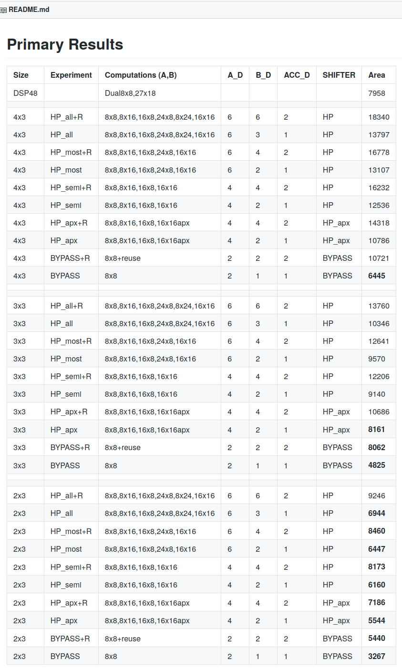

Slide 15
412MHz without pipeline
Counter
PE Control signals
MLBlobk - PEFlex

Slide 16
For reusement:
Each extra reusement requires one more results register
8
X
8
8
16
16
X
16
X
8
X
16
8
24
X
24
X
8

Slide 17
Why Dot product comparing to Systolic?
Circuit fusion and optimisation
Both have same unrolling factor
Efficient pipelining rather than structured pipelines
Register replacing and retiming
Systolic are designed for better scaling (we are focusing on PE design which is small size)
  If we talk for inside a PE ==> dot-product is better
  If we explore PE-PE structure ==> Systolic manner
Vector unit or systolic? Number of IO is much better in Systolic arrays
My MLBlock benefit both Systolic-array and dot-product based accelerators.
  Without using Systolic interconnections: MLBlock = a dot-product unit. Great for Supertile
  Using interconnections: MLBlock = a column based systolic array structure Great for TPU/SeanFPT like

Slide 18
IO requirements
Types:
  Stream (Windowing) vs RAM:
    Reasonable windowing
  # of IOs
    Less out
    Maximum input

Slide 19
For every parameter in a given algorithm
P = P_{Comp_Sch} x P_{Comp_PE}
P_{Comp_Sch} = П P_{Sch-i}
P_{Comp_PE} = P_{Comp_Un} x P_{Comp_Seq}
_{IO aspect of a PE}
P_{Comp_Un} x P_{Comp_Seq} = P_{IO_Un} x P_{IO_Seq}
P_{IO_Seq} : dictate the clock cycles for fully recharge
P_{IO_Seq} should be

Slide 20
For every parameter in a given algorithm
Required Multipliers = П P_{comp_PE}
P_{Comp_Un} x P_{Comp_Seq} = P_{IO_Un} x P_{IO_Seq}
P_{IO_Seq} : clock cycles for fully recharge
P_{Comp_Seq} :

Slide 21
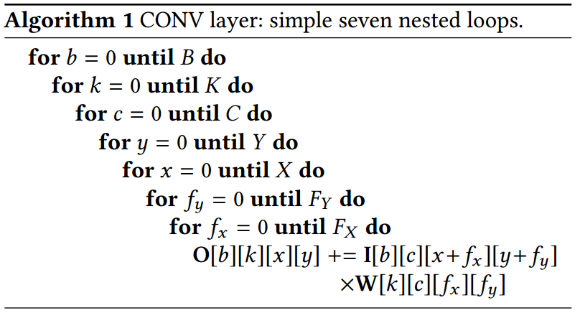
Extracting from
Algorithm
Index | I | W | O | Mult
B | n | 1 | n | n
K | 1 | n | n | n
C | n | n | 1 | n
Y | n | 1 | n | n
X | n | 1 | n | n
Fy | n | n | n | 1
Fx | n | n | n | 1
Each index affect everyplace if it is used there. example:
“b” is used in “O” and “I”. Thus having n times unrolling “b” requires:
1) n times more output result signals
2) n times more input signals
3) as it is used for “I” in multiplication. It requires n times more Multipliers.
4) There is no effect on “W”
Streaming does not affect anything.
Streaming + Windowing reduces the IOs by saving them inside
Who can be windowed? The elements of input’s or weight’s indexes which includes more than one elements (each element has the chance to be choosen).
X, Fx, Y, Fy all are the candidates. Selecting one or more is acceptable. Since they are in “I”, they just affect the “I” requirements. The affects of selecting a variable to be windowed is the added shift registers and in adition to unrolled regisres which can be relaised by the algorithm and loop orders.

Slide 22
For every parameter in a given algorithm

Slide 23
Precision
Maybe 9x9 is better than 8x8
It is Xilinx style
Fit BRAM well and URAM in a good shape (URAM’s width = 72 = 8*9. So both 8 and 9 are great.
Then supporting 27x18 is available (keep in mind that Acc width is pain full. 45 bits at least).
  A size: 3
  B size: 2 x reuse
  Acc size: reuse x (at least 45)

Slide 24
Reusement
Reusement factor for different layers (for input act)
Standard: KKC
DW: C
PW: C
FC: C
Mat-Mat Mult: C

Slide 25
Which PE arch to pick?
Highest utilisation rate.
Power will be managed by scheduling (Stanford paper): Power analysis on PE structure is generally non significant
Scalability
Flexible precision
Reusement
Less partial outputs
Don’t trust on batch parallelism since it is not the case for embedded designs
Limited number of multipliers

Slide 26
Ideas
Lop-based model→ for different algorith → ASIC PE
Bench marking by Ideal PE archs(from 1) of current architectures (How well archs can implement the Ideal PEs)
How Synthetic arch can be generated?

Slide 27
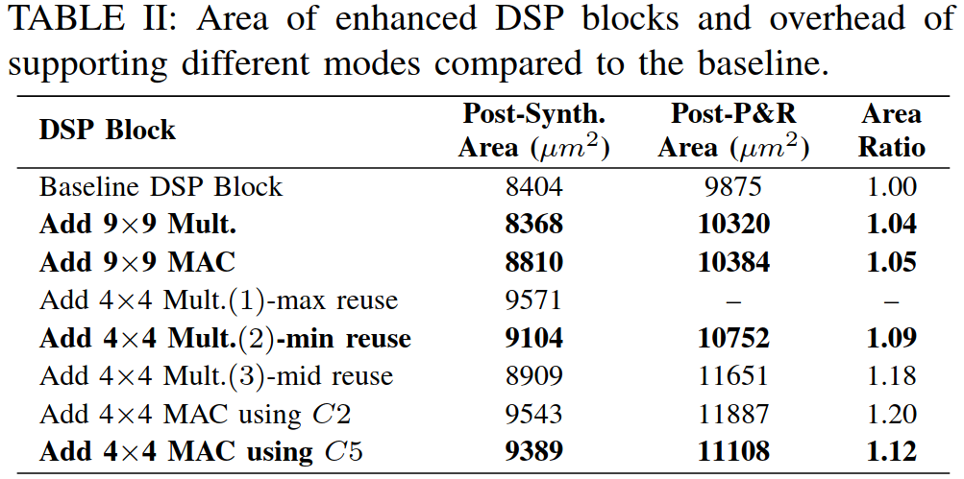
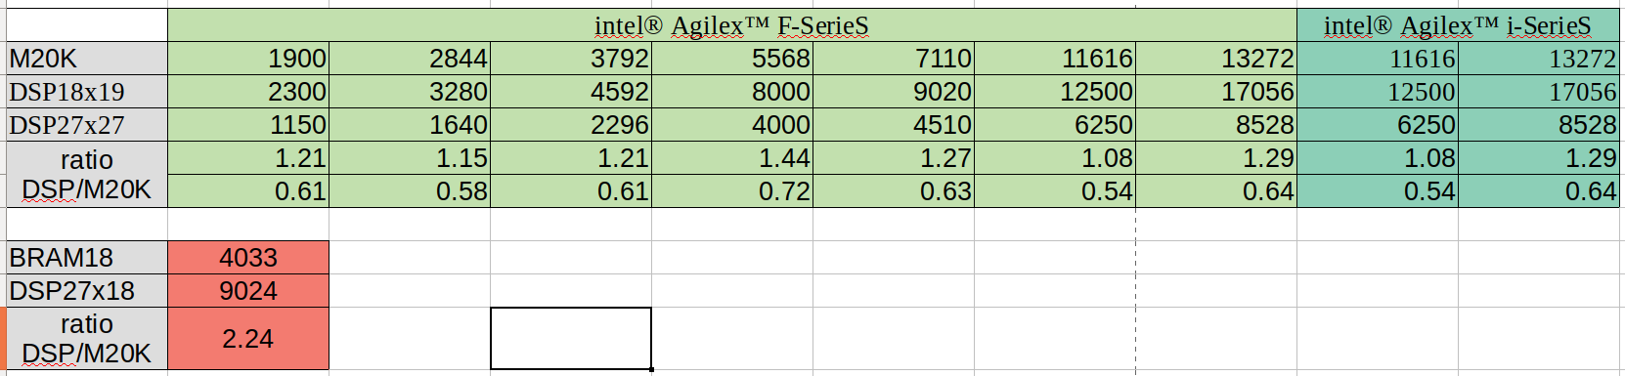
Intel Architecture
Same as Xilinx
DSP is bigger, BRAM is bigger as well
DSP 28nm:

Slide 28
Roofline model
Mem band width
MLBlobk + DSP
MLBlobk
DSP+LUT+BRAM
DSP+LUT
DSP

