Slide 1

MLBlocks: FPGA Blocks for Machine Learning Applications
SeyedRamin Rasoulinezhad, David Boland, and Philip H.W. Leong
School of Electrical and Information Engineering, The University of Sydney
Notes:
Abstract—Abstract—Quantization is a key optimization strategy to improve the performance of floating-point deep neural network (DNN) accelerators. Digital signal processing (DSP) blocks on field-programmable gate arrays are not efficiently utilized when the accelerator precision is much lower than the DSP precision. Through three modifications to Xilinx DSP48E2 DSP blocks, we address this issue for important computations in embedded DNN accelerators, namely the standard, depth-wise, and pointwise convolutional layers. First, we propose a flexible precision, run-time decomposable multiplier architecture for CNN implementations. Second, we propose a significant upgrade to DSPDSP interconnect, providing a semi-2D low precision chaining capability which supports our low-precision multiplier. Finally, we improve data reuse via a register file which can also be configured as FIFO. Compared with the 27 × 18-bit mode in the Xilinx DSP48E2, our Precision, Interconnect, and Reuse-optimized DSP (PIR-DSP) offers a 6× improvement in multiply-accumulate operations per DSP in the 9 × 9-bit case, 12× for 4 × 4 bits, and 24× for 2 × 2 bits. We estimate that PIR-DSP decreases the run time energy to 31/19/13% of the original value in a 9/4/2-bit MobileNet-v2 DNN implementation.
Biography
Philip Leong received the B.Sc., B.E. and Ph.D. degrees from the University of Sydney. In 1993 he was a consultant to ST Microelectronics in Milan, Italy working on advanced flash memory-based integrated circuit design. From 1997-2009 he was with the Chinese University of Hong Kong. He is currently an Associate Professor in the School of Electrical and Information Engineering at the University of Sydney, a Visiting Professor at Imperial College, London and the Chief Technology Advisor to Cluster Technology.
He was the co-founder and program co-chair of the International Conference on Field Programmable Technology (FPT); program co-chair of the International Conference on Field Programmable Logic and Applications (FPL) and is an associate editor for the ACM Transactions on Reconfigurable Technology and Systems. The author of more than 100 technical papers and 4 patents, Dr. Leong was the recipient of the 2005 FPT conference Best Paper as well as the 2007 and 2008 FPL conference Stamatis Vassiliadis Outstanding Paper awards.
<number>

Slide 2
Motivation
Observation:
FPGA architectures are Optimized for networking, signal/image processing using high-precision DSP blocks
DSP48 → 27×18 multiplier, 48-bit Accumulation or two one input shared 8x8 MACs
Previous works:
Enhancing existing DSP blocks: PIR-DSP [1], Boutrous et al [2], Intel Agilex Architecture
Works on logic elements: LUXOR [3], Boutros et al. [4]
Integrating domain-specific engines: Xilinx Versal AI-engines
Fundamental issue: They do not address the shortcomings of current FPGA architectures
Designing a new embedded block: Hamamu [5], Achronix MLP72
Aim: How to design a new block by a systematic fashion targeting future workloads
1

Slide 3
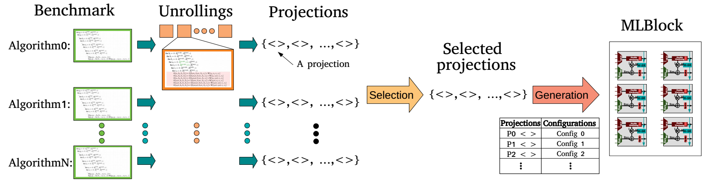
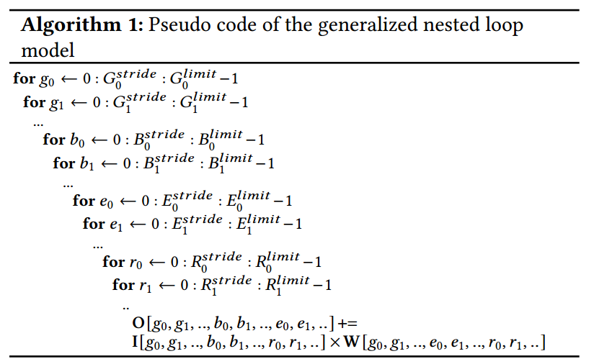
Overview and Generalized nested loop model
Four loop variable groups:
Reduction(IW) → reuse of temporary O
Like: dot product
Expansion(WO) → reuse of I
Batching(IO) → reuse of W
Grouping(IWO) → computation replication
Used in depth-wise and grouped convolution
1

Slide 4
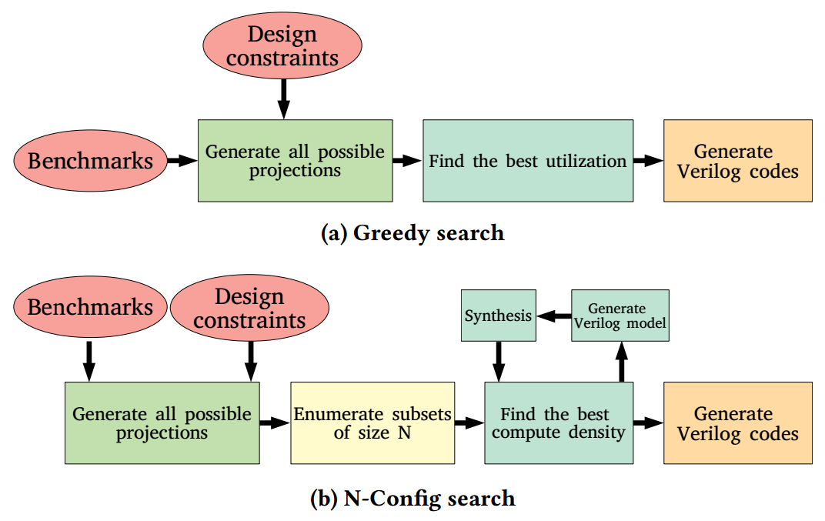
Projection selections
1

Slide 5
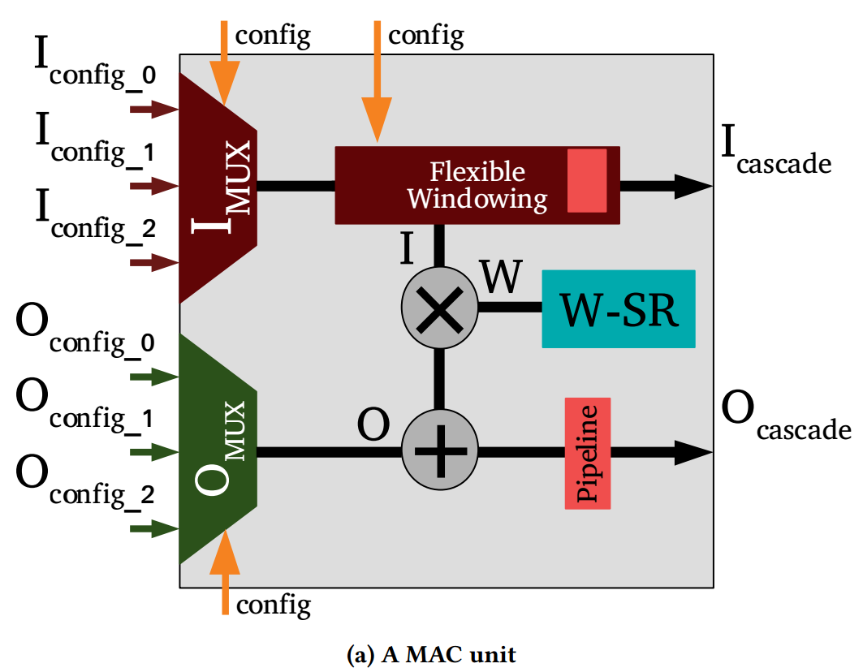
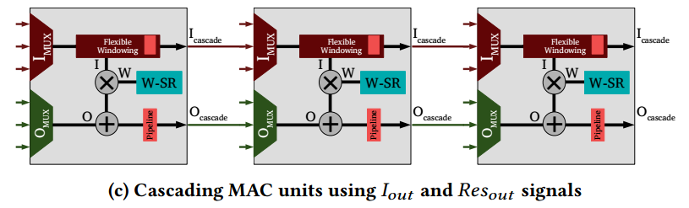
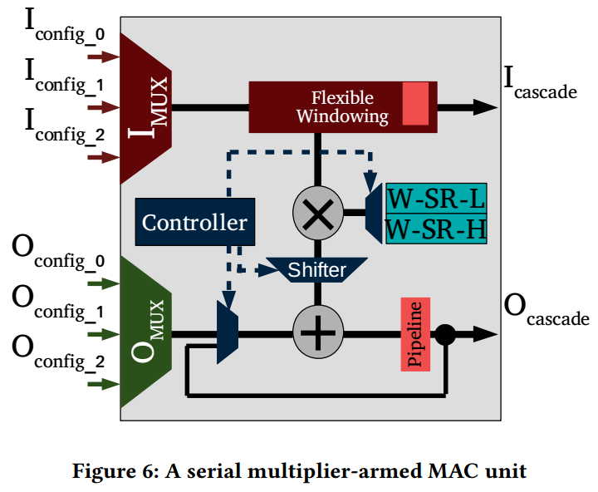
Micro Architecture
+ Serial Multiplier
1

Slide 6
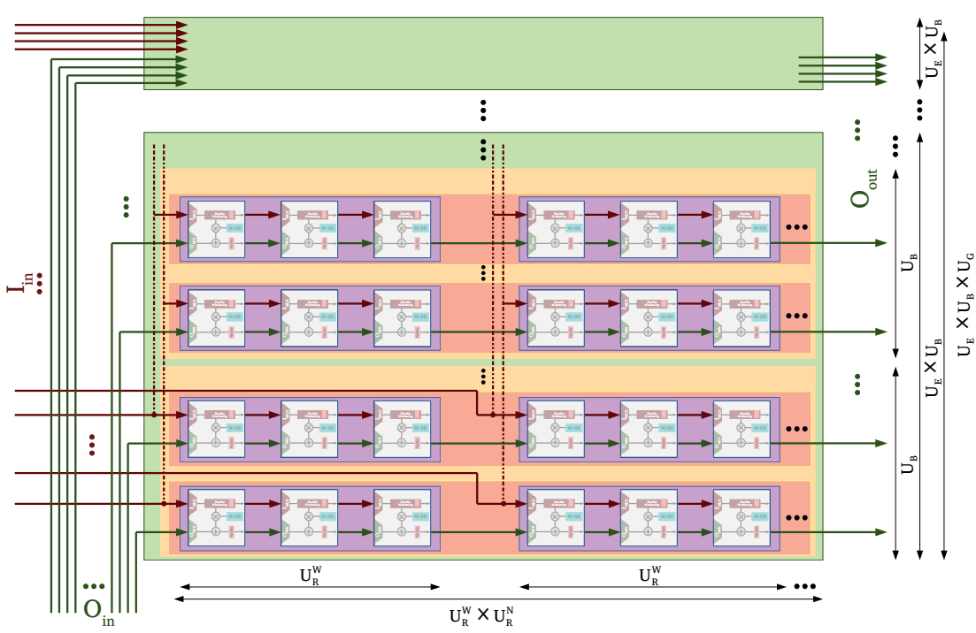
Macro Architecture
Each selected projection maps to an MLBlock configuration
A projection routing:
1

Slide 7
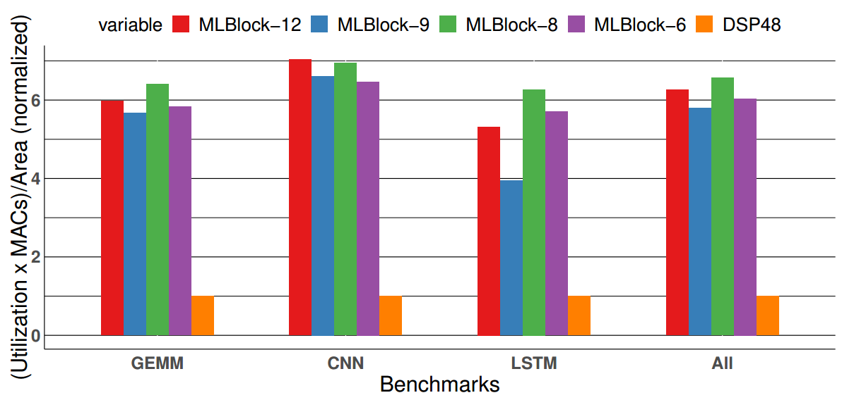
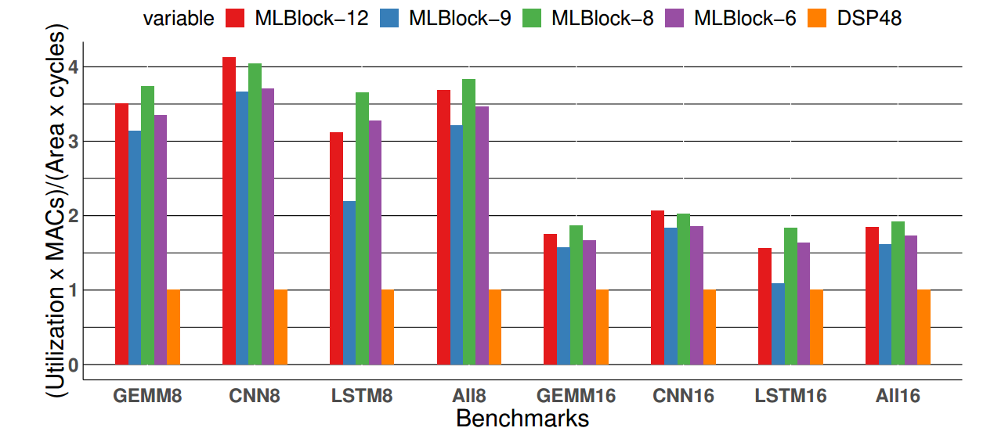
Results – DSP48-like MLBlocks
Assumptions:
Greedy projection selection
DSP48 IO and Area constraints
Compute density improvement:
Only 8x8 (top)
8x8, 8x16, 16x8, 16x16 (down)
1

Slide 8
Conclusion
Briefly our contributions are:
A Methodology for designing coarse-grained embedded blocks for machine learning applications.
MLBlocks, a parameterized embedded block architecture
Two configuration selection techniques, called Greedy and heuristic
A python based framework to generate hardware description of an efficient MLBlock instance for a given set of constraints
Conclusions:
Using Xilinx DSP48 constraints, our approach results to embedded blocks with 6 times more compute density
1

Slide 9
References
[1] S. Rasoulinezhad, H. Zhou, L. Wang, and P. H. W. Leong, PIR-DSP: an FPGA DSP block architecture for multi-precision deep neural networks, FCCM 2019,
[2] A. Boutros, S. Yazdanshenas, and V. Betz, Embracing diversity: Enhanced DSP blocks for low-precision deep learning on FPGAs, FPL 2018
[3] S. Rasoulinezhad, Siddhartha, H. Zhou, L. Wang, D. Boland, and P. H. W. Leong, LUXOR: an FPGA logic cell architecture for efficient compressor tree implementations, in FPGA ’20
[4] A. Boutros, M. Eldafrawy, S. Yazdanshenas, and V. Betz, Math doesn’t have to be hard: Logic block architectures to enhance low-precision multiply-accumulate on FPGAs, FPGA 2019
[5]A. Aror, Z. Wei2, and L. K. John, Hamamu: Specializing FPGAs for ML Applications by Adding Hard Matrix Multiplier Blocks, ASAP20
1

Slide 10
Spare Slides
1

Slide 11
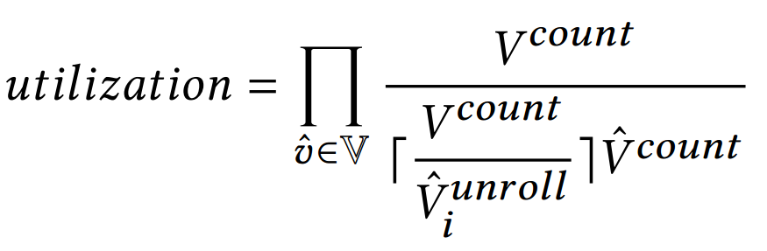
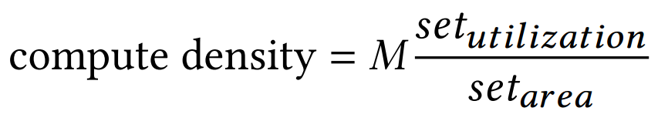
Projection selections
1

Slide 12
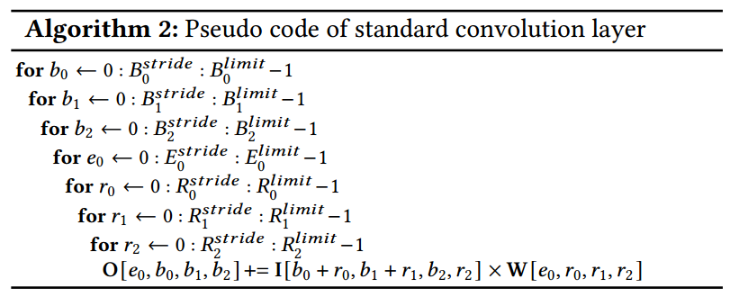
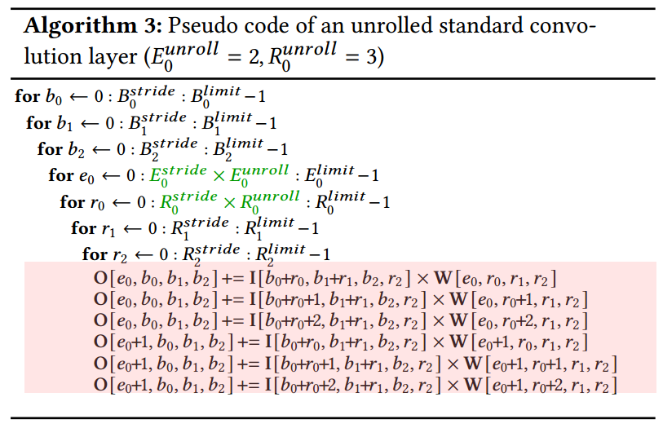
Unrolling
Unroll
Unrolling a variable increases the number of:
MACs by the same factor
IO (I W O) where the variable accesses
Variables in the same group
Have the same characteristics
Describe dimensions of the same access pattern
Example: in a Convolution layer x and y are similar when f_{x} is different (respectively B2, B1, R2)
An Exception: Some variables in Reduction group can be windowed → we a separate them as two subgroups for Reduction group called, Windowed and NonWindowed.
1

Slide 13
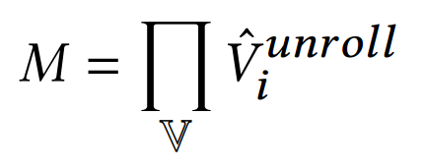
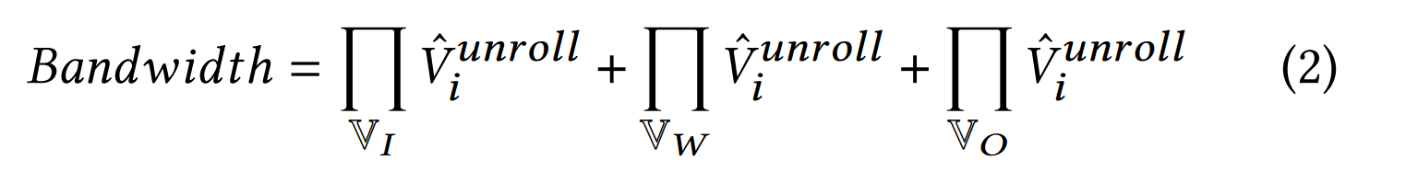
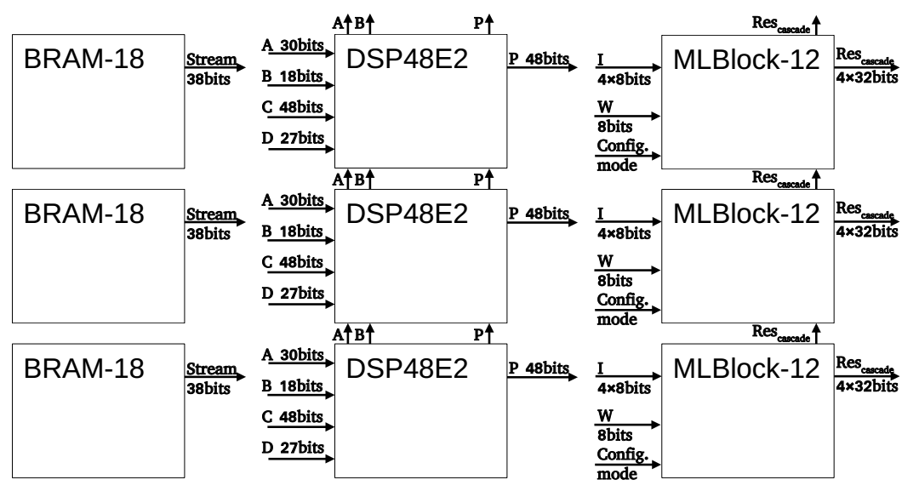
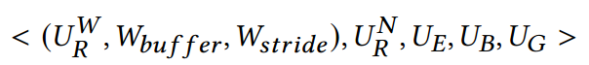
Projections
We define unrolling degree for each group:
Then total number of MACs and required IOs are as follows:
Where , , , are all variables, and the variables appeared in I, W, and O respectively
A projection is a circuit abstraction based on unrolling degrees and windowing details:
A projection maps to a block configuration
Finding projection is non-invertible, So, more than one unrolling could be mapped to a projection
1

Slide 14
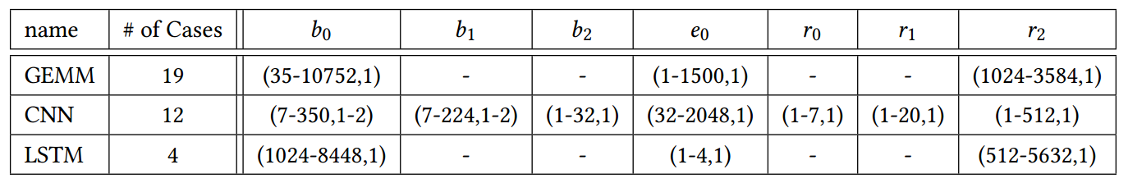
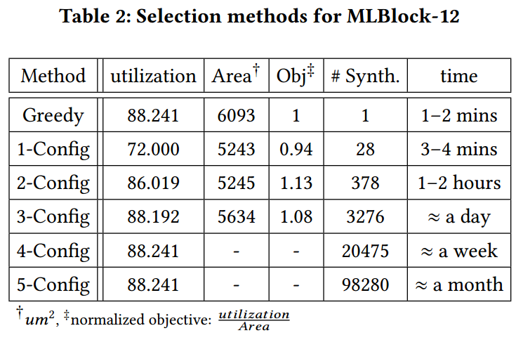
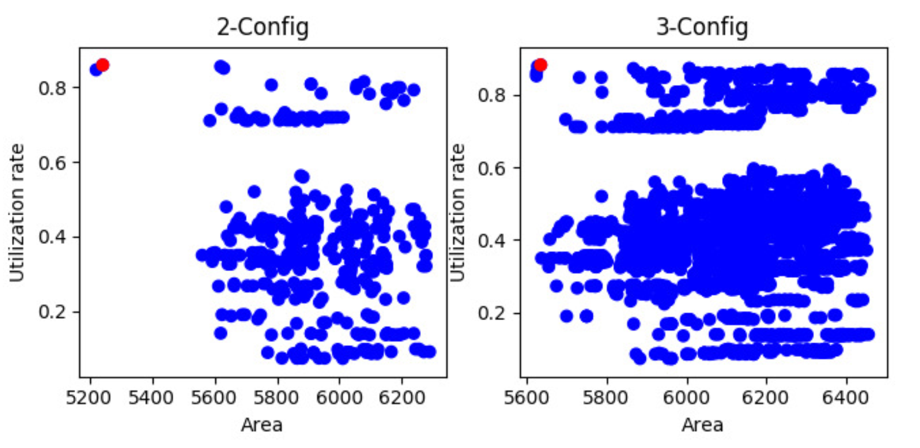
Results - Projection Selections
Benchmarks: Selected kernels from DeepBench-Baidu [25], for Training/inference tasks.
Greedy vs N-Config
<number>

Slide 15
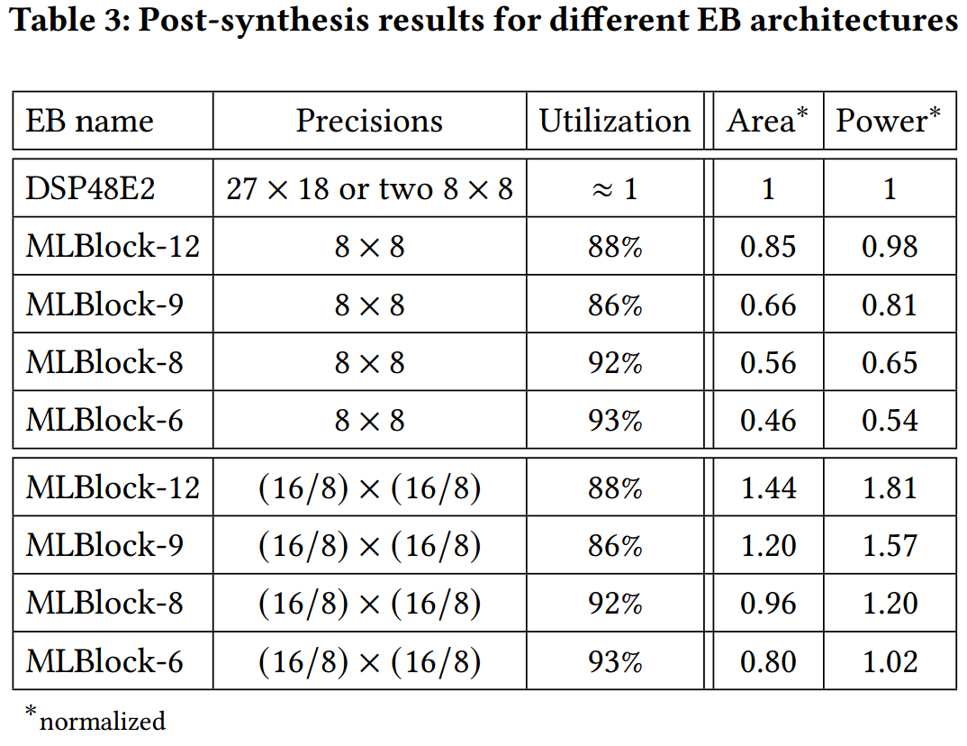
Results – DSP48-like MLBlocks
Using greedy approach for projection selection
<number>

