Slide 1
Design
constraints
Benchmarks
Generate all possible
projections
Find the best utilization
Generate
Verilog codes
a) Heuristic
Benchmarks
Design
constraints
Synthesis
Generate
Verilog model
Generate all possible
projections
Enumerate subsets
of size N
Find the best
compute density
Generate
Verilog codes
b) N-Config search

Slide 2
Design
constraints
Benchmarks
Pick all configurations which are
necessary to delivering the highest utilization
Generate
Verilog model
a) Heuristic
Design
constraints
Synthesis
Generate
Verilog model
Benchmarks
Generate All possible
Configurations
Find the best perform
N-combinations
of Configurations
Generate
Verilog model
b) N-Config search

Slide 3
Design
constraints
Benchmarks
Find valid
unroll instances
Pick the best
Perform Unroll
instance set (Utilization)
Generate Block
Configurations
Generate
Verilog model
a) Heuristic
Design
constraints
Synthesis
Generate
Verilog model
Benchmarks
Find valid
unroll instances
Generate All possible
Block Configurations
Find the best perform
N-combinations
of Configurations
Generate
Verilog model
b) N-Config search

Slide 4
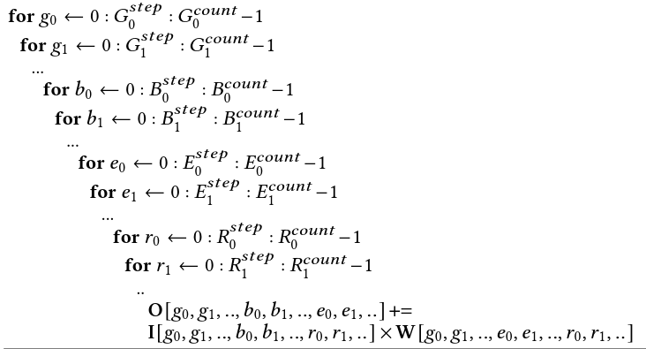
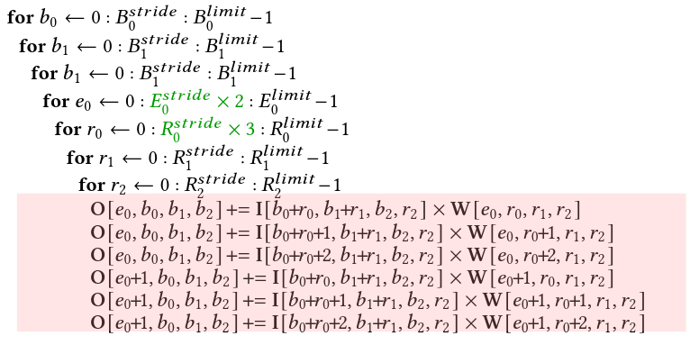
Unrollings
Projections
<
U_{R-W}
(
,
,
)
,
U_{R-N}
W_{rate}
W_{stride}
,
,
,
>
Algorithm
U_{E}
U_{B}
U_{G}
<
U_{R-W}
(
,
,
)
,
U_{R-N}
W_{rate}
W_{stride}
,
,
,
>
U_{E}
U_{B}
U_{G}
<
U_{R-W}
(
,
,
)
,
U_{R-N}
W_{rate}
W_{stride}
,
,
,
>
U_{E}
U_{B}
U_{G}

Slide 5
Unrollings
₀
₀
Projections
₀
₀
₀
₀
₀
P(0):<
U_{R-W}
(
,
,
)
,
U_{R-N}
W_{rate}
W_{stride}
,
,
,
>
Algorithm
U_{E}
U_{B}
U_{G}
₁
₁
₁
₁
₁
₁
₁
P(1):<
U_{R-W}
(
,
,
)
,
U_{R-N}
W_{rate}
W_{stride}
,
,
,
>
U_{E}
U_{B}
U_{G}
_{N}
_{N}
_{N}
_{N}
_{N}
_{N}
_{N}
P(N):<
U_{R-W}
(
,
,
)
,
U_{R-N}
W_{rate}
W_{stride}
,
,
,
>
U_{E}
U_{B}
U_{G}

Slide 6
Benchmark
Projections
MLBlock
Algorithm 0:
{<>,<>, …,<>}
Selected projections
I_{MUX}
Flexible
Windowing
I_{MUX}
Flexible
Windowing
I_{in}
I_{in}
W
W
×
W-SR
×
W-SR
Res_{in}
Res_{in}
Algorithm 1:
{<>,<>, …,<>}
Selection
Generation
Res_{MUX}
+
Pipeline
Res_{MUX}
+
Pipeline
{<>,<>, …,<>}
I_{MUX}
Flexible
Windowing
I_{MUX}
Flexible
Windowing
I_{in}
I_{in}
W
W
×
W-SR
×
W-SR
Res_{in}
Res_{in}
Res_{MUX}
+
Pipeline
Res_{MUX}
+
Pipeline
I_{MUX}
Flexible
Windowing
I_{MUX}
Flexible
Windowing
I_{in}
I_{in}
W
W
×
W-SR
×
W-SR
Res_{in}
Res_{in}
Res_{MUX}
+
Pipeline
Res_{MUX}
+
Pipeline
Algorithm N:
{<>,<>, …,<>}

Slide 7
Benchmark
Unrollings
Projections
MLBlock
Algorithm0:
{<>,<>, …,<>}
Selected
projections
I_{MUX}
Flexible
Windowing
I_{MUX}
Flexible
Windowing
I_{in}
I_{in}
W
W
×
W-SR
×
W-SR
Res_{in}
Res_{in}
Selection
Generation
Res_{MUX}
+
Pipeline
Res_{MUX}
+
Pipeline
{<>,<>, …,<>}
I_{MUX}
Flexible
Windowing
I_{MUX}
Flexible
Windowing
I_{in}
I_{in}
W
W
×
W-SR
×
W-SR
{<>,<>, …,<>}
Res_{in}
Res_{in}
Algorithm1:
Res_{MUX}
+
Pipeline
Res_{MUX}
+
Pipeline
I_{MUX}
Flexible
Windowing
I_{MUX}
Flexible
Windowing
I_{in}
I_{in}
W
W
×
W-SR
×
W-SR
Res_{in}
Res_{in}
Res_{MUX}
+
Pipeline
Res_{MUX}
+
Pipeline
AlgorithmN:
{<>,<>, …,<>}

Slide 8
Benchmark
Unrollings
Projections
MLBlock
Algorithm0:
{<>,<>, …,<>}
Selected
projections
A projection
I_{MUX}
Flexible
Windowing
I_{MUX}
Flexible
Windowing
I_{in}
I_{in}
W
W
×
W-SR
×
W-SR
Res_{in}
Res_{in}
Selection
Generation
Res_{MUX}
+
Pipeline
Res_{MUX}
+
Pipeline
{<>,<>, …,<>}
I_{MUX}
Flexible
Windowing
I_{MUX}
Flexible
Windowing
I_{in}
I_{in}
Algorithm1:
{<>,<>, …,<>}
W
W
×
W-SR
×
W-SR
Res_{in}
Res_{in}
Res_{MUX}
+
Pipeline
Res_{MUX}
+
Pipeline
Projections
Configurations
I_{MUX}
Flexible
Windowing
I_{MUX}
Flexible
Windowing
I_{in}
I_{in}
P0 < >
Config 0
W
W
×
W-SR
×
W-SR
Res_{in}
Res_{in}
P1 < >
Config 1
Res_{MUX}
+
Pipeline
Res_{MUX}
+
Pipeline
AlgorithmN:
{<>,<>, …,<>}
P2 < >
Config 2

Slide 9
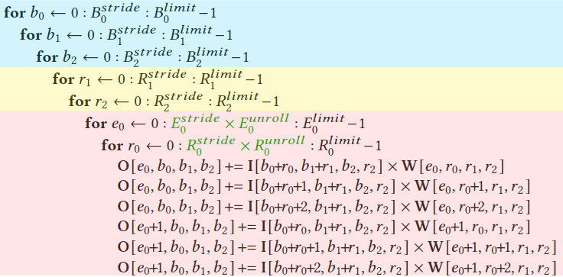
Benchmark
Unrolling
instances
Projection
instances
Algorithm 0:
MLBlock-M
Unroll
Projection
{<>,<>, …,<>}
Selected
projections
I_{MUX}
Flexible
Windowing
I_{MUX}
Flexible
Windowing
I_{in}
I_{in}
W
W
A projection
×
W-SR
×
W-SR
Res_{in}
Res_{in}
Res_{MUX}
+
Pipeline
Res_{MUX}
+
Pipeline
Algorithm 1:
Selection
Generation
I_{MUX}
Flexible
Windowing
I_{MUX}
Flexible
Windowing
I_{in}
I_{in}
{<>,<>, …,<>}
W
W
Unroll
Projection
×
W-SR
×
W-SR
{<>,<>, …,<>}
Res_{in}
Res_{in}
Res_{MUX}
+
Pipeline
Res_{MUX}
+
Pipeline
Projections
Configurations
P0 < >
Config 0
P1 < >
Config 1
I_{MUX}
Flexible
Windowing
I_{MUX}
Flexible
Windowing
I_{in}
I_{in}
W
W
Algorithm N:
P2 < >
Config 2
×
W-SR
×
W-SR
Res_{in}
Res_{in}
Res_{MUX}
+
Pipeline
Res_{MUX}
+
Pipeline
Unroll
Projection
{<>,<>, …,<>}

Slide 10
Benchmark
Unrollings
Algorithm 0:
Projections
MLBlock-M
Unroll
Projection
{<>,<>, …,<>}
Selected
projections
A projection
I_{MUX}
Flexible
Windowing
I_{MUX}
Flexible
Windowing
I_{in}
I_{in}
W
W
×
W-SR
×
W-SR
Algorithm 1:
Res_{in}
Res_{in}
Selection
Generation
Res_{MUX}
+
Pipeline
Res_{MUX}
+
Pipeline
Unroll
Projection
{<>,<>, …,<>}
{<>,<>, …,<>}
Projections
Configurations
I_{MUX}
Flexible
Windowing
I_{MUX}
Flexible
Windowing
I_{in}
I_{in}
W
W
×
W-SR
×
W-SR
P0 < >
Config 0
Res_{in}
Res_{in}
P1 < >
Config 1
Res_{MUX}
+
Pipeline
Res_{MUX}
+
Pipeline
Algorithm N:
P2 < >
Config 2
Unroll
Projection
{<>,<>, …,<>}

