Slide 1
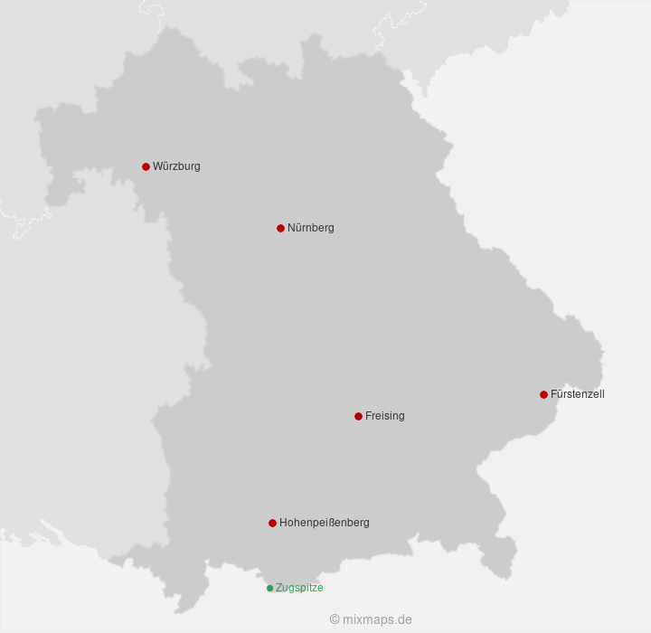
Production of Solar Energy in Bavaria
Short-term predictions using weather data and production capacity
Long-term forecast using time-series approach

Slide 2
Hypothesis
A prediction of daily produced solar energy based on weather data (sun) and the up-to-date production capacity
A forecast of the year 2024 based on actual produced solar energy in the years of 2015 – 2023
Data Gathering:
Production Data: TenneT (Transmission System Operator)
Solar Panels Capacity: Marktstammdatenregister (by Bundesnetzagentur)
Weather Data: 6 Stations in Bavaria (from Deutscher Wetterdienst(DWD))

Slide 3
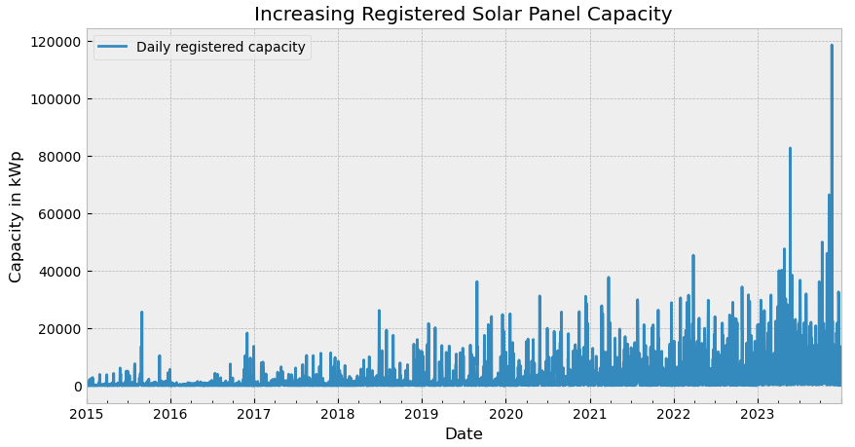
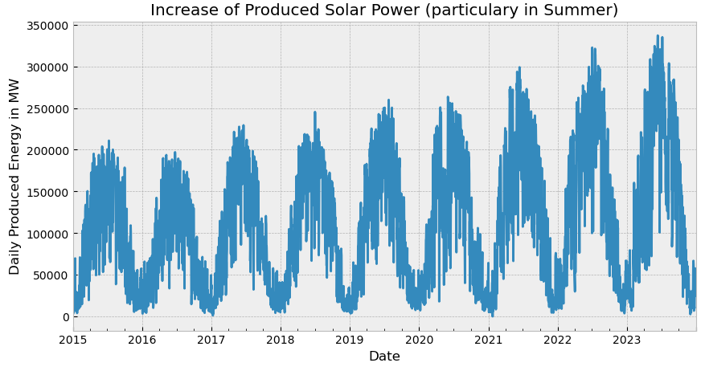
Explorative Data Analysis
Checking the raw data on plausibility and missing values
No issues for Marktstammdatenregister and produced energy (TenneT).

Slide 4
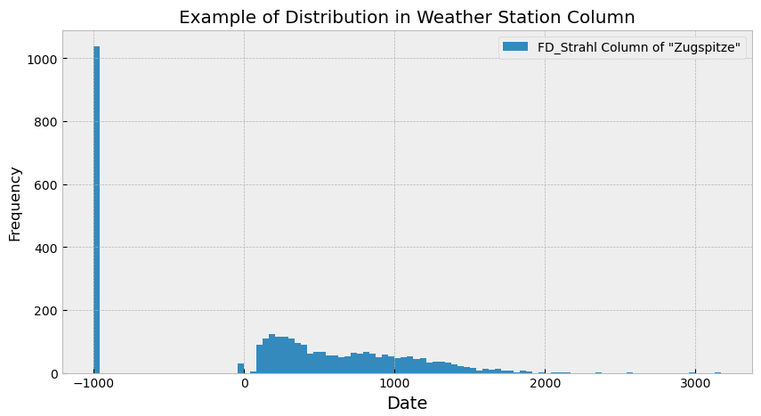
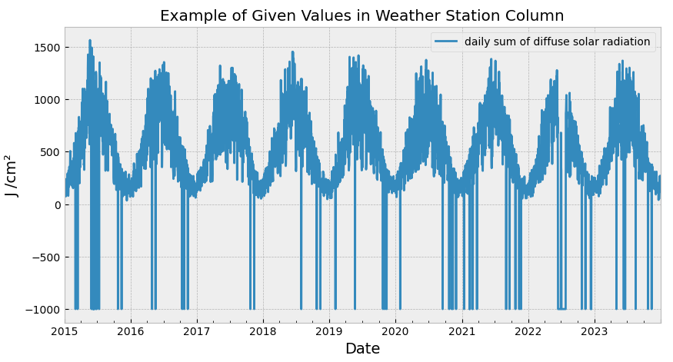
Explorative Data Analysis
Obviously missing data from DWD (value: -999), also rarely implausible values for solar radiation (value: 0 (J/cm²))

Slide 5
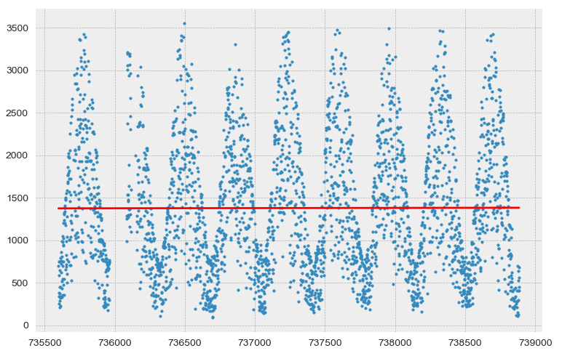
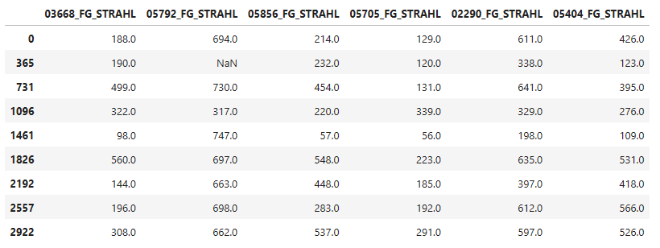
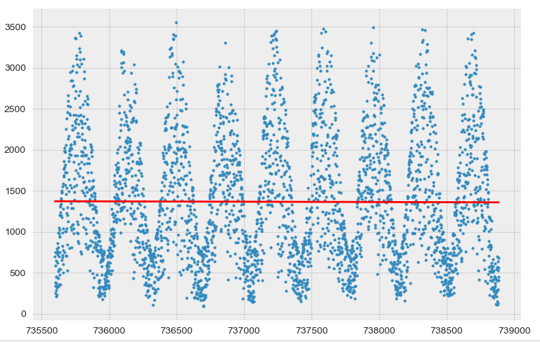
Data Imputation
Comparison before and after Imputation
Mean of median of column and median of row is used for imputation
Slope before imputation: 0.002
Slope after imputation: -0.004

Slide 6
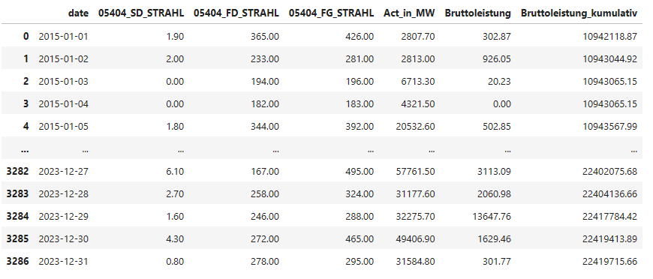
Example of Dataframe

Slide 7
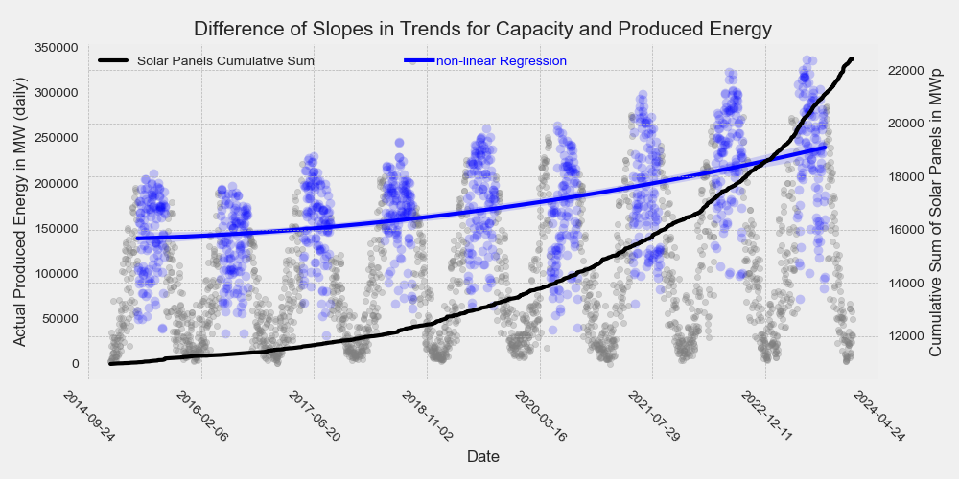
Trends within the data
Cumulative area of solar modules
Summer-Peaks of produced solar energy (May-August)
Technical details about measuring and usage of power presumed reason

Slide 8
Conclusion and Outlook
Forecast and prediction are both valid, usability is given, with very different use cases
Additional data can be used fore increased precision
Further scale of this project could be different states, countries and type of renewable energy (wind)
Regression-approach for forecasting: using trends and means of given data

