Slide 1
Regression Models(WO PCA/W PCA) :
Linear Regression
KNN Regression
Ridge Regression
Lasso Regression
Support Vector Machine Regression
Decision Tree Regression
Random Forest Regression
Modeling of Actual Solar Energy Power Generation at Bayern stations(2015-2023) with Regressor and Neural Network models
Non-Regression Models :
Sequential Neural Network
GRU - Sequential Neural Network
LSTM - Sequential Neural Network
Arranged by RAMIN SADRPANAH

Slide 2
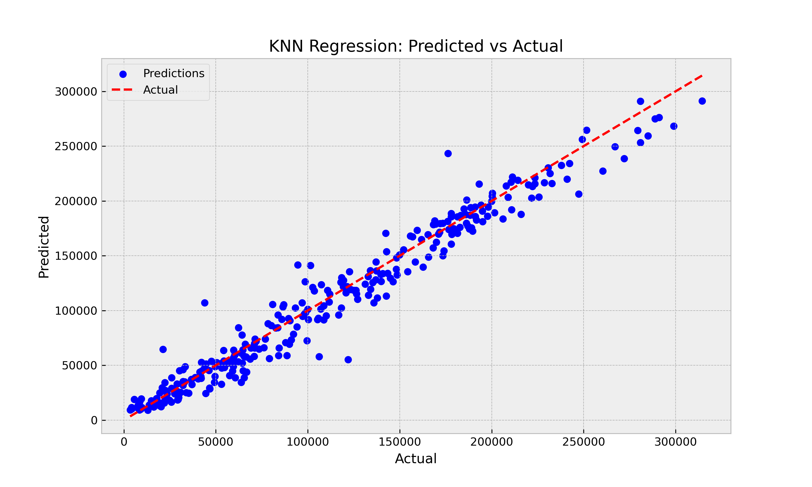
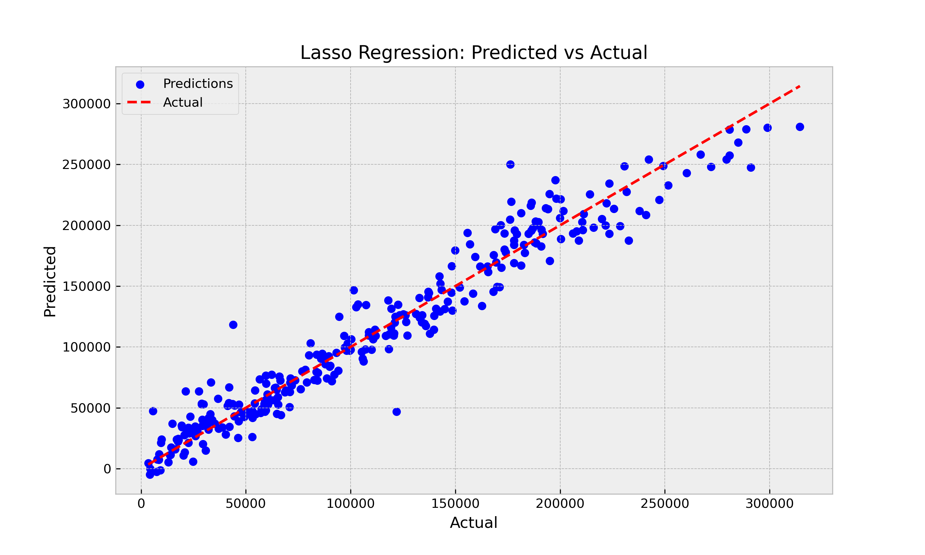
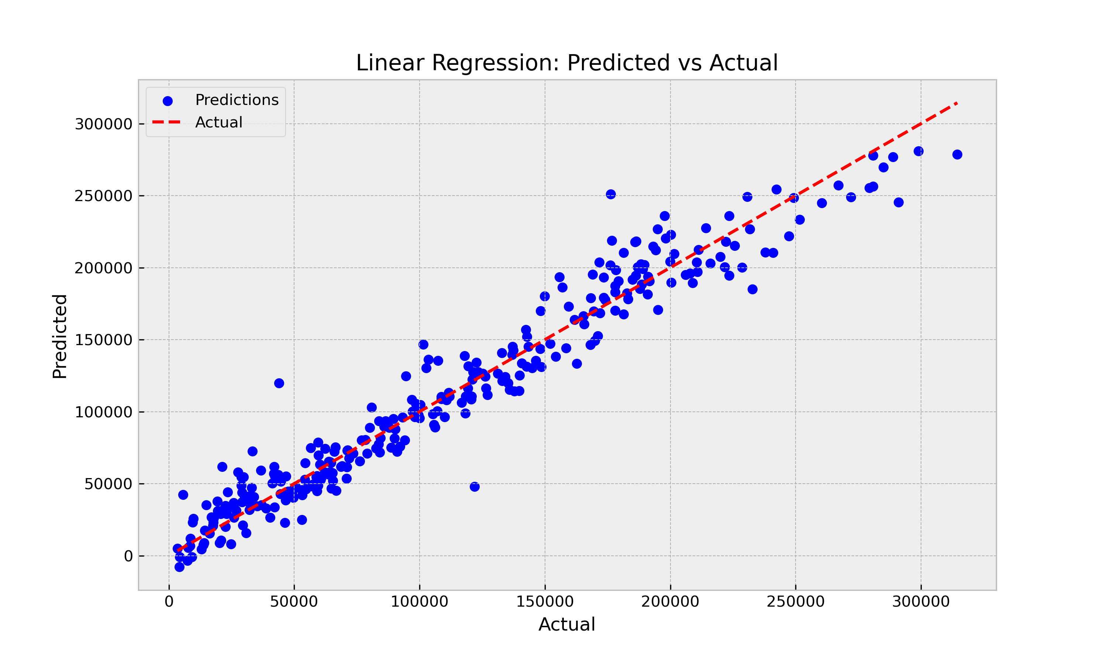
W/O PCA Step
Model | R2 score | MAE | MSE
KNN Regression | 0,959 | 10.781,40 | 224.022.258,54
Lasso Regression | 0,946 | 12.779,06 | 297.446.069,86
Linear Regression | 0,946 | 12.794,24 | 296.086.064,20
Ridge Regression | 0,945 | 12.770,61 | 299.820.066,05
DT Regression | 0,938 | 13.261,78 | 336.755.168,48
SVM Regression | 0,924 | 14.557,65 | 411.506.974,45

Slide 3
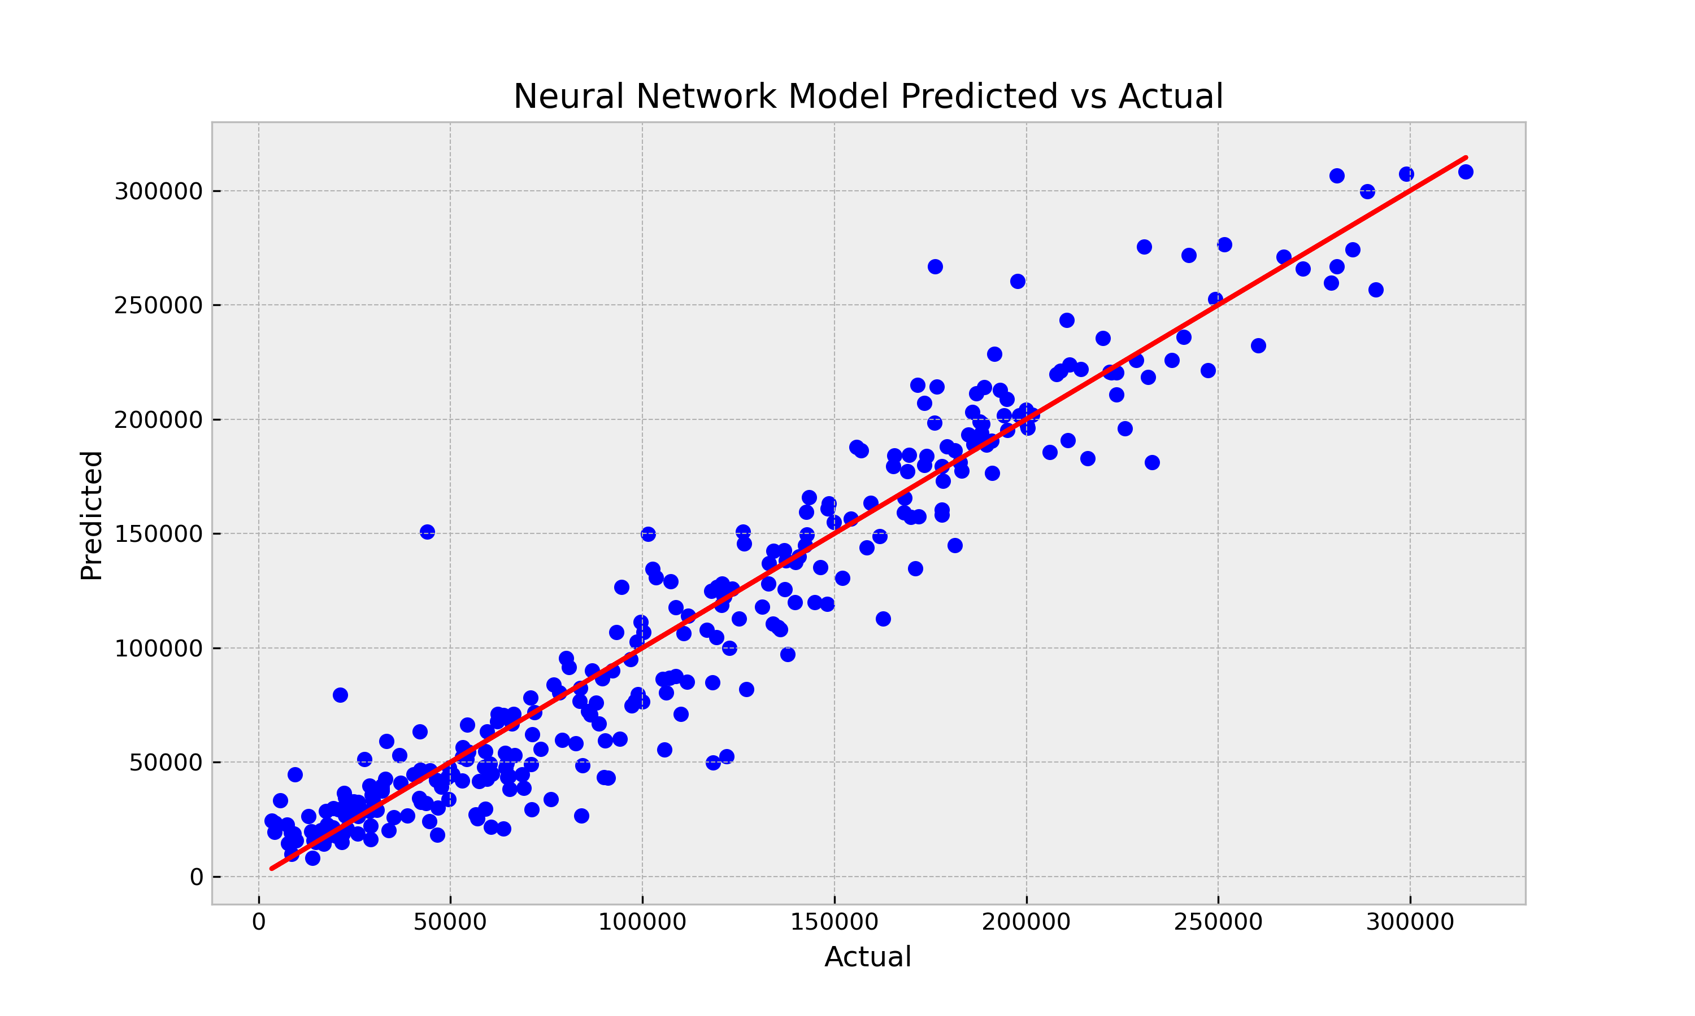
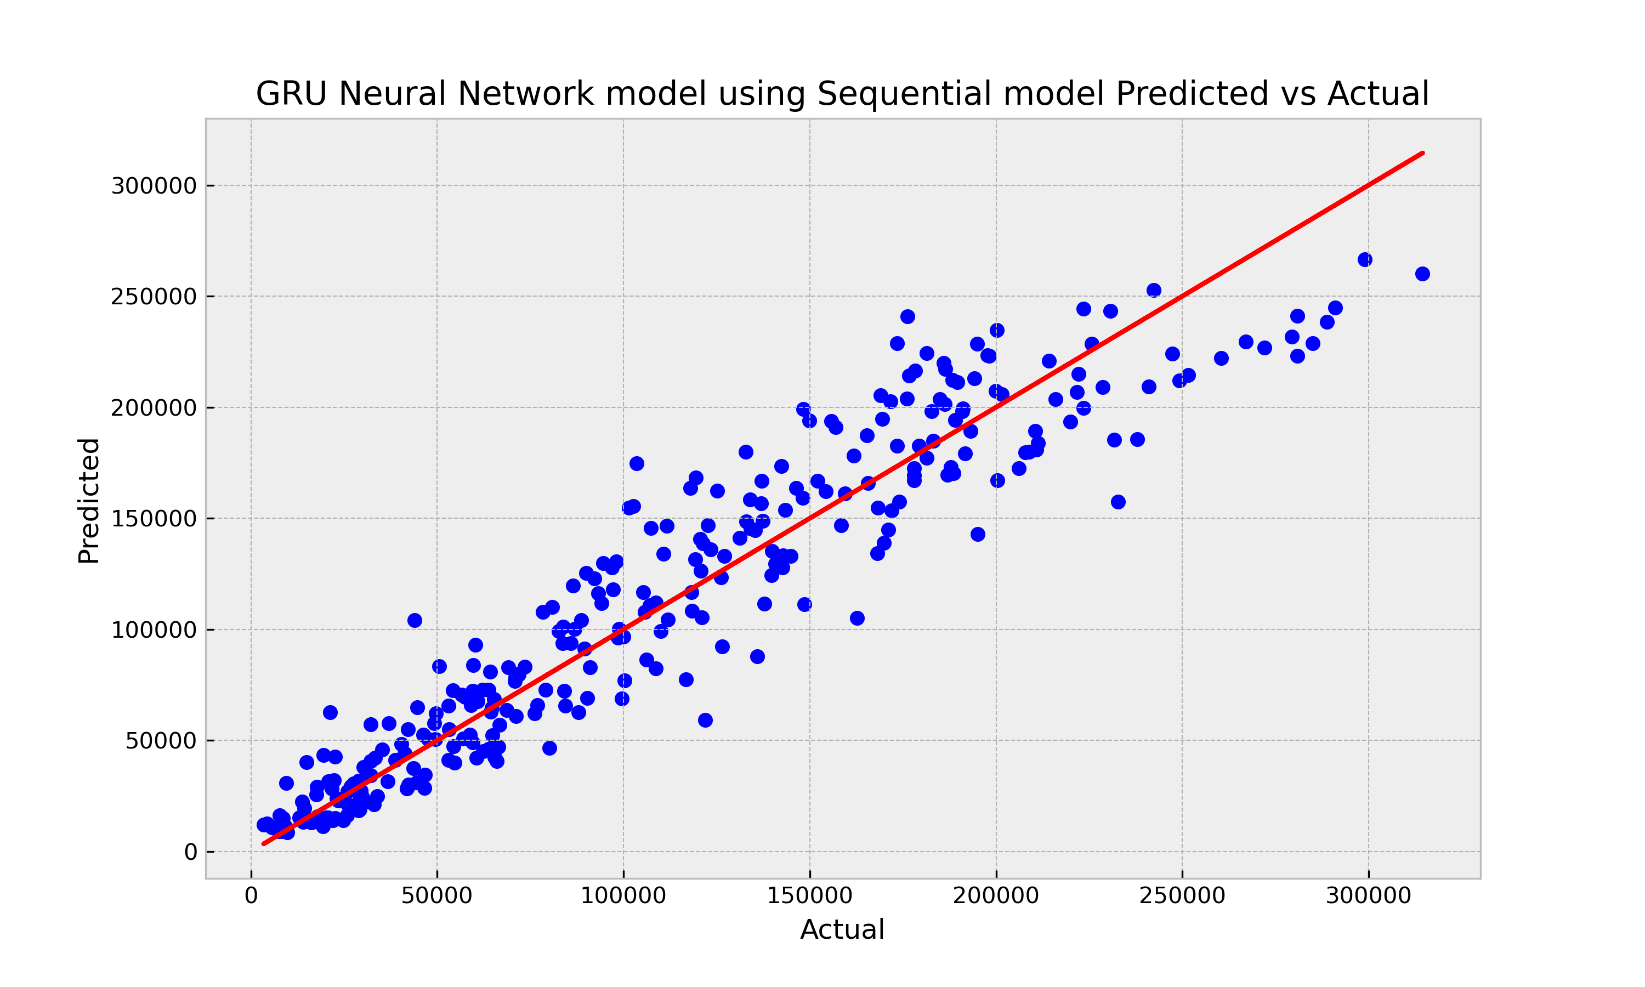
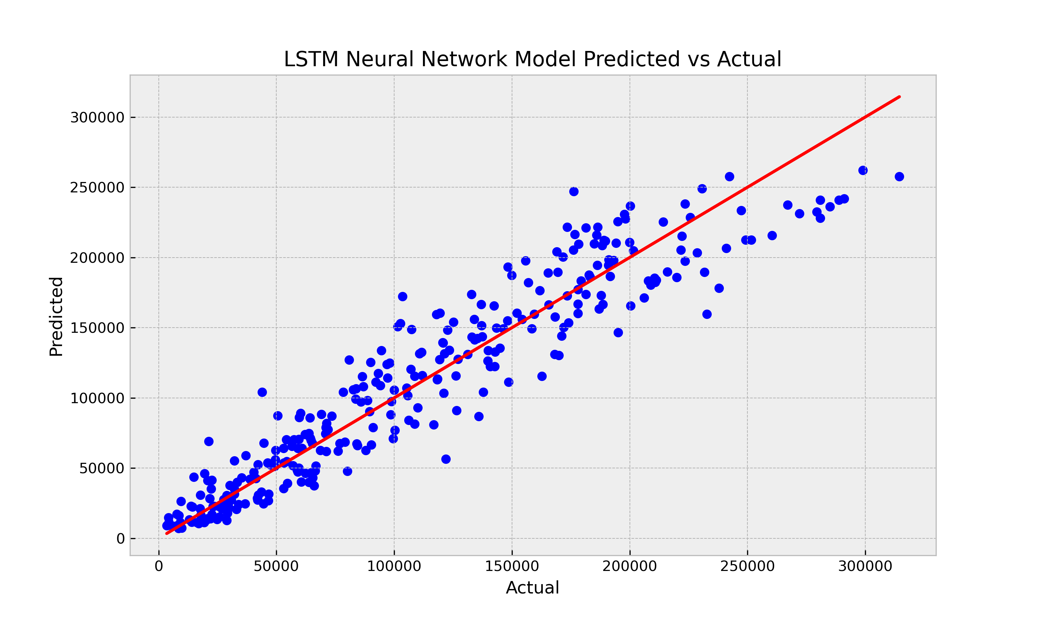
W/O PCA Step
Model | R2 score | MAE | MSE
NN - Sequential | 0,916 | 15.400,48 | 460.665.251,72
LSTM - NN | 0,889 | 19.092,38 | 605.512.615,47
GRU - NN | 0,889 | 19.389,78 | 607.048.866,33
W/O PCA Step

Slide 4
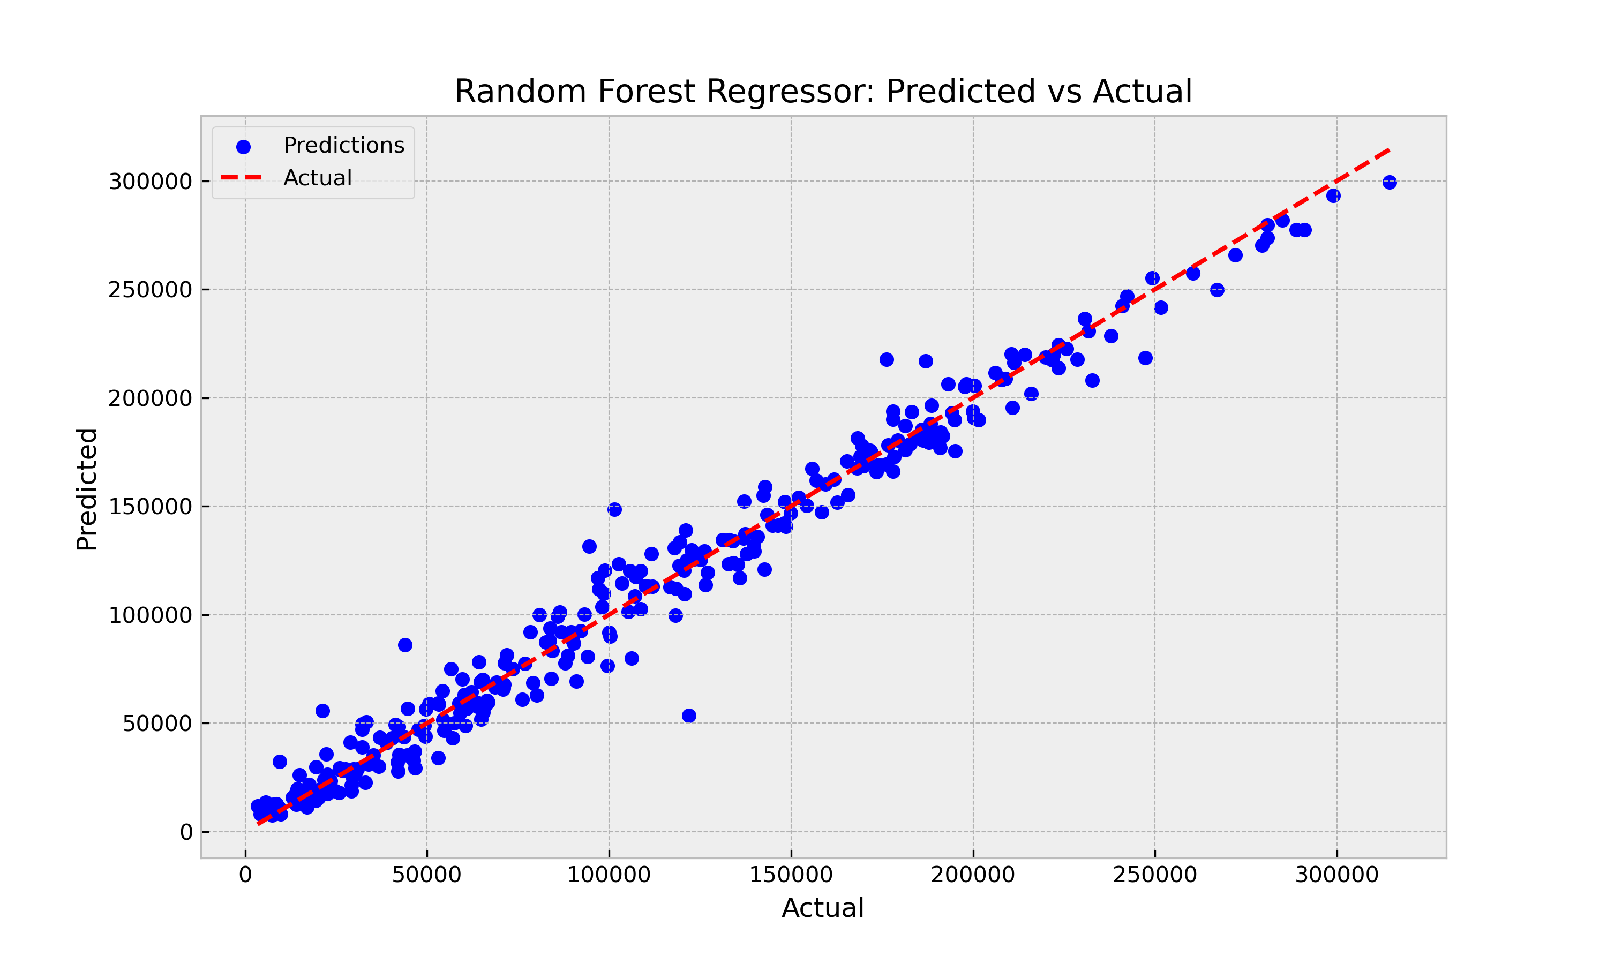
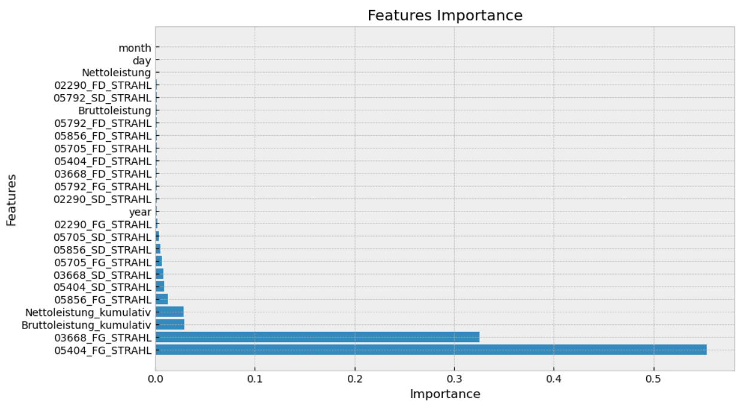
Apply Random Forest Regression Model on Train and Test DataFrame
W/O PCA Step
Model | R2 score | MAE | MSE
RF - Regression | 0,976 | 8.139,91 | 130.904.514,65
KNN-Regression | 0,959 | 10.781,40 | 224.022.258,54
NN -TensorFlow | 0,916 | 15.400,48 | 460.665.251,72

Slide 5
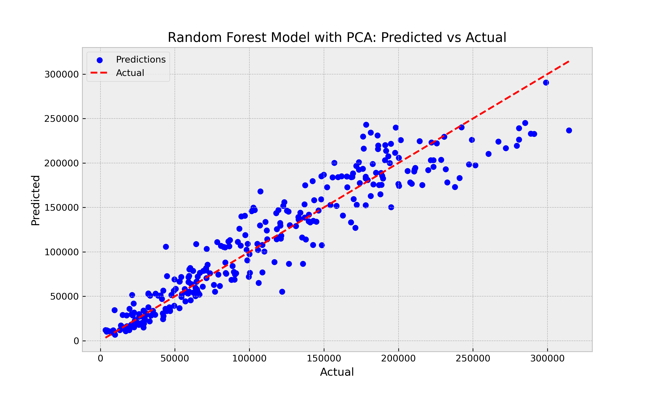
Apply PCA Step on FG Columns of Train and Test DataFrame
PCA Step | W/O PCA Step |  | W PCA Step
Model | R2 score | MAE | R2 score | MAE
RF -Regression | 0,976 | 8.139,91 | 0,896 | 17.766,60
KNN Regression | 0,959 | 10.781,40 | 0,879 | 19.546.23
Linear Regression | 0,946 | 12.794,24 | 0,876 | 19.034,50

Slide 6
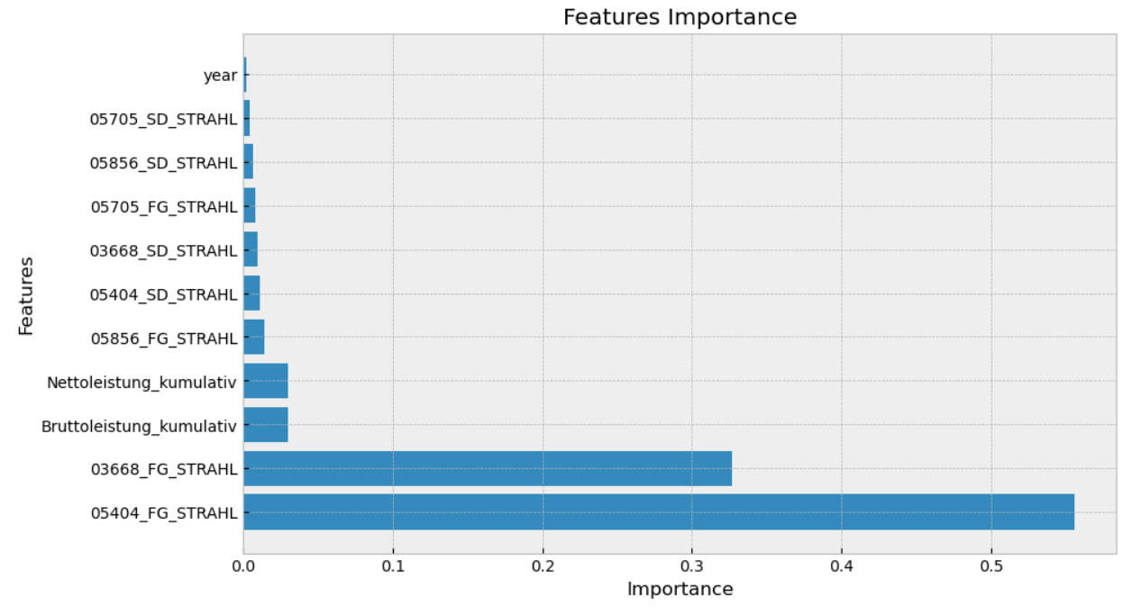
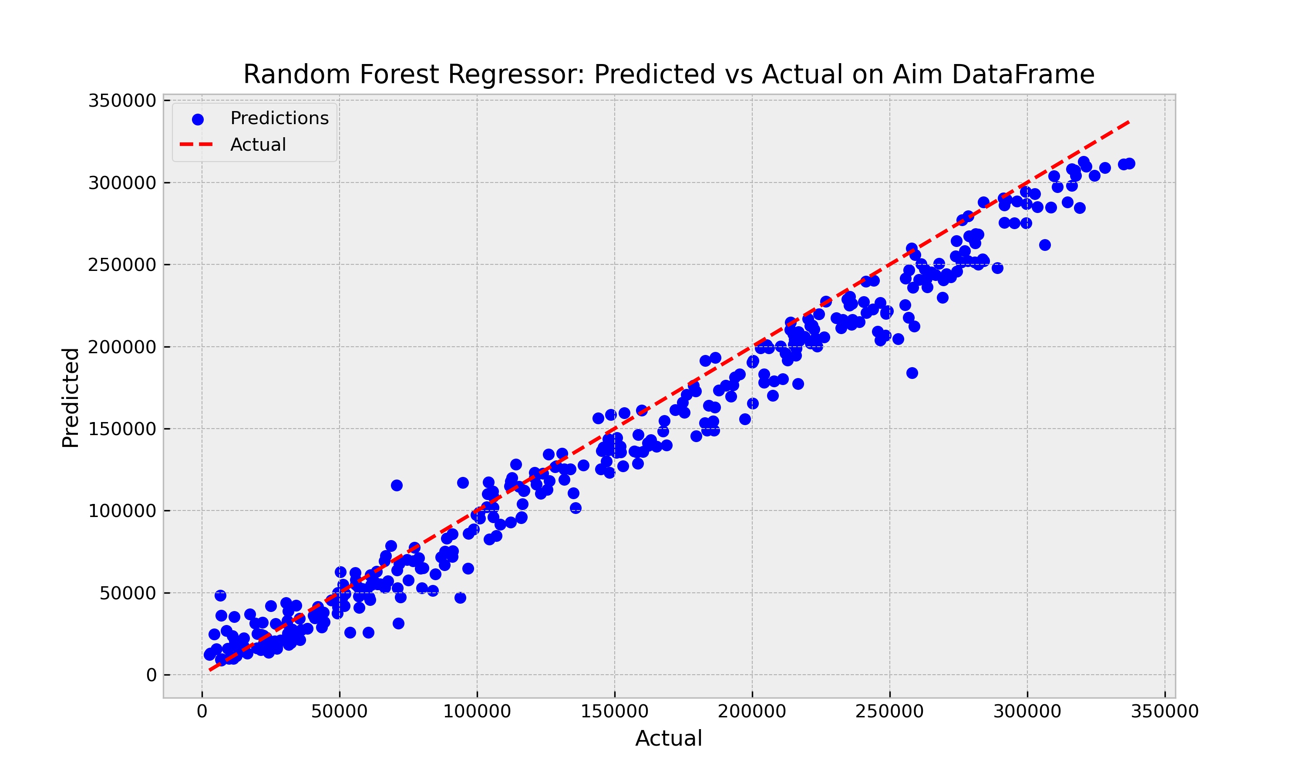
Conclusion
Best Model
Random Forest Regressor
Features Engineering : decrease features from 25 to 11
Metric values on Test DataFrame :
R2 score 0.975 and MAE = 8.218,07
Metric values on Aim DataFrame :
R2 score = 96,6 and MAE = 13.882,04
Model Development
  Adding daily weather features including Temperature, Moisture content, wind speed, cloud content

