Slide 1
Marine Weather Prediction
Ramin Estadabadi
Yixuan Huang
Zane Hallauer

Slide 2
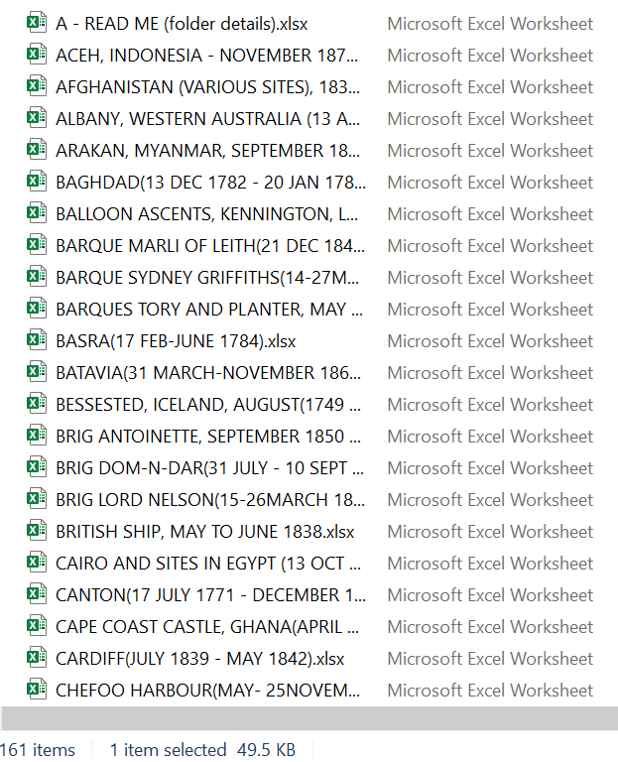
Data Source
ICOADS - International Comprehensive Ocean-Atmosphere Data Set
Download from NCAR
160 Excel files
Each Excel file contains different attributes

Slide 3
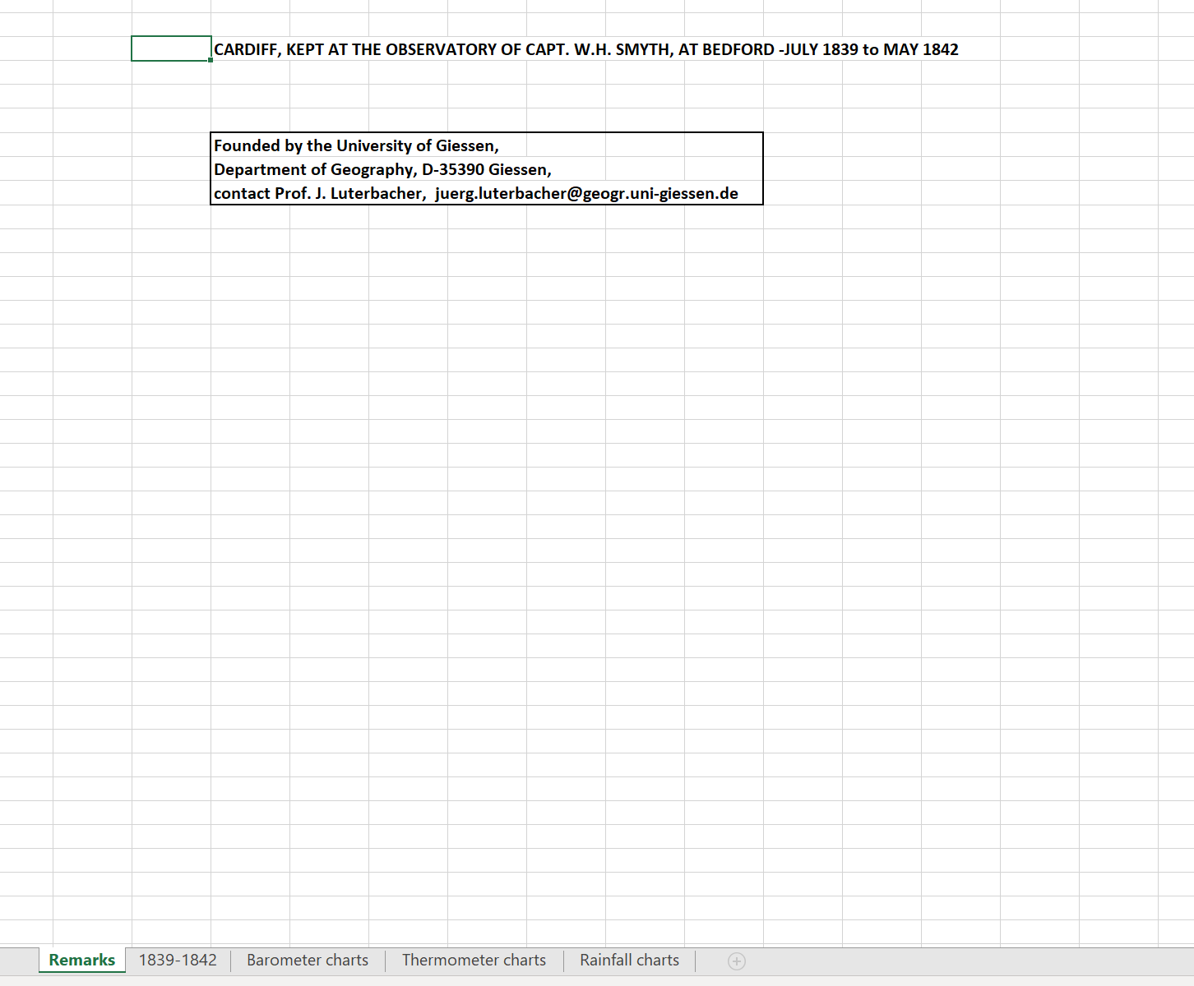
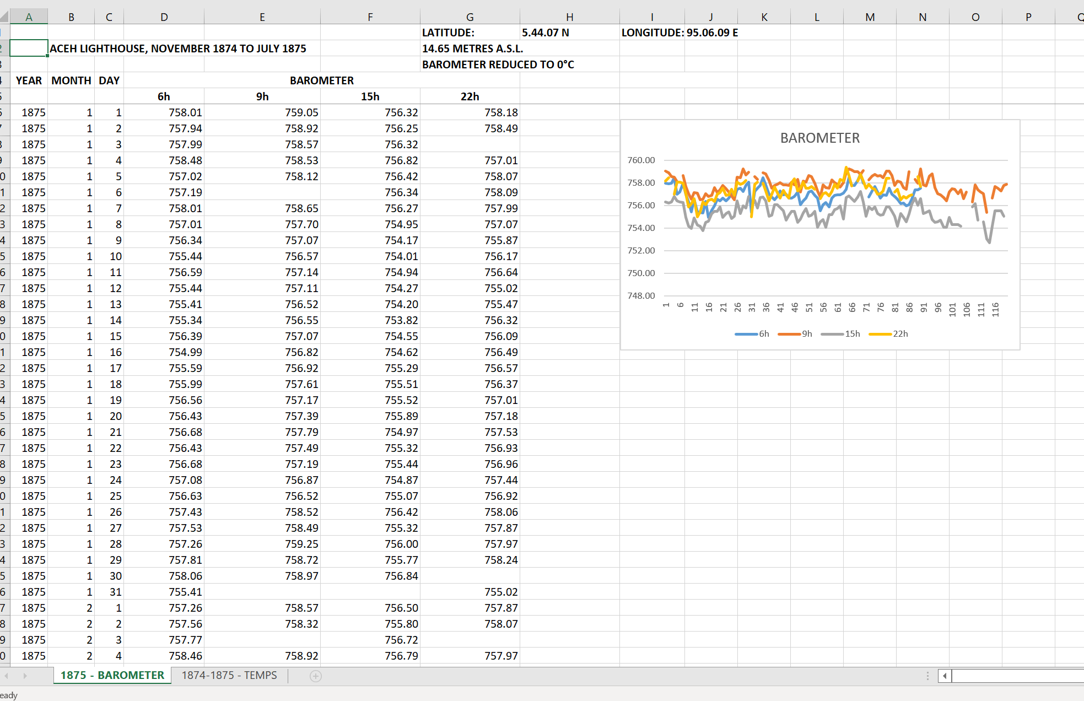
Data File Sample
Potential issues
Multiple sheets (up to 5)
Figures
Useless titles and subtitles
Different units are used

Slide 4
Data Cleaning Process
Extracted 81 data files with Barometer and Thermometer data between 1800-1900
Make pandas data frame of each useful sheet (which dropped all empty sheets, summary sheets, and visualization sheets)
The most columns that were present and needed for the model are: Year, Month, Day, Barometer, Thermometer, Longitude, and Latitude.
All columns were presented in different ways in each data frame, for example:
Name issue: barmoter, BAROMETER, Barometer., and many other versions
Unit issue: Celsius and Fahrenheit in Thermometer column; MM and Inches in Barometer
Cleaning Process: Column name cleaned, units transformed, unnecessary columns and rows dropped.
Merge all data frames into one big final data frame.

Slide 5
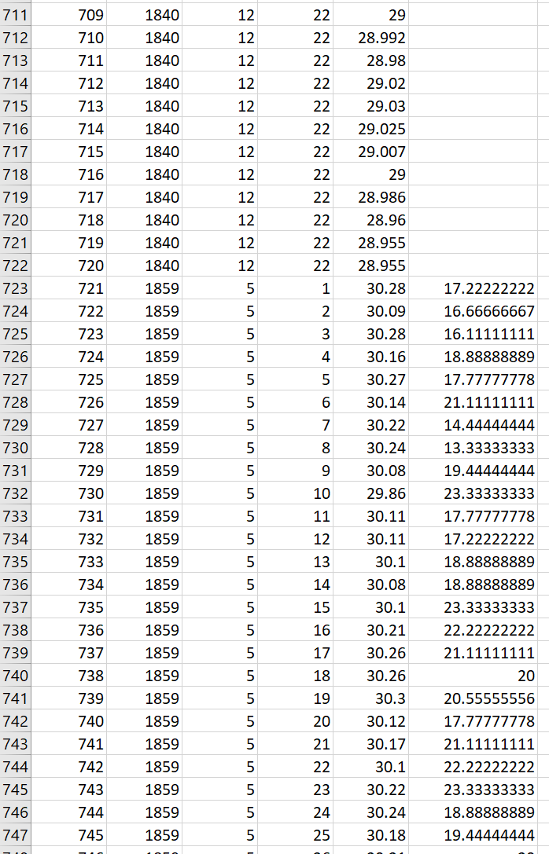
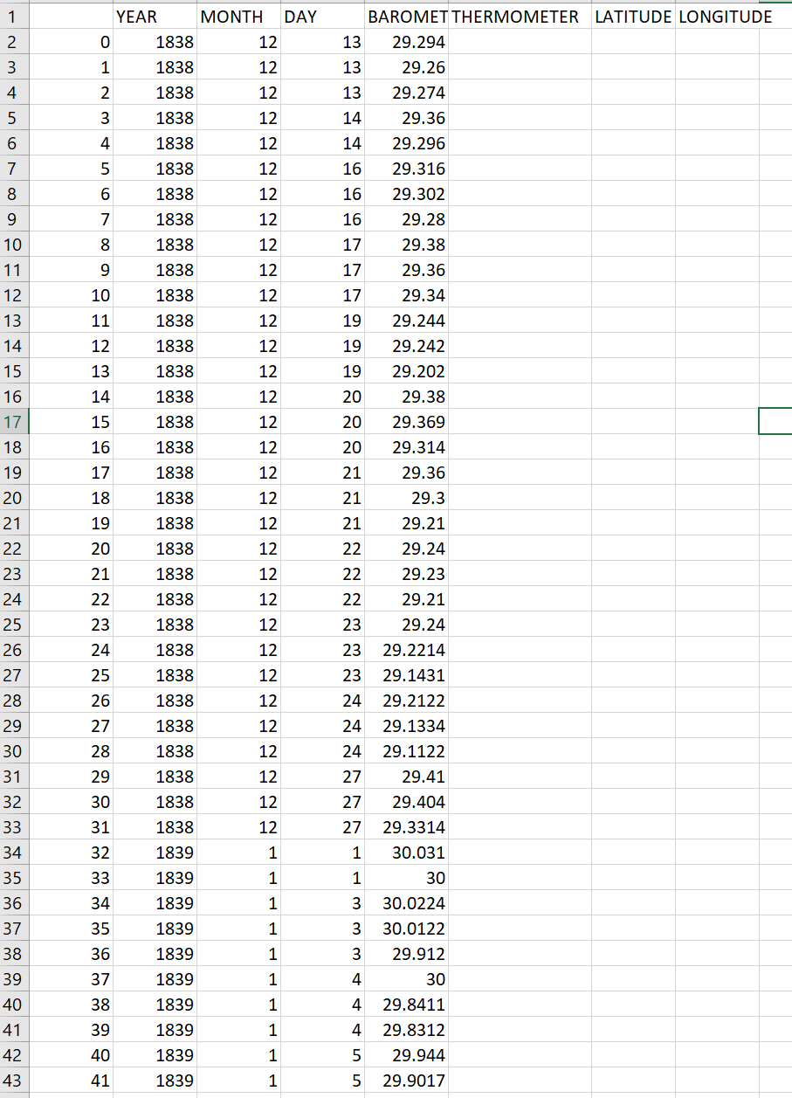
Final data frame
92612 rows
7 columns
Missing values

Slide 6
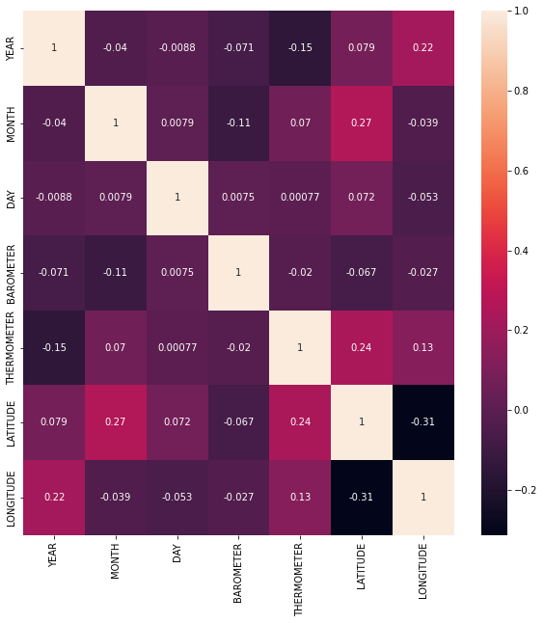
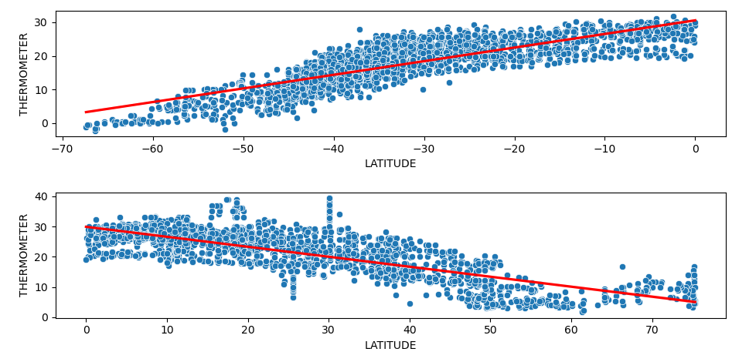
Correlation Matrix
North and South hemispheres

Slide 7
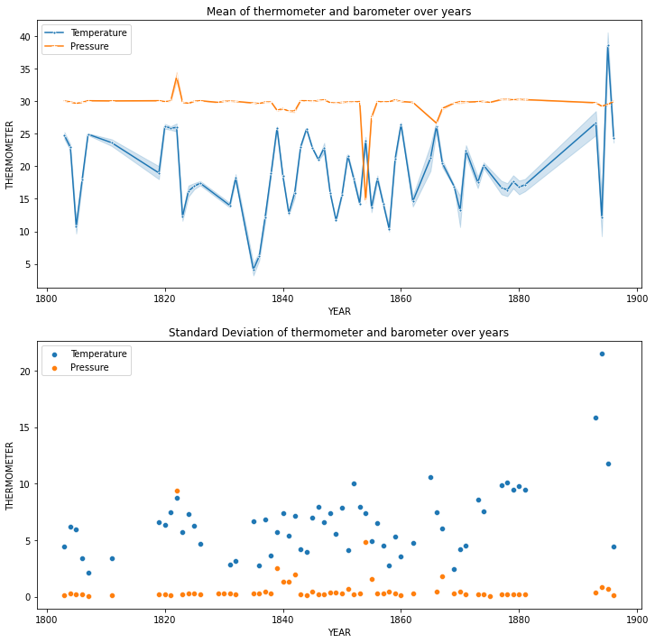
Mean of Temp/Pressure vs Std Deviation
Volcanic eruption in 1845 in the Pacific ocean caused several barometric readers to report extremely low pressures.

Slide 8
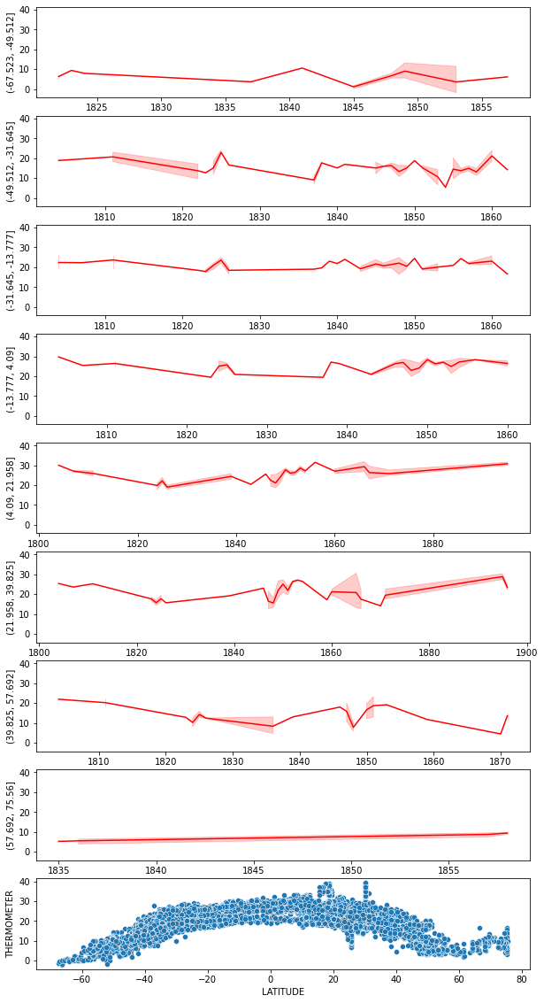
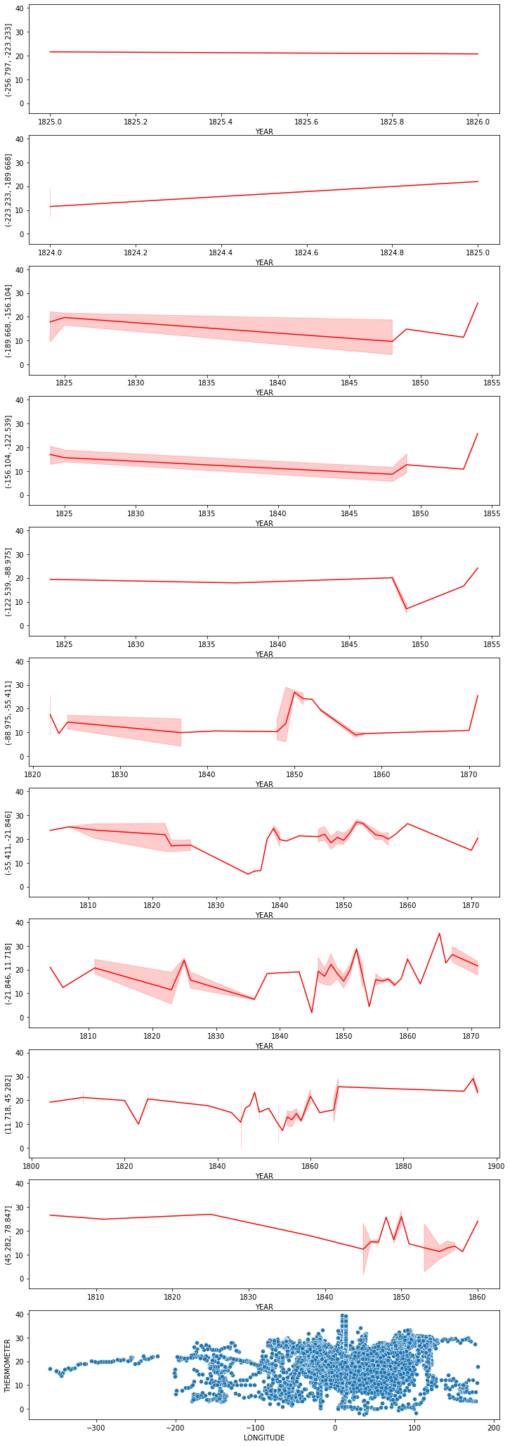
Temperature Graphed by Bin
1800 - 1900
Latitude broken out by 20° increments
Most bins show a mostly flat change in temperature over time
North Pole bin shows slow, constant increase
Longitude broken out by 36° segments
No correlation between longitude and temperature

