Slide 1

Pneumonia Detection Using CNN Based Feature Extraction
By:
G. Mahesh-17RA1A0514
P. Sairam Reddy-17RA1A0527
G. Sri Sai Kamal Teja-17RA1A0537
Under The Esteemed Guidance Of:
CH. Shailaja

Slide 2

ABSTRACT
Pneumonia is a life-threatening infectious disease affecting one or both lungs in humans commonly caused by bacteria called Streptococcus pneumonia. One in three deaths in India is caused due to pneumonia as reported by World Health Organization (WHO). Chest X-Rays which are used to diagnose pneumonia need expert radiotherapists for evaluation. Thus, developing an automatic system for detecting pneumonia would be beneficial for treating the disease without any delay particularly in remote areas. Due to the success of deep learning algorithms in analyzing medical images, Convolutional Neural Networks (CNNs) have gained much attention for disease classification. In addition, features learned by pre-trained CNN models on large-scale datasets are much useful in image classification tasks. In this work, we appraise the functionality of pre-trained CNN models utilized as feature-extractors followed by different classifiers for the classification of abnormal and normal chest X-Rays. We analytically determine the optimal CNN model for the purpose. Statistical results obtained demonstrates that pretrained CNN models employed along with supervised classifier algorithms can be very beneficial in analyzing chest X-ray images, specifically to detect Pneumonia.

Slide 3
INTRODUCTION
Pneumonia is an infection in one or both lungs. It can be caused by bacteria, viruses, or fungi. Bacterial pneumonia is the most common type in adults. Pneumonia causes inflammation in the air sacs in your lungs, which are called alveoli. The alveoli fill with fluid or pus, making it difficult to breathe. According to National Institutes of Health (NIH), chest x-ray is the best test for pneumonia diagnosis. However, reading x-ray images can be tricky and requires domain expertise and experience. It would be nice if we can just ask a computer to read the images and tell us the results. The main aim of this project is to predict whether the person has Pneumonia from his X-ray report of lungs. So that we can build a model to predict the rate of Pneumonia in a city by collecting the people’s X-ray reports. We used a neural network classification model in keras to classify Normal and Pneumonia persons. Here the input parameters are the training data and the output will either 0 or 1 i.e. having Pneumonia or not.
A convolutional neural network (CNN) is a specific type of artificial neural network that uses Perceptrons, a machine learning unit algorithm, for supervised learning, to analyze data.A convolutional neural network consists of an input and an output layer, as well as multiple hidden layers. The hidden layers of a CNN typically consist of convolutional layers,RELU layer i.e. activation function, pooling layers, fully connected layers and normalization layers.
.

Slide 4
Existing System
The Existing system converts the images in to text data using Artificial Neural Network (ANN) and Machine learning (ML). The accuracy and prediction are less accurate and time consumption is more.
Disadvantages
Each narrow application needs to be specially trained.
Require large amounts of hand-crafted, structured training data.
Learning must generally be supervised: Training data must be tagged.
Require lengthy offline/ batch training.

Slide 5
Proposed System
Convolution neural networks have been one of the most influential innovations in the field of computer vision. CNNs are fully connected feed forward neural networks. CNNs are very effective in reducing the number of parameters without losing on the quality of models.
Our Proposed system uses CNN and SVM and we use different layers for filtering out the features of the scanned image, which is then passed through a Fully-connected Dense Layer to verify if Pneumonia is present.
This model gives out an accuracy of 88.5% compared to existing models which give out an accuracy of around 80%.

Slide 6
Advantages
The main advantage of CNN compared to its predecessors is that it automatically detects the important features without any human supervision
CNN is also computationally efficient.
It uses special convolution and pooling operations and performs parameter sharing

Slide 7
System Requirements
Software Requirements
Operating system: Windows 10 Ultimate, Linux, Mac.
Front-End : Python.
Coding Language : Python.
Software Environment : Anaconda / Google Colab.
Hardware Requirements
System : Intel I - 3, 5, 7 Processor
Hard Disk : 500 GB
Monitor : 14’ Color Monitor
Mouse : Optical Mouse
Ram : 2 Gb

Slide 8
System Architecture

Slide 9
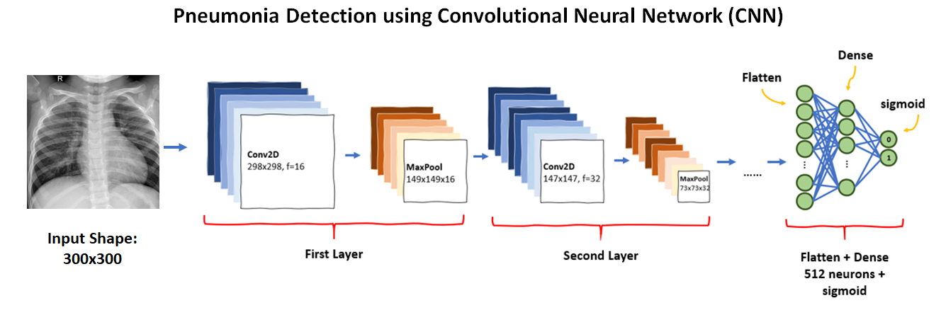
Process of CNN is to detect and categorize images from learned features. It is very effective in a multi-layered structure when obtaining and assessing necessary features of graphical images. Figure 1 illustrates the CNN process

Slide 10
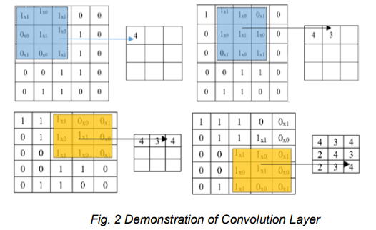
Convolution Layer
This layer conceptualizes the characteristics of each image input. It stores three-dimensional connection among pixels by means of discovering significant image characteristics with small squares of image input. Described in figure 2 below is the overall process and functions of kernel, where in the image input is converted into 5x5 matrix pixel values and the resulting filter is 3x3 matrix or the resulting feature map in this layer. Feature map contains specific details of the original image necessary to determine an input. The feature map then down sampled with the ReLU method reducing any negative values to zero and remains all others intact.

Slide 11
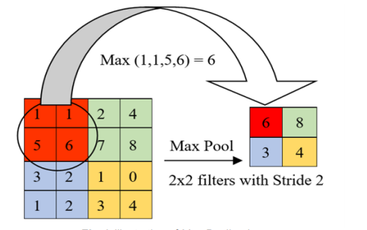
Max-Polling Layer
This layer cut down the values further to half of its original value by choosing only max values from the kernel matrix. The sample illustration is the 4x4 matrix pixel values of an input image degraded into 2x2 filters

Slide 12
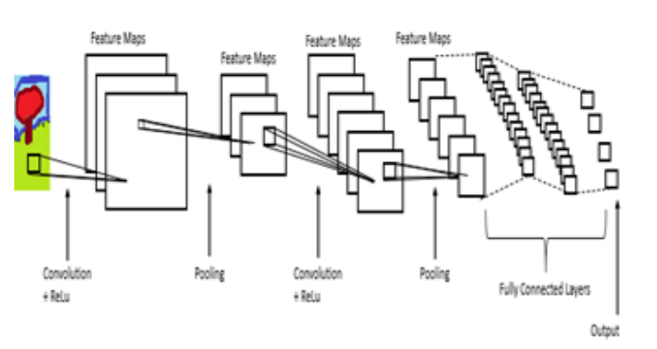
Fully-Connected Layer
Multi-layer perceptron in this layer confirms that all neurons is interconnected to every neuron of every succeeding layers in the purpose of classifying input images created through the preserved features of image. Fig illustrates the outcomes of image input after it has obtained characteristics from the provided data set and extracted features.

Slide 13
UML Diagrams

Slide 14
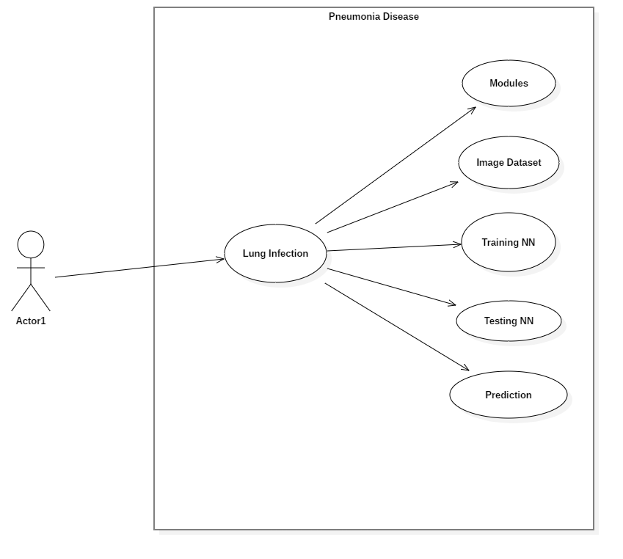
Use Case Diagram

Slide 15
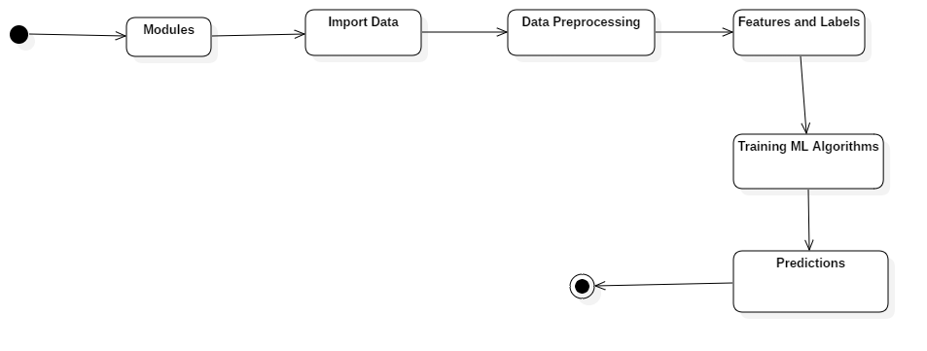
Activity Diagram

Slide 16
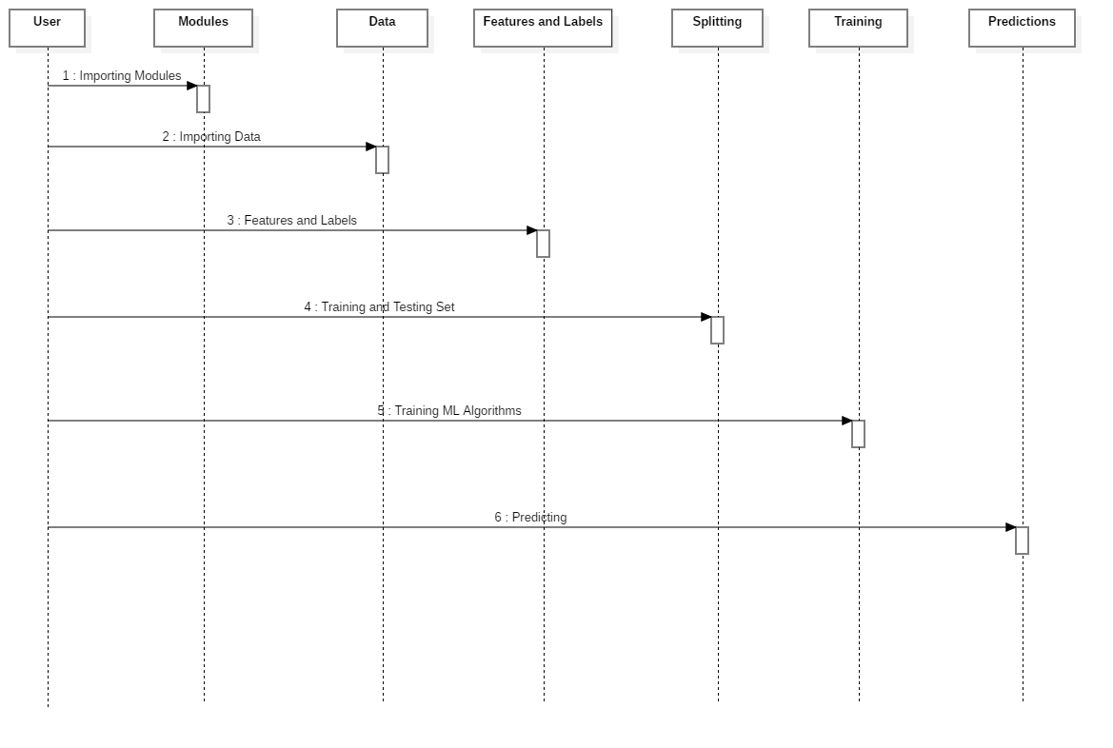
Sequence Diagram

Slide 17
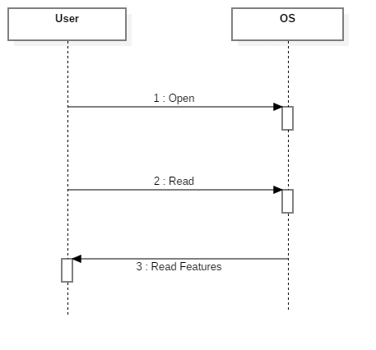

Slide 18
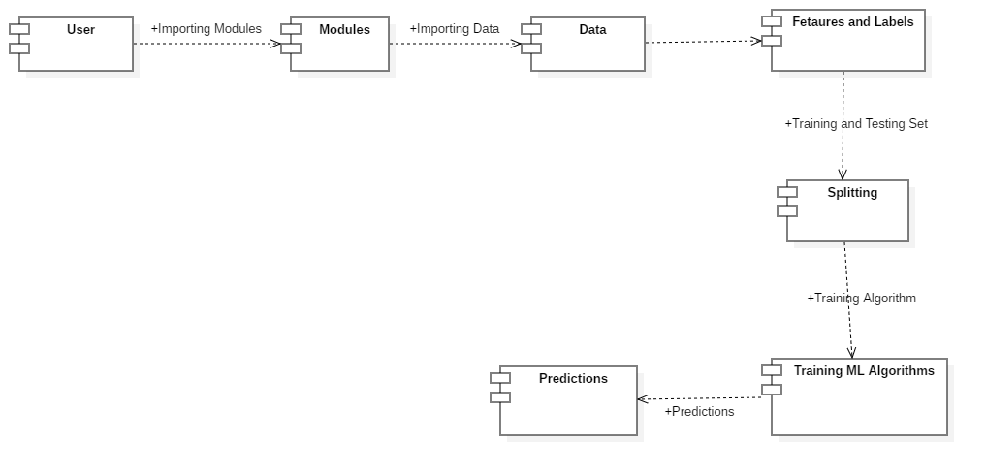
Component Diagram

Slide 19
Modules

Slide 20
Main Libraries
Numpy
Pandas
Scipy
Matplotlib
Scikit-Learn
StatsModles
Boosting
XGBoost
LightGBM
Deep Learning Libraries
Tensorflow
Theano
PyTorch
Keras

Slide 21
Pseudocode

Slide 22
Connecting to Google Colab and Kaggle
Import google.colab
Upload kaggle.json
Install required libraries for kaggle
Download the dataset from kaggle (Paul Mooney Dataset)
Unzip the dataset

Slide 23
Creating and Training the Model
Import Required libraries and dependencies
classifier = Sequential()
classifier.add(Convo2D Layer)
classifier.add(MaxPooling2D Layer)
classifier.add(Flatten())
classifier.add(Dense Layer, with relu activation)
classifier.add(Dense Layer, with sigmoid activation)
for each image in test folder:
images.flow_from_directory(test_folder, binary mode)

Slide 24
for each image in training folder:
images.flow_from_directory(training_folder, binary mode)
Classifier.compile(adam optimizer, binary_crossentropy, accuracy metrics)
Print classifier summary
Define the epochs
Train the classifier on the training images for the inputted number of epochs

Slide 25
Implementing the Model
Img = plt.imread(Image Location)
Img = cv2.resizeImage(Dimensions)
Convert image to numpy array
Result = classifier.predict(Numpy array of image)
If result > 0.5:
Prediction = ‘Pneumonia’
else:
prediction = ‘Normal’
Print Prediction

Slide 26
Testing the Model for Accuracy Metrics
Initialize empty arrays for test data and labels
for cond in [‘Normal’, ‘Pneumonia’]:
for img in Test_folder:
Img = plt.imread(Image Location)
Img = cv2.resizeImage(Dimensions)
Convert image to numpy array
if cond == ‘Normal’:
label = 0
else if cond == ‘Pneumonia’:
label = 1
add data and labels to respective arrays

Slide 27
Import required libraries for plotting
Prediction = Classifier.predict(Testing Data)
consufionMatrix = confusion_matrix(Test Labels)
accuracy = accuracy_score(Test Labels)
Precision = precision()
Recall = recall()
F1_score = f1_score()
Print the accuracy metrics

Slide 28
Save the classifier for future use
Import Pickle Module
Filename = “Name”
Pickle.dump(Classifier, Filename)
Classifier.save(Model Name)

Slide 29
Screenshots

Slide 30
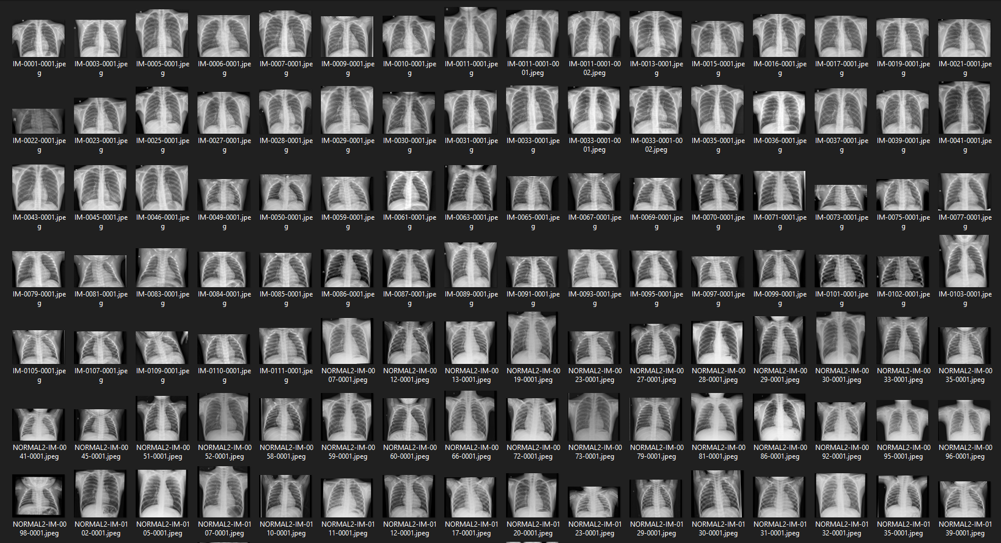
Input
Normal Chest X-Rays

Slide 31
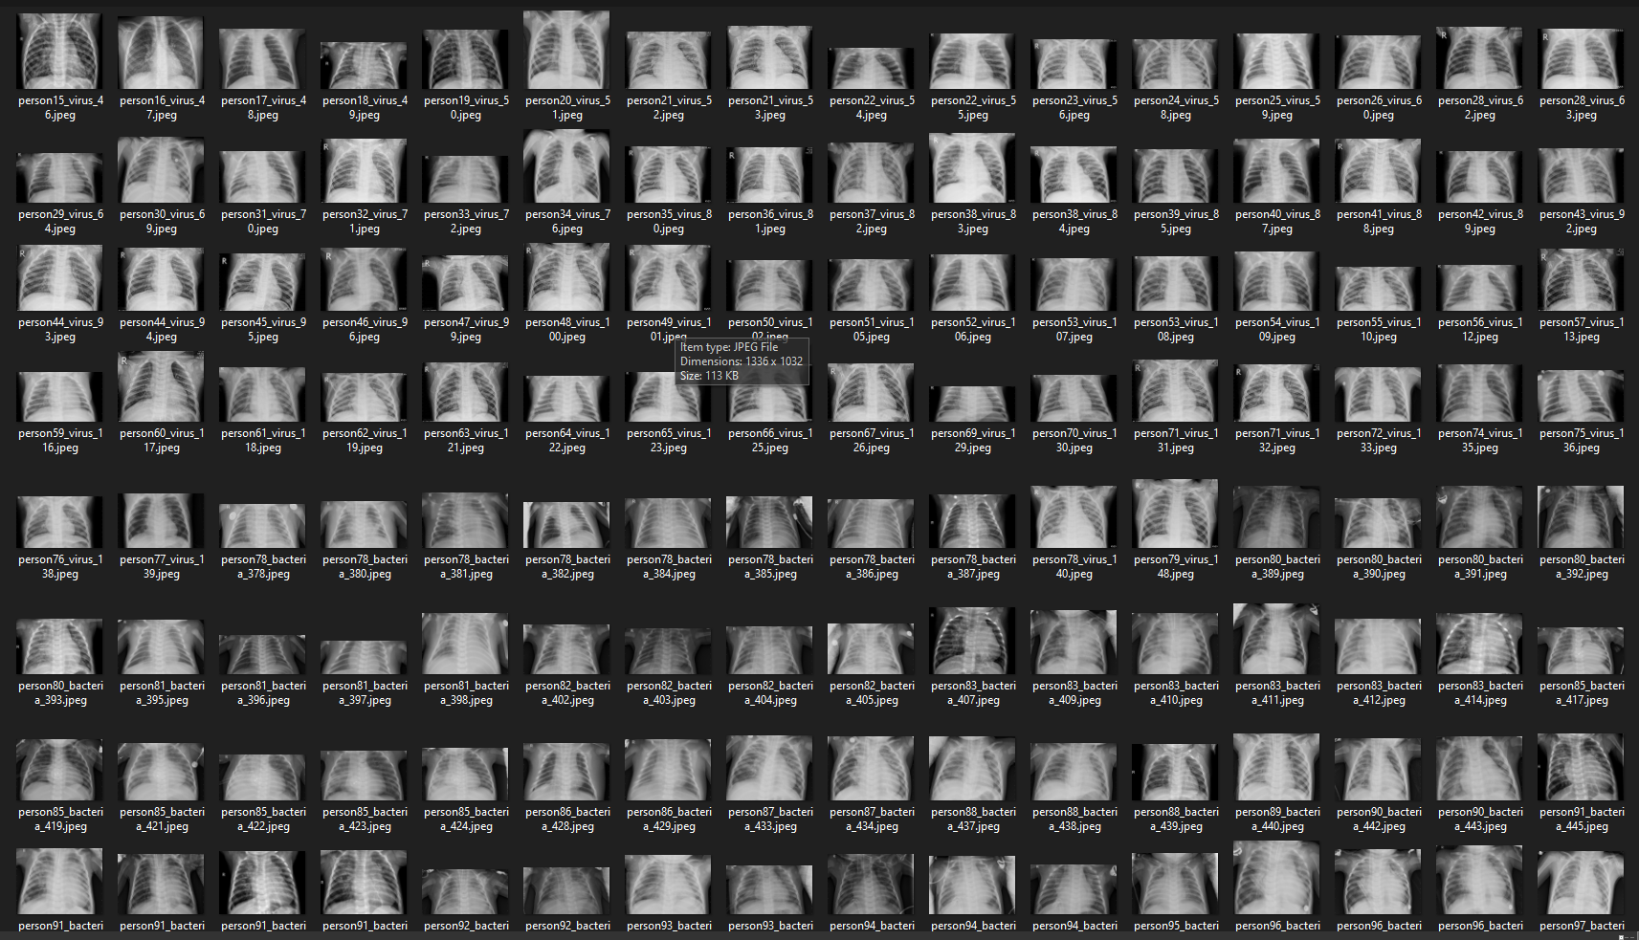
Input
Pneumonia Chest X-Rays

Slide 32
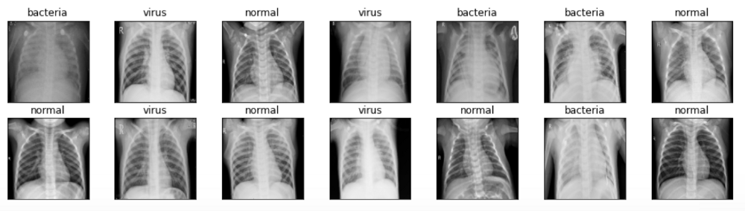
Output
Processed Images

Slide 33
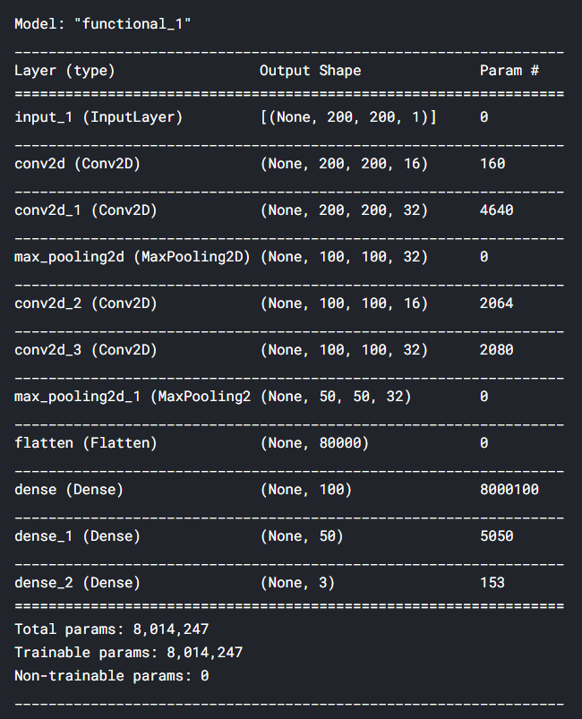
Model Summary

Slide 34
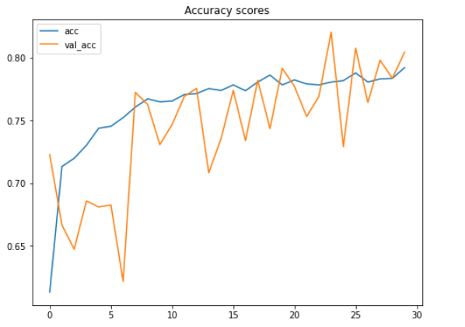
Accuracy Scores Improvement

Slide 35
Loss Value Decrease

Slide 36
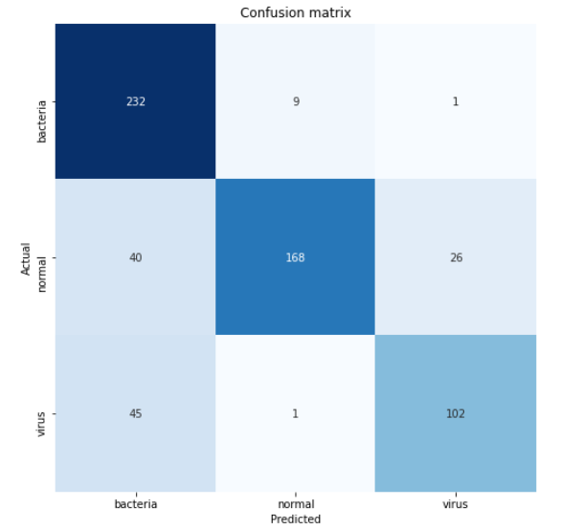
Confusion Matrix

Slide 37
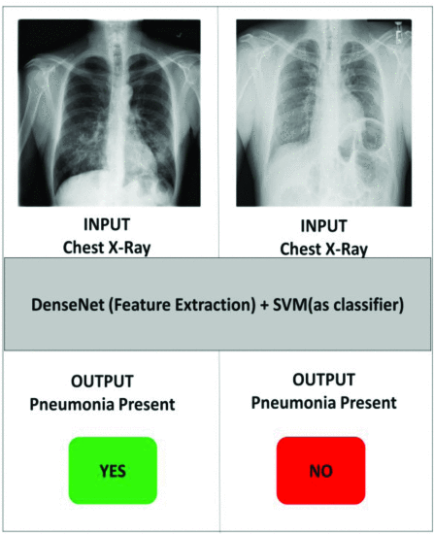
Output Format

Slide 38
Conclusion
Presence of expert radiologists is the topmost necessity to properly diagnose any kind of thoracic disease. This project primarily aims to improve the medical adeptness in areas where the availability of radiotherapists is still limited. Our aim is to facilitate the early diagnosis of Pneumonia to prevent adverse consequences (including death) in such remote areas. So far, not much work has been contributed to specifically to detect Pneumonia from the mentioned dataset. The development of algorithms in this domain can be highly beneficial for providing better health-care services.
In this classifier we implemented a pre-trained CNN model along with distinct classifiers and then on the basis of statistical results selected DenseNet169 for the feature extraction stage and SVM for the classification stage. We also were able to identify Pneumonia based chest X-rays with an accuracy of 88.5%, using this it will be more easy and convenient for people to complete the initial diagnosis of the chest X-rays and determine the possibility of being affected with Pneumonia

Slide 39
Future Scope
Although the results were overwhelming, there were still some limitations in our model which we believe are vital to keep in consideration.
For our future work we are planning to include lateral view chest X-rays as well as they have proved to increase the possibility of Pneumonia classification.
Also as we have used a model which exercises a lot of convolutional layers, the model needs very high computational power otherwise it’ll eat up a lot of time in computations. So for next iteration we are planning on using an even faster algorithm which is less computation intensive.

Slide 40
Bibliography
http://globocan.iarc.fr/Pages/fact_sheets_ cancer.aspx.
https://www.livemint.com/Politics/3eXX60XBig4bWZ25Kr1iQO/Indiarecordedabout39-million-cancer-cases-in-2016data.html
Using Deep Learning for Classification of Lung Tumors on Computed Tomography Images.
M.S. Al-Tarawneh, “Lung cancer detection using image processing techniques,” Leonardo Electronic Journal of Practices and Technologies, vol. 20, pp. 147– 58, May 2012.
LUNA16, “Lung tumor analysis 2016.” https:// luna16.grand-challenge.org/.
A Manikandarajan, S Sasikala, Detection and Segmentation of Lymph Nodes for Lung Cancer Diagnosis. National Conference on System Design and Information Processing – 2013.
M.S. Al-Tarawneh, “Lung cancer detection using image processing techniques,” Leonardo Electronic Journal of Practices and Technologies, vol. 20, pp. 147– 58, May 2012
Albert Chon, Peter Lu, NiranjanBalachandar “Deep Convolutional Neural Networks for Lung Cancer Detection”.
Wavelet Recurrent Neural Network for Lung Cancer Classification”:3rd ICSTcomputer,2017.
A.Kavitha, Anusiyasaral and P.Senthil,” Design Model of Retiming Multiplier For FIR Filter &its Verification”, International Journal of Pure and Applied Mathematics, Vol116 No12, 2017, pp. 239-247

Slide 41

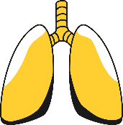
Thank You

