Slide 1
1
A pictorial
illustrating
a key concept
2
Frequently asked
questions raised
by students
Summary
of essential notions
6
Module
# 1
Guiding
principles
Quiz
3
Common pitfalls
(“do-nots”)
5
4

Slide 2
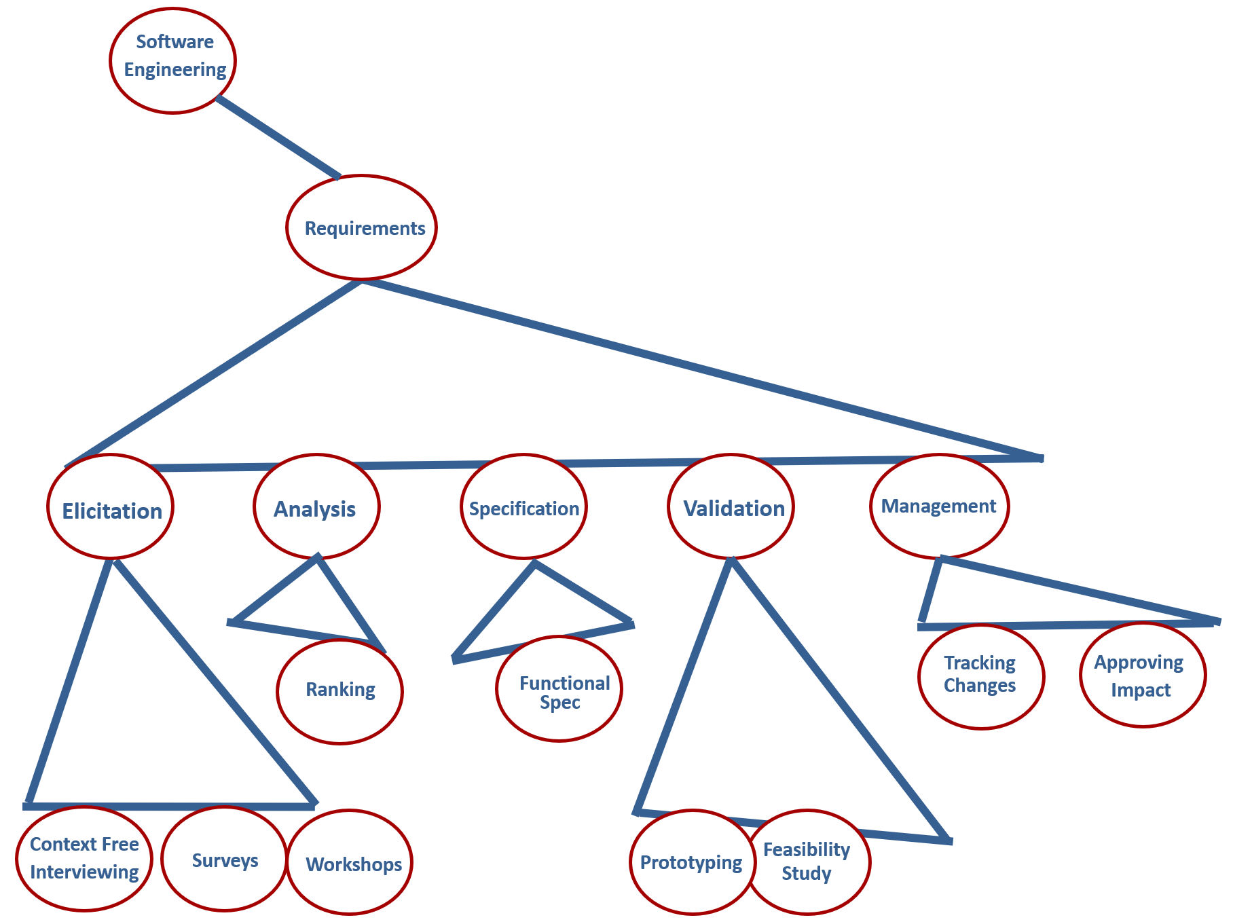
1
Taxonomy tree for the requirements space shows how various terms relate to each other. This in turn offers an insight into each term.

Slide 3
2
Attributes of a solid requirement are comprised below.
Unambiguous
Non-overlapping
Complete
Testable
Clearly stated
Consistent
Correct
Modifiable
Prioritized
Traceable & Traced
Uniquely identified
Design-Free

Slide 4
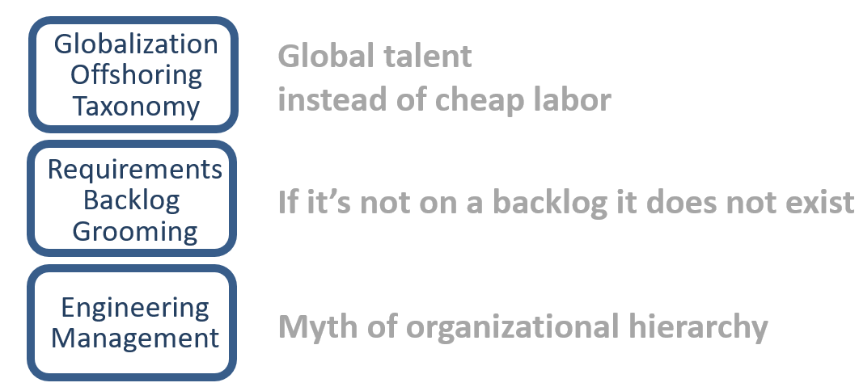
3

Slide 5
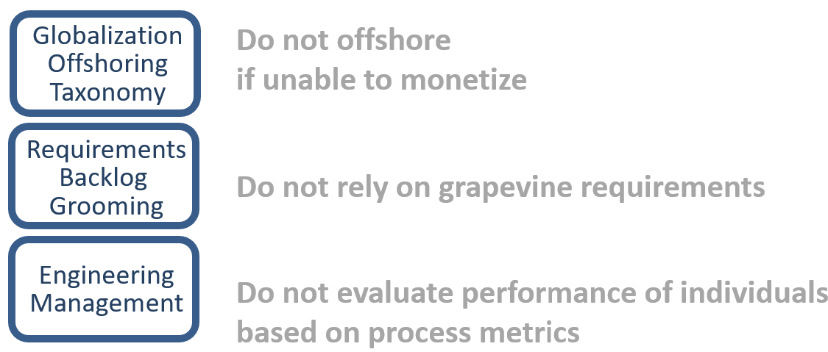
4

Slide 6
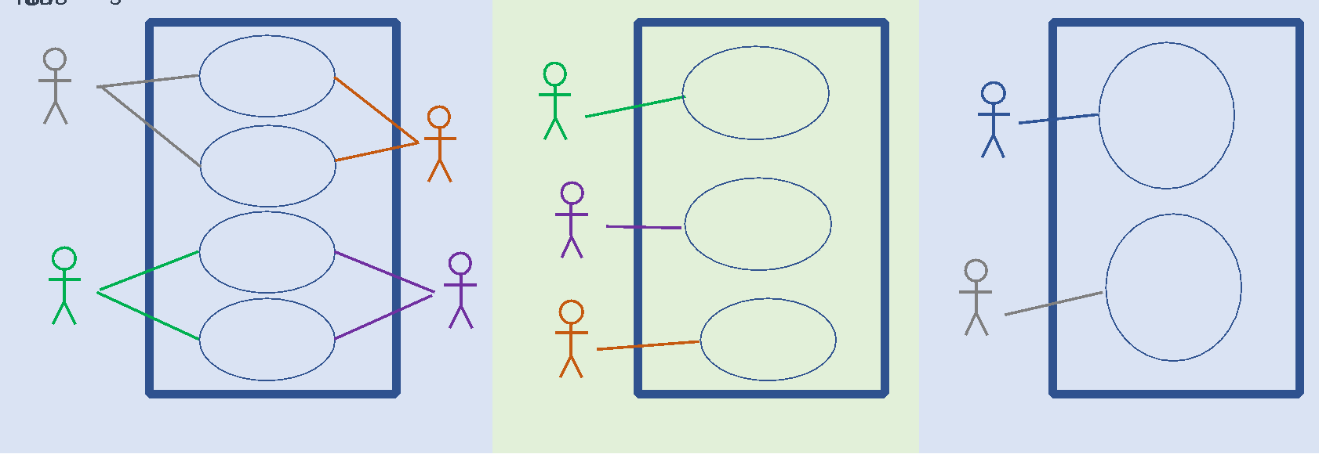
5
When defining personas for a project, we should do it in a most clear and unambiguous manner. Consider three options to define personas.
Which one definition is ambiguous?

Slide 7
6
Question. Is this class difficult or easy?
Answer. The class covers multiple topics. It is rewarding for a student to learn new material and be able to apply it. Six modules include over a thousand pages of course notes, quizzes, assignments, final exam, term project.

