Slide 1
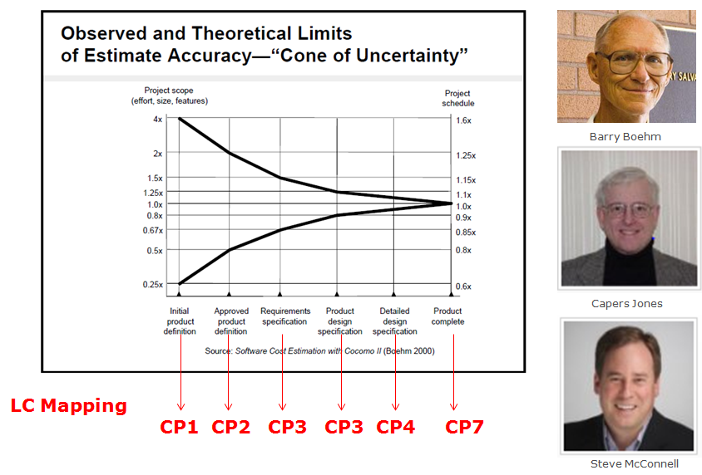
1
Three Gurus of Estimation

Slide 2
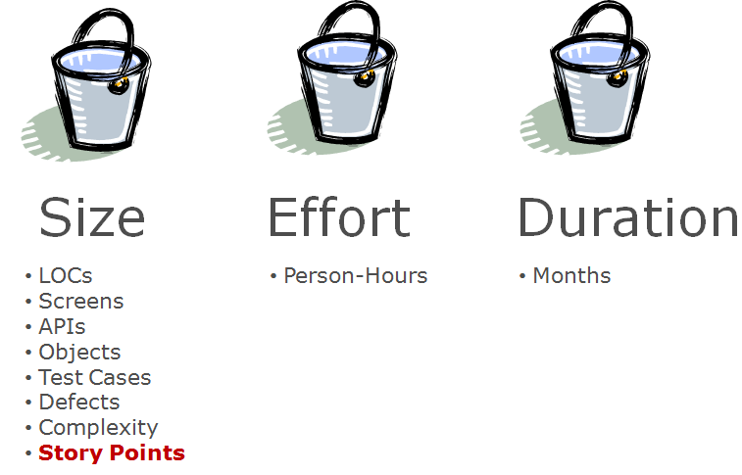
2
Estimation Framework - Three Buckets

Slide 3
3
Software
Configuration
Management
Identification , Control,
Auditing, Reporting
Estimation
Precision equal to accuracy

Slide 4
4
Do not make a version - a part of file’s name
Do not accumulate changes before implementing them
Do not average estimates
Software
Configuration
Management
Estimation

Slide 5
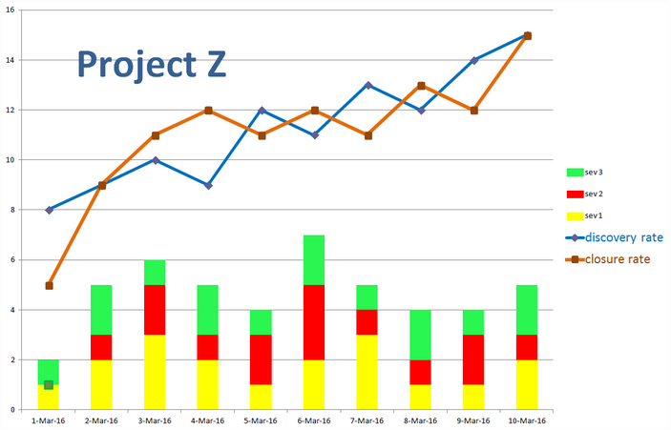
5
What logical conclusion can you derive from the chart below? Select one among these three options.
Since 'discovery rate' keeps rising, we should slow down the testing effort and then ship the product.
Since the 'closure rate' is approximately equal to the 'discovery rate' and the number of outstanding defects is below acceptable limit, the product could be shipped.
The product is not ready for shipment

Slide 6
6
Question. Should I take the role on a project that I am most comfortable with or a role that I am interested to learn about ?
Answer. You should take the role that you are most comfortable with. For example, if you are a professional Ux Engineer, you should design wireframes for the term project. The timeline is short, hence the way you learn here is through interacting with peers and through completing a useful app.

