Slide 1

Wireframes Have No Color
1
During project presentation, first show a wireframe, then show the actual screenshot.
Identify the gap. Bring examples of a peer review comments that were implemented. These comments are crucial in explaining the team’s thought process.
As a starting point, you need to prove that you did follow the peer review process. You need to demonstrate that you did not jump to building UI, without considering inputs from everyone.
Alleviate dependency between Functionality and Colors. Disengage. Do one-thing-at-a-time.
Functionality – first. Colors – second.
Effective
Ineffective
Each time the functionality is changed, it triggers the corresponding change in details and color. It’s ineffective to keep reviewing all together. The shorter path is to converge on functionality and then adjust details and color to match the functionality.
Activities # 4, #7, #10 are redundant. Multiple adjustment of colors instead of a single adjustment of colors.

Slide 2

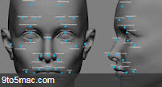

From Radio Button to Augmented Reality
2
Electronic
Tattoo
1975, Mythical Man-Month, Fred Brooks, “The programmer, like the poet, works only slightly removed from pure thought-stuff”
Brain Implant
Neuralink
Augmented R
(AR) Facebook
Elton Mask wants to insert a wire
into your head
Speech (SR)
Siri
How to unlock IPhone 8? Just look at it.
Facial recognition
Haptic
Interaction
you do not hit the button, but the button hits you
Wearables
Google Glass
from Amanda Rosenberg
Dual Touch
3D Touch
You are here
Navigation Bar
Left / Top
Dropdown List
Text Box
Radio Button
Check Box
Drag&Drop
List Box
Theme Button
Combo Box
Spin Box

Slide 3
3
Low coupling and high cohesion
Software
Design
States aren’t screens
SW Tools
Evaluation
Scale optimization
Risk = Threat X Vulnerability
IT Security

Slide 4
4
Do not color wireframes
Software
Design
Do not introduce a tool that does not support the common process
SW Tools
Evaluation
Do not focus on threats before addressing vulnerabilities
IT Security

Slide 5
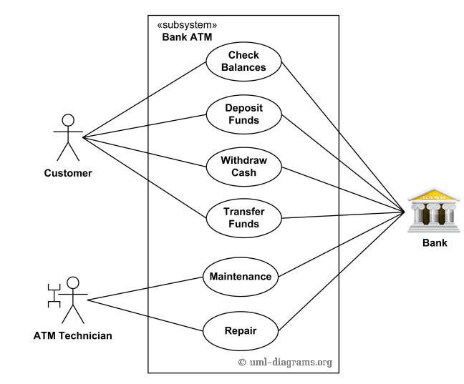
5
Instance
Next-door neighbor
Mary White
The man with a puppy
Archetype
Persona
Actor
Market segment
Definition of personas is the initial part of any project. The task here is to distill few real personas from a great variety of instances. To map which instances correspond to which archetypes. To reduce the sea of instances to a selected personas, which you can use as a foundation to build the product.
Many-To-One
Auditor
Audit
Next-door neighbor
Many-To-One
Many-To-One
Mary White
Man with a puppy
Which ones of the following statements are true?
When designing test cases – we use Archetypes – we do not use Instances
When ascertaining the size of a system – we use the number of Personas – we do not use the number of Instances
The thick line with system boundaries – separates the scope of this release from the scope of the next release
Icebox of Pivotal Tracker is mapped into the scope of the next release
Whatever is inside system boundaries – belongs to the next release (False)
Design of a system is done against Instances and not against Archetypes (False)
Pictures with puppies are for Instances. Product features are for Archetypes.

Slide 6
6
Question. Why do we need both Requirements and Use Cases, since both of them describe the same user needs?
Answer. Product backlog is the numbered and ranked list of user requirements. The unique angle of Use Cases is that it adds the visualization of the dynamic behavior. System Boundaries show which use cases are implemented in this release and which ones are planned for the next release.

