Slide 1

Mid Presentation SSD Project
.
Notes:
1

Slide 2
We are group SSD-11

Slide 3
PROBLEM DESCRIPTION
Our Aim is to create a puzzle game for dyslexic people
it is often challenging for a kid with dyslexia to stay motivated to learn.
It is a proven fact that mind-games such as word games,memory games etc. are effective in helping children with dyslexia , but it is hard to keep them engaged.
The games must be simple as well as interesting in parallel.
There are a numerous games in the market which are good at the logics but not engaging enough.
Our puzzle game comes to the rescue,by combining the old-school honeycomb maze concept with many effective dyslexic games ,proving a whole new interactive experience to the children.

Slide 4
SOLUTION APPROACH
OUR PUZZLE GAME CONSISTS OF A 3-D MAZE.
SOME WALLS WILL HAVE DOORWAYS WHICH ARE LOCKED BY A MINI DYSLEXIA PUZZLE GAME.
AFTER SOLVING THE MINI PUZZLE ,THE DOORWAY WILL VANISH AND THE USER CAN MOVE FORWARD IN THE MAZE.
THE AIM IS TO REACH THE BRICK ROOM ,WHICH IS THE LAST ROOM IN THE MAZE.
THERE CAN BE MULTIPLE PATHS TO REACH THE BRICK ROOM, DEPENDING UPON THE CHOICES OF THE USER.
EACH PUZZLE WILL BE UNIQUE IN ITSELF , AND THEREFORE THE USER WILL BE SOLVING NUMEROUS PUZZLES BEFORE FINISHING THE GAME.
THIS SOLUTION APPROACH IS DIFFERENT FROM THE PREVAILING SOLUTIONS AS NO OTHER DYSLEXIA PUZZLE GAME IS AS INTERACTIVE AND DOES NOT PROVIDE SOLVING OF SUCH A VARIETY OF PUZZLES IN A SINGLE GAME RUN.

Slide 5
Technical Details
A-FRAME IS OUR DRIVING TECHNOLOGY.
WE RAN INTO FEW DIFFICULTIES , AND USED CERTAIN A-FRAME ADD-ONS AND LIBRARIES TO SOLVE THE ISSUES.
Walking through walls
One of the first snags we ran into was that the camera would pass through objects and walls. After some research, we came across a-frame-extras. It includes an add-on called “kinematic-body” that helped solve this issue for us.
Controls
A-frame extras also has helpers for controls. It gave US an easy way to implement controls for keyboard, mouse etc.
Generating rooms
We used a 2-D array or a map to generate our MAP .The walls were made as static-bodies so camera could’nt pass through them.
Embedding Puzzles
We are working on a variety of puzzles, which are embedded on the doorways with the help of aframe and made interactive by adding an onClickListener and making them clickable objects.The puzzles are coded with the help of Javascript.
Libraries
Refrences from stackOverflow and A-Frame documentation have been taken and external libraries such as aframe-master.min.js,aframe-mouse-cursor-component etc. are used.

Slide 6
Technical Details
A-FRAME IS OUR DRIVING TECHNOLOGY.
WE RAN INTO FEW DIFFICULTIES , AND USED CERTAIN A-FRAME ADD-ONS AND LIBRARIES TO SOLVE THE ISSUES.
Walking through walls
One of the first snags we ran into was that the camera would pass through objects and walls. After some research, we came across a-frame-extras. It includes an add-on called “kinematic-body” that helped solve this issue for us.
Controls
A-frame extras also has helpers for controls. It gave US an easy way to implement controls for keyboard, mouse etc.
Generating rooms
We used a 2-D array or a map to generate our MAP .The walls were made as static-bodies so camera could’nt pass through them.
Embedding Puzzles
We are working on a variety of puzzles, which are embedded on the doorways with the help of aframe and made interactive by adding an onClickListener and making them clickable objects.The puzzles are coded with the help of Javascript.
Libraries
Refrences from stackOverflow and A-Frame documentation have been taken and external libraries such as aframe-master.min.js,aframe-mouse-cursor-component etc. are used.

Slide 7
DEMO VIDEO
Video links
https://drive.google.com/file/d/1XBR3g2gi98uJ35tvjzOUOyG59NtrMuZf/view?usp=sharing
https://drive.google.com/file/d/12pGVpzn1JwgQWevsc3uFvqUe8EjxCa6R/view?usp=sharing
https://drive.google.com/file/d/11ADGJi-ITUYdRVYHeZE4D3QP-QGzuUCr/view?usp=sharing

Slide 8
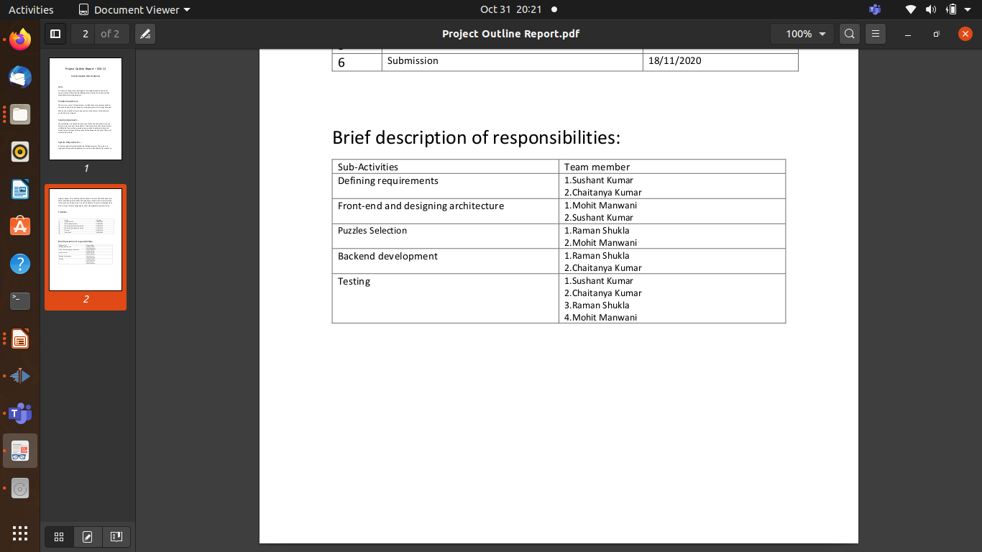
Work Distribution & Further Timeline
Every member contributed to some extent in all the fields, but here is a brief description of responsibiities, although the roles were not well defined throughout the course of this project.
In the furthur stages of developement we will be refining the games, we are trying to add a character(player) for third person perspective,a simultaneous working cursor with camera controls,more interactive gameplay and a cleaner UI.

Slide 9
Thank You!

