Slide 1
The effects of Wildfire Smoke on Labor Profits for Clovis, New Mexico
By Ramiro Steinmann Petrasso

Slide 2
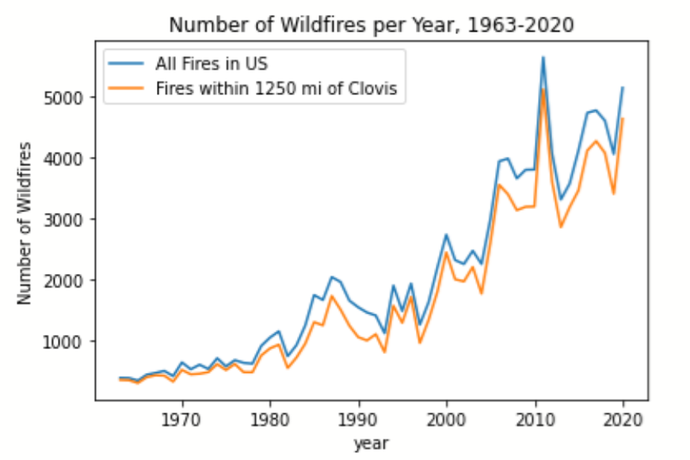
Wildfires on the Rise (nationally and at home)
The number of Wildfires, both nationwide and close to Clover, has been rapidly rising
Source: USGS Dataset for Wildfires in the USA

Slide 3




Research into association of wildfire smoke with labor profits
Several researchers have researched the association of Wildfire Smoke with various socioeconomic factors: one of these are labor profits/total earnings
Idea spearheaded by researchers at UIUC, in a study from 2021, looking into how much days of smoke coverage impact overall earnings
I hypothesize a similar association will hold for our town of Clovis
Each “smoke day” a county experiences is associated with in a 0.097% decrease in quarterly labor earnings
Left to Right:
Mark Borgschulte
David Molitor
Eric Yongchen Zou

Slide 4
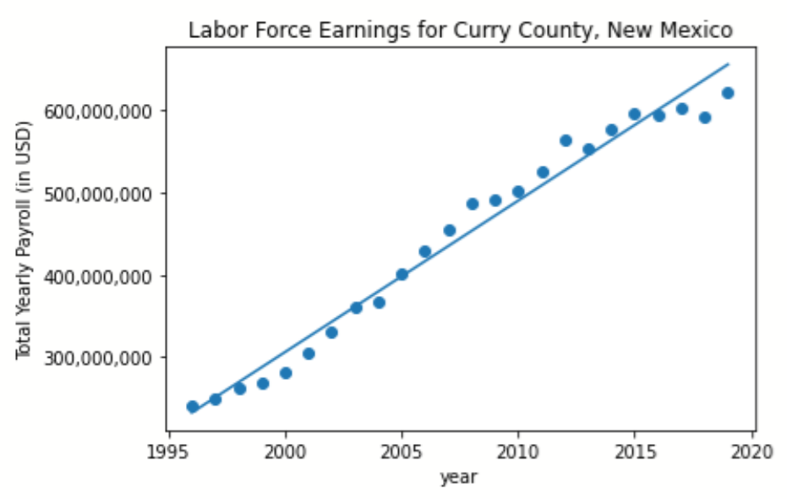
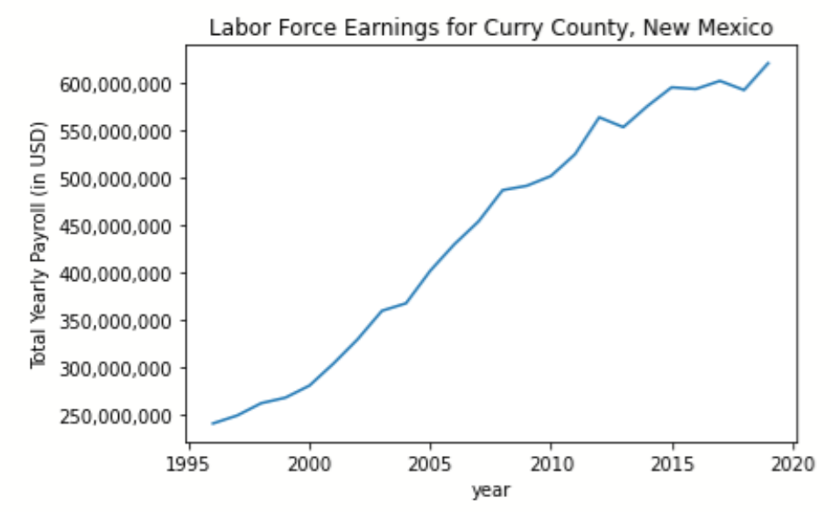
QWI estimator labor profit data
Offered at the county level rather than city level
However, Curry county in New Mexico is mostly just the city of Clovis
It’s the county seat and has 38k of the county’s 48k residents
Source: U.S. Census’s Quarterly Workforce Indicators

Slide 5
Challenges for localizing analysis
The effects of wildfire smoke are usually due to the particulate pollution they cause, which the UIUC researchers factored into their analysis
This pollution is usually measured by the EPA’s Air Quality System, which calls it particulate matter PM2.5 (inhalable particles 2.5 micrometers or smaller)
EPA has several sensors nationwide, but none are reliably close to Clovis
Closest are in Roswell, NM and Amarillo, TX, which are roughly 75 mi away

Slide 6
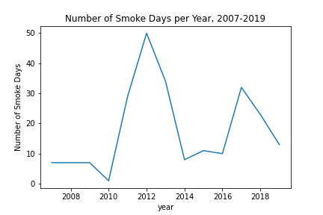
Workarounds
The National Oceanic and Atmospheric Administration (NOAA) has a Hazard Mapping System that tracks the days that some counties are covered in various amounts of smoke
This is what was used for UIUC’s “smoke day” (days of near total coverage)
Source: National Oceanic and Atmospheric Administration’s Hazard Mapping System (HMS)

Slide 7
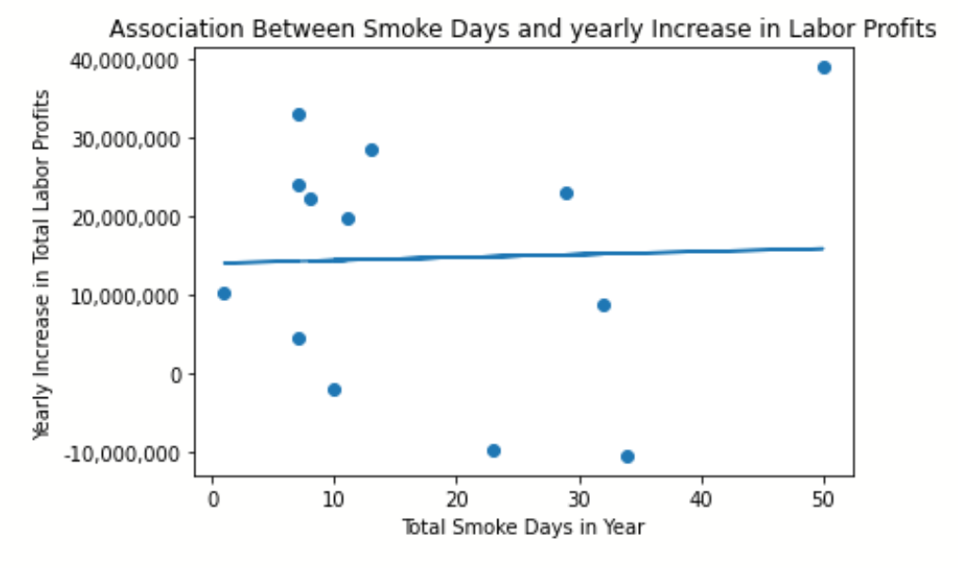
Yearly smoke days vs Rate of Increase of Labor Earnings

Slide 8
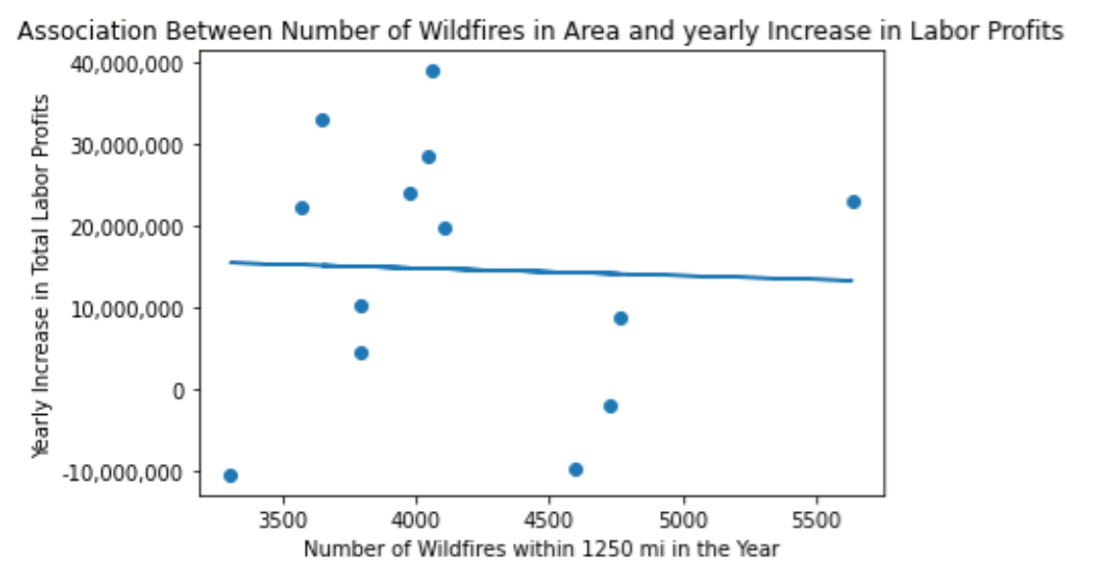
Number of nearby Wildfires vs Rate of Increase of Labor Earnings

Slide 9
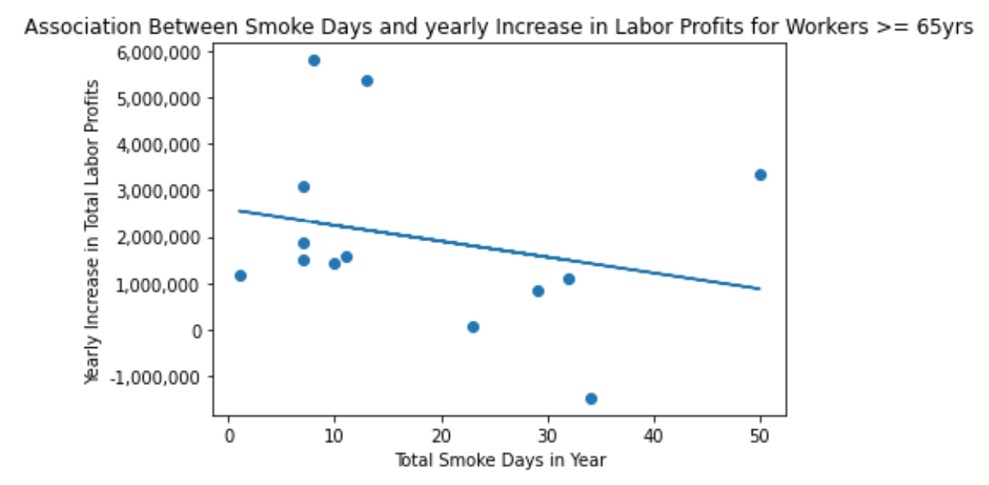
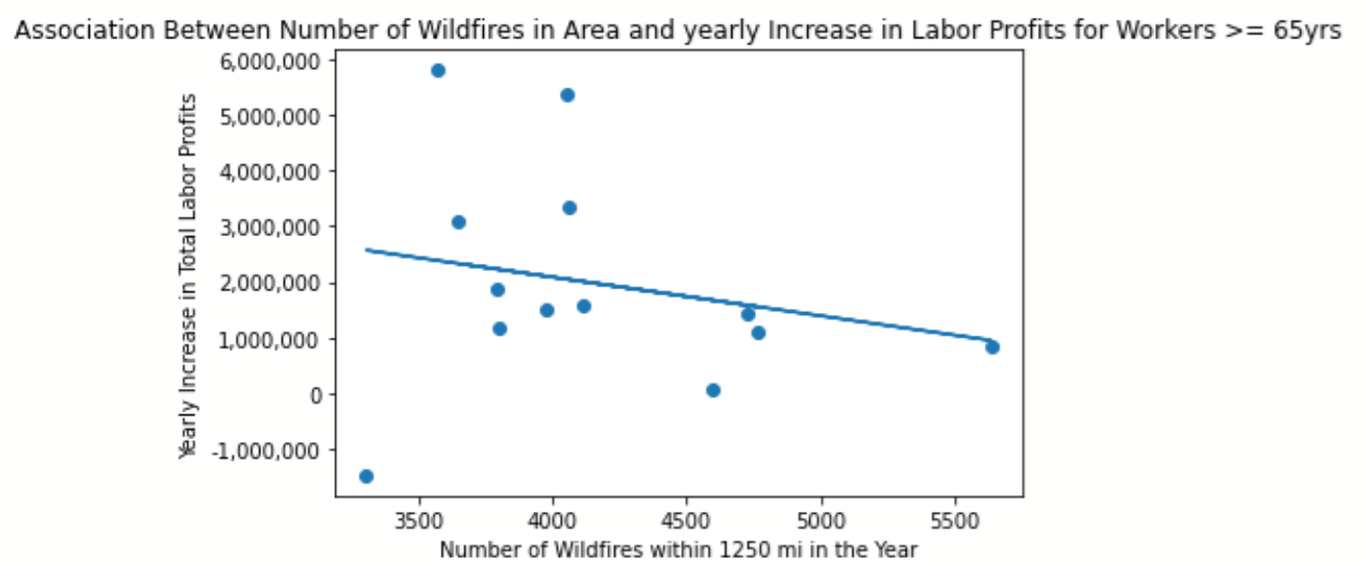
Effect becomes evident when focusing on Elderly Workers

Slide 10
Interpretation and Future Avenues of Exploration
Relationship between wildfires/smoke does not quite seem linear for all of Clovis’s labor earnings
Relationship starts to appear when zeroing in on elderly workers
Effect may be confined to those vulnerable to smoke
PM2.5 data for Curry and Clovis is missing; finding a suitable way to incorporate would deepen analysis

Slide 11
Closing remarks
While a direct relationship between labor profits/earnings and wildfire smoke were not able to be definitively proven for all of Clovis, there are indications of effects on a subset of population (elderly)
Need to test for other vulnerable groups (those with medical conditions)
Potential policymaking preparations:
Increase investment in cardiovascular care
Tax incentives for workers sensitive to smoke on years where effects are felt, especially on older workers

