Slide 1


TEAM
PRESENTATION
Team 17
NAME: LAMIA HASAN RODOSHI
ID: 19301248
Name: RAMISA FARIHA JOYEE
ID: 19301250

Slide 2

INTRODUCTION
Biomedical Named Entities for Bangla Language is not as much recognized as other languages. Because it has not enough NLP resources. In a recent paper, named-entity recognition (NER) frameworks aim to identify NE from unstructured text documents and categorically predefined them and then tokenized and annoted them in 4 classes of entity which are anatomy, Diseases and Symptoms, Chemical and Drug, and Medical Procedure.
CONTRIBUTIONS
Address the lack of annotated data in the Bangla Biomedical and Health domain
They manually annotated the corpus in token level in four classes
They provided statistics of the frequency and structures of various types of entities in the corpus

Slide 3
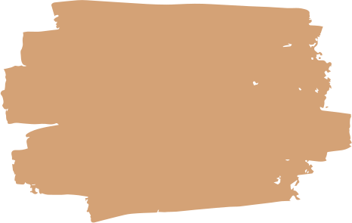
RELATED WORKS
01
02
ENGLISH BIOMEDICAL CORPUS
NON-ENGLISH BIOMEDICAL CORPUS
Many research paper worked on English Language. Some paper used variational dropout, transfer learning and multi-task learning to improve the generalizing ability of BioNER. In other papers, authors performed multi-stage annotations for entities.
There are also many researches on Biomedical named entities in French Language, Swedish, Romanian Language, Spanish Language etc. The largest Spanish Biomedical corpus is consisting of 750M tokens.

Slide 4
Data Collection & Pre-Processing
Collected health related Bangla articles from ‘Prothom Alo’ newspaper
Text data were manually excerpted and segmented into sentences
Each sentence was tokenized into words and punctuations
Classified into 4 types; such as – Anatomical, Chemicals and Drugs, Disease and Symptoms, Medical Procedures
Performed entity annotation at sentence level; independently annotated duplicated entities; did not consider intensity of tokens
Followed IOB2 format for automatic NER task

Slide 5
Result
Total tokens = 11196
Entity words = 1968
Non – entity words = 9228
Unbalanced distribution of corpus regarding different entities
Most dominant entity type: Disease and symptoms class

Slide 6
Future Plan
First biomedical named entity annotated corpus in Bangla in IOB2 standard
Increase the size of annotated corpus
Create strong baselines for automatic NER tasks with transformer based language models
Observe to leverage cross lingual resources from other languages to improve performance of NER task

