Slide 1

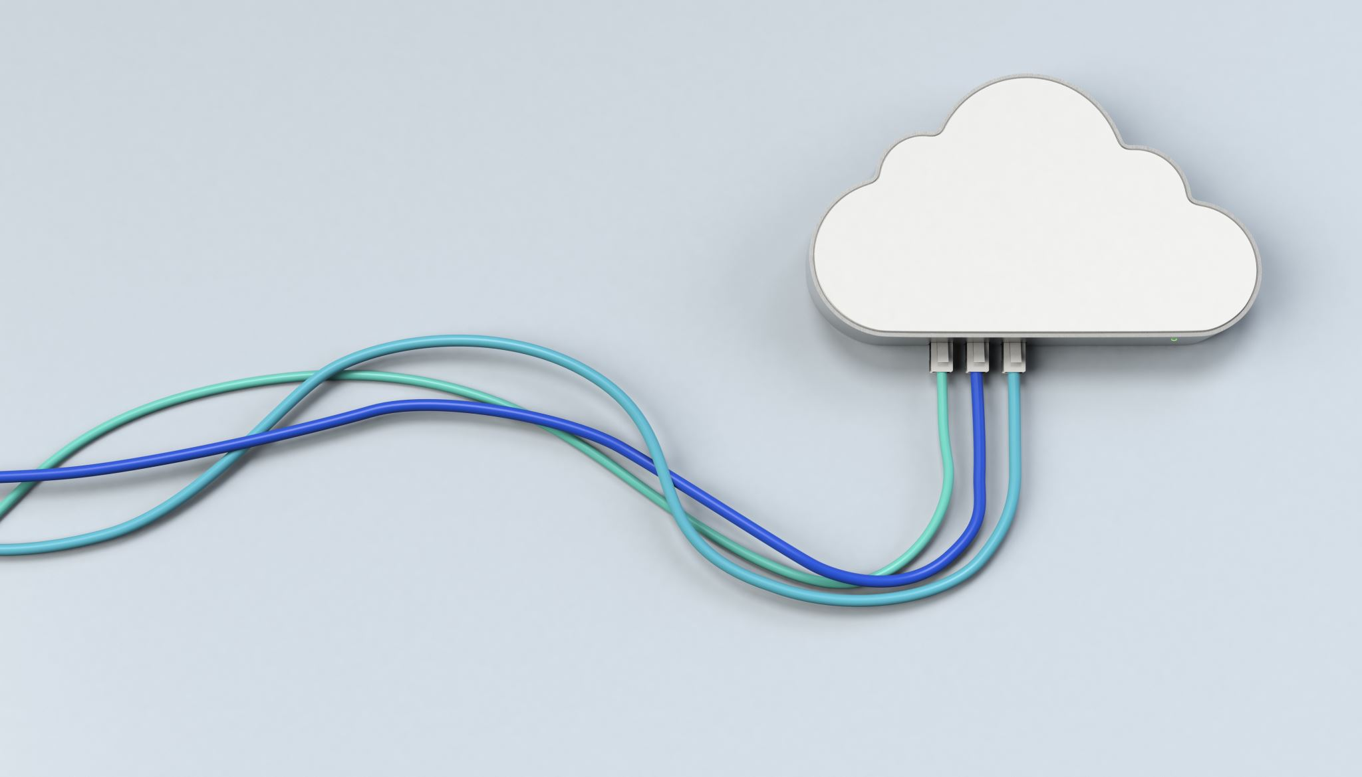
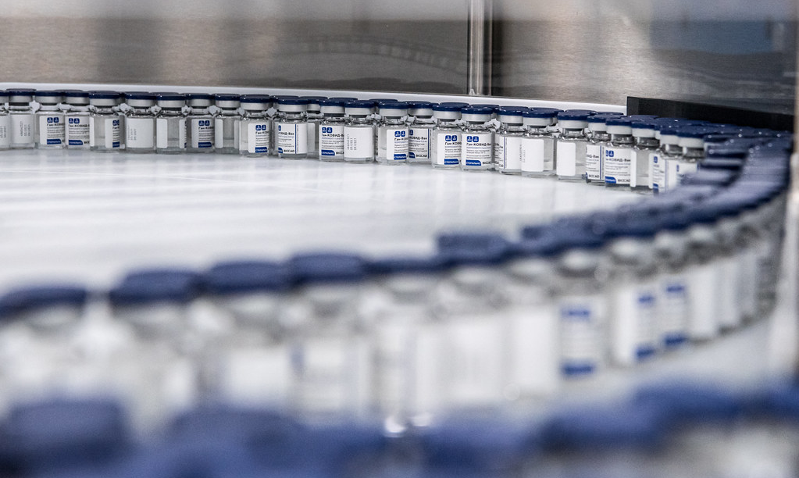
Smart Vital Detection: With Chatbot Integration
Presented by
Syed Naseer Rizwan
Sreerasya Kolla
Sai Hemanth Paturi
Vennela Ramisetty

Slide 2
So far.... (Vial Quality Assessment Using CNN)
Data Augmentation
Shear, Zoom, Rotation.
Width & Height Shift.
Horizontal Flip.
Model Architecture
Input: 150x150 RGB Images.
Convolutional Layers
32 Filters, Kernel Size: 3x3, ReLU Activation.
Max Pooling LayersPool
Size: 2x2, Strides: 2.
Flatten Layer, Dense Layers
128 Units, ReLU Activation.
Output Layer
Sigmoid Activation.

Slide 3
So far... (Vial Quality Assessment Using CNN)
Training:
Optimizer: Adam.
Loss: Binary Crossentropy.
Metrics: Accuracy.
Epochs: 50.
Validation:
Test Set: 'Validation' Folder.
Class Mode: Binary.
Prediction:
Image Path: 'Good Piece'.
Result: Good Piece (or Reject Piece) based on >0.5 threshold.

Slide 4
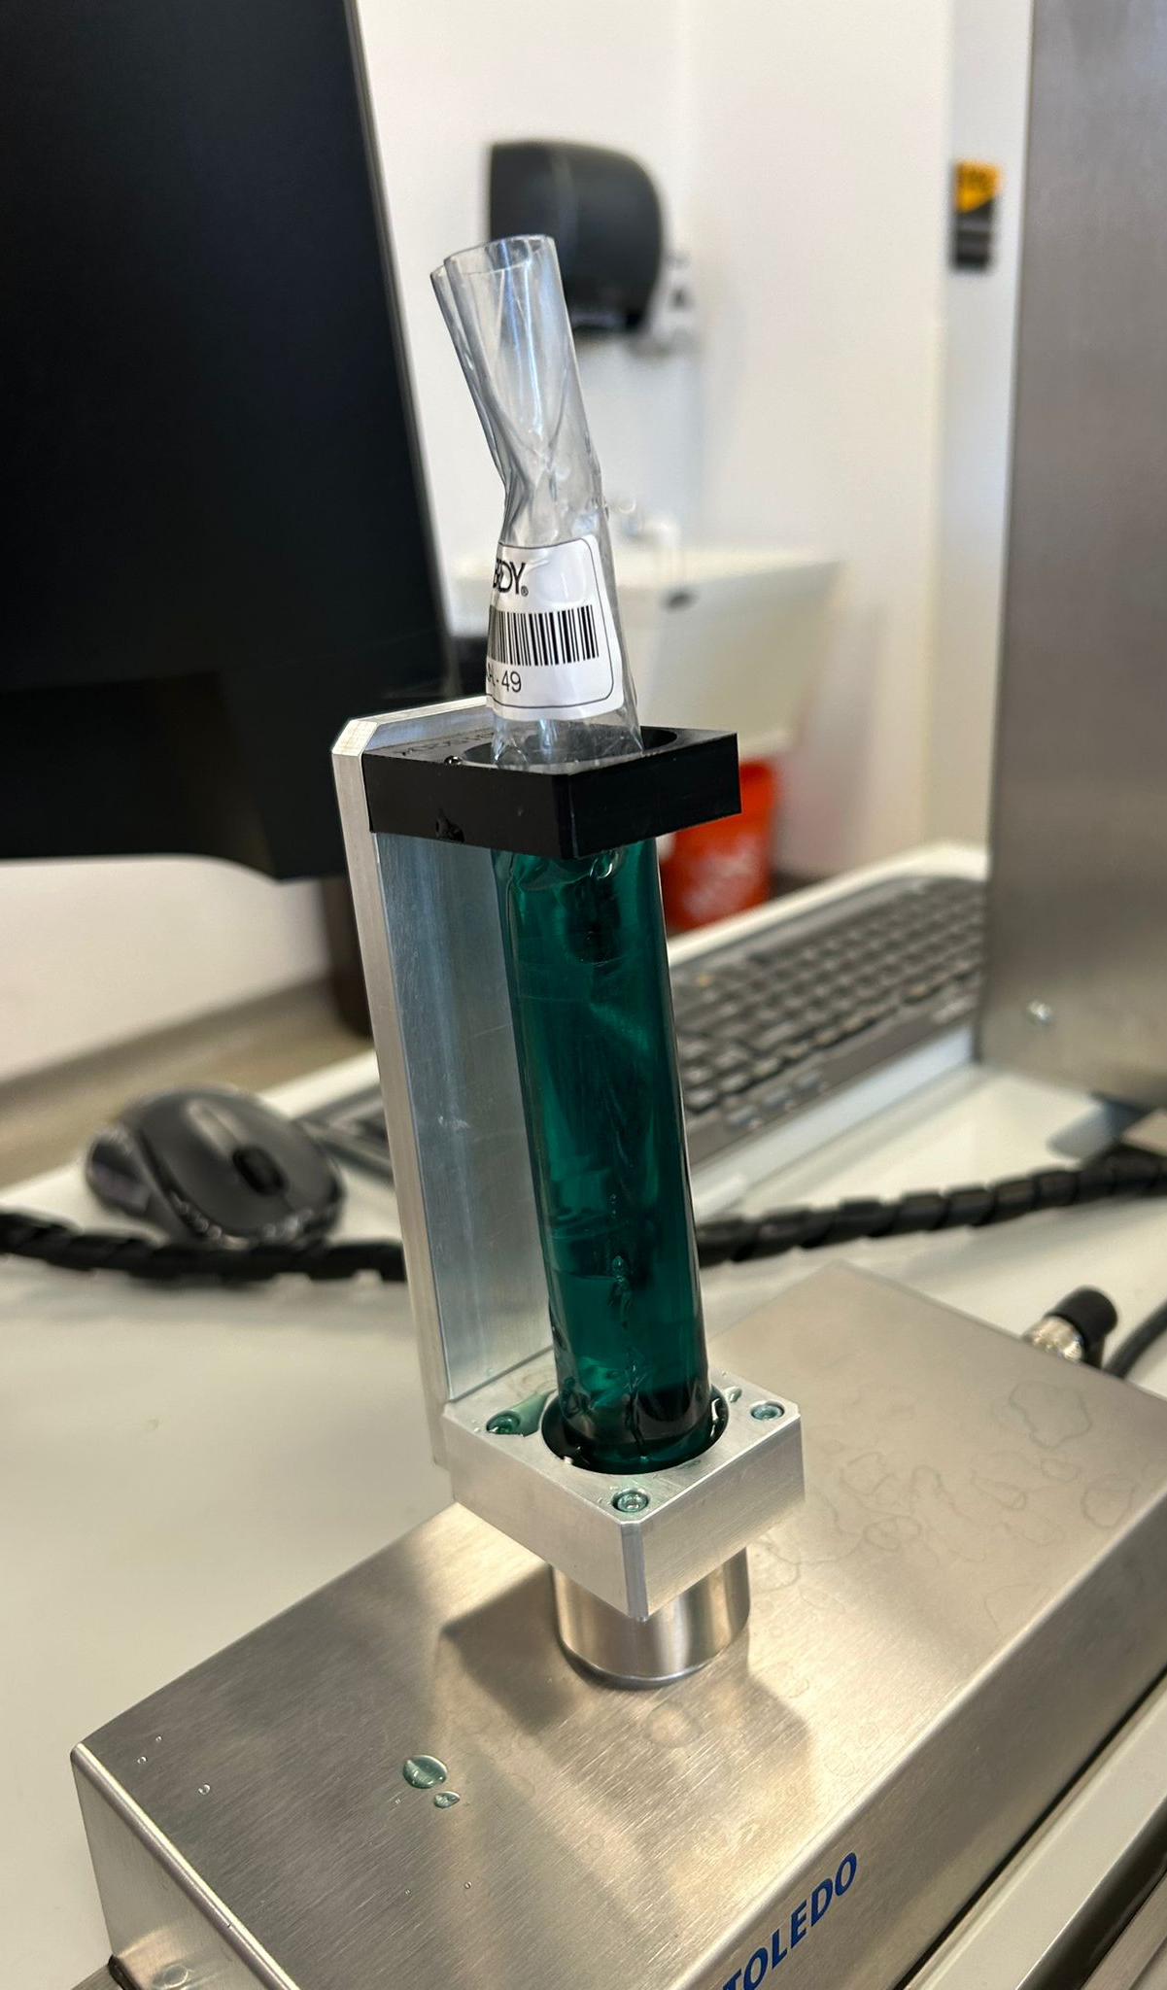
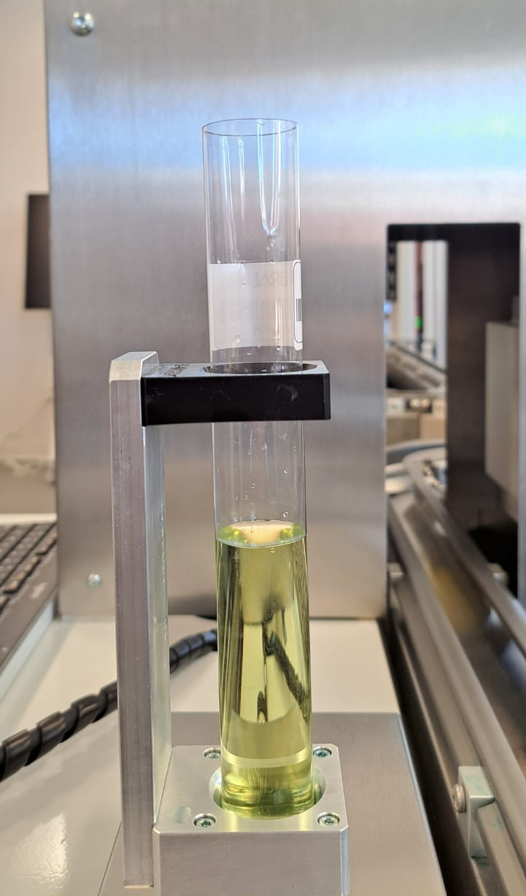
So far... (Vial Quality Assessment using CNN)
Able to classify whether the vial is good or broken.

Slide 5
Need for Enhancement
Lack of real-time monitoring and interaction.

Slide 6
Enhanced System Overview
Video recording system for live production.
Vial classification using CNN.
Cloud storage for data management.
Real-time monitoring system.
Chatbot for reports and queries.
User can access data anytime/ anywhere using chatbot

Slide 7
Chatbot Training
Data
JSON file with intents and responses.
Steps
Tokenization, Model Architecture.
Model
Embedding layer, Dense layers.
Compilation
Loss - Sparse Categorical crossentropy
Training
Accuracy & Loss over epochs.
Visualization
Optimizer - Adam
Metrics - Accuracy
Iterations.
Epochs - 500

Slide 8
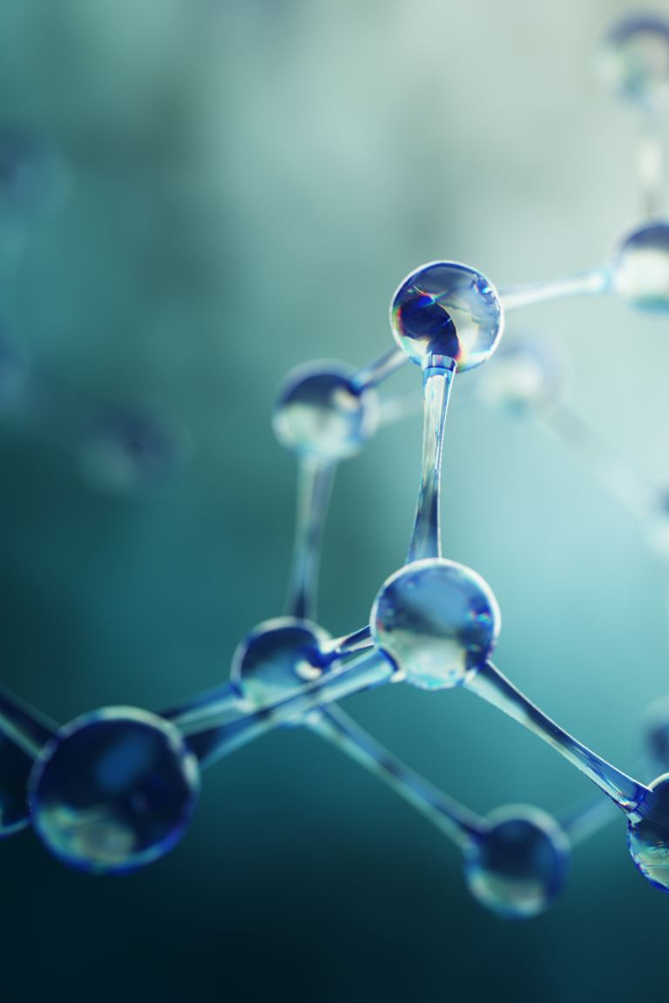
Chatbot Deployment
Model
Tokenizer
Label Encoder.

Slide 9

Challenges
Challenge was to build chat bot using Neural Network. But interesting and got a lot granular level understanding.
Initial loss was too high to handle.
Major challenge is data. As the data is too small, We used JSON to feed chatbot instead Blob Storage as its expensive.

Slide 10
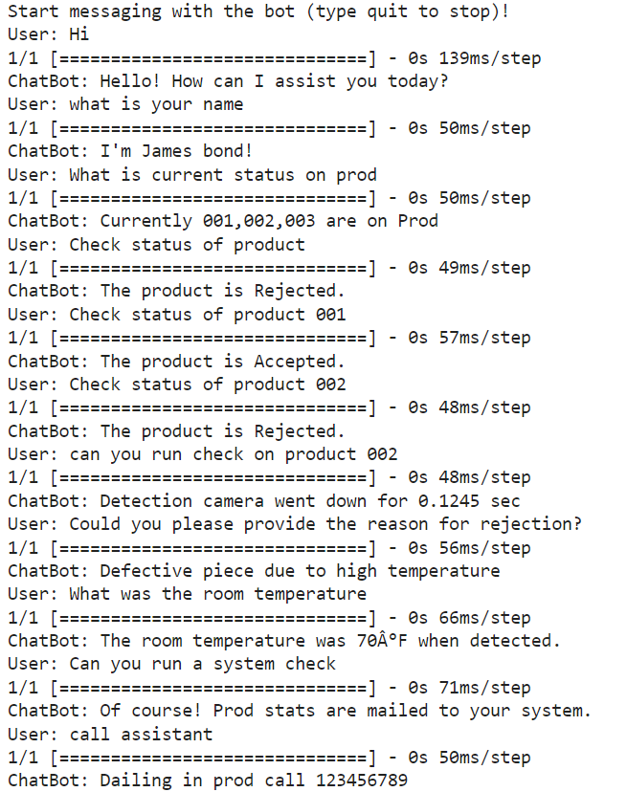
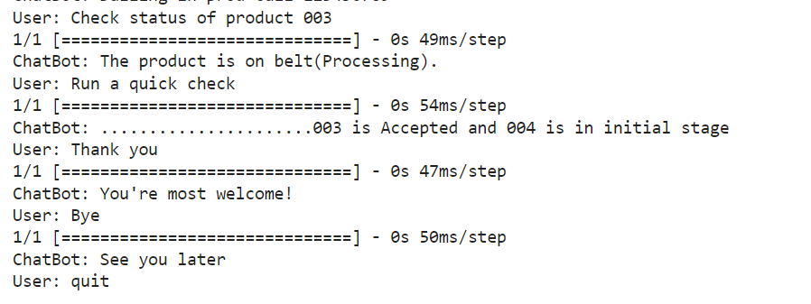
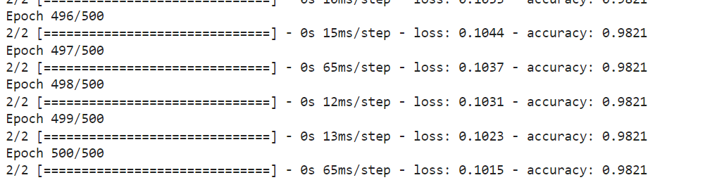
Conclusion
Chatbot effectively handled inquiries about production status, providing accurate information on accepted and rejected products with an accuracy of 98.2%

Slide 11
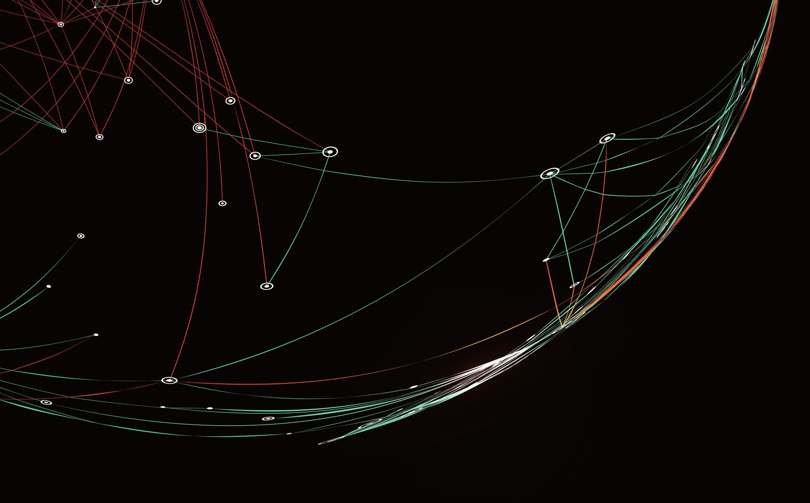
Thank You!

