Slide 1
CSS
By
Ramit Sharma

Slide 2
What is CSS?
CSS stands for Cascading Style Sheets
CSS describes how HTML elements are to be displayed on screen, paper, or in other media
CSS saves a lot of work. It can control the layout of multiple web pages all at once
External stylesheets are stored in CSS files

Slide 3
Why use CSS?
HTML was NEVER intended to contain tags for formatting a web page!
HTML was created to describe the content of a web page, like:
<h1>This is a heading</h1>
<p>This is a paragraph.</p>
When tags like <font>, and color attributes were added to the HTML 3.2 specification, it started a nightmare for web developers.
To solve this problem, the World Wide Web Consortium (W3C) created CSS.
CSS removed the style formatting from the HTML page!
With an external stylesheet file, you can change the look of an entire website by changing just one file!

Slide 4
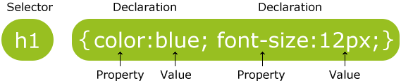
CSS Syntax
The selector points to the HTML element you want to style.
The declaration block contains one or more declarations separated by semicolons.
Each declaration includes a CSS property name and a value, separated by a colon.
A CSS declaration always ends with a semicolon, and declaration blocks are surrounded by curly braces.

Slide 5
CSS Selectors
CSS selectors are used to "find" (or select) HTML elements based on their element name, id, class, attribute, and more.

Slide 6
The element Selector
Select all HTML elements by element type.
Eg. Selecting all paragraph elements:
p { text-align: center; color: red; }

Slide 7
The id Selector
The id selector uses the id attribute of an HTML element to select a specific element.
Eg. Applying style to HTML element with id="para1":
#para1 { text-align: center; color: red; }

Slide 8
The class Selector
The class selector selects elements with a specific class attribute.
Eg. Applying style to HTML element with id="para1":
.center { text-align: center; color: red; }
You can also specify that only specific HTML elements should be affected by a class.
p.center { text-align: center; color: red; }

Slide 9
Grouping Selectors
Elements with the same style definitions, can be grouped together.
h1, h2, p { text-align: center; color: red; }

Slide 10
CSS comments
p { color: red; /* This is a single-line comment */ text-align: center; } /* This is a multi-line comment */

Slide 11
Applying CSS
There are three ways of inserting a style sheet:
External style sheet
Internal style sheet
Inline style

Slide 12
External style sheet
With an external style sheet, you can change the look of an entire website by changing just one file!
The style sheet file must be saved with a .css extension
Each page must include a reference to the external style sheet file inside the <link> element. The <link> element goes inside the <head> section:
<head> <link rel="stylesheet" type="text/css" href="mystyle.css"> </head>

Slide 13
Internal Style Sheet
An internal style sheet may be used if one single page has a unique style.
Internal styles are defined within the <style> element, inside the <head> section of an HTML page:
<head> <style> body { background-color: linen; } h1 { color: maroon; margin-left: 40px; } </style>
</head>

Slide 14
Inline Style Sheet
An inline style may be used to apply a unique style for a single element.
An inline style (inside a specific HTML element) has the highest priority, which means that it will override a style defined inside the <head> tag, or in an external style sheet
<h1 style="color:blue;margin-left:30px;">This is a heading.</h1>

Slide 15
CSS Color
Colors are displayed combining RED, GREEN, and BLUE light.
Colors in CSS are most often specified by:
a valid color name - like "red"
an RGB value - like "rgb(255, 0, 0)"
a HEX (#RRGGBB) value - like "#ff0000“
#FF0000 is displayed as red, because red is set to its highest value (FF) and the others are set to the lowest value (00)
red = rgb(255,0,0) = #FF0000

Slide 16
CSS Background
CSS Background properties:
background-color | Sets all the background properties in one declaration
background-image | Sets the background image for an element
background-repeat | Sets how a background image will be repeated
background-attachment | Sets whether a background image as fixed/scrolling
background-position | Sets the starting position of a background image

Slide 17
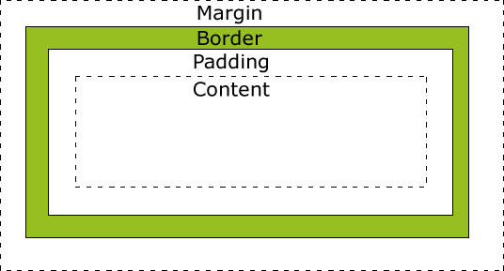
Box Model
All HTML elements can be considered as boxes.
The box consists of margins, borders, padding, and the actual content.
Example:
div { width: 320px; padding: 10px; border: 5px solid gray; margin: 0; }
The total width of an element =
20px (width) + 20px (left + right padding) + 10px (left + right border) + 0px (left + right margin) = 350px

Slide 18
CSS Border
The CSS border properties allow you to specify the style, width, and color of an element's border.
The border-style property specifies what kind of border to display.
The following values are allowed:
dotted - Defines a dotted border
dashed - Defines a dashed border
solid - Defines a solid border
double - Defines a double border
groove - Defines a 3D grooved border. The effect depends on the border-color value
ridge - Defines a 3D ridged border. The effect depends on the border-color value
inset - Defines a 3D inset border. The effect depends on the border-color value
outset - Defines a 3D outset border. The effect depends on the border-color value
none - Defines no border
hidden - Defines a hidden border

Slide 19
CSS Margins
The CSS margin properties are used to generate space outside the border of the elements.
CSS has properties for specifying the margin for each side of an element:
margin-top
margin-right
margin-bottom
margin-left
All the margin properties can have the following values:
auto - the browser calculates the margin
length - specifies a margin in px, pt, cm, etc.
% - specifies a margin in % of the width of the containing element
inherit - specifies that the margin should be inherited from the parent element

Slide 20
Margin Shorthand
If the margin property has four values:
margin: 25px 50px 75px 100px;
top margin is 25px
right margin is 50px
bottom margin is 75px
left margin is 100px
If the margin property has three values:
margin: 25px 50px 75px;
top margin is 25px
right and left margins are 50px
bottom margin is 75px
If the margin property has two values:
margin: 25px 50px;
top and bottom margins are 25px
right and left margins are 50px
If the margin property has one value:
margin: 25px;
all four margins are 25px

Slide 21
CSS Padding
The padding properties set the size of the white space between the element content and the element border.
Just as for the margins, there are 4 padding properties:
padding-top
padding-right
padding-bottom
padding-left
Just like margins, there are shorthand notations for padding as well.

Slide 22
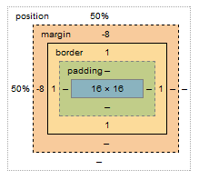
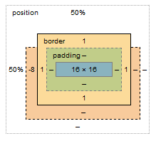
Margin vs Padding
margins auto-collapse, and padding doesn't.
Margin can have negative values, padding can’t
Example, margin-top:-8px;
- --->

Slide 23
CSS Height and Width
The height and width properties are used to set the height and width of an element.
The height and width can be set to auto (this is default. Means that the browser calculates the height and width), or be specified in length values, like px, cm, etc., or in percent (%) of the containing block.
Properties: height, width, max-height, min-height, max-width, min-width.
Example:
div { width: 500px; height: 80%;
max-height: 100px; }

Slide 24
CSS Text
The color property is used to set the color of the text.
h1 { color: green; }
The text-align property is used to set the horizontal alignment of a text.
A text can be left or right aligned, centered, or justified (words equally spaced).
h1 { text-align: center; }
The text-decoration property is used to set or remove decorations from text. Values can be none, overline, line-through, underline.
The value ’none’ is often used to remove underlines from links:
a { text-decoration: none; }

Slide 25
CSS Text
The text-transform property is used to specify uppercase and lowercase letters in a text.
It can be used to turn everything into uppercase or lowercase letters, or capitalize the first letter of each word.
p.lowercase { text-transform: lowercase; }
The text-align property is used to set the horizontal alignment of a text.
The letter-spacing property is used to specify the space between the characters in a text.
h1 { letter-spacing: 3px; }
The line-height property is used to specify the space between lines:
p.small { line-height: 0.8; }

Slide 26
CSS Fonts
The font family of a text is set with the font-family property.
The font-style property is mostly used to specify italic text.
The font-size property sets the size of the text.
The font-weight property specifies the weight of a font.
p { font-family: "Times New Roman", Times, serif;
font-style: italic;
font-size: 14px;
font-weight: bold; }

Slide 27
Pseudo-classes
A pseudo-class is used to define a special state of an element.
For example, it can be used to:
Style an element when a user mouses over it
Style visited and unvisited links differently
Style an element when it gets focus
a:visited { color: #00FF00; Visited Anchor element }
div:hover { background-color: blue; Hover on div elements }
p:first-child { color: blue; First <p> element that is child of any element }

Slide 28
CSS Links
Links can be styled with any CSS property (e.g. color, font-family, background, etc.).
The four links states:
unvisited link | visited link | mouse over link | selected link
a:link { color: red; text-decoration : none; background-color : yellow; } | a:visited { color: green; text-decoration : none; background-color : cyan; } | a:hover { color: hotpink; text-decoration : underline; background-color : lightgreen; } | a:active { color: blue; text-decoration : underline; background-color : hotpink; }

Slide 29
CSS Lists
In HTML, there are two main types of lists:
unordered lists (<ul>) - the list items are marked with bullets
ordered lists (<ol>) - the list items are marked with numbers or letters
The CSS list properties allow you to:
Set different list item markers for ordered lists
Set different list item markers for unordered lists
Set an image as the list item marker
Add background colors to lists and list items
The list-style-type property specifies the type of list item marker.
4 types: circle, square, upper-roman, lower-alpha. Example:
ul.a { list-style-type: circle; }

Slide 30
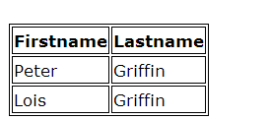
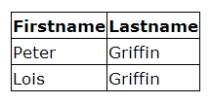
CSS Tables
The look of an HTML table can be greatly improved with CSS
To specify table borders in CSS, use the border property.
table, th, td { border: 1px solid black; }
The border-collapse property sets whether the table borders should be collapsed into a single border
table { border-collapse: collapse; } table, th, td { border: 1px solid black; }

Slide 31
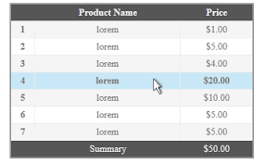

CSS Tables (contd)
The text-align property sets the horizontal alignment (like left, right, or center) of the content in <th> or <td>.
To control the space between the border and the content in a table, use the padding property on <td> and <th> elements.
Highlighting table rows on mouse over:
tr:hover {background-color: #f5f5f5}
For zebra-striped tables, use the nth-child() selector and add a background-color to all even (or odd) table rows:
tr:nth-child(even) {background-color: #f2f2f2}

Slide 32
CSS Outlines
An outline is a line that is drawn around elements (outside the borders) to make the element "stand out"
The outline is NOT a part of an element's dimensions; the element's total width and height is not affected by the width of the outline.
The outline-style property can have one of the following values:
dotted - Defines a dotted outline
dashed - Defines a dashed outline
solid - Defines a solid outline
double - Defines a double outline
groove - Defines a 3D grooved outline. The effect depends on the outline-color value
ridge - Defines a 3D ridged outline. The effect depends on the outline-color value
inset - Defines a 3D inset outline. The effect depends on the outline-color value
outset - Defines a 3D outset outline. The effect depends on the outline-color value
none - Defines no outline
hidden - Defines a hidden outline

Slide 33
Block vs Inline
A block-level element always starts on a new line and takes up the full width available (stretches out to the left and right as far as it can).
Examples of block-level elements:
<div>
<h1> - <h6>
<p>
<header>
<footer>
<section>
<li>
An inline element does not start on a new line and only takes up as much width as necessary
Examples:
<span>
<a>
<img>

Slide 34
CSS Layout - display property
The display property specifies if/how an element is displayed.
display : none hides the element
display : block/inline shows the element
Every element has a default display value, which can be overridden by the display property
Example, for creating inline menu items:
li { display: inline; }

Slide 35
display:none or visibility:hidden?
Both are used to hide the element.
With visibility:hidden; the element will be hidden, but still affect the layout.
With display:none; the element will be hidden, without affecting the layout as if the element was never there on the page

Slide 36
CSS Layout – position property
The position property specifies the type of positioning method used for an element.
There are four different position values:
static
relative
fixed
absolute
Elements are then positioned using the top, bottom, left, and right properties. However, these properties will not work unless the position property is set first.

Slide 37
CSS Layout – position property
Static positioned elements are not affected by the top, bottom, left, and right properties. This is the default positioning property.
An element with position: relative; is positioned relative to its normal position.
Setting the top, right, bottom, and left properties of a relatively-positioned element will cause it to be adjusted away from its normal position. Other content will not be adjusted to fit into any gap left by the element.
An element with position: fixed; is positioned relative to the viewport, which means it always stays in the same place even if the page is scrolled. The top, right, bottom, and left properties are used to position the element.
An element with position: absolute; is positioned relative to the nearest positioned ancestor (instead of positioned relative to the viewport, like fixed).
However; if an absolute positioned element has no positioned ancestors, it uses the document body, and moves along with page scrolling.

Slide 38
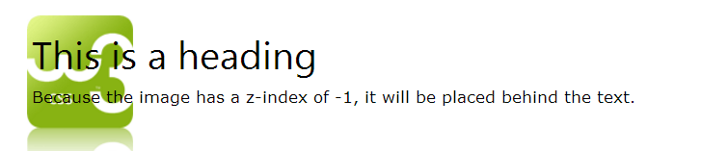
Overlapping elements
When elements are positioned, they can overlap other elements.
The z-index property specifies the stack order of an element (which element should be placed in front of, or behind, the others).
An element can have a positive or negative stack order.
img { position: absolute; left: 0px; top: 0px; z-index: -1; }

Slide 39
CSS Layout - float and clear
The float property can be used to wrap text around images.
img { float: right; margin: 0 0 10px 10px; }
The clear property is used to control the behavior of floating elements.
Elements after a floating element will flow around it. To avoid this, use the clear property.
div { clear: left; }

Slide 40
CSS Layout – clearfix hack
If an element is taller than the element containing it, and it is floated, it will overflow outside of its container.
Then we can add overflow: auto; to the containing element to fix this problem:
.clearfix { overflow: auto; }

Slide 41
CSS Layout – inline-block
The float-clear effect can be achieved via a new single property:
display : inline-block
.floating-box { display: inline-block; width: 150px; height: 75px; margin: 10px; border: 3px solid #73AD21; }
Now, no need of giving clear property in the elements to follow.

Slide 42
CSS Combinators
A combinator is something that explains the relationship between the selectors.
There are four different combinators in CSS3:
descendant selector (space)
child selector (>)
adjacent sibling selector (+)
general sibling selector (~)

Slide 43
Excercise : Vertical Navigation bar
Navigation Bar = List of Links
<ul> <li><a href="default.asp">Home</a></li> <li><a href="news.asp">News</a></li> <li><a href="contact.asp">Contact</a></li> <li><a href="about.asp">About</a></li> </ul>
Remove the bullets and the margins and padding from the list
Style the <a> elements inside the list to make a fixed width area clickable
Centre align links and add borders
Convert the vertical menu to Full-height Fixed Vertical Navbar

Slide 44
Excercise : Horizontal Navigation bar
Navigation Bar = List of Links
List can be made horizontal in 2 ways: display:inline, float:left
Add background color to ul
Add the border-right property to <li> to create link dividers
Make the navigation bar stay at the top or the bottom of the page, even when the user scrolls the page

Slide 45
CSS tooltip
A tooltip is often used to specify extra information about something when the user moves the mouse pointer over an element.
Use a container element (like <div>) and add the "tooltip" class to it. When the user mouse over this <div>, it will show the tooltip text.
The tooltip text is placed inside an inline element (like <span>) with class="tooltiptext“
The tooltip class uses position element to position relative to tooltip text
The tooltiptext class holds the actual tooltip text. It is hidden by default, and will be visible on hover
CSS3 border-radius property is used to add rounded corners to the tooltip text

Slide 46
CSS Attribute Selectors
Style HTML elements that have specific attributes or attribute values. Eg:
a[target] { a[target="_blank"] { background-color: yellow; background-color: yellow;
} }
[attribute~="value"] selector is used to select elements with an attribute value containing a specified word.
[attribute|="value"] selector is used to select elements with the specified attribute starting with the specified value.
[attribute^="value"] selector is used to select elements whose attribute value begins with a specified value.
[attribute$="value"] selector is used to select elements whose attribute value ends with a specified value.

Slide 47
CSS 3

Slide 48
CSS3 Introduction
CSS3 is the latest standard for CSS
CSS3 is completely backwards-compatible with earlier versions of CSS
Most of the new CSS3 properties are implemented in modern browsers.
CSS3 has been split into "modules". It contains the "old CSS specification" (which has been split into smaller pieces). In addition, new modules are added.
Some of the most important CSS3 modules are:
Selectors
Box Model
Backgrounds and Borders
Image Values and Replaced Content
Text Effects
2D/3D Transformations
Animations
Multiple Column Layout
User Interface

Slide 49
CSS3 Rounded Corners
The border-radius property is used to give rounded corners to any element
You can specify different radius for different corners. Here are the rules:
Four values: first value applies to top-left, second value applies to top-right, third value applies to bottom-right, and fourth value applies to bottom-left corner
Three values: first value applies to top-left, second value applies to top-right and bottom-left, and third value applies to bottom-right
Two values: first value applies to top-left and bottom-right corner, and the second value applies to top-right and bottom-left corner
One value: all four corners are rounded equally

Slide 50
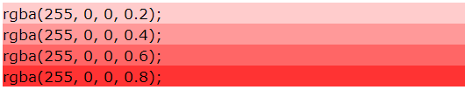
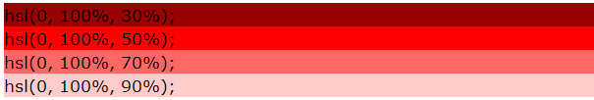
CSS3 Colors
RGBA colors
An RGBA color value is specified with: rgba(red, green, blue, alpha). The alpha parameter is a number between 0.0 (fully transparent) and 1.0 (fully opaque).
HSL colors
An HSL color value is specified with: hsl(hue, saturation, lightness).

Slide 51
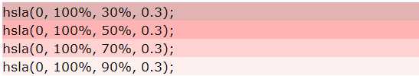
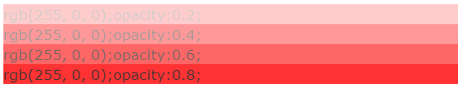
CSS3 Colors
HSLA colors
HSLA color values are an extension of HSL color values with an alpha channel - which specifies the opacity for a color.).
Opacity
The CSS3 opacity property sets the opacity for a specified (css) RGB value.

Slide 52
CSS3 Gradients
CSS3 gradients let you display smooth transitions between two or more specified colors.
Earlier, you had to use images for these effects. However, by using CSS3 gradients you can reduce download time and bandwidth usage. In addition, elements with gradients look better when zoomed, because the gradient is generated by the browser.
CSS3 defines two types of gradients:
Linear Gradients (goes down/up/left/right/diagonally)
Radial Gradients (defined by their center)

Slide 53
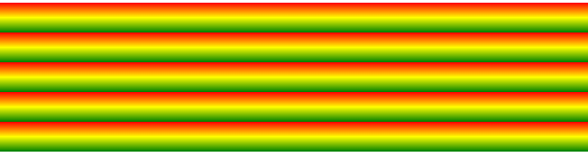
Linear Gradients
Syntax:
background: linear-gradient(direction, color-stop1, color-stop2, ...);
(Default direction is top to bottom)
To create a linear gradient you must define at least two color stops.
Color stops are the colors you want to render smooth transitions among.
You can also set a starting point and a direction (or an angle) along with the gradient effect.
Use the rgba() function to add transparency
repeating-linear-gradient() function is used to repeat linear gradients

Slide 54
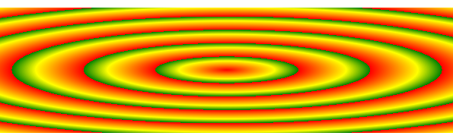
Radial Gradients
Syntax:
background: radial-gradient(shape size at position, start-color, ..., last-color);
(By default, shape is ellipse, size is farthest-corner, and position is centre.)
To create a radial gradient you must define at least two color stops.
The size parameter defines the size of the gradient. It can take four values:
closest-side, farthest-side, closest-corner, farthest-corner
The repeating-radial-gradient() function is used to repeat radial gradients

Slide 55

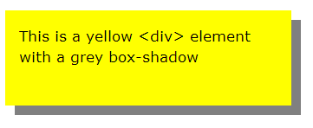
CSS3 Shadow effects
The text-shadow property applies shadow to text.
h1 { text-shadow: 2px 2px red; }
The CSS3 box-shadow property applies shadow to elements.
div { box-shadow: 10px 10px grey; }

Slide 56


CSS3 Text : text-overflow
The CSS3 text-overflow property specifies how overflowed content that is not displayed should be signalled to the user.
p.test1 { white-space: nowrap; Clipped width: 200px; border: 1px solid #000000; overflow: hidden; text-overflow: clip; }
p.test2 { white-space: nowrap; Ellipsis width: 200px; border: 1px solid #000000; overflow: hidden; text-overflow: ellipsis; }

Slide 57

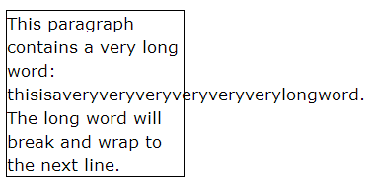
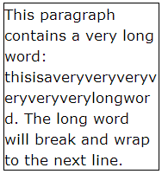
CSS3 Text : word-wrap
The CSS3 word-wrap property allows long words to be able to be broken and wrap onto the next line.
If a word is too long to fit within
an area, it expands outside:

Slide 58


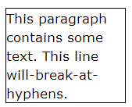
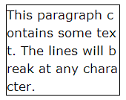
CSS3 Text : word-break
The CSS3 word-break property allows long words to be able to be broken and wrap onto the next line.

Slide 59
CSS3 Web Fonts
Web fonts allow Web designers to use fonts that are not installed on the user's computer.
When you have found/bought the font you wish to use, just include the font file on your web server, and it will be automatically downloaded to the user when needed.
@font-face { font-family: myFirstFont; src: url(sansation_light.woff); } div { font-family: myFirstFont; }

Slide 60
Different font formats
TrueType Fonts (TTF)
TrueType is a font standard developed in the late 1980s, by Apple and Microsoft. TrueType is the most common font format for both the Mac OS and Microsoft Windows operating systems.
OpenType Fonts (OTF)
OpenType is a format for scalable computer fonts. It was built on TrueType, and is a registered trademark of Microsoft. OpenType fonts are used commonly today on the major computer platforms.
The Web Open Font Format (WOFF)
WOFF is a font format for use in web pages. It was developed in 2009, and is now a W3C Recommendation. WOFF is essentially OpenType or TrueType with compression and additional metadata. The goal is to support font distribution from a server to a client over a network with bandwidth constraints.
The Web Open Font Format (WOFF 2.0)
TrueType/OpenType font that provides better compression than WOFF 1.0.
SVG Fonts/Shapes
SVG fonts allow SVG to be used as glyphs when displaying text. The SVG 1.1 specification define a font module that allows the creation of fonts within an SVG document. You can also apply CSS to SVG documents, and the @font-face rule can be applied to text in SVG documents.
Embedded OpenType Fonts (EOT)
EOT fonts are a compact form of OpenType fonts designed by Microsoft for use as embedded fonts on web pages.

Slide 61
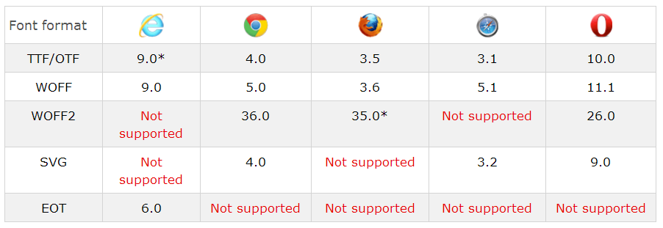
Browser Support for Font Formats

Slide 62
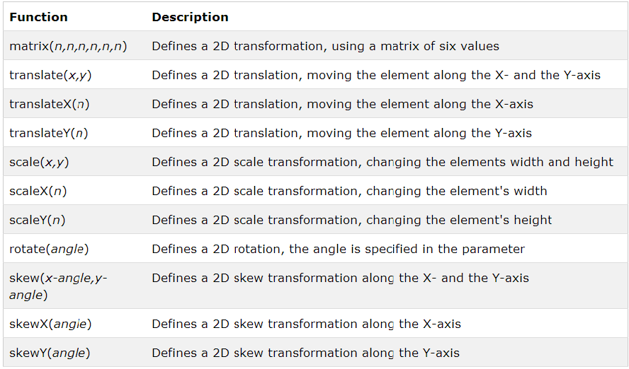
2D Transformations

Slide 63
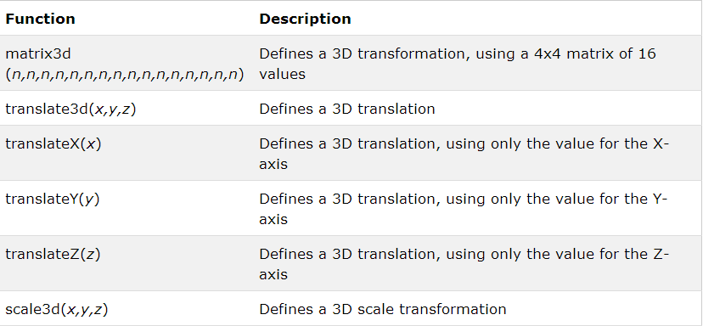
3D Transformations

Slide 64
CSS3 Media Queries
The @media rule, introduced in CSS2, made it possible to define different style rules for different media types.
Media queries in CSS3 extend the CSS2 media types idea: Instead of looking for a type of device, they look at the capability of the device.
Syntax:
@media not|only mediatype and (expressions) { CSS-Code; }
Unless you use the not or only operators, the media type is optional and the all type will be implied.
You can also have different stylesheets for different media:
<link rel="stylesheet" media="mediatype and|not|only (expressions)" href="print.css">
CSS3 Media types:
all , print, screen, speech

Slide 65
CSS3 Transitions
CSS3 transitions allows you to change property values smoothly (from one value to another), over a given duration.
To create a transition effect, you must specify two things:
the CSS property you want to add an effect to
the duration of the effect
Note: If the duration part is not specified, the transition will have no effect, because the default value is 0.
The transition-timing-function property can have the following values:
ease - specifies a transition effect with a slow start, then fast, then end slowly (this is default)
linear - specifies a transition effect with the same speed from start to end
ease-in - specifies a transition effect with a slow start
ease-out - specifies a transition effect with a slow end
ease-in-out - specifies a transition effect with a slow start and end
cubic-bezier(n,n,n,n) - lets you define your own values in a cubic-bezier function

Slide 66
CSS3 Animations
An animation lets an element gradually change from one style to another.
When you specify CSS styles inside the @keyframes rule, the animation will gradually change from the current style to the new style at certain times.
Animation properties:
animation-delay: Specifies a delay for the start of an animation
animation-direction: whether an animation should play in reverse direction or alternate cycles
animation-duration: Time for 1 animation cycle
animation-fill-mode:Specifies a style for the element when the animation is not playing
animation-iteration-count: number of times an animation should be played
animation-name: Specifies the name of the @keyframes animation
animation-play-state: Specifies whether the animation is running or paused
animation-timing-function: Specifies the speed curve of the animation

Slide 67

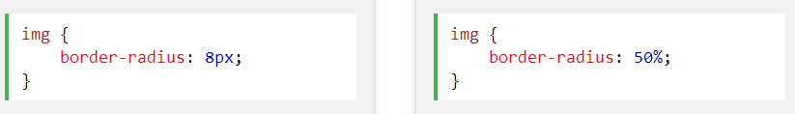
CSS3 Images
Rounded Images using border-radius property

Slide 68

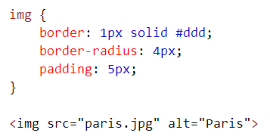
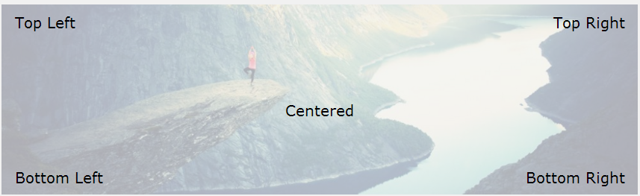
CSS3 Images
Use the border property to create thumbnail images.
Adding text to an image:

Slide 69



Styling buttons
Using CSS, buttons can be styled with colors, different sizes, rounded corners, colored borders, hovering effect, shadow effect, animated buttons etc.
Colored buttons with sizes:
Shadow effect:
Rounded Buttons:

Slide 70
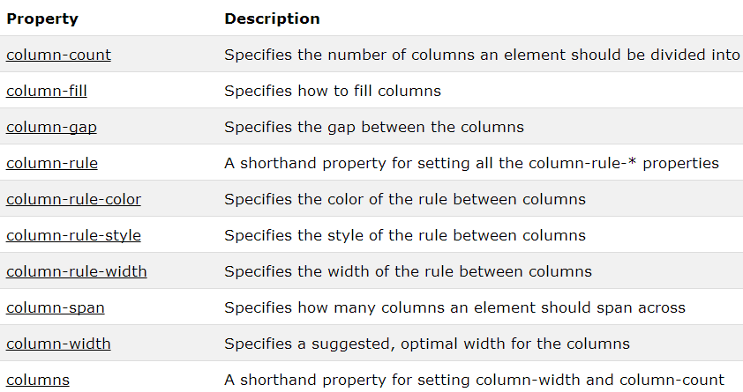
CSS3 Multiple columns
The CSS3 multi-column layout allows easy definition of multiple columns of text
Multi column properties:

Slide 71
Responsive CSS

Slide 72
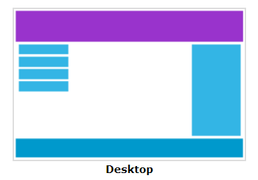
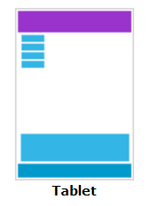
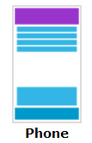
Responsive web design
Responsive web design makes your web page look good on all devices.
Instead of having multiple websites for desktop, mobile etc., have a single website and adapt to the device using HTML + CSS features.

Slide 73
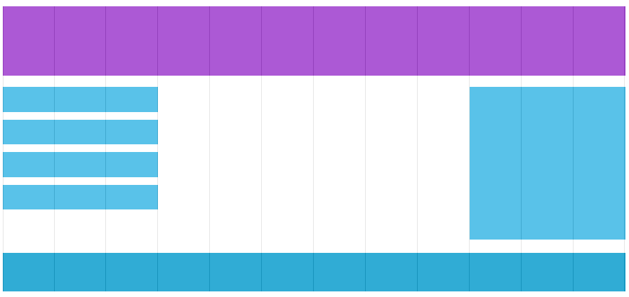
Responsive grid
A web page based on grid view means that the page is divided into columns.
It makes it easier to place elements on the page.
A responsive grid-view often has 12 columns, and has a total width of 100%, and will shrink and expand as you resize the browser window.

Slide 74
Responsive Media Query
Using media queries, we can add a breakpoint where certain parts of the design will behave differently on each side of the breakpoint.
Breakpoints should be created taking care of Mobile First approach.
Mobile First Approach means designing for mobile before designing for desktop or any other device (This will make the page display faster on smaller devices).
Breakpoint for Desktop = 768px, for tablet = 600px.
Eg:
/* For mobile phones: */ [class*="col-"] { width: 100%; } @media only screen and (min-width: 768px) { /* For desktop: */ .col-1 {width: 8.33%;} .col-2 {width: 16.66%;} ..............

Slide 75
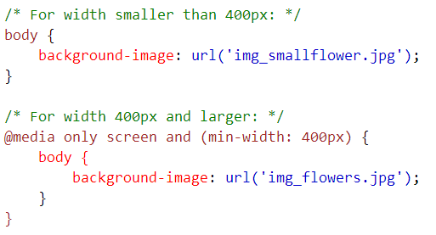
Responsive Images
If the width property is set to 100%, the image will be responsive and scale up and down, but it may scalre larger than its original size.
With max-width property set to 100%, the picture will scale up and down but never larger than its original size.
You can have different images for different devices, using the media query:

Slide 76
Responsive Frameworks
Some popular frameworks for developing a responsive applications:
W3.css
Skeleton
Bootstrap

Slide 77
References
http://www.w3schools.com/css/
http://caniuse.com/#cats=CSS
https://en.wikipedia.org/wiki/Responsive_web_design

Slide 78
Thank You

