Slide 1
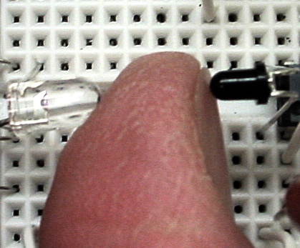
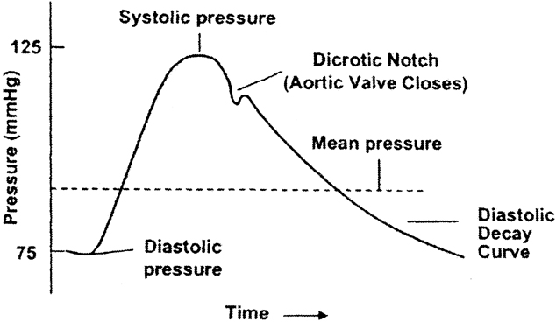
Project: Pulse meter
Idea: Use noninvasive infrared light to probe blood pressure and pulse rate in a finger tip.
Uses: A variant of this device is used routinely in hospitals and is called a pulse-oximeter.
Components:
  Comparator
  Amplifiers and filters
  Light emitting diodes and photosensors

Slide 2
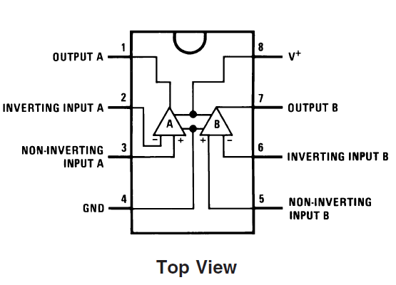
Operational Amplifier LM358
Opamp is used in many circuits to compare voltages, amplify voltages, or to amplify currents.
One physical DIP package contains two opamps. Each opamp has many transistors, but we can usually ignore the internal complexity.
Opamps require power to run, in our case +5 volts on pin 8 and -5 volt on pin 4.
From: http://www.national.com/ds/LM/LM158.pdf

Slide 3
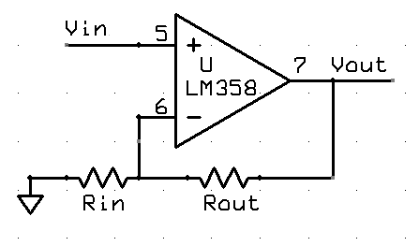
LM358 as an amplifier
Vout= Vin * (1 + Rout/Rin)
Vout is limited to being no bigger than +9 volt and
no smaller than -1 volt.
Special case: if you leave out Rin and make Rout=zero (a wire) then Vout=Vin. Then why bother? LM358 acts a current amplifier with a gain of several million.
From http://www.national.com/ds/LM/LM555.pdf

Slide 4
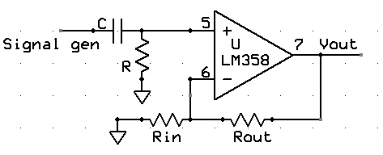
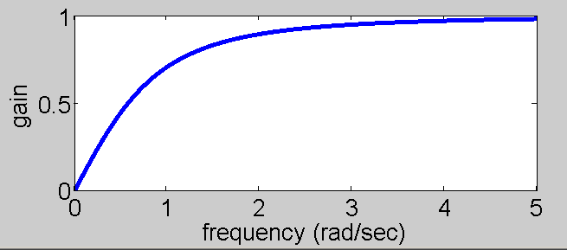
LM358 as an amplifier and high-pass filter
Let τ=RC. And f be the sine wave frequency of the signal generator. Define ω=2πf.
Vout= Signal_gen * (1 + Rout/Rin) * τω/sqrt(1+ω²τ²)
See plot for τ=1, Rin=infinity
At zero frequency there is zero output. Another way of say this is that the circuit ‘blocks’ steady (DC) signals.
This circuit is very useful for getting rid of unwanted steady signals which tend to be amplified too much and block the desired small, changing signal.

Slide 5
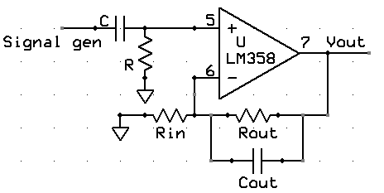
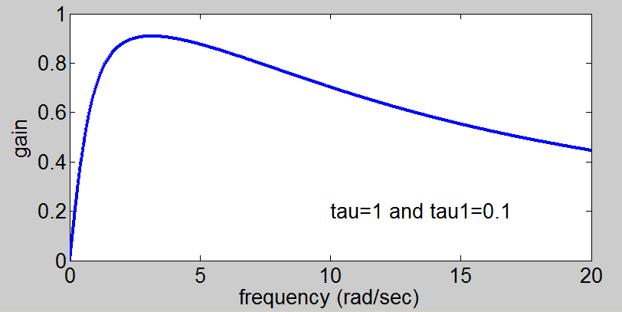
LM358 as an amplifier and band-pass filter
Let τ=RC and τ₁=RoutCout. And f be the sine wave frequency of the signal generator. Define ω=2πf.
Vout= Signal_gen*(1+Rout/Rin)* τω/sqrt(1+ω²τ²)*1/sqrt(1+ω²τ₁²)
This circuit is very useful for getting rid of unwanted steady signals which tend to be amplified too much and block the desired small, changing signal. It also gets rid of noise at higher frequencies.

Slide 6

IR LED and IR sensor
  The clear device to the left is an infrared emitting LED.
    amount of light → amount of current L = k*I
    Wavelength (color) sets voltage.
    For IR, V is around 1.2 volts
    Only works one direction
    Use your cell phone camera to see if it operates.
    The black device to the right is an IR sensor (phototransistor)
Current flows when light is absorbed:
    I = k*L
Your finger absorbs more IR if there is more blood.
Each heart beat sends more blood into your finger and changes the IR absorption, but the change is small.

Slide 7
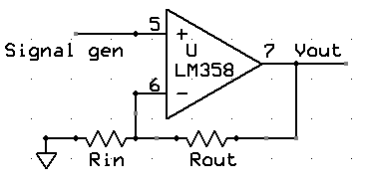
LM358 testing part 1
Testing:
  Build a noninverting amplifier with a gain of 101 using resistors between 100 ohms and 1Mohm. Use power supply voltages of +5 and -5 volts.
  Test it by connecting the input to the waveform generator and the output to the scope as shown below.
  Set up the waveform generator to produce a 0.01 volt amplitude sine wave, then hook one scope probe to the input. You may need to build a two-resistor voltage divider to make an amplitude this small.
  Measure the output as you vary frequency. Is it constant?

Slide 8
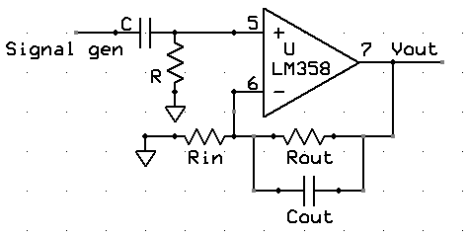
LM358 testing part 2
Testing:
  Build a noninverting amplifier with a gain of 11. A high pass filter at 1 radian/sec and low pass at 100 radians/sec. Use power supply voltages of +5 and -5 volts.
  Test it by connecting the input to the waveform generator and the output to the scope as shown below.
  Set up the waveform generator to produce a 0.1 volt amplitude square wave, then hook one scope probe to the input, another to the output and explain what you see as you vary the frequency.
  Vary Cout and show what happens to the output at higher frequencies.

Slide 9
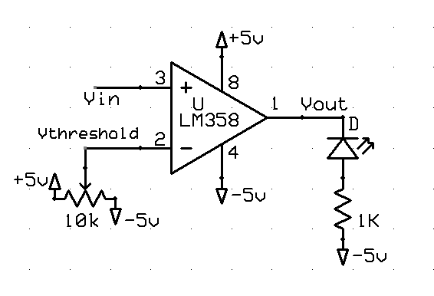
LM358 testing part 3
Testing:
  Build a comparator as shown to the
  right. The circuit compares two
  voltages
  Vout = 5 volts if Vin>Vthreshold
  Vout = -5 volts if Vin<Vthreshold
  Test it by connecting the input Vin to the waveform generator with a frequency of around 1 Hz and output amplitude of around 1 volt.
  Adjust the potentiometer until the LED blinks.

Slide 10
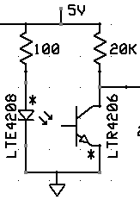
LED and sensor testing
Build the circuit shown, noting that the long lead of each device is marked with an asterisk.
Hook the scope up to the output between the 20k resistor and the photosensor.
Be sure that the LED and sensor point at each others rounded ends.
Putting your finger between the two should result in a voltage change. How much?

Slide 11
Overall Scheme
Use sensor to detect blood flow
Amplify and filter sensor output so that easier to detect the heart beat.
Use a comparator to detect actual beat and blink an LED. Optional -- implement an auto threshold circuit to replace the potentiometer.
Optional – build an oscillator and make the circuit beep for every heart beat.
Note that cold fingers have very little blood flow, so the circuit works poorly.

Slide 12
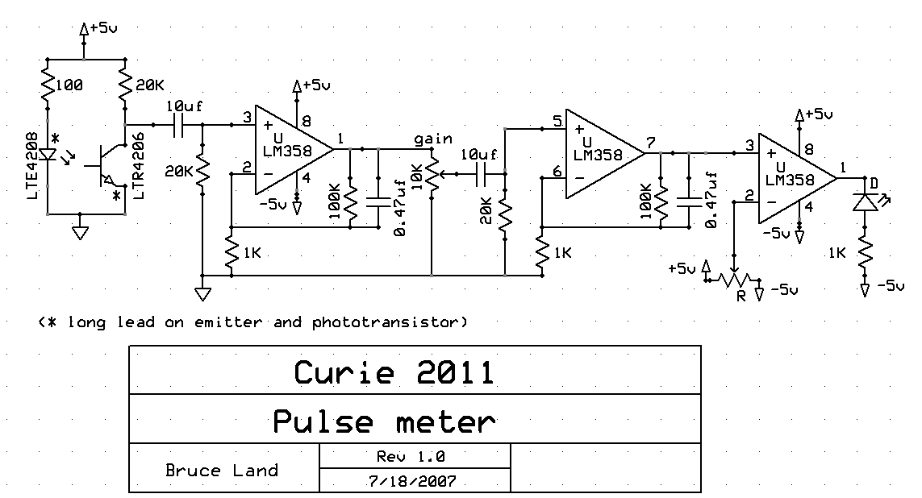
Schematic: Pulse Meter

Slide 13
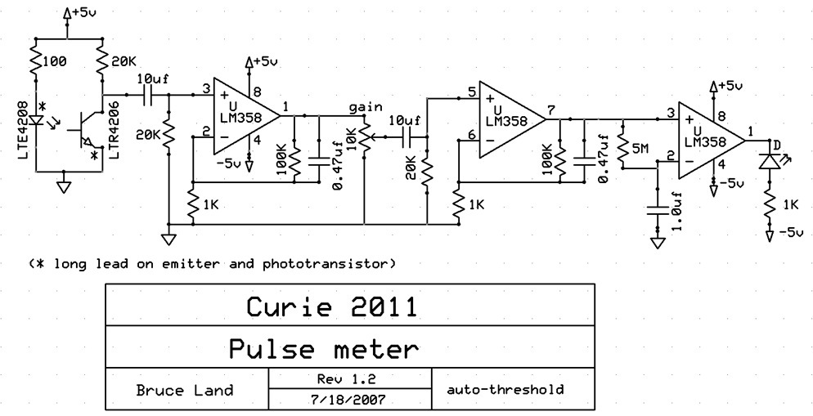
Schematic: Pulse Meter
(auto-threshold)

Slide 14
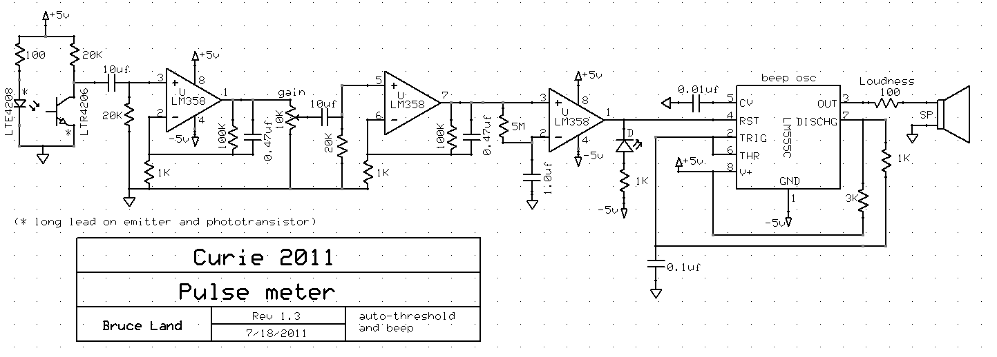
Schematic: Pulse Meter
(auto-threshold and beep)

