Slide 1
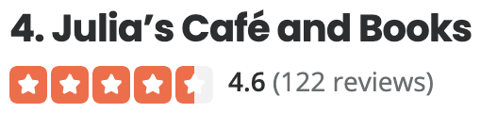
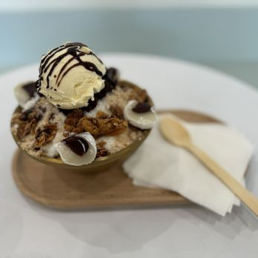
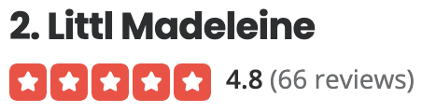
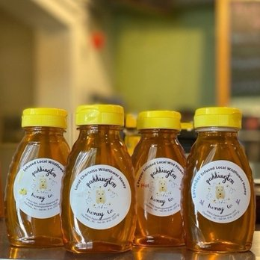



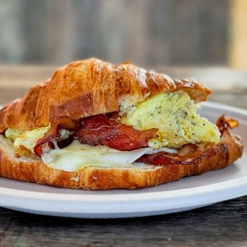
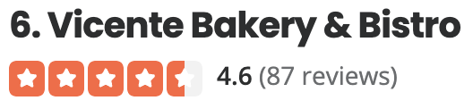
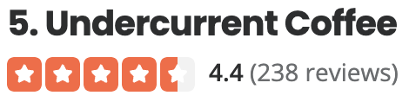

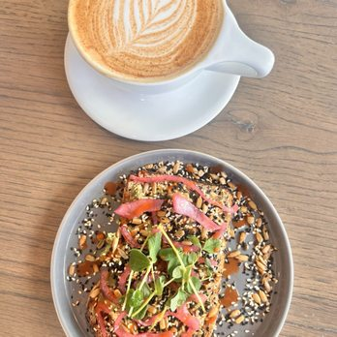



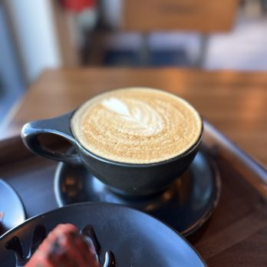
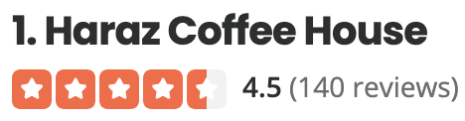


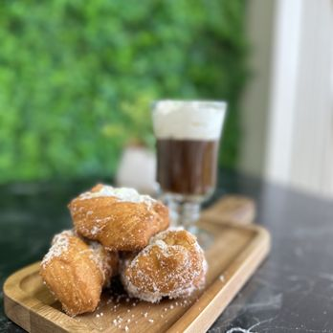

Star-based ranking
Serendipity-based reranking
Tiny chic Korean bakery. Their signature pastry are the Madeline's of course…..
Can you recommend a cafe where to meet with my friends?
I was spoiled with an abundance of French bakeries where I moved from ...
1.2
ATARS
The coffee selection is broad … I perused the book section, where I found an interesting Batman Adventures issue from 96 [3] …
0.6
I love this spot, and I am amazed that they stay open so late for a coffee shop in..…
Sheldon is a devoted fan of graphic storytelling and likes to collect comic books and vintage graphic novels, with a soft spot for Batman. He also runs a YouTube channel where he reviews comic books and movies.
He went into the counter and filled our bag was savory treats. There was around 7/8 items ...
has autographed memorabilia from movies like The Dark Knight [1] ...

