Slide 1
HBM vs DDR Memory Price Trend Analysis (2024-2026)
Industry Aggregated Data Based Visualization

Slide 2
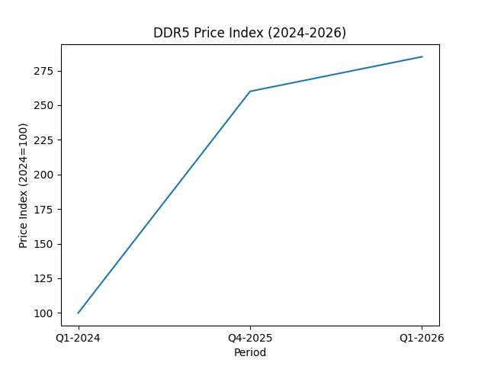
DDR5 Price Index Trend

Slide 3
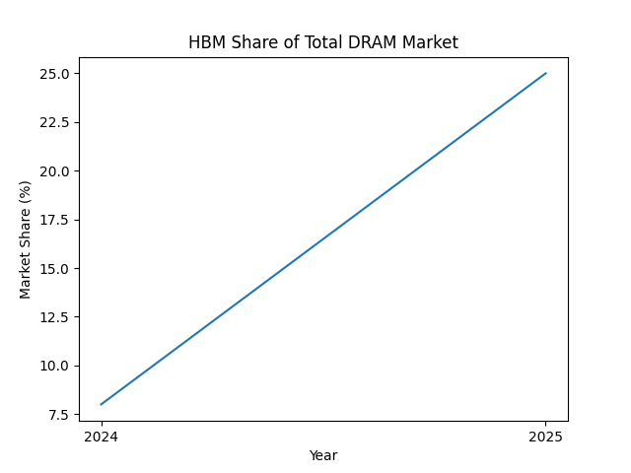
HBM Market Share Growth

Slide 4
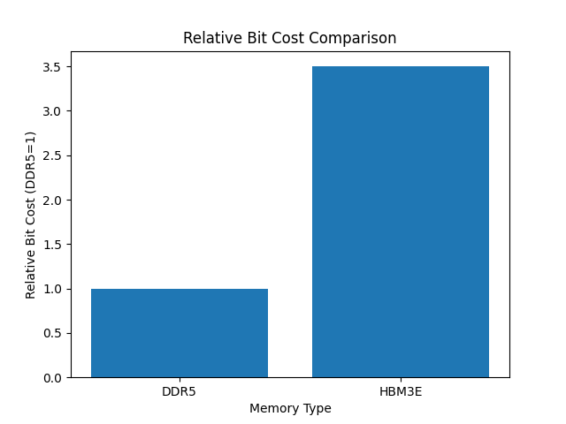
Relative Bit Cost Comparison

