Slide 1
HBM & DDR Memory Market Technical Seminar
2024-2026 Price, Supply, and Structural Analysis

Slide 2
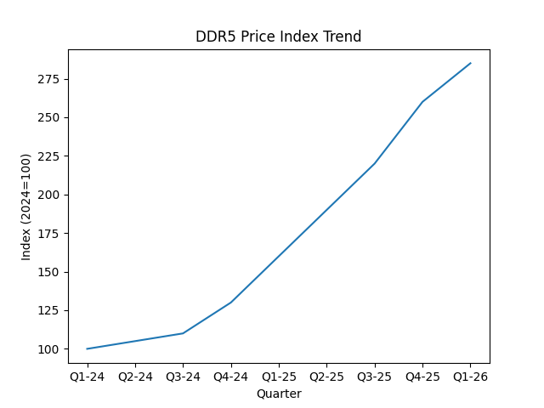
Analysis Slide 1

Slide 3
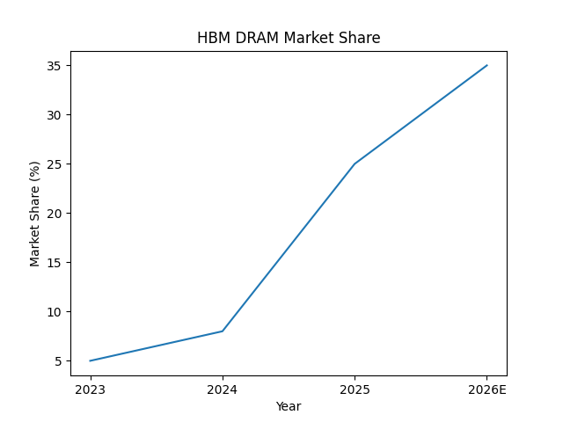
Analysis Slide 2

Slide 4
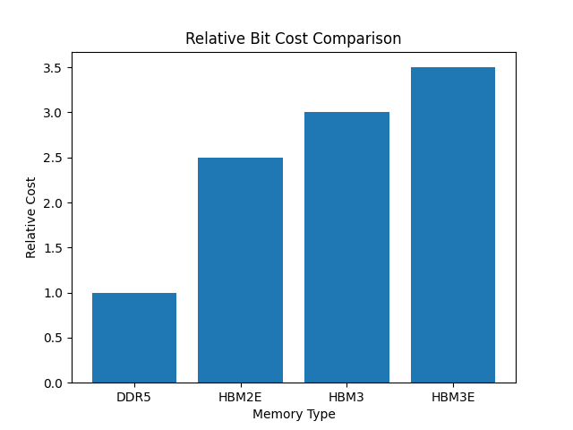
Analysis Slide 3

Slide 5
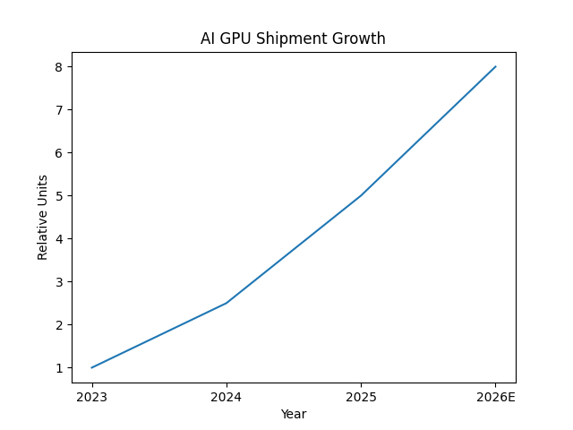
Analysis Slide 4

Slide 6
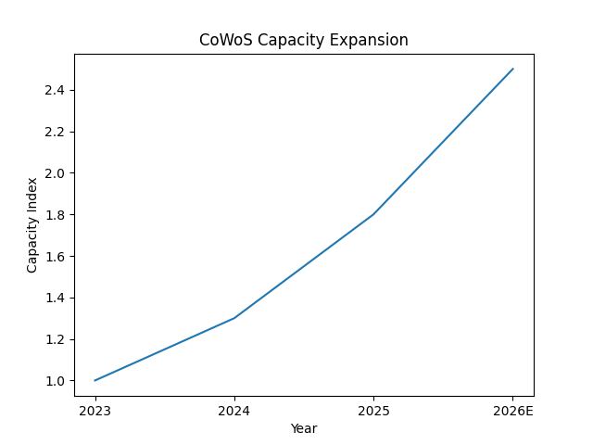
Analysis Slide 5

Slide 7
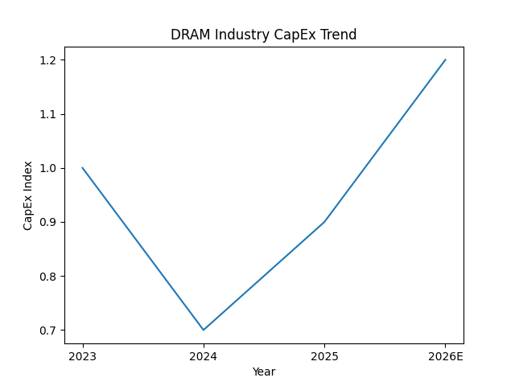
Analysis Slide 6

Slide 8
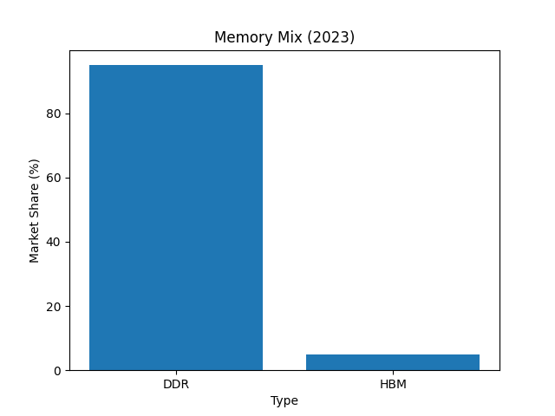
Analysis Slide 7

Slide 9
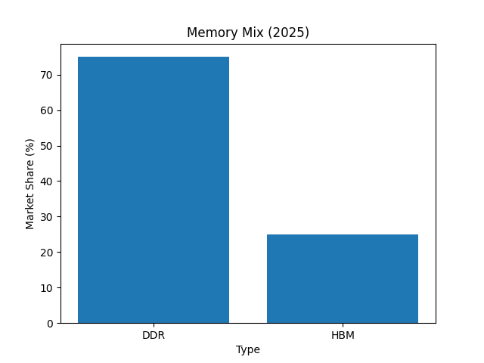
Analysis Slide 8

Slide 10
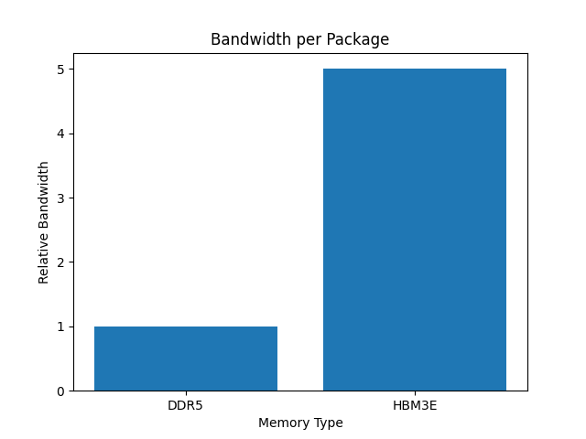
Analysis Slide 9

Slide 11
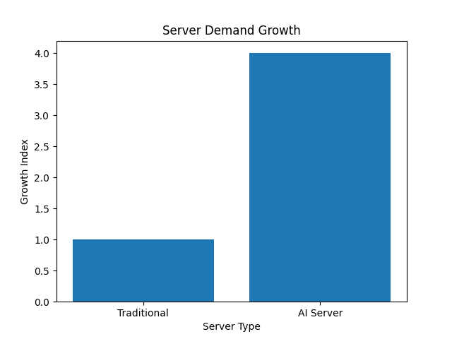
Analysis Slide 10

Slide 12
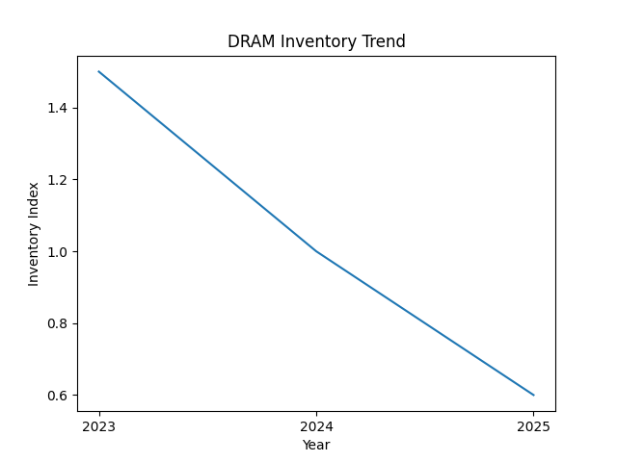
Analysis Slide 11

Slide 13
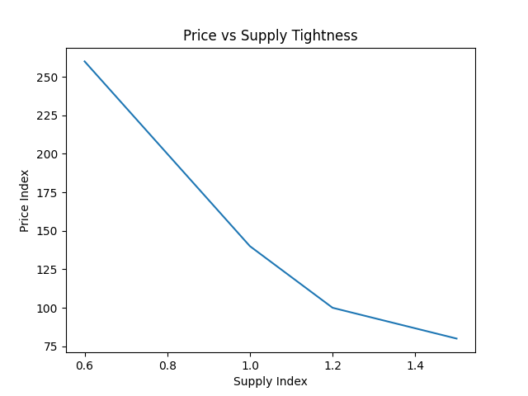
Analysis Slide 12

Slide 14
Conclusion & Insight 1
Key structural impact of AI demand and HBM-driven supply reallocation.

Slide 15
Conclusion & Insight 2
Key structural impact of AI demand and HBM-driven supply reallocation.

Slide 16
Conclusion & Insight 3
Key structural impact of AI demand and HBM-driven supply reallocation.

