Slide 1

US Housing Market
By: Rami walid & Andre luiz cardoso

Slide 2
USA Housing market dataset
4000 row dataset containing a record of sale of US homes
Provides features (18) of each home such as:
Date Sold
Sale Price
Number of Rooms (Bathrooms + Bedrooms)
Square Feet of Living Space
Square Feet of Basement
Number of Floors
Ranking of View (0-4)
Ranking of Condition (1-5)
Year Built
Year Renovated
Location (Street, City, State, Zip, Country)

Slide 3
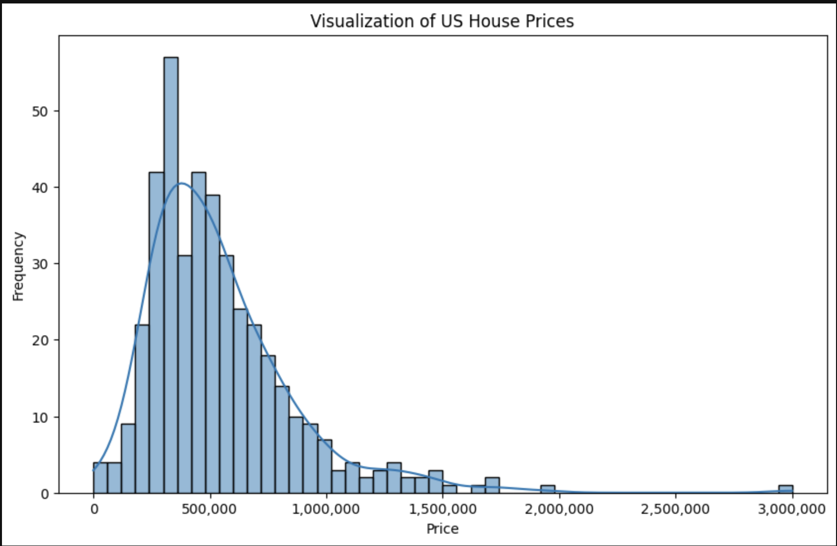
Visualization of US Home Prices

Slide 4
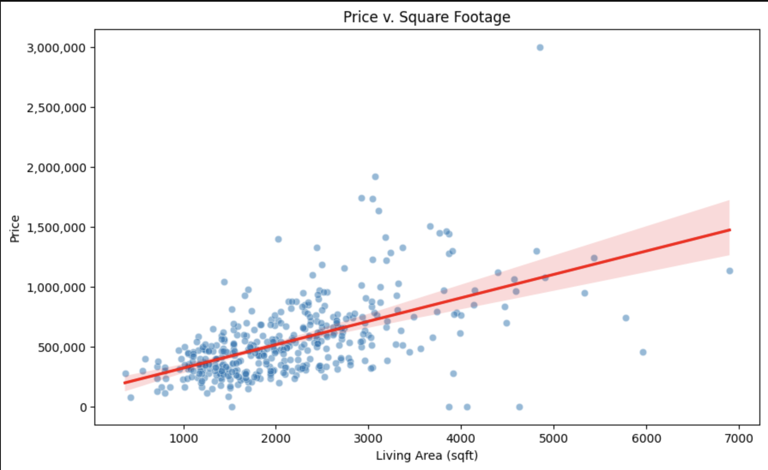
Price v. Square footage

Slide 5
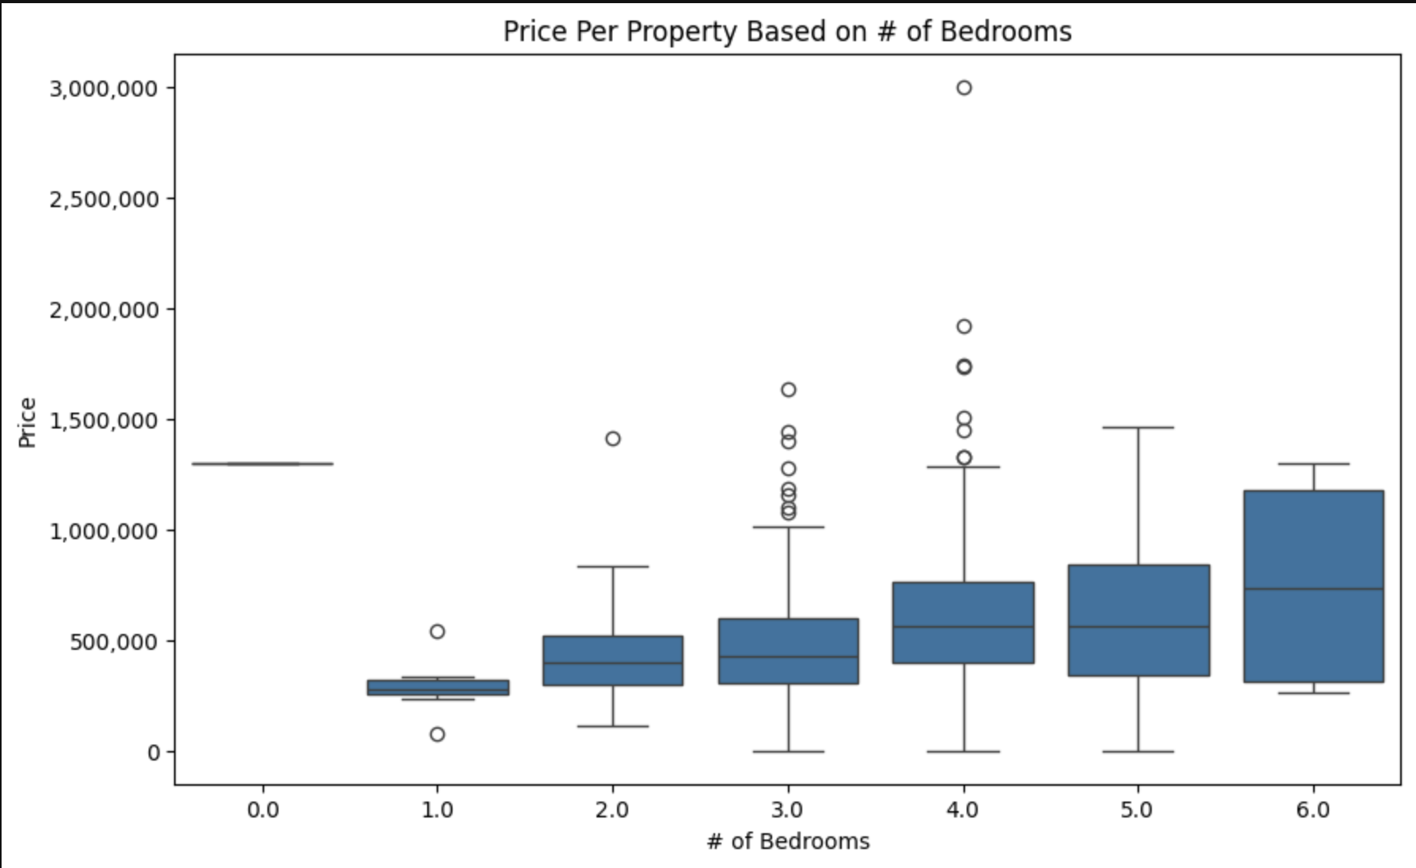
Price per property based on # of bedrooms

Slide 6
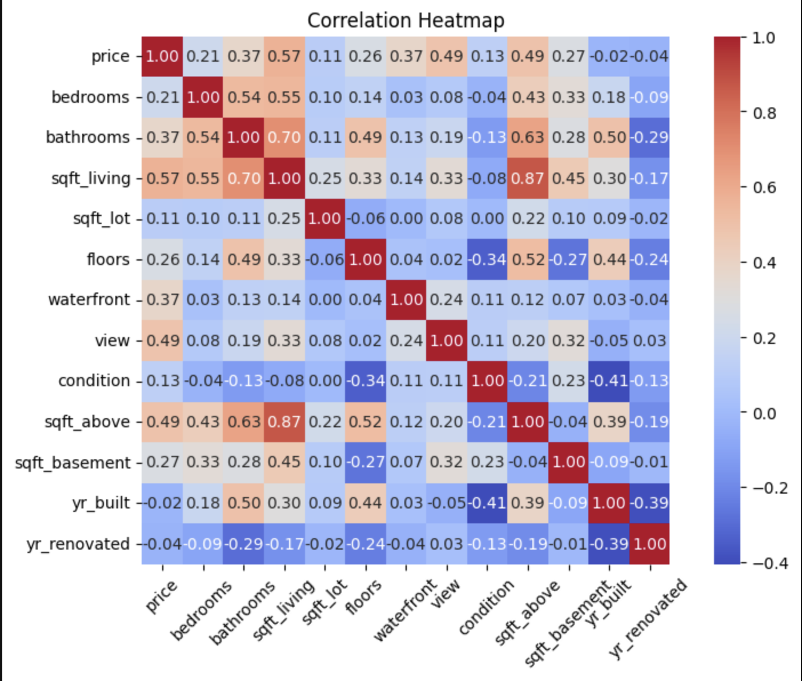
Feature correlation heatmap

Slide 7

Problem Statement
Can we use regression models to predict the price of a US home based on the features of the house?

Slide 8
Pre-Processing

Slide 9
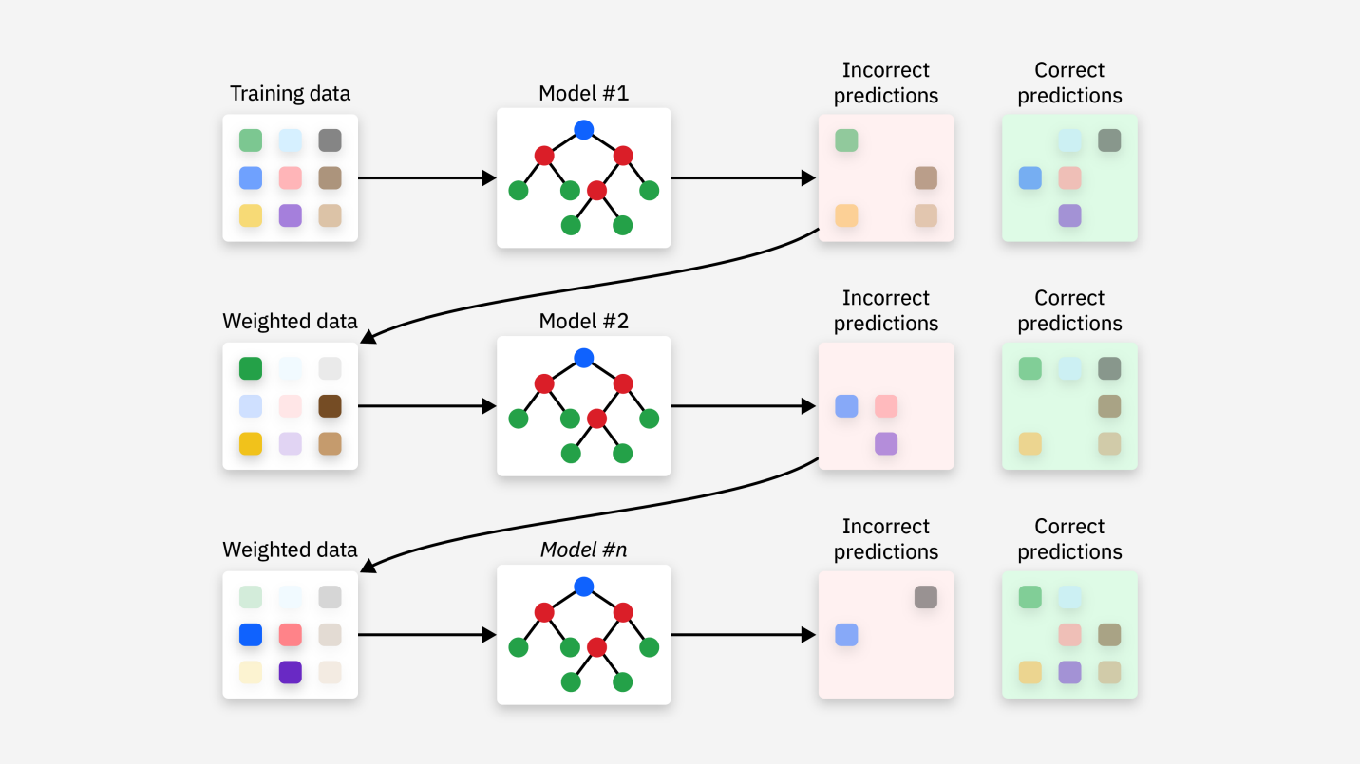
Gradient boosting model
Builds an ensemble of weak prediction models, called decision trees.
Decision trees are built sequentially and learn from the mistakes of the previous model
Leads to a powerful final model with more accuracy than prior individual components
In each step:
Gradient of the loss function is calculated with respect to the predictions
Adjusts the next model to move in the direction that reduces the error
Continues one-by-one until a final, more accurate model is reached

Slide 10
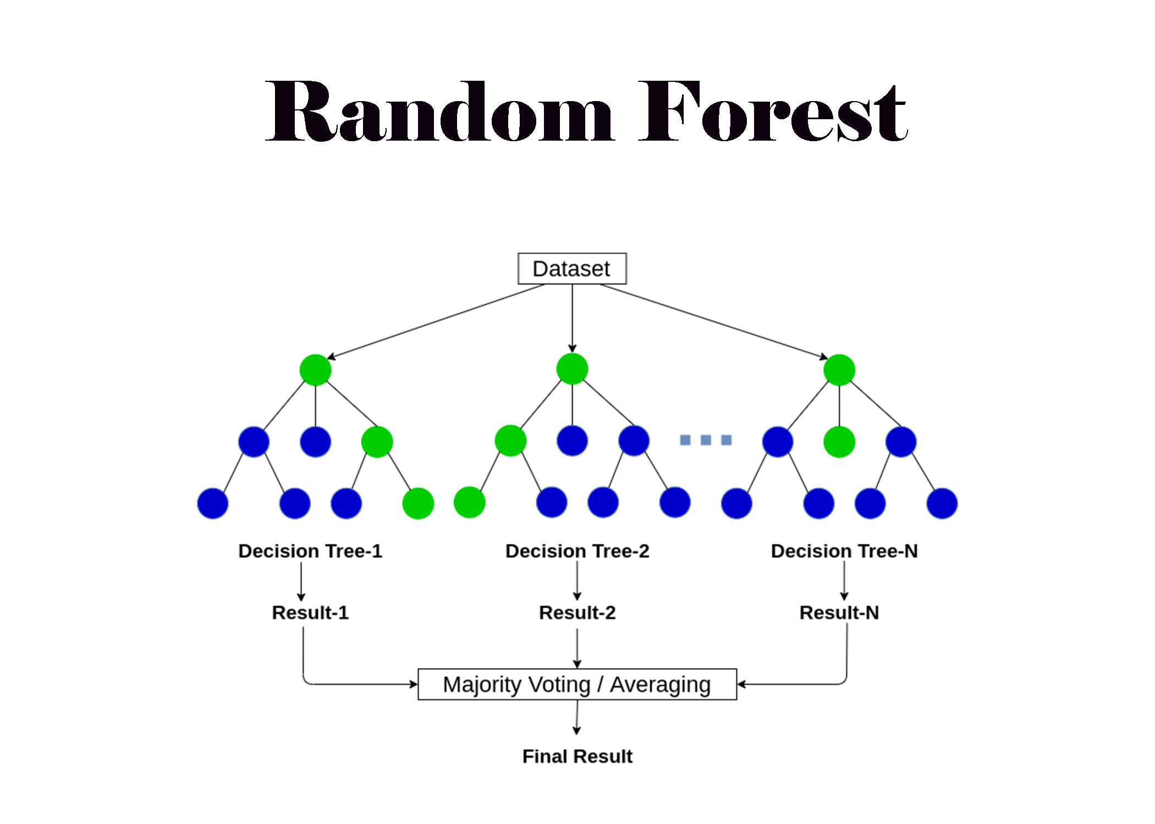
Random Forest model
Ensemble learning method, combining multiple decision trees to make predictions
Predictions are made by asking a series of questions about the dataset
”Random” comes from its use of random subsets of the data and features to train each tree
Each tree is trained on a slightly different subset of the data and a random subset of features
The final prediction is made up of an aggregation of the individual tree predictions
For regression, the random forest averages the predictions of all individual trees

Slide 11
Summary of findings
R² Score
Random Forest: 0.6202 or 62.02%
Gradient Boosting: 0.6907 or 69.07%
MAE
Random Forrest: $93,572.37
Gradient Boosting: $80,909.74

Slide 12
Reasons for lackluster performance
Dataset contained mostly structural features
Bedrooms, Bathrooms, Square footage, etc.
Missing features like market trends, crime rates, commute time, etc. led to hole in variance
Random Forrest Regressor
Can’t fill in missing context well and associate subtle relationships together
Saw our structural features and built good rules but hit a ceiling without further information
Gradient Boosting Regressor
Prone to overfitting, especially with excess of structural features not indicative of true market value
Can track subtle relationships so it performed better but needed contextual features to make more accurate predictions.

Slide 13
Winner
Gradient Boosting
Why?
Handles datasets with noise or complexity better
Outperforms Random Forrest when outliers or nonlinear patterns exist
Due to each tree learning from the previous and minimizing the loss function
Random Forrest tends be low variance and high bias, where GB has lower bias
Meaning Random Forrest makes strong assumptions about the data and is too simple
Underfits the data and doesn’t detect subtle relationships amongst features

Slide 14
Sources
US Housing Dataset ~ Kaggle
Wikipedia
Pandas
Numpy
Seaborn

Slide 15

Thank you

