Slide 1
Credit Card Fraud Detection
© Templateswise.com
Machine Learning CS 688

Slide 2
Team Details
Ramaswamy Iyappan : G01348097
Joel Sadanand Samson : G01352483
Abhijeet Amitava Banerjee : G01349260

Slide 3

Credit Card Fraud
Credit card fraud is the act of using another person’s credit card to make purchases or request cash advances without the cardholder’s knowledge or consent.

Slide 4


Credit card fraudsters are increasingly using digital means to steal the credit card number and accompanying personal information to make illicit transactions, according to the National Credit Union for Western Union (NCU).
This has been tied to Identity theft which is common today

Slide 5

Credit Card Fraud Statistics
A total of $28.58 billion credit card fraud loss was suffered by credit card issuers, merchants, and consumers in 2020.
The global loss due to credit card fraud is estimated to reach e $49.32 billion in 2030.
The total amount of money lost on fraud performed on UK-issued cards in 2020 is £574.2 million.
In 2020, 3.5% of American credit card holders reported a credit card loss, theft, or fraud in the past 12 months.
The Federal Trade Commission reported receiving 389,845 credit card fraud reports in 2021.
88,354 of the frauds that resulted in money loss in 2021 involved credit cards.

Slide 6
Credit Card Fraud Detection
Credit card fraud detection is the collective term for the policies, tools, methodologies, and practices that credit card companies and financial institutions take to combat identity fraud and stop fraudulent transactions.
In recent years, as the amount of data has exploded and the number of payment card transactions has skyrocketed, fraud detection has become largely digitized and automated.
Most modern solutions leverage artificial intelligence (AI) and machine learning (ML) to manage data analysis, predictive modeling, decision-making, fraud alerts and remediation activity that occur when individual instances of credit card fraud are detected.

Slide 7

Challenges With Current Fraud Detection
Unbalanced Data - Less than 0.5% credit card transactions are fraud which is rare occurrence.
Optimal Efficiency - Less than 8 sec to flag a transaction.
Incorrect Flagging - Avoid harassing real customers.

Slide 8

Approach to tackle Credit Card Fraud
Rule-Based or Traditional Based Approach
Data Science Approach

Slide 9

Rule-Based or Traditional Based Approach
A rule-based system is a system that applies human-made rules to store, sort and manipulate data.
Algorithms are written by fraud analysts which follow strict rules.

Slide 10


Disadvantages
Changes for detecting new frauds are done manually.
Increase in customer and data, increases human effort.
High rates of false positives, results in losing a lot of genuine customers.
Cannot recognize hidden patterns.
Time consuming and costly.
Data Science to the Rescue

Slide 11

Data Science Approach
We leverage the vast amounts of Data collection from online transactions and model it in a way that allows us to flag or predict fraud in future transactions.

Slide 12

Dataset
The dataset contains transactions made by credit cards in September 2013 by European cardholders.
This dataset presents transactions that occurred in two days, where we have 492 frauds out of 284,807 transactions.
The dataset is highly unbalanced, the positive class (frauds) account for 0.172% of all transactions.

Slide 13

Exploratory Data Analysis
Dataset is prepared by applying PCA(Dimensionality reduction) over several features and are brought down to 30 features which are still censored for privacy and security.
There are no NULL values present.
“Time” column dropped because of irrelevancy.
Scaled “Amount” feature.

Slide 14

Problems dealing with class imbalance
Classifier tends to favor majority class (in this case legitimate transactions).
Large classification error over the fraud cases.
Classifiers learn better from a balanced distribution.

Slide 15
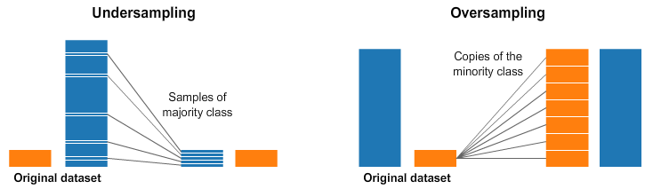
Techniques to Overcome Imbalance
Over Sampling
Under Sampling

Slide 16
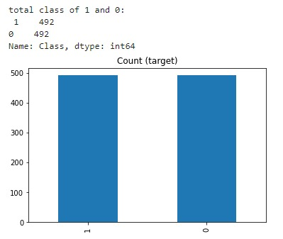
Under Sampling
Under sampling involves randomly selecting examples based on a strategy from the majority class and deleting them from the training dataset.

Slide 17
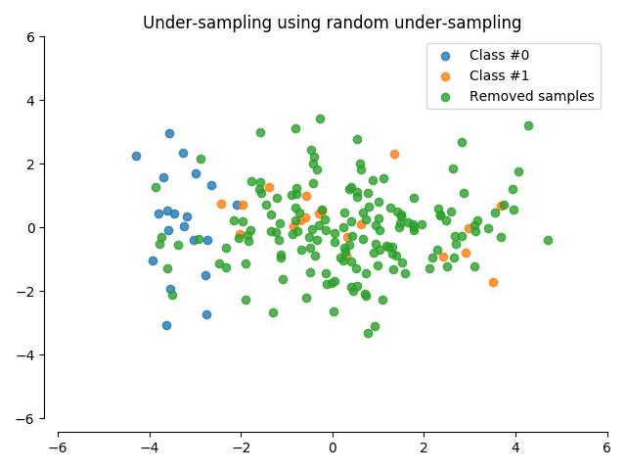
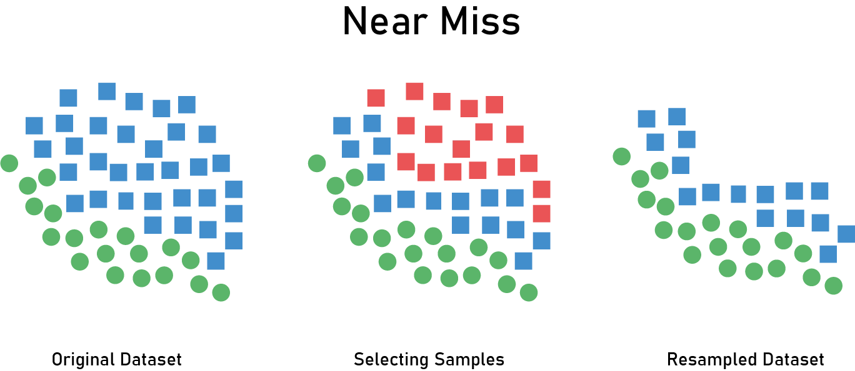
Under Sampling Techniques Used
Random Under Sampling
Near Miss

Slide 18
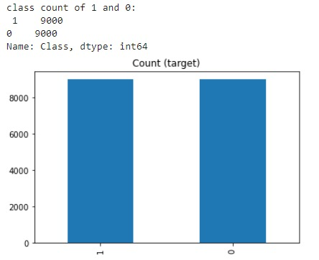
Over Sampling
Oversampling involves randomly selecting examples from the minority class and adding them to the training dataset.

Slide 19
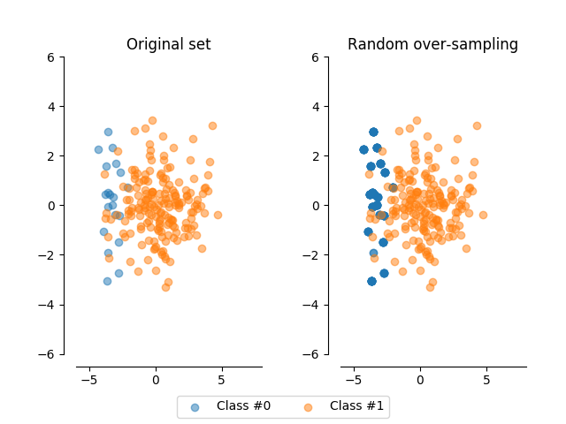
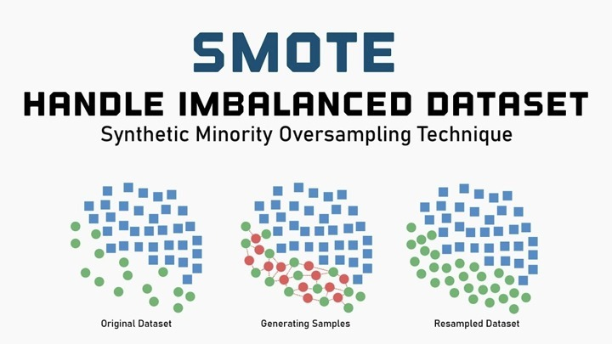
Over Sampling Techniques Used
Random Over Sampling
SMOTE

Slide 20
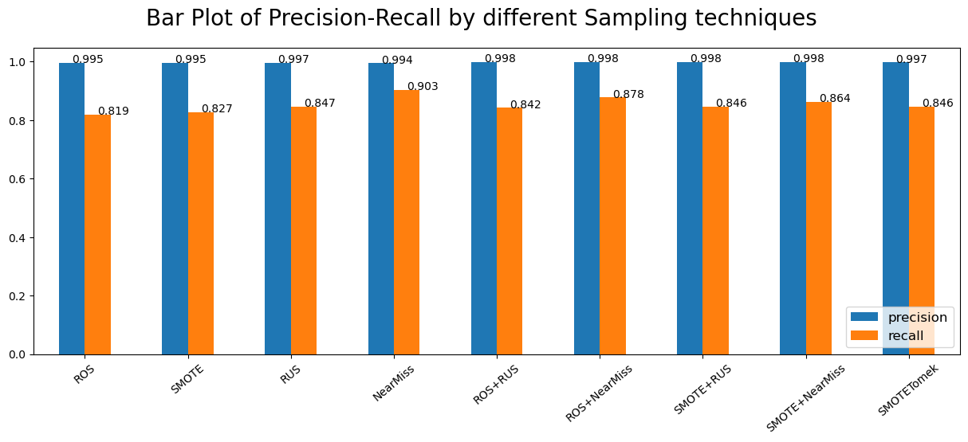
Comparing Scores by Different sampling Techniques

Slide 21
Related Work
In ref. [1], the authors implemented a system using several ML algorithms including LR, DT, SVM and RF. The researcher used the classification accuracy to assess the performance of each ML approach.
In ref. [2], to deal with the class imbalance problem present in the dataset, the researcher implemented the Synthetic Minority Oversampling Technique (SMOTE) oversampling technique. Following ML algorithms were included RF, NB and MLP.
In ref. [3], to deal with the highly imbalanced nature of this dataset, the authors employed the SMOTE sampling technique. The following ML methods were considered: DT, LR, and Isolation Forest (IF).

Slide 22

Methodology
Bagging
Boosting
Voting Classifier
Artificial Neural Network

Slide 23
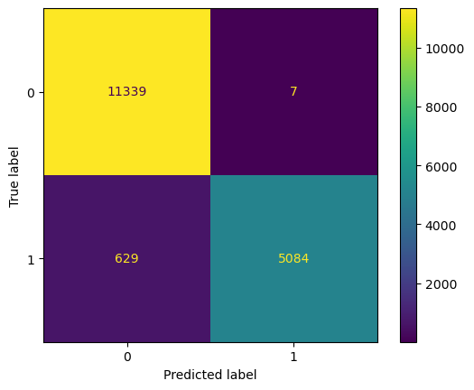
Bagging (Random Forest)
Involves using a single machine learning algorithm usually decision trees and training each model on different sample of the same training data set.
Parallel approach.

Slide 24
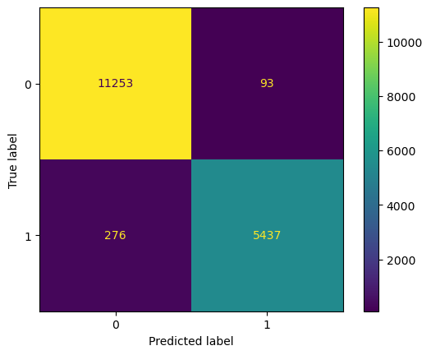
Boosting(XG Boost)
The key property of boosting ensemble is the idea of correcting prediction errors.
Sequential approach.

Slide 25
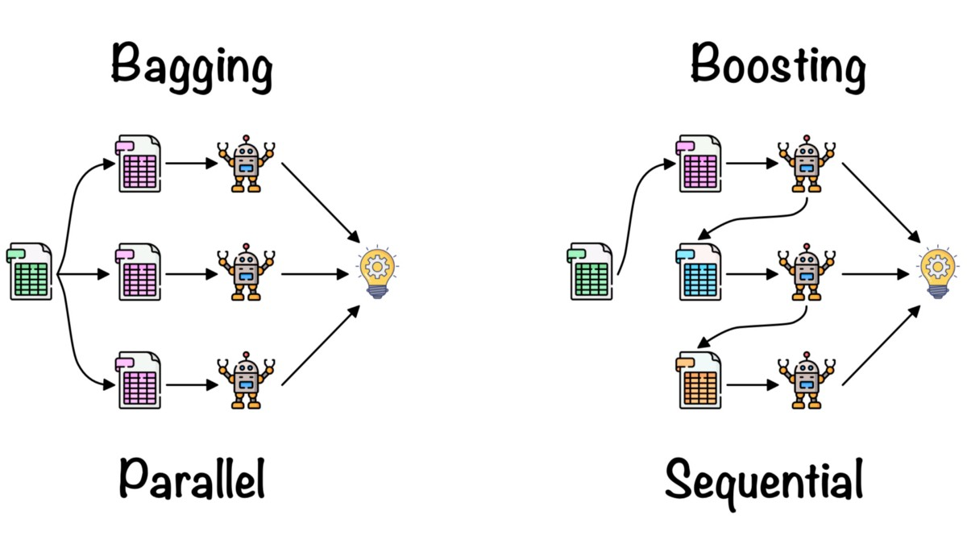

Slide 26

Voting Classifier
Voting ensemble is a machine learning model that combines predictions from multiple other models.
Used for ideally achieving better performance than any single model used in the ensemble.

Slide 27

Neural Network(MLP Classifier)
Multi Layer Perceptron classifier is a supplement of feed forward neural network.
Uses SGD optimizer to optimize cross entropy loss.

Slide 28
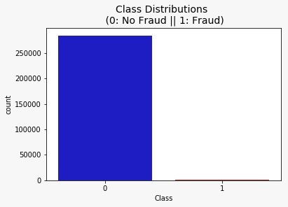
Why is Accuracy not a good metric?
The ML model trained on this dataset will show that its 98% accurate even if you predict everything as not fraud which is misleading.

Slide 29

Performance Evaluation
Precision
Recall
ROC – AUC Curve

Slide 30
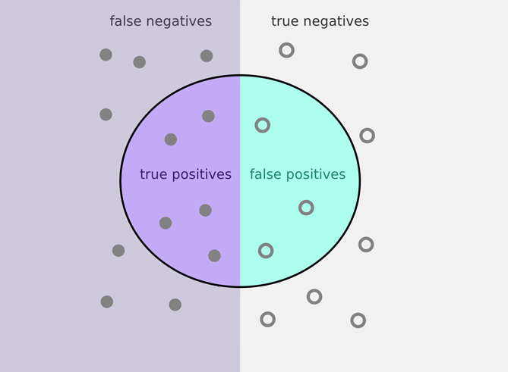
Precision
Proportion of observations correctly predicted to be positive, out of all predicted positive observations.
Here, precision defines how many predicted frauds are true fraud transactions.

Slide 31
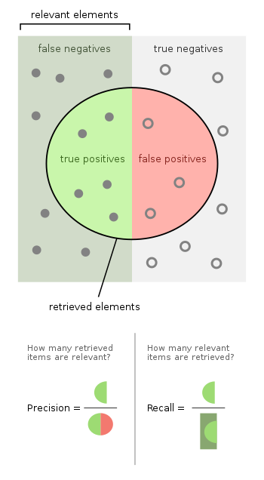
Recall
Recall is a metric that quantifies the number of correct positive predictions made out of all true positive observations.
Here, recall measures how many actual fraud transactions were predicted correctly out of all true fraud transactions that happened.

Slide 32
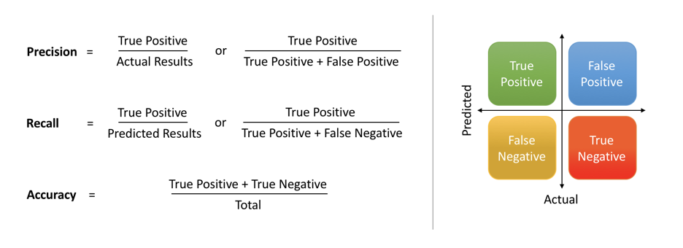

Slide 33
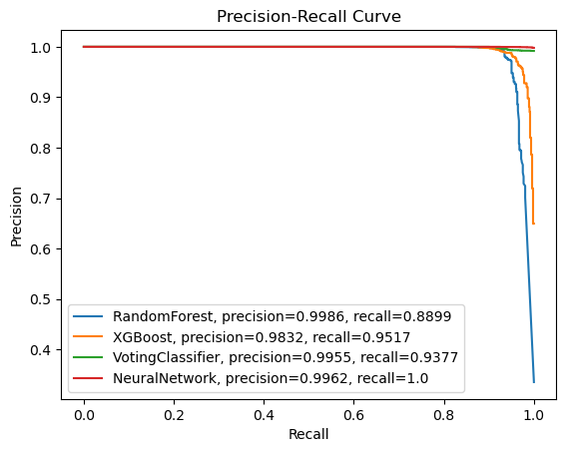

Slide 34
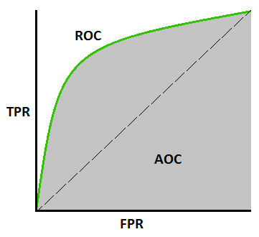
ROC - AUC Curve
AUC - ROC curve is a performance measurement for the classification problems at various threshold settings.
ROC is a probability curve and AUC represents the degree or measure of separability.
It tells how much the model is capable of distinguishing between classes.

Slide 35
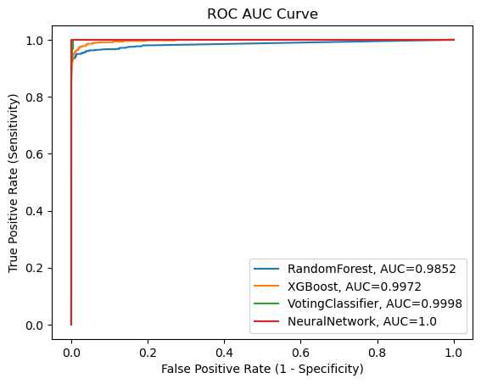

Slide 36
Comparing Results
Model | Precision | Recall | AUC | Accuracy
Random Forest | 0.998 | 0.889 | 0.9852 | 98.27%
XG Boost | 0.983 | 0.951 | 0.997 | 97.83%
Voting Classifier | 0.995 | 0.937 | 0.999 | 97.77%
MLP Classifier | 0.996 | 1.0 | 1.0 | 99.87%

Slide 37

Future Improvements
Different sampling Techniques may be used such as borderline smote ,Tomek links, Edited nearest neighbors, SOA-S.
Model Tuning can be done to find optimal estimates for Hyperparameters.

Slide 38

Conclusion
There are some instances in the real-world such as class imbalance which cannot be prevented due to various reasons.
Thanks to Machine learning techniques like Resampling, varying thresholds, ensemble learning, etc., Which can be used to deal with such specific real-world problems.
Advances in Deep Learning, Re-inforcement Learning provide more methods to learn back from mistakes and make more close-to reality predictions.

Slide 39
Reference
Campus K. Credit card fraud detection using machine learning models and collating machine learning models. Int J Pure Appl Math. 2018;118(20):825–38.
Varmedja D, Karanovic M, Sladojevic S, Arsenovic M, Anderla A. Credit card fraud detection-machine learning methods. In: 18th international symposium INFOTEH-JAHORINA (INFOTEH); 2019. p. 1-5.
Dornadula VN, Geetha S. Credit card fraud detection using machine learning algorithms. Proc Comput Sci. 2019;165:631–41.

Slide 40


