Slide 1
Dataset Debugger
Automated Detection of Mislabeled Samples
in Large-Scale Image Datasets
Ramiz Allahverdiyev
March 2026
Tiny ImageNet
ResNet-18
Data-Centric AI
PyTorch

Slide 2
The Problem: Label Noise in Real-World Datasets
Why dataset quality matters more than model architecture
Real datasets contain label errors
Label Corruption Example
Crowdsourced annotations introduce 3–10% error rates
Mislabeled samples create contradictory training signals
Models learn to fit wrong labels — hurting performance
Manual inspection of 100k+ samples is infeasible
True Label: 167 (goldfish)
Flipped to: 28 (poodle)
→ Same image content, completely wrong label
→ Model receives contradictory gradient signal
→ Loss remains persistently high throughout training
→ This is what our debugger detects
Data-Centric AI Insight
A cleaner dataset with the same model almost always beats a better model trained on noisy data.
Ramiz Allahverdiyev · Dataset Debugger · March 2026
1 / Motivation

Slide 3
Experimental Setup
Tiny ImageNet with controlled 10% label corruption
Tiny ImageNet
Corruption Protocol
Model Architecture
200 classes
100,000 train images
64×64 pixel resolution
Perfectly balanced (500/class)
10% labels randomly flipped
10,000 corrupted samples
Uniform random target class
Seed 42 — reproducible
3× ResNet-18 (seeds 42/43/44)
Modified for 64×64 input
~11M parameters each
Trained 20 epochs on P100
Training Results
Model A (seed 42)
Model B (seed 43)
Model C (seed 44)
Val Acc: 54.46%
Val Acc: 54.81%
Val Acc: 54.52%
Ramiz Allahverdiyev · Dataset Debugger · March 2026
2 / Setup

Slide 4
Detection Methods Overview
Four complementary signals — each capturing a different aspect of label quality
1
Training Loss Analysis
w=40%
Mislabeled samples have persistently high loss throughout training (4.7× higher than clean)
2
Embedding Similarity
w=30%
Mislabeled samples don't geometrically fit their assigned class cluster in feature space
3
Model Disagreement
w=20%
3 independently trained models all predict a different class than the corrupted label
4
Anomaly Detection
w=10%
Isolation Forest identifies statistically unusual samples in 512-dim embedding space
Ramiz Allahverdiyev · Dataset Debugger · March 2026
3 / Methods

Slide 5
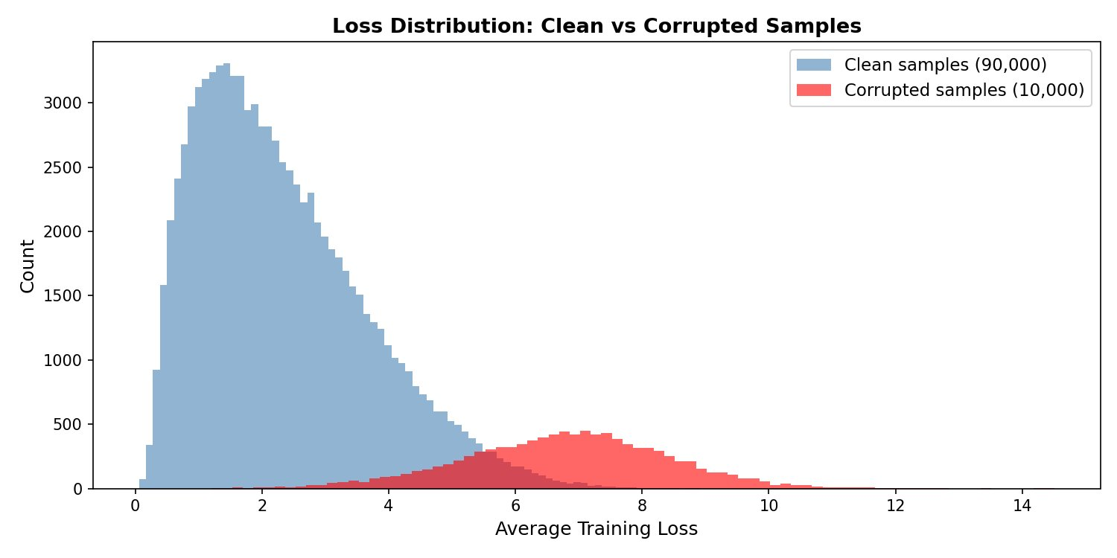
Method 1: Training Loss Analysis
Corrupted samples have 4.7× higher average training loss than clean samples
Key Finding
Clean mean loss: 1.51
Corrupted mean loss: 7.12
Ratio: 4.7× higher
Clean samples: loss drops steadily as model learns correct class
Corrupted samples: contradictory gradient — model cannot converge
Result: persistently elevated loss across ALL training epochs
0.977
1.000
0.993
Fig. Distribution of average training loss — clean (blue) vs corrupted (red)
AUROC
Prec@100
Precision
Ramiz Allahverdiyev · Dataset Debugger · March 2026
4 / Loss Analysis

Slide 6
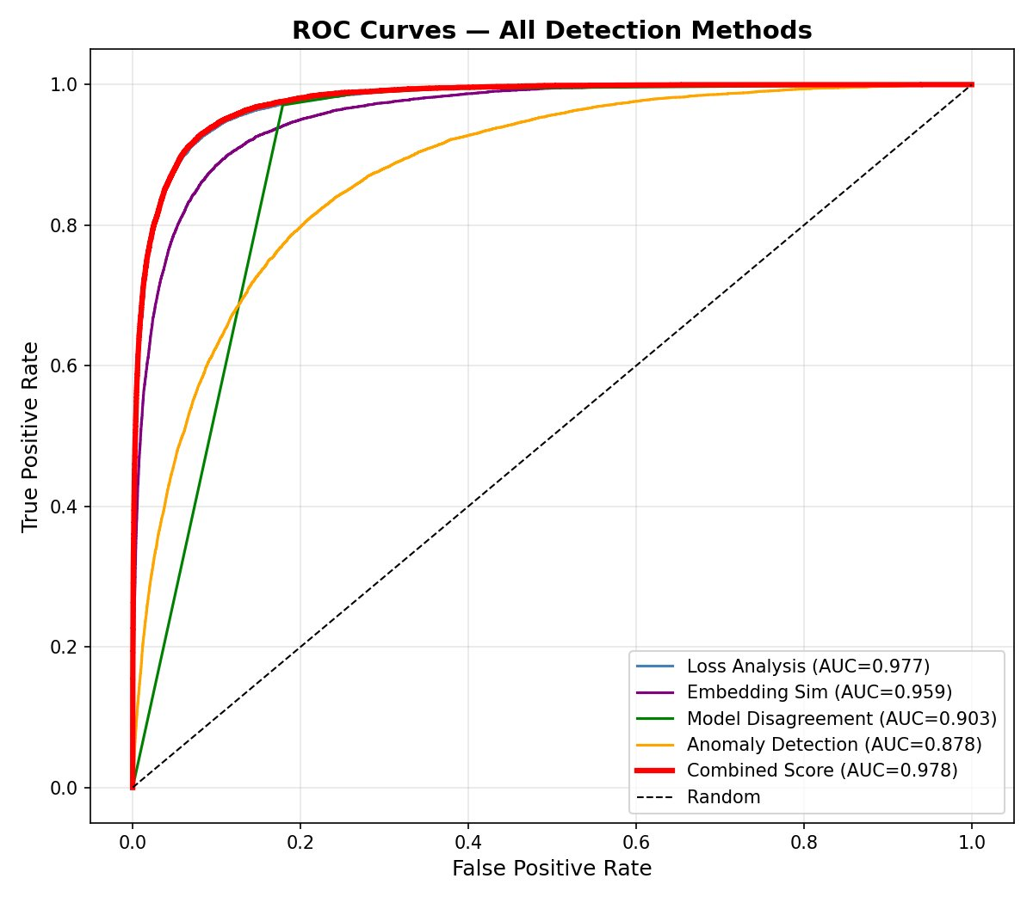
Methods 2 & 3: Embedding + Disagreement
Geometric and ensemble-based detection signals
Method 2 — Embedding Similarity
Method 3 — Model Disagreement
Extract 512-dim penultimate layer features.
For each sample, compute cosine similarity to top-50 nearest neighbors in its assigned class.
Low similarity = sample doesn't fit its class.
3 models trained with different seeds vote on each sample. If all 3 disagree with the label, it is likely mislabeled.
Produces 4 discrete scores: {0, 0.33, 0.67, 1.0}
Example:
Model A predicts: dog
Model B predicts: dog
Model C predicts: dog
Dataset label: cat ← WRONG
Recall: 0.988 (catches almost all errors)
Precision: 0.291 (flags some clean samples too)
Ramiz Allahverdiyev · Dataset Debugger · March 2026
5 / Methods 2 & 3
AUROC: 0.959 · Prec@100: 0.980

Slide 7
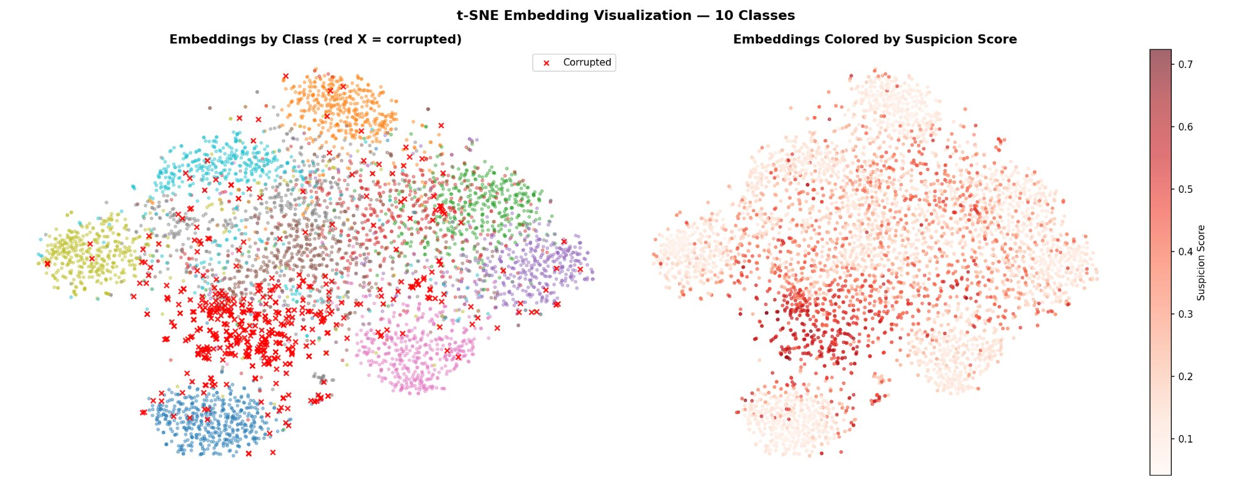
Embedding Space: t-SNE Visualization
Corrupted samples appear between class clusters — they don't belong where they are
Fig. t-SNE: corrupted samples (red ×) appear at class boundaries; suspicion heatmap (right) concentrates high scores at boundary regions.
Corrupted samples (×) scatter across class clusters — positioned near their TRUE class, not their ASSIGNED class
Suspicion score heatmap correctly concentrates high scores at cluster boundaries
Visual confirmation that embedding geometry reliably reveals label errors
Ramiz Allahverdiyev · Dataset Debugger · March 2026
6 / Embeddings

Slide 8
Combined Suspicion Score
Weighted ensemble of all 4 signals into a single ranked list
s(i) = 0.40 · s_loss(i) + 0.30 · s_embed(i) + 0.20 · s_disagree(i) + 0.10 · s_anomaly(i)
Loss (40%)
Strongest individual signal — AUROC 0.977, near-perfect separation between clean and corrupted
Embedding (30%)
Complementary geometric signal — high precision at small K, independent from loss
Disagree (20%)
Recall booster — catches samples other methods miss, despite lower precision
Anomaly (10%)
Catch-all for genuine outliers and statistically unusual samples
Ramiz Allahverdiyev · Dataset Debugger · March 2026
7 / Combined Score

Slide 9
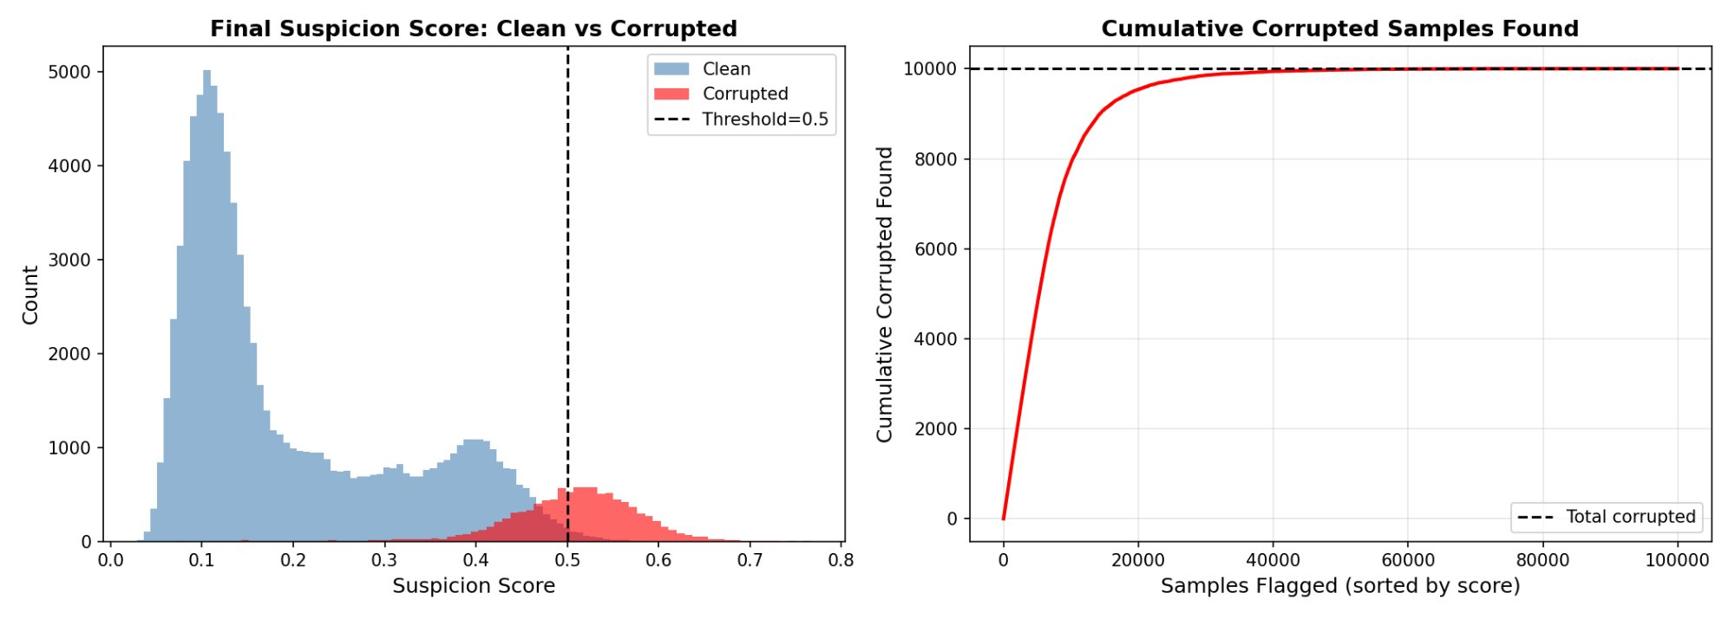
Suspicion Score Analysis
Clean and corrupted samples are clearly separated by the combined score
Fig. Left: score distributions (clean vs corrupted, threshold=0.5). Right: cumulative corrupted recovered — 15% of data → 90% recall.
★ Key Practical Finding:
Reviewing just 15,000 samples (15% of dataset) recovers 9,000 of 10,000 corrupted labels (90% recall). This represents an 85% reduction in manual review effort.
Ramiz Allahverdiyev · Dataset Debugger · March 2026
8 / Score Analysis

Slide 10
Evaluation Results
Combined score outperforms all individual methods across every metric
Method | Precision | Recall | F1 | AUROC
Loss Analysis | 0.9926 | 0.1341 | 0.2363 | 0.9767
Embedding Sim | 0.7500 | 0.0003 | 0.0006 | 0.9586
Model Disagreement | 0.2909 | 0.9877 | 0.4495 | 0.9034
Anomaly Detection | 0.3796 | 0.6825 | 0.4879 | 0.8776
Combined Score ★ | 0.9265 | 0.5782 | 0.7120 | 0.9780
Precision@K (Combined Score)
K=100 | K=500 | K=1,000 | K=2,000 | K=5,000
1.0000 | 0.9980 | 0.9980 | 0.9875 | 0.9522
Ramiz Allahverdiyev · Dataset Debugger · March 2026
9 / Results

Slide 11
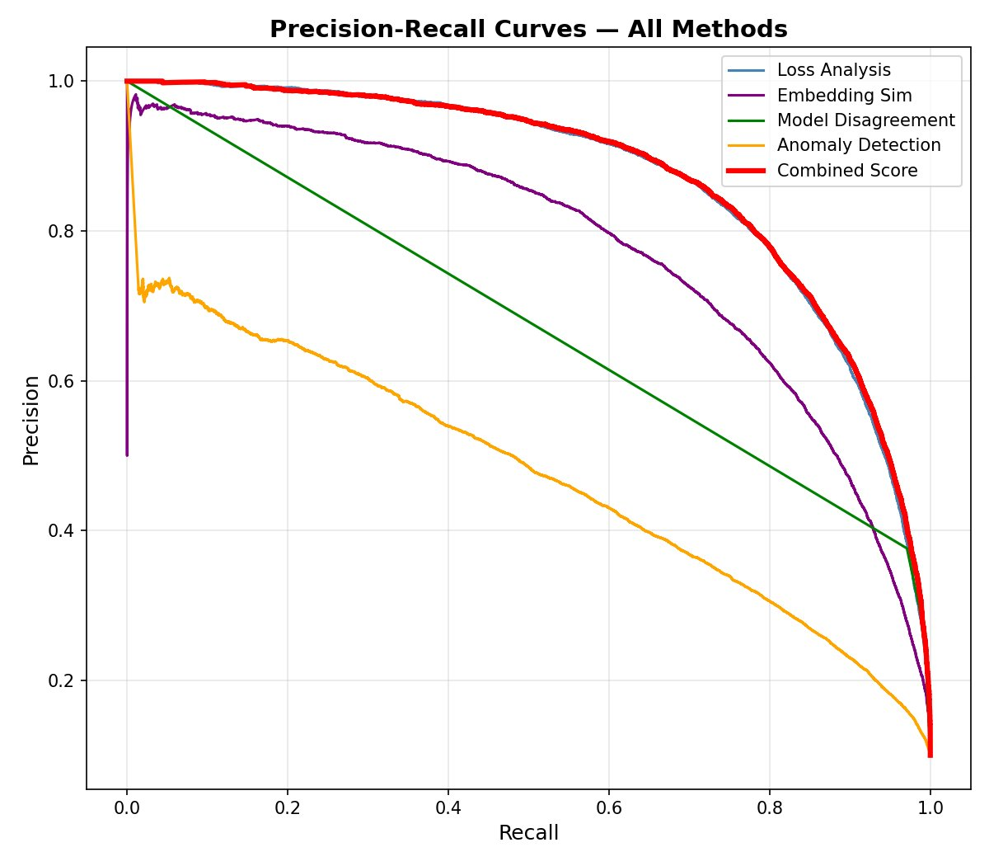
ROC & Precision-Recall Curves
Combined score dominates — AUROC 0.978 across all methods
ROC Curves — All Methods
Precision-Recall Curves — All Methods
Combined: 0.978
Loss: 0.977
Embed: 0.959
Disagree: 0.903
Anomaly: 0.878
Ramiz Allahverdiyev · Dataset Debugger · March 2026
10 / Curves

Slide 12
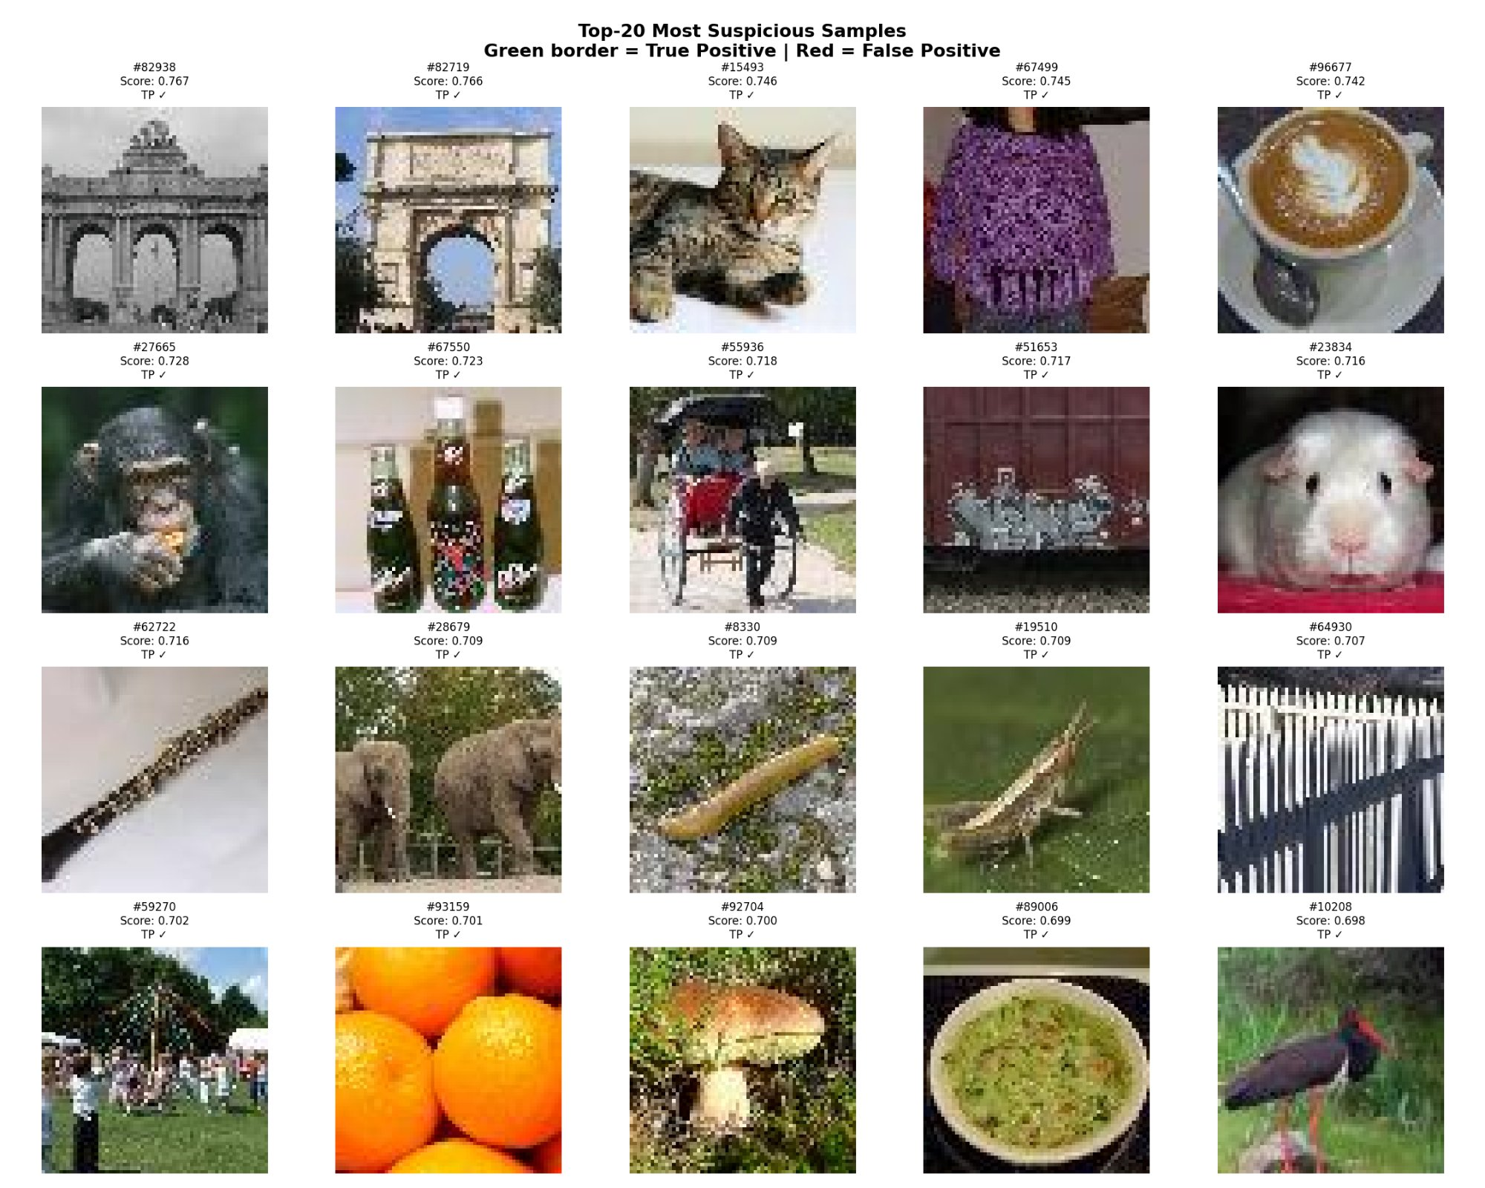
Top-20 Most Suspicious Samples
20 / 20 True Positives — every top-flagged sample is genuinely corrupted
All 20 samples: green border = True Positive. Scores 0.698–0.767. Spans diverse categories across all 200 classes.
Ramiz Allahverdiyev · Dataset Debugger · March 2026
11 / Gallery

Slide 13
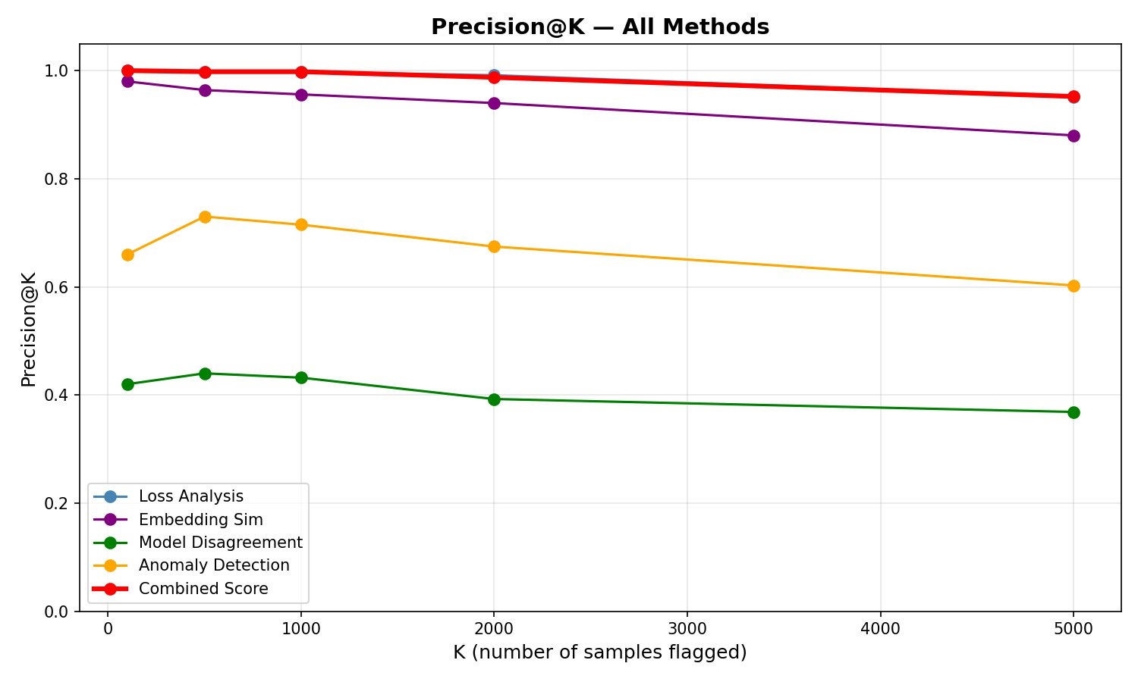
Precision@K — Practical Utility
The combined score dominates all methods across every K value
Fig. Combined score (red) maintains >0.95 precision at all K values. Model Disagreement (green) flatlines ~0.40.
Ranking (Combined ≈ Loss Analysis >> Embedding >> Anomaly >> Disagreement) — each method has a clear niche
Ramiz Allahverdiyev · Dataset Debugger · March 2026
12 / Precision@K

Slide 14
Key Takeaways
01
Training loss is the strongest signal
02
Ensemble beats every individual method
Corrupted samples have 4.7× higher average loss — near-perfect separation from clean samples (AUROC 0.977 alone)
Combined score AUROC 0.978 and F1 0.712 — no single method achieves this balance of precision and recall
03
Precision@100 = 1.000
04
85% reduction in review effort
The top 100 flagged samples are ALL genuinely corrupted — perfect precision for high-confidence review
Reviewing 15% of the dataset (15,000 samples) recovers 90% of all label errors
Ramiz Allahverdiyev · Dataset Debugger · March 2026

