Slide 1
LINEAR INTEGRATED CIRCUITS AND APPLICATIONS
J.RAJANIKANTH
Associate Professor
Department: Electronics & Communication Engineering
Siddarth Institute of Engg & Technology

Slide 2
UNIT-V A/D & D/A CONVERTERS

Slide 3
Analog Signals
Analog signals – directly measurable quantities in terms of some other quantity
Examples:
Thermometer – mercury height rises as temperature rises
Car Speedometer – Needle moves farther right as you accelerate
Stereo – Volume increases as you turn the knob.

Slide 4
Examples of A/D Applications
Microphones - take your voice varying pressure waves in the air and convert them into varying electrical signals
Strain Gages - determines the amount of strain (change in dimensions) when a stress is applied
Thermocouple – temperature measuring device converts thermal energy to electric energy
Voltmeters
Digital Multi meters

Slide 5
1. DAC
In an electronic circuit, a combination of high voltage (+5V) and low voltage (0V) is usually used to represent a binary number. For example, a binary number 1010 is represented by
Weighting
2³
2²
2¹
2⁰
Binary Digit
1
0
1
0
State
+5V
0V
+5V
0V
DACs are electronic circuits that convert digital, (usually binary) signals (for example, 1000100) to analog electrical quantities (usually voltage) directly related to the digitally encoded input number.

Slide 6
DACs are used in many other applications, such as voice synthesizers, automatic test system, and process control actuator. In addition, they allow computers to communicate with the real (analog) world.

Slide 7
Register: Use to store the digital input (let it remain a constant value) during the conversion period.
Voltage: Similar to an ON/OFF switch. It is ‘closed’ when the input is ‘1’. It is ‘opened’ when the input is ‘0’.
Resistive Summing Network: Summation of the voltages according to different weighting.
Amplifier: Amplification of the analog according to a pre-determined output voltage range. For example, an operation amplifier

Slide 8
The two most popular types of resistive summing networks are:
• Weighted binary resistance type, and
• Ladder resistance (R-2R) type

Slide 9
Just what does an A/D converter DO?
Converts analog signals into binary words

Slide 10
Analog → Digital Conversion 2-Step Process:
Quantizing - breaking down analog value is a set of finite states
Encoding - assigning a digital word or number to each state and matching it to the input signal

Slide 11
Classification of ADCs
Direct type ADC.
Integrating type ADC
Direct type ADCs
Flash (comparator) type converter
Counter type converter
Tracking or servo converter.
Successive approximation type converter

Slide 12
Real world (lab) is analog
Computer (binary) is digital
V
V
t
t
D/A Conversion
Computer
DAC
A/D Conversion
Computer
DAC

Slide 13
Digital to Analog Conversion (DAC or D/A)
8 bits
A/D
Computer

Slide 14
Digital to Analog conversion involves transforming the computer’s binary output in 0’s and 1’s (1’s typically = 5.0 volts) into an analog representation of the binary data

Slide 15
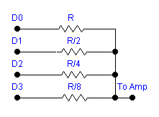
D/A conversion can be as simple as a weighted resistor network
4 - bit DAC Converter
Resistor values correspond to binary weights of the number D₃ D₂ D₁ D₀ , i.e. 1/8, 1/4, 1/2, and 1
Using EWB we can model this device

Slide 16
Difficulties:
1. This setup requires a wide range of precision resistors
A 10 bit DAC needs resistors ranging from R to R/1024.
2. The circuit driving the DAC (usually a computer) must supply a wide range of currents for a constant V_{out}

Slide 17
As was seen in the Workbench example, the output voltage from a DAC can change by only discrete amounts, corresponding to the level associated with a 1 bit binary change.
For a 8-bit DAC
Smallest step in output voltage is v/256
8 bits corresponds to 256 different values
For a 5.0 volt DAC this step size is ~ 19.5 mV

Slide 18
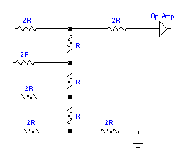
A modification of the weighted resistor DAC is the so called R-2R LADDER DAC, that uses only 2 different resistances

Slide 19
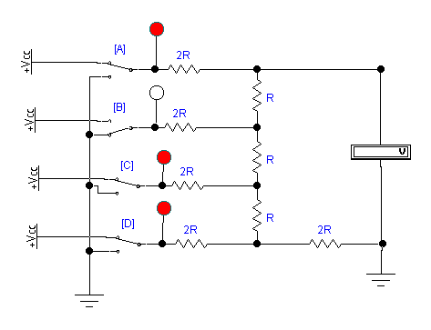
An actual R-2R DAC showing input 1 0 1 1
Voltmeter reading is determined by the binary number ABCD and the resistor weights

Slide 20
MSB = 1/2 of V_{ref}
= 1/4 of V_{ref}
= 1/8 of V_{ref}
LSB = 1/16 of V_{ref}
1 0 1 1 = 1/2 (5) + 1/4 (0) + 1/8 (5) + 1/16 (5)
≅ 3.4 volts
In actual DACs, the converters will drive amplifier circuits in most cases

Slide 21
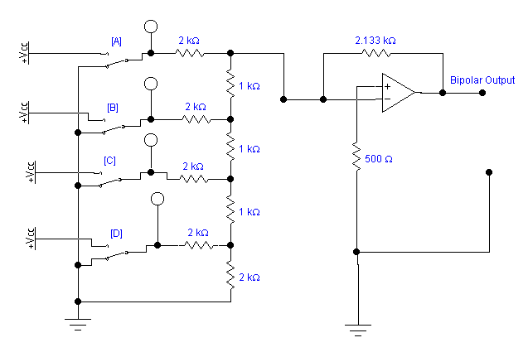
Amplified DAC with bipolar ( ± V_{out} ) output
r2rdac.ewb

Slide 22
Analog-to Digital Conversion (ADC or A/D)
8 bits
Computer
A/D

Slide 23
An ideal A/D converter takes an input analog voltage and converts it to a perfectly linear digital representation of the analog signal
If you are using an 8-bit converter, the binary representation is 8-bit binary number which can take on 2⁸ or 256 different values. If your voltage range were 0 - 5 volts, then
0 VOLTS 0000 0000
5 VOLTS 1111 1111

Slide 24
An 8-bit converter can represent a voltage to within one part in 256, or about 0.25 %. This corresponds to an inherent uncertainty of ± ½ LSB (least significant bit).
Decimal 128 = 0 1 1 1 1 1 1 1
Bit 7
Bit 6
Bit 5
Bit 4
Bit 3
Bit 2
Bit 1
Bit 0
MSB
LSB
Notice the bits are designated B7 - B0. Bit B7 is the Most Significant Bit while B0 is the Least Significant Bit

Slide 25
Analog Voltage
1 LSB
Voltage (Volts)
00000000
00000010
11111100
00000001
00000011
11111101
11111110
11111111
. . . . . . . . .

Slide 26
Number of Bits (N) Resolution (1/2^{N}) Increment (mV) for 5 volts
6 1/64 78.1
8 1/256 19.6
10 1/1024 4.9
12 1/4096 1.2
14 1/16384 0.3
16 1/65536 0.07

Slide 27
Types of Analog to Digital Converters
1. Counter Type
2. Integrating or Dual Slope
3. Parallel or Flash
4. Successive Approximation

Slide 28
Counter Type
Comparator
START
V_{in}
Control Logic
clock
Counter
D A C
Digital Output
When START is received,
control logic initializes the system, (sets counter to 0), and
turns on Clock sending regular pulses to the counter.

Slide 29
As the Clock sends regular pulses to the counter, the counter outputs a digital signal to the Digital-to-Analog converter
Comparator
START
V_{in}
Control Logic
clock
Counter
D A C
Digital Output

Slide 30
As the ramp voltage increases to the comparator, it rises closer and closer to V_{in} at which point the comparator shifts states
Comparator
START
V_{in}
Control Logic
clock
Counter
D A C
Digital Output

Slide 31
When the ramp voltage exceeds V_{in} , the comparator output shifts which signals the control logic to turn off the clock
Comparator
With the clock off, the counter reading is proportional to V_{in}
V_{in}
Note that the conversion time depends on the size of the input signal
V_{in}
V’_{in}
Conversion time
Conv.time

Slide 32
Once the digital output has been read by the associated circuitry, a new start signal is sent, repeating the cycle.
Comparator
START
V_{in}
Control Logic
clock
Counter
D A C
Digital Output

Slide 33
With a counter type A/D, if the signal is varying rapidly, the counter must count up and reset before each cycle can begin, making it difficult to follow the signal.

Slide 34
Tracking ADC - similar to the counter type except it uses an up/down counter and can track a varying signal more quickly
Comparator
V_{in}
Track & Hold Logic
clock
Up/Down Counter
D A C
Digital Output

Slide 35
Integrating or Dual Slope A/D
integrator
comparator
V_{in}
-V_{ref}
clock
Control logic
Counter
Digital Output

Slide 36
When conversion is initialized, the switch is connected to V_{in} which is applied to the op amp integrator. The integrator output (>0) is applied to the comparator
integrator
comparator
V_{in}
-V_{ref}
clock
Control logic
Counter
Digital Output

Slide 37
As conversion is initiated, the control logic enables the clock which then sends pulses to the counter until the counter fills (9999)
integrator
comparator
V_{in}
-V_{ref}
clock
Control logic
Counter
Digital Output

Slide 38
As the counter resets (9999 → 0000), an overflow signal is sent to the control logic
this activates the input switch from V_{in} to -V_{ref} , applying a negative reference voltage to the integrator
integrator
comparator
V_{in}
-V_{ref}
clock
Control logic
overflow
Counter
Digital Output

Slide 39
The negative reference voltage removes the charge stored in the integrator until the charge becomes zero.
At this point, the comparator switches states producing a signal that disables the clock and freezes the counter reading.
The total number of counts on the counter (determined by the time it took the fixed voltage V_{ref} to cancel V_{in} ) is proportional to the input voltage, and thus is a measure of the unknown input voltage.

Slide 40
The operation of this A/D requires 2 voltage slopes, hence the common name DUAL-SLOPE.
full scale conversion
charging up the capacitor
discharging the capacitor
Integrator Output Voltage
half scale conversion
quarter scale conversion
fixed time
measured time

Slide 41
Since this A/D integrates the input as part of the measuring process, any random noise present in the signal will tend to integrate to zero, resulting in a reduction in noise.
These type of A/D s are used in almost all digital meters. Such meters usually are not used to read rapidly changing values in the lab. Consequently the major disadvantage of such converters (very low speeds) is not a problem when the readout update rate is only a few times per second.

Slide 42
Flash Converters
If very high speed conversions are needed, e.g. video conversions, the most commonly used converter is a Flash Converter.
While such converters are extremely fast, they are also very costly compared to other types.

Slide 43
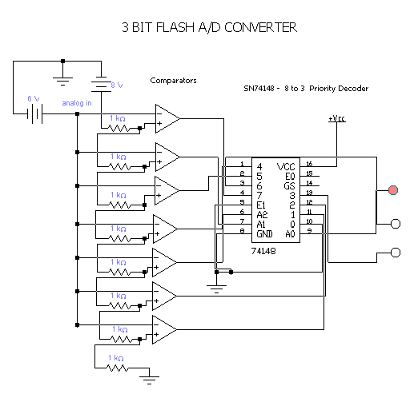

Slide 44
Parallel or Flash Converters
The resistor network is a precision voltage divider, dividing V_{ref} (8 volts in the sample) into equal voltage increments (1.0 volts here) to one input of the comparator. The other comparator input is the input voltage
Each comparator switches immediately when V_{in} exceeds V_{ref} . Comparators whose input does not exceed V_{ref} do not switch.
A decoder circuit (a 74148 8-to-3 priority decoder here) converts the comparator outputs to a useful output (here binary)

Slide 45
The speed of the converter is limited only by the speeds of the comparators and the logic network. Speeds in excess of 20 to 30 MHz are common, and speeds > 100 MHz are available
The cost stems from the circuit complexity since the number of comparators and resistors required increases rapidly. The 3-bit example required 7 converters, 6-bits would require 63, while an 8-bits converter would need 256 comparators and equivalent precision resistors.

Slide 46
While integrating or dual-slope A/Ds are widely used in digital instruments such as DVMs, the most common A/D used in the laboratory environment is the successive approximation.
Successive approximation converters are reasonably priced for large bit values, i.e. 10, 12 and even 16 bit converters can be obtained for well under $100. Their conversion times, typically ~ 10-20 μs, are adequate for most laboratory functions.

Slide 47
Successive-Approximation A/D
V_{ref}
analog input
D/A Converter
Digital Output Data
comparator
Successive Approximation Register
clock
STRT
At initialization, all bits from the SAR are set to zero, and conversion begins by taking STRT line low.

Slide 48
Successive-Approximation A/D
V_{ref}
analog input
D/A Converter
Digital Output Data
comparator
Successive Approximation Register
clock
STRT
First the logic in the SAR sets the MSB bit equal to 1 (+5 V). Remember that a 1 in bit 7 will be half of full scale.

Slide 49
analog input voltage
¾FS
D/A output for 8-bit conversion with output code 1011 0111
½FS
¼FS
CLOCK PERIOD
1 2 3 4 5 6 7 8

Slide 50
Successive approximation search tree
for a 4-bit A/D
1111
1110
1101
1100
1011
1010
1001
1000
0111
0110
0101
0100
0011
0010
0001
D/A output compared with V_{in} to see if larger or smaller

Slide 51
Integrating type converters
An ADC converter that perform conversion in an indirect manner by first changing the analog I/P signal to a linear function of time or frequency and then to a digital code is known as integrating type A/D converter

Slide 52
Sample and hold circuit
A sample and hold circuit is one which samples an input signal and holds on to its last sampled value until the input is sampled again. This circuit is mainly used in digital interfacing, analog to digital systems, and pulse code modulation systems.

Slide 53
Sample and hold circuit
The time during which the voltage across the capacitor in sample and hold circuit is equal to the input voltage is called sample period.The time period during which the voltage across the capacitor is held constant is called hold period

Slide 54
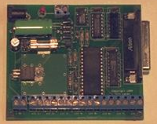
In practice, an ADC is usually in form of an integrated circuit (IC). ADC0808 and ADC0809 are two typical examples of 8-bit ADC with 8-channel multiplexer using successive approximation method for its conversion.
ADC0809
National Semiconductor
For more information,
http://www.national.com/ads-cgi/viewer.pl/ds/AD/ADC0808.pdf

Slide 55
3. Selection of DAC
For the selection of an IC DAC, there are several parameters that can determine the suitability of a particular device.
Resolution
The number of bits making up the input data word that will ultimately determine the output step voltage as a percentage of full-scale output voltage.
Example: Calculate the resolution of an 8-bit DAC.
Solution: Resolution = 8 bits

Slide 56
Output Voltage Range
This is the difference between the maximum and minimum output voltages expressed in volts.
Example:
Calculate the output voltage range of a 4-bit DAC if the output voltage is +4.5V for an input of 0000 and +7.5V for an input of 1111.
Solution:
Output voltage range = 7.5 – 4.5 = 3.0V

Slide 57
Accuracy
The accuracy is usually expressed by the error in output voltage compared with the expected output voltage. The higher the accuracy, the lower will be the error. Due to the incremental nature of the digital input word, an error can be tolerated but it should not exceed ±½LSB or ½resolution.
Example. The error at full-scale for an 8-bit DAC with 10V maximum output is 50mV. Calculate the error and compare it with the resolution.

Slide 58
The accuracy is not as good as the error = ½ resolution, but for many applications, it is quite satisfactory. Some commercially available DACs have their accuracy specified as worse than ½ resolution.
Sources of errors may be broadly classified under four categories:
· Non-monotonicity
· Non-linearity
· Scale-factor error
· Offset error

Slide 59
Settling time
The time taken for the applied digital input to be converted to an analog output. Typical period can be as low as 100ns, making DA conversion a very fast process compared with those of AD conversion.
Input coding
The digital input can be in binary format or it can be in binary coded decimal format depending on the application. Binary format is more commonly used.

Slide 60
It should be noted in the table above that the BCD coding is the binary equivalent of the decimal digit. However, BCD and binary are not the same.
For example,
49₁₀ in binary is 110001₂,
but
49₁₀ in BCD is 01001001_{BCD}.
Each decimal digit is converted to its binary equivalent.

Slide 61
4. Selection of ADC
The parameters used in selecting an ADC are very similar to those considered for a DAC selection.
Error/Accuracy: Quantising error represents the difference between an actual analog value and its digital representation. Ideally, the quantising error should not be greater than ± ½ LSB.
Resolution: DV to cause 1 bit change in output
Output Voltage Range ⇒ Input Voltage Range
Output Settling Time ⇒ Conversion Time
Output Coding (usually binary)

Slide 62
Thank you

